Slide 1

26 Data Augmentation
Peter H. Chen

Slide 2
26 Data Augmentation
https://www.youtube.com/watch?v=mTVf7BN7S8w&list=PLeo1K3hjS3uu7CxAacxVndI4bE_o3BDtO&index=26
Data Augmentation (0:00-0:30/31:32)
Out of the box, CNN (Convolutional Neural Network) is scale invariant or rotation invariant, i.e., the image in dataset is not scalable and is not rotatable.
What is this means?
For example, if we are trying to classify roses and tulips, the training set contains the clear images for both roses and tulips.
After we train with CNN, we do the test.
When we test with rotated image of a rose for the classification, CNN may not perform well.
When we do the CNN, the original data may not perform well.
To solve the problem, we use the technique called Data Augmentation.
In the data augmentation, we use the existed sample to generate the new samples.

Slide 3
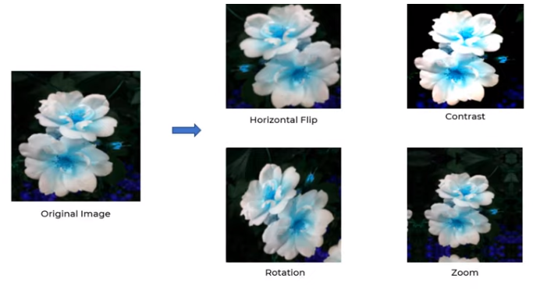
26 Data Augmentation
https://www.youtube.com/watch?v=mTVf7BN7S8w&list=PLeo1K3hjS3uu7CxAacxVndI4bE_o3BDtO&index=26
Data Augmentation (0:31-1:30/31:32)
For example, we have the picture of original flower. The original image have only one type of flower image. It is a clear, unrotated image.
CNN can not predict well.
To improve the prediction accuracy, we can do the transformation (data augmentation), such as: 1. Horizontal flip, 2, contrast, 3. Rotation, 4. Zoom (Scaling), 5. shift, etc.
We can generate new samples. In this example, we generate four new samples base on the one original image.
This technique is very effective.
In this discussion, we do CNN for the flower classification. We will use data augmentation to generate the mew samples and increase the accuracy of the model.

Slide 4
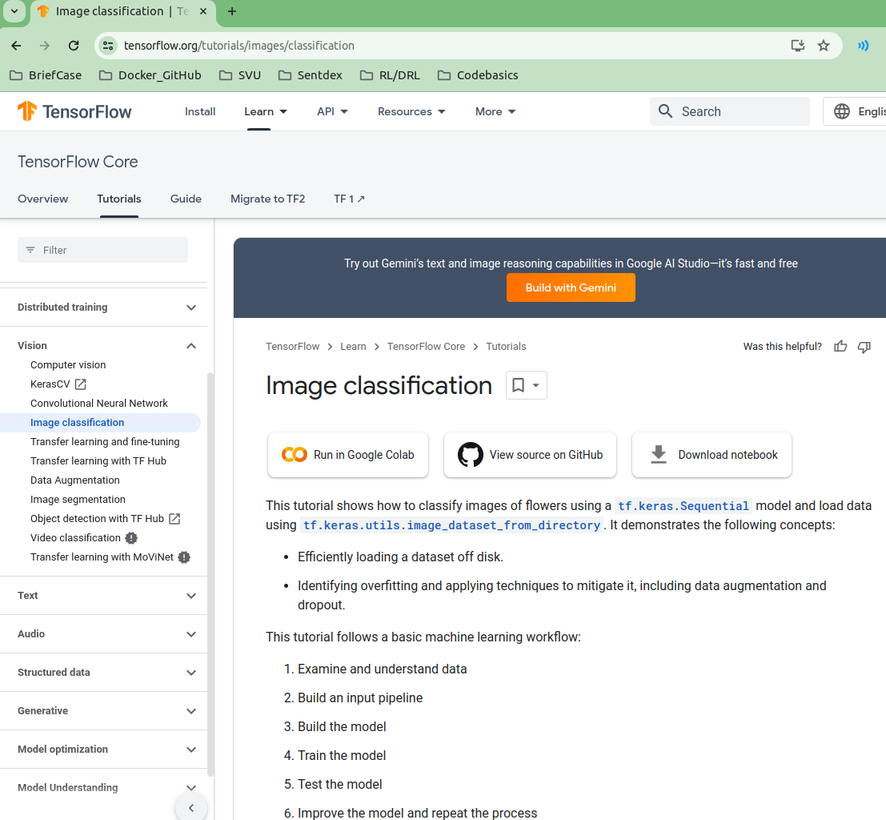
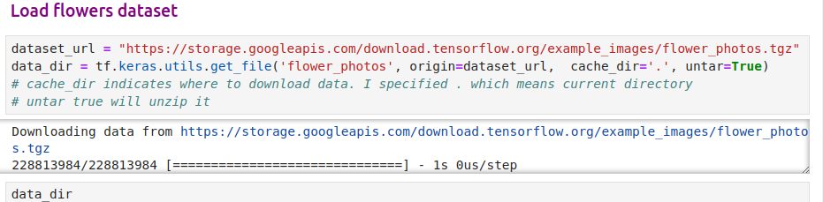
26 Data Augmentation
https://www.youtube.com/watch?v=mTVf7BN7S8w&list=PLeo1K3hjS3uu7CxAacxVndI4bE_o3BDtO&index=26
Data Augmentation (1:31-2:30/31:32)
https://www.tensorflow.org/tutorials/images/classification
The tensorflow already have API to download the data. We can directly use it without modification (to mount google drive and to read the image from google drive).

Slide 5
26.1 Colab: Import Libraries

Slide 6
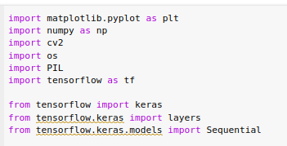
26.1 Colab: Import Libraries
https://www.youtube.com/watch?v=mTVf7BN7S8w&list=PLeo1K3hjS3uu7CxAacxVndI4bE_o3BDtO&index=26
Colab: Import Libraries (1:31-2:30/31:32)
https://www.tensorflow.org/tutorials/images/classification
Import Libraries:

Slide 7
26.1 Load Flower Dataset

Slide 8
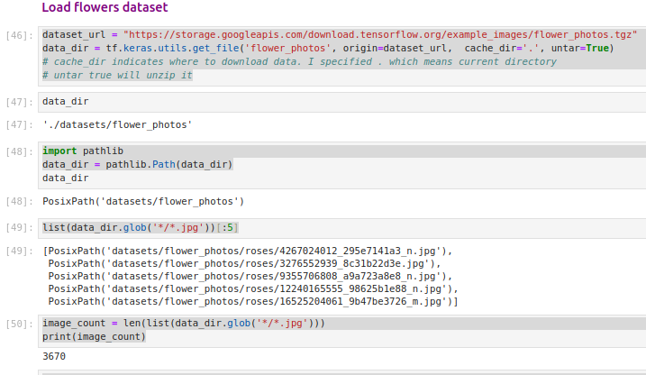
26.1 Load Flower Dataset
https://www.youtube.com/watch?v=mTVf7BN7S8w&list=PLeo1K3hjS3uu7CxAacxVndI4bE_o3BDtO&index=26
Load Flowers Dataset (2:31-3:30/31:32)
We read image file on google colab.
Image count: 3670

Slide 9
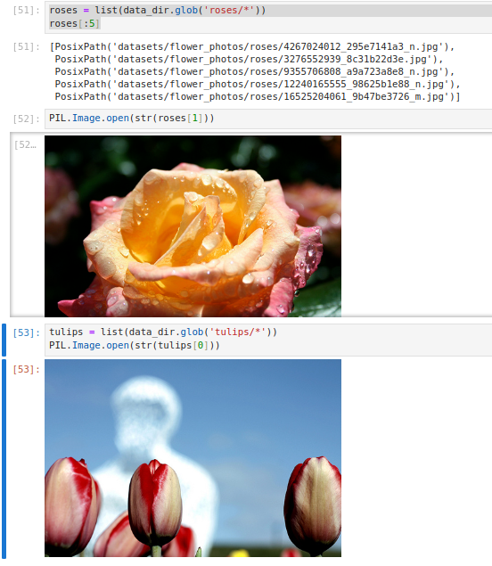
26.1 Load Flower Dataset
https://www.youtube.com/watch?v=mTVf7BN7S8w&list=PLeo1K3hjS3uu7CxAacxVndI4bE_o3BDtO&index=26
Load Flowers Dataset (3:31-4:30/31:32)
Check Images.

Slide 10
26.2 Colab: Read Flower Images from Disk

Slide 11
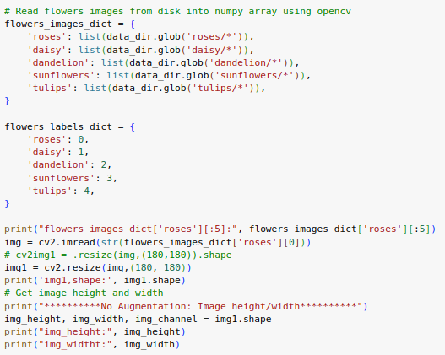
26.2 Colab: Read Flower Images from Disk
https://www.youtube.com/watch?v=mTVf7BN7S8w&list=PLeo1K3hjS3uu7CxAacxVndI4bE_o3BDtO&index=26
Read Flower Images From Disk (4:31-5:30/31:32)
Resize the image size: 180 x 180.

Slide 12
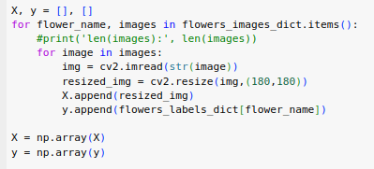
26.2 Colab: Read Flower Images from Disk
https://www.youtube.com/watch?v=mTVf7BN7S8w&list=PLeo1K3hjS3uu7CxAacxVndI4bE_o3BDtO&index=26
Read Flower Images From Disk (5:31-6:30/31:32)
Put into X and y.

Slide 13
26.3 Split Train and Test Data

Slide 14
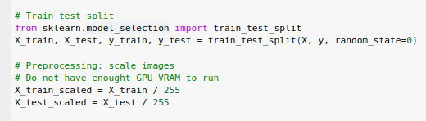
26.3 Split Train and Test Data
https://www.youtube.com/watch?v=mTVf7BN7S8w&list=PLeo1K3hjS3uu7CxAacxVndI4bE_o3BDtO&index=26
Split Train and Test Data (6:31-7:30/31:32)
Put into X and y.

Slide 15
26.4 No Data Augment: Build/Train Model

Slide 16
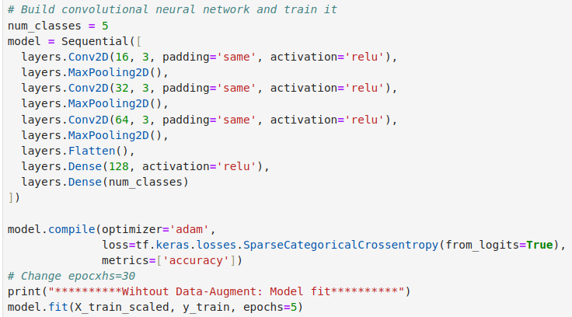
26.4 No Data Augment: Build/Train Model
https://www.youtube.com/watch?v=mTVf7BN7S8w&list=PLeo1K3hjS3uu7CxAacxVndI4bE_o3BDtO&index=26
No Data Augment: Build/Train Model (7:31-11:30/31:32)

Slide 17
26.5 No Data Augment: Evaluate/Test Model

Slide 18
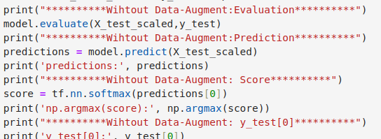
26.5 No Data Augment: Evaluate/Test Model
https://www.youtube.com/watch?v=mTVf7BN7S8w&list=PLeo1K3hjS3uu7CxAacxVndI4bE_o3BDtO&index=26
No Data Augment: Evaluate/Test Model (11:31-15:30/31:32)

Slide 19
26.6 No Data Augment: Result

Slide 20
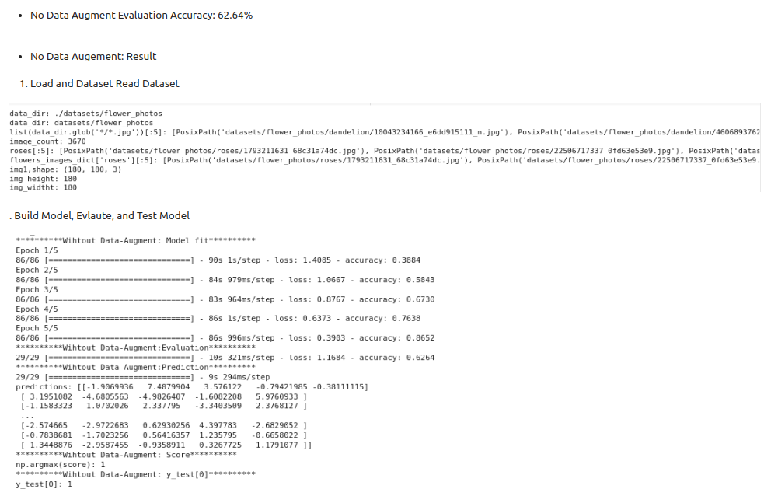
26.6 No Data Augment: Result
https://www.youtube.com/watch?v=mTVf7BN7S8w&list=PLeo1K3hjS3uu7CxAacxVndI4bE_o3BDtO&index=26
No Data Augment: Result (15:31-17:30/31:32)

Slide 21
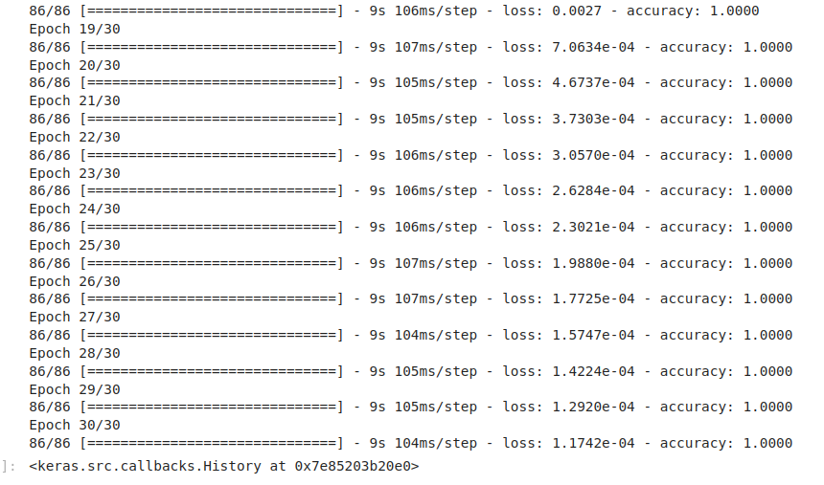
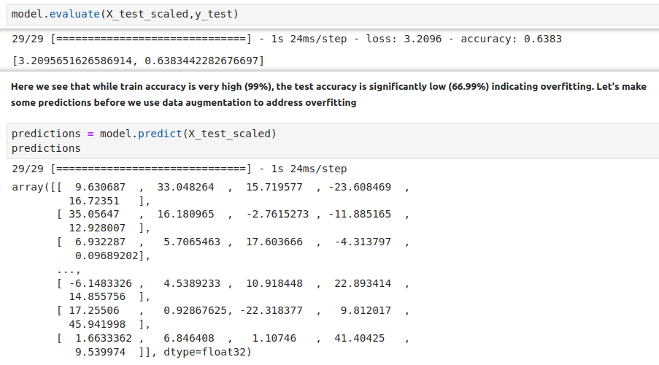
26.6 No Data Augment: Result
https://www.youtube.com/watch?v=mTVf7BN7S8w&list=PLeo1K3hjS3uu7CxAacxVndI4bE_o3BDtO&index=26
No Data Augment: Result (17:31-19:30/31:32)
We have Model training 99% to 100%.
The test accuracy is only 66.9%. The test image may contain: rotation, flip, contrast, shift, zoom/scale, etc.
Model Train accuracy = 100%
Test accuracy = 66.9%

Slide 22
26.7 Data Augment: Flip, Rotation, and Zoom

Slide 23
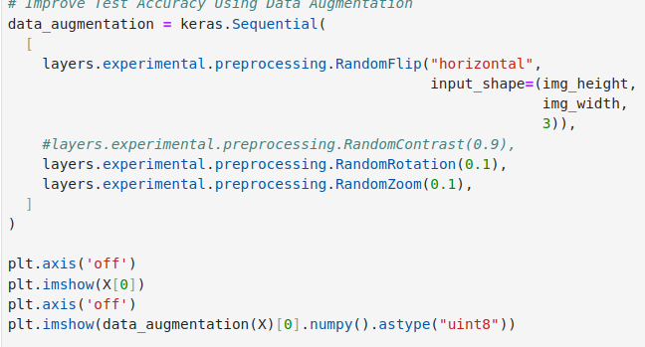
26.7 Data Augment: Flip, Rotation, and Zoom
https://www.youtube.com/watch?v=mTVf7BN7S8w&list=PLeo1K3hjS3uu7CxAacxVndI4bE_o3BDtO&index=26
Data Augment: Flip, Rotation, and Zoom (19:31-20:30/31:32)
Below code shows horizontal/vertical flip, random contrast, rotation, zoom/scale.
https://www.tensorflow.org/tutorials/images/data_augmentation

Slide 24
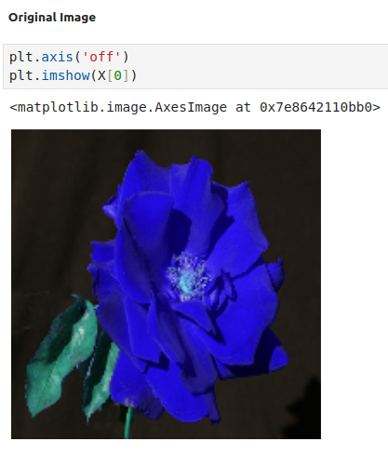
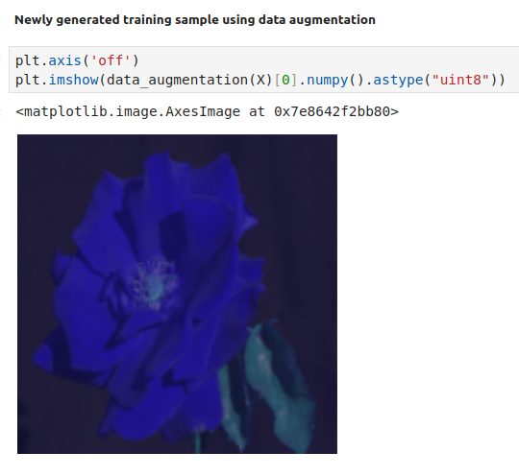
26.7 Data Augment: Flip, Rotation, and Zoom
https://www.youtube.com/watch?v=mTVf7BN7S8w&list=PLeo1K3hjS3uu7CxAacxVndI4bE_o3BDtO&index=26
Data Augment: Flip, Rotation, and Zoom (19:31-23:30/31:32)
Original Image and image after flip, rotation, and zoom.
https://www.tensorflow.org/tutorials/images/data_augmentation

Slide 25
26.8 Data Augment: Build/Train Model

Slide 26
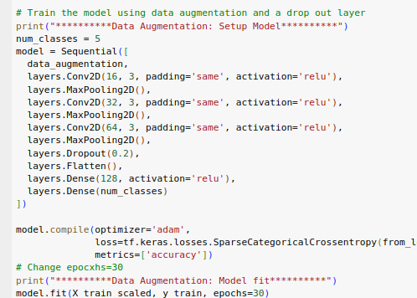
26.8 Data Augment: Build/Train Model
https://www.youtube.com/watch?v=mTVf7BN7S8w&list=PLeo1K3hjS3uu7CxAacxVndI4bE_o3BDtO&index=26
No Data Augment: Build/Train Model (23:31-27:30/31:32)
We use the flip, rotation, zoom “data_augmentation” to train the model again.

Slide 27
26.8 Data Augment: Build/Train Model
https://www.youtube.com/watch?v=mTVf7BN7S8w&list=PLeo1K3hjS3uu7CxAacxVndI4bE_o3BDtO&index=26
No Data Augment: Build/Train Model (23:31-27:30/31:32)

Slide 28
26.9 Data Augment: Evaluate/Test Model

Slide 29
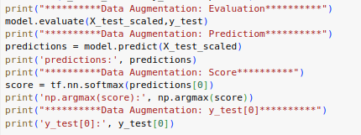
26.9 Data Augment: Evaluate/Test Model
https://www.youtube.com/watch?v=mTVf7BN7S8w&list=PLeo1K3hjS3uu7CxAacxVndI4bE_o3BDtO&index=26
No Data Augment: Evaluate/Test Model (27:31-30:30/31:32)

Slide 30
26.10 Data Augment: Result

Slide 31
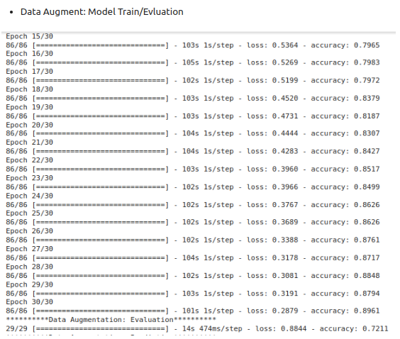
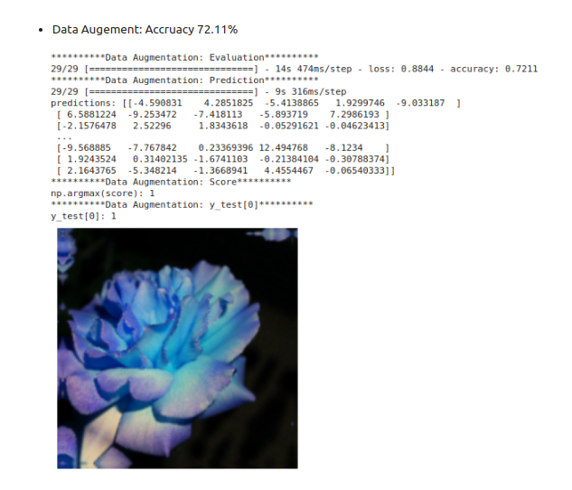
26.10 Data Augment: Result
https://www.youtube.com/watch?v=mTVf7BN7S8w&list=PLeo1K3hjS3uu7CxAacxVndI4bE_o3BDtO&index=26
No Data Augment: Result (30:31-31:32/31:32)
Accuracy: 72.11%

Slide 32
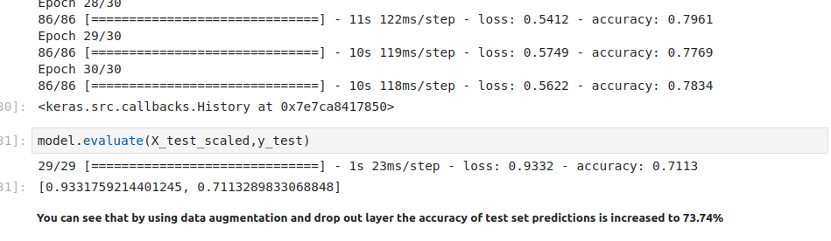
26.10 Data Augment: Result
https://www.youtube.com/watch?v=mTVf7BN7S8w&list=PLeo1K3hjS3uu7CxAacxVndI4bE_o3BDtO&index=26
No Data Augment: Result (30:31-31:32/31:32)
Accuracy: 72%
After we do the horizontal shift, the test accuracy improve from 66% to 72%.
Test accuracy = 66.9%
Test accuracy = 71%

Slide 33
End

