Slide 1

45 Optimize Pipeline
Peter H. Chen

Slide 2
45 Optimize Pipeline
https://www.youtube.com/watch?v=MLEKEplgCas&list=PLeo1K3hjS3uu7CxAacxVndI4bE_o3BDtO&index=45
Optimize Pipeline (0:00-0:20/26:15)
We discussed tf.data.dataset class for input data pipeline.
We will discuss how to optimize the performance of input pipeline using prefetch and caching.

Slide 3
45.1 Optimize Pipeline: Theory

Slide 4

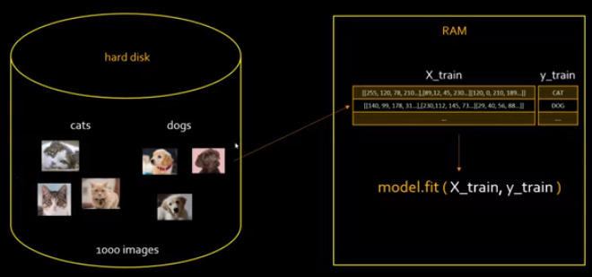
45.1 Optimize Pipeline: Theory
https://www.youtube.com/watch?v=MLEKEplgCas&list=PLeo1K3hjS3uu7CxAacxVndI4bE_o3BDtO&index=45
Optimize Pipeline: Theory (0:21-0:30/26:15)
We discuss Tensorflow Prefetch and Caching for Input Pipeline.
It is fine that we have 1,000 images load into the RAM for model training.

Slide 5
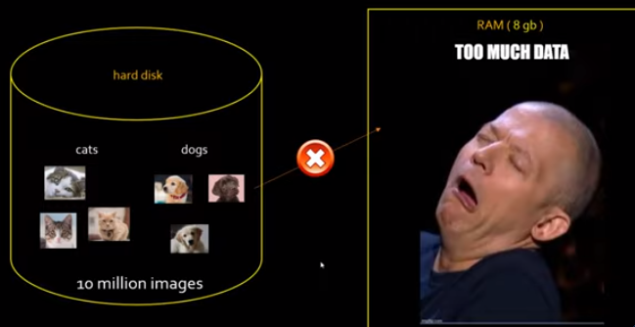
45.1 Optimize Pipeline: Theory
https://www.youtube.com/watch?v=MLEKEplgCas&list=PLeo1K3hjS3uu7CxAacxVndI4bE_o3BDtO&index=45
Optimize Pipeline: Theory (0:31-0:50/26:15)
However, we have problem to load in 10 millions (10,000,000) images into the RAM.
It is too much data that computer can handle it.

Slide 6
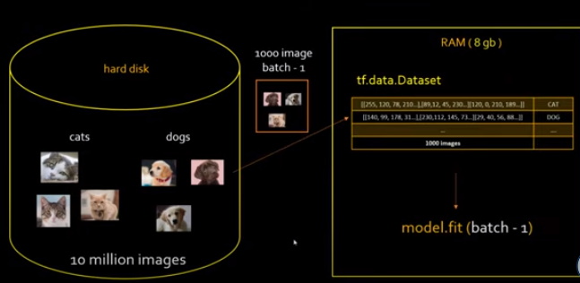
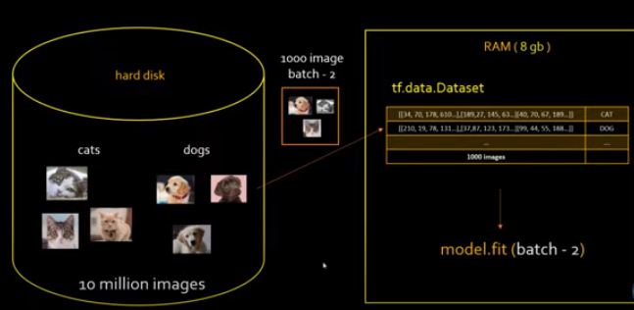
45.1 Optimize Pipeline: Theory
https://www.youtube.com/watch?v=MLEKEplgCas&list=PLeo1K3hjS3uu7CxAacxVndI4bE_o3BDtO&index=45
Optimize Pipeline: Theory (0:55-1:00/26:15)
Therefore, it.data.dataset class is useful because we need to split 10 millions images into 1,000 image batch to do the model training.
These batches are one-by-one (batch-1, batch-2, etc).

Slide 7
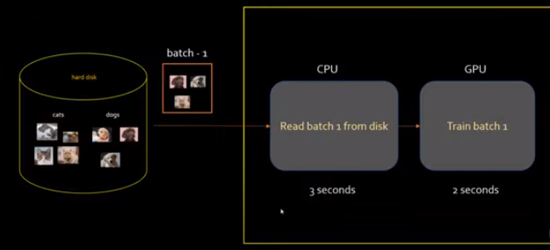
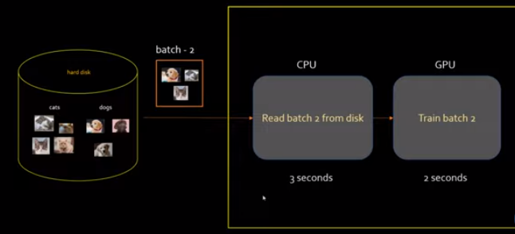
45.1 Optimize Pipeline: Theory
https://www.youtube.com/watch?v=MLEKEplgCas&list=PLeo1K3hjS3uu7CxAacxVndI4bE_o3BDtO&index=45
Optimize Pipeline: Theory (1:10-1:30/26:15)
We have the same diagram for CPU and GPU.
CPU and VGA is located at north bridge and mainly for display.
GPU and Video RAM is mainly for Model training (matrix addition, subtraction, multiplication, Transpose, Log, etc), forward pass, back-propagation, etc.
Below, we load the batch-1 (e.g., 1,000 images) by CPU and then we do the training by GPU.
Similarly for batch-2.

Slide 8
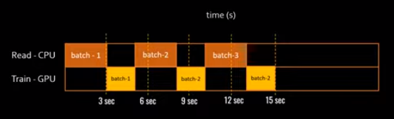
45.1 Optimize Pipeline: Theory
https://www.youtube.com/watch?v=MLEKEplgCas&list=PLeo1K3hjS3uu7CxAacxVndI4bE_o3BDtO&index=45
Optimize Pipeline: Theory (1:46-2:20/26:15)
Below diagram shows the timing view of the read image and model training operations.
We have three batches, each bacth has 3 seconds for image reading and 2 seconds for model training, respectively.
Overall Pipeline is 15 seconds.

Slide 9
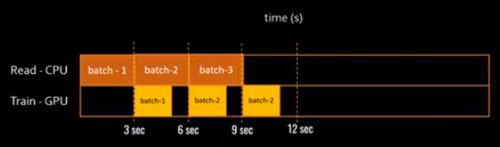
45.1 Optimize Pipeline: Theory
https://www.youtube.com/watch?v=MLEKEplgCas&list=PLeo1K3hjS3uu7CxAacxVndI4bE_o3BDtO&index=45
Optimize Pipeline: Theory (3:04-3:20/26:15)
The right-below diagram shows:
1. When CPU does the batch-1 model training, the CPU can do the batch-2 image reading.
2. When CPU does the bacth-2 model training, the CPU can do the batch-3 image reading.
This approach will take overall 11 seconds.
The previous diagram takes overall 15 seconds.

Slide 10
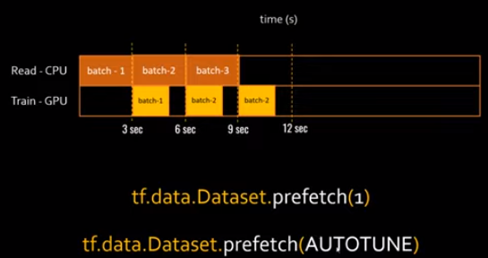
45.1 Optimize Pipeline: Theory
https://www.youtube.com/watch?v=MLEKEplgCas&list=PLeo1K3hjS3uu7CxAacxVndI4bE_o3BDtO&index=45
Optimize Pipeline: Theory (2:30-3:50/26:15)
In order to do the data pipeline in 11 seconds, we just need to do the following command:
> td.data.Dataset.prefetch (1).
The argument 1 means only 1-batch run in the GPU.
Normally, we use argument “AUTOTUNE” to tensorflow and let tensorflow decide by itself.
We see people use “AUTOTUNE” very often.

Slide 11
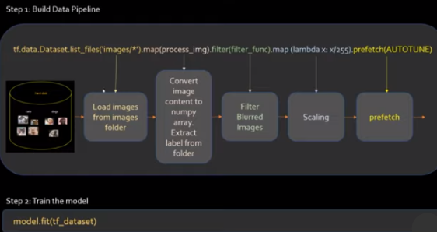
45.1 Optimize Pipeline: Theory
https://www.youtube.com/watch?v=MLEKEplgCas&list=PLeo1K3hjS3uu7CxAacxVndI4bE_o3BDtO&index=45
Optimize Pipeline: Theory (3:58-5:25/26:15)
Below, we have step 1 (Build the Data Pipeline) and step 2 (Train the Model).
In the step 1 (Build the Data Pipeline), we use tensorflow prefetch command of tf.data.Dataset.
In the step 1, we have q sequence of pipelines: a) list_files (to read image files), b) map function to process image, c) filter function to filter the noisy, d) map function to scale image pixel, e) at the end, we make CPU and GPU optimization by the command prefetch (AUTOTUNE).
Then, we do multiple epochs for step 1 (Build Data Pipeline) and Step 2 (Train the Model).

Slide 12
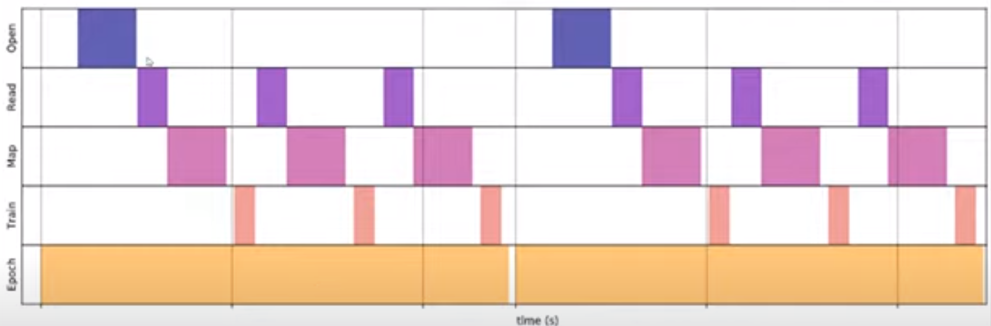
45.1 Optimize Pipeline: Theory
https://www.youtube.com/watch?v=MLEKEplgCas&list=PLeo1K3hjS3uu7CxAacxVndI4bE_o3BDtO&index=45
Optimize Pipeline: Theory (5:30-6:00/26:15)
https://www.tensorflow.org/guide/data_performance
Below, we just use CPU and GPU pipeline. We do not use any caching
Here, x-axis is time in second, y-axis are “Open File”, “Read Image”, “Map”, “Train”, and “Epoch”.
The Epochs run in sequence. Open them same file and different images.

Slide 13
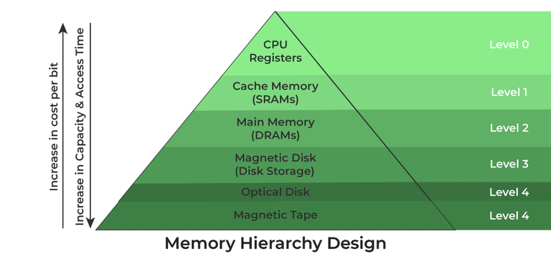
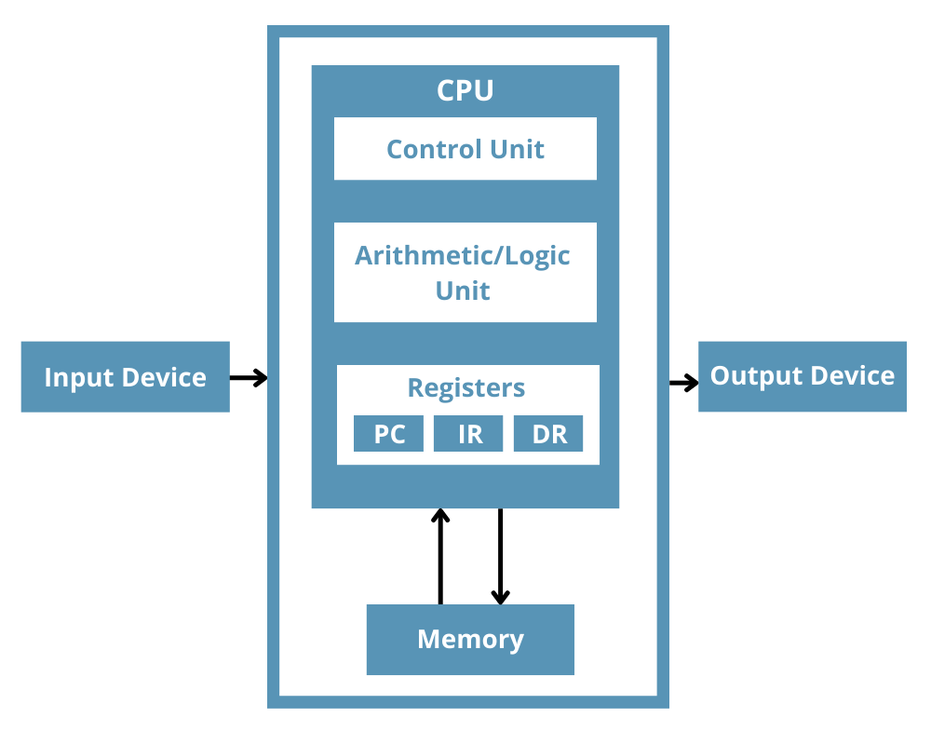
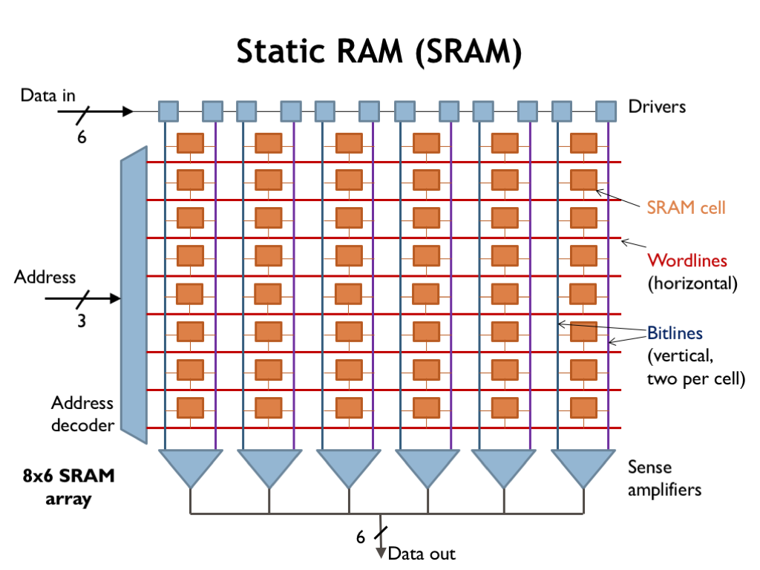
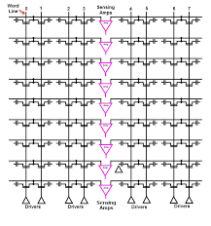
45.1 Optimize Pipeline: Theory
https://www.youtube.com/watch?v=MLEKEplgCas&list=PLeo1K3hjS3uu7CxAacxVndI4bE_o3BDtO&index=45
Optimize Pipeline: Theory (6:01-6:30/26:15)
https://www.geeksforgeeks.org/memory-hierarchy-design-and-its-characteristics/
What is the ranks of memory speed?
1. CPU Register: registers inside CPU (fastest)
2. Cache Memory: SRAMs (Static RAM)
3. DRAM: capacitor, cycle refresh
4. Disk: SSD (Solid-State Disk) or Magnetic coil storage.
5. Optical Disk: CR, DVD
6. Magnetic Tape: Mechanic Sequential read (Slowest)
1. CPU Register: flip-flop latch memory
2. Cache memory (SRAM): Use flip-flop latch to latch data without refresh Memory.
3. DRAM: Need power refresh Memory

Slide 14
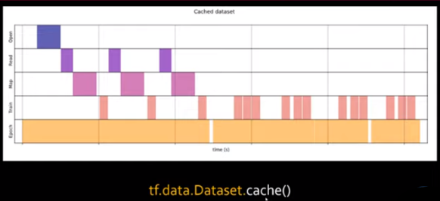
45.1 Optimize Pipeline: Theory
https://www.youtube.com/watch?v=MLEKEplgCas&list=PLeo1K3hjS3uu7CxAacxVndI4bE_o3BDtO&index=45
Optimize Pipeline: Theory (7:01-7:30/26:15)
https://www.tensorflow.org/guide/data_performance
What is the difference between the pipeline and pipeline with cache?
1. In the pipeline, we only do inside the epoch. Each epoch run one-by-one.
2. In the pipeline with cache:
2.1 Intel CPU has very fast (flip-flop) cache memory for cache table (cache-1, cache-2, cache-3, etc) in stead of slower capacitor cycle-refresh RAM.
2.1 In cache, we only “Open” the file once by CPU.
2.2 The “Read”, “Map”, are waiting in sequence and processes next.
2.3 When the GPU are available, the training tasks will come in and run.

Slide 15
45.2 Optimize Pipeline: Coding

Slide 16
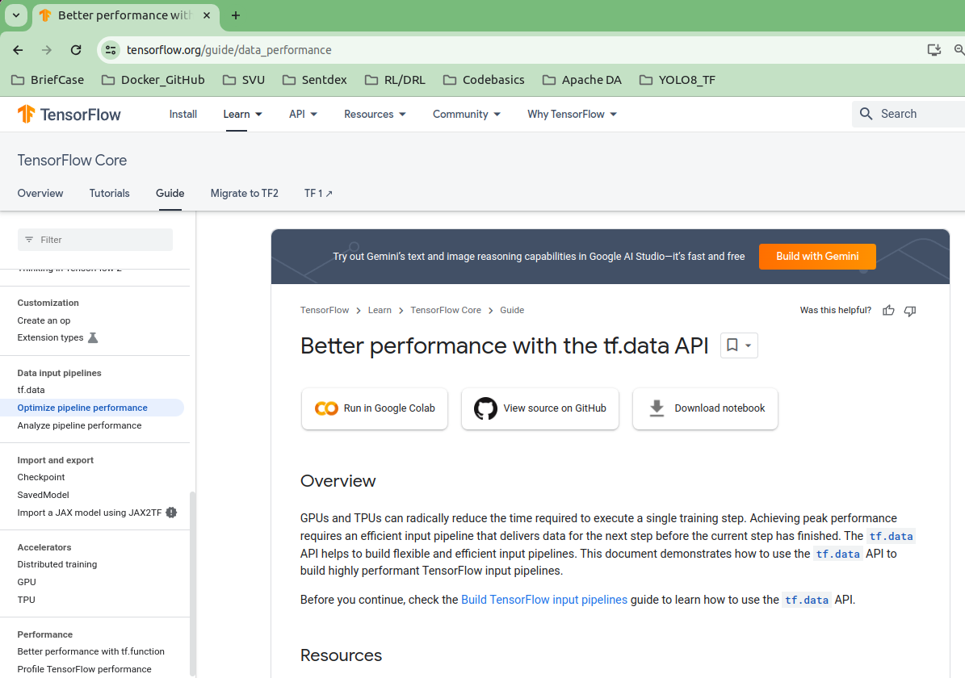
45.2 Optimize Pipeline: Coding
https://www.youtube.com/watch?v=MLEKEplgCas&list=PLeo1K3hjS3uu7CxAacxVndI4bE_o3BDtO&index=45
Optimize Pipeline: Coding (7:38-7:50/26:15)
https://www.tensorflow.org/guide/data_performance
Google tensorflow “Optimize pipeline performance” give us the document how to get better performance by using prefetch, cache, etc.

Slide 17
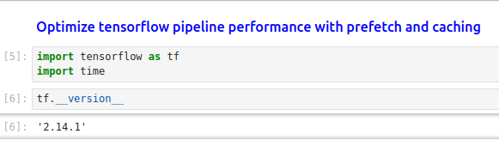
45.2 Optimize Pipeline: Coding
https://www.youtube.com/watch?v=MLEKEplgCas&list=PLeo1K3hjS3uu7CxAacxVndI4bE_o3BDtO&index=45
Optimize Pipeline: Coding (7:38-8:20/26:15)
https://www.tensorflow.org/guide/data_performance
We will run prefetch() and cache() locally on my machine.
Import the tensorflow framework.

Slide 18
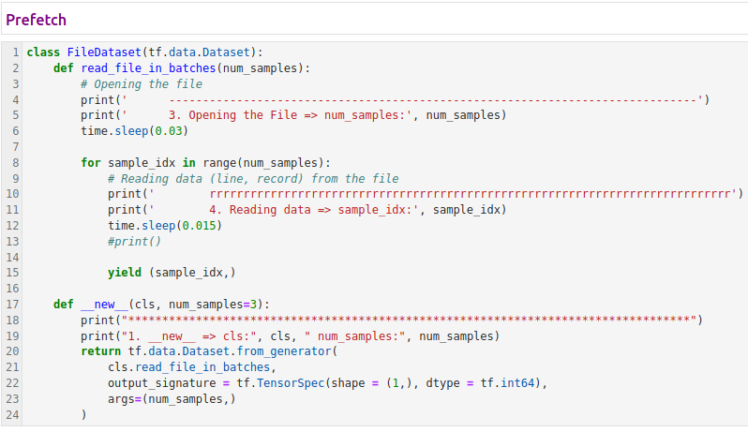
45.2 Optimize Pipeline: Coding
https://www.youtube.com/watch?v=MLEKEplgCas&list=PLeo1K3hjS3uu7CxAacxVndI4bE_o3BDtO&index=45
Optimize Pipeline: Coding (8:31-10:30/26:15)
https://www.tensorflow.org/guide/data_performance
Read Dataset:
1. Open file: delay 0.03 sec for reading.
2. read image: 0.015 second
3. __new__: num_of_sample =3 and return image_sample

Slide 19
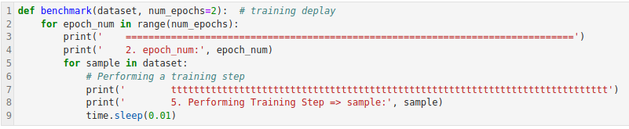
45.2 Optimize Pipeline: Coding
https://www.youtube.com/watch?v=MLEKEplgCas&list=PLeo1K3hjS3uu7CxAacxVndI4bE_o3BDtO&index=45
Optimize Pipeline: Coding (10:31-14:30/26:15)
https://www.tensorflow.org/guide/data_performance
Define benchmark(): # Training Delay.

Slide 20
45.2 Optimize Pipeline: Coding
https://www.youtube.com/watch?v=MLEKEplgCas&list=PLeo1K3hjS3uu7CxAacxVndI4bE_o3BDtO&index=45
Optimize Pipeline: Coding (14:31-15:00/26:15)
https://www.tensorflow.org/guide/data_performance
Benchmark:
run CPU with GPU with prefetch.

Slide 21
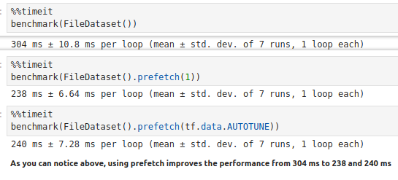
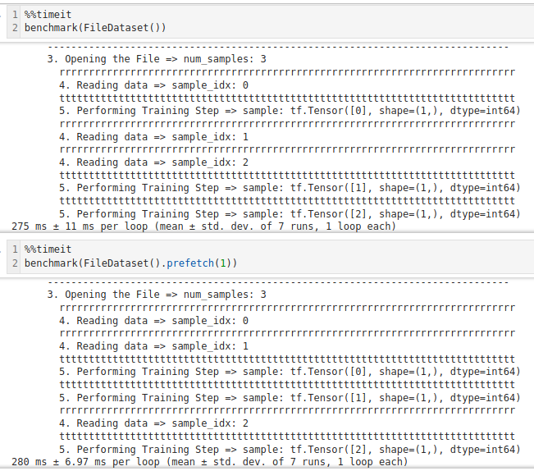
45.2 Optimize Pipeline: Coding
https://www.youtube.com/watch?v=MLEKEplgCas&list=PLeo1K3hjS3uu7CxAacxVndI4bE_o3BDtO&index=45
Optimize Pipeline: Coding (15:01-18:00/26:15)
https://www.tensorflow.org/guide/data_performance
Left: 4-CPU with preftech. you can see the run time is reduced from 304 ms to 238/240 ms
Right: my computer has only GPU. No effect in prefetch.

Slide 22
45.2 Optimize Pipeline: Coding
https://www.youtube.com/watch?v=MLEKEplgCas&list=PLeo1K3hjS3uu7CxAacxVndI4bE_o3BDtO&index=45
Optimize Pipeline: Coding (10:01-18:30/26:15)
https://www.tensorflow.org/guide/data_performance
Benchmark:
run CPU with GPU with GPU and cache.

Slide 23
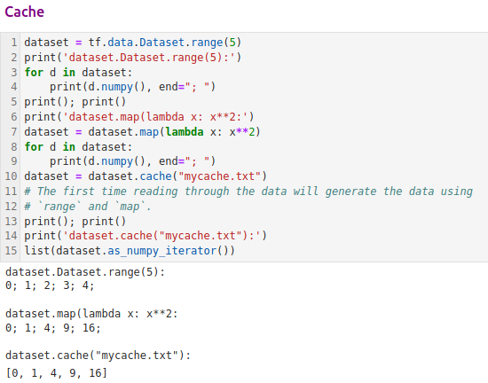
45.2 Optimize Pipeline: Coding
https://www.youtube.com/watch?v=MLEKEplgCas&list=PLeo1K3hjS3uu7CxAacxVndI4bE_o3BDtO&index=45
Optimize Pipeline: Coding (18:31-23:00/26:15)
https://www.tensorflow.org/guide/data_performance
Benchmark:
run CPU with GPU with GPU and cache.

Slide 24
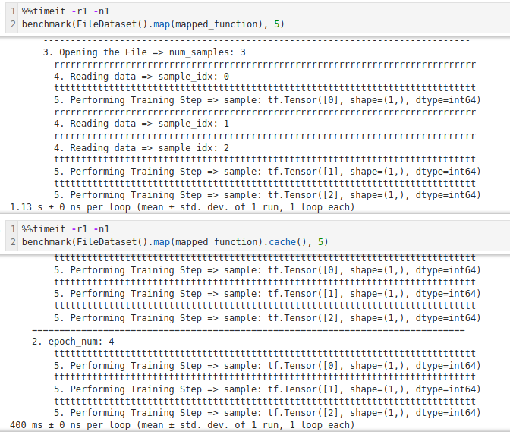
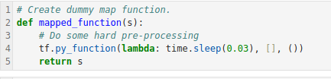
45.2 Optimize Pipeline: Coding
https://www.youtube.com/watch?v=MLEKEplgCas&list=PLeo1K3hjS3uu7CxAacxVndI4bE_o3BDtO&index=45
Optimize Pipeline: Coding (23:01-26:15/26:15)
https://www.tensorflow.org/guide/data_performance
Map function for pre-processing: use py_function and lambda function.
Using the cache, we reduce from 1.13 sec to 400 msec.

Slide 25
45.3 Optimize Pipeline: Summary

Slide 26
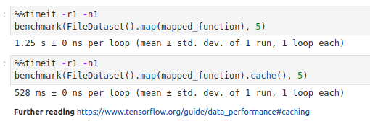
45.3 Optimize Pipeline: Sumamry
https://www.youtube.com/watch?v=MLEKEplgCas&list=PLeo1K3hjS3uu7CxAacxVndI4bE_o3BDtO&index=45
Optimize Pipeline: Summary (23:01-26:15/26:15)
1. NVIDA GSX Station 4-GPU:
1.1 No prefetch: 304 ms
1.2 Tensorflow prefetch with 1-bacth: 238 ms
1.3 Tensorflow prefetch with AUTOTUNE: 240 ms
2. Intel Cache and NVIDIA GSX Station 4-GPU:
2.1 No Cache: 1.25 sec
2.2 with Cache: 528 ms

Slide 27
End

