Slide 1

16 Tensorboard
Peter H. Chen

Slide 2
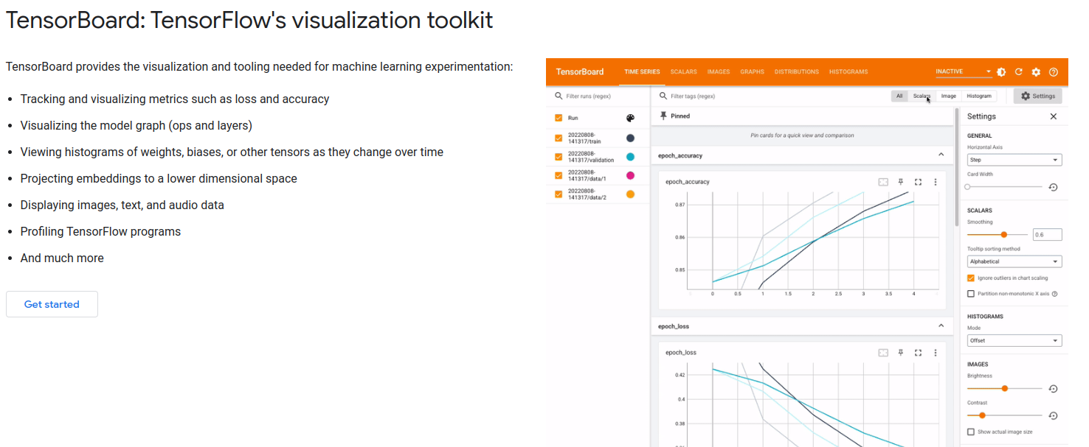
16 Tensorboard
https://www.youtube.com/watch?v=9SdLOcGnebU&list=PLeo1K3hjS3uu7CxAacxVndI4bE_o3BDtO&index=16
Tensorboard (0:00-0:10/14:55)
https://www.tensorflow.org/tensorboard
We look at the tensorboard today.
Tensorboard is a tool that allow you to debug the issues with neural network.
Tensorboard is also helpful in tracking and visualizing metrics, such as, loss and accuracy.
Below the official tensorflow for tensorboard.
We compare the result of hyperparameters: 1. Adam and 2. SGD (Stochastic Gradient Descent).

Slide 3
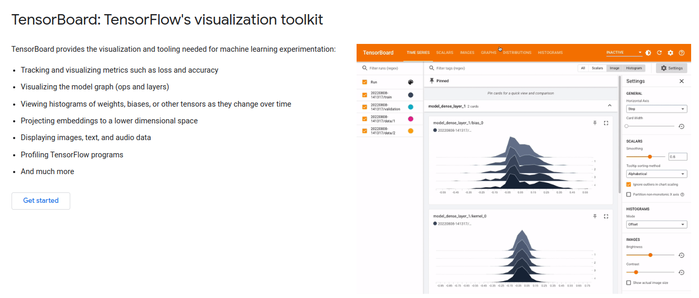
16 Tensorboard
https://www.youtube.com/watch?v=9SdLOcGnebU&list=PLeo1K3hjS3uu7CxAacxVndI4bE_o3BDtO&index=16
Tensorboard (0:11-0:20/14:55)
https://www.tensorflow.org/tensorboard
Tensorboard is a tool comes with tensorflow.
So you don’t have to do a separate installation for tensorboard.
Below shows the Kernel (weights) histogram (distribution) and bias distribution.

Slide 4
16 Tensorboard
https://www.youtube.com/watch?v=9SdLOcGnebU&list=PLeo1K3hjS3uu7CxAacxVndI4bE_o3BDtO&index=16
Tensorboard (0:21-0:26/14:55)
https://www.tensorflow.org/tensorboard
Tensorboard provides the visualization and tools for machine learning.
1. Track and visualize metrics, such as, loss and accuracy
2. Visualize the model graph (ops and layers)
3. View histograms of weights, biases, or other tensors as they change over time
4. Project embeddings (inside view) to a lower dimensional space
5. Display images, text, and audio data
6. Profile/outline TensorFlow programs

Slide 5
16 Tensorboard
https://www.youtube.com/watch?v=9SdLOcGnebU&list=PLeo1K3hjS3uu7CxAacxVndI4bE_o3BDtO&index=16
Tensorboard (0:27-0:28/14:55)
If yo have duplicate tensorboard installed (one from nightly, one from normal)
Namely:
pip uninstall tb-nightly tensorboard tensorflow tensorflow-estimator tf-estimator-nightly tf-nightly
# Repleat above command several times to remove nightly version.
pip install tensorflow # or `tensorflow-gpu`, or `tf-nightly`, ...

Slide 6
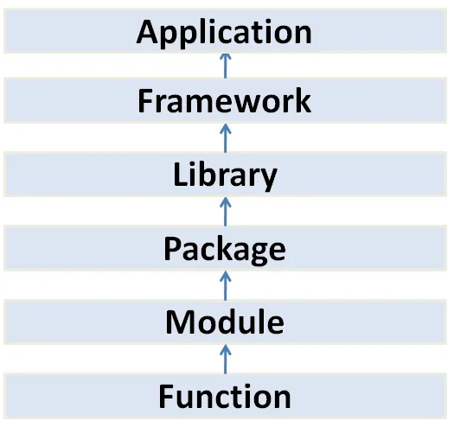
16 Tensorboard
https://www.youtube.com/watch?v=9SdLOcGnebU&list=PLeo1K3hjS3uu7CxAacxVndI4bE_o3BDtO&index=16
Tensorboard (0:29-0:30/14:55)
Recall the below diagram.
We have the tensorflow framework and Tensorboard package.
Tensorflow Playground
(Browser-based Application)
Google Tensorflow, Google Angular
Meta PyTorch, Meta ReactJS, Keras
Tensorboard, numpy, pandas, Matplotlib, Seaborn,
GUI Tkinter, Nokia PyQt, ...
Folder/Directory with __init__.py
File
class
math
Method
sqrt()

Slide 7
16.1 Improve NN Performance by TB

Slide 8
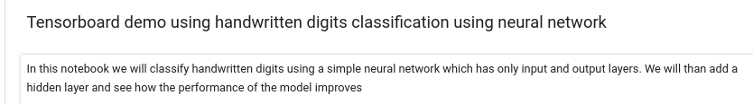
16.1 Improve NN Performance by TB
https://www.youtube.com/watch?v=9SdLOcGnebU&list=PLeo1K3hjS3uu7CxAacxVndI4bE_o3BDtO&index=16
Improve NN Performance by TB (0:31-0:32/14:55)
We use the hand written digits classification and improve the performance by tensorboard.
1. We will use the simple neural network which classify the handwritten digit.
2. The neural network has only input and output layers.
3. We will add a hidden layer and see how the performance of the model improves.

Slide 9
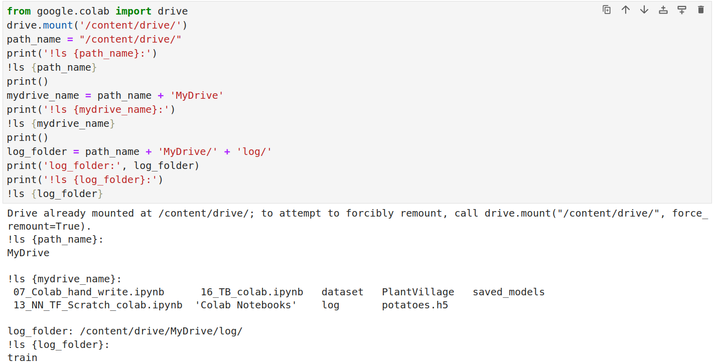
16.1 Improve NN Performance by TB
https://www.youtube.com/watch?v=9SdLOcGnebU&list=PLeo1K3hjS3uu7CxAacxVndI4bE_o3BDtO&index=16
Improve NN Performance by TB (0:33-0:34/14:55)
We create the folder on the google mount drive.

Slide 10
16.2 Review Handwriting Digit NN

Slide 11
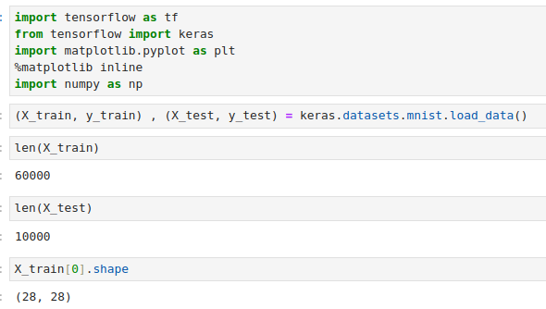
16.2 Review Handwriting Digit NN
https://www.youtube.com/watch?v=9SdLOcGnebU&list=PLeo1K3hjS3uu7CxAacxVndI4bE_o3BDtO&index=16
Review Handwriting Digit NN (0:35-0:36/14:55)
Display Data.

Slide 12
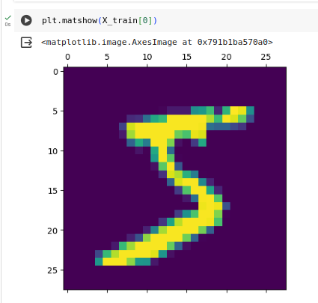
16.2 Review Handwriting Digit NN
https://www.youtube.com/watch?v=9SdLOcGnebU&list=PLeo1K3hjS3uu7CxAacxVndI4bE_o3BDtO&index=16
Review Handwriting Digit NN(0:37-0:38/14:55)
Plot input image X_train[0].

Slide 13
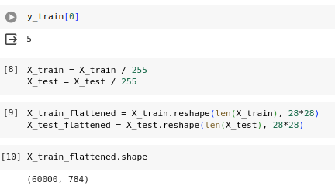
16.2 Review Handwriting Digit NN
https://www.youtube.com/watch?v=9SdLOcGnebU&list=PLeo1K3hjS3uu7CxAacxVndI4bE_o3BDtO&index=16
Review Handwriting Digit NN (0:39-0:43/14:55)
1. We scale data
2. We reshape data into flatten.

Slide 14
16.3 Flatten by Tensorflow

Slide 15
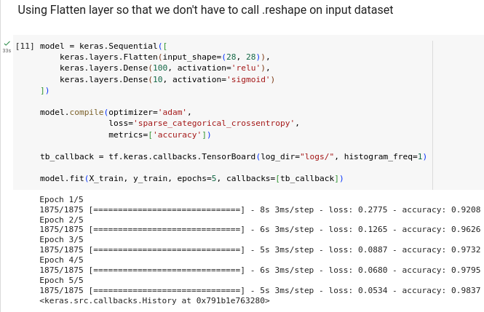
16.3 Flatten by Tensorflow
https://www.youtube.com/watch?v=9SdLOcGnebU&list=PLeo1K3hjS3uu7CxAacxVndI4bE_o3BDtO&index=16
Flatten by Tensorflow (0:33-0:51/14:55)
We do not have to call reshape to flatten the image data. In stead, we can use tensorflow to flatten the image data. Here,
1. We have first input layer with Flatten.
2. Then, we second hidden layer with 100 neurons.
3. We have third layer with 10 output neurons for digit 0 to 9.

Slide 16
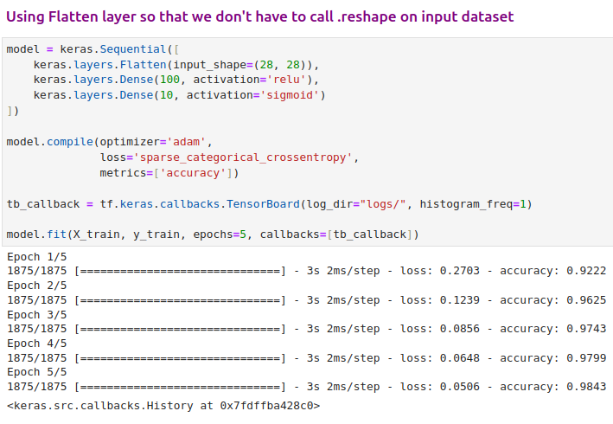
16 Tensorboard
https://www.youtube.com/watch?v=9SdLOcGnebU&list=PLeo1K3hjS3uu7CxAacxVndI4bE_o3BDtO&index=16
Tensorboard (01:01-01:40/14:55)
We have 5 epochs.
Each epoch have loss and accuracy for the training dataset.
We have model parameters, optimizer = ‘adam’, loss = ‘sparse_categorical_crossentropy’, and metrics = ‘accuracy’.

Slide 17
16.4 Add Tensorboard

Slide 18
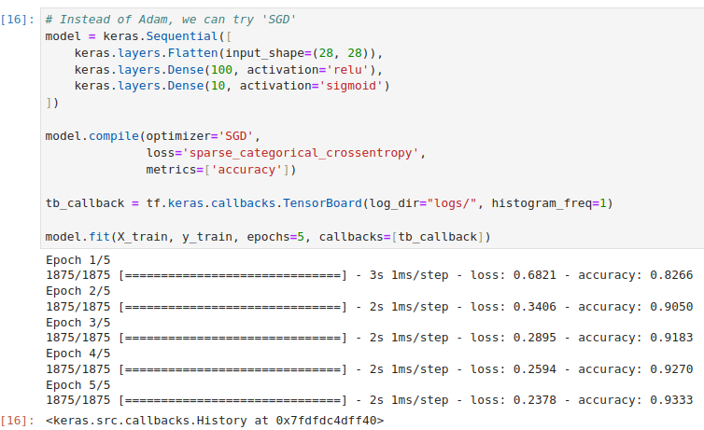
16.4 Add Tensorboard
https://www.youtube.com/watch?v=9SdLOcGnebU&list=PLeo1K3hjS3uu7CxAacxVndI4bE_o3BDtO&index=16
Add Tensorboard (01:41-02:09/14:55)
Instead of ‘adam’, we can try ‘SGD’. For 5 epochs, the result of adam (loss = 0.05, accuracy = 98.4%) is better than SGD (loss = 0.23, accuracy = 93%).
For longer run, the result maybe different.
Wee add Tensorboard to view the results.

Slide 19
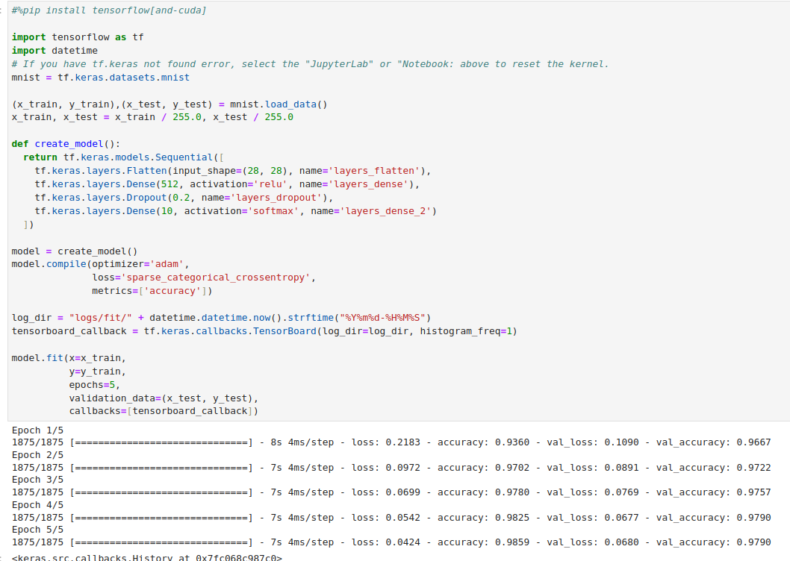
16.4 Add Tensorboard
https://www.youtube.com/watch?v=9SdLOcGnebU&list=PLeo1K3hjS3uu7CxAacxVndI4bE_o3BDtO&index=16
Add Tensorboard (02:10-02:11/14:55)
We create the directory ‘logs’ to store the results for tensorflow.
There is a callback function write the epoch information.
In stead of “adam” optimizer, we can try ‘SGD’.

Slide 20
16.5 Adam vs SGD

Slide 21
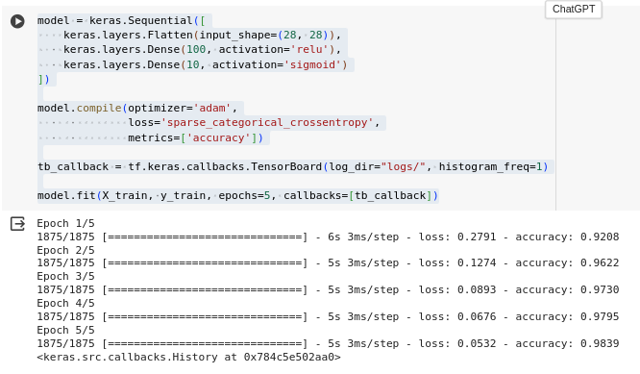
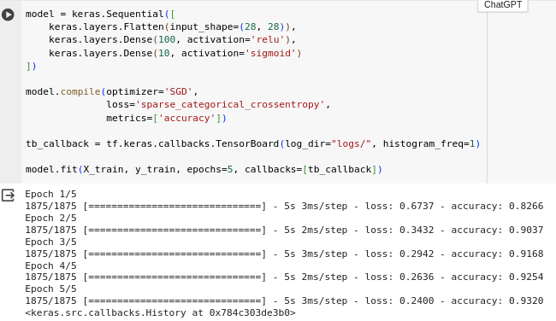
16.5 Adam vs SGD
https://www.youtube.com/watch?v=9SdLOcGnebU&list=PLeo1K3hjS3uu7CxAacxVndI4bE_o3BDtO&index=16
Adam vs SGD (02:11-03:00/14:55)
In stead of “adam” optimizer, we can try ‘SGD’.
1. Adam: accuracy = 0.9839
2. SGD: accuracy = 0.9326

Slide 22
16.6 TB Callbacks

Slide 23
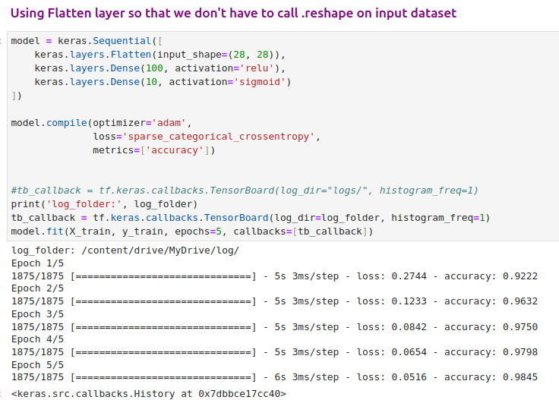
16.6 TB Callbacks
https://www.youtube.com/watch?v=9SdLOcGnebU&list=PLeo1K3hjS3uu7CxAacxVndI4bE_o3BDtO&index=16
TB Callbacks (03:01-03:30/14:55)
1. We also can change the epochs to higher.
2. We add the callbacks = [tb_callback]. This supply all information to each epochs.
3. Here, we use the mount drive so that we can view on the google drive.
This will put all the information to the log directory.

Slide 24
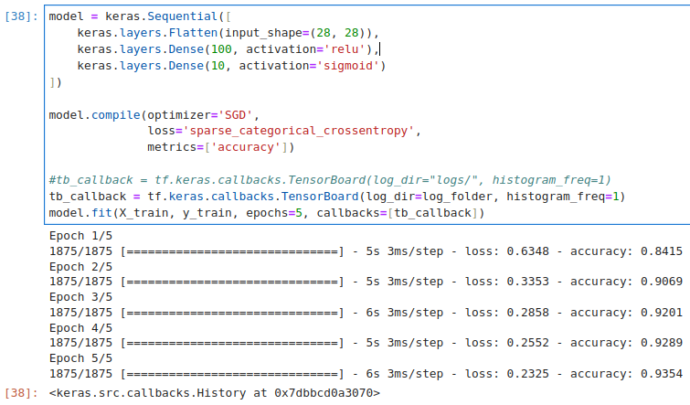
16.6 TB Callbacks
https://www.youtube.com/watch?v=9SdLOcGnebU&list=PLeo1K3hjS3uu7CxAacxVndI4bE_o3BDtO&index=16
TB Callbacks (03:31-04:00/14:55)
We change the ‘Adam’ to ‘SGD’

Slide 25
16.7 View Folder logs on Colab

Slide 26
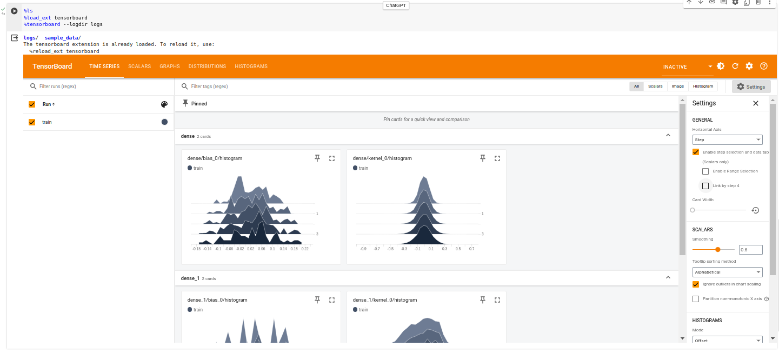
16.7 View Folder logs on Colab
https://www.youtube.com/watch?v=9SdLOcGnebU&list=PLeo1K3hjS3uu7CxAacxVndI4bE_o3BDtO&index=16
View Folder logs on Colab (04:01-04:02/14:55)
Where can we find the logs folder in colab?
1. % ls
We use ‘ls’ to find the folders on colab. We can see folders “logs/” and “sample_data/”
2. % load_ext tensorboard
3. % tensorboard --logdir logs

Slide 27
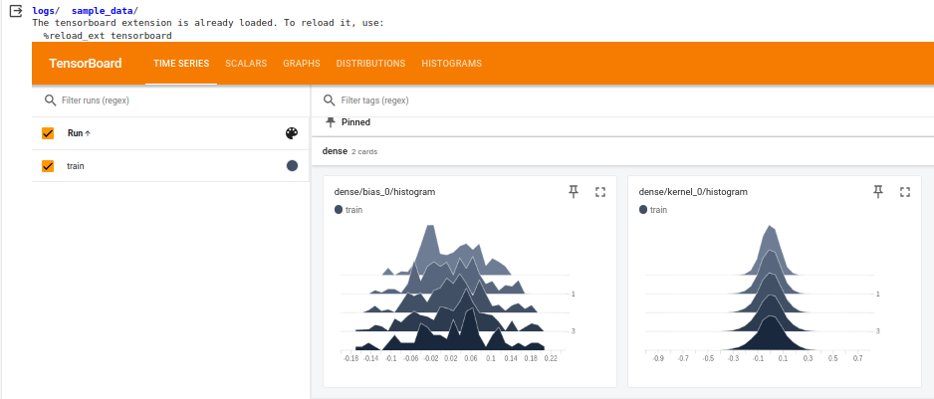
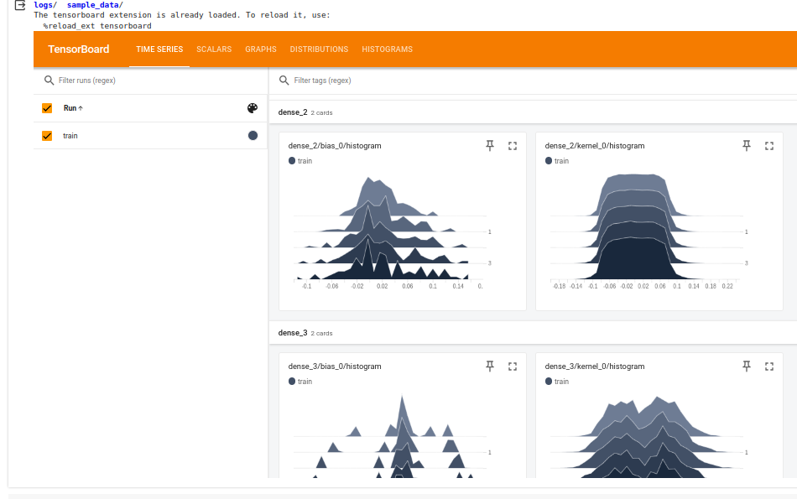
16.7 View Folder logs on Colab
https://www.youtube.com/watch?v=9SdLOcGnebU&list=PLeo1K3hjS3uu7CxAacxVndI4bE_o3BDtO&index=16
View Folder logs on Colab (04:03-04:04/14:55)
We view layers of dense, dense_1, dense_2, dense_3.

Slide 28
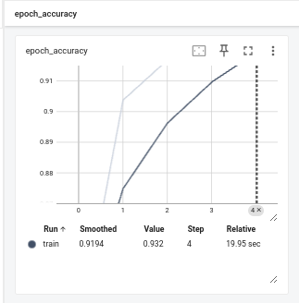
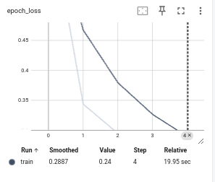
16.7 View Folder logs on Colab
https://www.youtube.com/watch?v=9SdLOcGnebU&list=PLeo1K3hjS3uu7CxAacxVndI4bE_o3BDtO&index=16
View Folder logs on Colab (04:05-04:06/14:55)
We view accuracy and loss.

Slide 29
16.8 View Folder logs on Local

Slide 30
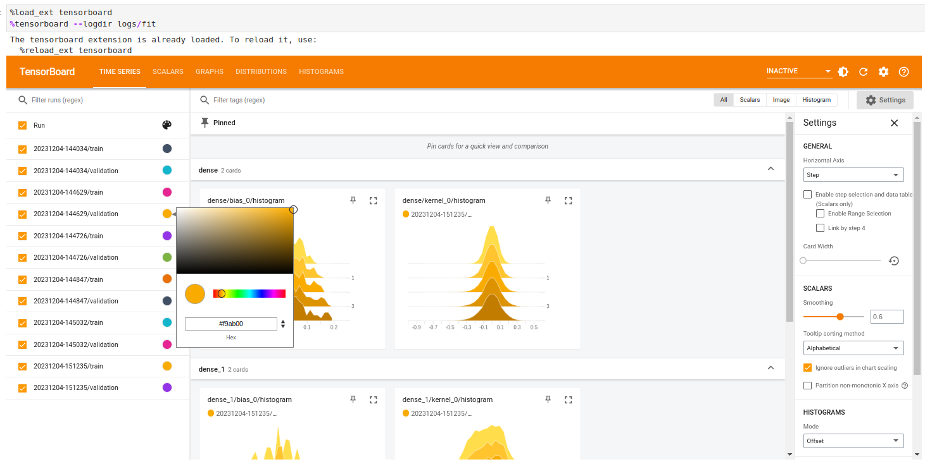
16.8 View Folder logs on Local
https://www.youtube.com/watch?v=9SdLOcGnebU&list=PLeo1K3hjS3uu7CxAacxVndI4bE_o3BDtO&index=16
View Folder logs on Local (05:57-06:57/14:55)
You also can launch them in the jupyter notebook.
> %load_ext tensorboard
> %tensorboard --logdir logs/fit

Slide 31
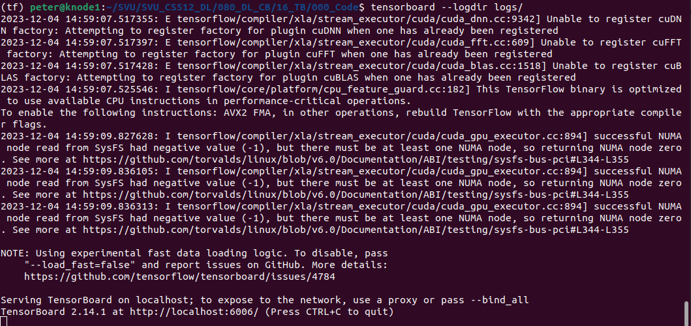
16.8 View Folder logs on Local
https://www.youtube.com/watch?v=9SdLOcGnebU&list=PLeo1K3hjS3uu7CxAacxVndI4bE_o3BDtO&index=16
View Folder logs on Local (04:57-05:57/14:55)
Either run above inline magic or go to git bash or your command prompt and type below to run it,¶
> tensorboard --logdir logs/
This will launch tensorboard at this url which you can open in your browser http://localhost:6006/
Note:
If you encounter the “Duplicate Projector” message, this means you have duplicate tensorboard installed, for example, one come from nightly version, one installation come from regular installation version.
Follow the error messages and remove both versions first and then install the regular version.

Slide 32
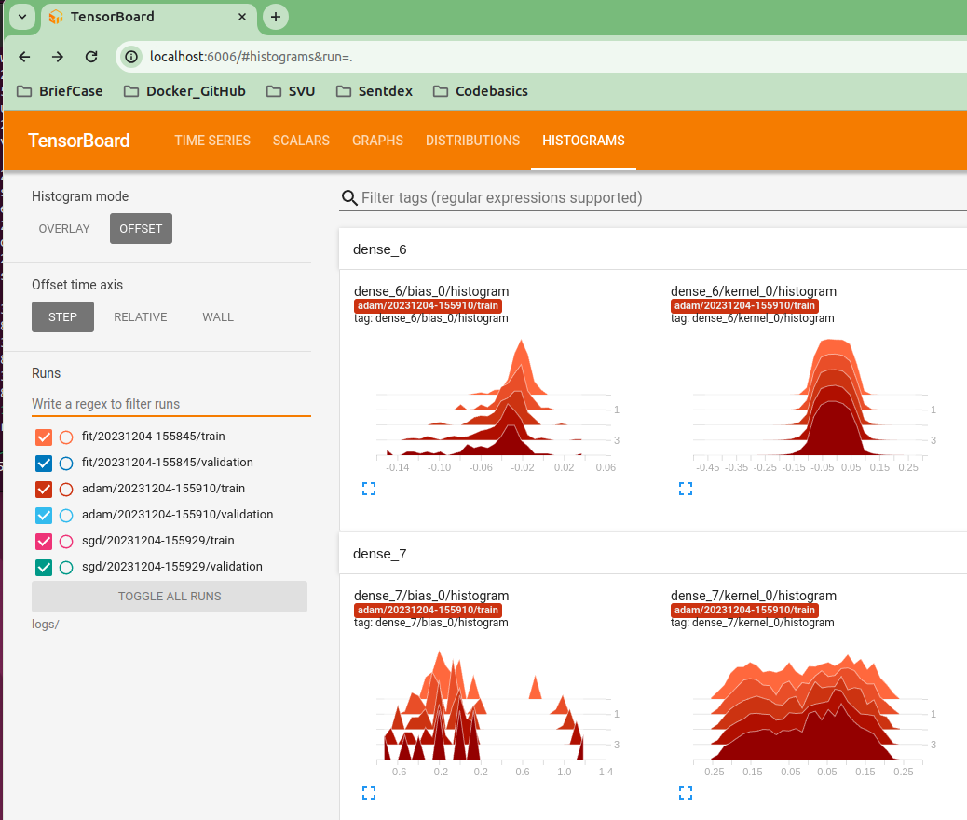
16.8 View Folder logs on Local
https://www.youtube.com/watch?v=9SdLOcGnebU&list=PLeo1K3hjS3uu7CxAacxVndI4bE_o3BDtO&index=16
View Folder logs on Local (05:57-08:50/14:55)
On the browser, enter
> hpp:http://localhost:6006
We have several runs:
Search “adam” to filter out “fit” and “sgd”
> adam
Histogram: Data distribution
Here data is Kernel: weight and bias

Slide 33
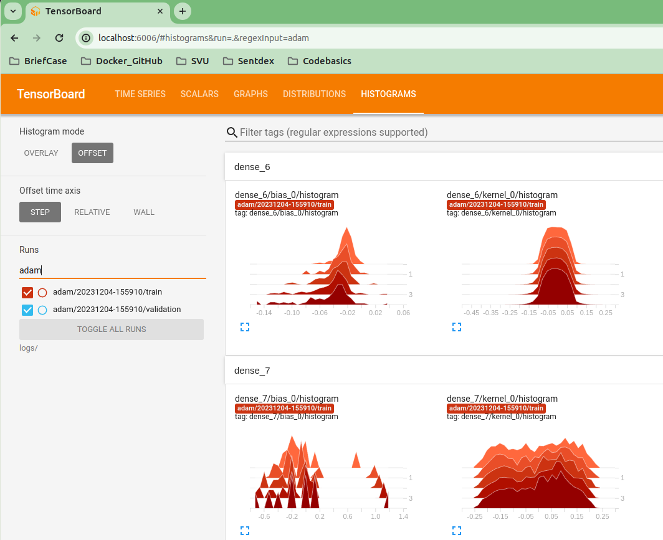
16.8 View Folder logs on Local
https://www.youtube.com/watch?v=9SdLOcGnebU&list=PLeo1K3hjS3uu7CxAacxVndI4bE_o3BDtO&index=16
View Folder logs on Local (08:57-9:30/14:55)
Search “adam”
> adam

Slide 34
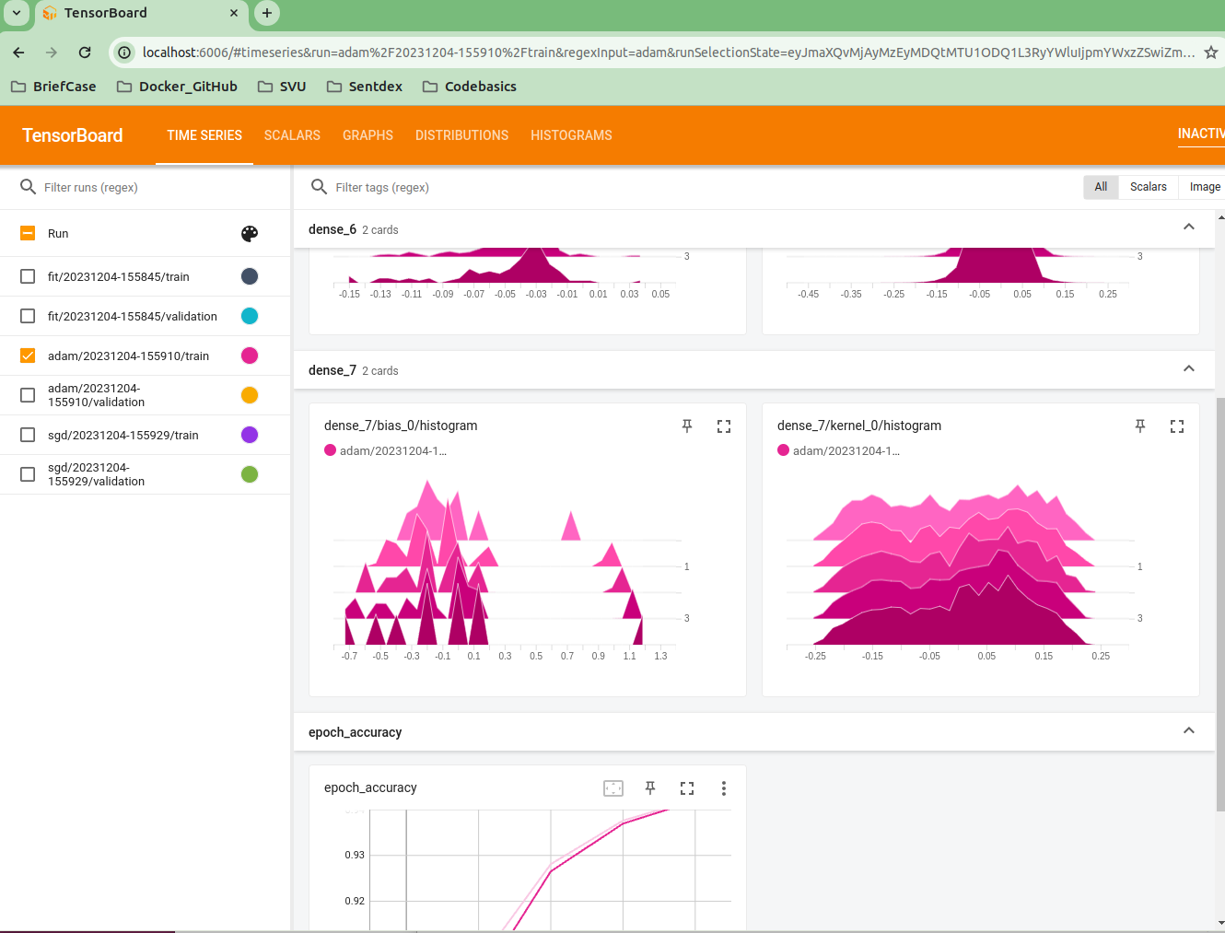
16.8 View Folder logs on Local
https://www.youtube.com/watch?v=9SdLOcGnebU&list=PLeo1K3hjS3uu7CxAacxVndI4bE_o3BDtO&index=16
View Folder logs on Local (09:31-09:50/14:55)
We can select “train” or “validation”

Slide 35
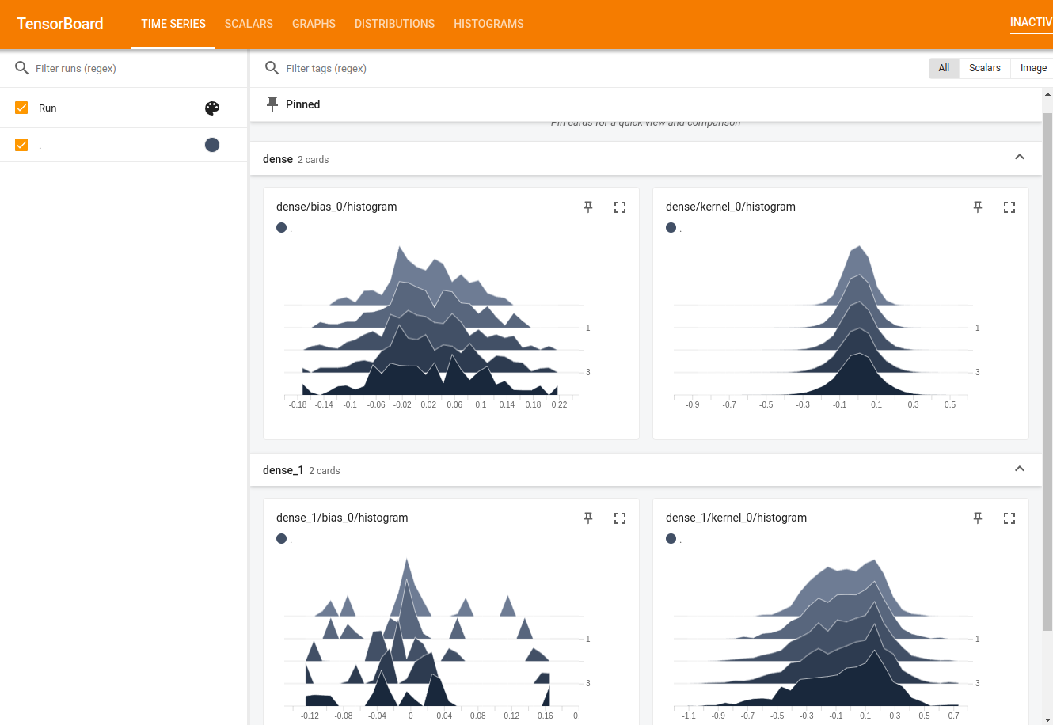
16.8 View Folder logs on Local
https://www.youtube.com/watch?v=9SdLOcGnebU&list=PLeo1K3hjS3uu7CxAacxVndI4bE_o3BDtO&index=16
View Folder logs on Local (09:51-10:50/14:55)
Click “Time Series”

Slide 36
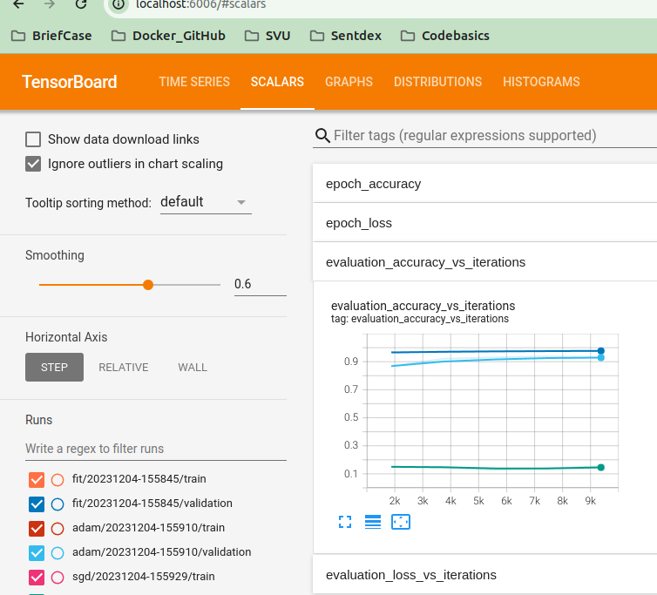
16.8 View Folder logs on Local
https://www.youtube.com/watch?v=9SdLOcGnebU&list=PLeo1K3hjS3uu7CxAacxVndI4bE_o3BDtO&index=16
View Folder logs on Local (10:51-11:50/14:55)
Click “Scalars”

Slide 37
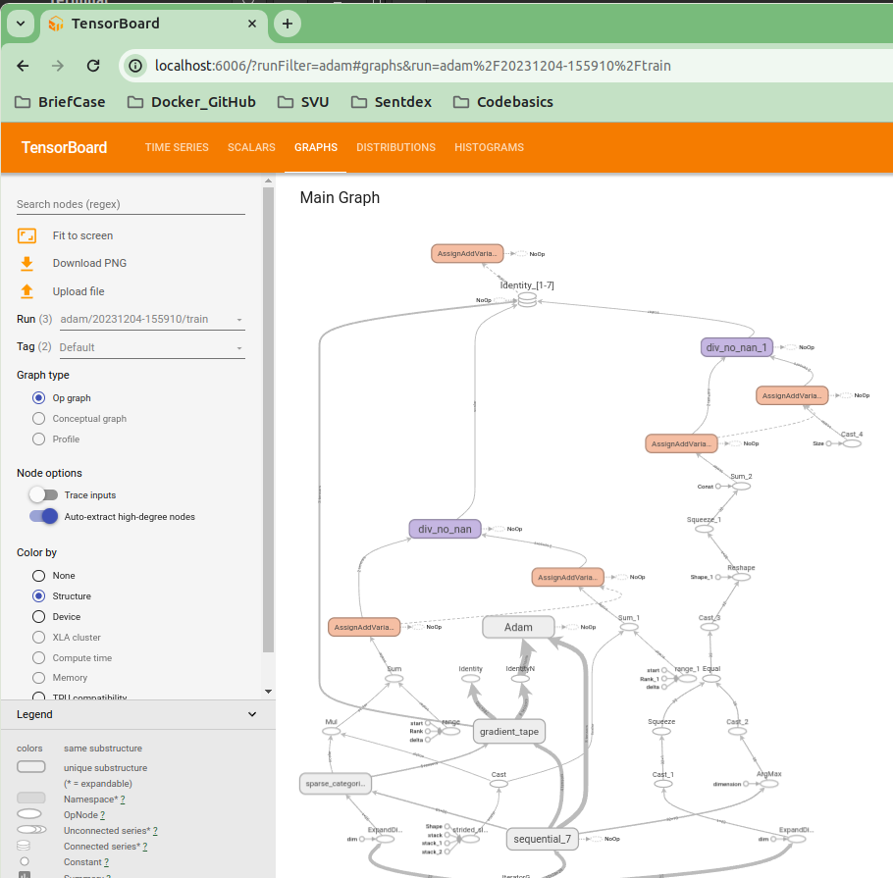
16.8 View Folder logs on Local
https://www.youtube.com/watch?v=9SdLOcGnebU&list=PLeo1K3hjS3uu7CxAacxVndI4bE_o3BDtO&index=16
View Folder logs on Local (11:51-12:50/14:55)
Click “Graph”

Slide 38
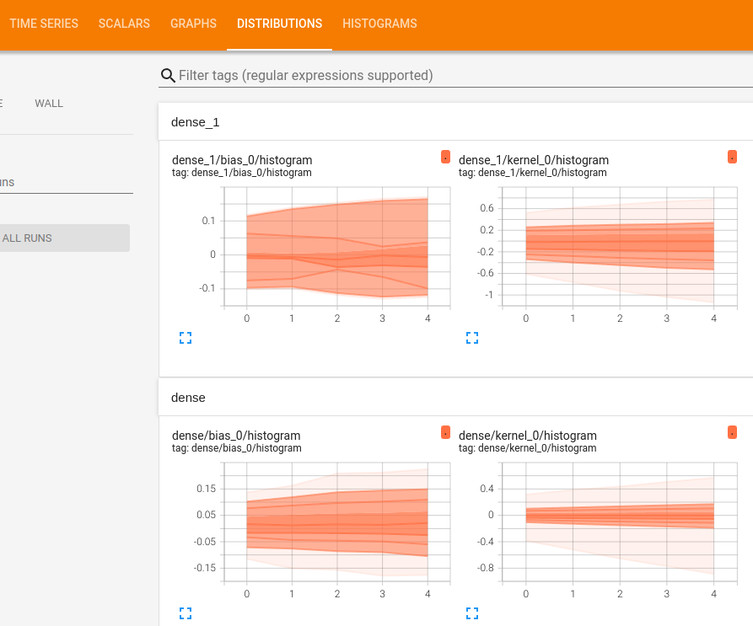
16.8 View Folder logs on Local
https://www.youtube.com/watch?v=9SdLOcGnebU&list=PLeo1K3hjS3uu7CxAacxVndI4bE_o3BDtO&index=16
View Folder logs on Local (12:51-13:50/14:55)
Click “Distribution”

Slide 39
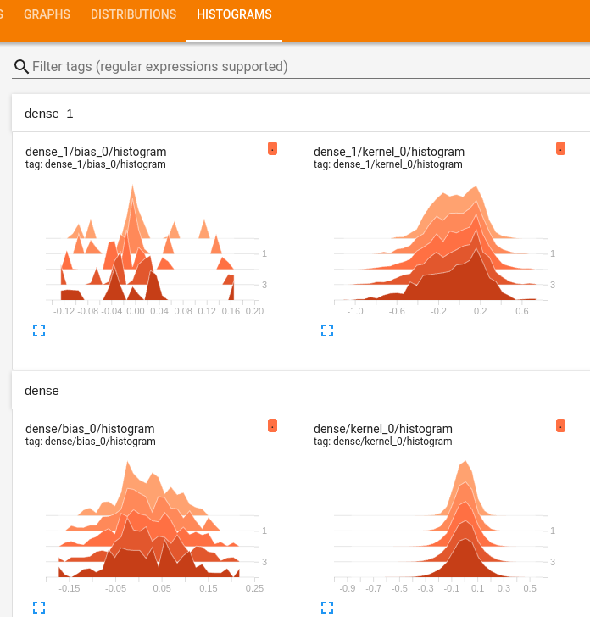
16.8 View Folder logs on Local
https://www.youtube.com/watch?v=9SdLOcGnebU&list=PLeo1K3hjS3uu7CxAacxVndI4bE_o3BDtO&index=16
View Folder logs on Local (13:51-14:55/14:55)
Click “Histogram”

Slide 40
End

