Slide 1

20.00 Review Confusion Matrix
Peter H. Chen

Slide 2
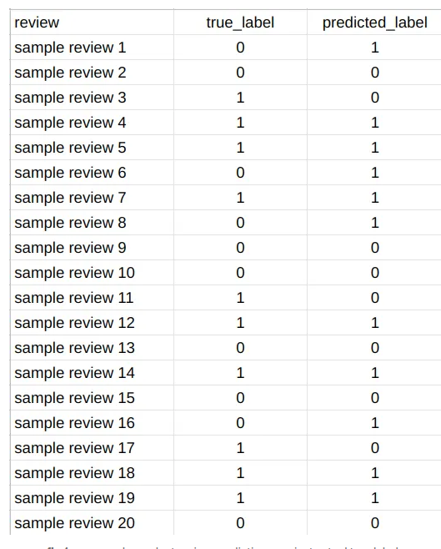
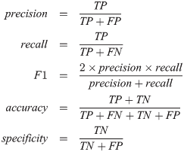
20.00 Review Confusion Matrix
https://medium.com/analytics-vidhya/how-to-calculate-confusion-matrix-manually-14292c802f52
Review Confusion Matrix
Given a Dataset as below:
1. Calculate the Confusion Matrix (True Label/Predicted Label).
2. Calculate Precision, Recall, F1-Score, Accuracy, and Specificity.
 |  | Model Prediction ( ŷ)
 |  | 1 | 0
Actual Value (y) | 1 | TP | FN
 | 0 | FP | TN
1
Based on True Model Prediction
Based on True Actual
2
Based on False Actual
Specificity [特异性;
特異性(とくいせい)]

Slide 3
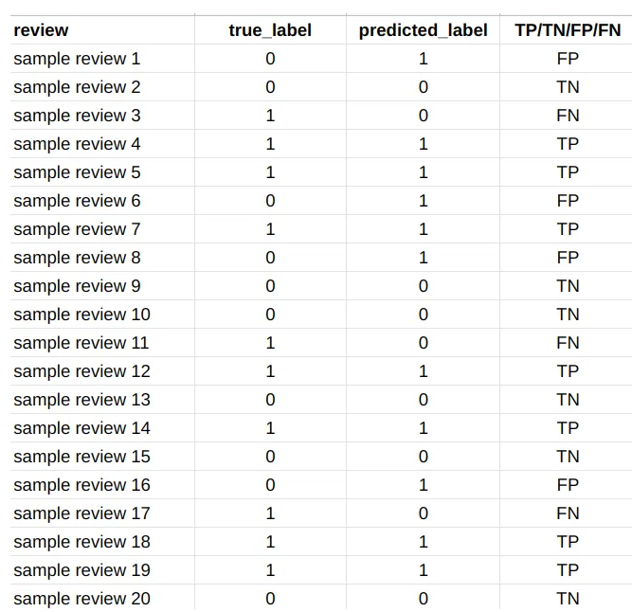
20.00 Review Confusion Matrix
https://medium.com/analytics-vidhya/how-to-calculate-confusion-matrix-manually-14292c802f52
Review Confusion Matrix
Prediction: 0: Negative, 1: Positive
True Label: TP (True Positive), TN (True Negative), FP (False Positive), FN (False Negative)

Slide 4
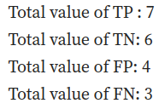
20.00 Review Confusion Matrix
https://medium.com/analytics-vidhya/how-to-calculate-confusion-matrix-manually-14292c802f52
Review Confusion Matrix
Histogram count of TP, TN, FP, FN: TP = 7, TN = 6, FP = 4, FN = 3

Slide 5
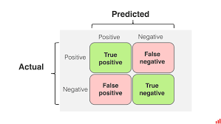
20.00 Review Confusion Matrix
https://medium.com/analytics-vidhya/how-to-calculate-confusion-matrix-manually-14292c802f52
Review Confusion Matrix
Histogram count of TP, TN, FP, FN: TP = 7, TN = 6, FP = 4, FN = 3
 |  | Model Prediction ( ŷ)
 |  | 1 | 0
Actual Value (y) | 1 | 7 (TP) | 3 (FN)
 | 0 | 4 (FP) | 6 (TN)

Slide 6





20.00 Review Confusion Matrix
https://medium.com/analytics-vidhya/how-to-calculate-confusion-matrix-manually-14292c802f52
Review Confusion Matrix
1
Based on True Model Prediction
precision = 7/(7+4) = 7/11 = 63.6%
 |  | Model Prediction ( ŷ)
 |  | 1 | 0
Actual Value (y) | 1 | 7 (TP) | 3 (FN)
 | 0 | 4 (FP) | 6 (TN)
2
Based on True Actual
recall = 7/(7+3) = 7/10 = 70%
3
F1-Score = 2 x (0.636 x 0.7) /(0.636 + 0.7)
= 2 x 0.4452 /1.336 = 66.5%
4
Accuracy = (7+3)/(7 + 3 + 6 + 4) = 10/20
= 50.0%
5
Based on False Actual
Specificity [特异性;
特異性(とくいせい)]
specificity = 3 / (6 + 4) = 3/10
= 30%

Slide 7
End

