Slide 1
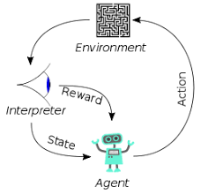
000 Moodle Screen Share
Peter H. Chen

Slide 2
000 Moodle Screen Share
https://www.youtube.com/watch?v=fHJqq_pjUPc
Key:
1. Create Activities: Select BBB (Big Blue Button)
2. Must set the time inside the “session time” range
3. The “Join Session” will be displayed.
4. Click “Join Session”
5. There are “Share screen”, “Webcam”, “Microphone”, etc.

Slide 3
End

