Slide 1

13 NN from Scratch: Coding
Peter H. Chen

Slide 2
13 NN from Scratch: Coding
https://www.youtube.com/watch?v=PQCE9ChuIDY&list=PLeo1K3hjS3uu7CxAacxVndI4bE_o3BDtO&index=13
NN from Scratch: Coding (0:00-0:20/13:22)
We implement the Neural Network from scratch in Python.
We have looked at Gradient Descent by Tensorflow.
We will extend the concept the Tensorflow code and write our own neural network class.
We write the neural network class with purely in Python and without using TensorFlow and without keras. Just pure python class.
We will make the prediction with our own class.

Slide 3
13.1 Import Libraries

Slide 4
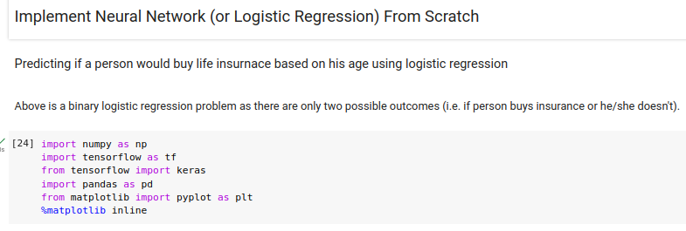
13.1 Import Libraires
https://www.youtube.com/watch?v=PQCE9ChuIDY&list=PLeo1K3hjS3uu7CxAacxVndI4bE_o3BDtO&index=13
Import Libraries (0:25-0:30/13:22)
We import framework and library.

Slide 5
13.2 Mount Google Drive

Slide 6
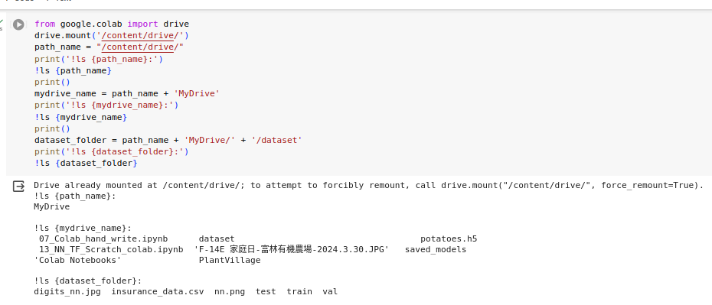
13.2 Mount Google Drive
https://www.youtube.com/watch?v=PQCE9ChuIDY&list=PLeo1K3hjS3uu7CxAacxVndI4bE_o3BDtO&index=13
Mount Google Drive (0:31-0:35/13:22)
We mount the Google drive from Colab.

Slide 7
13.3 Read Dataset

Slide 8
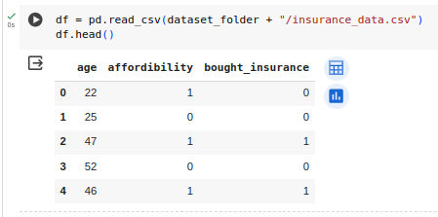
13.3 Read Dataset
https://www.youtube.com/watch?v=PQCE9ChuIDY&list=PLeo1K3hjS3uu7CxAacxVndI4bE_o3BDtO&index=13
Read Dataset (0:36-0:40/13:22)
read “insurance_data.csv” from google drive.

Slide 9
13.4 Split Data into Train/Test

Slide 10
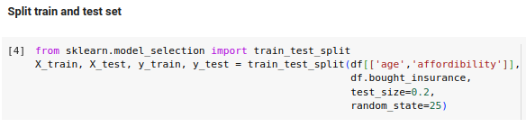
13.4 Split Data into Train/Test
https://www.youtube.com/watch?v=PQCE9ChuIDY&list=PLeo1K3hjS3uu7CxAacxVndI4bE_o3BDtO&index=13
Split Data into Train/Test (0:41-0:45/13:22)
1. Split the data set into training data and test data.
2. Scale the train data/100.

Slide 11
13.5 Scale Data

Slide 12
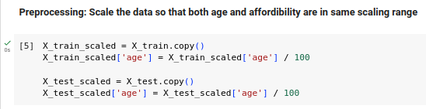
13.5 Scale Data
https://www.youtube.com/watch?v=PQCE9ChuIDY&list=PLeo1K3hjS3uu7CxAacxVndI4bE_o3BDtO&index=13
Scale Data (0:46-0:50/13:22)
Scale the train data/100.

Slide 13
13.6 Neural Network Model

Slide 14
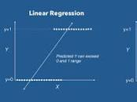
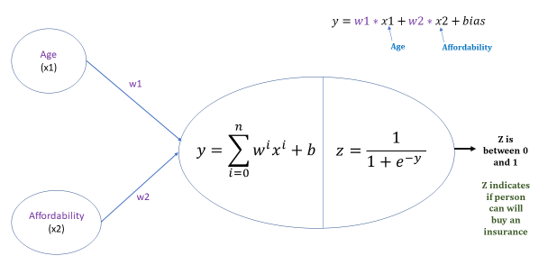
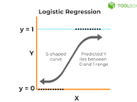
13.6 Neural Network Model
https://www.youtube.com/watch?v=PQCE9ChuIDY&list=PLeo1K3hjS3uu7CxAacxVndI4bE_o3BDtO&index=13
Neural Network Model (0:51-1:05/13:22)
We have neural network with one hidden layer with single neuron.
Input has two neurons.
This is a logistic regression: linear regression + sigmoid function = logistic regression
What is logistic regression?
Logistic regression is a process of modeling the probability of a discrete outcome given an input variable. The most common logistic regression models a binary outcome; something that can take two values such as true/false, yes/no, and so on.

Slide 15
13.7 Tensorflow NN

Slide 16
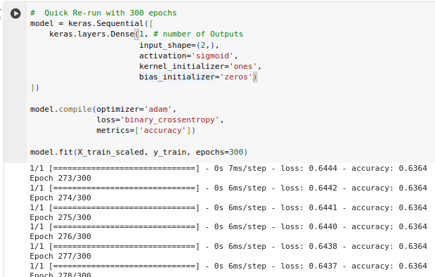
13.7 Tensorflow NN
https://www.youtube.com/watch?v=PQCE9ChuIDY&list=PLeo1K3hjS3uu7CxAacxVndI4bE_o3BDtO&index=13
Tensorflow NN (1:07-1:15/13:22)
Below is the keras code of Tensorflow for the above neural network.
We set 300 epochs for tensorflow Neural Network.

Slide 17
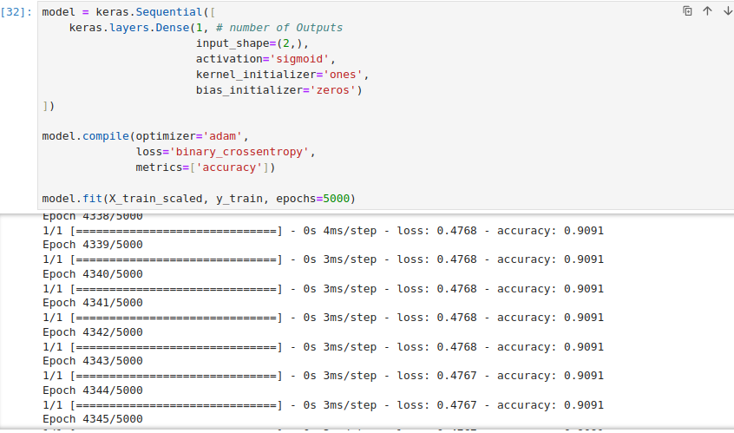
13.7 Tensorflow NN
https://www.youtube.com/watch?v=PQCE9ChuIDY&list=PLeo1K3hjS3uu7CxAacxVndI4bE_o3BDtO&index=13
Tensorflow NN (1:07-1:15/13:22)
Tensorflow Neural Network with 5000 epochs.

Slide 18
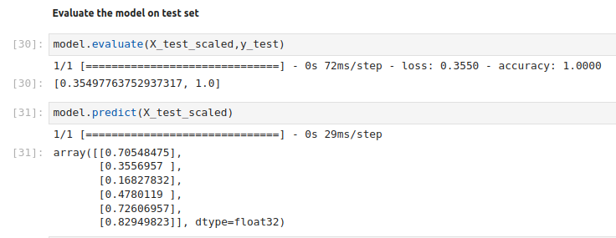
13.7 Tensorflow NN
https://www.youtube.com/watch?v=PQCE9ChuIDY&list=PLeo1K3hjS3uu7CxAacxVndI4bE_o3BDtO&index=13
Tensorflow NN (1:18-1:20/13:22)
1. We do the evaluation for X_test_scaled and y_test. We have error = 0.35 and accuracy 100%.
2. We do the prediction for X_test_scaled. We have prediction 70%, 35%, 16%, 47%, etc. to buy the insurance.

Slide 19
13.8 Check Data Frame

Slide 20
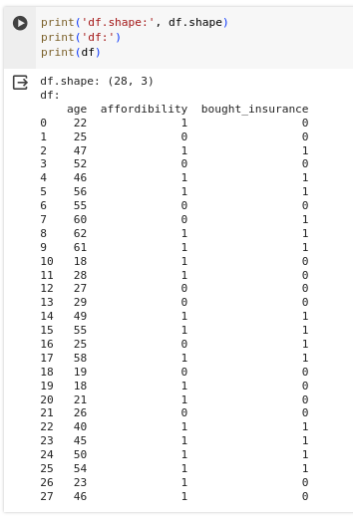
13.8 Check Data Frame
https://www.youtube.com/watch?v=PQCE9ChuIDY&list=PLeo1K3hjS3uu7CxAacxVndI4bE_o3BDtO&index=13
Check Data Frame (1:18-1:19/13:22)
Check the data frame:

Slide 21
13.9 Check X_train/X_test

Slide 22
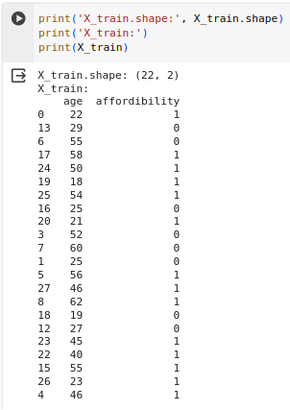
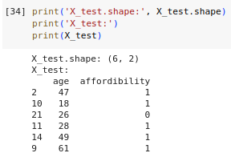
13.9 Check X_train/X_test
https://www.youtube.com/watch?v=PQCE9ChuIDY&list=PLeo1K3hjS3uu7CxAacxVndI4bE_o3BDtO&index=13
Check X_train/X_test (1:18-1:19/13:22)
Check X_train and X_test

Slide 23
13.10 Check y_train/y_test

Slide 24
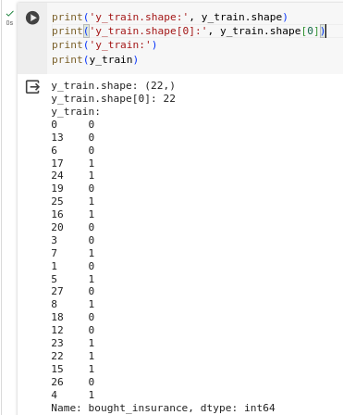
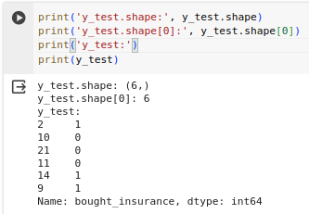
13.10 Check y_train/y_test
https://www.youtube.com/watch?v=PQCE9ChuIDY&list=PLeo1K3hjS3uu7CxAacxVndI4bE_o3BDtO&index=13
Check y_train/y_test (1:18-1:19/13:22)
Check y_train and y_test

Slide 25
13.11 Get Model Weights/Bias

Slide 26
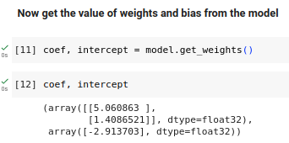
13.11 Get Model Weights/Bias
https://www.youtube.com/watch?v=PQCE9ChuIDY&list=PLeo1K3hjS3uu7CxAacxVndI4bE_o3BDtO&index=13
Get Model Weights/Bias (1:18-1:19/13:22)
.Get Model Weights and Bias

Slide 27
13.12 Customized Model

Slide 28
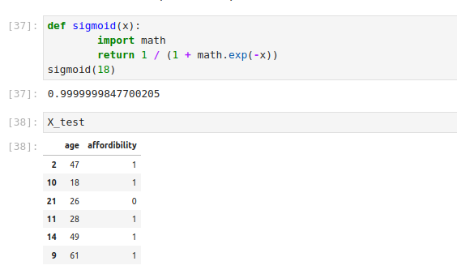
13.12 Customized Model
https://www.youtube.com/watch?v=PQCE9ChuIDY&list=PLeo1K3hjS3uu7CxAacxVndI4bE_o3BDtO&index=13
Customized Model (1:19-1:20/13:22)
1. We have sigmoid function implemented by Python.
2. Original X_test data.

Slide 29
13.13 Customized Prediction

Slide 30
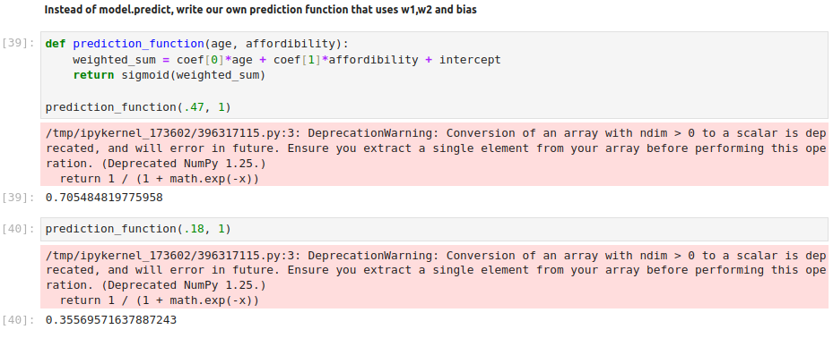
13.13 Customized Prediction
https://www.youtube.com/watch?v=PQCE9ChuIDY&list=PLeo1K3hjS3uu7CxAacxVndI4bE_o3BDtO&index=13
Customized Prediction (1:21-1:22/13:22)
1. We implement the prediction function with coef (for weights w1 and w2) and intercept (for bias b).
2. Test for prediction function with (age = 0.47, affordability =1) and (age = 0.18, affordability = 1).

Slide 31
13.14 Customized Sigmoid_numpy

Slide 32
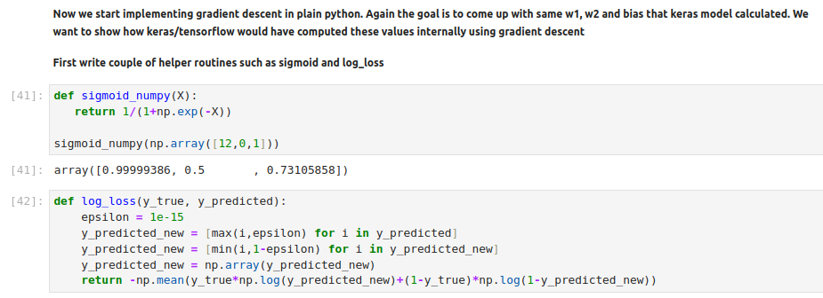
13.14 Customized Sigmoid_numpy
https://www.youtube.com/watch?v=PQCE9ChuIDY&list=PLeo1K3hjS3uu7CxAacxVndI4bE_o3BDtO&index=13
Customized Sigmoid_numpy (1:23-1:24/13:22)
1. We implement sigmoid numpy.
2. We implement log loss() with python.

Slide 33
13.15 Customized log_loss

Slide 34
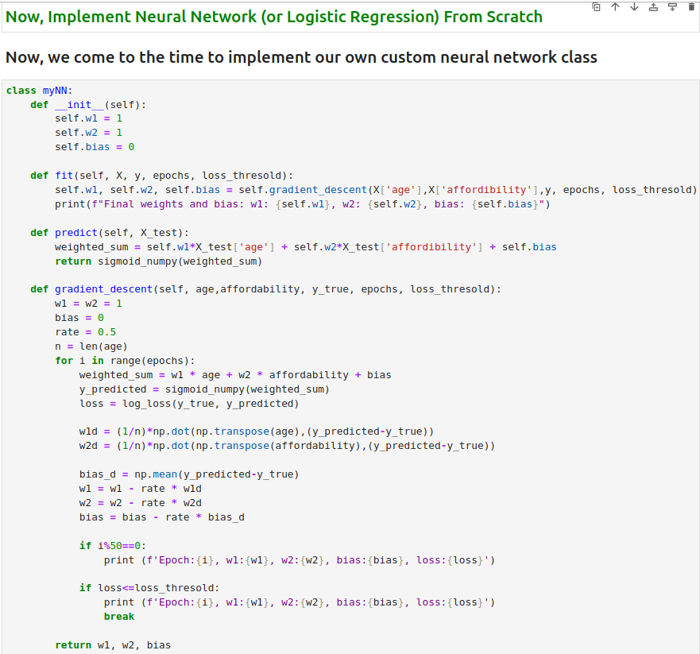
13.15 Customized log_loss
https://www.youtube.com/watch?v=PQCE9ChuIDY&list=PLeo1K3hjS3uu7CxAacxVndI4bE_o3BDtO&index=13
Customized log_loss (1:23-5:24/13:22)
1. Define myNN class.
2. We have defined fit(), predict(), and gradient_descent() function.

Slide 35
13.16 Customized Class

Slide 36
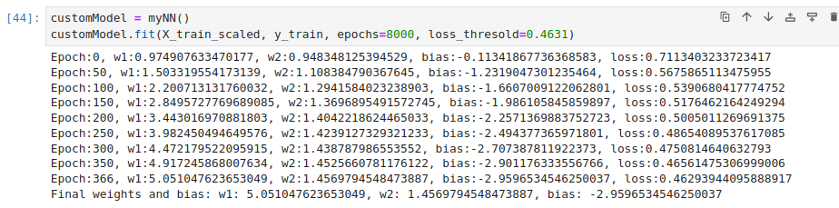
13.16 Customized Class
https://www.youtube.com/watch?v=PQCE9ChuIDY&list=PLeo1K3hjS3uu7CxAacxVndI4bE_o3BDtO&index=13
Customized Class (6:02-6:24/13:22)
1. Create instance with class myNN()
2. fit (X_train_scaled, y_train) with epochs=8000.
We have the weights (w1, w2) and bias (b): w1 = 5.051, w2 = 1.45, b = -2.959

Slide 37
13.17 Compare TF/Customized Class

Slide 38
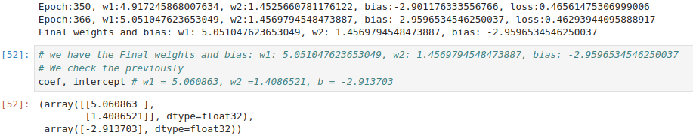
13.17 Compare TF/Customized Class
https://www.youtube.com/watch?v=PQCE9ChuIDY&list=PLeo1K3hjS3uu7CxAacxVndI4bE_o3BDtO&index=13
Compare TF/Customized Class (10:02-11:24/13:22)
We compare our python implementation with TensorFlow result.

Slide 39
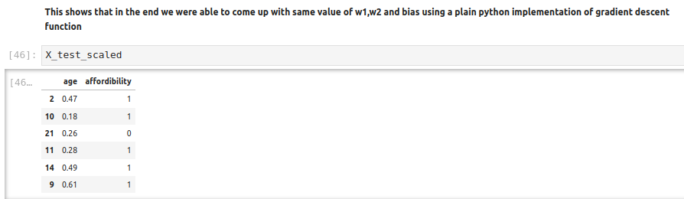
13.16 Customized Class
https://www.youtube.com/watch?v=PQCE9ChuIDY&list=PLeo1K3hjS3uu7CxAacxVndI4bE_o3BDtO&index=13
NN from Scratch: Coding (10:02-11:24/13:22)
Check X_test_scaled

Slide 40
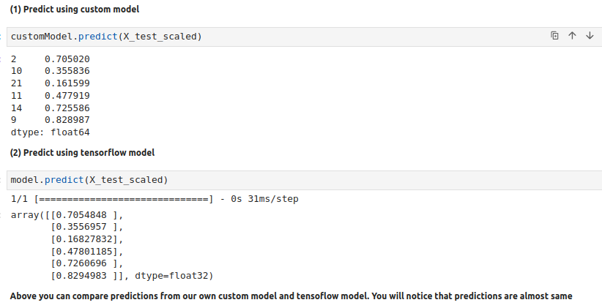
013 NN from Scratch
https://www.youtube.com/watch?v=PQCE9ChuIDY&list=PLeo1K3hjS3uu7CxAacxVndI4bE_o3BDtO&index=13
NN from Scratch: Coding (11:25-13:22/13:22)
Check Prediction from our python implementation vs Tensorflow result.
Both Results are the same but performance is much faster.
Our implementation is for one neuron, for more neuron, we need tensorflow and Keras.

Slide 41
End

