Slide 1

12.1 Week 02 Review
Peter H. Chen

Slide 2
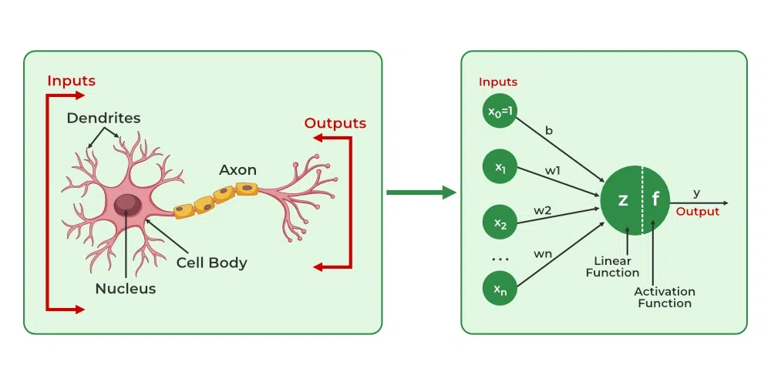
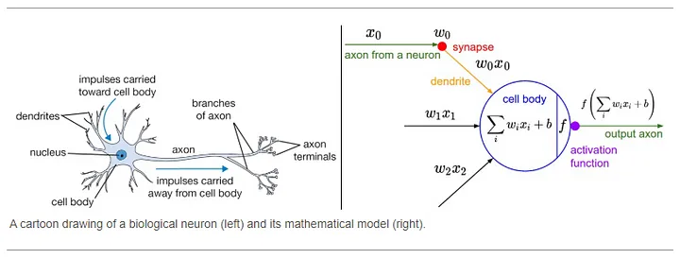
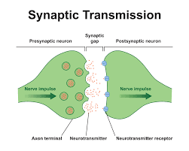
12.1 Week 02 Review
https://github.com/peterhchen/AIU_CS512_DL/tree/main/000_Lecture_Project/week03
Week 2 Review
https://ai.stackexchange.com/questions/6099/what-activation-function-does-the-human-brain-use
Biological Neuron vs. Neural Network Neuron:
1 Dendrite: weight
2 Cell Body: summation
3 Synapse: Transmitter for ion (Sodium or Chloride) channel.
Note:
1. The brains of mammals do not use an activation function.
2. Only machine learning model have activation function.

Slide 3
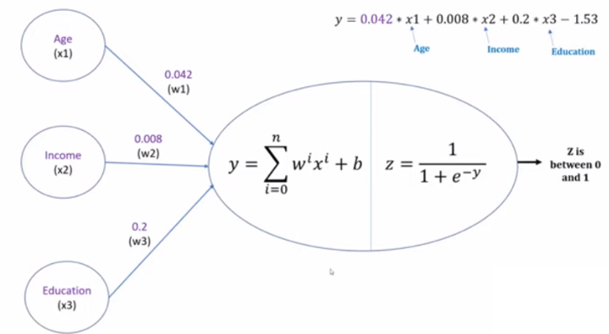
12.1 Week 02 Review
https://github.com/peterhchen/AIU_CS512_DL/tree/main/000_Lecture_Project/week03
Week 2 Review
We look the activation function with a single neuron and implement activation function with PyTorch.
We have some negative infinity and positive infinity at the end of neuron.
We use sigmoid function to convert the output between 0 (not buy insurance) and 1 (buy insurance).

Slide 4
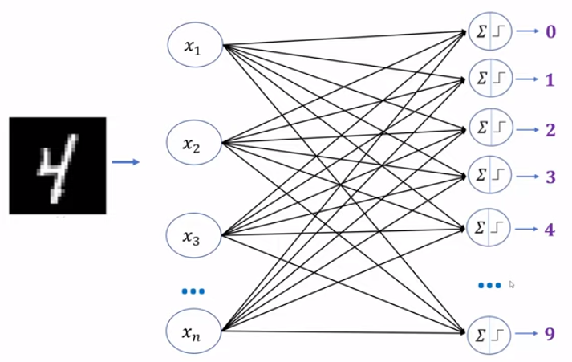
12.1 Week 02 Review
https://github.com/peterhchen/AIU_CS512_DL/tree/main/000_Lecture_Project/week03
Week 2 Review
Use probability between 0 to 1 (for example 0.82), instead of 0 or 1, for Multi-class Classification, i.e., Categorical Decision.
The probability os a float number, not integer 0 or 1.
Multi-Class Classification
0.02
0.31
0.7
0.08
0.82
0.05

Slide 5
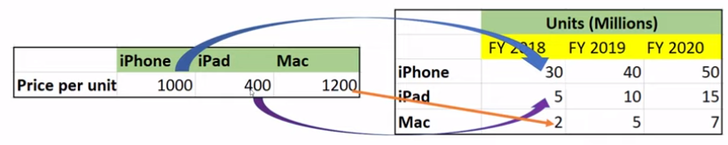
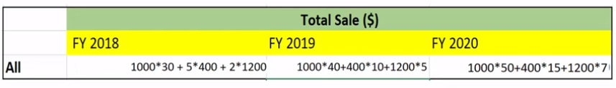
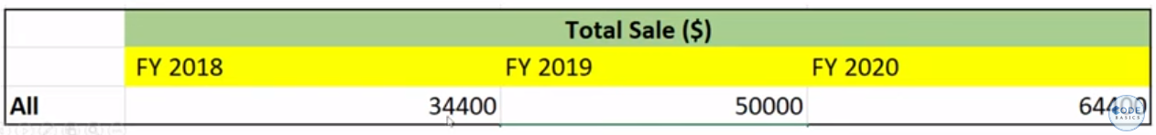
12.1 Week 02 Review
https://github.com/peterhchen/AIU_CS512_DL/tree/main/000_Lecture_Project/week03
Week 2 Review
Another example:
Multiply the unit price to total number and sum together.
64400

Slide 6
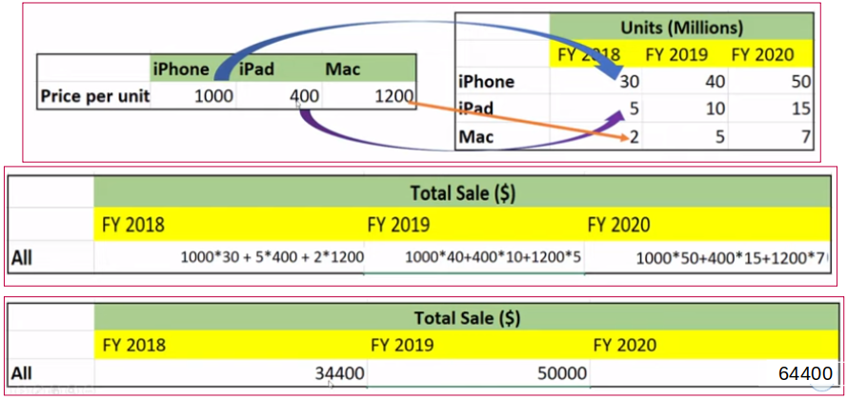
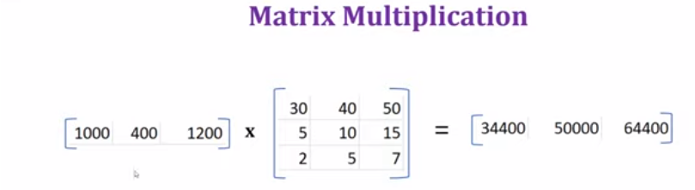
12.1 Week 02 Review
https://github.com/peterhchen/AIU_CS512_DL/tree/main/000_Lecture_Project/week03
Week 2 Review
Matrix Multiplication

Slide 7
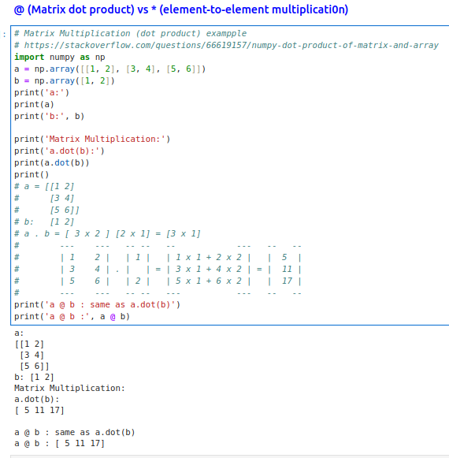
12.1 Week 02 Review
https://github.com/peterhchen/AIU_CS512_DL/tree/main/000_Lecture_Project/week03
Week 2 Review
Matrix Operation: @ (dot)

Slide 8
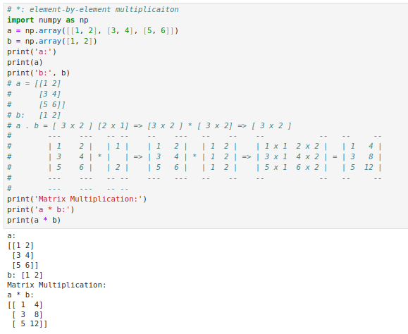
12.1 Week 02 Review
https://github.com/peterhchen/AIU_CS512_DL/tree/main/000_Lecture_Project/week03
Week 2 Review
Matrix Operation: * (element-by-element)

Slide 9
End

