Slide 1

13.0 Week 03 Review
Peter H. Chen

Slide 2
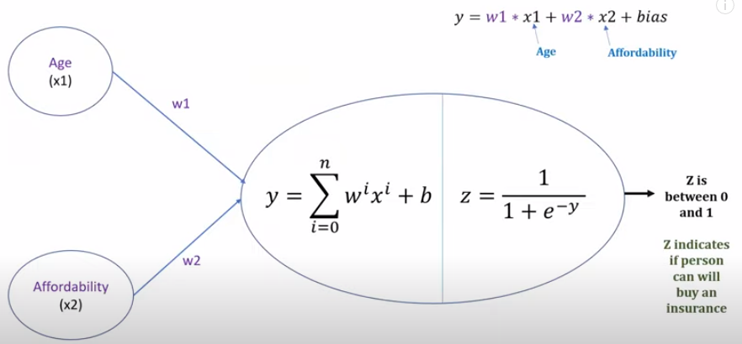
13.0 Train Neural Network
https://www.youtube.com/watch?v=pXGBHV3y8rs&list=PLeo1K3hjS3uu7CxAacxVndI4bE_o3BDtO&index=12
Train Neural Network (4:45-5:20/41:33)
We define a simple three layers (input, hidden, output) of neural network with single neuron.
It is a simple logistic regression with single neuron.
This is a machine learning is a shallow neural network (three layers of neural network).
In logistic regression, there are two components, one is weighted sum and the second one is the sigmoid function.

Slide 3
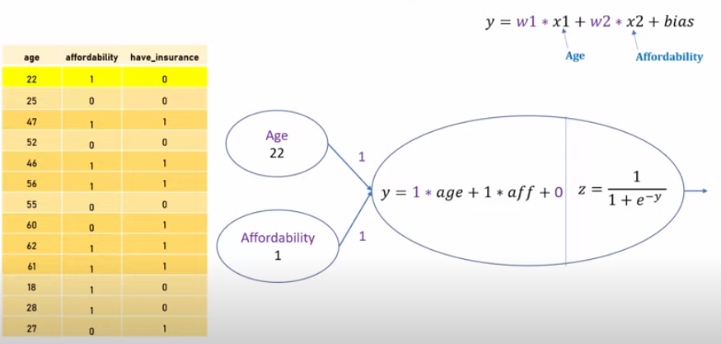
13.0 Train Neural Network
https://www.youtube.com/watch?v=pXGBHV3y8rs&list=PLeo1K3hjS3uu7CxAacxVndI4bE_o3BDtO&index=12
Train Neural Network (5:26-6:30/41:33)
When we train a neural network, The Gradient Descent is used during the training of neural network.
We have 13 data points for neural network. We want to use all of the 13 data to train this neural network. We have age 22 and affordability 1.
We initialize the weight w1 = 1, w2 = 1 and bias = 0 (or randomized between 0 and 1).
We can substitute the data for calculation. We call this substitution a forward pass.
y = 1 * 22 + 1 * 1 + 0 = 23.
z = 1 / [1 + exp (-23)] = 0.999999999989

Slide 4
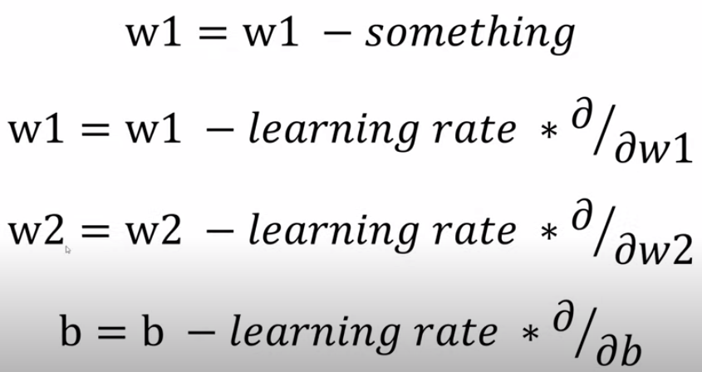
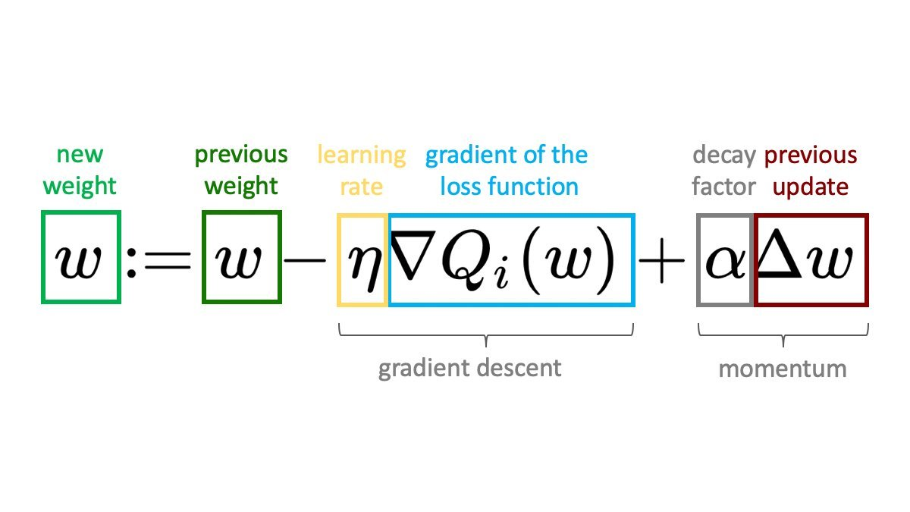
13.0 Gradient and Gradient Descent
https://www.youtube.com/watch?v=pXGBHV3y8rs&list=PLeo1K3hjS3uu7CxAacxVndI4bE_o3BDtO&index=12
Gradient and Gradient Descent (11:11-11:30/41:33)
The learning rate * Gradient is called Gradient Descent.

Slide 5
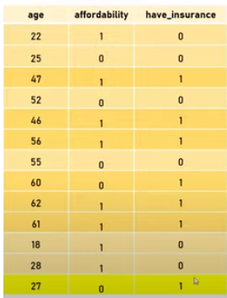
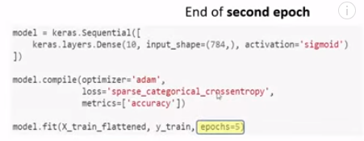
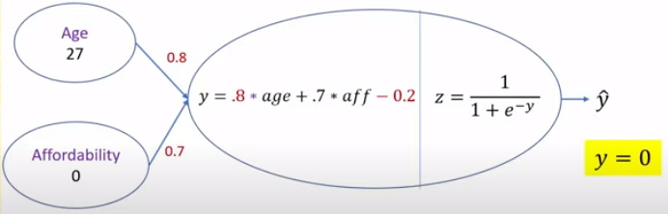

13.0 Gradient Descent in Epoch
https://www.youtube.com/watch?v=pXGBHV3y8rs&list=PLeo1K3hjS3uu7CxAacxVndI4bE_o3BDtO&index=12
Gradient Descent in Epoch (14:07-14:30/41:33)
In the hand-writing prediction example, we have epochs =5. The epoch is one of the parameter in the model.fit(…, epoch=5) in our tensorflow code.
Now, we know it make sense what epoch is.

Slide 6
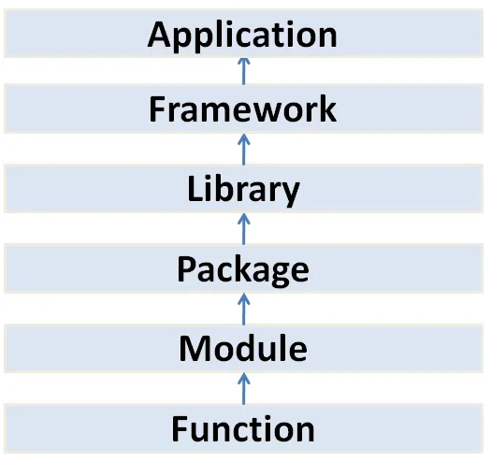
13.0 Mount Google Drive
https://www.youtube.com/watch?v=pXGBHV3y8rs&list=PLeo1K3hjS3uu7CxAacxVndI4bE_o3BDtO&index=12
Mount Google Drive (17:13-17:15/41:33)
Use classes as blueprints for objects that model your problem domain. Class contains methods.
Use modules to collect functionality into logical units.
Python package means “folder”.
Tensorflow Playground
(Browser-based Application)
Google Tensorflow, Angular
Meta PyTorch, ReactJS, Keras
Tensorboard, numpy, pandas, Matplotlib, Seaborn,
Tkinter, PyQt, ...
Folder/Directory with __init__.py
File
class
math
Method
sqrt()

Slide 7
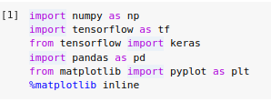
13.0 Mount Google Drive
https://www.youtube.com/watch?v=pXGBHV3y8rs&list=PLeo1K3hjS3uu7CxAacxVndI4bE_o3BDtO&index=12
Mount Google Drive (17:13-17:15/41:33)
Examples:
> from tensorflow (framework) import keras (library)
> from keras (library) import layers, sequential, … (package)
> from matplotlib (Package) import pyplot (module) as plt
> from math (module) import sqrt (function)

Slide 8

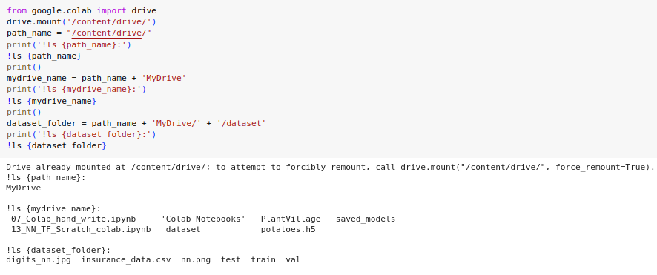
13.0 Mount Google Drive
https://www.youtube.com/watch?v=pXGBHV3y8rs&list=PLeo1K3hjS3uu7CxAacxVndI4bE_o3BDtO&index=12
Mount Google Drive (17:13-17:15/41:33)
1. Mount google drive from colab.
2. Read dataset from the paths.

Slide 9
End

