Slide 1

17 CPU vs. GPU Benchmark
Peter H. Chen

Slide 2
17 CPU vs. GPU Benchmark
https://www.youtube.com/watch?v=YmDaqXMIoeY&list=PLeo1K3hjS3uu7CxAacxVndI4bE_o3BDtO&index=17
CPU vs. GPU Benchmark (0:00-0:30/23:57)
We discuss the CPU vs. GPU Benchmark with ANN. We take 60,000 small images and classify them by ANN (Artificial Neural network).
In this discussion, we use ANN to benchmark the CPU/GPU.
To make the simple comparison, we do not use CNN (Convolutional Neural Network) to reduce the run time. In CNN, we do extract the image features to reduce the computation speed.
We train model by CPU and then benchmark by NVIDIA RTX Titan and Google Colab.
The benchmark result shows
1. NVIDIA RTX Titan is 15 times faster then CPU, 1 Epoch and 10 Epochs, respectively.
2. Colab TPU/GPU is 11 to 16 faster than CPU, 1 Epoch and 10 Epochs, respectively.
Difference between ANN, CNN, RNN:
1. ANNs (Artificial Neural Networks) are linear stack of neurons to solve complex problems.
2. CNNs (Convolution Neural Networks): CNN = ANN + feature extraction (by filter). CNNs are used to solve Computer Vision-related problems to reduce computation time.
3. RNNs (Recurrent Neural Networks) has memory and are used in Natural Language Processing.

Slide 3
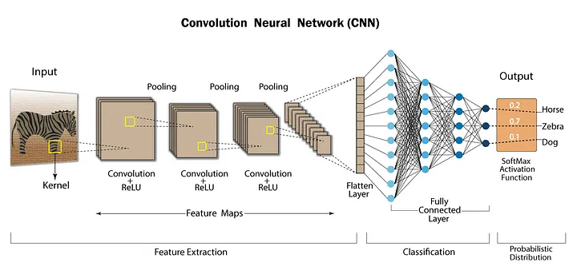
17 CPU vs. GPU Benchmark
https://www.youtube.com/watch?v=YmDaqXMIoeY&list=PLeo1K3hjS3uu7CxAacxVndI4bE_o3BDtO&index=17
CPU vs. GPU Benchmark (0:31-1:00/23:57)
Difference between ANN, CNN, RNN:
1. ANNs (Artificial Neural Networks) are linear stack of neurons to solve complex problems.
2. CNNs (Convolution Neural Networks): CNN = ANN + feature extraction filter. CNNs are used to solve Computer Vision-related problems to reduce computation time.
3. RNNs (Recurrent Neural Networks, not shown in below diagram) has memory and are used in Natural Language Processing.
ANN
Feature Extraction Filter

Slide 4
17.1 Verify CPU and GPU Mode

Slide 5

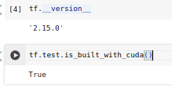
17.1 Verify CPU and GPU Mode
https://www.youtube.com/watch?v=YmDaqXMIoeY&list=PLeo1K3hjS3uu7CxAacxVndI4bE_o3BDtO&index=17
Verify CPU and GPU Mode (1:01-3:20/23:57)
Make sure we have both CPU and GPU on Colab.
Otherwise, colab will run CPU mode only.
The results will be same (or similar)

Slide 6
17.2 Load Sample

Slide 7
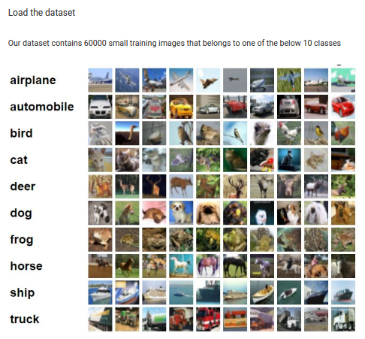
17.2 Load Sample
https://www.youtube.com/watch?v=YmDaqXMIoeY&list=PLeo1K3hjS3uu7CxAacxVndI4bE_o3BDtO&index=17
Load Sample (3:21-5:20/23:57)

Slide 8
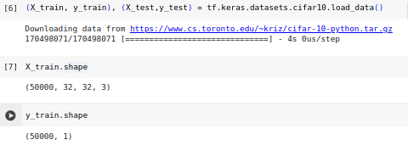
17.2 Load Sample
https://www.youtube.com/watch?v=YmDaqXMIoeY&list=PLeo1K3hjS3uu7CxAacxVndI4bE_o3BDtO&index=17
Load Sample (5:21-7:20/23:57)

Slide 9
17.3 Data Visualization

Slide 10
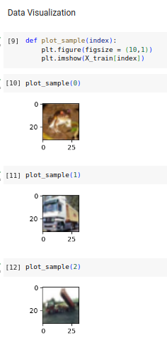
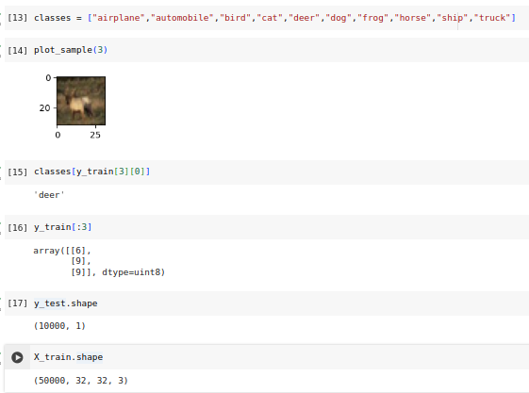
17.3 Data Visualization
https://www.youtube.com/watch?v=YmDaqXMIoeY&list=PLeo1K3hjS3uu7CxAacxVndI4bE_o3BDtO&index=17
Data Visualization (7:21-9:20/23:57)

Slide 11
17.4 Preprocessing: Scale Images

Slide 12
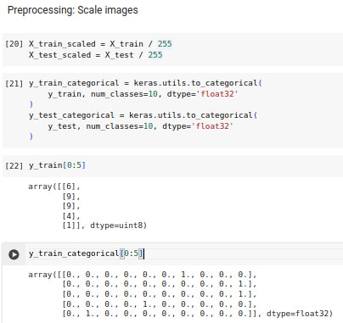
17.4 Preprocessing: Scale Images
https://www.youtube.com/watch?v=YmDaqXMIoeY&list=PLeo1K3hjS3uu7CxAacxVndI4bE_o3BDtO&index=17
Preprocessing: Scale Image (5:21-6:20/23:57)

Slide 13
17.5 Model Building and Training

Slide 14
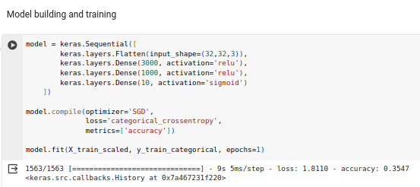
17.5 Model Building and Training
https://www.youtube.com/watch?v=YmDaqXMIoeY&list=PLeo1K3hjS3uu7CxAacxVndI4bE_o3BDtO&index=17
Model Building and Training (09:21-11:20/23:57)

Slide 15
17.6 Make Prediction

Slide 16
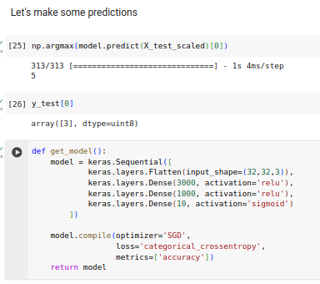
17.6 Make Prediction
https://www.youtube.com/watch?v=YmDaqXMIoeY&list=PLeo1K3hjS3uu7CxAacxVndI4bE_o3BDtO&index=17
Make Prediction (11:21-13:20/23:57)

Slide 17
17.7 Train with CPU: 1 Epoch

Slide 18
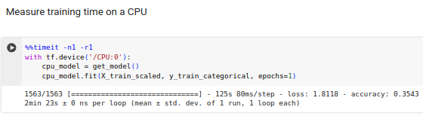
17.7 Train with CPU: 1 Epoch
https://www.youtube.com/watch?v=YmDaqXMIoeY&list=PLeo1K3hjS3uu7CxAacxVndI4bE_o3BDtO&index=17
Train with CPU: 1 Epoch (13:21-15:20/23:57)
143 sec (2min 23 sec)

Slide 19
17.8 Train with GPU: 1 Epoch

Slide 20
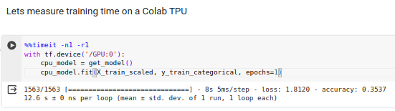
17.8 Train with GPU: 1 Epoch
https://www.youtube.com/watch?v=YmDaqXMIoeY&list=PLeo1K3hjS3uu7CxAacxVndI4bE_o3BDtO&index=17
Train with GPU: 1 Epoch (15:21-17:20/23:57)
12.6 sec

Slide 21
17.9 Train with CPU: 10 Epoch

Slide 22
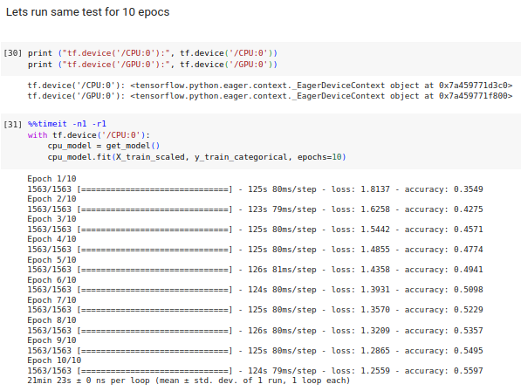
17.9 Train with CPU: 10 Epoch
https://www.youtube.com/watch?v=YmDaqXMIoeY&list=PLeo1K3hjS3uu7CxAacxVndI4bE_o3BDtO&index=17
Train with CPU: 10 Epoch (17:21-19:20/23:57)
1283 sec (21 min 23 sec)

Slide 23
17.10 Train with GPU: 10 Epoch

Slide 24
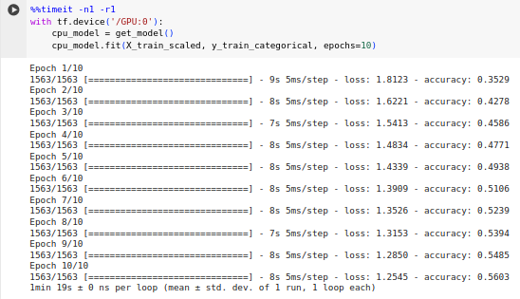
17.10 Train with GPU: 10 Epoch
https://www.youtube.com/watch?v=YmDaqXMIoeY&list=PLeo1K3hjS3uu7CxAacxVndI4bE_o3BDtO&index=17
Train with GPU: 10 Epoch (19:21-21:20/23:57)
79 sec (1 min 19 sec)

Slide 25
17.5 Summary

Slide 26
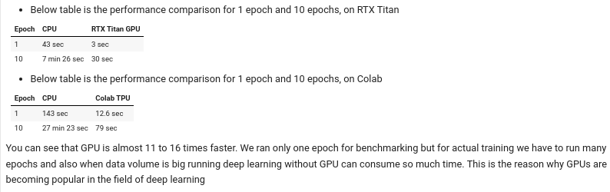
17.5 Summary
https://www.youtube.com/watch?v=YmDaqXMIoeY&list=PLeo1K3hjS3uu7CxAacxVndI4bE_o3BDtO&index=17
Summary (21:21-23:57/23:57)
CPU/NVIDA RTX GPU Benchmark:
Colab CPU/GPU Benchmark:
Epoch | CPU (sec) | GPU (sec) | Benchmark
1 | 44.5 | 3.6 | 44.5/3.6 = 12.36
10 | 446 (7 min 26 sec) | 30 | 446/30 = 14.8
Epoch | CPU (sec) | Colab TPU (sec) | Benchmark
1 | 143 sec (2min 23 sec) | 12.6 | 143/12.6 = 11.3
10 | 1643 (27 min 23 sec) | 79 | 1683/79 = 16.2

Slide 27
End

