Slide 1

27 Transfer Learning
Peter H. Chen

Slide 2
27 Transfer Learning
https://www.youtube.com/watch?v=LsdxvjLWkIY&list=PLeo1K3hjS3uu7CxAacxVndI4bE_o3BDtO&index=27
Transfer Learning (0:00-1:30/25:54)
Transfer Learning has become popular in image classification and NLP (Natural Language Processing),
We have a pre-trained Model, we try to re-train it for new problem.
In the last data augmentation discussion, we have flower dataset which we classify five types of flowers.
In this discussion, we use a MobileNet pre-trained model from Google Tensorflow Hub.
We will use this pre-trained model to classify google flower dataset.
Previously, we used to take 30 epochs to train the model and achieve the high accuracy.
If we use the transfer learning with pre-trained model, we just need less than 5 epochs to achieve the same high accuracy.
Transfer learning use pre-trained model to save a lot of computation power.
The pre-trained model is available at tensorflow hub (Tensorflow > resources). These pre-trained model are trained by millions of images.
If you try to train your model to the pre-trained model, it will take days and months to reach that accuracy.
To save time, you can download the pre-trained model, get the pre-trained weights and bias, and then you can train the last layers or last few layers for your new problem and get the super high accuracy.

Slide 3
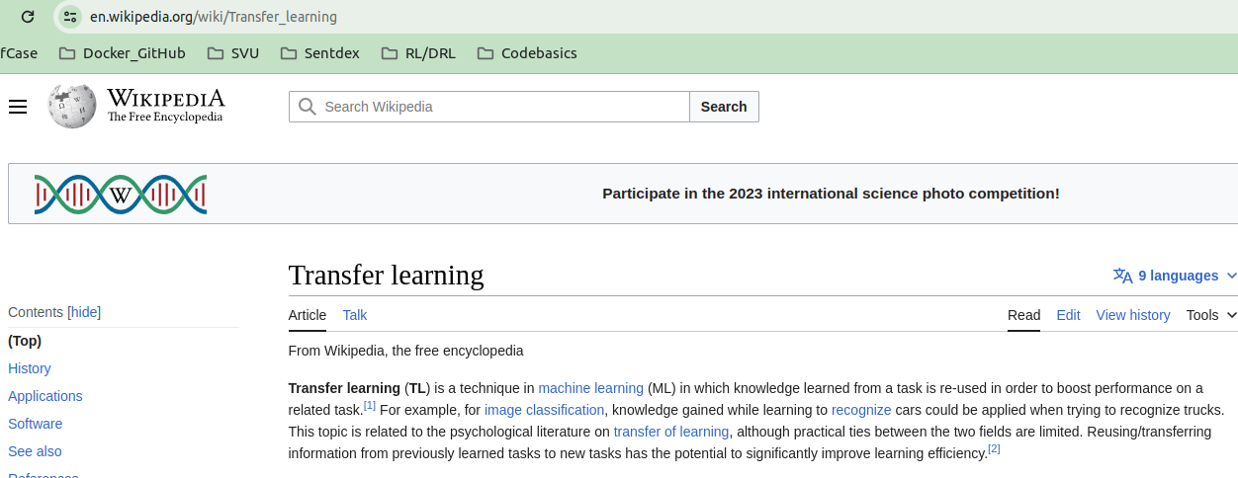
27 Transfer Learning
https://www.youtube.com/watch?v=LsdxvjLWkIY&list=PLeo1K3hjS3uu7CxAacxVndI4bE_o3BDtO&index=27
Transfer Learning (1:41-2:10/25:54)
Below is the wiki definition for Transfer Learning.
We focus on stored and gained knowledge and apply the different but related problem.
For example, we have a model that can recognize cars, we can use this model to recognize the truck as well because the basic features, for example, tires, steering wheel, some components, etc. between cars and trucks are similar.
We can use this knowledge of visual world and transfer the knowledge to solve different problem.

Slide 4
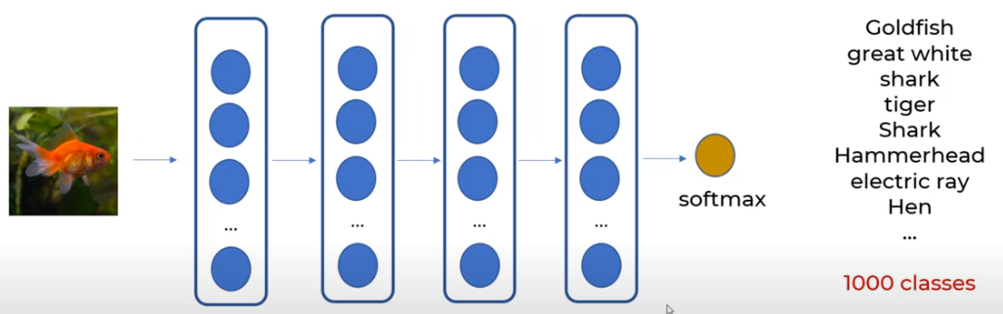
27 Transfer Learning
https://www.youtube.com/watch?v=LsdxvjLWkIY&list=PLeo1K3hjS3uu7CxAacxVndI4bE_o3BDtO&index=27
Transfer Learning (2:20-3:00/25:54)
We take Google MobileNet V2 Model for transfer learning coding.
Google pre-trained MobileNet V2 Model contains 1.4 million images and total 1000 classes.
Google take a long time (months to years) and lots of computational resources to train MobileNet V2 Model.
MobileNet V2 Model is the Deep Learning Model with huge dataset.
The output is 1,000 classes. It is a very diverse with Goldfish, great white shark, some animal, hammerhead shark, military uniform, etc.

Slide 5
27 Transfer Learning
https://www.youtube.com/watch?v=LsdxvjLWkIY&list=PLeo1K3hjS3uu7CxAacxVndI4bE_o3BDtO&index=27
Transfer Learning (3:01-3:20/25:54)
Google MobileNet V2 Model is not just animals. It contains 1,000 classes of objects.
When MobileNet Model is trained, it has input layers, hidden layers, output layer, and softmax layer, and classify the input objects into 1,000 categories.
In the below of the deep learning model, all the layers are pre-trained and frozen except the last layer. All the layers are frozen to classify the gold fish.

Slide 6
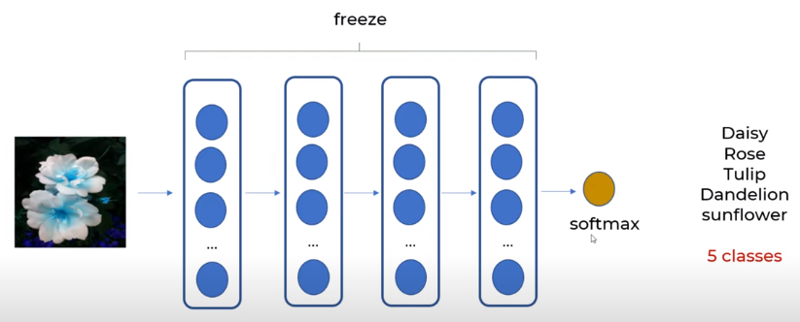
27 Transfer Learning
https://www.youtube.com/watch?v=LsdxvjLWkIY&list=PLeo1K3hjS3uu7CxAacxVndI4bE_o3BDtO&index=27
Transfer Learning (3:21-4:50/25:54)
Now, we will use the all the frozen layers to classify the flowers. The pre-trained model is used to classify 1000 classes is frozen, the model weights will not change.
When we perform the new training, the frozen weights of model do not changed.
The frozen pre-trained model looks like a non-liner regression equation. This pre-trained model is used to classify 1,000 classes.
We pass the flower into the non-linear regression equation to get feature vectors, then we use the softmax layer to classify five classes instead of thousand.
We use the frozen layer to classify the new classes, during the training, non of the weights is change, only the weights of last layer, last two layers, or last three layers, etc are changed.

Slide 7
27.1 Tensorflow Hub

Slide 8
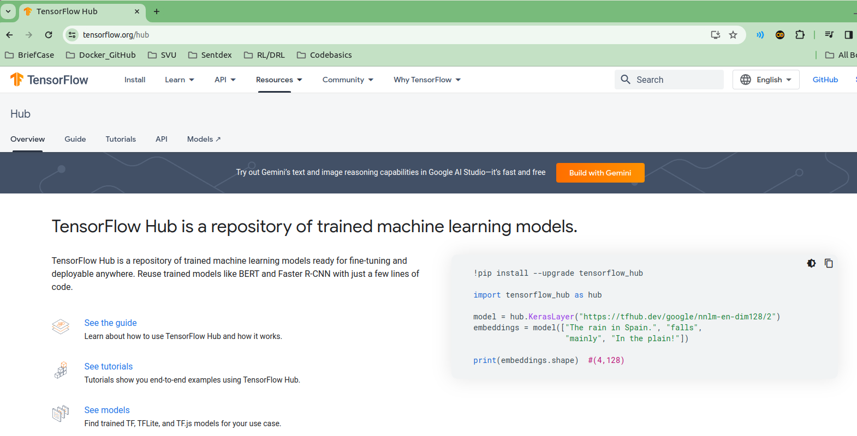
27.1 Tensorflow Hub
https://www.youtube.com/watch?v=LsdxvjLWkIY&list=PLeo1K3hjS3uu7CxAacxVndI4bE_o3BDtO&index=27
Tensorflow Hub (5:01-5:30/25:54)
Now, we use MobileNet V2 to classify the flower.
We download the pre-trained from Tensorflow Hub.
The Tensorflow Hub is a repository of trained Machine Learning models ready for fine-tuning and deployable anywhere. We can re-use (or embedding) trained models, such as, BERT and Faster-RNN with a few lines of code.

Slide 9
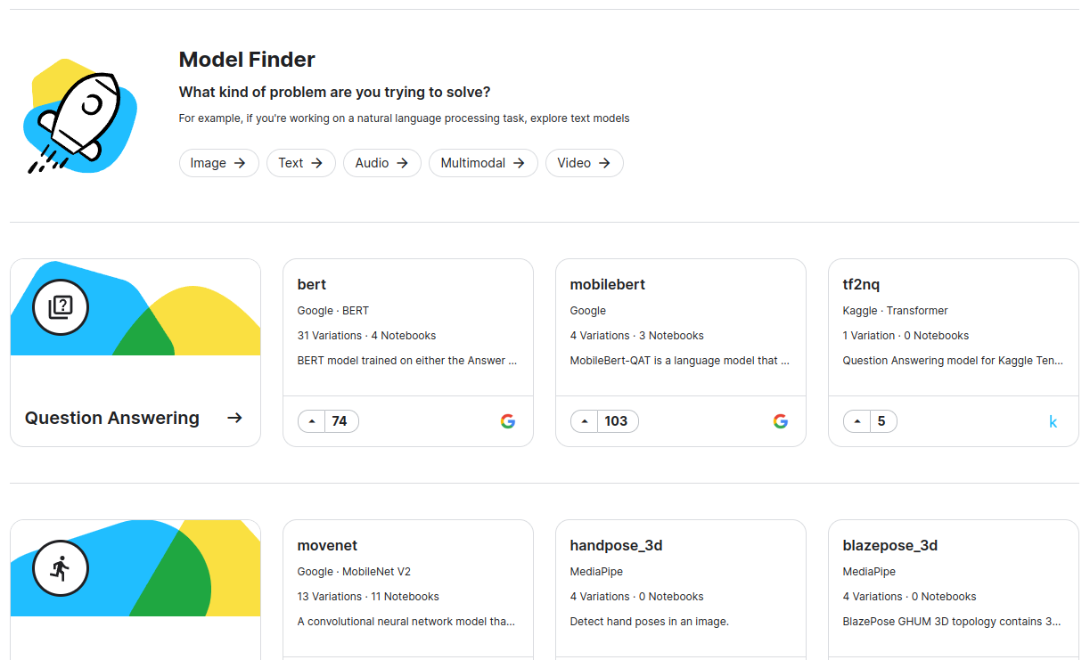
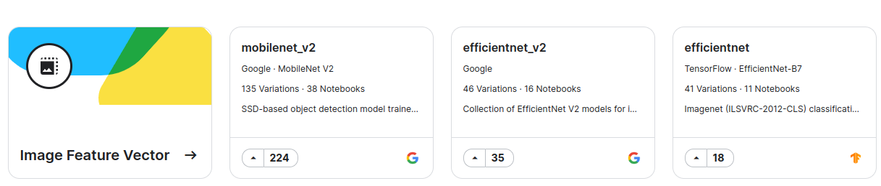
27.1 Tensorflow Hub
https://www.youtube.com/watch?v=LsdxvjLWkIY&list=PLeo1K3hjS3uu7CxAacxVndI4bE_o3BDtO&index=27
Tensorflow Hub (5:031-5:50/25:54)
Google Hub have collection of Models: Images, Text, Audio, Multi-modal, and Video.

Slide 10
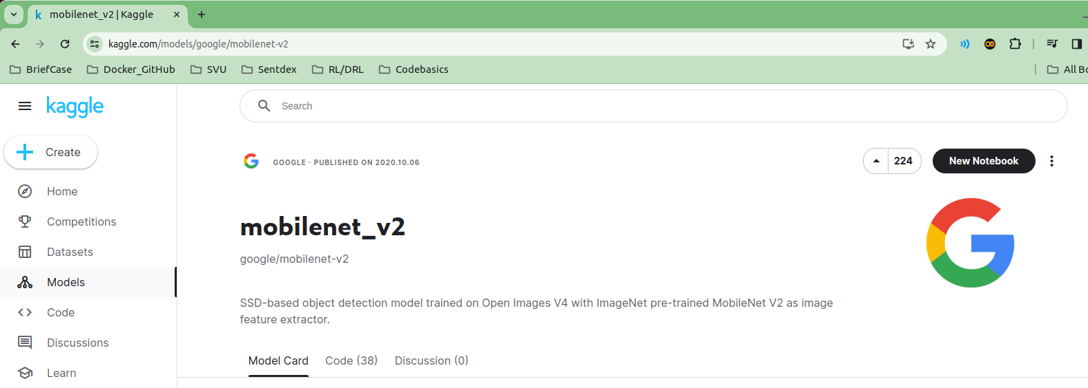
27.1 Tensorflow Hub
https://www.youtube.com/watch?v=LsdxvjLWkIY&list=PLeo1K3hjS3uu7CxAacxVndI4bE_o3BDtO&index=27
Tensorflow Hub (5:031-5:50/25:54)
Select the MobileNet V2 (mobilenet_v2). Tensorflow redirect to Kaggle site. Kaggle is acquired by Google in 2017.

Slide 11
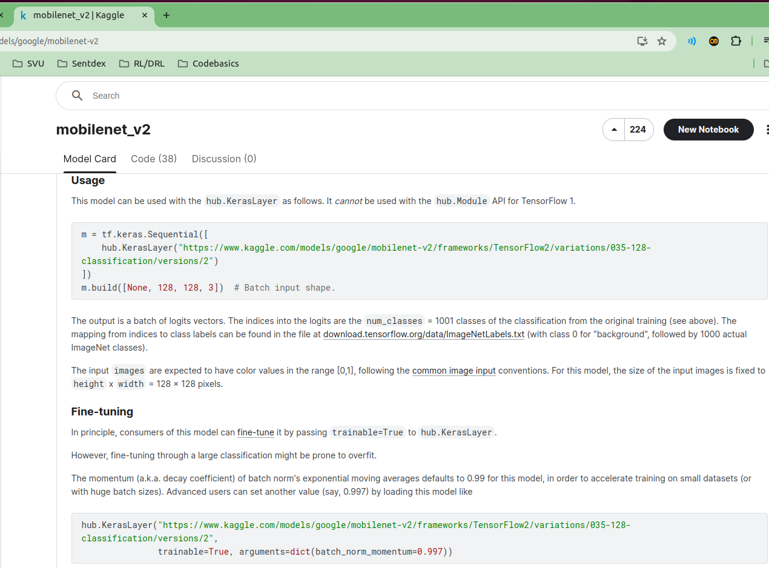
27.1 Tensorflow Hub
https://www.youtube.com/watch?v=LsdxvjLWkIY&list=PLeo1K3hjS3uu7CxAacxVndI4bE_o3BDtO&index=27
Tensorflow Hub (5:031-5:50/25:54)
Select the MobileNet V2 (mobilenet_v2). Tensorflow redirect to Kaggle site. Kaggle is acquired by Google in 2017.

Slide 12
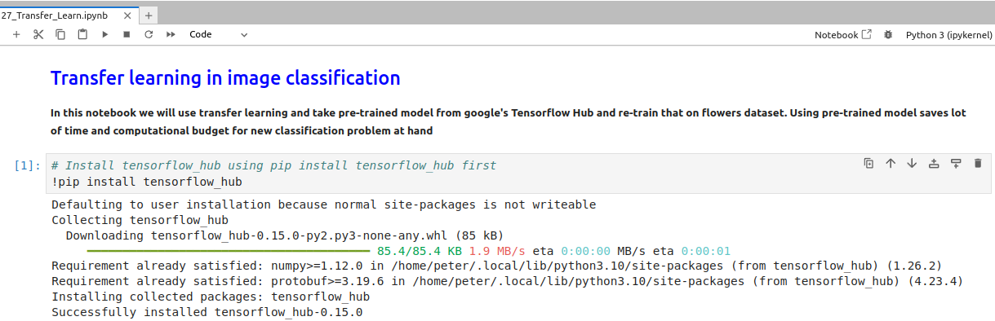
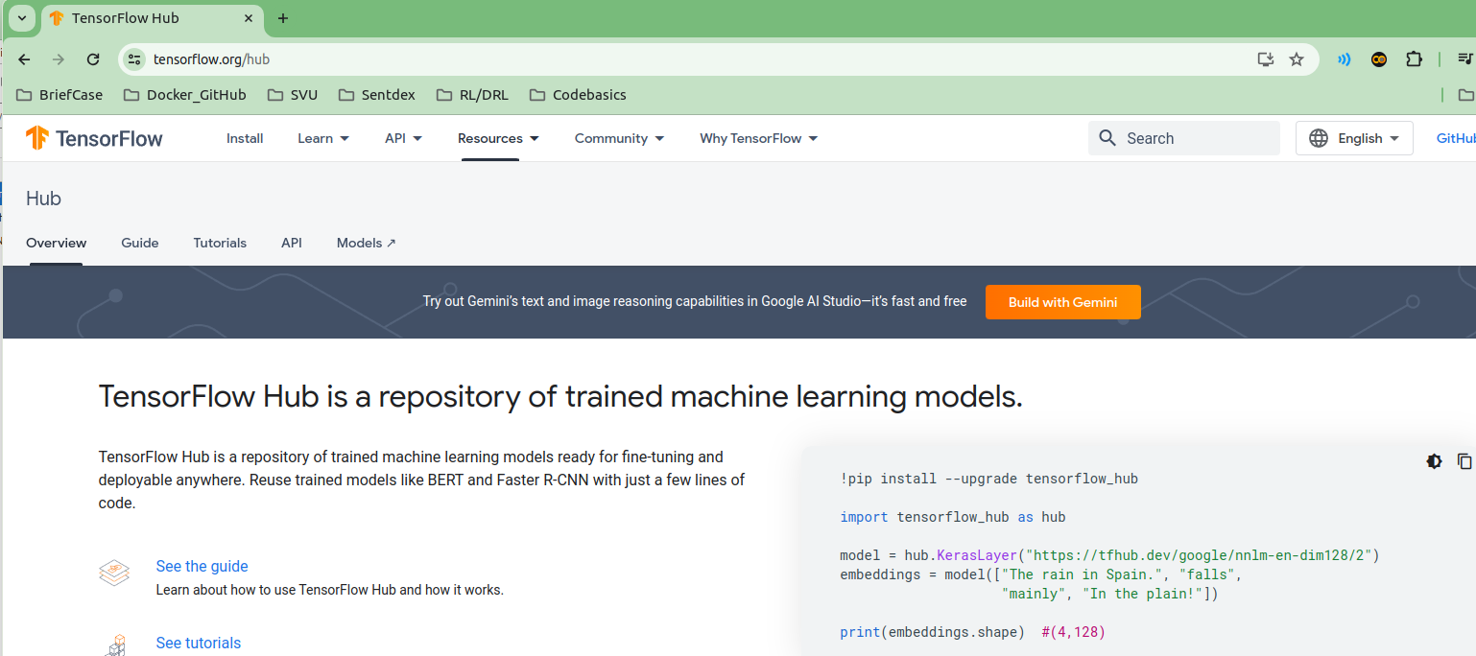
27.1 Tensorflow Hub
https://www.youtube.com/watch?v=LsdxvjLWkIY&list=PLeo1K3hjS3uu7CxAacxVndI4bE_o3BDtO&index=27
Tensorflow Hub (5:31-6:20/25:54)
> pip install tensorflow_hub

Slide 13
27.2 Pre-trained Prediction

Slide 14
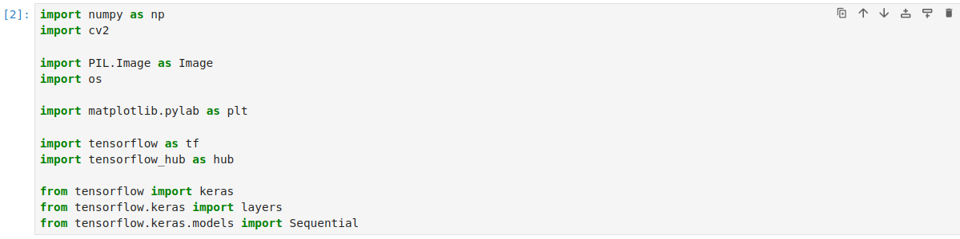
27.2 Pre-trained Prediction
https://www.youtube.com/watch?v=LsdxvjLWkIY&list=PLeo1K3hjS3uu7CxAacxVndI4bE_o3BDtO&index=27
Pre-trained Prediction (6:21-6:50/25:54)
https://www.tensorflow.org/hub/tutorials/tf2_image_retraining
We use the google tutorial for image retraining for transfer learning.
First, we to the pre-trained Model prediction with the goldfish.
Import all the libraries

Slide 15
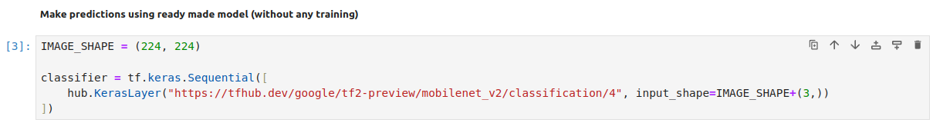
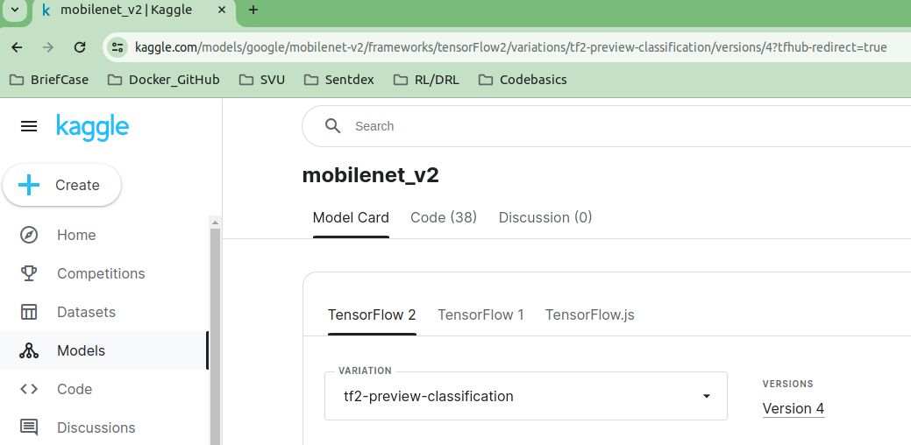
27.2 Pre-trained Prediction
https://www.youtube.com/watch?v=LsdxvjLWkIY&list=PLeo1K3hjS3uu7CxAacxVndI4bE_o3BDtO&index=27
Pre-trained Prediction (6:21-6:50/25:54)
https://www.tensorflow.org/hub/tutorials/tf2_image_retraining
We first create the model based on the pip install model from tensorflow_hub.
We can google search:
“https://tfhub.dev/google/tf2-preview/mobilenet_v2/classification/4”

Slide 16
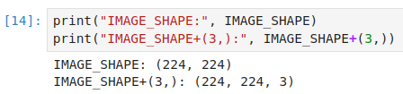
27.2 Pre-trained Prediction
https://www.youtube.com/watch?v=LsdxvjLWkIY&list=PLeo1K3hjS3uu7CxAacxVndI4bE_o3BDtO&index=27
Pre-trained Prediction (6:21-6:50/25:54)
Check the image shape: (224, 224)

Slide 17
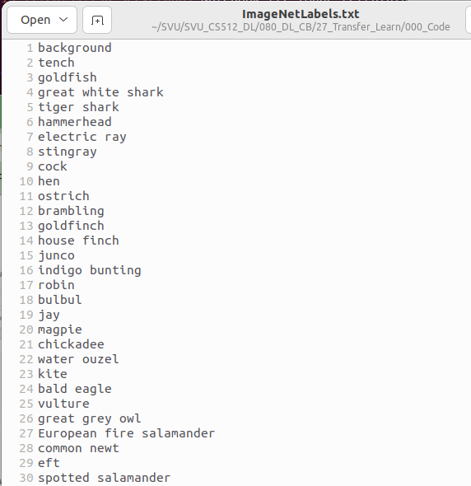
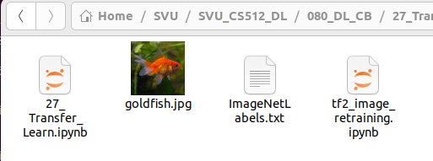
27.2 Pre-trained Prediction
https://www.youtube.com/watch?v=LsdxvjLWkIY&list=PLeo1K3hjS3uu7CxAacxVndI4bE_o3BDtO&index=27
Pre-trained Prediction (6:21-6:50/25:54)
Open the image label, we have 1000+ label for classification.
Gold Fish is one of the classes.

Slide 18
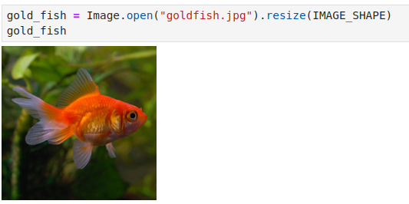
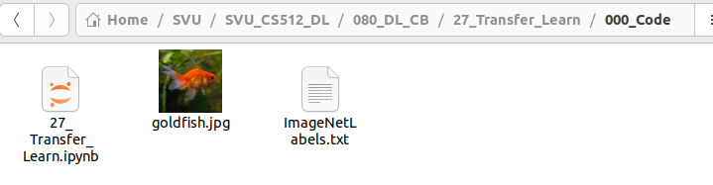
27.2 Pre-trained Prediction
https://www.youtube.com/watch?v=LsdxvjLWkIY&list=PLeo1K3hjS3uu7CxAacxVndI4bE_o3BDtO&index=27
Pre-trained Prediction (6:21-6:50/25:54)
We can Image.open(“goldfish.jpg”) to classify.

Slide 19

27.2 Pre-trained Prediction
https://www.youtube.com/watch?v=LsdxvjLWkIY&list=PLeo1K3hjS3uu7CxAacxVndI4bE_o3BDtO&index=27
Pre-trained Prediction (7:01-9:00/25:54)
Before we classify, we need to rescale the image pixel between 0 and 1.

Slide 20
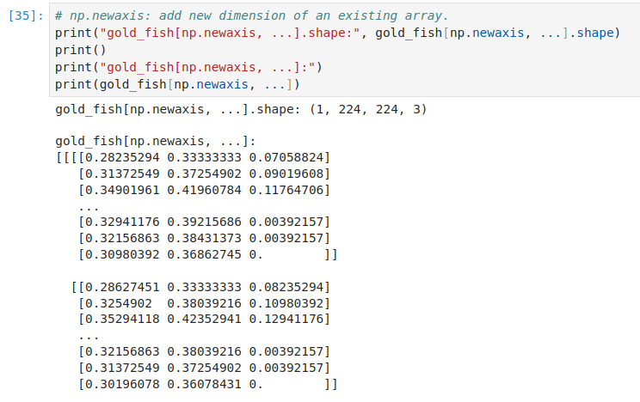
27.2 Pre-trained Prediction
https://www.youtube.com/watch?v=LsdxvjLWkIY&list=PLeo1K3hjS3uu7CxAacxVndI4bE_o3BDtO&index=27
Pre-trained Prediction (9:21-10:39/25:54)
We add new dimension (np.newaxis) for image gold_fish.
The first dimension is the index of image.

Slide 21
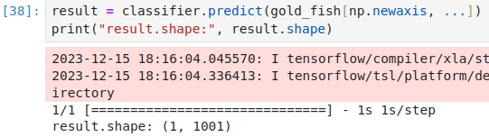
27.2 Pre-trained Prediction
https://www.youtube.com/watch?v=LsdxvjLWkIY&list=PLeo1K3hjS3uu7CxAacxVndI4bE_o3BDtO&index=27
Pre-trained Prediction (10:41-10:58/25:54)
Now, we can do the gold_fish prediction.
We have shape (1, 1001)
We need to get the argmax.

Slide 22

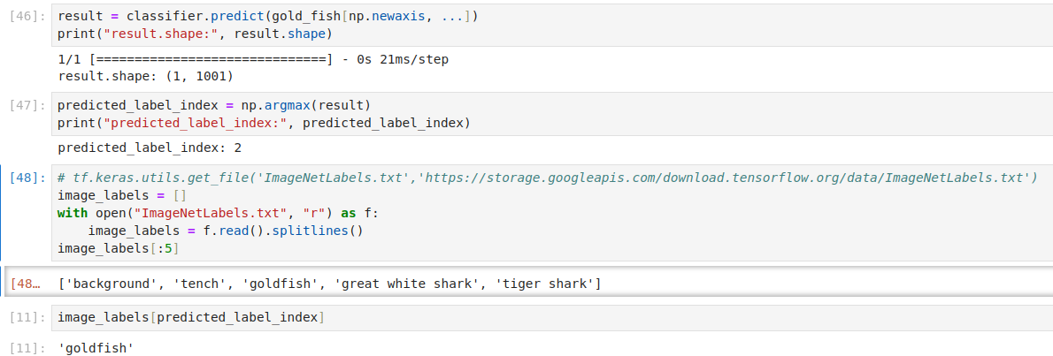
27.2 Pre-trained Prediction
https://www.youtube.com/watch?v=LsdxvjLWkIY&list=PLeo1K3hjS3uu7CxAacxVndI4bE_o3BDtO&index=27
Pre-trained Prediction (11:01-13:50/25:54)
1. We have prediction result shape (1, 1001)
2. We need to get the argmax. We have index = 2.
3. Open “ImageNetLabels.txt” and index =2 will get the “goldfish”.
1
2
3

Slide 23
27.3 Transfer Learning Prediction

Slide 24
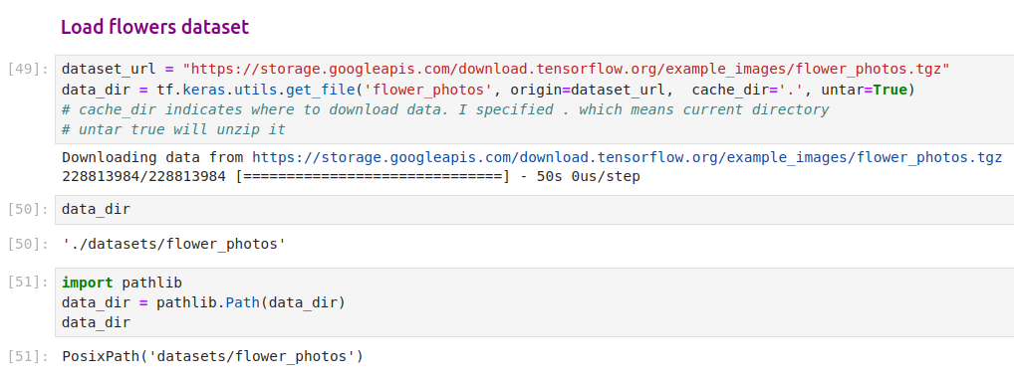
27.3 Transfer Learning Prediction
https://www.youtube.com/watch?v=LsdxvjLWkIY&list=PLeo1K3hjS3uu7CxAacxVndI4bE_o3BDtO&index=27
Transfer Learning Prediction (11:01-12:00/25:54)
Now, we do the transfer learning prediction by flowers.
First, we download the flower dataset.

Slide 25
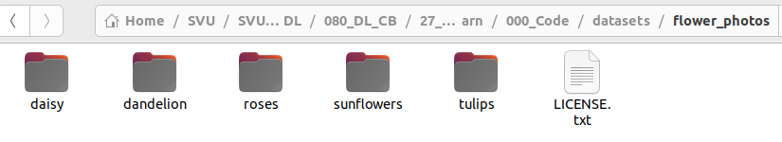
27.3 Transfer Learning Prediction
https://www.youtube.com/watch?v=LsdxvjLWkIY&list=PLeo1K3hjS3uu7CxAacxVndI4bE_o3BDtO&index=27
Transfer Learning Prediction (12:01-13:00/25:54)
We get all the files.

Slide 26
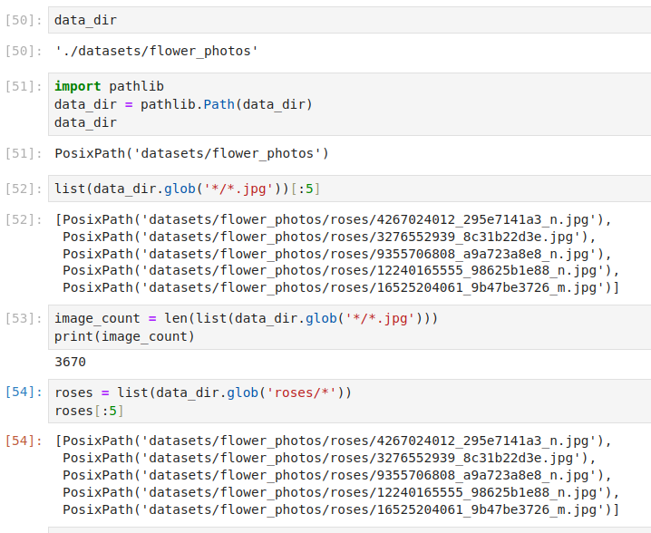
27.3 Transfer Learning Prediction
https://www.youtube.com/watch?v=LsdxvjLWkIY&list=PLeo1K3hjS3uu7CxAacxVndI4bE_o3BDtO&index=27
Transfer Learning Prediction (12:01-13:00/25:54)
We get all the files.

Slide 27
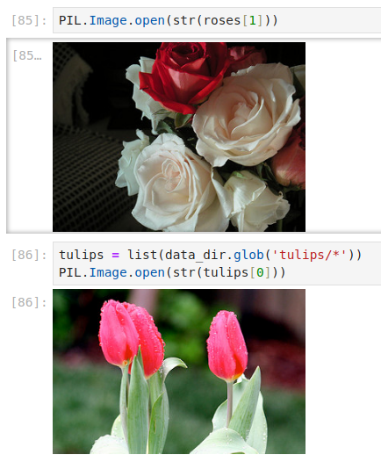
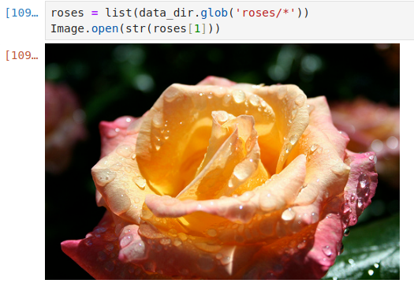
27.3 Transfer Learning Prediction
https://www.youtube.com/watch?v=LsdxvjLWkIY&list=PLeo1K3hjS3uu7CxAacxVndI4bE_o3BDtO&index=27
Transfer Learning Prediction (13:01-15:10/25:54)
Display the flower images.
Glob take all the files from a directory into a list.

Slide 28
End

