Slide 1

28 Computer Vision
Peter H. Chen

Slide 2
28 Computer Vision
https://www.youtube.com/watch?v=taC5pMCm70U&list=PLeo1K3hjS3uu7CxAacxVndI4bE_o3BDtO&index=28
Computer Vision (0:00-0:15/2:31)
In computer vision, we have three problems need to be solved:
1. image classification,
2. object detection, and
3. image segmentation.

Slide 3
28.1 Image Classification

Slide 4
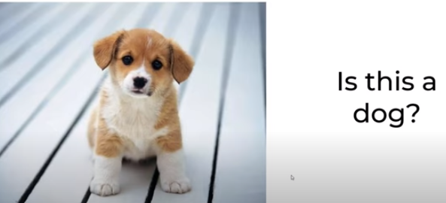
28.1 Image Classification
https://www.youtube.com/watch?v=taC5pMCm70U&list=PLeo1K3hjS3uu7CxAacxVndI4bE_o3BDtO&index=28
Image Classification (0:18-0:28/2:31)
Image classification:
Is this a dog or not?
We classify the image in one of the class.

Slide 5
28.2 Image Classification with Localization

Slide 6
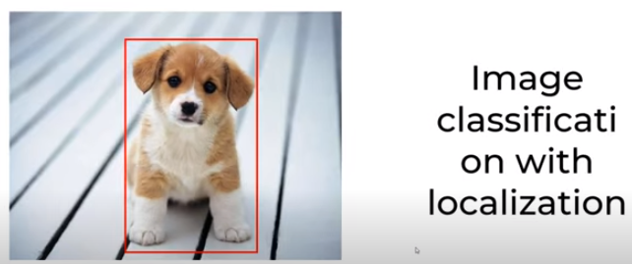
28.2 Image Classification with Localization
https://www.youtube.com/watch?v=taC5pMCm70U&list=PLeo1K3hjS3uu7CxAacxVndI4bE_o3BDtO&index=28
Image Classification with Localization (0:28-0:50/2:31)
What us image classification with localization?
We:
1. Classify the image as one of the class and
2. Find the location of that object within the image.

Slide 7
28.3 Object Detection

Slide 8
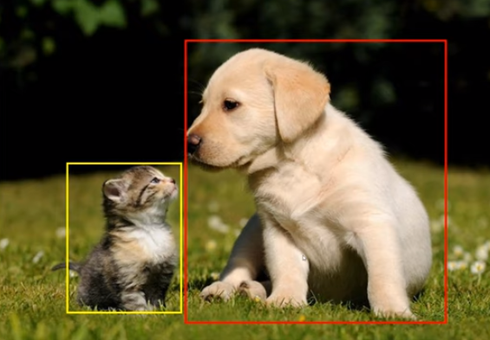
28.3 Object Detection
https://www.youtube.com/watch?v=taC5pMCm70U&list=PLeo1K3hjS3uu7CxAacxVndI4bE_o3BDtO&index=28
Object Detection (0:56-1:15/2:31)
Object detection:
If we have multiple object in the image, we try to find the bounding boxes or rectangle.
We can try drawing the locations of these classes.
In the image, we try to detect the objects. In this cases, they are cat and dog. We draw the bounding boxes or rectangles. This is the object detection.

Slide 9
28.4 Image Segmentation

Slide 10
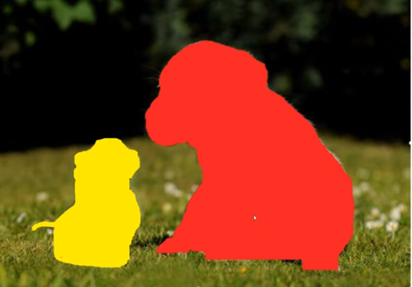
28.4 Image Segmentation
https://www.youtube.com/watch?v=taC5pMCm70U&list=PLeo1K3hjS3uu7CxAacxVndI4bE_o3BDtO&index=28
Image Segmentation (1:19-1:25/2:31)
Image Segmentation:
We can go one level up and classify each pixel as one of the classes.
For examples, here all the red pixels belong to dog and yellow pixels belong to cat.
This is more fine grained classification where you are exactly specifying each pixel belongs to each class.

Slide 11
28.5 Summary

Slide 12
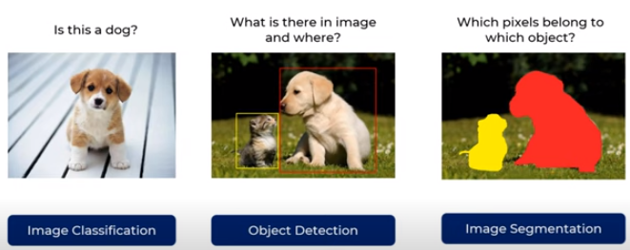
28.4 Summary
https://www.youtube.com/watch?v=taC5pMCm70U&list=PLeo1K3hjS3uu7CxAacxVndI4bE_o3BDtO&index=28
Summary (1:38-2:31/2:31)
Summary:
1. Image Classification: We classify the entire image of one of the classes.
2. Object Detection: We detect the objects within the image with the rectangular bounding boxes.
3. Image Segmentation: Classify each of the pixels as one of the classes. There are two kinds of segmentation, the example here is called Instance Segmentation. The other one is called semantic segmentation

Slide 13
End

