Slide 1

21 Imbalanced Dataset
Peter H. Chen

Slide 2
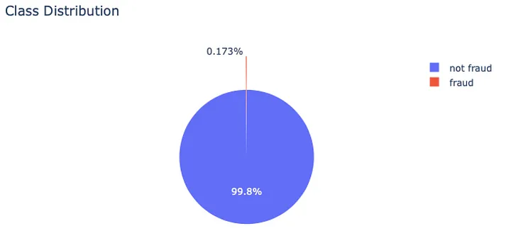
21 Imbalanced Dataset
https://www.youtube.com/watch?v=JnlM4yLFNuo&list=PLeo1K3hjS3uu7CxAacxVndI4bE_o3BDtO&index=21
Imbalanced Dataset (0:00-0:30/38:25)
In the fraud training dataset, such as, dataset for fraud detection.
The dataset may contain 1,000 good data and only 1 fraud data, i.e., there are a lot of non-fraud data but few is fraud data. This data is imbalanced.
If you write the prediction function, you may get 99% accuracy. But in reality, because of 99% is non-fraud data, we cannot use imbalanced data for training and prediction the fraud.
We implement various techniques to handle imbalanced data in machine learning.
Below diagram shows the example of imbalanced dataset with fraud (99.8%) and non-fraud (0.173%) classification. How do we solve the imbalanced Dataset problem?
https://medium.com/analytics-vidhya/techniques-you-need-to-know-while-handling-imbalanced-data-d48a586c848d

Slide 3
21.01 Imbalanced to Balanced

Slide 4
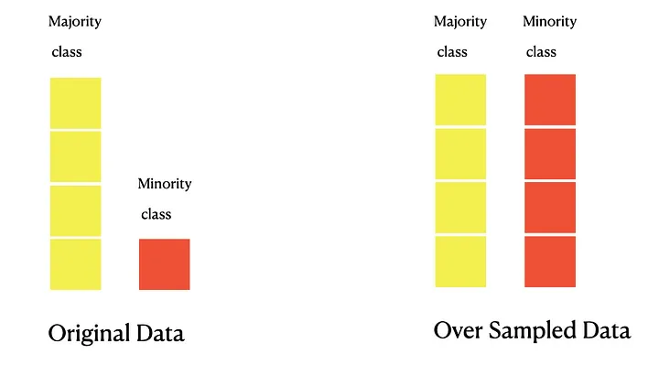
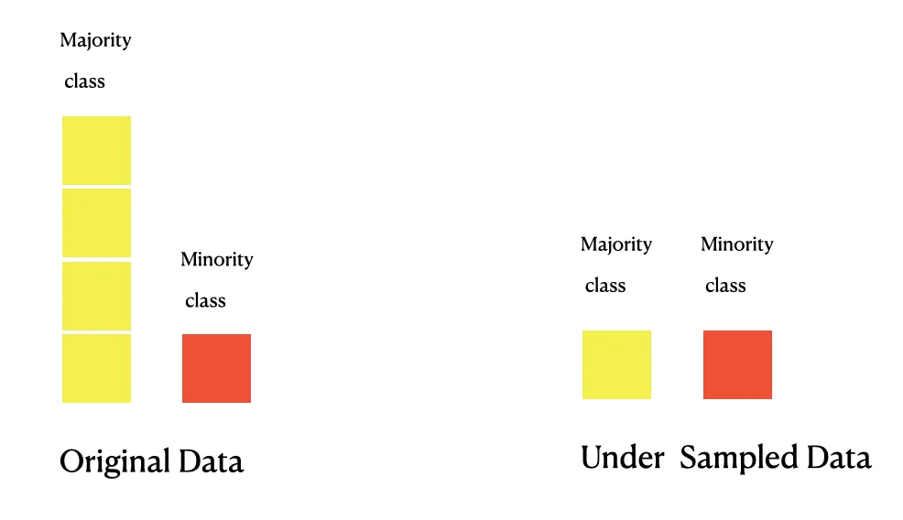
21.01 Imbalanced to Balanced
https://www.youtube.com/watch?v=JnlM4yLFNuo&list=PLeo1K3hjS3uu7CxAacxVndI4bE_o3BDtO&index=21
Imbalanced to Balanced (1:01-1:30/38:25)
How to solve the Imbalanced dataset problem?
Intuitively, we have:
1. Over sampled data for minority Data or
2. Under Sampling for Majority Data to generate the dataset with balanced data.
What are the other ways we can have?
https://medium.com/analytics-vidhya/techniques-you-need-to-know-while-handling-imbalanced-data-d48a586c848d
1
2

Slide 5
21.02 Under Sampling

Slide 6

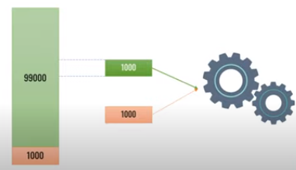
21.02 Under Sampling
https://www.youtube.com/watch?v=JnlM4yLFNuo&list=PLeo1K3hjS3uu7CxAacxVndI4bE_o3BDtO&index=21
Under Sampling (1:10-2:00/38:25)
The first technique is called “Under Sampling Majority Class”.
If we have 99,000 samples belong one class (green class) and 1,000 belong another class (red class).
This is the fraud detection (or credit card) classification. 99% is non-fraud sample and only 1% is fraud sample.
To tackle this problem, we randomly select 1,000 samples from 99,000 samples and discard the remaining samples, then, we combine this 1,000 samples with red samples.
We keep both samples with 1,000 samples. Totally, we have 2,000 samples.
This may not the best choice, because we only select 1% samples and sacrifice too 99% samples in the 99,000 samples.

Slide 7
21.03 Over Sampling

Slide 8
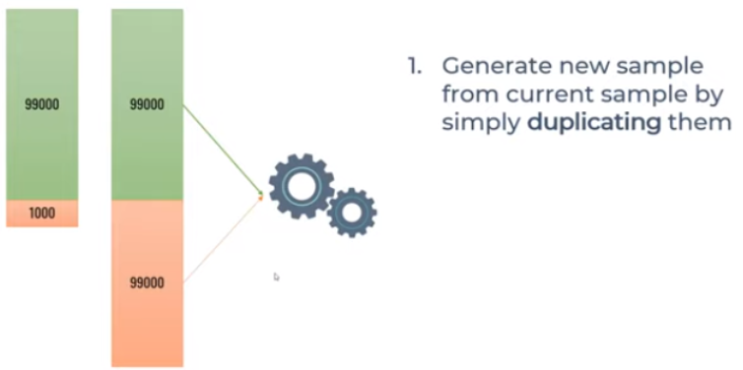
21.03 Over Sampling
https://www.youtube.com/watch?v=JnlM4yLFNuo&list=PLeo1K3hjS3uu7CxAacxVndI4bE_o3BDtO&index=21
Over Sampling (2:05-2:30/38:25)
The second technique is “Over sampling minority class by duplication”.
How do we over sample the minor class?
We duplicate 99 times of the minority samples.
Do we have the better option?

Slide 9
21.04 SMOTE Sampling

Slide 10
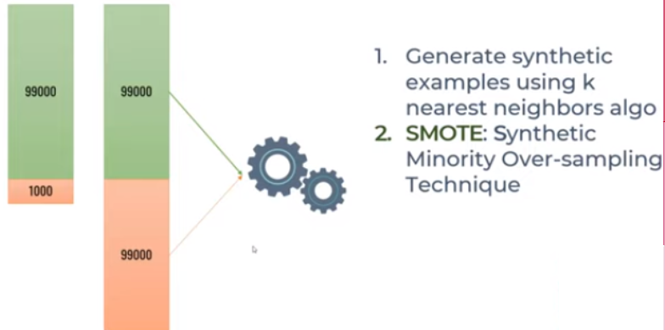

21.04 SMOTE Sampling
https://www.youtube.com/watch?v=JnlM4yLFNuo&list=PLeo1K3hjS3uu7CxAacxVndI4bE_o3BDtO&index=21
SMOTE Sampling (2:33-3:00/38:25)
The third technique is “SMOTE”.
1. What is SMOTE (Synthetic Minority Oversampling Technique)
SMOTE uses near K-neighborhood algorithm and try to produce Synthetic samples from your thousand samples. That is why we called this is SMOTE.
2. What is difference between the oversampling and SMOTE?
Answer:
2.1 Unlike random oversampling, in SMOTE algorithm minority class is over-sampled by generating synthetic examples rather than by oversampling with replacement.
2.2 The SMOTE algorithm creates artificial examples based on the feature space (based on distribution), rather than data space (duplicated data).
2.3 The SMOTE generates data based on similarities between existing minority examples.

Slide 11
21.05 Ensemble Sampling

Slide 12

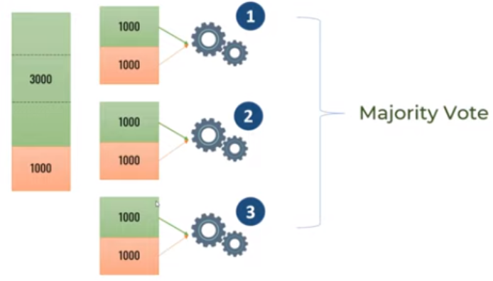
21.05 Ensemble Sampling
https://www.youtube.com/watch?v=JnlM4yLFNuo&list=PLeo1K3hjS3uu7CxAacxVndI4bE_o3BDtO&index=21
Ensemble Sampling (3:01-3:30/38:25)
The fourth technique is “Ensemble Sampling”.
We have 3 thousand samples in first class and 1 thousand samples in second class.
We can divide 3 thousand samples into three batches.
Take each batch with the second class to train the model 1, model 2, and model 3.
Now, we have three models, we use the majority vote.
This is similar to random forests. We have a bunch of tress and we take the majority of vote.

Slide 13
21.06 Focal Loss

Slide 14
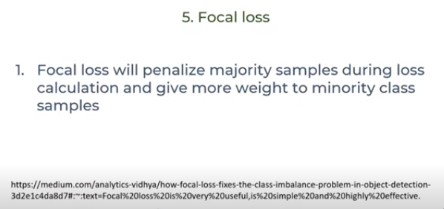
21.06 Focal Loss
https://www.youtube.com/watch?v=JnlM4yLFNuo&list=PLeo1K3hjS3uu7CxAacxVndI4bE_o3BDtO&index=21
Focal Loss (3:40-3:00/38:25)
The fifth technique is “Focal Loss”.
This method penalize the majority samples and give more weight to minority class samples.
https://medium.com/analytics-vidhya/how-focal-loss-fixes-the-class-imbalance-problem-in-object-detection-3d2e1c4da8d7

Slide 15
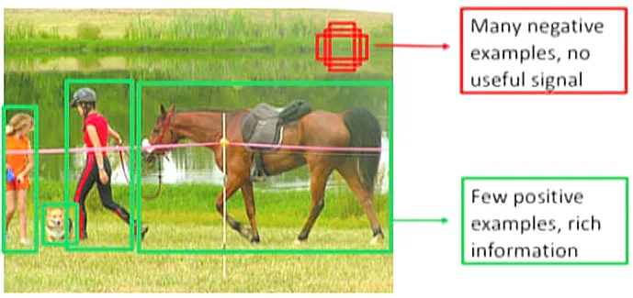
21.06 Focal Loss
https://www.youtube.com/watch?v=JnlM4yLFNuo&list=PLeo1K3hjS3uu7CxAacxVndI4bE_o3BDtO&index=21
Focal Loss (3:40-4:00/38:25)
Focal Loss Example:
The “Focal Loss” consider the foreground is more important but few samples.
The background have more samples but not important.
https://medium.com/analytics-vidhya/how-focal-loss-fixes-the-class-imbalance-problem-in-object-detection-3d2e1c4da8d7

Slide 16
End

