Slide 1

20.02 Without Dropout: Code
Peter H. Chen

Slide 2
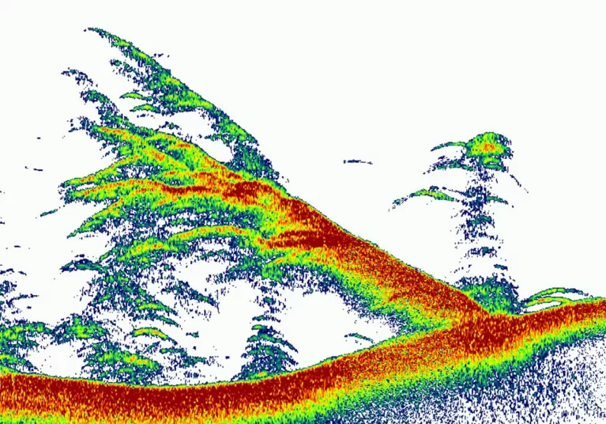
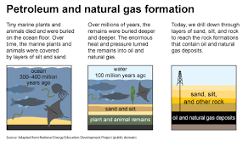
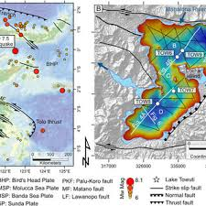
20.02 Without Dropout: Code
https://www.youtube.com/watch?v=lcI8ukTUEbo&list=PLeo1K3hjS3uu7CxAacxVndI4bE_o3BDtO&index=20
Python Coding (5:28-6:00/19:01)
Now, we look at python code for Dropout Regularization for Sonar Chirp (Noise).
Question:
What is the use of Sonar Chirp?
CHIRP (Compressed High Intensity Radar Pulse) examples:
1. Fish in the water
2. Petroleum/Gas Detection
2. goo-structure
2
3
1

Slide 3
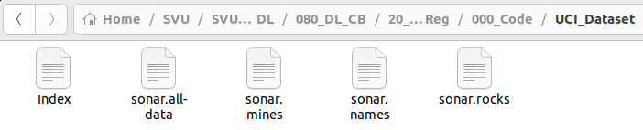
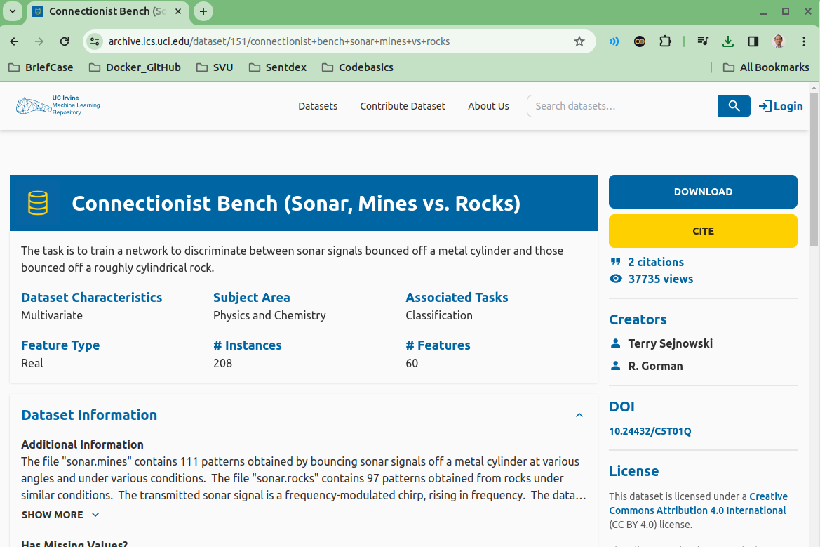
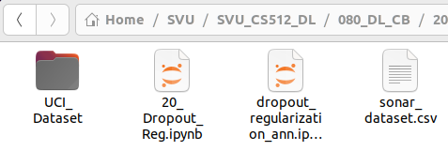
20.02 Without Dropout: Code
https://www.youtube.com/watch?v=lcI8ukTUEbo&list=PLeo1K3hjS3uu7CxAacxVndI4bE_o3BDtO&index=20
Python Coding (6:01-6:30/19:01)
Now, we look at python code for Dropout Regularization and see how it help the overfit/underfit problem.
We are going to use dataset from UCI machine Learning.
We download and unzip. Find “sonar.all-data” into “sonar_dataset.csv” put in the working directory.

Slide 4
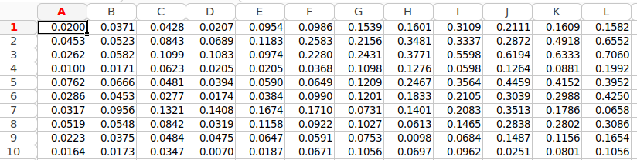
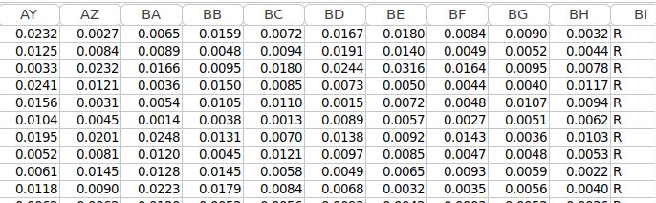
20.02 Without Dropout: Code
https://www.youtube.com/watch?v=lcI8ukTUEbo&list=PLeo1K3hjS3uu7CxAacxVndI4bE_o3BDtO&index=20
Python Coding (6:31-7:30/19:01)
This dataset describes the sonar chirp (noise) returns bouncing off different services.
The 60 input variables are the strength of the return at different angles.
Sonar: Sound Navigation and Ranging
In Column 60, R (Rock): means Rocks are detected, M (Mines) means Mines are detected.

Slide 5
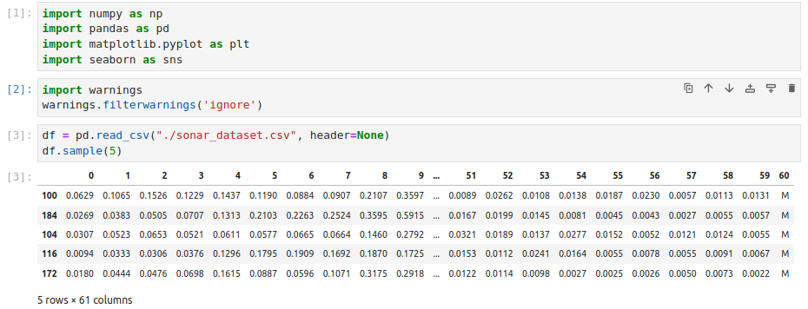
20.02 Without Dropout: Code
https://www.youtube.com/watch?v=lcI8ukTUEbo&list=PLeo1K3hjS3uu7CxAacxVndI4bE_o3BDtO&index=20
Python Coding (6:31-6:35/19:01)
Read in dataset “sonar_dataset.csv”.
When we load the data, we have header = None. We don’t have columns name.
Print first 5 lines samples.

Slide 6
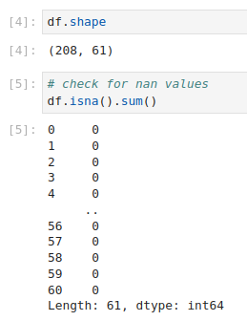
20.02 Without Dropout: Code
https://www.youtube.com/watch?v=lcI8ukTUEbo&list=PLeo1K3hjS3uu7CxAacxVndI4bE_o3BDtO&index=20
Python Coding (6:31-6:35/19:01)
1. Check shape 208 rows x 61 columns
2. Check for columns that contains the NaN (Not a number). There are all 0. None of the columns has the NaN.

Slide 7
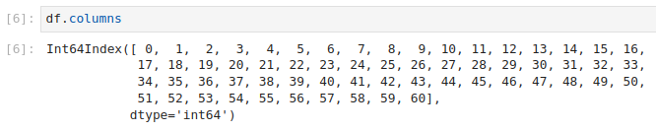
20.02 Without Dropout: Code
https://www.youtube.com/watch?v=lcI8ukTUEbo&list=PLeo1K3hjS3uu7CxAacxVndI4bE_o3BDtO&index=20
Python Coding (7:01-7:15/19:01)
1. Check the column names (0, 1, 2, …, 60).
Columns 0 to 59 is the features. Column 60 is the target variables.

Slide 8

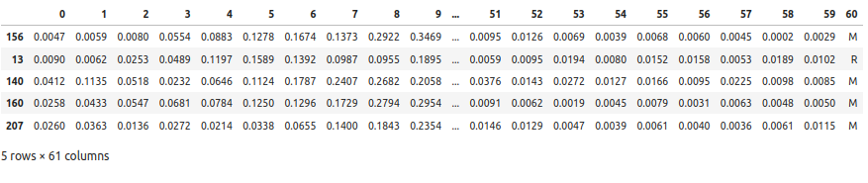
20.02 Without Dropout: Code
https://www.youtube.com/watch?v=lcI8ukTUEbo&list=PLeo1K3hjS3uu7CxAacxVndI4bE_o3BDtO&index=20
Python Coding (7:16-7:43/19:01)
We check how many M and R in columns 60.
We totally have 208 rows.
111 + 97 = 208
We have 111 is M and 97 is R.

Slide 9
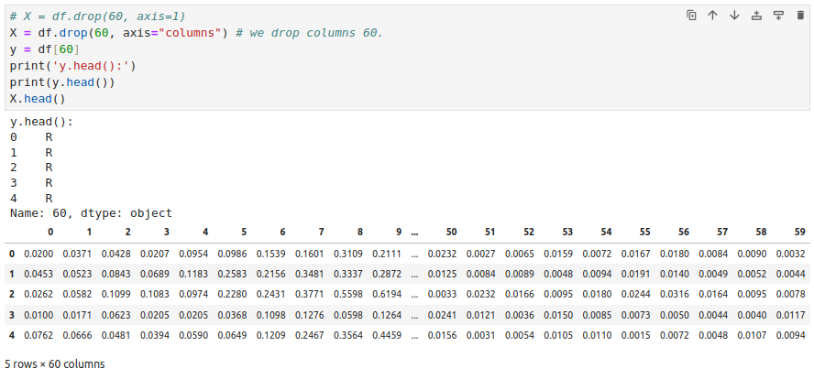
20.02 Without Dropout: Code
https://www.youtube.com/watch?v=lcI8ukTUEbo&list=PLeo1K3hjS3uu7CxAacxVndI4bE_o3BDtO&index=20
Python Coding (7:51-8:15/19:01)
Now, we prepare the data y and X.

Slide 10
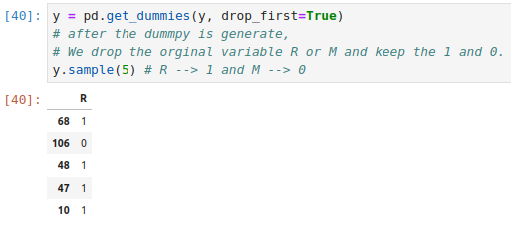
20.02 Without Dropout: Code
https://www.youtube.com/watch?v=lcI8ukTUEbo&list=PLeo1K3hjS3uu7CxAacxVndI4bE_o3BDtO&index=20
Python Coding (8:17-9:10/19:01)
Now, we do the one-hot encoding by get_dummies().
After the one-hot encoding is generated, the original R (Rocks) and M (Mines) are drop.
Only 1 or 0 are kept.
Below are y (target) 1 (Rocks) or 0 (Mines).

Slide 11
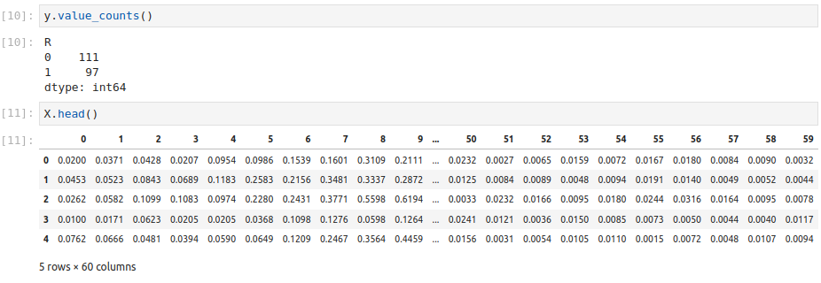
20.02 Without Dropout: Code
https://www.youtube.com/watch?v=lcI8ukTUEbo&list=PLeo1K3hjS3uu7CxAacxVndI4bE_o3BDtO&index=20
Python Coding (9:10-9:16/19:01)
1. We have y value counts: We have M (Mines) is converted into 0 and R (Rocks) converted into 1.
2. Check the X data.

Slide 12
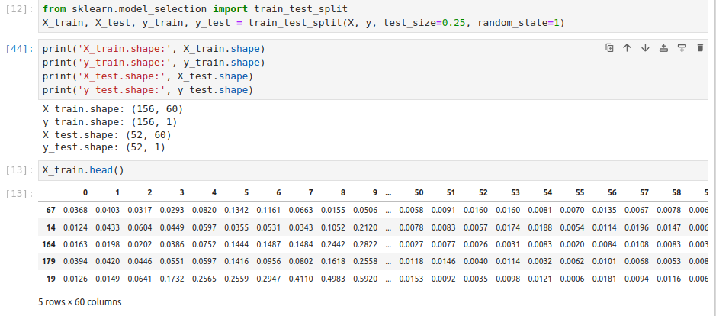
20.02 Without Dropout: Code
https://www.youtube.com/watch?v=lcI8ukTUEbo&list=PLeo1K3hjS3uu7CxAacxVndI4bE_o3BDtO&index=20
Python Coding (9:31-10:30/19:01)
We split data into train and test.
We have X_train, y_train, X_test. y_test.

Slide 13
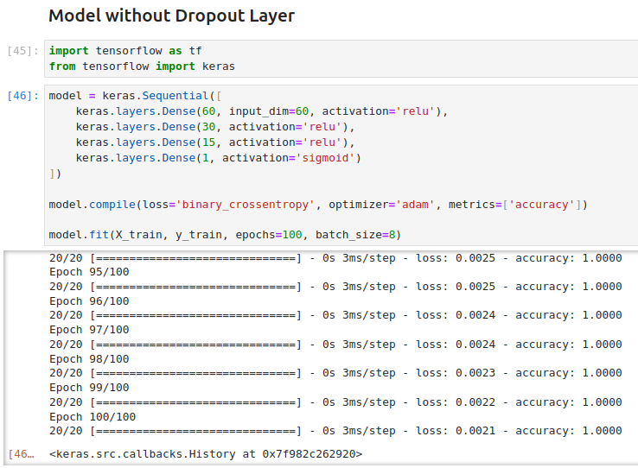
20.02 Without Dropout: Code
https://www.youtube.com/watch?v=lcI8ukTUEbo&list=PLeo1K3hjS3uu7CxAacxVndI4bE_o3BDtO&index=20
Python Coding (10:31-12:50/19:01)
We model without dropout.
1. We have 60 columns. We have input dimension = 60 and neuron=60.
2. We have two hidden layers and try and error for number of neuron 30 and 15. We have ReLU for activation function.
3. We have output activation function sigmoid for probability distribution.
1. We have loss function binary cross entropy.
2. Optimizer adam
3. We use accuracy for measurement.
1. We train for 100 epochs for feed samples forward and back-propagation.
2. We use mini-batch size = 8 samples in each epoch.
We have accuracy 100%. This is too good.

Slide 14
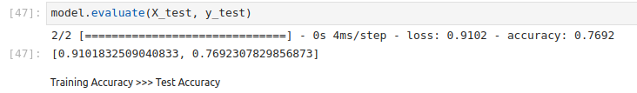
20.02 Without Dropout: Code
https://www.youtube.com/watch?v=lcI8ukTUEbo&list=PLeo1K3hjS3uu7CxAacxVndI4bE_o3BDtO&index=20
Python Coding (12:51-13:00/19:01)
We evaluate and accuracy is 76%.
We have 100% in accuracy but only 76% in test.
We have very good accuracy in training dataset but very poor in test dataset.
This means that we are overfitting in our model.

Slide 15
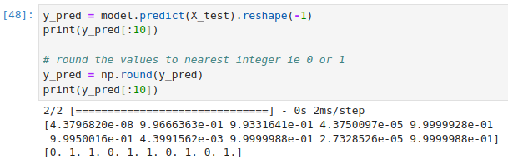
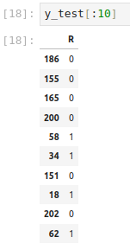
20.02 Without Dropout: Code
https://www.youtube.com/watch?v=lcI8ukTUEbo&list=PLeo1K3hjS3uu7CxAacxVndI4bE_o3BDtO&index=20
Python Coding (13:01-13:26/19:01)
We make some prediction:
1. initial prediction and
2. round to 0 and 1.
We view the result.

Slide 16
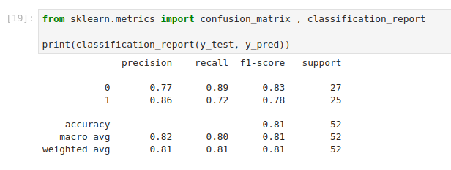
20.02 Without Dropout: Code
https://www.youtube.com/watch?v=lcI8ukTUEbo&list=PLeo1K3hjS3uu7CxAacxVndI4bE_o3BDtO&index=20
Python Coding (14:01-14:10/19:01)
We view the confusion matrix: precision, recall, f1-score, and support (how many points we measured).

Slide 17
End

