Slide 1

27 Transfer Learning
Peter H. Chen

Slide 2
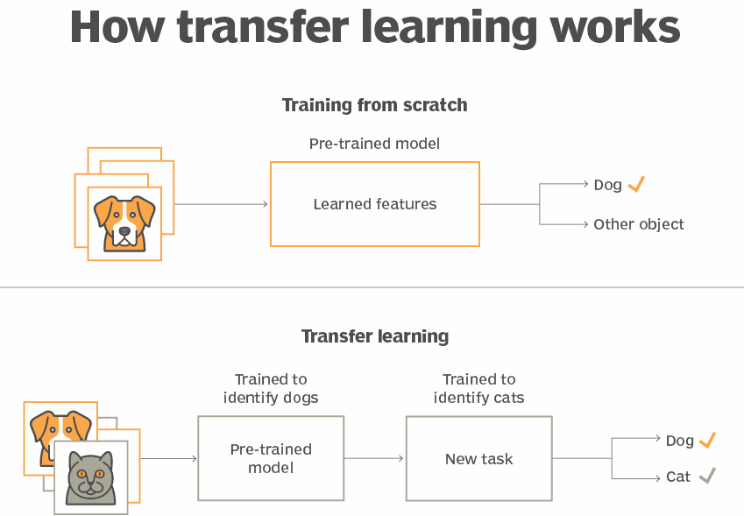
27 Transfer Learning
https://www.youtube.com/watch?v=LsdxvjLWkIY&list=PLeo1K3hjS3uu7CxAacxVndI4bE_o3BDtO&index=27
Introduction to Transfer Learning (0:00-0:05/25:54)
What is transfer Learning?
1. Transfer of learning uses the previously acquired knowledge and fine-tune with new knowledge for future prediction or classification.
2. The similarities and analogies between previous and current learning content and processes are important and play a crucial role.
3. For example, Using transfer learning, a model that is pre-trained for identifying dogs can be used to identify cats.

Slide 3
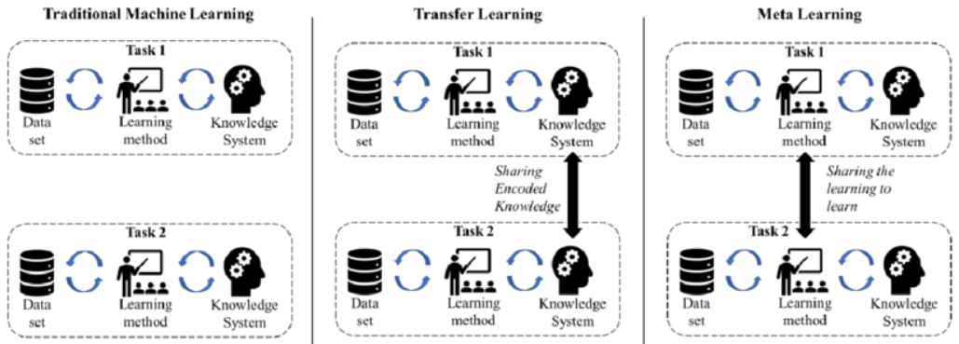
27 Transfer Learning
https://www.youtube.com/watch?v=LsdxvjLWkIY&list=PLeo1K3hjS3uu7CxAacxVndI4bE_o3BDtO&index=27
Introduction to Transfer Learning (0:06-0:10/25:54)
What is difference between Traditional Machine Learning, transfer learning and meta learning?
1. Traditional Machine Learning: Re-train the original weights and bias of neural network with new dataset. Take long time.
2. Transfer Learning: Keep the original weight and bias of neural network. Add new layer for new dataset.
3. Meta Learning: Learn (Share the learning) from output of another learning system.
https://www.researchgate.net/figure/Traditional-ML-versus-Transfer-Learning-versus-Meta-Learning_fig3_339895075

Slide 4
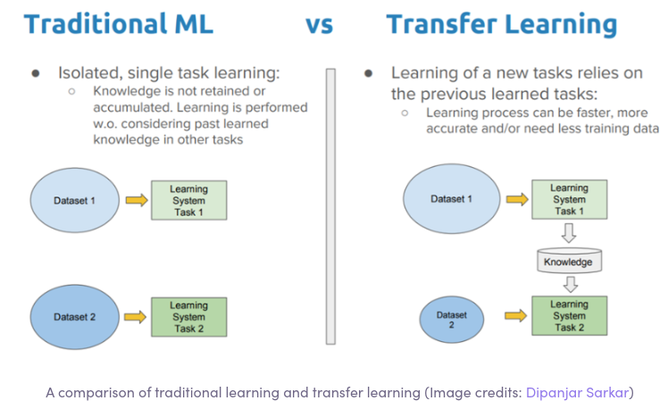
27 Transfer Learning
https://www.youtube.com/watch?v=LsdxvjLWkIY&list=PLeo1K3hjS3uu7CxAacxVndI4bE_o3BDtO&index=27
Introduction to Transfer Learning (0:11-0:15/25:54)
What is advantage of Transfer Learning vs traditional Machine Learning?
1. Neural networks are trained on large datasets of images to recognize objects.
2. However, this training and the use of huge datasets is a time-consuming process and a tedious one too. Use the transfer learning, we save time with pre-train Model and fine-tune for future model prediction or classification.

Slide 5
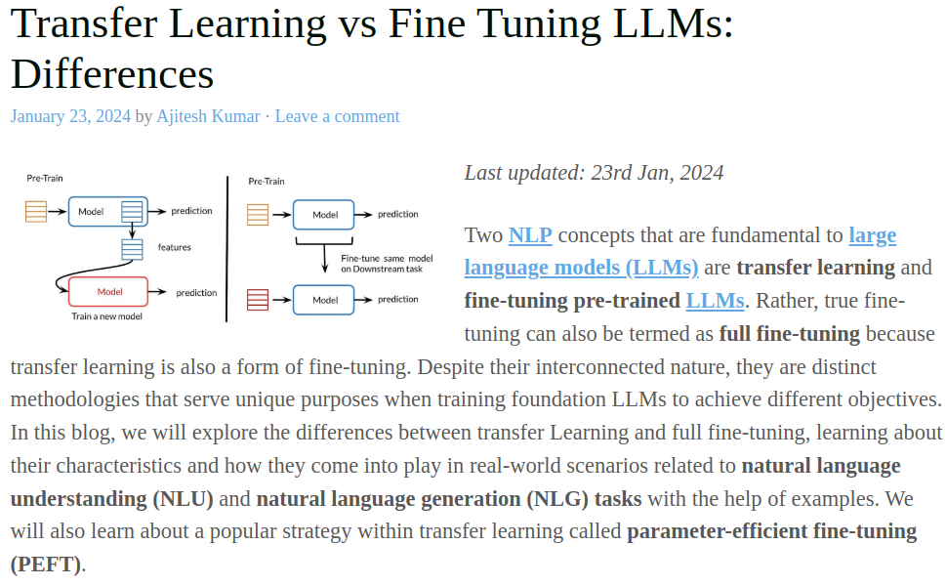
27 Transfer Learning
https://www.youtube.com/watch?v=LsdxvjLWkIY&list=PLeo1K3hjS3uu7CxAacxVndI4bE_o3BDtO&index=27
Introduction to Transfer Learning (0:16-0:20/25:54)
What is difference of Fine-Tune and Transfer Learning?
1. Transfer Learning is a kinds of fine-tuning.
2. Fine-Tune tune the parameter. Transfer learning fix the original parameters and add additional layers for new knowledge.
https://vitalflux.com/transfer-learning-vs-fine-tuning-differences/

Slide 6
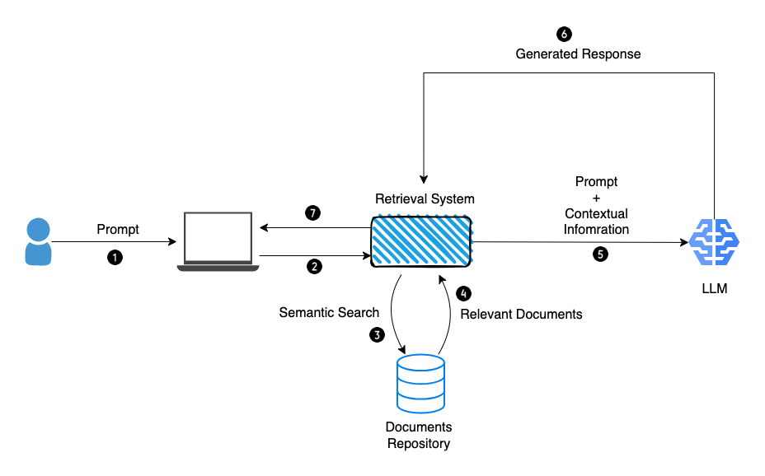
27 Transfer Learning
https://www.youtube.com/watch?v=LsdxvjLWkIY&list=PLeo1K3hjS3uu7CxAacxVndI4bE_o3BDtO&index=27
Introduction to Transfer Learning (0:21-0:25/25:54)
Is RAG a type of transfer learning?
1. RAG (Retrieval-Augmented Generation) is a transfer learning technique that enriches a generative model's training data by retrieving relevant documents from an external corpus.
2. The LLM (Large Language Model) Google Gemini, Meta Llama, and OpenAI GPT, are pre-trained Model. We can use transfer learning technique to fine-tune the pre-train Model with private Database.
3. The RAG (Retrival Augmented Generative) to improve the LLM by their internal private dataset.
https://blog.gopenai.com/retrieval-augmented-generation-101-de05e5dc21ef

Slide 7
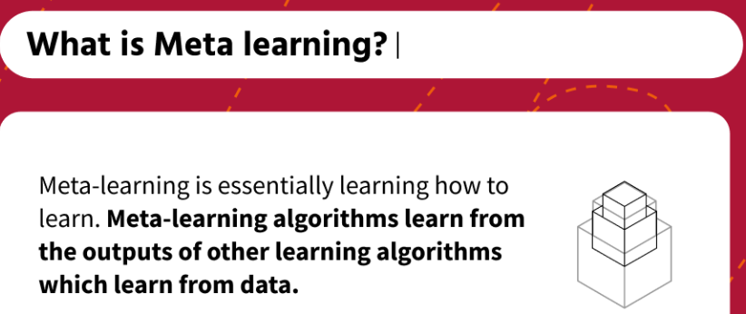
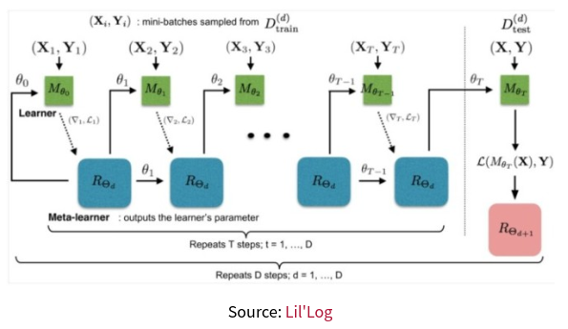
27 Transfer Learning
https://www.youtube.com/watch?v=LsdxvjLWkIY&list=PLeo1K3hjS3uu7CxAacxVndI4bE_o3BDtO&index=27
Introduction to Transfer Learning (0:25-0:30/25:54)
What is is meta learning?
Meta Learning learn (or share the learning or learn from summary) from output of other learning algorithms.
https://www.engati.com/glossary/meta-learning

Slide 8
27.01 Introduction to Transfer Learning

Slide 9
27.01 Introduction to Transfer Learning
https://www.youtube.com/watch?v=LsdxvjLWkIY&list=PLeo1K3hjS3uu7CxAacxVndI4bE_o3BDtO&index=27
Introduction to Transfer Learning (0:30-1:30/25:54)
Transfer Learning has become popular in image classification and NLP (Natural Language Processing).
We have a pre-trained Model, we try to re-train it for new problem.
In the last discussion (data augmentation), we have flower dataset which we classify five types of flowers, i.e., Roses, Daisy, Dandelion, Sunflowers, Tulips. We use image flip, rotation, contrast, zoom, etc. to improve the accuracy from 63% to 73%.
In this discussion, we use a MobileNet V2 (From Fei-Fei Li’s ImageNet) pre-trained model from Google Tensorflow Hub.
We will use this pre-trained model to classify google flower dataset. We only can 10% only or less. We want to improve to 99% Accuracy. How can we do that?
Previously, we used to take 30 epochs to train the model and achieve the high accuracy.
If we use the transfer learning with pre-trained model, we just need less than 5 epochs to achieve the same high accuracy.
Transfer learning use pre-trained model to save a lot of computation power.

Slide 10
27.01 Introduction to Transfer Learning
https://www.youtube.com/watch?v=LsdxvjLWkIY&list=PLeo1K3hjS3uu7CxAacxVndI4bE_o3BDtO&index=27
Introduction to Transfer Learning (1:31-1:40/25:54)
The pre-trained MobileNet model is available at tensorflow hub (Tensorflow > resources).
These pre-trained model are trained by millions of images.
If we try to train our model to be the pre-trained model, it may take several hundreds of years to reach that accuracy.
For example, to train Google Gemini, google use computer resources (NVIDIA H100, A100 8 GPUs and 80 GB x 8 = 640 GB) to reach that accuracy. My computer with NVIDIA RTX (Real-time Ray Tracing) 3050 (1 GPU and 8GB) is not enough to train trillions of input words. My computer will come up Error or hangup.
To save time and computer resource, we can
1. Download the pre-trained model,
2. Get the pre-trained weights and bias, and
3. then we can train the last layer or last few layers for your new problem and get the super high accuracy.
We will go through some theory of Transfer Learning and then do the coding.

Slide 11
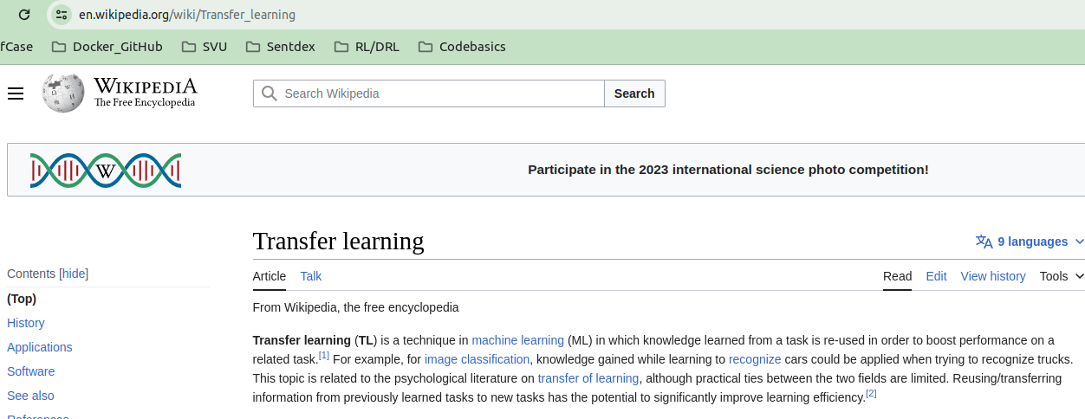
27.01 Introduction to Transfer Learning
https://www.youtube.com/watch?v=LsdxvjLWkIY&list=PLeo1K3hjS3uu7CxAacxVndI4bE_o3BDtO&index=27
Introduction to Transfer Learning (1:41-2:10/25:54)
Below is the wiki definition for Transfer Learning.
We focus on stored and gained knowledge and apply the different but related problem.
For example, we have a model that can recognize cars, we can use this model to recognize the truck as well because the basic features, for example, tires, steering wheel, some components, etc. between cars and trucks are similar.
We can use this knowledge of visual world and transfer the knowledge to solve different problem.

Slide 12
27.02 Google MobileNet

Slide 13
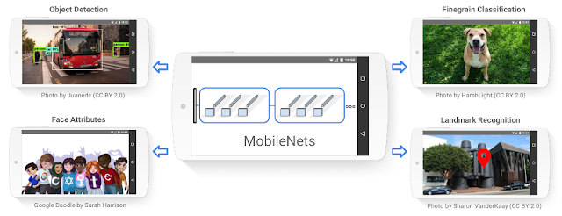
27.02 Google MobileNet
https://www.youtube.com/watch?v=LsdxvjLWkIY&list=PLeo1K3hjS3uu7CxAacxVndI4bE_o3BDtO&index=27
Google MobileNet (2:20-2:21/25:54)
1. What is Google MobileNets?
Ans: MobileNets (MobileNet, MobileNet2, MobileNet3) is a family of lightweight CNN (Convolutional Neural Network) Architectures by Google Research for efficient deployment on mobile and embedded devices.
2. When was MobileNet invented?
Ans: 2017.
https://research.google/blog/mobilenets-open-source-models-for-efficient-on-device-vision/

Slide 14
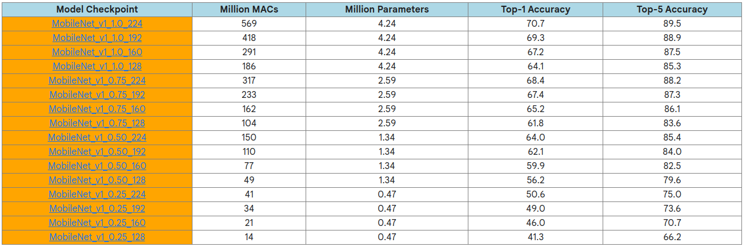
27.02 Google MobileNet
https://www.youtube.com/watch?v=LsdxvjLWkIY&list=PLeo1K3hjS3uu7CxAacxVndI4bE_o3BDtO&index=27
Google MobileNet (2:21-2:22/25:54)
MobileNet release contains
1. MobileNets in TensorFlow using TF-Slim library (TF-Slim is a lightweight library for defining, training and evaluating complex models).
2. 16 pre-trained ImageNet classification checkpoints for use in mobile projects of all sizes.
What is MACs?
Ans: MACs (Multiply-Accumulates) or MADDs (Multiply-Adds): The number of multiply-accumulates needed to compute an inference on a single image. It is a metric to measure the efficiency of the model.
https://research.google/blog/mobilenets-open-source-models-for-efficient-on-device-vision/

Slide 15
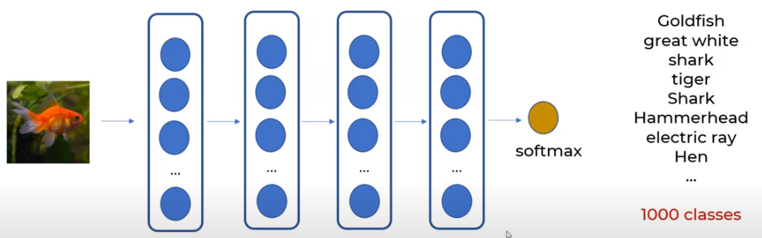
27.02 Google MobileNet
https://www.youtube.com/watch?v=LsdxvjLWkIY&list=PLeo1K3hjS3uu7CxAacxVndI4bE_o3BDtO&index=27
Google MobileNet (2:23-3:00/25:54)
We take Google MobileNet V2 Model for transfer learning coding.
Google pre-trained MobileNet V2 Model contains 1.4 million images and total 1000 classes.
Google take a long time (months to years) and lots of computational resources to train MobileNet V2 Model.
MobileNet V2 Model is the Deep Learning Model with huge dataset.
The output is 1,000 classes. It is a very diverse with Goldfish, great white shark, some animal, hammerhead shark, military uniform, etc.

Slide 16
27.02 Google MobileNet
https://www.youtube.com/watch?v=LsdxvjLWkIY&list=PLeo1K3hjS3uu7CxAacxVndI4bE_o3BDtO&index=27
Google MobileNet (3:01-3:20/25:54)
Google MobileNet V2 Model is not just animals. It contains 1,000 classes of objects.
When MobileNet Model is trained, it has input layers, hidden layers, output layer, and softmax layer, and classify the input objects into 1,000 categories.
In the below of the deep learning model, all the layers are pre-trained and frozen except the last layer. All the layers are frozen to classify the gold fish.

Slide 17
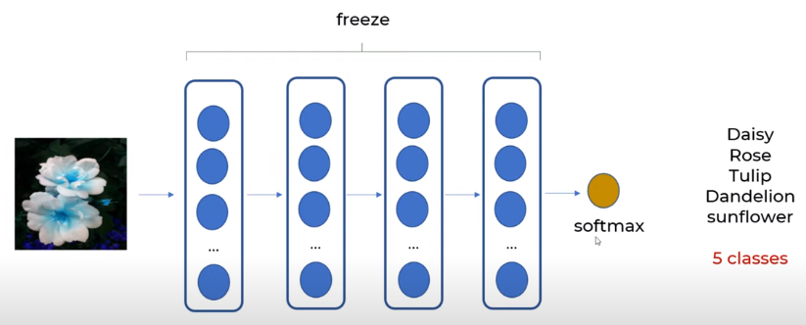
27.02 Google MobileNet
https://www.youtube.com/watch?v=LsdxvjLWkIY&list=PLeo1K3hjS3uu7CxAacxVndI4bE_o3BDtO&index=27
Google MobileNet (3:21-5:10/25:54)
Now, we will use the all the frozen layers to classify the flowers. The pre-trained model is used to classify 1000 classes is frozen, the model weights will not change.
Only the weights of last layer is changed. Now, we use the MobileNet to classify 5 flowers as shown below.
When we perform the new training, the frozen weights of model do not changed.
The frozen pre-trained model looks like a non-liner regression equation. This pre-trained model is used to classify 1,000 classes.
We pass the flower into the non-linear regression equation to get feature vectors, then we use the softmax layer to classify five classes instead of thousand.
We use the frozen layer to classify the new classes, during the training, non of the weights is change, only the weights of last layer, last two layers, or last three layers, etc are changed.

Slide 18
27.03 Tensorflow Hub

Slide 19
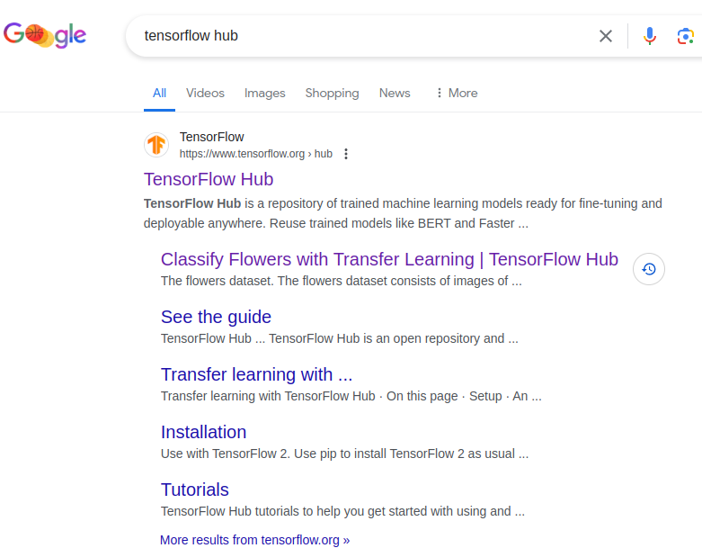
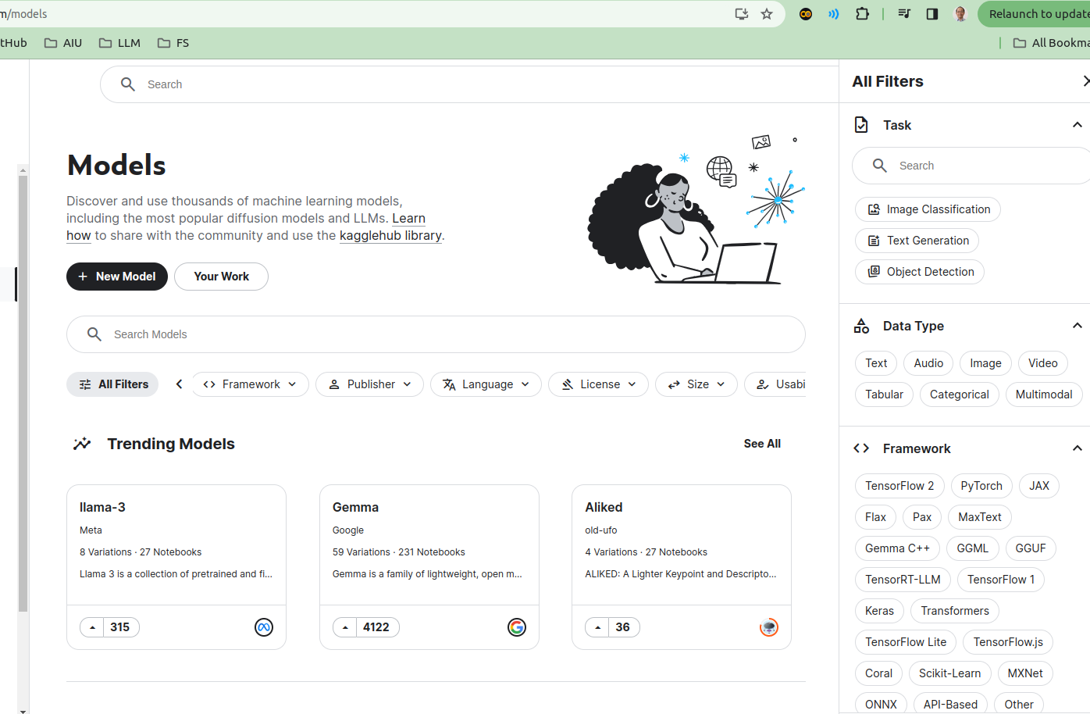
27.03 Tensorflow Hub
https://www.youtube.com/watch?v=LsdxvjLWkIY&list=PLeo1K3hjS3uu7CxAacxVndI4bE_o3BDtO&index=27
Tensorflow Hub (5:11-5:12/25:54)
We can see Google search “Tensorflow Hub”. We can see
1. Tensorflow Hub: Click to see the Tensorflow Hub/Kaggle for CNN Image hosting.
2. Classify Flowers with Transfer Learning: we will click later on to see CNN Transfer Learning example on Google Colab.
1
2

Slide 20
27.03 Tensorflow Hub
https://www.youtube.com/watch?v=LsdxvjLWkIY&list=PLeo1K3hjS3uu7CxAacxVndI4bE_o3BDtO&index=27
Tensorflow Hub (5:15-5:16/25:54)
Goggle/Kaggle host CNN related Models.
Note: Google/HuggingFace host NLP/LLM related models. There are too many models.

Slide 21
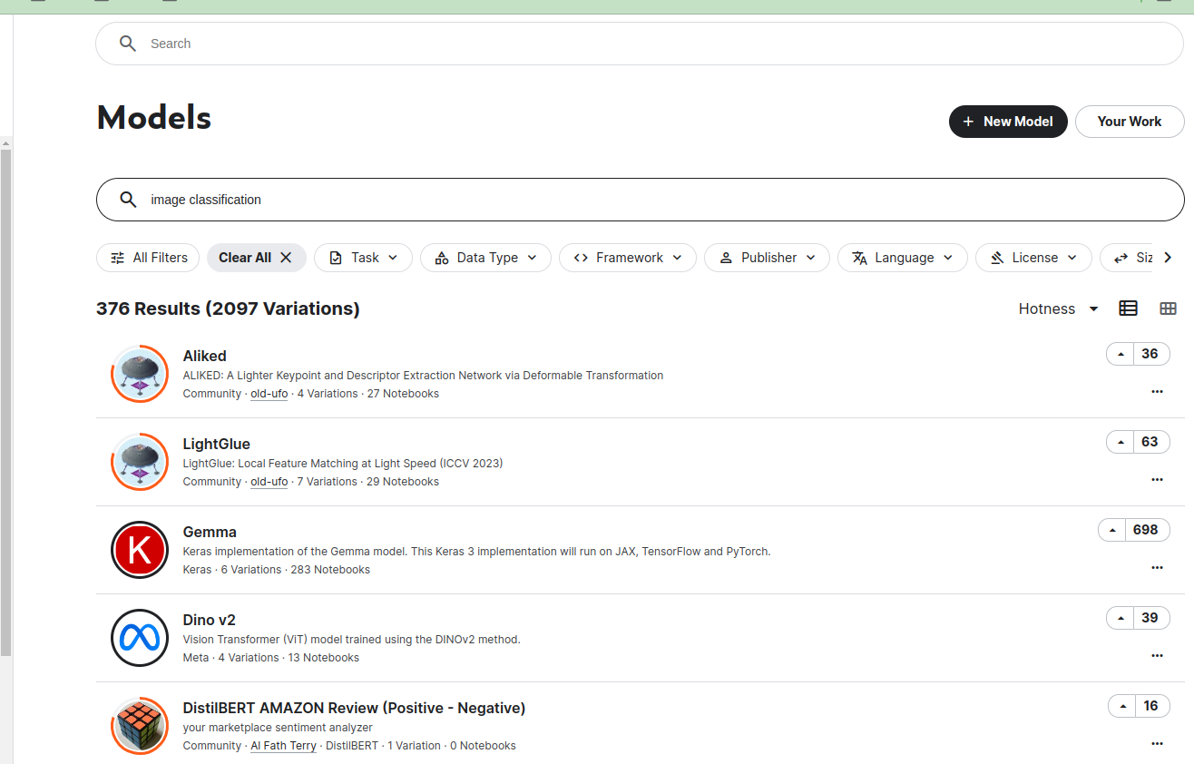
27.03 Tensorflow Hub
https://www.youtube.com/watch?v=LsdxvjLWkIY&list=PLeo1K3hjS3uu7CxAacxVndI4bE_o3BDtO&index=27
Tensorflow Hub (5:17-5:18/25:54)
Search for “Image classification”
There are 376 models related to “image Classification”

Slide 22
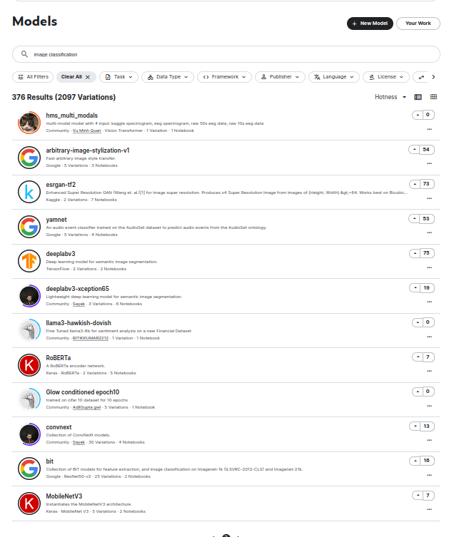
27.03 Tensorflow Hub
https://www.youtube.com/watch?v=LsdxvjLWkIY&list=PLeo1K3hjS3uu7CxAacxVndI4bE_o3BDtO&index=27
Tensorflow Hub (5:17-5:18/25:54)
Scroll to page 7, we can see there are MobileNet V3 (in page 7).

Slide 23
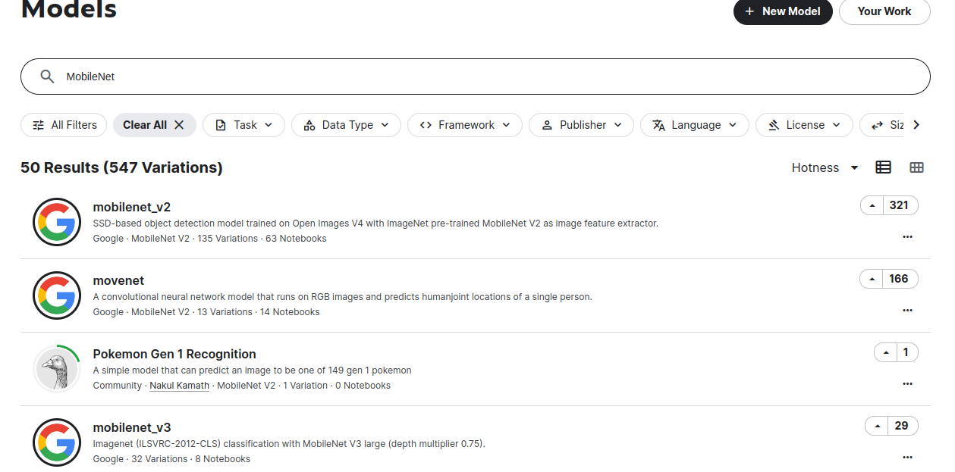
27.03 Tensorflow Hub
https://www.youtube.com/watch?v=LsdxvjLWkIY&list=PLeo1K3hjS3uu7CxAacxVndI4bE_o3BDtO&index=27
Tensorflow Hub (5:19-5:30/25:54)
Search “mobileNet” is easier. We can see 50 results: “MobileNet V2” and “MobileNet V3”.
Click “MobileNet V2”

Slide 24
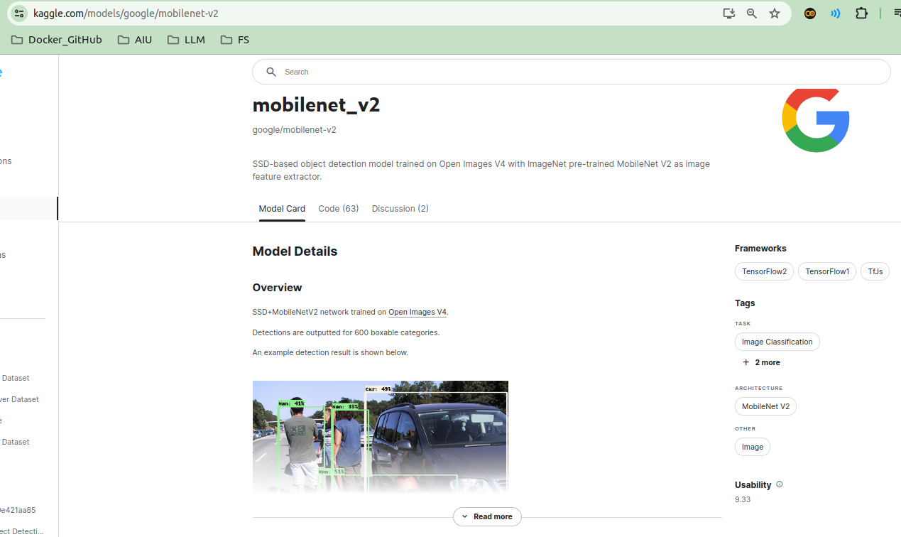
27.03 Tensorflow Hub
https://www.youtube.com/watch?v=LsdxvjLWkIY&list=PLeo1K3hjS3uu7CxAacxVndI4bE_o3BDtO&index=27
Tensorflow Hub (5:31-6:00/25:54)
We use model “MobileNet V2”.
This is the model we will use.

Slide 25
27.04 Colab Example for CNN Transfer Learning

Slide 26
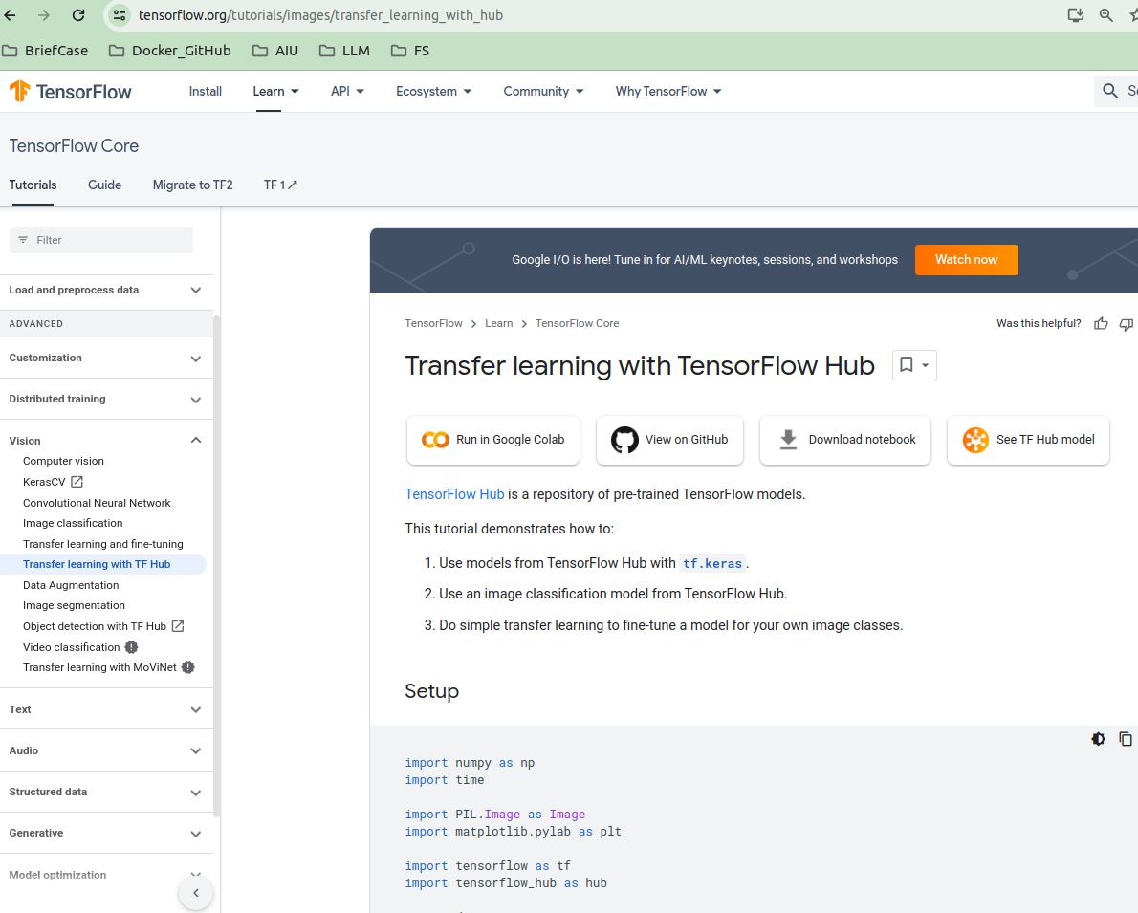
27.04 Colab Example for CNN Transfer Learning
https://www.youtube.com/watch?v=LsdxvjLWkIY&list=PLeo1K3hjS3uu7CxAacxVndI4bE_o3BDtO&index=27
Colab Example for CNN Transfer Example (6:01-6:20/25:54)
We can see Google search “Tensorflow Hub”.
Click “Classify Flowers with Transfer Learning” to see the colab example.
2

Slide 27
End

