Slide 1

24 CNN Classify
Peter H. Chen

Slide 2
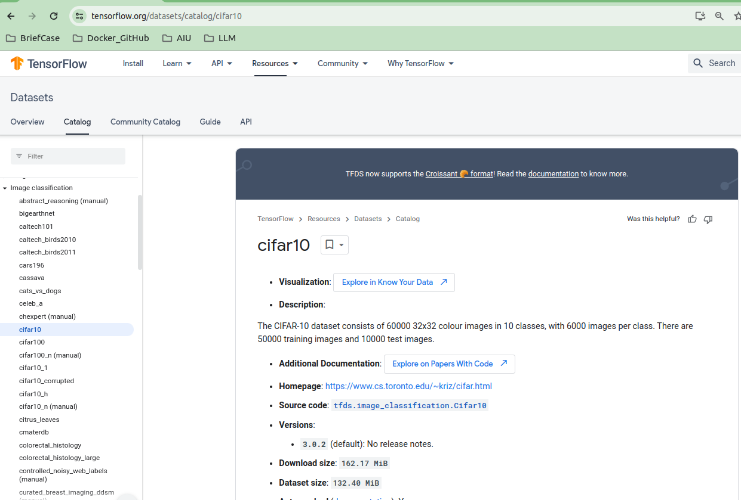
24 CNN Classify
https://www.youtube.com/watch?v=7HPwo4wnJeA&list=PLeo1K3hjS3uu7CxAacxVndI4bE_o3BDtO&index=24
CNN Classify (0:00-0:10/28:11)
We discussed CNN (Convolutional Neural Network). Now, we will do 65,000 small images classification.
We uses CIFAR-10 (Canadian Institute For Advanced Research, pronounced as “See-Far” 10 classes) dataset and code from Tensorflow framework.
https://www.tensorflow.org/datasets/catalog/cifar10

Slide 3
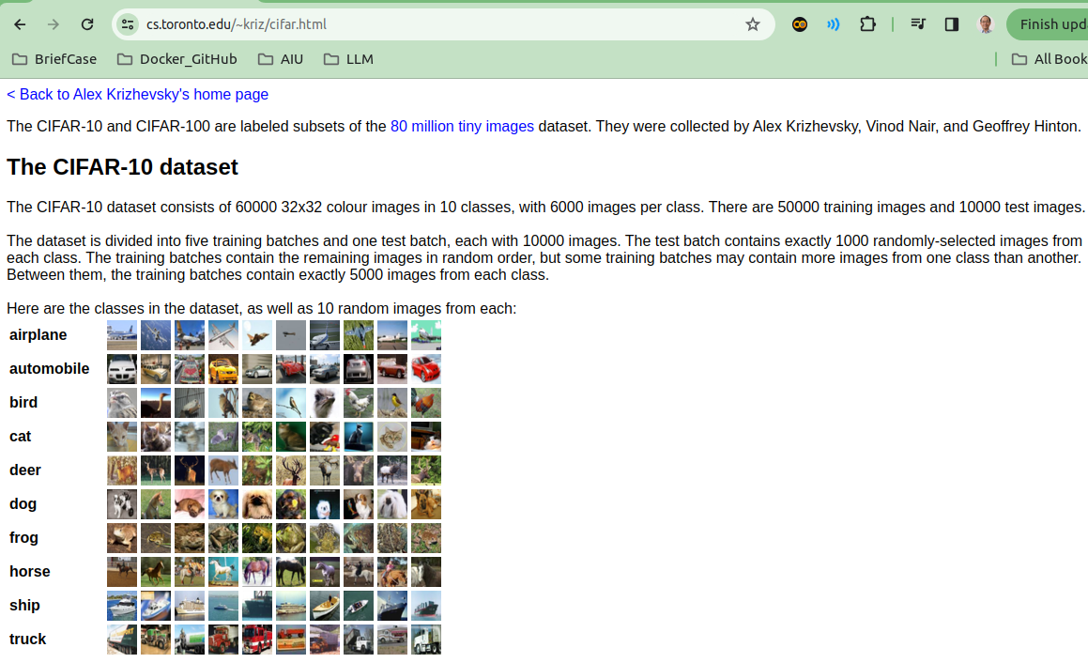
24 CNN Classify
https://www.youtube.com/watch?v=7HPwo4wnJeA&list=PLeo1K3hjS3uu7CxAacxVndI4bE_o3BDtO&index=24
CNN Classify (0:11-0:30/28:11)
CIFAR-10 dataset contains 10 classes of objects: 1) Airplane, 2) Automobile, 3) Bird, 4) Cat, 5) Deer, 6) Dog, 7) Frog, 8) Horse, 9) Ship, and 10) Truck.
We can use CIFAR-10 images for classification using CNN (Convolutional Neural Network) and do the exercise at the end.
https://www.cs.toronto.edu/~kriz/cifar.html

Slide 4
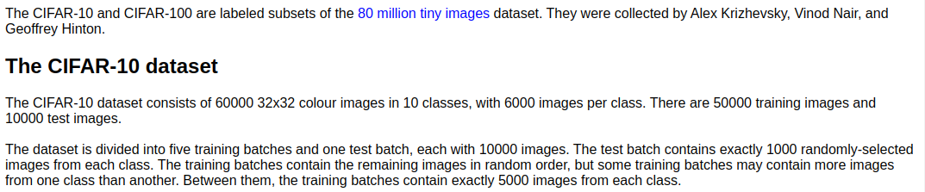
24 CNN Classify
https://www.youtube.com/watch?v=7HPwo4wnJeA&list=PLeo1K3hjS3uu7CxAacxVndI4bE_o3BDtO&index=24
CNN Classify (0:11-0:20/28:11)
CIFAR-10 images:
1. 60,000 images.
2. Each image size is 32 x 32.
3. The images are labeled into 10 classes. Each class contains 6,000 images.
https://www.cs.toronto.edu/~kriz/cifar.html

Slide 5
24 CNN Classify
https://www.youtube.com/watch?v=7HPwo4wnJeA&list=PLeo1K3hjS3uu7CxAacxVndI4bE_o3BDtO&index=24
CNN Classify (0:21-0:30/28:11)
CIFAR-10 dataset (60,000 images) structure are grouped as below:
1. CIFAR-10 dataset is divided into 50,000 images training dataset and 10,000 images testing dataset.
2. Training dataset is divided into 5 training batches.
3. Test dataset is 1 testing batch.
4. Each train/test 10,000 test images are divided into 10 classes.
5. Each class contains 1,000 images.
https://www.cs.toronto.edu/~kriz/cifar.html
CIFAR-10: 60,000 images
Training dataset: 50,000 images
Testing dataset: 10,000 images
Batch 5: 10,000 images
Class 1: 1,000 images
Batch 4: 10,000 images
Class 2: 1,000 images
Batch 1: 10,000 images
Class 1: 1,000 images
Class 1: 1,000 images
Batch 3: 10,000 images
...
Class 2: 1,000 images
Class 2: 1,000 images
Class 1: 1,000 images
Class 9: 1,000 images
Batch 2: 10,000 images
...
...
Class 2: 1,000 images
Class 10: 1,000 images
Class 1: 1,000 images
Class 9: 1,000 images
Class 9: 1,000 images
Batch 1: 10,000 images
...
Class 2: 1,000 images
Class 10: 1,000 images
Class 1: 1,000 images
Class 9: 1,000 images
Class 10: 1,000 images
...
Class 2: 1,000 images
Class 10: 1,000 images
Class 9: 1,000 images
...
Class 9: 1,000 images
Class 10: 1,000 images
Class 10: 1,000 images

Slide 6
24 CNN Classify
https://www.youtube.com/watch?v=7HPwo4wnJeA&list=PLeo1K3hjS3uu7CxAacxVndI4bE_o3BDtO&index=24
CNN Classify (0:31-0:40/28:11)
Dataset download:
CIFAR-10 contains the API to download directly for tensorflow. We can run anywhere, from your local computer, from colab, or GCP (Google Cloud Platform) without modification, e.g., google drive mount.
https://www.cs.toronto.edu/~kriz/cifar.html

Slide 7
24.1 Import Libraries

Slide 8
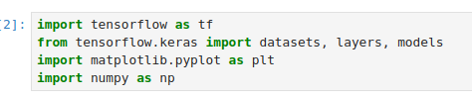
24.1 Import Libraries
https://www.youtube.com/watch?v=7HPwo4wnJeA&list=PLeo1K3hjS3uu7CxAacxVndI4bE_o3BDtO&index=24
Import Libraries (0:50-1:00/28:11)
We import the libraries.

Slide 9
24.1 Import Libraries

Slide 10
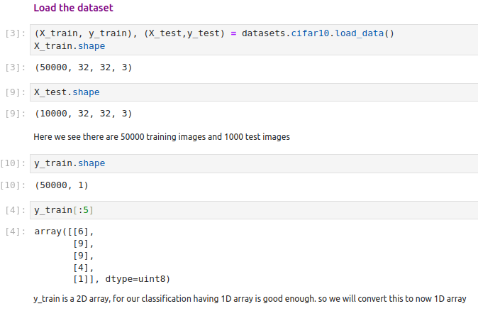
24.2 Load Dataset
https://www.youtube.com/watch?v=7HPwo4wnJeA&list=PLeo1K3hjS3uu7CxAacxVndI4bE_o3BDtO&index=24
Load Dataset (1:05-2:00/28:11)
Load the dataset into the jupyter notebook.
We have training samples 50000. size is 32 x 32 x 3.\
Note:
CIFAR-10 contains the API to download directly for tensorflow. We can run anywhere, from your local computer, from colab, or GCP (Google Cloud Platform) without modification, e.g., google drive mount.

Slide 11
24.2 Plot Data

Slide 12
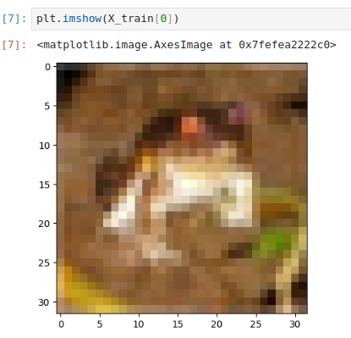
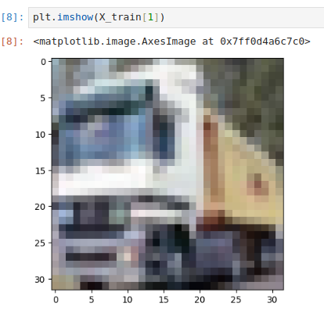
24.2 Plot Data
https://www.youtube.com/watch?v=7HPwo4wnJeA&list=PLeo1K3hjS3uu7CxAacxVndI4bE_o3BDtO&index=24
Plot Data (2:01-2:50/28:11)
Plot image X_train[0].
Plot image X_train[1].

Slide 13
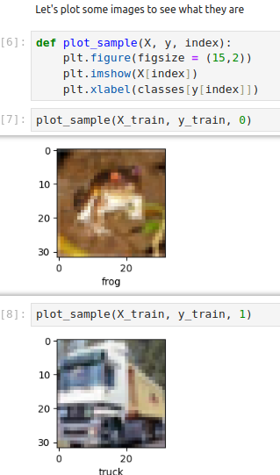
24.2 Plot Data
https://www.youtube.com/watch?v=7HPwo4wnJeA&list=PLeo1K3hjS3uu7CxAacxVndI4bE_o3BDtO&index=24
Plot Data (2:30-2:51/28:11)
Define plot_sample to plot: X_trian, y_train, classes (0, …, 9)
Class = [“airplane”, “automobile”, …, “truck”]
classes[y[index]]

Slide 14
24.3 Scale Data

Slide 15
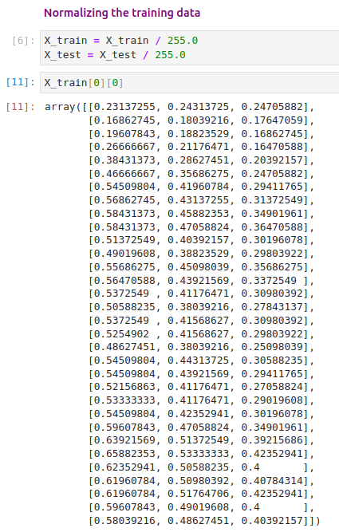
24.3 Scale Data
https://www.youtube.com/watch?v=7HPwo4wnJeA&list=PLeo1K3hjS3uu7CxAacxVndI4bE_o3BDtO&index=24
Scale Data (4:30-9:00/28:11)
We normalize the data.

Slide 16
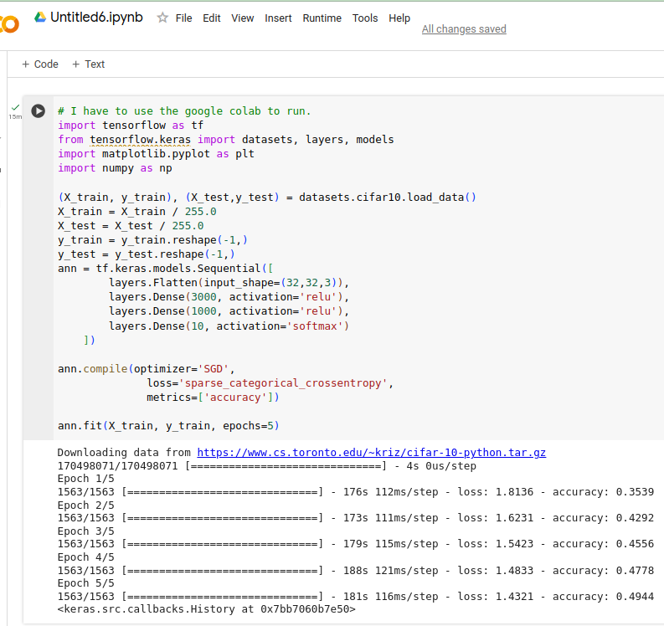
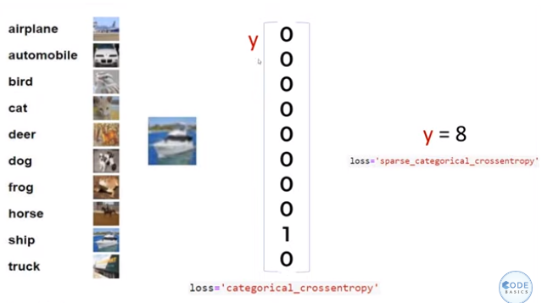
24.3 Scale Data
https://www.youtube.com/watch?v=7HPwo4wnJeA&list=PLeo1K3hjS3uu7CxAacxVndI4bE_o3BDtO&index=24
Scale Data (9:01-9:30/28:11)
We do the ANN first before CNN.
Note:
My computer does not have enough GPU VRAM to run CIFAR-10 Image training ANN.
I used Colab to run.

Slide 17
24.4 ANN Classification

Slide 18
24.4 ANN Classification
https://www.youtube.com/watch?v=7HPwo4wnJeA&list=PLeo1K3hjS3uu7CxAacxVndI4bE_o3BDtO&index=24
ANN Classification (12:01-12:30/28:11)
We do ANN classification without the feature extraction.
The classification accuracy = 49%. It is really bad in ANN.

Slide 19
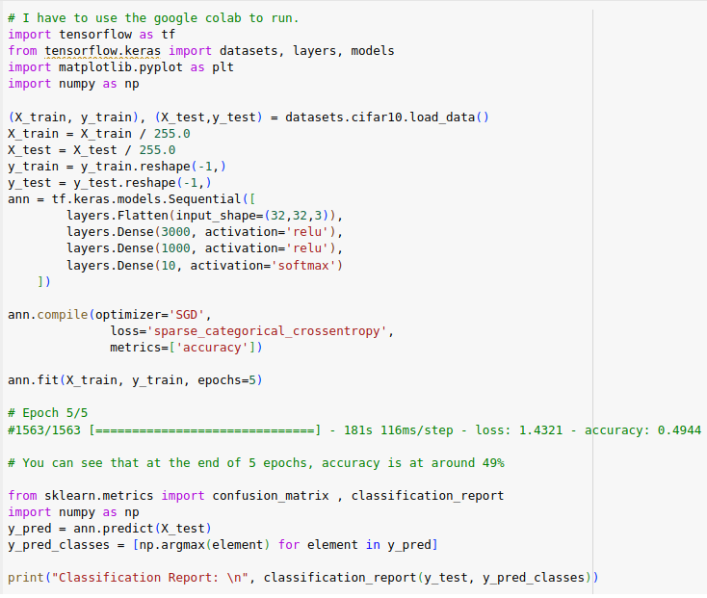
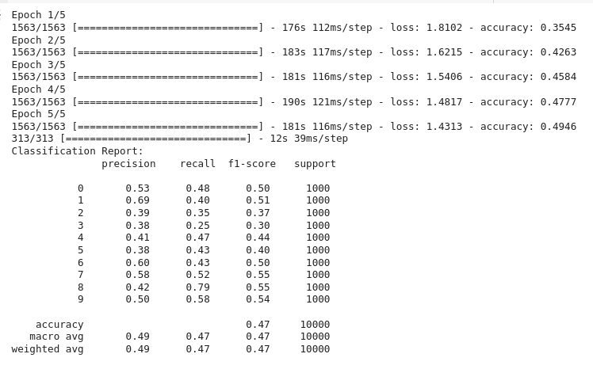
24.4 ANN Classification
https://www.youtube.com/watch?v=7HPwo4wnJeA&list=PLeo1K3hjS3uu7CxAacxVndI4bE_o3BDtO&index=24
ANN Classification (12:01-12:30/28:11)
We re-run with complete metrics. We have only 49% accuracy.

Slide 20
End

