Slide 1

013 NN from Scratch
Peter H. Chen

Slide 2
013 NN from Scratch
https://www.youtube.com/watch?v=PQCE9ChuIDY&list=PLeo1K3hjS3uu7CxAacxVndI4bE_o3BDtO&index=13
NN from Scratch (0:00-0:20/13:22)
We implement the Neural Network in Python from scratch.
We write the neural network class with pure Python and without using TensorFlow and without keras.
Just pure python class.

Slide 3
013.1 NN from Scratch: Coding

Slide 4
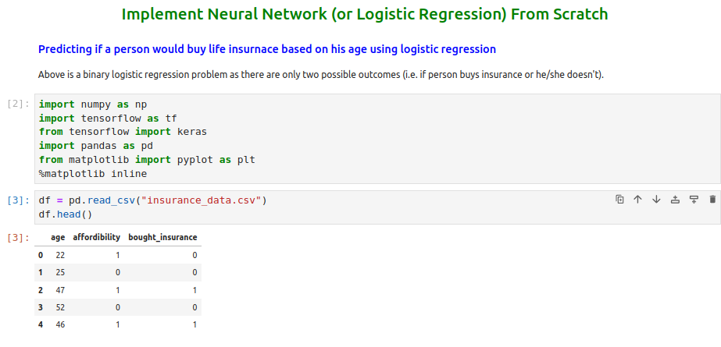
013 NN from Scratch
https://www.youtube.com/watch?v=PQCE9ChuIDY&list=PLeo1K3hjS3uu7CxAacxVndI4bE_o3BDtO&index=13
NN from Scratch: Coding (0:25-0:40/13:22)
Read insurance data from pandas.

Slide 5
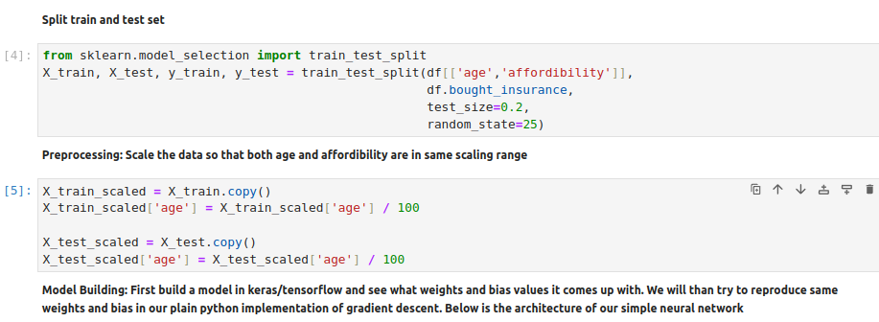
013 NN from Scratch
https://www.youtube.com/watch?v=PQCE9ChuIDY&list=PLeo1K3hjS3uu7CxAacxVndI4bE_o3BDtO&index=13
NN from Scratch: Coding (0:41-0:50/13:22)
1. Split the data set into training data and test data.
2. Scale the train data/100.

Slide 6
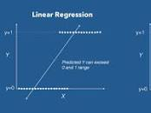
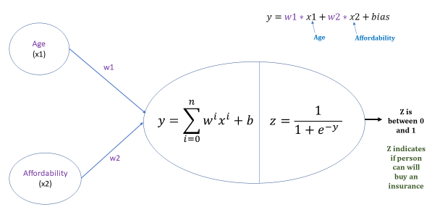
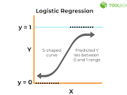
013 NN from Scratch
https://www.youtube.com/watch?v=PQCE9ChuIDY&list=PLeo1K3hjS3uu7CxAacxVndI4bE_o3BDtO&index=13
NN from Scratch: Coding (0:51-1:05/13:22)
We have neural network with one hidden layer with single neuron.
Input has two neurons.
This is a logistic regression: linear regression + sigmoid function = logistic regression
What is logistic regression?
Logistic regression is a process of modeling the probability of a discrete outcome given an input variable. The most common logistic regression models a binary outcome; something that can take two values such as true/false, yes/no, and so on.

Slide 7
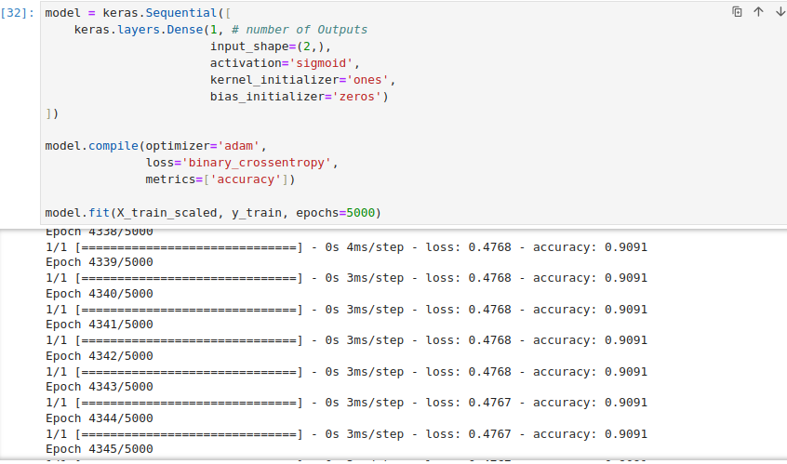
013 NN from Scratch
https://www.youtube.com/watch?v=PQCE9ChuIDY&list=PLeo1K3hjS3uu7CxAacxVndI4bE_o3BDtO&index=13
NN from Scratch: Coding (1:07-1:15/13:22)
Below is the keras code of Tensorflow for the above neural network.

Slide 8
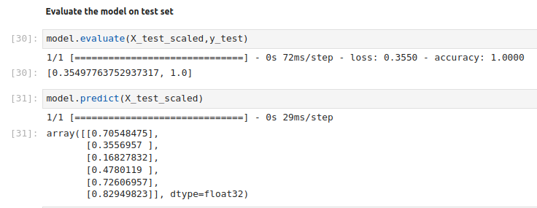
013 NN from Scratch
https://www.youtube.com/watch?v=PQCE9ChuIDY&list=PLeo1K3hjS3uu7CxAacxVndI4bE_o3BDtO&index=13
NN from Scratch: Coding (1:18-1:20/13:22)
1. We do the evaluation for X_test_scaled and y_test. We have error = 0.35 and accuracy 100%.
2. We do the prediction for X_test_scaled. We have prediction 70%, 35%, 16%, 47%, etc. to buy the insurance.

Slide 9
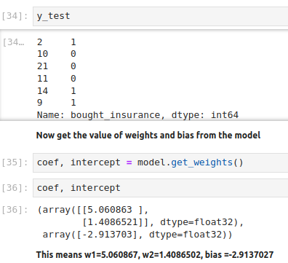
013 NN from Scratch
https://www.youtube.com/watch?v=PQCE9ChuIDY&list=PLeo1K3hjS3uu7CxAacxVndI4bE_o3BDtO&index=13
NN from Scratch: Coding (1:18-1:19/13:22)
1. We have test target y_test
2. We get the coefficients and intercept of neural networks.

Slide 10
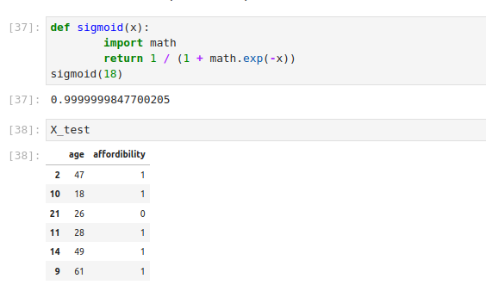
013 NN from Scratch
https://www.youtube.com/watch?v=PQCE9ChuIDY&list=PLeo1K3hjS3uu7CxAacxVndI4bE_o3BDtO&index=13
NN from Scratch: Coding (1:19-1:20/13:22)
1. We have sigmoid function implemented by Python.
2. Original X_test data.

Slide 11
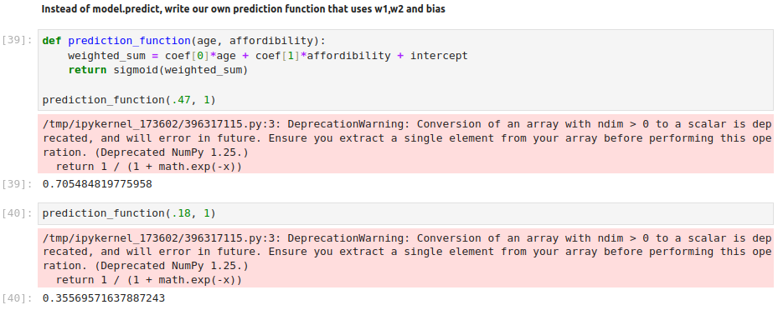
013 NN from Scratch
https://www.youtube.com/watch?v=PQCE9ChuIDY&list=PLeo1K3hjS3uu7CxAacxVndI4bE_o3BDtO&index=13
NN from Scratch: Coding (1:21-1:22/13:22)
1. We implement the prediction function with coef (for weights w1 and w2) and intercept (for bias b).
2. Test for prediction function.

Slide 12
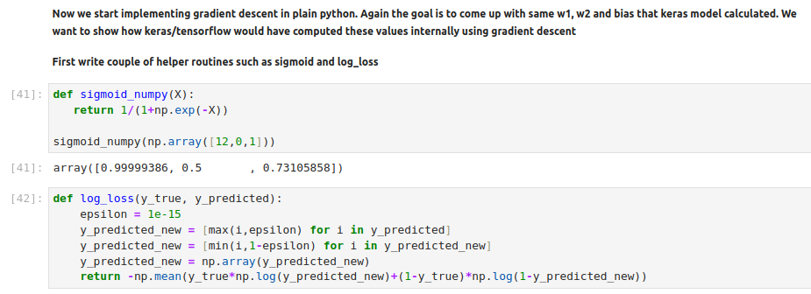
013 NN from Scratch
https://www.youtube.com/watch?v=PQCE9ChuIDY&list=PLeo1K3hjS3uu7CxAacxVndI4bE_o3BDtO&index=13
NN from Scratch: Coding (1:23-1:24/13:22)
1. We implement sigmoid numpy.
2. We implement log loss() with python.

Slide 13
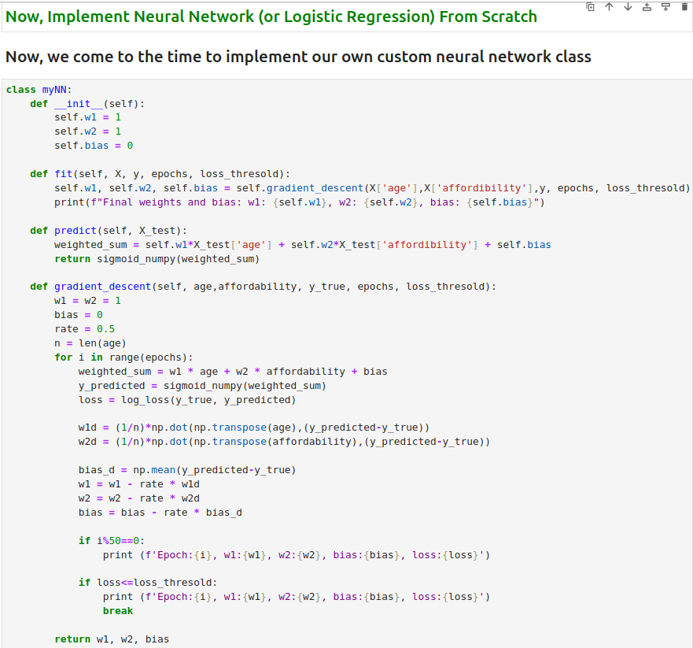
013 NN from Scratch
https://www.youtube.com/watch?v=PQCE9ChuIDY&list=PLeo1K3hjS3uu7CxAacxVndI4bE_o3BDtO&index=13
NN from Scratch: Coding (1:23-5:24/13:22)
1. Define myNN class.
2. We have defined fit(), predict(), and gradient_descent() function.

Slide 14
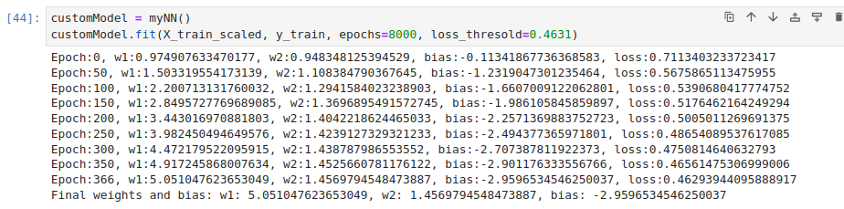
013 NN from Scratch
https://www.youtube.com/watch?v=PQCE9ChuIDY&list=PLeo1K3hjS3uu7CxAacxVndI4bE_o3BDtO&index=13
NN from Scratch: Coding (6:02-6:24/13:22)
1. Create instance with class myNN()
2. fit (X_train_scaled, y_train) with epochs=8000.
We have the weights (w1, w2) and bias (b): w1 = 5.051, w2 = 1.45, b = -2.959

Slide 15
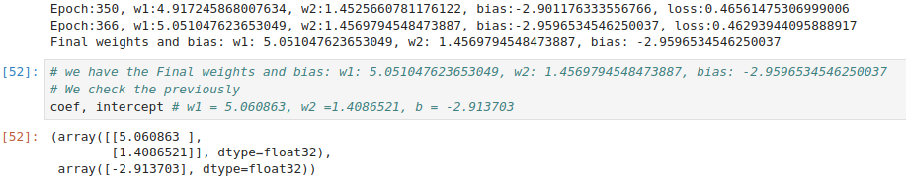
013 NN from Scratch
https://www.youtube.com/watch?v=PQCE9ChuIDY&list=PLeo1K3hjS3uu7CxAacxVndI4bE_o3BDtO&index=13
NN from Scratch: Coding (10:02-11:24/13:22)
We compare our python implementation with TensorFlow result.

Slide 16
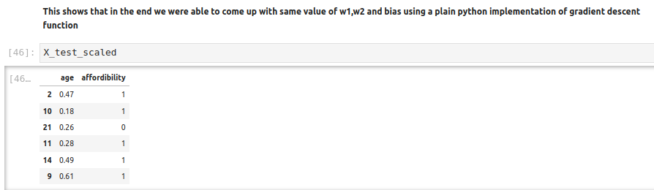
013 NN from Scratch
https://www.youtube.com/watch?v=PQCE9ChuIDY&list=PLeo1K3hjS3uu7CxAacxVndI4bE_o3BDtO&index=13
NN from Scratch: Coding (10:02-11:24/13:22)
Check X_test_scaled

Slide 17
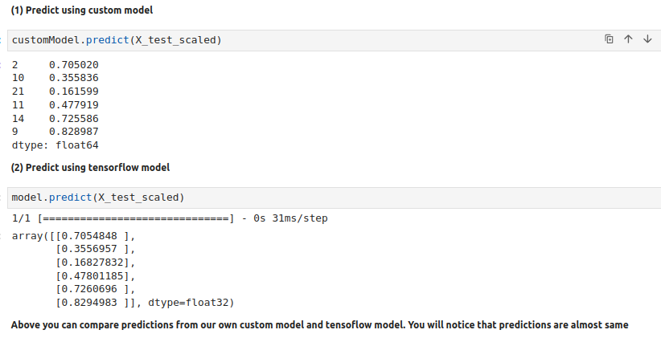
013 NN from Scratch
https://www.youtube.com/watch?v=PQCE9ChuIDY&list=PLeo1K3hjS3uu7CxAacxVndI4bE_o3BDtO&index=13
NN from Scratch: Coding (11:25-13:22/13:22)
Check Prediction from our python implementation vs Tensorflow result.
Both Results are the same but performance is much faster.
Our implementation is for one neuron, for more neuron, we need tensorflow and Keras.

Slide 18
End

