Slide 1

19 Introduction to Confusion Matrix
Peter H. Chen

Slide 2
19 Introduction to Confusion Matrix
https://www.youtube.com/watch?v=-dsoGHvk7II
Introduction to Confusion Matrix (0:00-0:10/25:12)
There are Introduction to Confusion Matrix (表现指标/パフォーマンス.メトリクス) in classification:
1. Confusion Matrix,
2. Accuracy:
3. Precision (True Positive divided by Positive Prediction): TP/(TP + FP)
4. Recall (TPR: True Positive Rate, True positive divided by Actual (Fact) or Sensitivity): TP/(TP + FN)
5. F1-Score
6. FPR (False Positive Rate ): Type I Error
7. FNR (False Negative Rate): Type II Error
8. Cohen Kappa: Measure imbalance in dataset.
9. ROC (Receiver Operating Characteristic) Curve, AUC (Area Under the ROC Curve) Score
10. PR (Precision-Recall) Curve
Here, we only discuss the commonly use Confusion Matrix, Accuracy, Recall (TPR), Precision, F1-Score, Class 0, Class 1) for performance measurement.

Slide 3
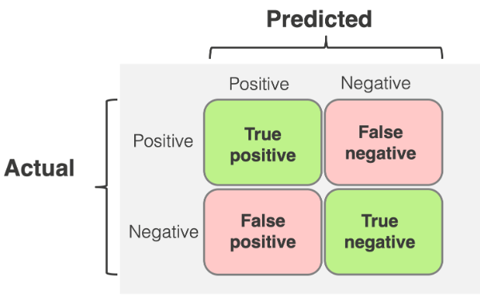
19 Introduction to Confusion Matrix
https://www.youtube.com/watch?v=-dsoGHvk7II
Introduction to Confusion Matrix (0:11-0:30/25:12)
What is Confusion Matrix?
Confusion matrix is 2×2 for binary classification with Actual (Fact) values (1/0) on vertical axis and Predicted (Model Prediction) with values (positive/negative) on horizontal axis.
(Model Prediction)
(1)
(0)
(1)
(Fact)
(0)

Slide 4
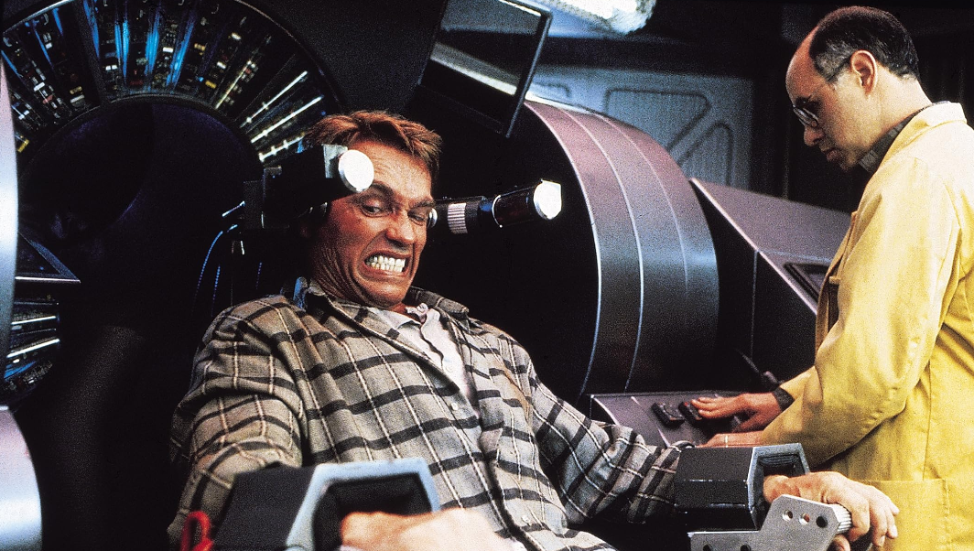


19 Introduction to Confusion Matrix
https://www.youtube.com/watch?v=-dsoGHvk7II
Introduction to Confusion Matrix (0:31-1:00/24:11)
What is difference of Recall (Facts: True or False) and Precision (Prediction: Positive or Negative)?
1. Recall (Actual Fact: True/False): True or False are the Actual Facts labeled by human being. True or False are the facts in recall (memory). There are two famous recall (memory) movies: US Hollywood movie “Total Recall (1990)” by Arnold Schwarzenegger and the India Bollywood movie “Ghajini (2008)” by Aamir Khan. Both movies try to find the facts (True or False) in their “recall (memory)”.
2. Precision (Prediction: Positive/Negative): Precision means how good of predictions by the model. The Hollywood movie “Minority Report (2002)” by Tom Cruise. The computer model predict crime people and kill them. The positive/negative prediction may be incorrect.
Recall (Fact):
Total Recall
Recall (Fact):
Ghajini
Precision (Model Prediction):
Minority Report

Slide 5
19.01 Convert Table into Confusion Matrix

Slide 6
19.01 Convert Table into Confusion Matrix
https://www.youtube.com/watch?v=-dsoGHvk7II
Convert Table into Confusion Matrix (1:01-01:30/24:11)
We will be discussing Confusion Matrix, TPR (True Positive Rate), FPR (False Positive Rate), TNR (True Negative Rate), and FNR (False Negative Rate).
First, if we want to see the accuracy of Model, we need the concept of Confusion Matrix.
Suppose:
1. True output (Target Label) is y and
2. Model Prediction output is ŷ.
3. We have the y and ŷ results as below table.
How to find the accuracy of Model?
y | ŷ
1 | 1
1 | 1
0 | 1
1 | 0
1 | 1

Slide 7
19.01 Convert Table into Confusion Matrix
https://www.youtube.com/watch?v=-dsoGHvk7II
Convert Table into Confusion Matrix (1:46-04:00/24:11)
From the left table, we create the right confusion Matrix:
Question a: From the left table, how many Actual Value (y) = 1 and model Prediction (ŷ ) = 1?
Answer: 3
Question b: From the left table, how many Actual Value (y) = 1 and model prediction (ŷ ) = 0?
Answer: 1
Question c: From the left table, how many Actual Value (y) = 0 and model prediction (ŷ ) = 1?
Answer: 1
Question d: From the left table, how many Actual Value (y) = 0 and model Prediction (ŷ ) = 0
Answer: 1
Target Label (Actual Value) Output, y | Model Prediction Output, ŷ
1 | 1
1 | 1
0 | 1
1 | 0
1 | 1
Confusion Matrix for two class labels
y |  | Model Prediction ( ŷ)
 |  | 1 | 0
Actual Value (y) | 1 | 3 | 1
 | 0 | 1 | 0

Slide 8
19.02 Confusion Matrix in Notation

Slide 9
19.02 Confusion Matrix in Notation
https://www.youtube.com/watch?v=-dsoGHvk7II
Confusion Matrix in Notation (4:01-07:00/24:11)
We use Notation (TP, FP, FN, and TN) to represent the numbers in the Confusion Matrix.
How to convert the number based Confusion Matrix into Notation based Confusion Matrix?
1. For prediction notation, we use
1.1 Prediction value 1 → P
1.2 Prediction value 0 → N.
2. For the actual notation, we need to match Actual value (0 or 1) with Model Prediction (0 or 1):
2.1 1 ↔ 1 → T (True)
2.2 1 ↔ 0 → F (False)
2.3 0 ↔ 0 → T (True)
2.4 0 ↔ 1 → F (False)
3. Then, we complete the number to notation conversion.
Confusion Matrix with Notation (FP, FN, FP, TN)
Confusion Matrix for two class labels
 |  | Model Prediction ( ŷ)
 |  | 1 | 0
Actual Value (y) | 1 | 3 | 1
 | 0 | 1 | 0
 |  | Model Prediction ( ŷ)
 |  | 1 | 0
Actual Value (y) | 1 | TP | FN
 | 0 | FP | TN

Slide 10
19.03 Accuracy

Slide 11

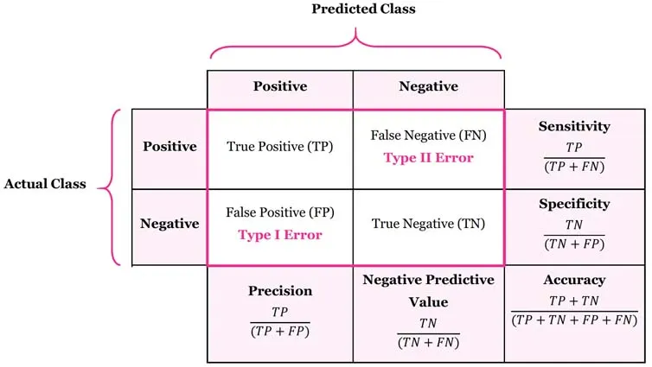
19.03 Accuracy
https://www.youtube.com/watch?v=-dsoGHvk7II
Accuracy (7:01-08:30/24:11)
Now, we want to calculate the
Accuracy = (TP + TN) / (TP + TN + FP + FN)
What is Accuracy means?
1. Here, we take all the correct (true) predictions: TP and TN in diagonal
2. Divide all the numbers: TP + TN + FP + FN.
Confusion Matrix with Notation (FP, FN, FP, TN)
 |  | Model Prediction ( ŷ)
 |  | 1 | 0
Actual Value (y) | 1 | TP | FN
 | 0 | FP | TN
P Actual
N Actual

Slide 12
19.04 Confusion Matrix for Multi-Class Labels

Slide 13

19.04 Confusion Matrix for Multi-Class Labels
https://www.youtube.com/watch?v=-dsoGHvk7II
Confusion Matrix for Multi-Class Labels (8:31-10:30/24:11)
If we have 5-labels, what is Confusion Matrix looks like?
We have 5 actual outputs (0, 1, 2, 3, 4).
What is the Accuracy of the 5 labels?
We have to sum all the numbers in the diagonal and divided by all the numbers in the table.
 |  | Model Prediction ( ŷ)
 |  | 0 | 1 | 2 | 3 | 4
Actual Value (y) | 0 | TP | FN
 | 1 | FP | TN
 | 2
 | 3
 | 4

Slide 14
19.05 TPR, TNR, FNR, and FPR

Slide 15
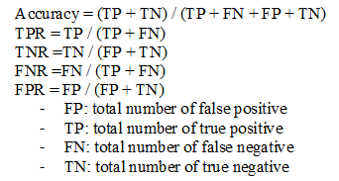
19.05 TPR, TNR, FNR, and FPR
https://www.youtube.com/watch?v=-dsoGHvk7II
TPR, TNR, FNR, and FPR (10:31-14:00/24:11)
Now, we look at
1. TPR (True Positive Rate) = TP / (P Actual) => TP / (TP + FN)
2. TNR (True Negative Rate) = TN / (N Actual) => TN / (FP + TN)
3. FNR (False Negative Rate) = FN / (P Actual) => FN / (TP + FN)
4. FPR (False Positive Rate) = FP / (N Actual) => FP / (FP + TN)
Confusion Matrix for Two Class Labels
 |  | Model Prediction ( ŷ)
 |  | 1 | 0
Actual Value (y) | 1 | TP | FN
 | 0 | FP | TN
P Actual
N Actual

Slide 16
19.06 Imbalanced Dataset

Slide 17
19.06 Imbalanced Dataset
https://www.youtube.com/watch?v=-dsoGHvk7II
Imbalanced Dataset (14:01-17:00/24:11)
Why is important of TPR (True Positive Rate), TNR (True Negative Rate), FNR (False Negative Rate), FPR (False Positive Rate)?
If we have an imbalanced test dataset with 1000 samples (rows) and we create a very bad/dumb model.
Out of 900/1000 samples are ‘yes’. 100/1000 samples are ‘no’
If our dumb model prediction is 900 (True Positive) and 100 (False Positive).
In the confusion Matrix, we have False Negative is 0 and True Negative is 0.
When we calculate the
Accuracy = (TP + TN)/ (TP + FP + TN + FN) = 900/1000 = 90%.
This bad model has very high accuracy 90%.
The accuracy is not useful in imbalanced data.
If your dataset is completely imbalanced for model, then we need the help from TPR, TNR, FPR, and FNR.
Imbalanced Test Dataset: Total 1000 sample (rows)
 |  | Model Prediction ( ŷ)
 |  | 1 | 0
Actual Value (y) | 1 | 900 (TP) | 0 (FN)
 | 0 | 100 (FP) | 0 (TN)
Yes | 900
No | 100

Slide 18
19.06 Imbalanced Dataset
https://www.youtube.com/watch?v=-dsoGHvk7II
Imbalanced Dataset (17:01-20:50/24:11)
We calculate
1. TPR = TP / (P Actual) = TP / (TP + FN) = 900/(900 + 0) = 100%.
2. TNR = TN / (N Actual) = 0 / (FP + TN) = 0%.
3. FNR = FN / (P Actual) = 0 / (TP + FN) = 0%.
4. FPR = FP / (N Actual) = 100 / (FP + TN) = 100/(100 + 0) = 100%.
We have TPR and FPR are 100% which is very high.
We have TNR and FNR are 0% which is very low.
We need to adjust the model.
Imbalanced Test Dataset: Total 1000 sample (rows)
 |  | Model Prediction ( ŷ)
 |  | 1 | 0
Actual Value (y) | 1 | 900 (TP) | 0 (FN)
 | 0 | 100 (FP) | 0 (TN)
Yes | 900
No | 100
P Actual
N Actual

Slide 19
19.07 Cancer Rate Prediction

Slide 20
19.07 Cancer Rate Prediction
https://www.youtube.com/watch?v=-dsoGHvk7II
Cancer Rate Prediciton (20:51-23:30/24:11)
If we have a model to predict whether the disease is cancer or not.
If the cancer dataset is imbalanced.
We have TPR and FPR are 100% which is very high.
We have TNR and FPR are 0% which is very low.
The bad model causes problem in medical domain:
1. In FNR case, if person have cancer (True) but FNR (False Negative) is 0% (prediction is 0). Then, report will show “No Cancer”.
2. In FPR case, if person No cancer (False) but TNR is 100%, then make wrong prediction (prediction is 1) “Has Cancer”.
 |  | Model Prediction ( ŷ)
 |  | 1 | 0
Actual Value (y) | 1 | 900 (TP) | 0 (FN)
 | 0 | 100 (FP) | 0 (TN)

Slide 21
19.08 Summary

Slide 22
19.08 Summary
https://www.youtube.com/watch?v=-dsoGHvk7II
Summary (20:51-23:30/24:11)
Summary of TPR, TNR, FNR, and FPR.
Confusion Matrix for Two Class Labels
 |  | Model Prediction ( ŷ)
 |  | 1 | 0
Actual Value (y) | 1 | TP | FN
 | 0 | FP | TN
P Actual
N Actual

Slide 23
End

