Slide 1

19 Binary Class: Confusion Matrix
Peter H. Chen

Slide 2
19 Binary Class: Confusion Matrix
https://www.youtube.com/watch?v=tYZ6cpatw-w
Binary Class: Binary Class: Confusion Matrix (0:00-0:32/11:45)
We go over Confusion Matrix, i.e., Accuracy (overall correctness), Precision (based on Model Prediction: True Positive, True Negative, True Negative, False Negative), Recall (based on Truth Table), F1-Score (combination of Precision and Recall), etc.
All these terms are very important and used everywhere in Machine Learning and Deep Learning.
First, we look at the Truth (Target Label, i.e., supervised mode labeled by human being):
Below, We have dataset of dog images.
There are 6 dog images (we label “Dog”) and 4 images are not dog images (We label “No Dog”).
1
2
3
4
5
6
Dog
Dog
Dog
Dog
Dog
Dog
1
2
3
4
No Dog
No Dog
No Dog
No Dog

Slide 3
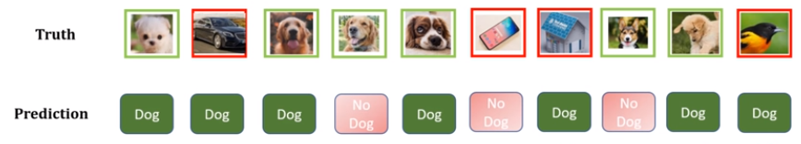
19 Binary Class: Confusion Matrix
https://www.youtube.com/watch?v=2osIZ-dSPGE&list=PLeo1K3hjS3uu7CxAacxVndI4bE_o3BDtO&index=19
Binary Class: Confusion Matrix (0:33-1:00/11:45)
Second, we look at the model prediction (Precision):
We build a machine learning model and ask we the model whether the images are dog or not dog.
Below is the the model prediction. The prediction may not correct because it makes some mistakes. We use “True or False” to judge the model prediction is correct or not correct.
Here, we gray out the negative prediction first. We focus on positive prediction only.
True/False
Positive/Negative

Slide 4
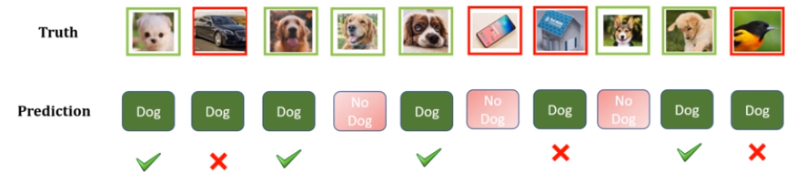
19 Binary Class: Confusion Matrix
https://www.youtube.com/watch?v=2osIZ-dSPGE&list=PLeo1K3hjS3uu7CxAacxVndI4bE_o3BDtO&index=19
Binary Class: Confusion Matrix (1:01-1:30/11:45)
Third, We look at the Positive Prediction (class 0 Model Prediction):
Let’s think about the Positive Prediction, i.e., “Dog” Prediction.
First (class 0: Dog), we take out the gray out, i.e, Negative Prediction (Red Color “No Dog” prediction).
We only keep the Position Prediction, i.e., “Dog” Prediction” (Green Color “Dog” prediction).
We have total 7 dog predictions.
1
2
3
4
5
6
7
Dog
Dog
Dog
Dog
Dog
Dog
Dog

Slide 5
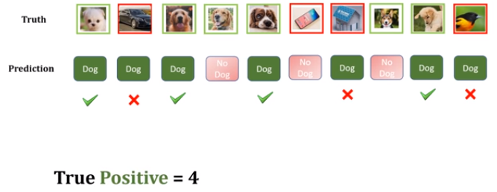

19 Binary Class: Confusion Matrix
https://www.youtube.com/watch?v=2osIZ-dSPGE&list=PLeo1K3hjS3uu7CxAacxVndI4bE_o3BDtO&index=19
Binary Class: Confusion Matrix (1:31-2:00/11:45)
Positive (Class 0 “Dog”):
Forget the “No Dog Prediction” (Negative Prediction) now.
Out of those seven “Dog Prediction” (Positive Prediction), how many of them are correct?
We have 4 are correct “Dog Prediction” (We mark them True) out of seven “Dog Prediction” and three are not correct (we mark them False).
For the positive class which is correct (dog), we have True Positive = 4 (green marks).
And three of the positive class which is incorrect (not dog), we have False Positive = 3 (red marks).
1
False
False
False
2
3
4
Dog
Dog
Dog
Dog
True
True
True
True

Slide 6
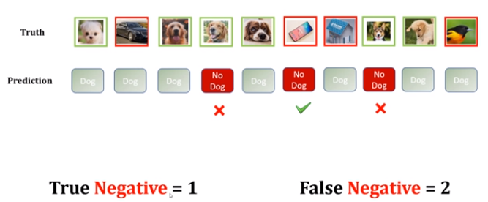
19 Binary Class: Confusion Matrix
https://www.youtube.com/watch?v=2osIZ-dSPGE&list=PLeo1K3hjS3uu7CxAacxVndI4bE_o3BDtO&index=19
Binary Class: Confusion Matrix (2:01-3:30/11:45)
Negative Model Prediction (Class 1 “No Dog” or Class 1 Precision)
1. Now, think about the “No Dog Prediction” (Negative Prediction).
We forget about green (“Dog Prediction” or Positive prediction) and
2. We focus on red button (“No Dog Prediction” or Negative Prediction) only..
2.1 We have 1 correct “No Dog Prediction” (Negative Prediction): True Negative (correct Negative prediction) = 1.
2.2 We have 2 incorrect “No Dog Prediction (Negative Prediction): False Negative (incorrect Negative prediction) = 2.

Slide 7
19.1 Accuracy

Slide 8
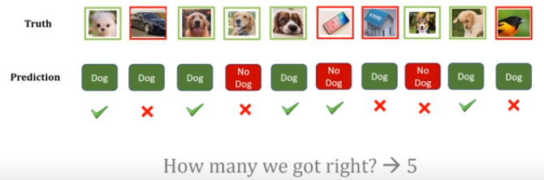

19.1 Accuracy
https://www.youtube.com/watch?v=2osIZ-dSPGE&list=PLeo1K3hjS3uu7CxAacxVndI4bE_o3BDtO&index=19
Accuracy (3:35-4:00/11:45)
Now, we turn on all of the predictions.
Which predictions are correct and which predictions are wrong.
We got total five rights. We have accuracy = 5/10 = 0.5.
No matter “Positive” or “Negative”, we got five out of ten is right.
And the accuracy is 0.5.

Slide 9
19.2 Prediction vs. Recall

Slide 10
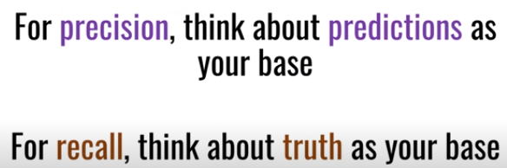
19.2 Prediction vs. Recall
https://www.youtube.com/watch?v=2osIZ-dSPGE&list=PLeo1K3hjS3uu7CxAacxVndI4bE_o3BDtO&index=19
Prediction vs. Recall (4:01-4:10/11:45)
1. Precision: base on Positive Prediction (Prediction Dog)
2. Recall: Base on Truth (How many Dog is in samples)

Slide 11
19.3 Precision

Slide 12

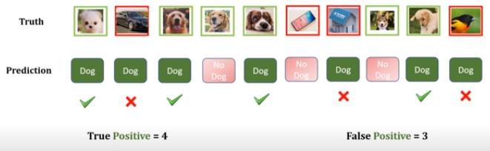

19.3 Precision
https://www.youtube.com/watch?v=2osIZ-dSPGE&list=PLeo1K3hjS3uu7CxAacxVndI4bE_o3BDtO&index=19
Precision (4:11-4:30/11:45)
In this diagram, what is the Positive (class 0: Dog) Prediction?
Precision is for Model Prediction. How many of you got right?
We have Class 0 (Dog) Precision:
Class 0 (Dog) Precision = TP / (TP + FP).
TP: True Positive, FP: False Positive.
Here, we have True Positive = 4 and False Positive = 3
TP + FP = 4 + 3 = 7
Positive (Class 1: Dog) Precision = 4/7 = 0.57.

Slide 13


19.3 Precision
https://www.youtube.com/watch?v=2osIZ-dSPGE&list=PLeo1K3hjS3uu7CxAacxVndI4bE_o3BDtO&index=19
Precision (4:31-4:50/11:45)
In this diagram, what is the Negative (Class 1: No Dog) Prediction?
Here, we have True Negative = 2 and False Negative = 1.
Class 1 (No Dog) Precision is out of Negative (No Dog) Prediction. How many of you got right?
We have Class 1 (No Dog) Precession:
Class 1 (No Dog) Precision = TN / (TN + FN).
TN: True Negative, FN: False Negative.
TN = 1, FN = 2, TN + FN = 3
Class 1 Precision:
TN/(TN + FN) = 1/3 = 0.33
Dog
Dog
Dog
No Dog
Dog
No Dog
Dog
No Dog
Dog
Dog

Slide 14
19.4 Recall

Slide 15
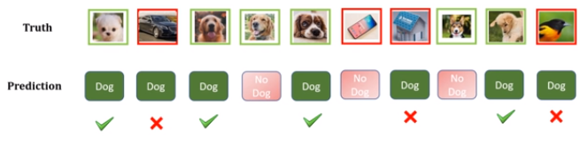
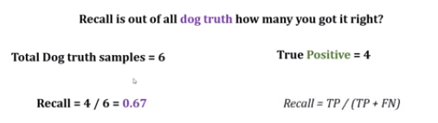
19.4 Recall
https://www.youtube.com/watch?v=2osIZ-dSPGE&list=PLeo1K3hjS3uu7CxAacxVndI4bE_o3BDtO&index=19
Recall (5:01-5:30/11:45)
Now, we talk about recall (recall “Truth” in the memory, same as, Arnold Schwarzenegger in movie “Total Recall”. He recall all the “Truth” from the memory).
We have truth (Class 0) as the baseline. What is the truth?
We have truth (class 0), total 6 samples are dog.
When I predicted, only 4 of them are correct prediction: True Positive = 4.
We have total 6 dog samples, how many of them are correct prediction? Only 4.
Recall = 4/6 = 0.67 or Recall = TP/(TP + FN)
TP: True Prediction, FN: False Negative
1
2
3
4
5
6
Dog
Dog
Dog
Dog
Dog
Dog

Slide 16
19.4 Recall
https://www.youtube.com/watch?v=2osIZ-dSPGE&list=PLeo1K3hjS3uu7CxAacxVndI4bE_o3BDtO&index=19
Recall (5:31-5:50/11:45)
What is recall of Class 1 (No Dog)?
We have truth (class 0), total 4 samples are Class 1 (No dog).
When I predicted, we have 1 of them are correct prediction: True Negative = 1.
We have total 4 No-Dog samples, how many of them are correct prediction? 1
Class 1 (No Dog) Recall = TN / (TN + FN)
TN: True Negative, FN: False Negative
TN = 1, FN = 3
Recall = 1/(1+3) = 0.25
1
2
3
4
No Dog
No Dog
No Dog
No Dog
Dog
Dog
Dog
No Dog
Dog
No Dog
Dog
No Dog
Dog
Dog

Slide 17
19.5 Negative Class: Prediction/Recall

Slide 18
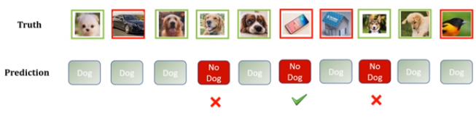
19.5 Negative Class: Prediction/Recall
https://www.youtube.com/watch?v=2osIZ-dSPGE&list=PLeo1K3hjS3uu7CxAacxVndI4bE_o3BDtO&index=19
Negative Class: Prediction and Recall (6:01-6:30/11:45)
Now, let talk about negative class.
Before, we have precision and Recall for Positive (Dog) Class.
Now, we have precision and Recall for Negative (“No Dog”) Class.
Precision: We have Negative (No Dog) Prediction = 3. How many of them is True Negative?
True Negative = 1
Precision = 1/3.

Slide 19
19.5 Negative Class: Prediction/Recall
https://www.youtube.com/watch?v=2osIZ-dSPGE&list=PLeo1K3hjS3uu7CxAacxVndI4bE_o3BDtO&index=19
Negative Class: Prediction and Recall (6:01-7:20/11:45)
Now, we have Truth baseline of Negative Class (No Dog).
How many of the samples are No Dog?
We have 4 samples are “No Dog”.
How many of them got right? Only 1.
So, Recall of Negative Class = 1/4 = 0.25

Slide 20
19.6 F1-Score

Slide 21
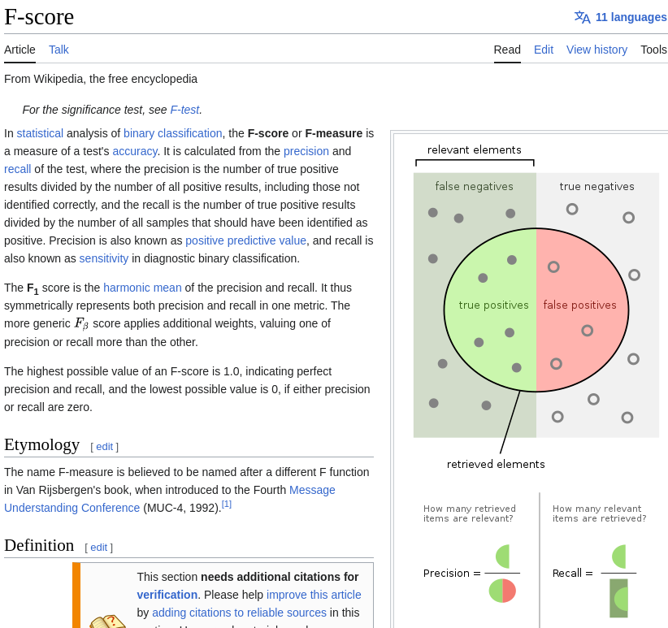
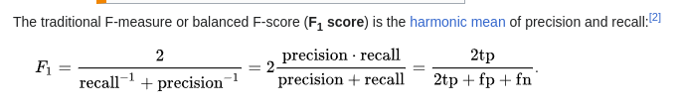
19.6 F1-Score
https://www.youtube.com/watch?v=2osIZ-dSPGE&list=PLeo1K3hjS3uu7CxAacxVndI4bE_o3BDtO&index=19
F1-Score (7:01-7:50/11:45)
Now, We talk F1-Score.
F1-Score is the harmonic mean of precision and recall: F1 = 2 /(1/Recall + 1/Precision).
F1-Score is overall performance of your model.

Slide 22
19.7 Python Binary Class: Confusion Matrix

Slide 23
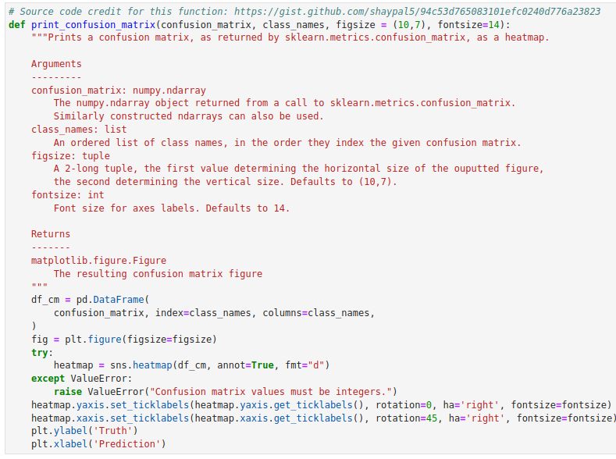
19.7 Python Binary Class: Confusion Matrix
https://www.youtube.com/watch?v=2osIZ-dSPGE&list=PLeo1K3hjS3uu7CxAacxVndI4bE_o3BDtO&index=19
Python Binary Class: Confusion Matrix (7:59-8:20/11:45)
We define print_confusion_matrix ():
Import libraries
Inputs:
1. confusion_matrix:
2. class_names: index given to confusion matrix:
3. fig-size:
4. font-size:

Slide 24
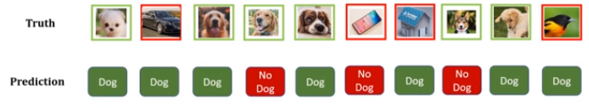
19.7 Python Binary Class: Confusion Matrix
https://www.youtube.com/watch?v=2osIZ-dSPGE&list=PLeo1K3hjS3uu7CxAacxVndI4bE_o3BDtO&index=19
Python Binary Class: Confusion Matrix (8:35-8:20/11:45)
What is confusion matrix?
We have
Truth array: [“Dog”, “Not a dog”, “Dog”, “Dog”, “Dog”, “No a dog”. “Not a dog”, ... ]
Prediction array = [“Dog”, “Dog”, “Dog”, “Not a dog”, “Dog”, ...]

Slide 25
19.7 Python Binary Class: Confusion Matrix
https://www.youtube.com/watch?v=2osIZ-dSPGE&list=PLeo1K3hjS3uu7CxAacxVndI4bE_o3BDtO&index=19
Python Binary Class: Confusion Matrix (8:35-8:50/11:45)
When we construct the confusion matrix, we need “truth” array and “prediction” array.
> cm = confusion_matrix (truth, prediction)

Slide 26
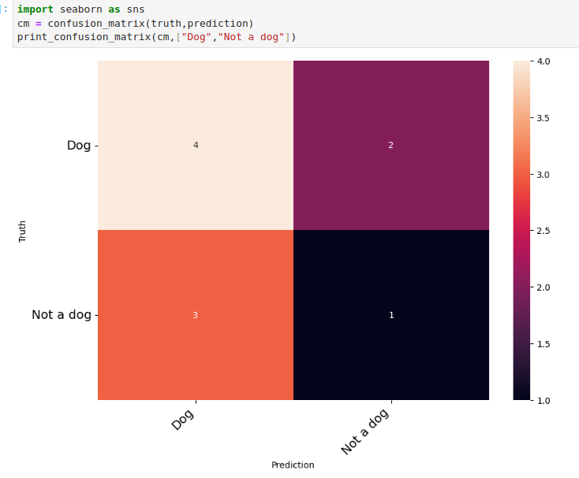
19.7 Python Binary Class: Confusion Matrix
https://www.youtube.com/watch?v=2osIZ-dSPGE&list=PLeo1K3hjS3uu7CxAacxVndI4bE_o3BDtO&index=19
Python Binary Class: Confusion Matrix (8:35-10:00/11:45)
> print_confusion_matrix (cm, {“Dog”, “Not a dog”].
4: True Positive: Truth os Dog = 4, Prediction is positive (Dog) is 4.
2: True Negative: Truth is Dog = 2, but prediction is negative = 2
3: False Negative: Truth is not a Dog, but prediction is a Dog.
1: False Negative: Truth is not a dog, prediction is not a Dog.
Diagonal are all correct prediction.
Off-diagonal are not the correct prediction.

Slide 27
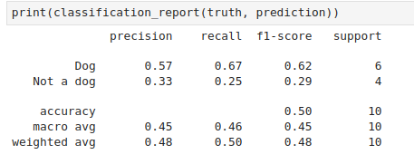
19.7 Python Binary Class: Confusion Matrix
https://www.youtube.com/watch?v=2osIZ-dSPGE&list=PLeo1K3hjS3uu7CxAacxVndI4bE_o3BDtO&index=19
Python Binary Class: Confusion Matrix (10:01-11:00/11:45)
> print_confusion_matrix (cm, {“Dog”, “Not a dog”].
Check the results of 19.01_Confusion_Matrix.ppt”.

Slide 28
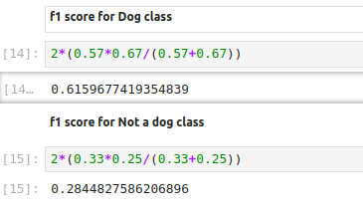
19.7 Python Binary Class: Confusion Matrix
https://www.youtube.com/watch?v=2osIZ-dSPGE&list=PLeo1K3hjS3uu7CxAacxVndI4bE_o3BDtO&index=19
Python Binary Class: Confusion Matrix (11:01-11:45/11:45)
> print_confusion_matrix (cm, {“Dog”, “Not a dog”].

Slide 29
End

