Slide 1

19.00 W08: Review One Hot Encoding Introduction
Peter H. Chen

Slide 2
19.00 W08: Review One Hot Encoding Introduction
https://www.youtube.com/watch?v=9yl6-HEY7_s&list=PLeo1K3hjS3uvCeTYTeyfe0-rN5r8zn9rw&index=6
Week 8 Review: One Hot Encoding Introduction (0:00-0:05/21:34)
We review one-hot-encoding.
Topics:
1. Categorical
2. Dummy Variables
3. One Hot Encoding
4. Using Pandas get_dummies
5. Using sklearn OneHotEncoder

Slide 3
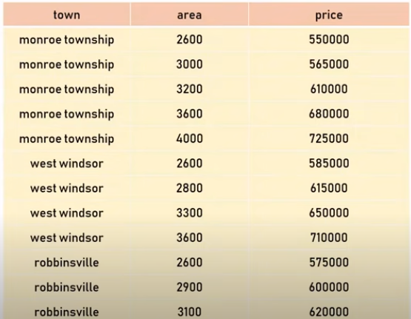
19.00 W08: Review One Hot Encoding Introduction
https://www.youtube.com/watch?v=9yl6-HEY7_s&list=PLeo1K3hjS3uvCeTYTeyfe0-rN5r8zn9rw&index=6
Week 8 Review: One Hot Encoding Introduction (0:06-0:30/21:34)
We have dataset as below. The columns area and price are same as before. The difference is the township column. Right now, the machine learning and neural network model can handle float and integer.
The township data are text. How to expand the text data for model?

Slide 4
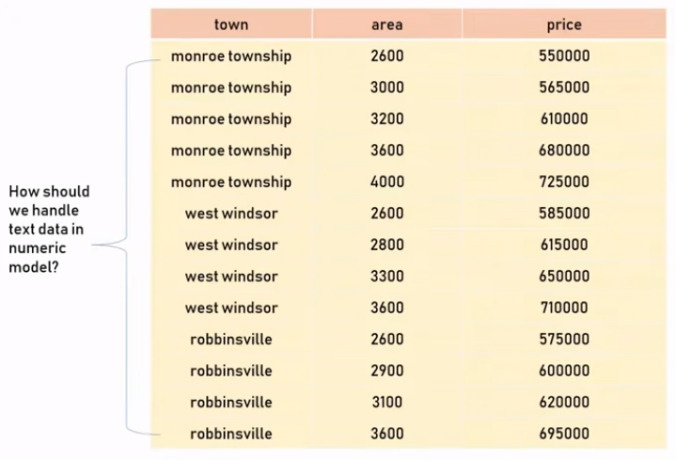
19.00 W08: Review One Hot Encoding Introduction
https://www.youtube.com/watch?v=9yl6-HEY7_s&list=PLeo1K3hjS3uvCeTYTeyfe0-rN5r8zn9rw&index=6
Week 8 Review: One Hot Encoding Introduction (0:31-0:50/21:34)
For example, we want to:
Build a predictor function to predict price of a home
1. with 3400 sq-ft area in west windsor.
2. 2800 sq-ft home in robbinsville.
Given this dataset, we want to build a predictor function that can take square foot of home and name of the township as an input and can tell us the price.
How do we handle the text data? Because the computer can only understand numbers (binary, integer, floats, double, etc).

Slide 5
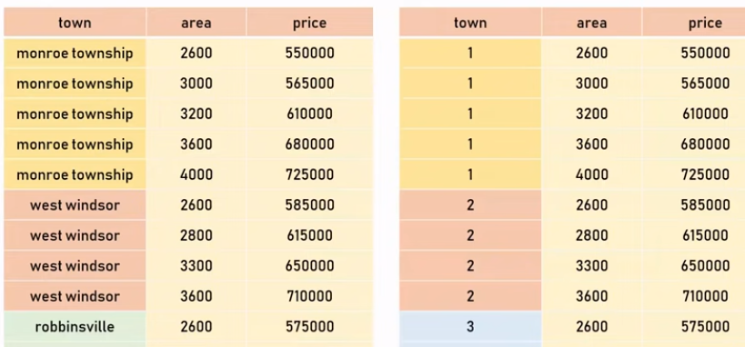
19.00 W08: Review One Hot Encoding Introduction
https://www.youtube.com/watch?v=9yl6-HEY7_s&list=PLeo1K3hjS3uvCeTYTeyfe0-rN5r8zn9rw&index=6
Week 8 Review: One Hot Encoding Introduction (0:51-1:20/21:34)
One way to do that is to convert all the towns (monroe township, west windsor, robbinsville, etc) into number.

Slide 6
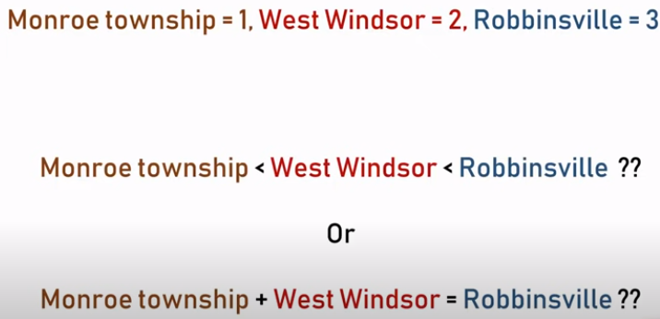
19.00 W08: Review One Hot Encoding Introduction
https://www.youtube.com/watch?v=9yl6-HEY7_s&list=PLeo1K3hjS3uvCeTYTeyfe0-rN5r8zn9rw&index=6
Week 8 Review: One Hot Encoding Introduction (1:21-1:30/21:34)
When we convert the township name into the number, there is a problem:
For example, we assume the monroe township = 1, west windsor = 2, robbinsville = 3
1. Monroe township is less than west windows and west windsor is less than robbinsville, or
2. monroe township + west windsor = robbinsville.
This does not quite make sense.

Slide 7
19.01 Categorical

Slide 8

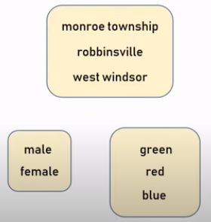
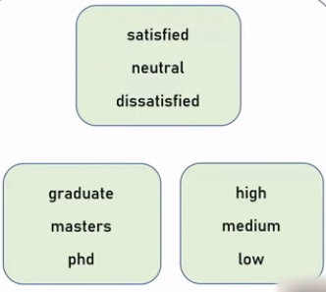
19.01 Categorical
https://www.youtube.com/watch?v=9yl6-HEY7_s&list=PLeo1K3hjS3uvCeTYTeyfe0-rN5r8zn9rw&index=6
Categorical (1:39-1:50/21:34)
These text variables below are called the “Categorical Variables”.
The township name are called “Nominal” [名义上; 名目上(めいもくじょう)] variable.
The categorical variables have two types:
1. Nominal: They don’t have any numeric order in between or any order relationship between each other: For example, township name, gender (male/female), colors names.
2.Ordinal (序数/じょすう): These can be order numerically.
The township names are nominal categorical variables, the simple integer encoding will not work. We need “One-hot-encoding” for nominal categorical variables.
Nominal
Ordinal

Slide 9
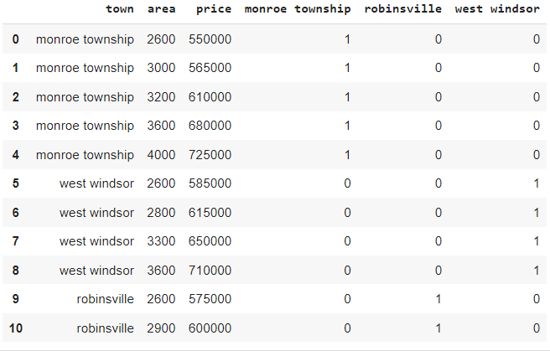
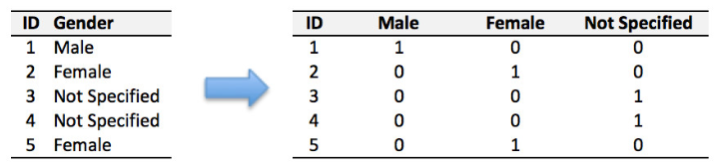
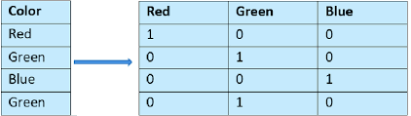
19.01 Categorical
https://www.youtube.com/watch?v=9yl6-HEY7_s&list=PLeo1K3hjS3uvCeTYTeyfe0-rN5r8zn9rw&index=6
Categorical (1:51-3:00/21:34)
Below are the one-hot-encoding examples:
1. township
2. gender
3. colors
1
2
3

Slide 10
19.02 Dummy Variables

Slide 11
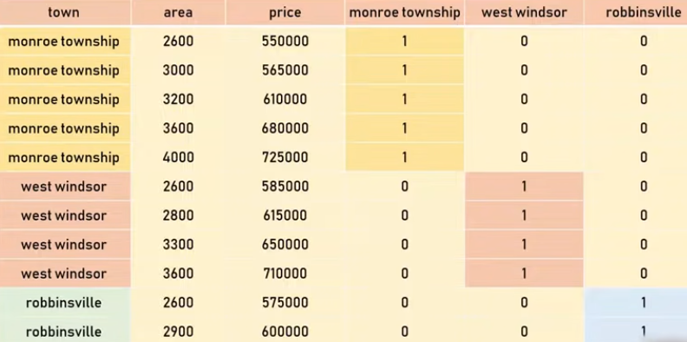
19.02 Dummy Variables
https://www.youtube.com/watch?v=9yl6-HEY7_s&list=PLeo1K3hjS3uvCeTYTeyfe0-rN5r8zn9rw&index=6
Dummy Variables (3:01-3:30/21:34)
The way that one-hot-encoding works is to
1. create a new column for each of the categories and
2. assign binary value of 1 or 0.
As the diagram below, for monroe township, we put “1” in “monroe township” and 0s for other related columns, same thing for “west windsor” column, and “robinsville” column.
These “monroe township”, “west windsor”, and “robinsville” are called the dummy variables.

Slide 12
19.03 Python: Read Dataset

Slide 13
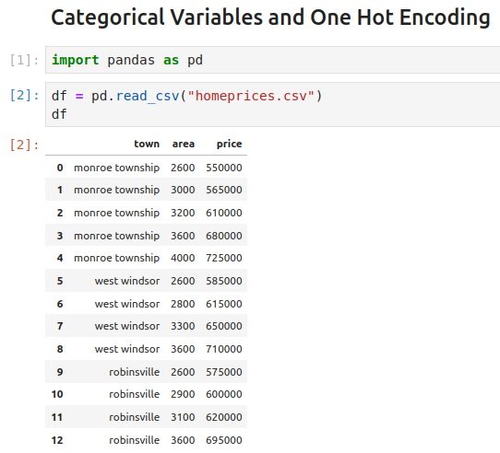
19.03 Python: Read Dataset
https://www.youtube.com/watch?v=9yl6-HEY7_s&list=PLeo1K3hjS3uvCeTYTeyfe0-rN5r8zn9rw&index=6
Python: Read Dataset (3:31-3:50/21:34)
Import library

Slide 14
19.04 Create Dummy Columns

Slide 15
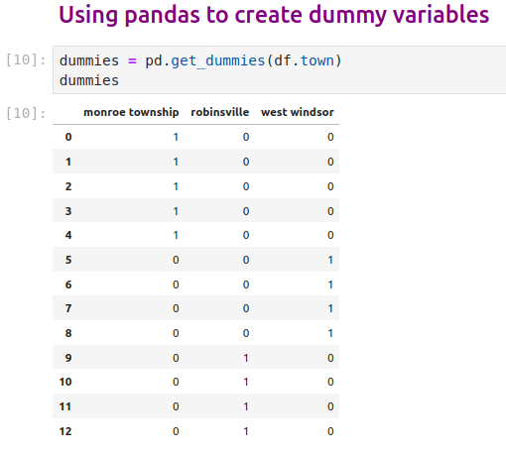
19.04 Create Dummy Columns
https://www.youtube.com/watch?v=9yl6-HEY7_s&list=PLeo1K3hjS3uvCeTYTeyfe0-rN5r8zn9rw&index=6
Create Dummy Columns (3:51-5:00/21:34)
Get dummies to create columns,

Slide 16
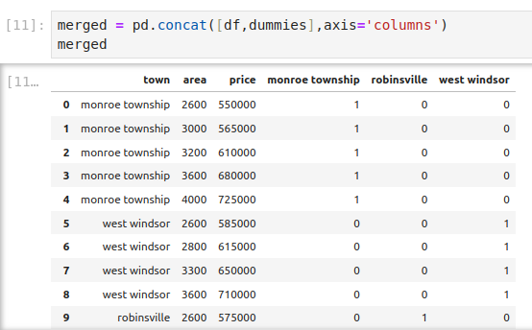
19.04 Create Dummy Columns
https://www.youtube.com/watch?v=9yl6-HEY7_s&list=PLeo1K3hjS3uvCeTYTeyfe0-rN5r8zn9rw&index=6
Create Dummy Columns (5:01-5:30/21:34)
Join the new dummy columns to original dataset.

Slide 17
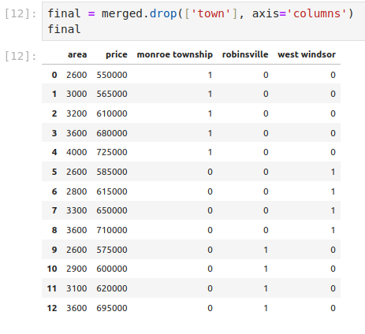
19.04 Create Dummy Columns
https://www.youtube.com/watch?v=9yl6-HEY7_s&list=PLeo1K3hjS3uvCeTYTeyfe0-rN5r8zn9rw&index=6
Create Dummy Columns (5:01-5:30/21:34)
Drop the original “town” column

Slide 18
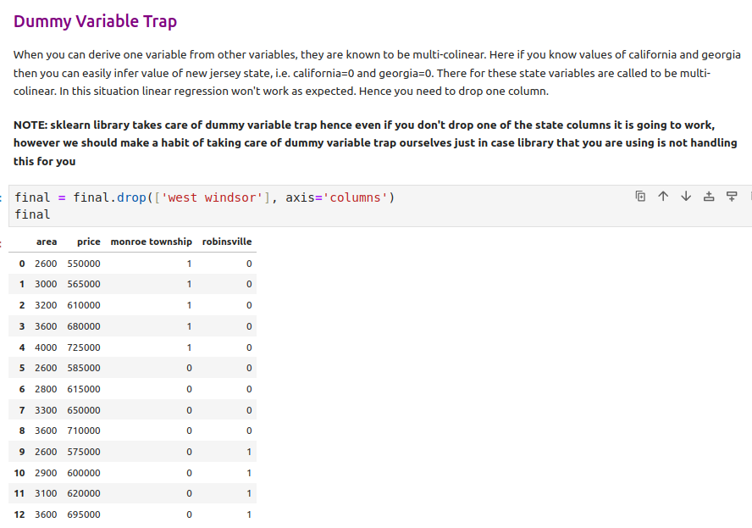
19.04 Create Dummy Columns
https://www.youtube.com/watch?v=9yl6-HEY7_s&list=PLeo1K3hjS3uvCeTYTeyfe0-rN5r8zn9rw&index=6
Create Dummy Columns (5:01-7:10/21:34)
In Pandas, we have to have to drop one of variable name to clean up variable name in the original objects.
This step is not required by sklearn. sklearn already drop for you (We will see example later on).

Slide 19
19.05 Create X and y

Slide 20
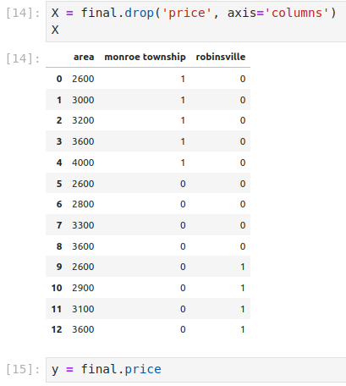
19.05 Create X and y
https://www.youtube.com/watch?v=9yl6-HEY7_s&list=PLeo1K3hjS3uvCeTYTeyfe0-rN5r8zn9rw&index=6
Create X and y (7:11-9:30/21:34)
We drop ‘price’ in X and create y for ‘price’ column.

Slide 21
19.06 Machine Learning Model by sklearn

Slide 22
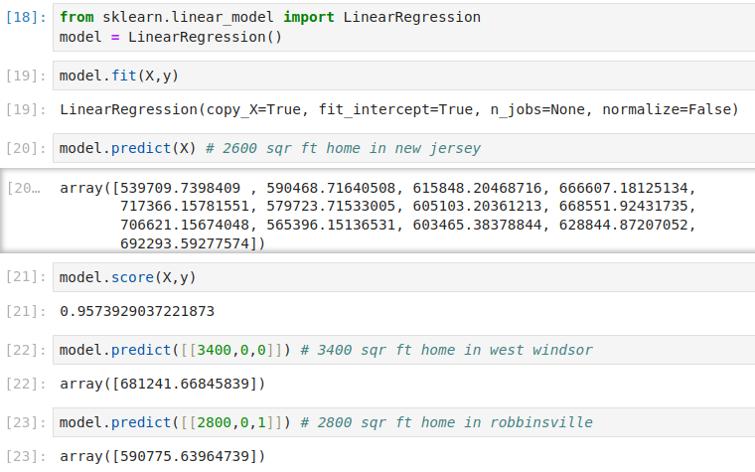
19.06 Machine Learning Model by sklearn
https://www.youtube.com/watch?v=9yl6-HEY7_s&list=PLeo1K3hjS3uvCeTYTeyfe0-rN5r8zn9rw&index=6
Machine Learning Model by sklearn (9:31-12:00/21:34)
We can do machine learning model or tensorflow flow neural network model,

Slide 23
19.07 sklearn OneHotEncoder

Slide 24
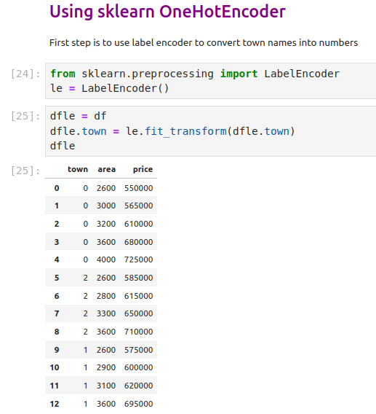
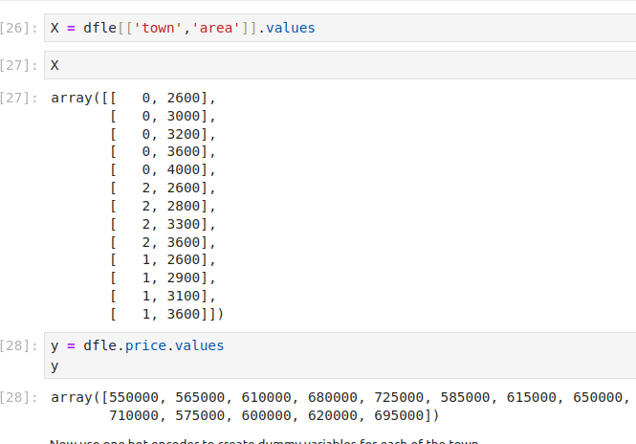
19.07 sklearn OneHotEncoder
https://www.youtube.com/watch?v=9yl6-HEY7_s&list=PLeo1K3hjS3uvCeTYTeyfe0-rN5r8zn9rw&index=6
sklearn OneHotEncoder (12:31-15:30/21:34)
We use OneHotEncoder to create One-Hot-Encoding for us.
First, The of town is converted into number but they are nominal, we need to convert ‘town’ into unique columns name.

Slide 25
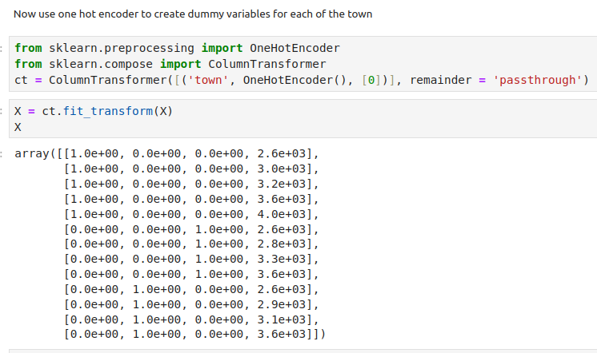
19.07 sklearn OneHotEncoder
https://www.youtube.com/watch?v=9yl6-HEY7_s&list=PLeo1K3hjS3uvCeTYTeyfe0-rN5r8zn9rw&index=6
sklearn OneHotEncoder (15:31-16:30/21:34)
We transform ‘town’ column into one-hot encoding.

Slide 26
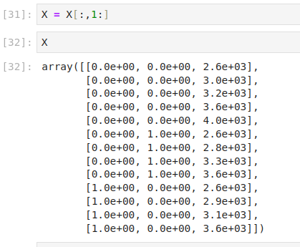
19.07 sklearn OneHotEncoder
https://www.youtube.com/watch?v=9yl6-HEY7_s&list=PLeo1K3hjS3uvCeTYTeyfe0-rN5r8zn9rw&index=6
sklearn OneHotEncoder (16:31-17:30/21:34)
Check ‘town’ column into one-hot encoding.

Slide 27
19.08 sklearn Model Fit

Slide 28
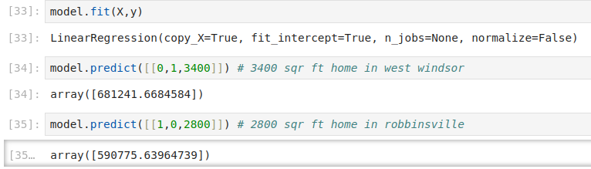
19.08 sklearn Model Fit
https://www.youtube.com/watch?v=9yl6-HEY7_s&list=PLeo1K3hjS3uvCeTYTeyfe0-rN5r8zn9rw&index=6
sklearn Model fit (17:31-20:00/21:34)
Check ‘town’ column into one-hot encoding.

Slide 29
19.09 Exercise

Slide 30
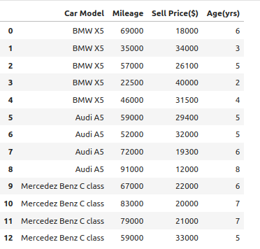
19.09 Exercise
https://www.youtube.com/watch?v=9yl6-HEY7_s&list=PLeo1K3hjS3uvCeTYTeyfe0-rN5r8zn9rw&index=6
Exercise (20:01-21:34/21:34)
We have nominal variable for car model “BMW X5”, “Audi A5”, “Mercedez Benz C class”, etc.
Use panda and sklearn to transform into the one-hot-encoding.

Slide 31
End

