Slide 1

27.05 Import Library
Peter H. Chen

Slide 2
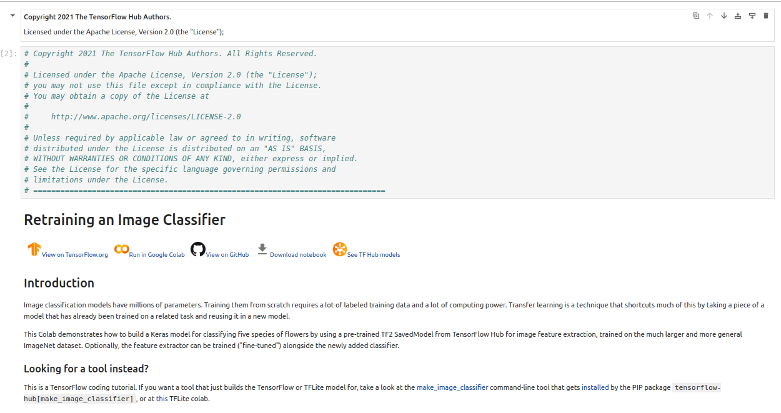
27.5 Import Library
https://www.youtube.com/watch?v=LsdxvjLWkIY&list=PLeo1K3hjS3uu7CxAacxVndI4bE_o3BDtO&index=27
Import Library (6:21-7:30/25:54)
Below is the colab code for MobileNet 2 Classifier.

Slide 3
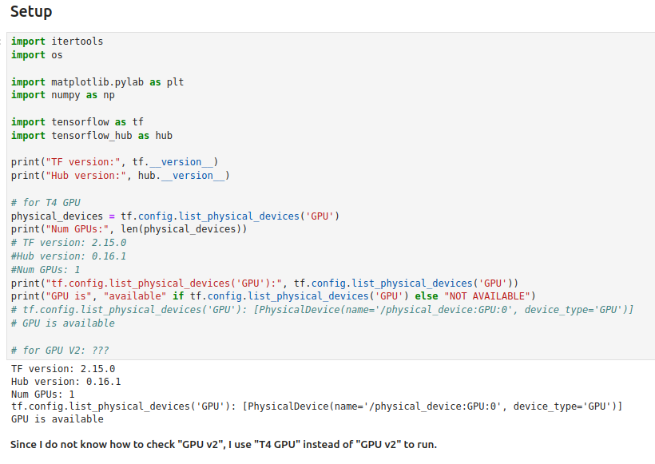
27.5 Import Library
https://www.youtube.com/watch?v=LsdxvjLWkIY&list=PLeo1K3hjS3uu7CxAacxVndI4bE_o3BDtO&index=27
Import Library (7:31-10:30/25:54)

Slide 4
27.06 Select Pre-Trained CNN Model

Slide 5
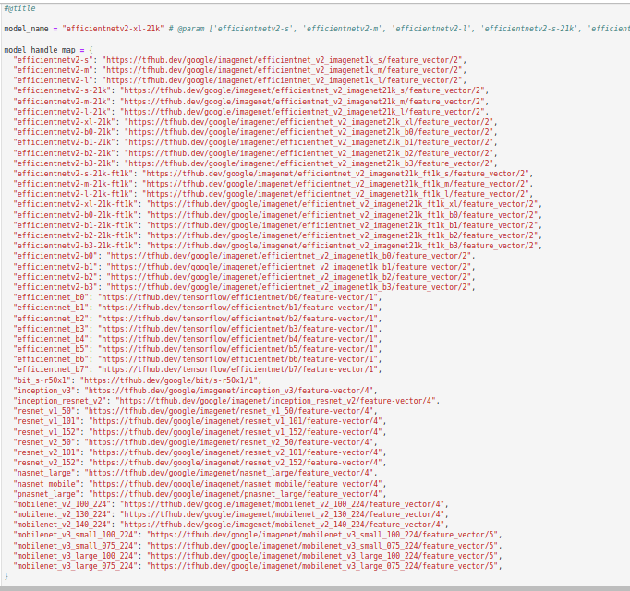
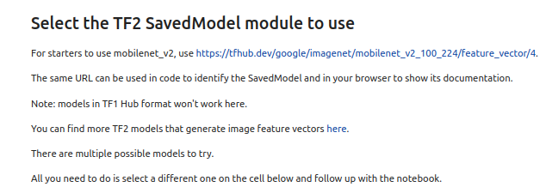
27.06 Select Saved Model
https://www.youtube.com/watch?v=LsdxvjLWkIY&list=PLeo1K3hjS3uu7CxAacxVndI4bE_o3BDtO&index=27
Select Saved Model (10:31-11:30/25:54)
We select model name = “efficientv2-xl-21k”

Slide 6
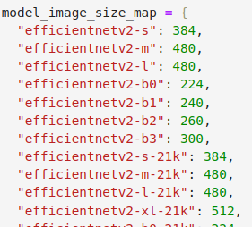
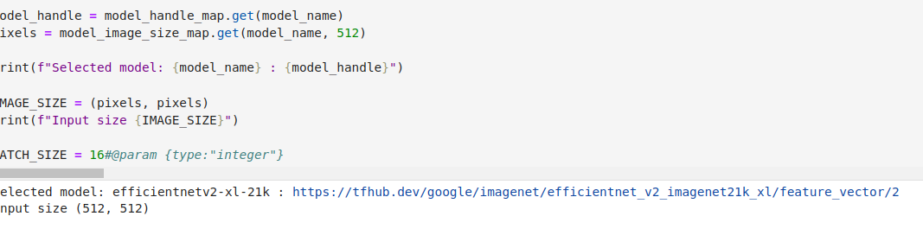
27.06 Select Saved Model
https://www.youtube.com/watch?v=LsdxvjLWkIY&list=PLeo1K3hjS3uu7CxAacxVndI4bE_o3BDtO&index=27
Select Saved Model (11:31-12:30/25:54)
We select model name = “efficientv2-xl-21k”

Slide 7
27.07 Setup Flower Dataset

Slide 8
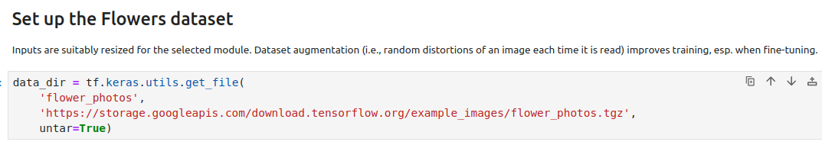
27.07 Setup Flower Dataset
https://www.youtube.com/watch?v=LsdxvjLWkIY&list=PLeo1K3hjS3uu7CxAacxVndI4bE_o3BDtO&index=27
Setup Flower Dataset (12:31-13:30/25:54)
Set up Flowers dataset.

Slide 9
27.08 Build Train and Validation Dataset

Slide 10
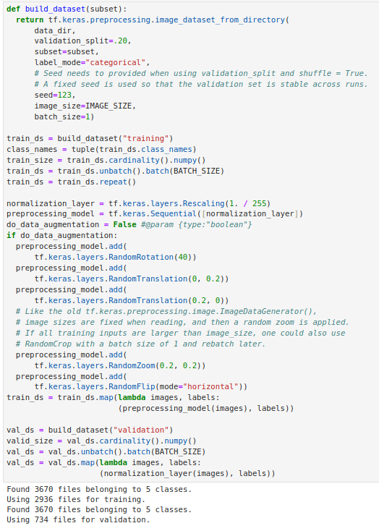
27.08 Build Train and Validation Dataset
https://www.youtube.com/watch?v=LsdxvjLWkIY&list=PLeo1K3hjS3uu7CxAacxVndI4bE_o3BDtO&index=27
Build Train and Validation Dataset (12:31-13:30/25:54)
Build Dataset:
trans_ds, val_ds

Slide 11
27.09 Define CNN Model

Slide 12
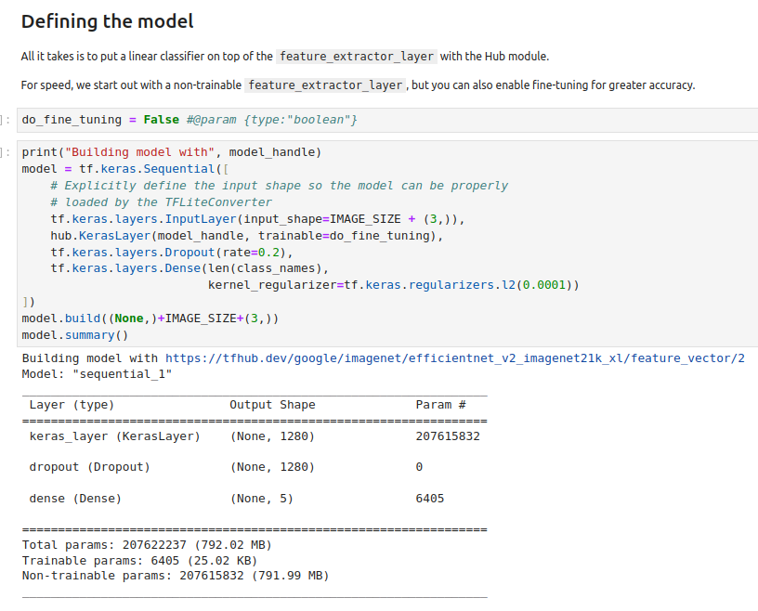
27.09 Define CNN Model
https://www.youtube.com/watch?v=LsdxvjLWkIY&list=PLeo1K3hjS3uu7CxAacxVndI4bE_o3BDtO&index=27
TF Transfer Learning (13:31-16:30/25:54)
Define the Model: We add the new transfer learning model at the end of the original pre-trained model.

Slide 13
27.10 Train CNN Model with Transfer Layers

Slide 14
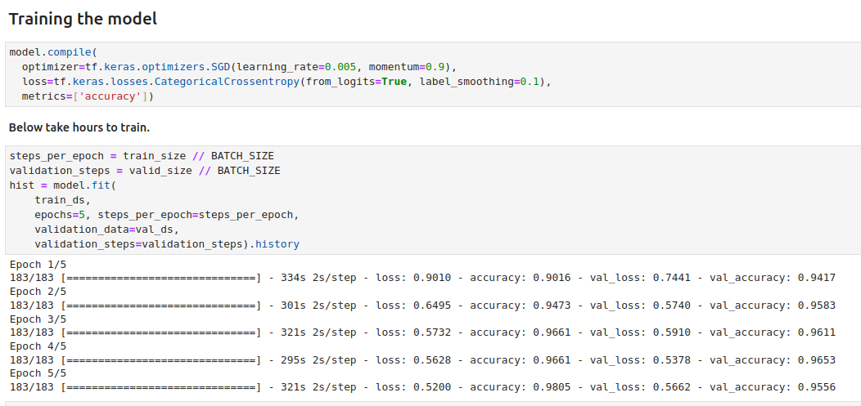
27.10 Train CNN Model with Transfer Layers
https://www.youtube.com/watch?v=LsdxvjLWkIY&list=PLeo1K3hjS3uu7CxAacxVndI4bE_o3BDtO&index=27
Train CNN Model with Transfer Layers (16:31-19:30/25:54)
Re-Compile and train the new transfer model with train_ds and val_ds.
Note: This transfer Learning will take hours to run.

Slide 15
27.11 Validate Accuracy

Slide 16
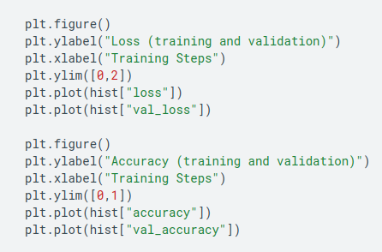
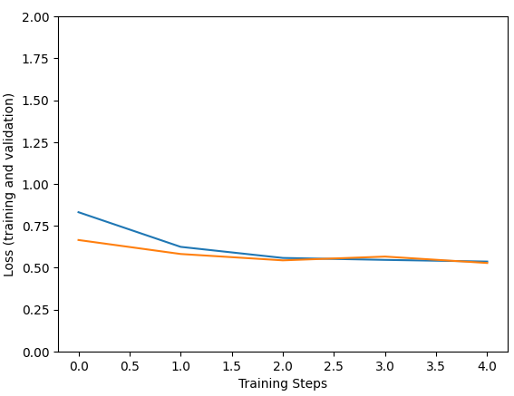
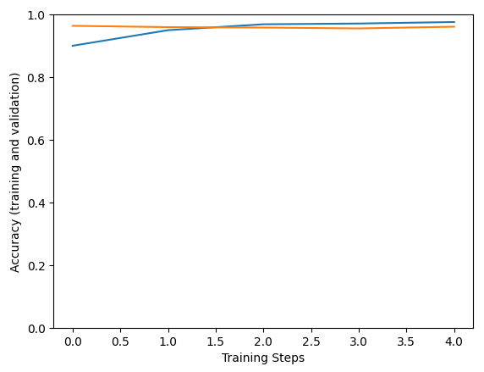
27.11 Validate Accuracy
https://www.youtube.com/watch?v=LsdxvjLWkIY&list=PLeo1K3hjS3uu7CxAacxVndI4bE_o3BDtO&index=27
Validate Accuracy (19:31-20:30/25:54)
Plot the result for loss/validate-loss and accuracy/validate-accuracy for new transfer model.

Slide 17
27.12 Verify Result

Slide 18
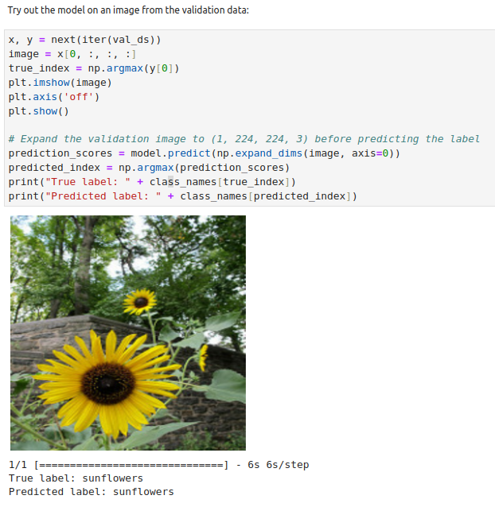
27.12 Verify Result
https://www.youtube.com/watch?v=LsdxvjLWkIY&list=PLeo1K3hjS3uu7CxAacxVndI4bE_o3BDtO&index=27
Verify Result (20:31-21:30/25:54)
Try out the model on an image from the validation data:

Slide 19
27.13 Save Fine-Tune Model

Slide 20
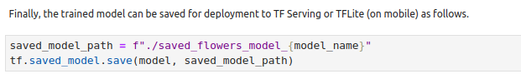
27.13 Save Fine-Tune Model
https://www.youtube.com/watch?v=LsdxvjLWkIY&list=PLeo1K3hjS3uu7CxAacxVndI4bE_o3BDtO&index=27
Save Fine-Tune Model (20:31-21:30/25:54)
Save the model.
Later on, we can use TF.Serving or TFLite (on mobile) to host on HuggingFace or google cloud.

Slide 21
27.14 Optional: Deploy TFLite

Slide 22
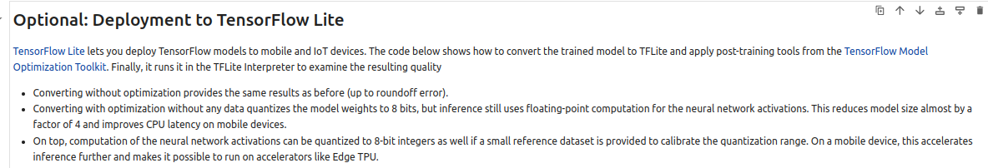
27.14 Optional: Deploy TFLite
https://www.youtube.com/watch?v=LsdxvjLWkIY&list=PLeo1K3hjS3uu7CxAacxVndI4bE_o3BDtO&index=27
Optional: Deploy TFLite (21:31-22:30/25:54)
Deployment with TFLite.

Slide 23
27.15 Convert/Save Model into TFLite

Slide 24
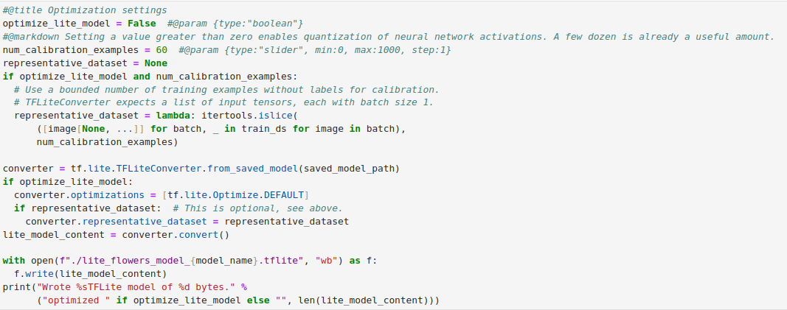
27.15 Convert/Save Model into TFLite
https://www.youtube.com/watch?v=LsdxvjLWkIY&list=PLeo1K3hjS3uu7CxAacxVndI4bE_o3BDtO&index=27
Convert/Save Model into TFLite (21:31-22:30/25:54)
TFLite is used to convert floating to integer.
TFLite model is used in iPhone or embedded system.

Slide 25
27.16 Load TFLite Model

Slide 26
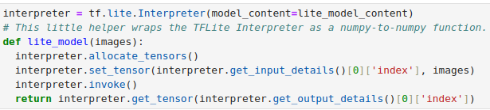
27.16 Load TFLite Model
https://www.youtube.com/watch?v=LsdxvjLWkIY&list=PLeo1K3hjS3uu7CxAacxVndI4bE_o3BDtO&index=27
Load TFLite Model (22:31-23:30/25:54)
Load TFLite Model

Slide 27
27.17 Verify Accuracy of TFLite vs. Original Model

Slide 28
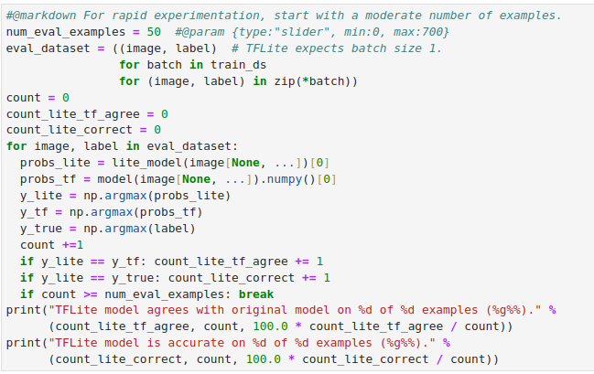
27.17 Verify Accuracy of TFLite vs. Original Model
https://www.youtube.com/watch?v=LsdxvjLWkIY&list=PLeo1K3hjS3uu7CxAacxVndI4bE_o3BDtO&index=27
Verify Accuracy of TFLite vs. Original Model (23:31-24:30/25:54)
Verify TFLite results are same as original model

Slide 29
End

