Slide 1
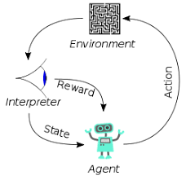
003 DL: Neuron
Peter H. Chen

Slide 2
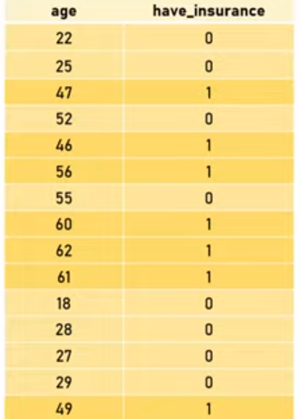
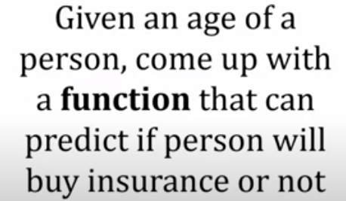
003 DL: Neuron
https://www.youtube.com/watch?v=VhRtaziEWd4&list=PLeo1K3hjS3uu7CxAacxVndI4bE_o3BDtO&index=3
DL: Neuron (0:00-1:24/16:48)
We have row/column dataset in excel format.
Persons have insurance or not.
Based on the dataset, we want to build a function that given you an age of a person, the function can tell you or can predict this person will buy insurance or not.

Slide 3
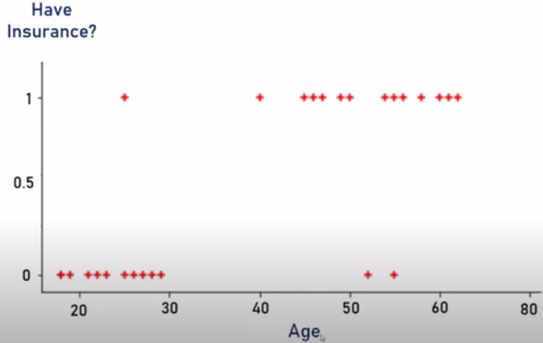
003 DL: Neuron
https://www.youtube.com/watch?v=VhRtaziEWd4&list=PLeo1K3hjS3uu7CxAacxVndI4bE_o3BDtO&index=3
DL: Neuron (1:34-1:50/16:48)
Scatter plot for age vs. have insurance.

Slide 4
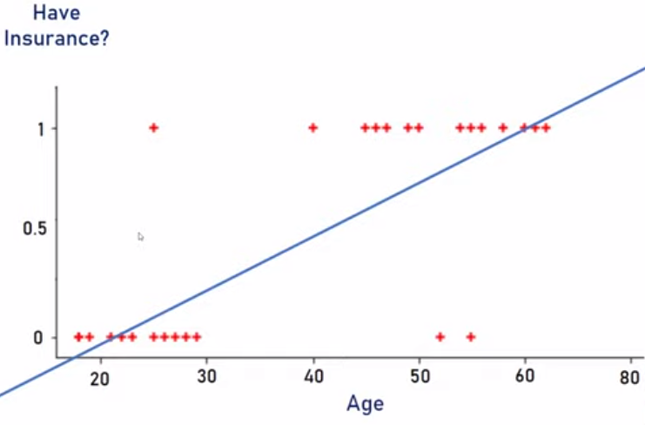
003 DL: Neuron
https://www.youtube.com/watch?v=VhRtaziEWd4&list=PLeo1K3hjS3uu7CxAacxVndI4bE_o3BDtO&index=3
DL: Neuron (1:51-2:00/16:48)
Linear regression for age vs have insurance.
How to draw this line? Linear regression is to draw the best fit line.

Slide 5
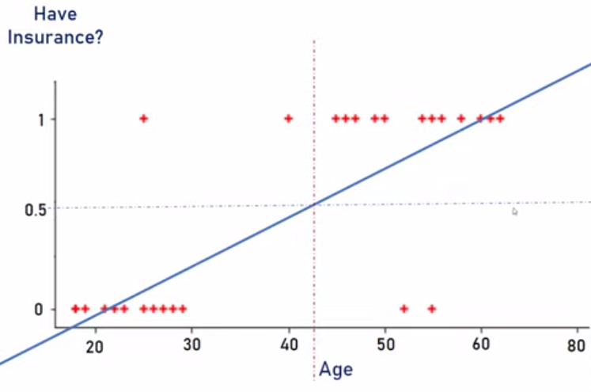
003 DL: Neuron
https://www.youtube.com/watch?v=VhRtaziEWd4&list=PLeo1K3hjS3uu7CxAacxVndI4bE_o3BDtO&index=3
DL: Neuron (2:01-3:10/16:48)
50% Boundary to buy insurance:
1. Age 42, people start to buy insurance.
2. below 43, people do not buy insurance.

Slide 6
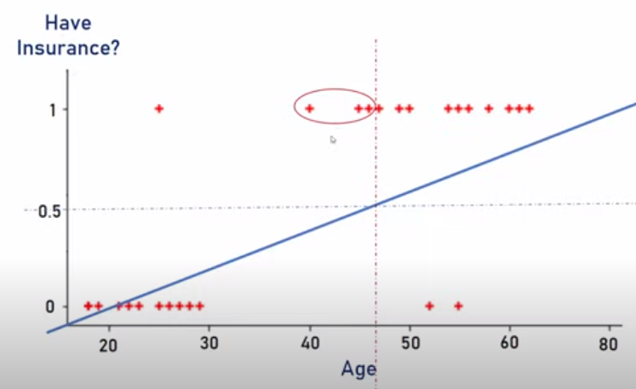
003 DL: Neuron
https://www.youtube.com/watch?v=VhRtaziEWd4&list=PLeo1K3hjS3uu7CxAacxVndI4bE_o3BDtO&index=3
DL: Neuron (3:10-4:00/16:48)
Points mis-classification.

Slide 7
003 DL: Neuron
https://www.youtube.com/watch?v=VhRtaziEWd4&list=PLeo1K3hjS3uu7CxAacxVndI4bE_o3BDtO&index=3
DL: Neuron (3:10-4:00/16:48)
Points mis-classification.

Slide 8
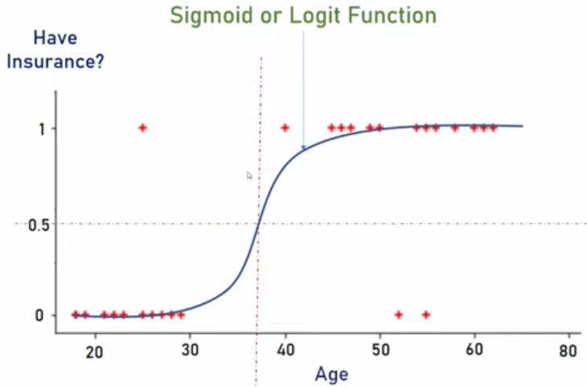
003 DL: Neuron
https://www.youtube.com/watch?v=VhRtaziEWd4&list=PLeo1K3hjS3uu7CxAacxVndI4bE_o3BDtO&index=3
DL: Neuron (4:10-4:30/16:48)
This line is much better for mis-classificaiton.

Slide 9
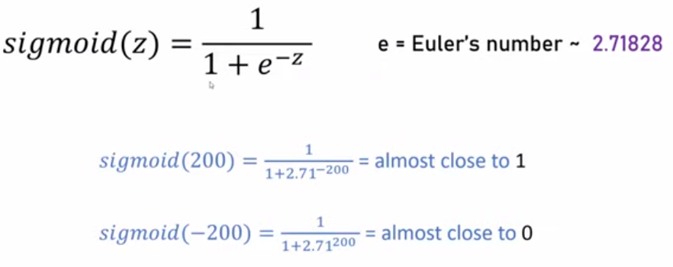

003 DL: Neuron
https://www.youtube.com/watch?v=VhRtaziEWd4&list=PLeo1K3hjS3uu7CxAacxVndI4bE_o3BDtO&index=3
DL: Neuron (5:20-7:00/16:48)
Why do we use Euler function?

Slide 10
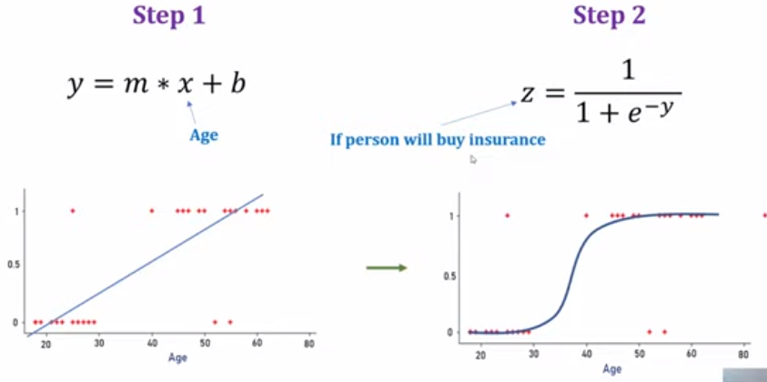
003 DL: Neuron
https://www.youtube.com/watch?v=VhRtaziEWd4&list=PLeo1K3hjS3uu7CxAacxVndI4bE_o3BDtO&index=3
DL: Neuron (7:20-8:30/16:48)
Euler is better fit for this problem.

Slide 11
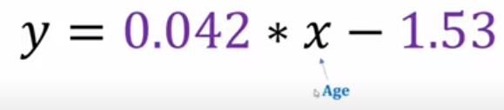
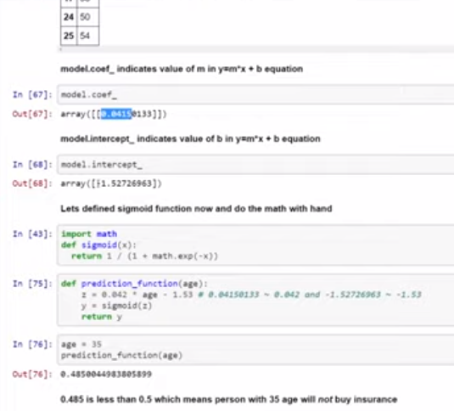
003 DL: Neuron
https://www.youtube.com/watch?v=VhRtaziEWd4&list=PLeo1K3hjS3uu7CxAacxVndI4bE_o3BDtO&index=3
DL: Neuron (9:00-10:10/16:48)
Linear regression formula:

Slide 12
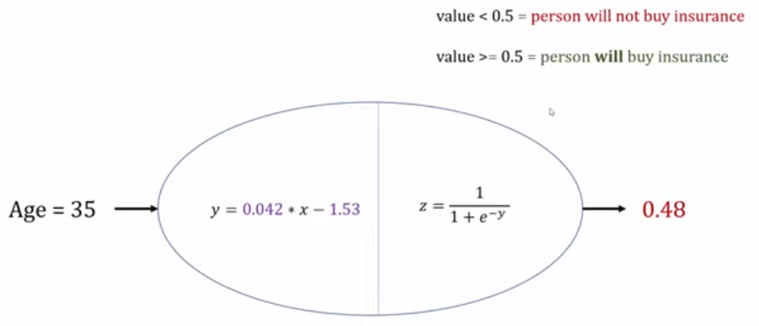
003 DL: Neuron
https://www.youtube.com/watch?v=VhRtaziEWd4&list=PLeo1K3hjS3uu7CxAacxVndI4bE_o3BDtO&index=3
DL: Neuron (10:20-10:30/16:48)
Age 38, 0.48 will buy.

Slide 13
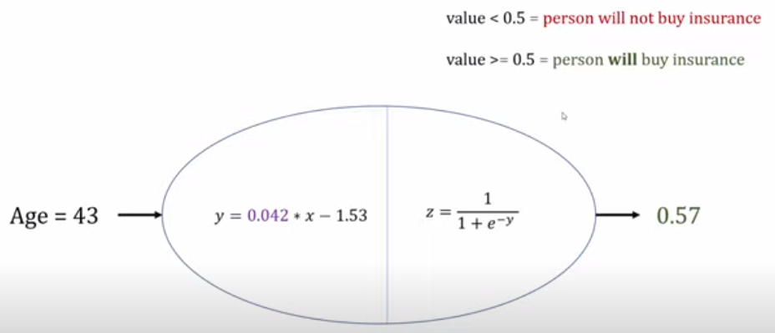
003 DL: Neuron
https://www.youtube.com/watch?v=VhRtaziEWd4&list=PLeo1K3hjS3uu7CxAacxVndI4bE_o3BDtO&index=3
DL: Neuron (11:00-11:30/16:48)
Age 43, 0.57will buy insurance.
This is almost like at neuron. Neuron have linear regression and activation function.
We can think of logistic regression like a neural neuron.

Slide 14
003 DL: Neuron
https://www.youtube.com/watch?v=VhRtaziEWd4&list=PLeo1K3hjS3uu7CxAacxVndI4bE_o3BDtO&index=3
DL: Neuron (11:31-12:30/16:48)
In machine learning, we called age is a feature.
In this case, we have only one feature (one input parameter or one independent variable).
The dependent variable is the person who will buy the insurance or not.

Slide 15
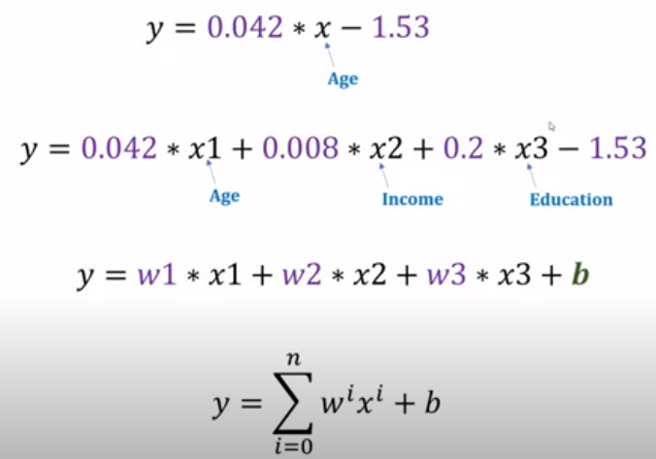
003 DL: Neuron
https://www.youtube.com/watch?v=VhRtaziEWd4&list=PLeo1K3hjS3uu7CxAacxVndI4bE_o3BDtO&index=3
DL: Neuron (12:31-14:10/16:48)
Now, you can have multiple factors:
in addition to age, you can have income and education.
In this case, we have three features: age, income, and education.
We may have more features than this example.

Slide 16
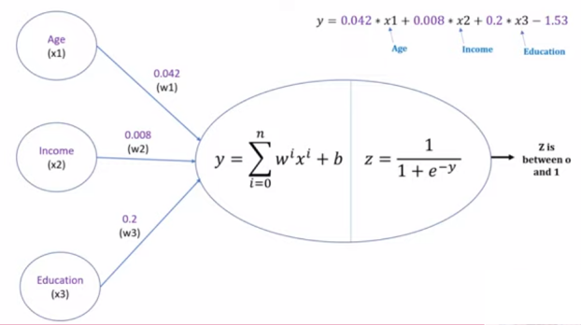
003 DL: Neuron
https://www.youtube.com/watch?v=VhRtaziEWd4&list=PLeo1K3hjS3uu7CxAacxVndI4bE_o3BDtO&index=3
DL: Neuron (14:41-16:48/16:48)
We have the neuron network as below.
We have input x, weight, and output y.
We have input y and activation output z.

Slide 17
End

