Slide 1
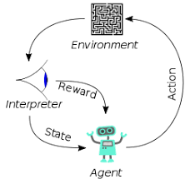
007 Write Digit
Peter H. Chen

Slide 2
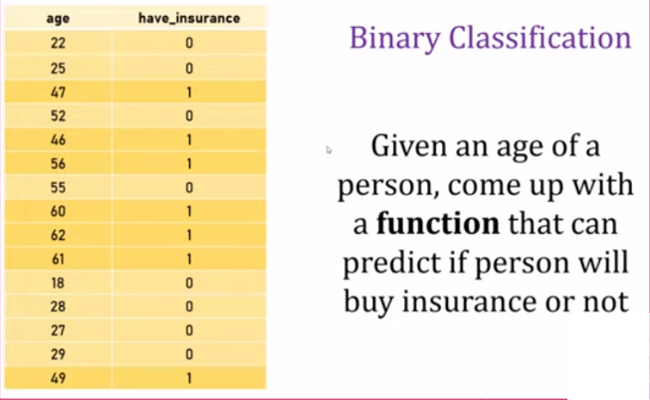
007 Write Digit
https://www.youtube.com/watch?v=iqQgED9vV7k&list=PLeo1K3hjS3uu7CxAacxVndI4bE_o3BDtO&index=7
Hand Write Digit (0:00-1:00/36:38)
Now, we move to hand-write digit with Neural Network.
First, we look at simple binary classification of insurance example: Buy Insurance or not Buy Insurance.

Slide 3
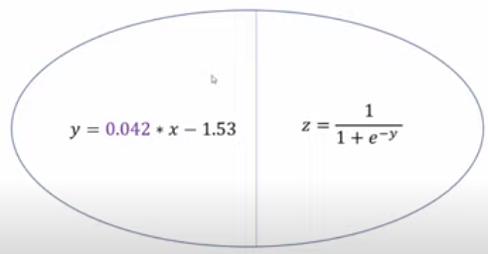
007 Write Digit
https://www.youtube.com/watch?v=iqQgED9vV7k&list=PLeo1K3hjS3uu7CxAacxVndI4bE_o3BDtO&index=7
Hand Write Digit (1:10-1:20/36:38)
We have a single neuron for logistic regression.
The first part is the regression.
The second part is the sigmoid function.

Slide 4
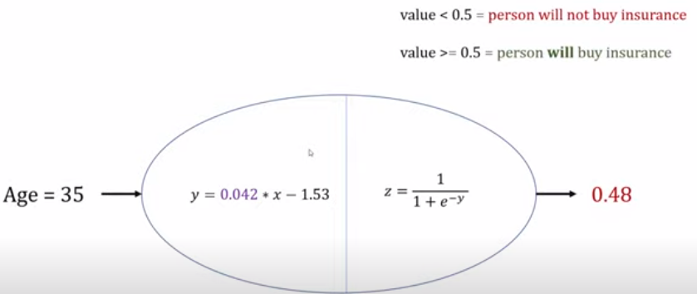
007 Write Digit
https://www.youtube.com/watch?v=iqQgED9vV7k&list=PLeo1K3hjS3uu7CxAacxVndI4bE_o3BDtO&index=7
Hand Write Digit (1:20-1:40/36:38)
You can give the age to neuron and will the answer of person who will buy the insurance or not.
If the value > 0.5, then the person will buy. Otherwise, he will not buy.

Slide 5
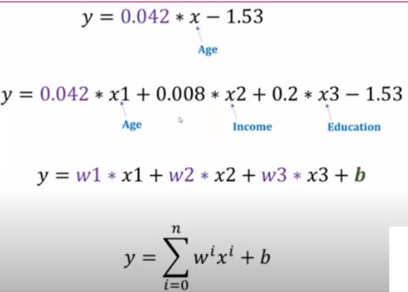
007 Write Digit
https://www.youtube.com/watch?v=iqQgED9vV7k&list=PLeo1K3hjS3uu7CxAacxVndI4bE_o3BDtO&index=7
Hand Write Digit (1:41-1:47/36:38)
We can give more features for the linear regression.

Slide 6
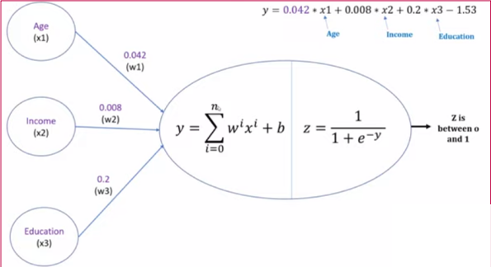
007 Write Digit
https://www.youtube.com/watch?v=iqQgED9vV7k&list=PLeo1K3hjS3uu7CxAacxVndI4bE_o3BDtO&index=7
Hand Write Digit (1:41-2:20/36:38)
We can give more features for the neural network for single neuron.
Since we have multiple features, our dataset will be more complicated.

Slide 7
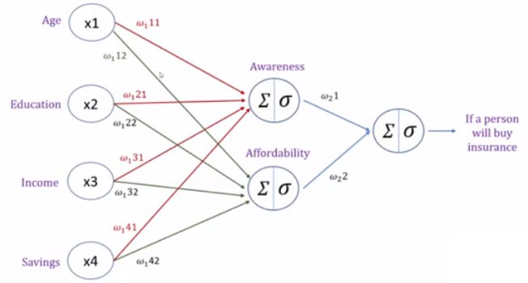
007 Write Digit
https://www.youtube.com/watch?v=iqQgED9vV7k&list=PLeo1K3hjS3uu7CxAacxVndI4bE_o3BDtO&index=7
Hand Write Digit (2:30-3:52/36:38)
The hidden layers of neuron can be awareness or affordability.

Slide 8
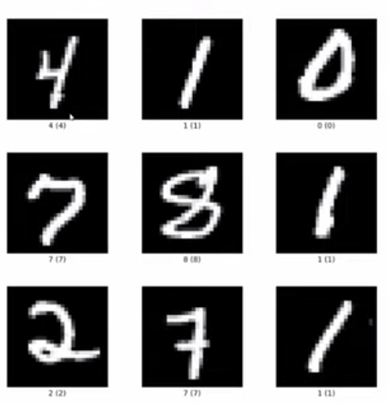
007 Write Digit
https://www.youtube.com/watch?v=iqQgED9vV7k&list=PLeo1K3hjS3uu7CxAacxVndI4bE_o3BDtO&index=7
Hand Write Digit (4:00-4:18/36:38)
Now, we move on the hand written digit.

Slide 9
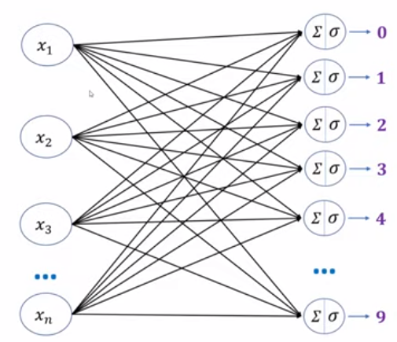
007 Write Digit
https://www.youtube.com/watch?v=iqQgED9vV7k&list=PLeo1K3hjS3uu7CxAacxVndI4bE_o3BDtO&index=7
Hand Write Digit (4:20-4:30/36:38)
The neural network can be as below:

Slide 10
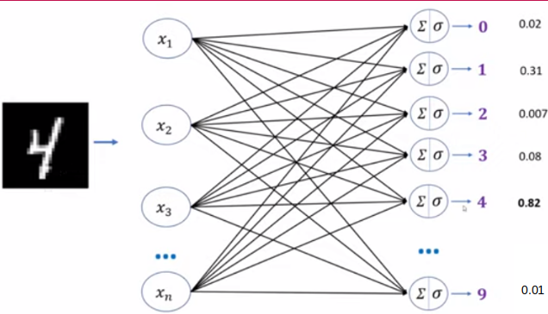
007 Write Digit
https://www.youtube.com/watch?v=iqQgED9vV7k&list=PLeo1K3hjS3uu7CxAacxVndI4bE_o3BDtO&index=7
Hand Write Digit (4:31-5:34/36:38)
We can input any hand-written image and output the probability of digit prediction.
In this case, 82% looks like digit “4”.

Slide 11
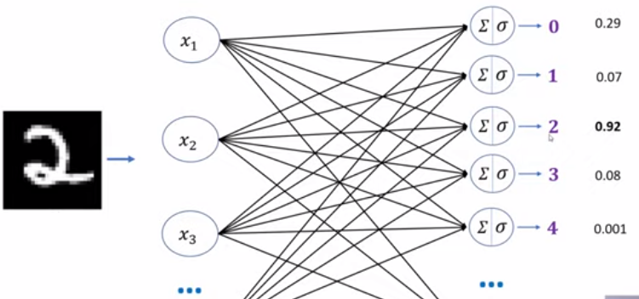
007 Write Digit
https://www.youtube.com/watch?v=iqQgED9vV7k&list=PLeo1K3hjS3uu7CxAacxVndI4bE_o3BDtO&index=7
Hand Write Digit (5:55-6:00/36:38)
Similarly, 92% looks like digit “2”.

Slide 12
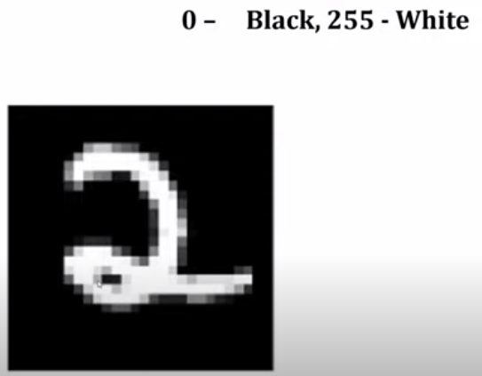
007 Write Digit
https://www.youtube.com/watch?v=iqQgED9vV7k&list=PLeo1K3hjS3uu7CxAacxVndI4bE_o3BDtO&index=7
Hand Write Digit (6:01-6:22/36:38)
We have two dimensional image with pixel 0 (black) to 255 (white).

Slide 13
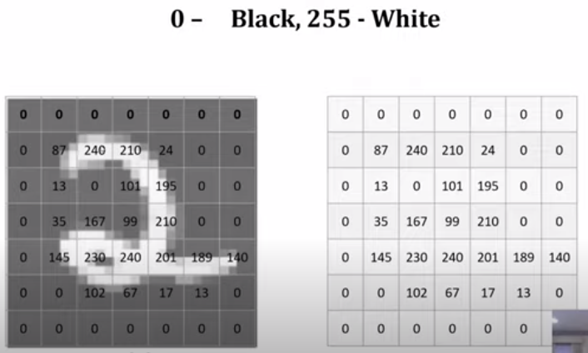
007 Write Digit
https://www.youtube.com/watch?v=iqQgED9vV7k&list=PLeo1K3hjS3uu7CxAacxVndI4bE_o3BDtO&index=7
Hand Write Digit (6:25-6:50/36:38)
Each pixel is represented between 0 (black) to 255 (white).

Slide 14
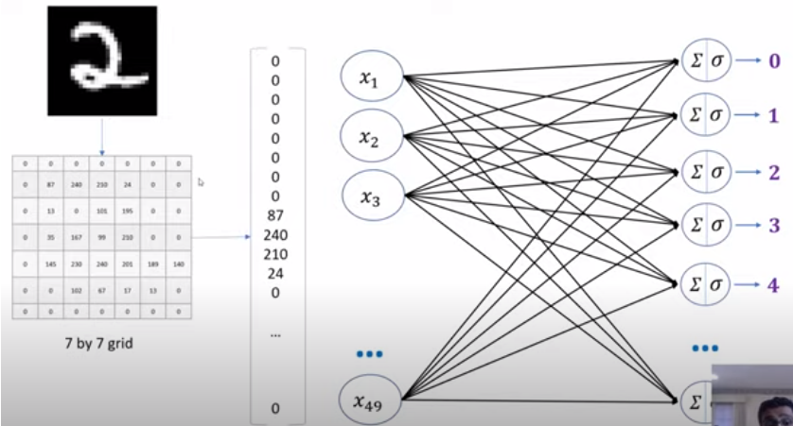
007 Write Digit
https://www.youtube.com/watch?v=iqQgED9vV7k&list=PLeo1K3hjS3uu7CxAacxVndI4bE_o3BDtO&index=7
Hand Write Digit (6:55-7:00/36:38)
You can convert the two-dimensional array into a one-dimensional array, i.e., flatten array.
Below, we convert 7 x 7 matrix into 49 array.

Slide 15
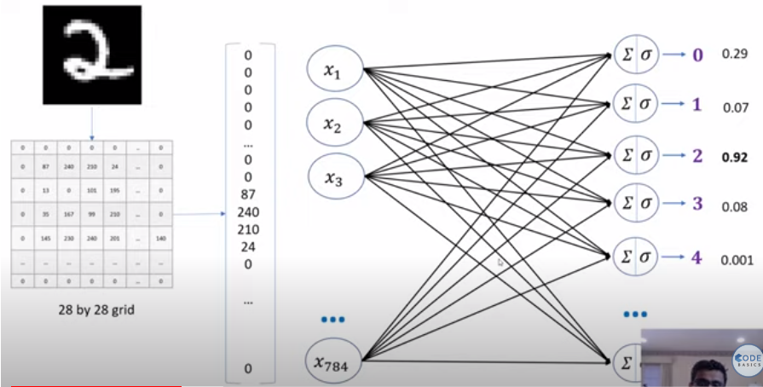
007 Write Digit
https://www.youtube.com/watch?v=iqQgED9vV7k&list=PLeo1K3hjS3uu7CxAacxVndI4bE_o3BDtO&index=7
Hand Write Digit (7:01-7:50/36:38)
Below, we convert 28 x 28 (=784) matrix into 784 array.

Slide 16
007.1 Jupyter Notebook

Slide 17
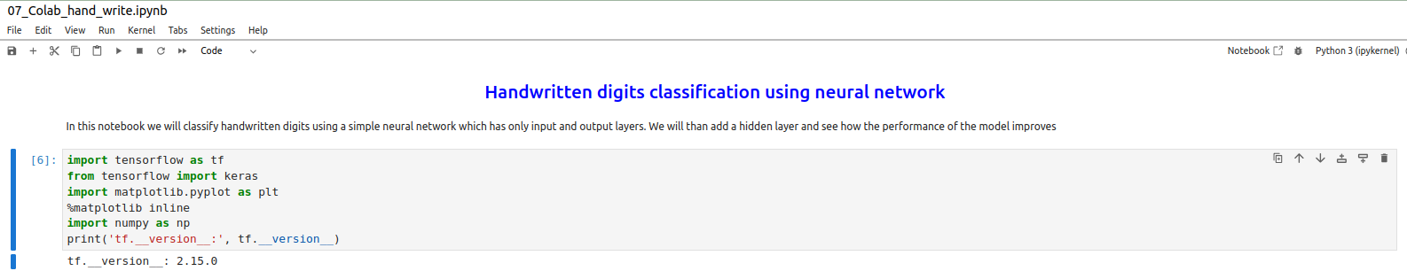
007.1 Jupyter Notebook
https://www.youtube.com/watch?v=iqQgED9vV7k&list=PLeo1K3hjS3uu7CxAacxVndI4bE_o3BDtO&index=7
Jupyter Notebook (8:01-8:38/36:38)
Now, we look at the code:
At the first time, we maybe need to setup once: select the kernel first before you start the Jupyter notebook. Select the “Jupyter Lab” or “(Jupyter) Notebook”
Note 1:
1. The “Jupyter Lab” is the newer version of “Jupyter Notebook”. Their functionalities are the same, only dependencies are different. We will need to “Purge” and re-install the newest versions if there are dependencies problem in between the frameworks.
2. Google Colab use the name “Notebook” instead of “Jupyter Lab” or “Jupyter Notebook”.
Note 3:
What is difference between “!” and “%”?
1. ! pip install tensorflow # install tensorflow in your OS (Ubuntu Linux)
2. % pip install tensorflow # Install tensorflow in “Jupyter notebook” environment only

Slide 18
007.1 Jupyter Notebook
https://www.youtube.com/watch?v=iqQgED9vV7k&list=PLeo1K3hjS3uu7CxAacxVndI4bE_o3BDtO&index=7
Jupyter Notebook (9:01-9:20/36:38)
Print the tensorflow version.

Slide 19
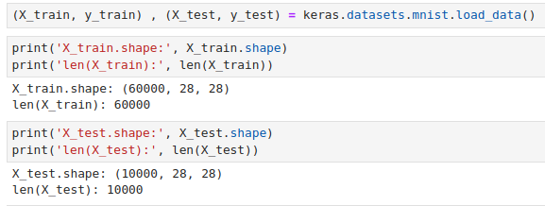
007.1 Jupyter Notebook
https://www.youtube.com/watch?v=iqQgED9vV7k&list=PLeo1K3hjS3uu7CxAacxVndI4bE_o3BDtO&index=7
Jupyter Notebook (9:01-9:20/36:38)
load the digit data.
We can see the X_train is 60,000 rows and X_test is 10,000 rows.

Slide 20
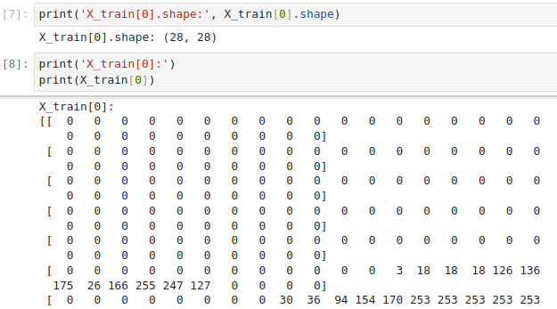
007.1 Jupyter Notebook
https://www.youtube.com/watch?v=iqQgED9vV7k&list=PLeo1K3hjS3uu7CxAacxVndI4bE_o3BDtO&index=7
Jupyter Notebook (9:01-9:20/36:38)
load the digit data.
We can print 28 x 28 pixels.

Slide 21
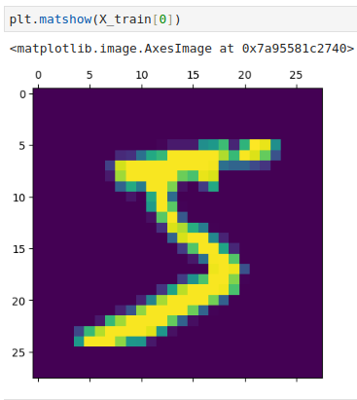
007.1 Jupyter Notebook
https://www.youtube.com/watch?v=iqQgED9vV7k&list=PLeo1K3hjS3uu7CxAacxVndI4bE_o3BDtO&index=7
Jupyter Notebook (9:01-9:20/36:38)
We can Display Image 0.

Slide 22
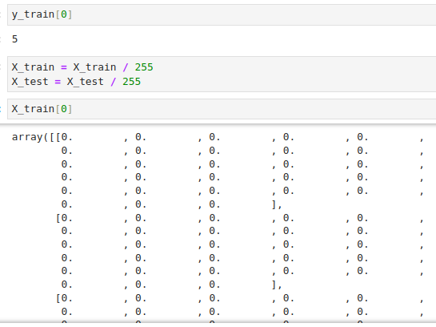
007.2 Jupyter Notebook
https://www.youtube.com/watch?v=iqQgED9vV7k&list=PLeo1K3hjS3uu7CxAacxVndI4bE_o3BDtO&index=7
Jupyter Notebook (09:31-10:10/36:38)
1. X_train[0]: 28 x 28.
2. First, we need to scale the image into [0, 1]. The scale 255 is very important.
Otherwise, the accuracy is very poor and prediction is very poor.

Slide 23
007.3 Train Model

Slide 24
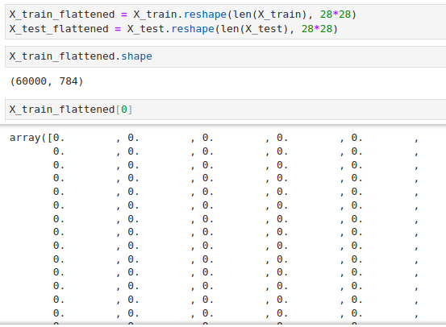
007.3 Train Model
https://www.youtube.com/watch?v=iqQgED9vV7k&list=PLeo1K3hjS3uu7CxAacxVndI4bE_o3BDtO&index=7
Train Model (13:30-15:28/36:38)
We flatten the X_train and X_test from 2-D matrix into 1-D array.

Slide 25
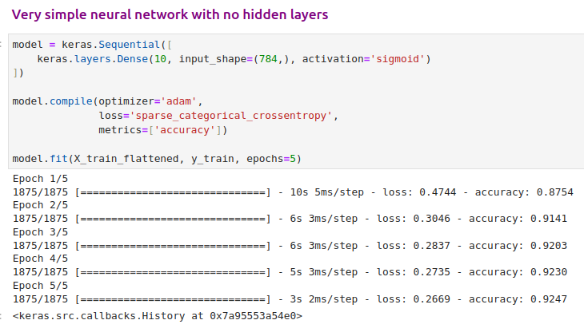
007.3 Train Model
https://www.youtube.com/watch?v=iqQgED9vV7k&list=PLeo1K3hjS3uu7CxAacxVndI4bE_o3BDtO&index=7
Train Model (15:30-23:50/36:38)
Our output = 10 categories, input_shape = (28 * 28 = 784, ), activation function = ‘sigmoid’.
Optimizer = ‘adam’, loss function is “categorical_crossentropy”, metrics is “accuracy” measurement.
Model fit X_train flattened data and y_train. The run epochs = 5.
What is difference between Epoch (时代)and Episode (一集)?
In machine learning or deep learning, we use epoch for training a single task.
In reinforcement learning or game, we use episode when game is over.

Slide 26
007.4 Evaluate Model

Slide 27

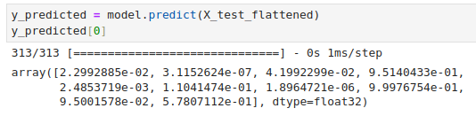
007.4 Evaluate Model
https://www.youtube.com/watch?v=iqQgED9vV7k&list=PLeo1K3hjS3uu7CxAacxVndI4bE_o3BDtO&index=7
Evaluate Model (23:51-24:00/36:38)
Evaluate X_test_flattened with y_test data.
We have Error = 0.27, we have initial accuracy = 92%.
We will improve the accuracy later on by adding extra hidden layer.

Slide 28
007.5 Test for first Image

Slide 29
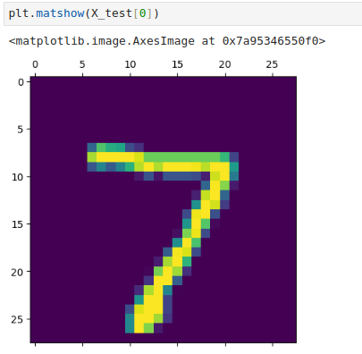
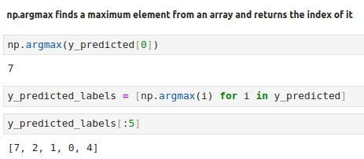
007.5 Test for First Image
https://www.youtube.com/watch?v=iqQgED9vV7k&list=PLeo1K3hjS3uu7CxAacxVndI4bE_o3BDtO&index=7
Test for First Image (24:01-24:30/36:38)
We have y_test labels and predicted labels. They both should be the same (Because the accuracy is 92%).
1. Display the First Digit image ‘7’.
2. We use “argmax” to find the biggest probability in the prediction which is ‘7’.
3. We print 0 to labels: [7, 2, 1, 0, 4].

Slide 30
007.6 Seaborn Plot

Slide 31
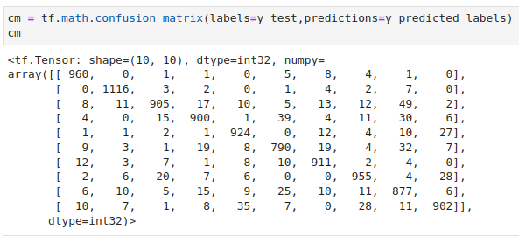
007.6 Seaborn Plot
https://www.youtube.com/watch?v=iqQgED9vV7k&list=PLeo1K3hjS3uu7CxAacxVndI4bE_o3BDtO&index=7
Seaborn plot (24:50-25:00/36:38)
In machine learning, we know have the confusion matrix as below.

Slide 32
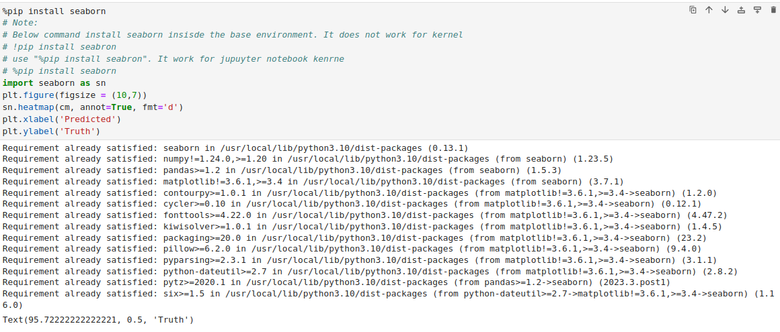
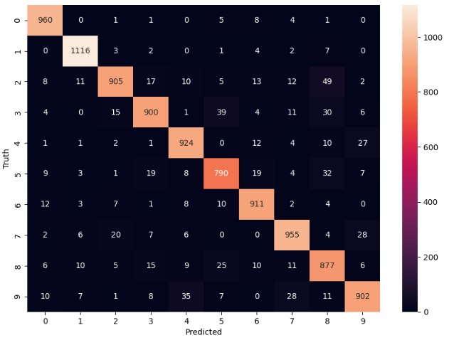
007.6 Seaborn Plot
https://www.youtube.com/watch?v=iqQgED9vV7k&list=PLeo1K3hjS3uu7CxAacxVndI4bE_o3BDtO&index=7
Seaborn plot (25:01-25:30/36:38)
Now, we use seaborn to plot the correlation.
We use “% pip install seaborn” to install in the Jupyter notebook environment.

Slide 33
007.7 Use Hidden Layer

Slide 34
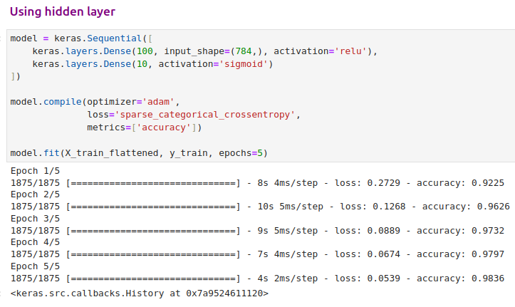
007.7 Use Hidden Layer
https://www.youtube.com/watch?v=iqQgED9vV7k&list=PLeo1K3hjS3uu7CxAacxVndI4bE_o3BDtO&index=7
Use Hidden Layer (26:00-28:30/36:38)
1. Previously, we have 92%. We add hidden layer (relu) to improve accuracy to 97.64%.
2. Note the output layer, we use the ‘sigmoid’.

Slide 35
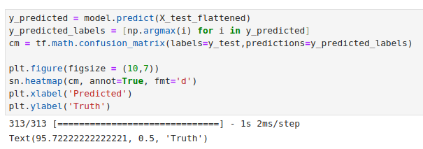
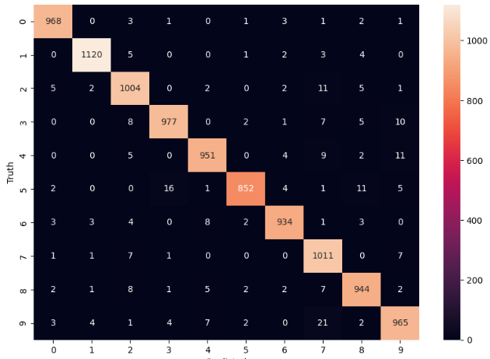
007.7 Use Hidden Layer
https://www.youtube.com/watch?v=iqQgED9vV7k&list=PLeo1K3hjS3uu7CxAacxVndI4bE_o3BDtO&index=7
Use Hidden Layer (28:31-30:30/36:38)
Seaborn plot.

Slide 36

007.7 Use Hidden Layer
https://www.youtube.com/watch?v=iqQgED9vV7k&list=PLeo1K3hjS3uu7CxAacxVndI4bE_o3BDtO&index=7
Use Hidden Layer (28:31-30:30/36:38)
Without the hidden layer, the accuracy is 92%.
When we add the hidden layer, the accuracy become 97%.
We improve the accuracy from 92% to 97%.

Slide 37
007.8 Use Keras Flatten Layer

Slide 38
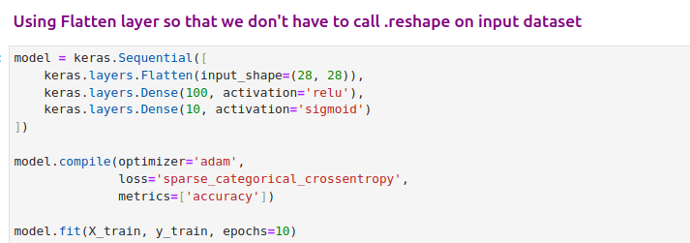
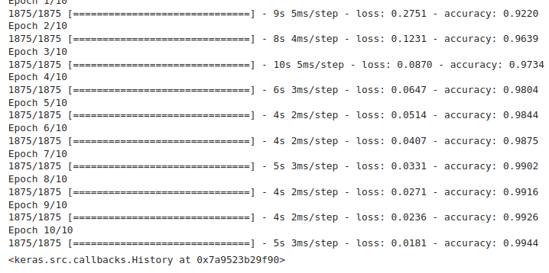
007.8 Use Keras Flatten Layer
https://www.youtube.com/watch?v=iqQgED9vV7k&list=PLeo1K3hjS3uu7CxAacxVndI4bE_o3BDtO&index=7
Use Keras Flatten Layer (31:00-36:30/36:38)
Keras let us add the flatten layer by Keras so that we don’t need to flatten by ourself.

Slide 39

007.8 Use Keras Flatten Layer
https://www.youtube.com/watch?v=iqQgED9vV7k&list=PLeo1K3hjS3uu7CxAacxVndI4bE_o3BDtO&index=7
Use Keras Flatten Layer (31:00-36:30/36:38)
Use Keras Flatten layer, we get the accuracy 97%.

Slide 40
007.9 Exercise

Slide 41
007.9 Exercise
https://www.youtube.com/watch?v=iqQgED9vV7k&list=PLeo1K3hjS3uu7CxAacxVndI4bE_o3BDtO&index=7
Exercise (36:01-36:38/36:38)
1. Use Colab
2. Add one more hidden layer.
3. Try different parameters number (Try and error): This the data scientist job to trial and error with any parameters.

Slide 42
End

