Slide 1

18.11 Exercise: Bank Churn: ANN
Peter H. Chen

Slide 2
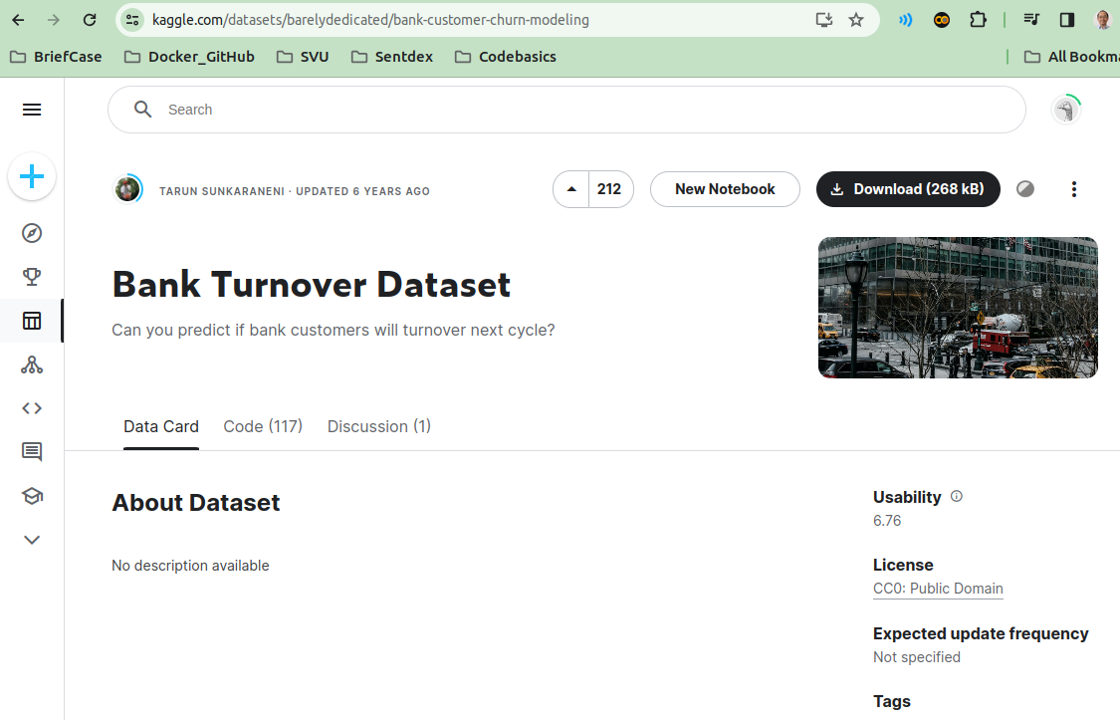
18.11 Exercise: Bank Customer Churn
https://www.youtube.com/watch?v=MSBY28IJ47U&list=PLeo1K3hjS3uu7CxAacxVndI4bE_o3BDtO&index=18
Exercise: Bank Customer Churn (40:01-40:02/40:40)
Exercise
1. Take this dataset for bank customer churn prediction:
https://www.kaggle.com/barelydedicated/bank-customer-churn-modeling
2. Build a deep learning model to predict churn rate at bank.
3. Once model is built, print classification report and analyze precision, recall, and f1-score
Below is the dataset. Dataset is under bank_churn folder.

Slide 3
18.12 Import Libraries

Slide 4
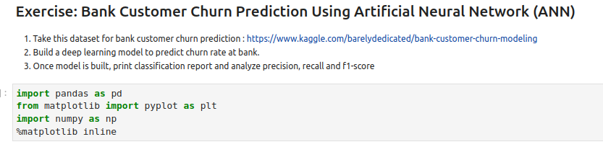
18.12 Import Libraries
https://www.youtube.com/watch?v=MSBY28IJ47U&list=PLeo1K3hjS3uu7CxAacxVndI4bE_o3BDtO&index=18
Import Libraries (40:03-40:04/40:40)

Slide 5
18.13 Check CPU/GPU

Slide 6
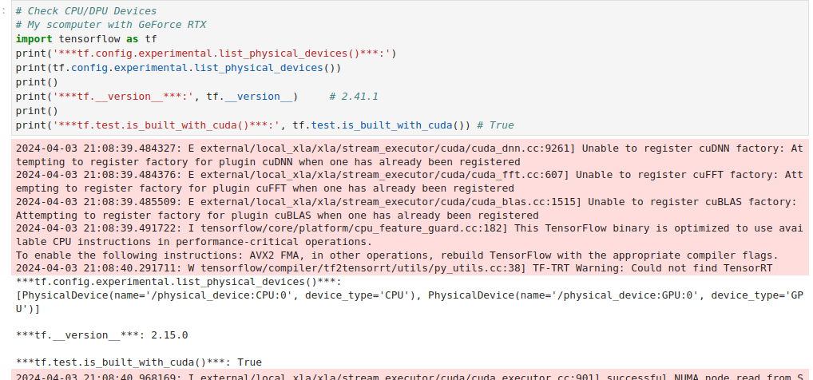
18.13 Check CPU/GPU
https://www.youtube.com/watch?v=MSBY28IJ47U&list=PLeo1K3hjS3uu7CxAacxVndI4bE_o3BDtO&index=18
Check CPU/GPU (40:05-40:06/40:40)

Slide 7
18.14 Load Dataset

Slide 8
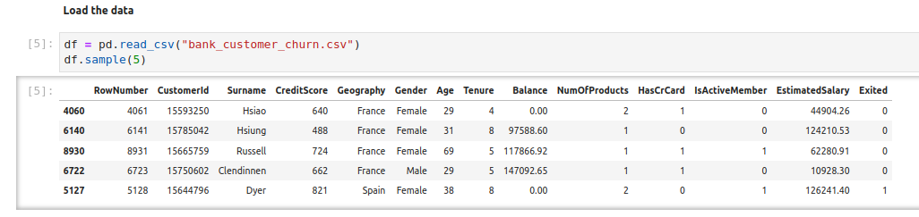
18.14 Load Dataset
https://www.youtube.com/watch?v=MSBY28IJ47U&list=PLeo1K3hjS3uu7CxAacxVndI4bE_o3BDtO&index=18
Load Dataset (40:07-40:08/40:40)

Slide 9
18.15 Drop Useless Columns

Slide 10
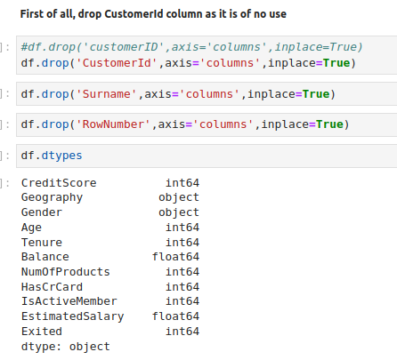
18.15 Drop Useless Columns
https://www.youtube.com/watch?v=MSBY28IJ47U&list=PLeo1K3hjS3uu7CxAacxVndI4bE_o3BDtO&index=18
Drop Useless Columns (40:09-40:10/40:40)

Slide 11
18.16 Check Invalid Data

Slide 12
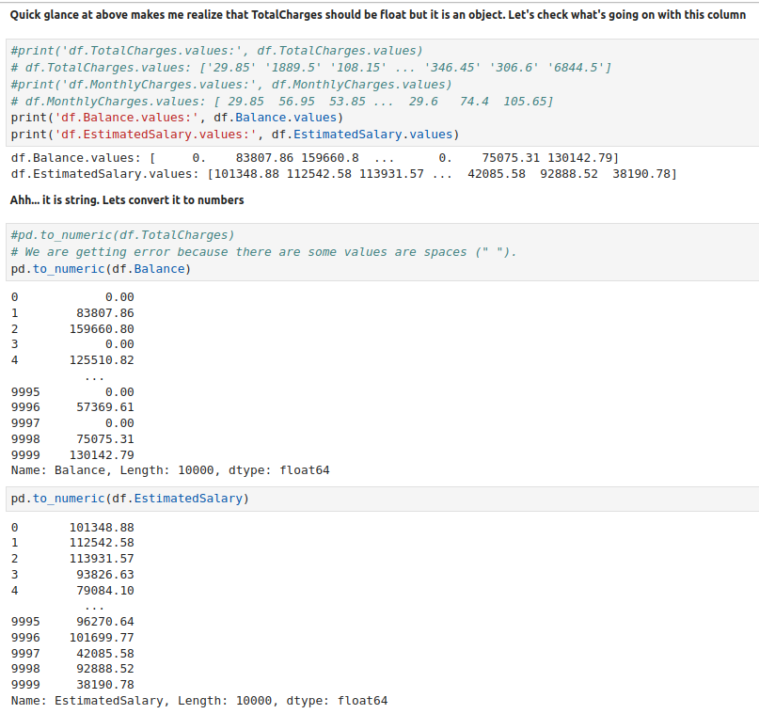
18.16 Check Invalid Data
https://www.youtube.com/watch?v=MSBY28IJ47U&list=PLeo1K3hjS3uu7CxAacxVndI4bE_o3BDtO&index=18
Check Invalid Data (40:11-40:12/40:40)
Invalid Data: NaN (‘ ‘)

Slide 13
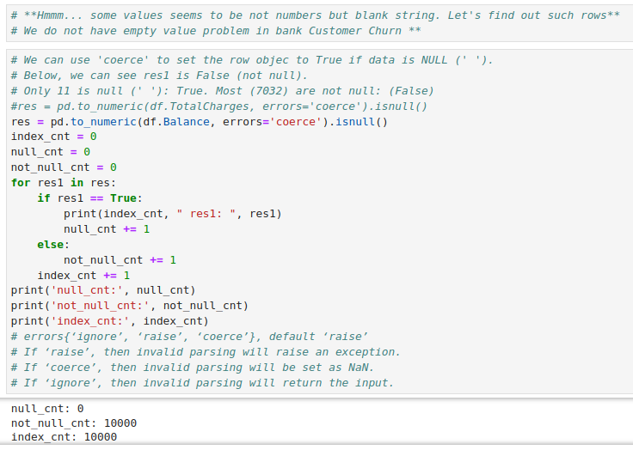
18.16 Check Invalid Data
https://www.youtube.com/watch?v=MSBY28IJ47U&list=PLeo1K3hjS3uu7CxAacxVndI4bE_o3BDtO&index=18
Check Invalid Data (40:13-40:14/40:40)
We do not have Invalid Data: NaN (‘ ‘)

Slide 14
18.17 Data Visualization

Slide 15
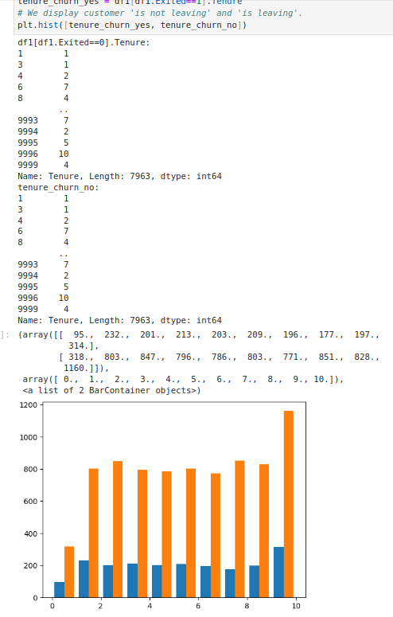
18.17 Data Visualization
https://www.youtube.com/watch?v=MSBY28IJ47U&list=PLeo1K3hjS3uu7CxAacxVndI4bE_o3BDtO&index=18
Data Visualization (40:15-40:16/40:40)
We view some important data

Slide 16
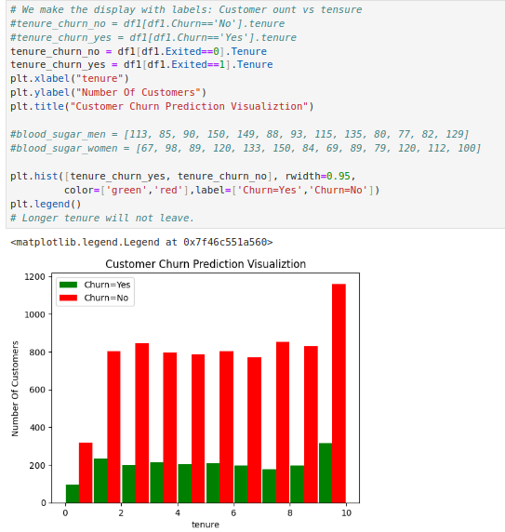
18.17 Data Visualization
https://www.youtube.com/watch?v=MSBY28IJ47U&list=PLeo1K3hjS3uu7CxAacxVndI4bE_o3BDtO&index=18
Data Visualization (40:17-40:18/40:40)
View Tenure histogram

Slide 17
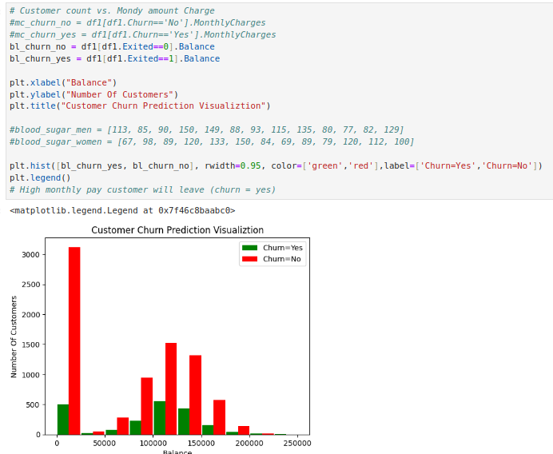
18.17 Data Visualization
https://www.youtube.com/watch?v=MSBY28IJ47U&list=PLeo1K3hjS3uu7CxAacxVndI4bE_o3BDtO&index=18
Data Visualization (40:19-40:20/40:40)
View Balance histogram

Slide 18
18.18 Unique Column Value

Slide 19
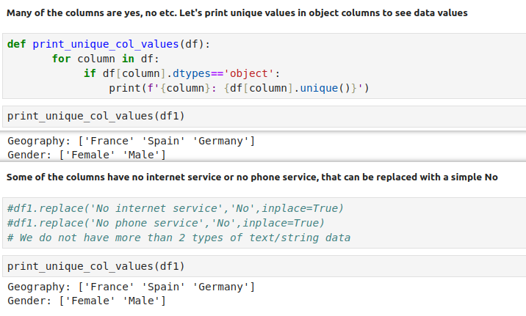
18.18 Unique Column Value
https://www.youtube.com/watch?v=MSBY28IJ47U&list=PLeo1K3hjS3uu7CxAacxVndI4bE_o3BDtO&index=18
Unique Column Value (40:21-40:22/40:40)
Print the columns with more than 2 (0 and 1) values.

Slide 20
18.19 Convert Yes/No to 1/0

Slide 21
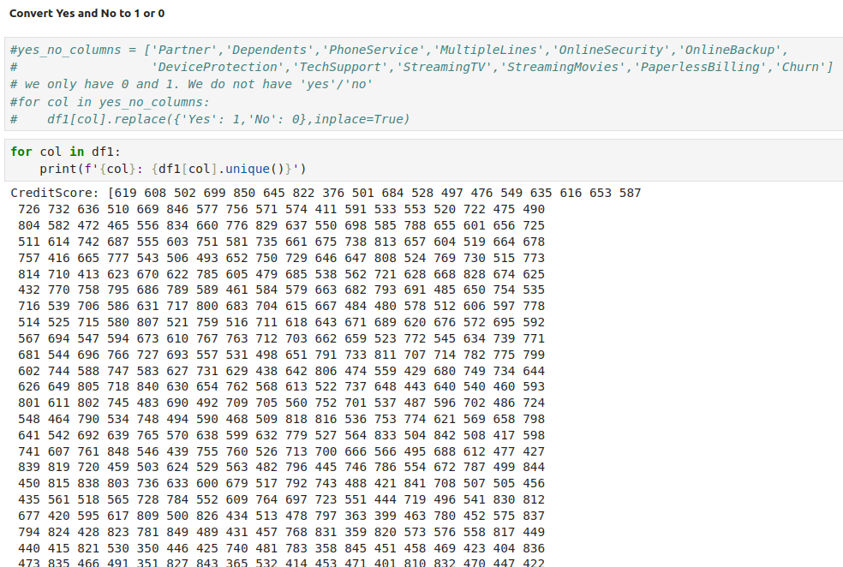
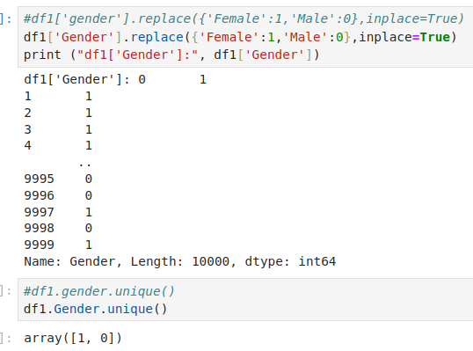
18.19 Convert Yes/No to 1/0
https://www.youtube.com/watch?v=MSBY28IJ47U&list=PLeo1K3hjS3uu7CxAacxVndI4bE_o3BDtO&index=18
Convert Yes/No to 1/0 (40:23-40:24/40:40)

Slide 22
18.20 One-Hot Encoding

Slide 23
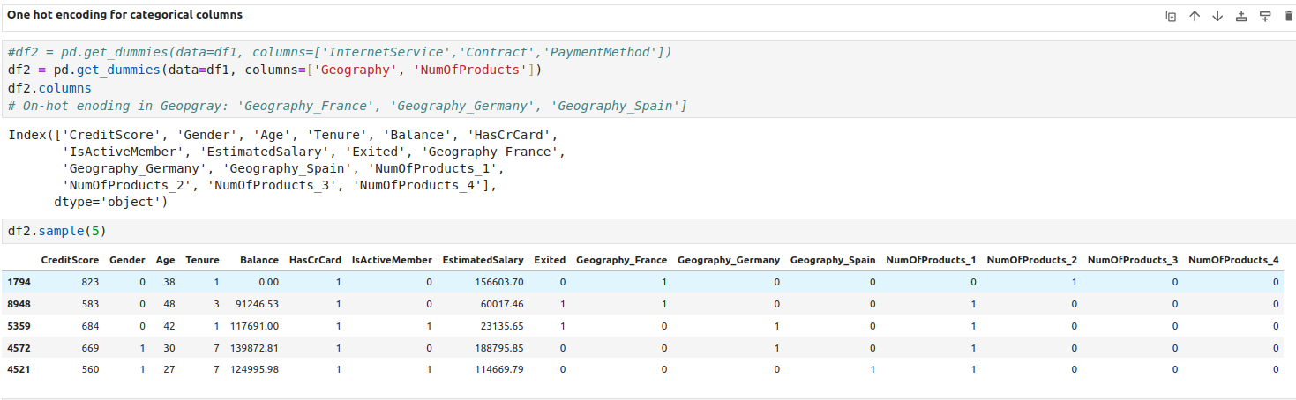
18.20 One-Hot Encoding
https://www.youtube.com/watch?v=MSBY28IJ47U&list=PLeo1K3hjS3uu7CxAacxVndI4bE_o3BDtO&index=18
One-Hot Encoding (40:25-40:26/40:40)

Slide 24
18.21 Scale Data

Slide 25
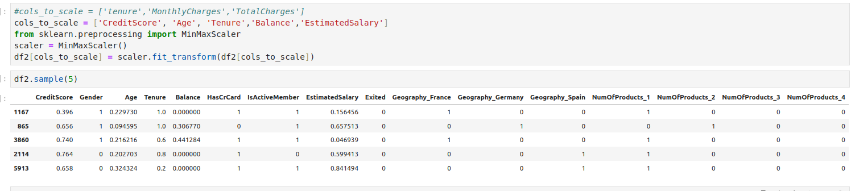
18.21 Scale Data
https://www.youtube.com/watch?v=MSBY28IJ47U&list=PLeo1K3hjS3uu7CxAacxVndI4bE_o3BDtO&index=18
Scale Data (40:27-40:28/40:40)

Slide 26
18.22 Split Data into Train/Test

Slide 27
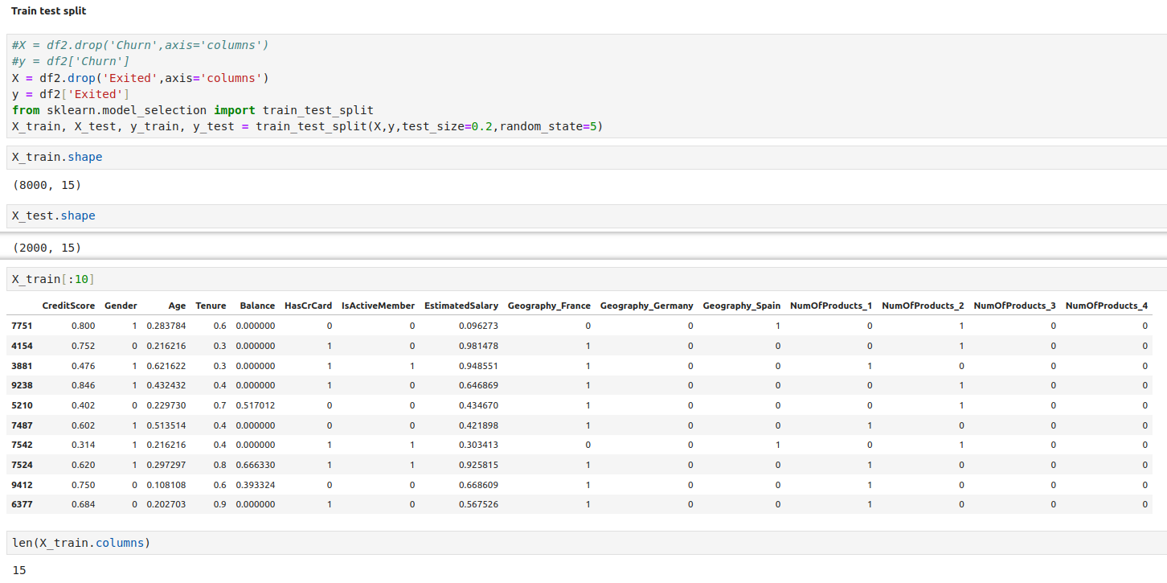
18.22 Split Data into Train/Test
https://www.youtube.com/watch?v=MSBY28IJ47U&list=PLeo1K3hjS3uu7CxAacxVndI4bE_o3BDtO&index=18
Split Data into Train/Test (40:27-40:28/40:40)

Slide 28
18.23 Build ANN Model

Slide 29
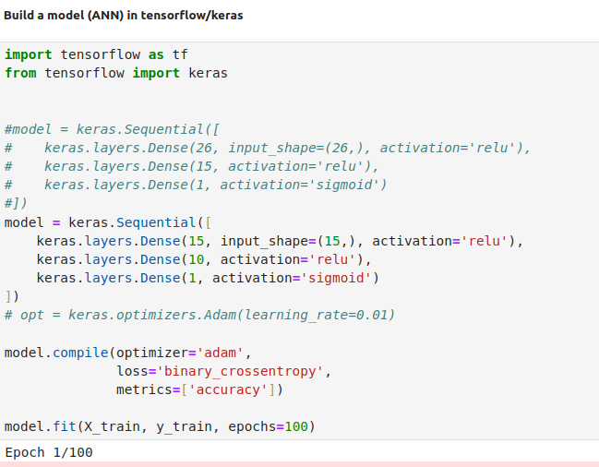
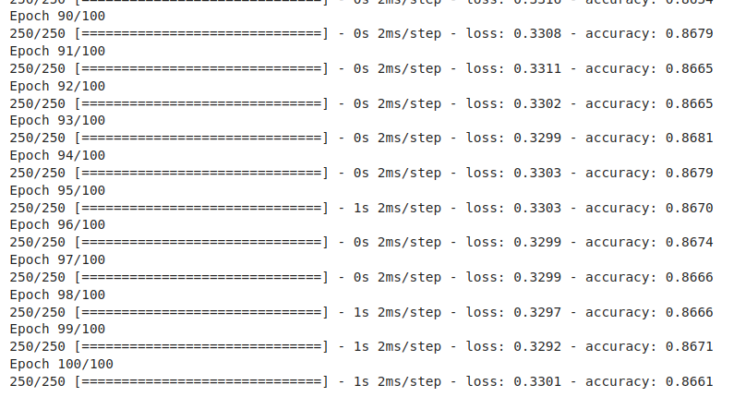
18.23 Build ANN Model
https://www.youtube.com/watch?v=MSBY28IJ47U&list=PLeo1K3hjS3uu7CxAacxVndI4bE_o3BDtO&index=18
Build ANN Model (40:29-40:30/40:40)

Slide 30
18.24 Test Model

Slide 31
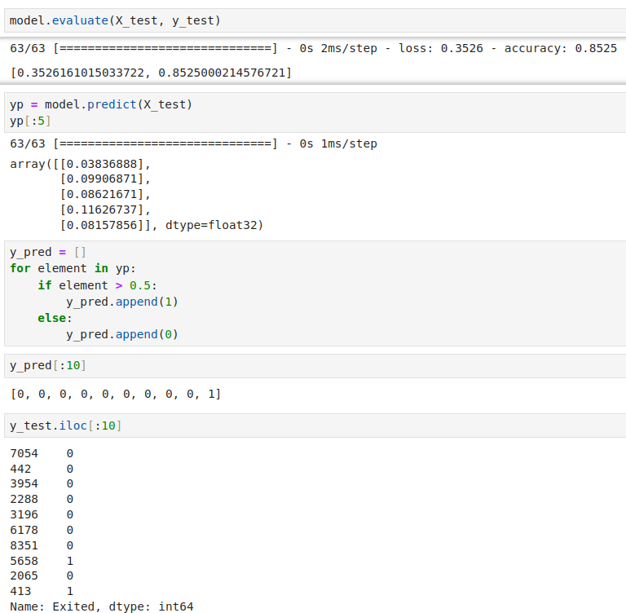
18.24 Test Model
https://www.youtube.com/watch?v=MSBY28IJ47U&list=PLeo1K3hjS3uu7CxAacxVndI4bE_o3BDtO&index=18
Test Model (40:31-40:32/40:40)

Slide 32
18.25 Sklearn Confusion Matrix

Slide 33
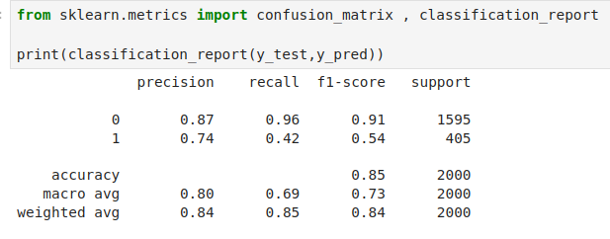
18.25 sklearn Confusion Matrix
https://www.youtube.com/watch?v=MSBY28IJ47U&list=PLeo1K3hjS3uu7CxAacxVndI4bE_o3BDtO&index=18
Sklearn Confusion Matrix (40:33-40:34/40:40)

Slide 34
18.26 Seaborn Plot Confusion Matrix

Slide 35
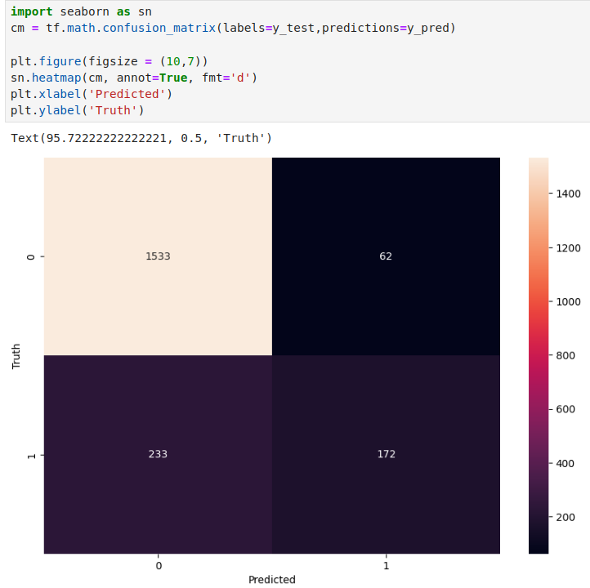
18.26 Seaborn Plot Confusion Matrix
https://www.youtube.com/watch?v=MSBY28IJ47U&list=PLeo1K3hjS3uu7CxAacxVndI4bE_o3BDtO&index=18
Seaborn Plot Confusion Matrix (40:35-40:36/40:40)

Slide 36
18.27 Confusion Matrix: Accuracy

Slide 37
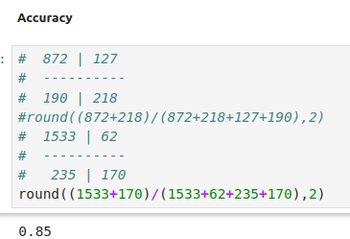
18.27 Confusion Matrix: Accuracy
https://www.youtube.com/watch?v=MSBY28IJ47U&list=PLeo1K3hjS3uu7CxAacxVndI4bE_o3BDtO&index=18
Confusion Matrix: Accuracy (40:37-40:38/40:40)

Slide 38
18.28 Confusion Matrix: Precision

Slide 39
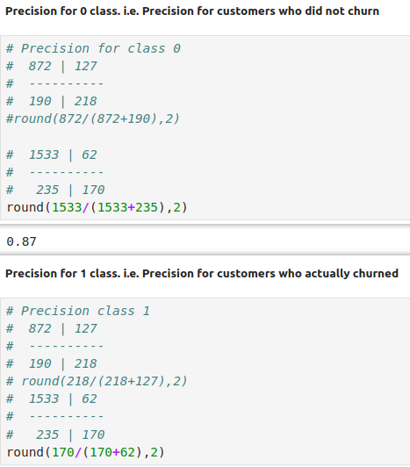
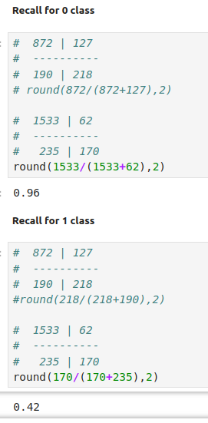
18.28 Confusion Matrix: Precision
https://www.youtube.com/watch?v=MSBY28IJ47U&list=PLeo1K3hjS3uu7CxAacxVndI4bE_o3BDtO&index=18
Confusion Matrix: Recall (40:39-40:40/40:40)

Slide 40
End

