Slide 1

32.02 Kaggle YOLO V8
Peter H. Chen

Slide 2
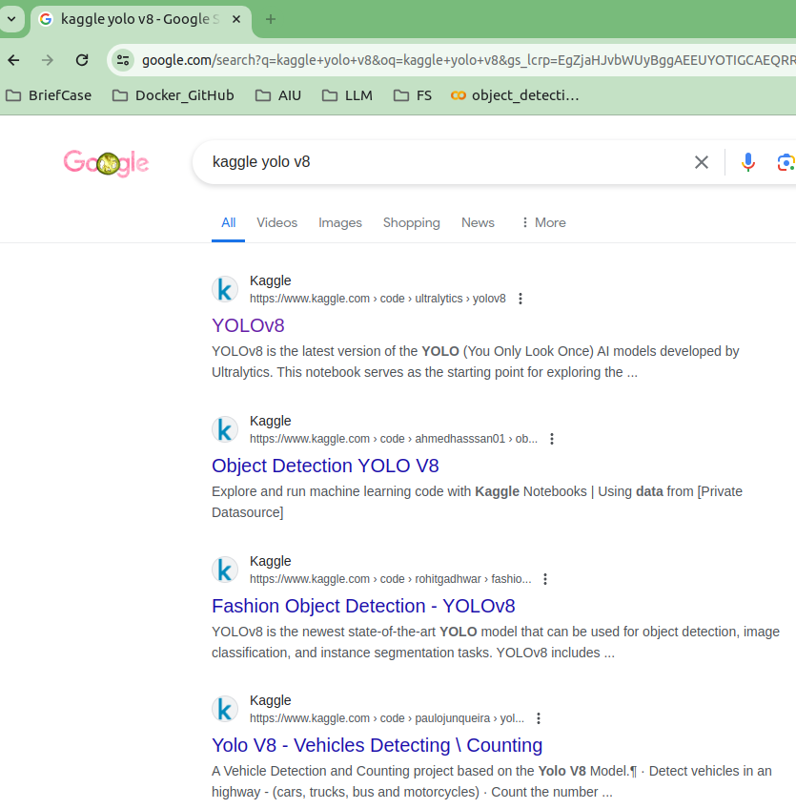
32.02 Kaggle YOLO V8
https://www.youtube.com/watch?v=IfRMV2MY9n0&list=PLeo1K3hjS3uu7CxAacxVndI4bE_o3BDtO&index=32
YOLO Code (2:21-3:30/14:52)
Google search “Kaggle YOLO V8”

Slide 3
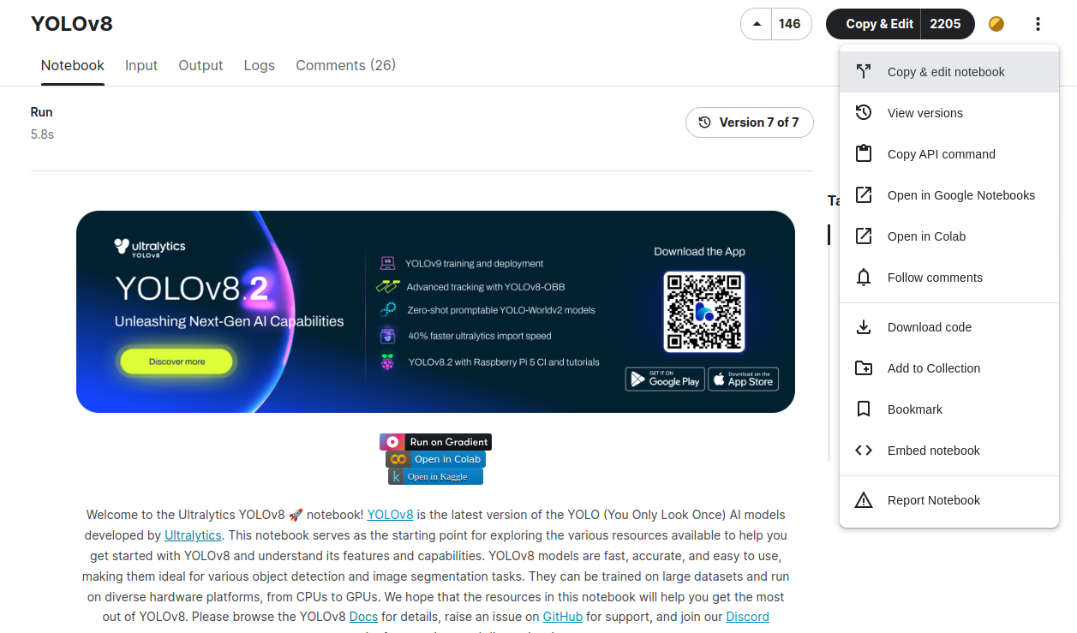
32.02 Kaggle YOLO V8
https://www.youtube.com/watch?v=IfRMV2MY9n0&list=PLeo1K3hjS3uu7CxAacxVndI4bE_o3BDtO&index=32
YOLO Code (3:31-4:30/14:52)
Right top menu: Open in Colab.

Slide 4
32.02.01 Setup

Slide 5
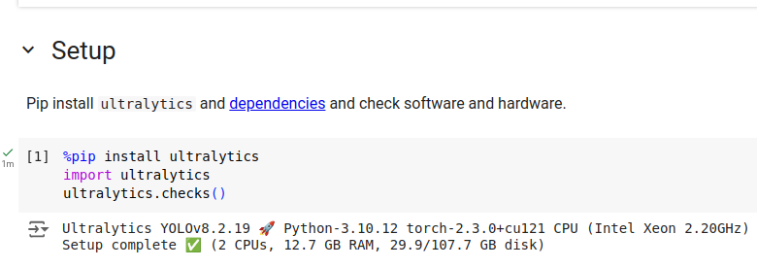
32.02.01 Setup
https://www.youtube.com/watch?v=IfRMV2MY9n0&list=PLeo1K3hjS3uu7CxAacxVndI4bE_o3BDtO&index=32
Setup (4:31-5:30/14:52)
> % pip install ultralytics
Install ultralytics inside the jupyter notebook
What is Ultralytics:
1. The Ultralytics command line interface (CLI) allows for simple single-line commands without the need for a Python environment.
2. CLI requires no customization or Python code.

Slide 6
32.02.02 Run Yolo V8

Slide 7
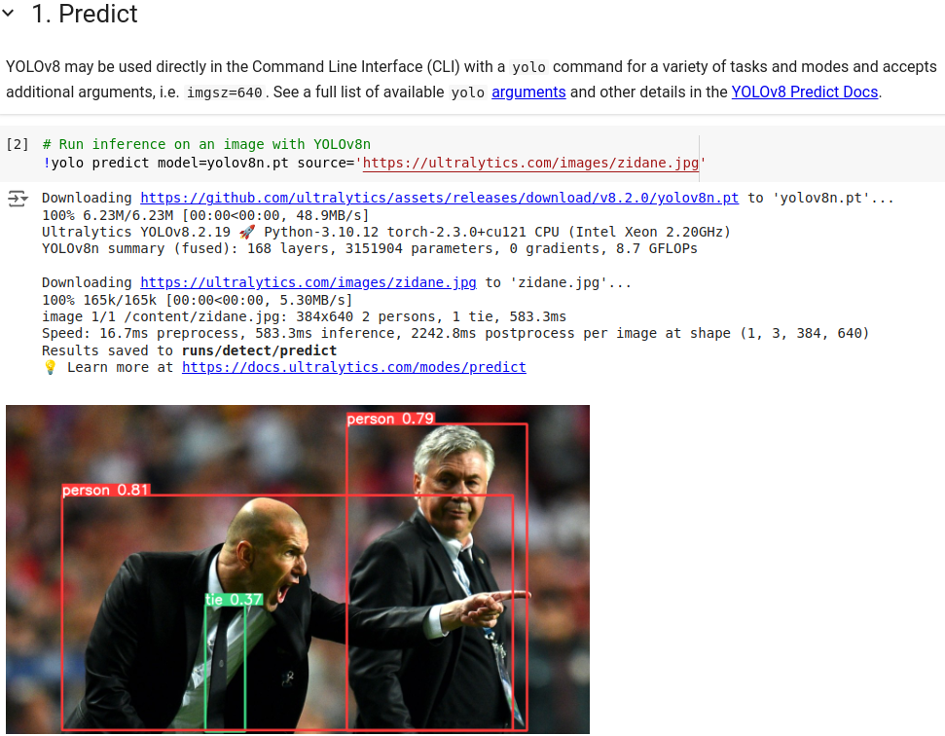
32.02.02 Run Yolo V8
https://www.youtube.com/watch?v=IfRMV2MY9n0&list=PLeo1K3hjS3uu7CxAacxVndI4bE_o3BDtO&index=32
Run Yolo V8 (5:31-6:30/14:52)
>!yolo predict model =yolo8 source =”image”
Ultralytics allow CLI command in jupyter notebook.
Run yolo command, select model, and select the image for object detection.

Slide 8
32.02.03 Validate on COCO Dataset Val

Slide 9
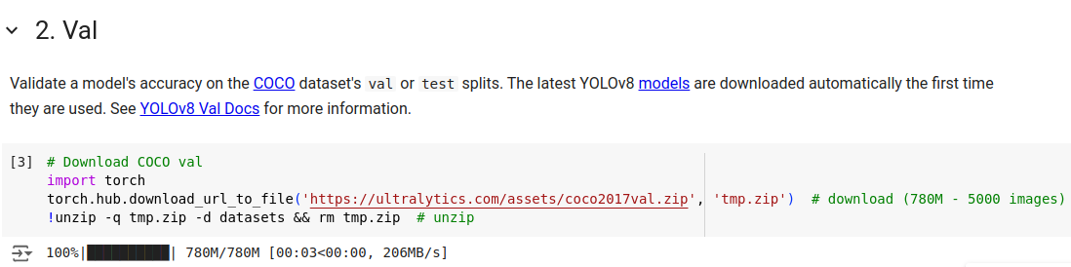
32.02.03 Validate on COCO Dataset
https://www.youtube.com/watch?v=IfRMV2MY9n0&list=PLeo1K3hjS3uu7CxAacxVndI4bE_o3BDtO&index=32
Validate on COCO Dataset (6:31-7:30/14:52)
Download COCO Dataset

Slide 10
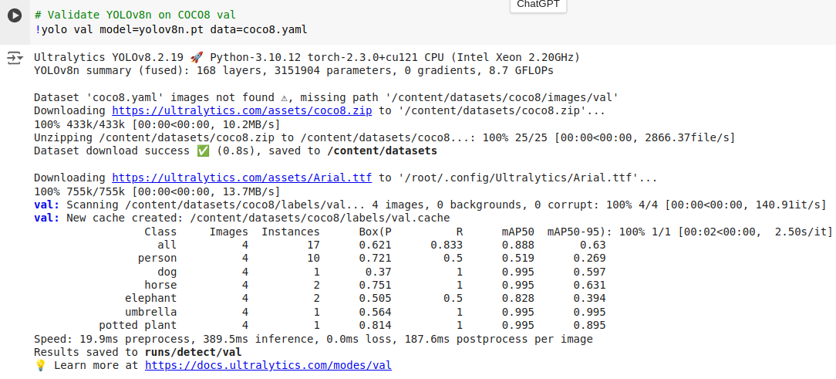
32.02.03 Validate on COCO Dataset
https://www.youtube.com/watch?v=IfRMV2MY9n0&list=PLeo1K3hjS3uu7CxAacxVndI4bE_o3BDtO&index=32
Validate on COCO Dataset (7:31-8:30/14:52)
Validate COCO Val Dataset with yolov8 model.
MAP (Mean Average Precision): all = 0.888, person = 0.519, …, umbrella = 0.995, plant = 0.995

Slide 11
32.02.04 Train

Slide 12
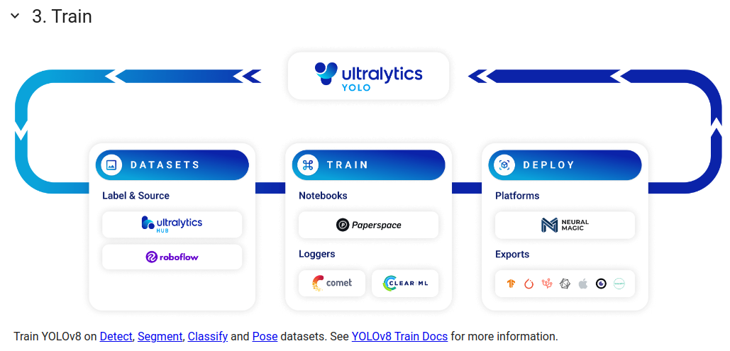
32.02.04 Train
https://www.youtube.com/watch?v=IfRMV2MY9n0&list=PLeo1K3hjS3uu7CxAacxVndI4bE_o3BDtO&index=32
Train (8:31-9:30/14:52)
Train YOLO V8 on Detection, Segmentation, Classification, Dataset

Slide 13
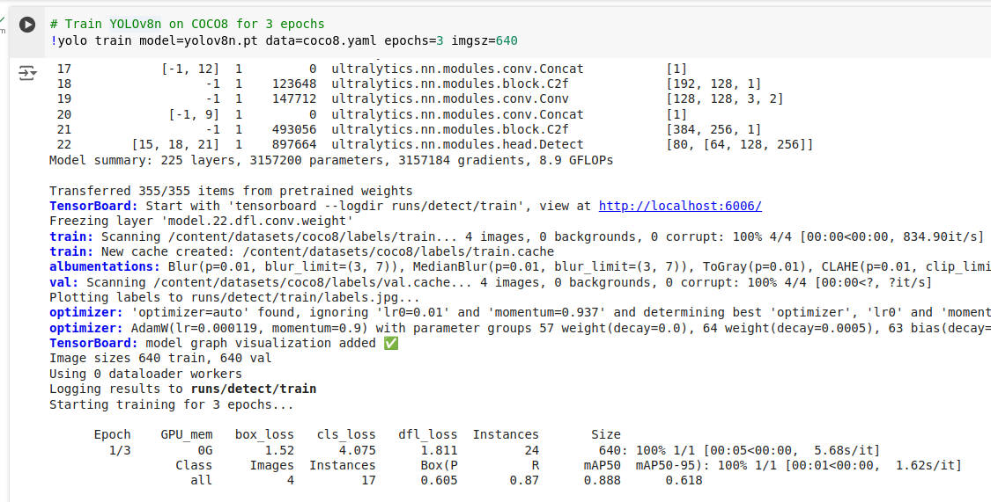
32.02.04 Train
https://www.youtube.com/watch?v=IfRMV2MY9n0&list=PLeo1K3hjS3uu7CxAacxVndI4bE_o3BDtO&index=32
Train (9:31-10:30/14:52)
Train YOLO V8 with 3 Epochs.

Slide 14
32.02.05 Export Model

Slide 15
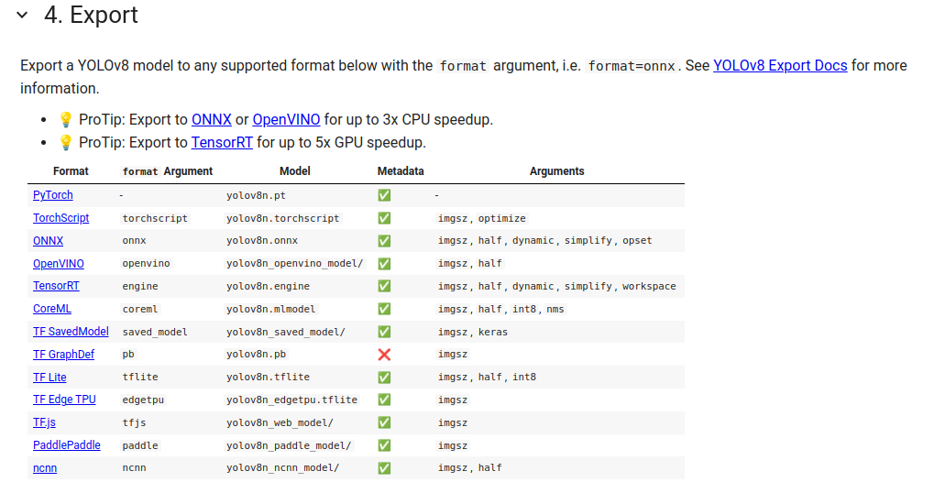
32.02.05 Export Model
https://www.youtube.com/watch?v=IfRMV2MY9n0&list=PLeo1K3hjS3uu7CxAacxVndI4bE_o3BDtO&index=32
Export Model (10:31-11:30/14:52)
Export YOLO V8 into PyTorch, Tensorflow Model, etc.

Slide 16
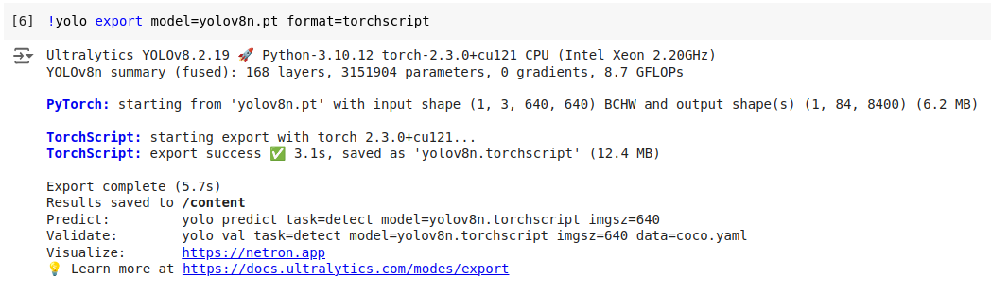
32.02.05 Export
https://www.youtube.com/watch?v=IfRMV2MY9n0&list=PLeo1K3hjS3uu7CxAacxVndI4bE_o3BDtO&index=32
Export Model (11:31-12:30/14:52)
Export YOLO V8 into PyTorch, Tensorflow Model, etc.

Slide 17
32.02.06 YOLO V8 in Python

Slide 18
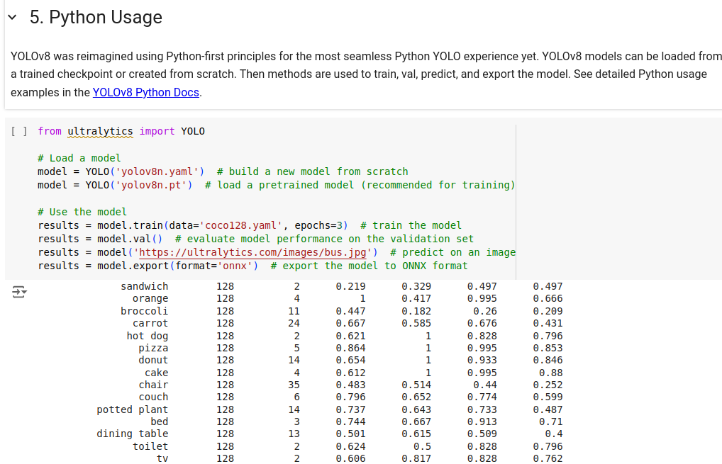
32.02.06 YOLO V8 in Python
https://www.youtube.com/watch?v=IfRMV2MY9n0&list=PLeo1K3hjS3uu7CxAacxVndI4bE_o3BDtO&index=32
YOLO V8 in Python (12:31-13:00/14:52)
YOLO V8 used in Python

Slide 19
32.02.07 Task

Slide 20
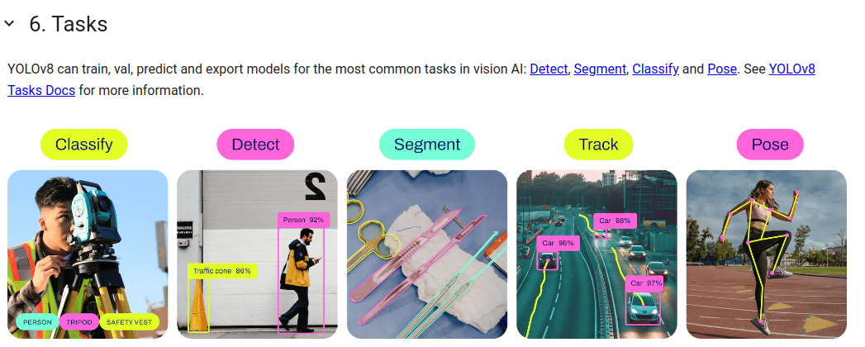
32.02.07 Task
https://www.youtube.com/watch?v=IfRMV2MY9n0&list=PLeo1K3hjS3uu7CxAacxVndI4bE_o3BDtO&index=32
Task (13:01-13:10/14:52)

Slide 21
32.02.08 Detection

Slide 22
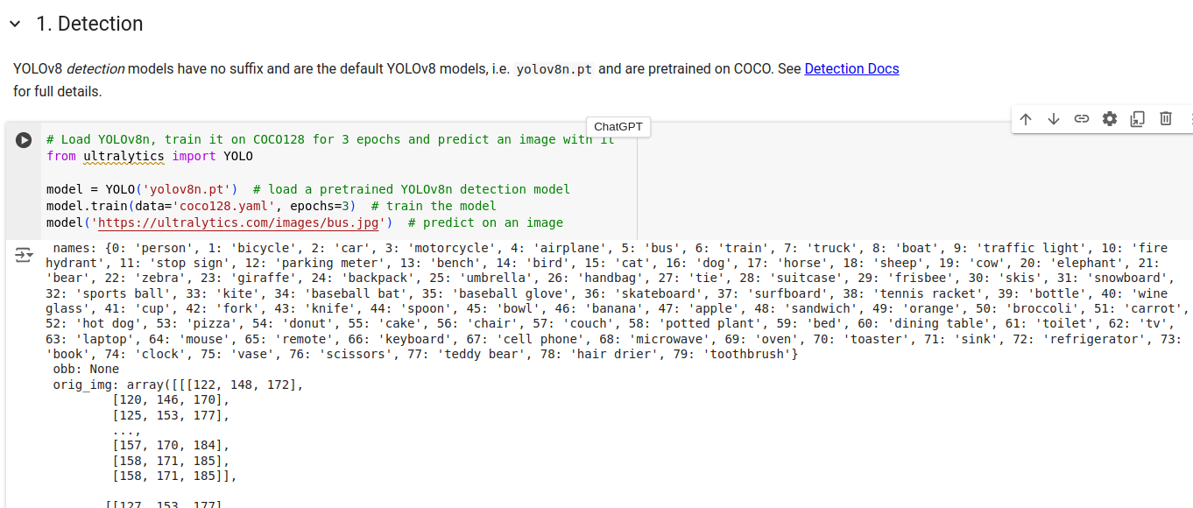
32.02.08 Detection
https://www.youtube.com/watch?v=IfRMV2MY9n0&list=PLeo1K3hjS3uu7CxAacxVndI4bE_o3BDtO&index=32
Detection (13:11-13:20/14:52)

Slide 23
32.02.09 Segmentation

Slide 24
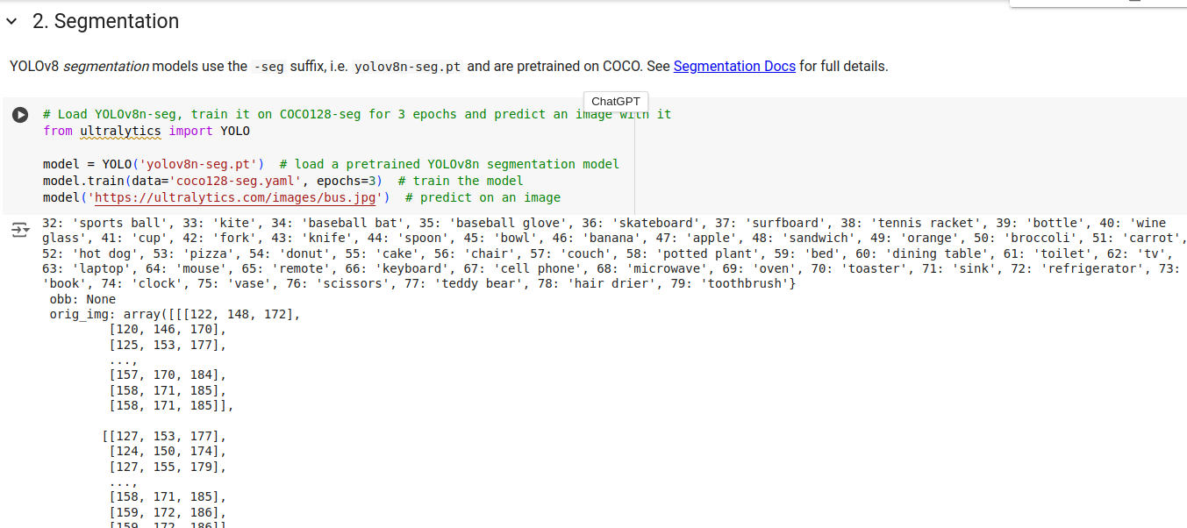
32.02.09 Segmentation
https://www.youtube.com/watch?v=IfRMV2MY9n0&list=PLeo1K3hjS3uu7CxAacxVndI4bE_o3BDtO&index=32
Segmentation (13:21-13:30/14:52)
Bounding Box for detected Objects

Slide 25
32.02.10 Classification

Slide 26
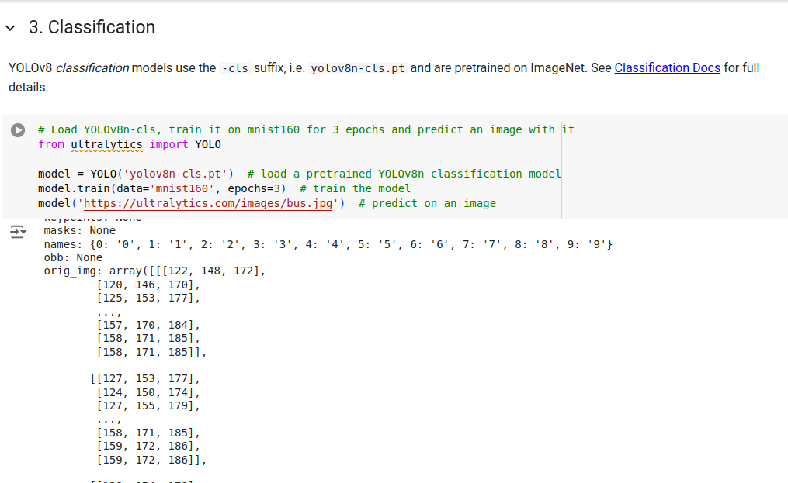
32.02.10 Classification
https://www.youtube.com/watch?v=IfRMV2MY9n0&list=PLeo1K3hjS3uu7CxAacxVndI4bE_o3BDtO&index=32
Classification (13:21-13:30/14:52)
Classify dog, cat, etc.

Slide 27
32.02.11 Pose

Slide 28
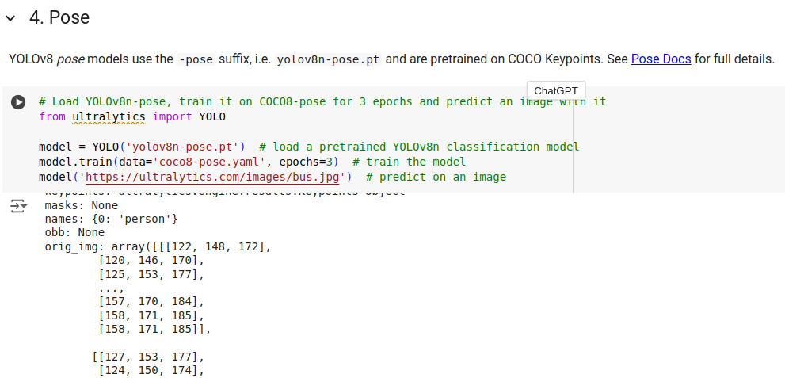
32.02.11 Pose
https://www.youtube.com/watch?v=IfRMV2MY9n0&list=PLeo1K3hjS3uu7CxAacxVndI4bE_o3BDtO&index=32
Pose (13:31-14:00/14:52)
Draw skeleton for different pose.

Slide 29
End

