Slide 1

32.03 YOLO V8 Object Detection
Peter H. Chen

Slide 2
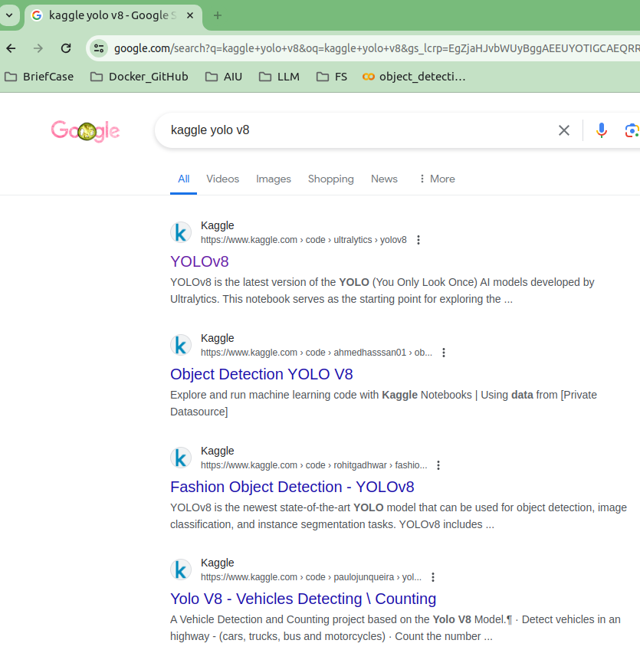
32.03 YOLO V8 Object Detection
https://www.youtube.com/watch?v=IfRMV2MY9n0&list=PLeo1K3hjS3uu7CxAacxVndI4bE_o3BDtO&index=32
YOLO V8 Object Detection (2:21-3:30/14:52)
Google search “Kaggle YOLO V8 Object Detection”

Slide 3
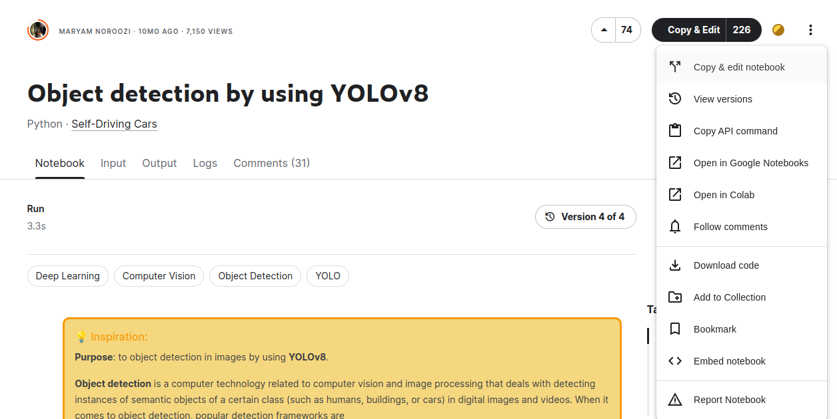
32.03 YOLO V8 Object Detection
https://www.youtube.com/watch?v=IfRMV2MY9n0&list=PLeo1K3hjS3uu7CxAacxVndI4bE_o3BDtO&index=32
YOLO V8 Object Detection (3:31-4:30/14:52)
Right top menu: Open in Colab.

Slide 4
32.03.01 Import Library

Slide 5
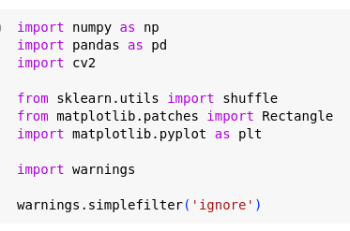
32.03.01 Import Library
https://www.youtube.com/watch?v=IfRMV2MY9n0&list=PLeo1K3hjS3uu7CxAacxVndI4bE_o3BDtO&index=32
Import Library (4:31-5:30/14:52)

Slide 6
32.03.02 Load Data

Slide 7
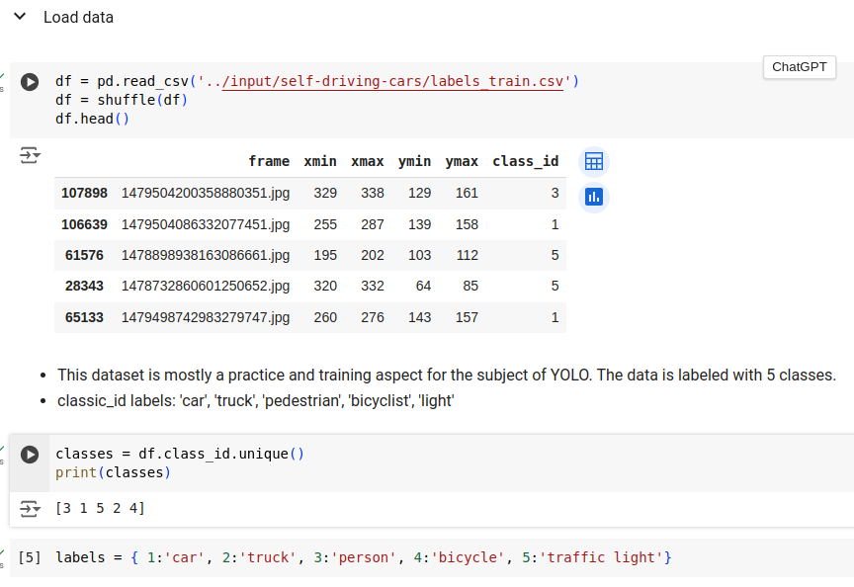
32.03.02 Load Data
https://www.youtube.com/watch?v=IfRMV2MY9n0&list=PLeo1K3hjS3uu7CxAacxVndI4bE_o3BDtO&index=32
Load Data (2:31-3:30/14:52)

Slide 8
32.03.03 Display Labeled Image

Slide 9
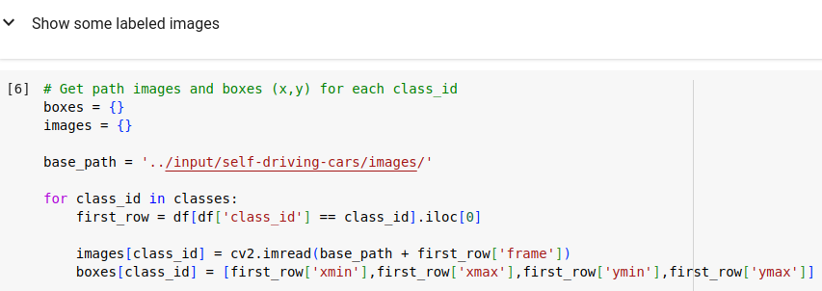
32.03.03 Display Labeled Image
https://www.youtube.com/watch?v=IfRMV2MY9n0&list=PLeo1K3hjS3uu7CxAacxVndI4bE_o3BDtO&index=32
Display Labeled Image (3:31-4:30/14:52)

Slide 10
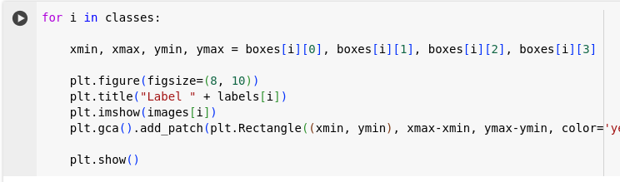
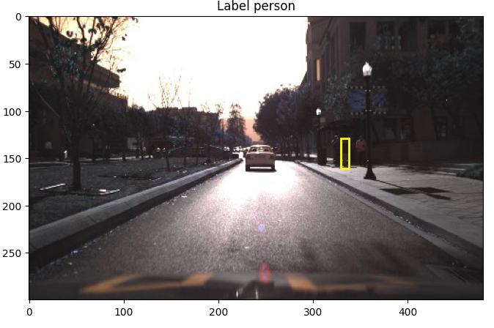
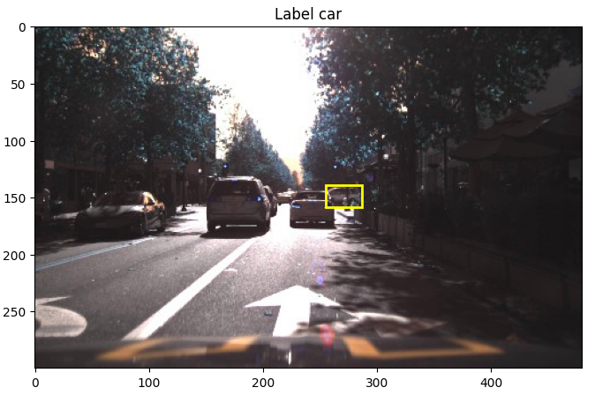
32.03.03 Display Labeled Image
https://www.youtube.com/watch?v=IfRMV2MY9n0&list=PLeo1K3hjS3uu7CxAacxVndI4bE_o3BDtO&index=32
Display Labeled Image (4:31-5:30/14:52)

Slide 11
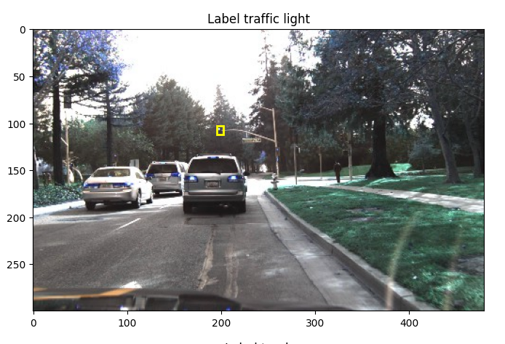
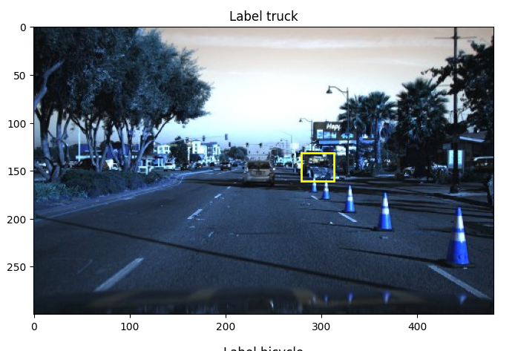
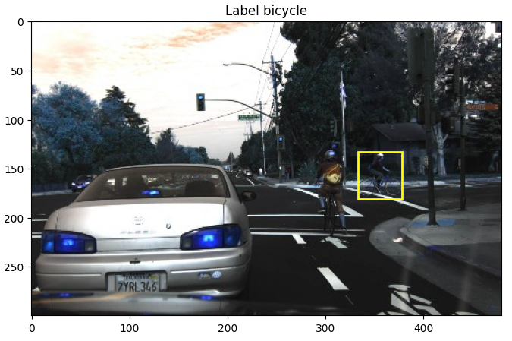
32.03.03 Display Labeled Image
https://www.youtube.com/watch?v=IfRMV2MY9n0&list=PLeo1K3hjS3uu7CxAacxVndI4bE_o3BDtO&index=32
Display Labeled Image (5:31-6:30/14:52)

Slide 12
32.03.04 Model

Slide 13
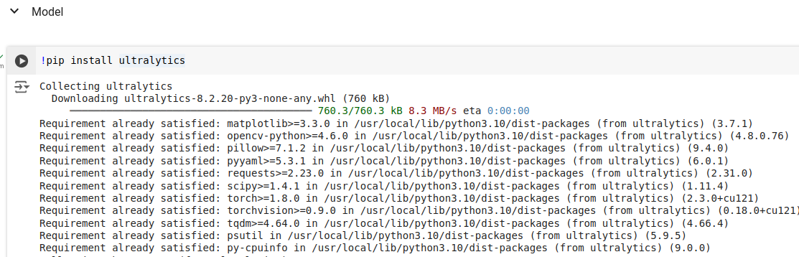
32.03.04 Model
https://www.youtube.com/watch?v=IfRMV2MY9n0&list=PLeo1K3hjS3uu7CxAacxVndI4bE_o3BDtO&index=32
Model (4:31-5:30/14:52)
Install Ultralytics (Linux command tools in Jupyter Notebook)

Slide 14
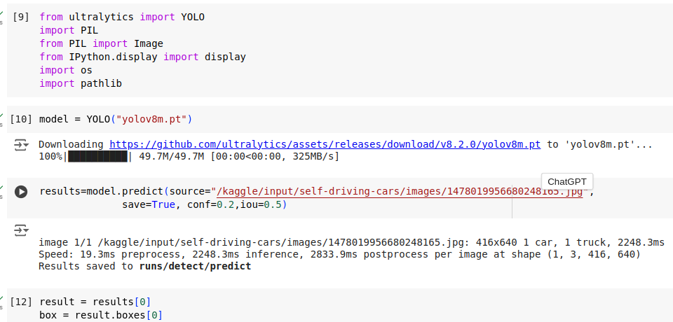
32.03.04 Model
https://www.youtube.com/watch?v=IfRMV2MY9n0&list=PLeo1K3hjS3uu7CxAacxVndI4bE_o3BDtO&index=32
Model (6:31-7:30/14:52)
Perform Object detection for load image

Slide 15
32.03.05 Prediction Result Processing

Slide 16
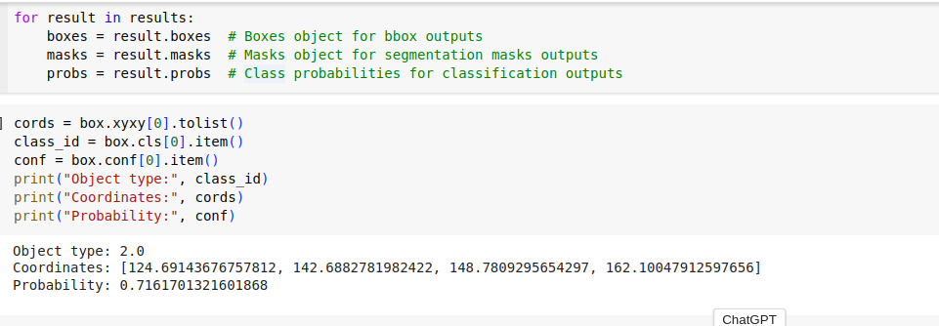
32.03.05 Prediction Result Processing
https://www.youtube.com/watch?v=IfRMV2MY9n0&list=PLeo1K3hjS3uu7CxAacxVndI4bE_o3BDtO&index=32
Prediction Result Processing (7:31-8:30/14:52)
Result processing

Slide 17
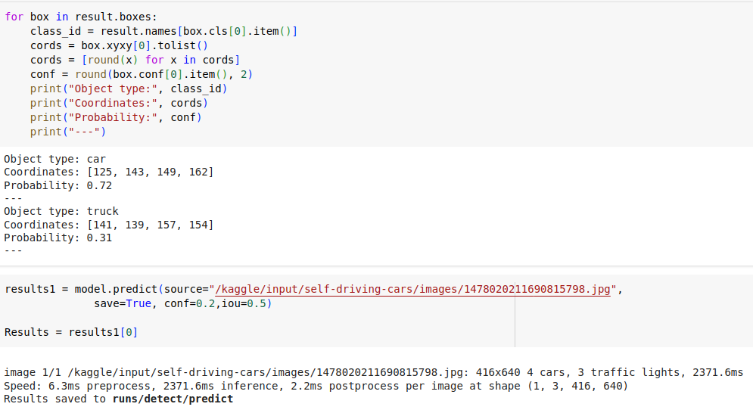
32.03.05 Prediction Result Processing
https://www.youtube.com/watch?v=IfRMV2MY9n0&list=PLeo1K3hjS3uu7CxAacxVndI4bE_o3BDtO&index=32
Prediction Result Processing (8:31-10:30/14:52)
Result processing

Slide 18
32.03.06 Plot Result

Slide 19
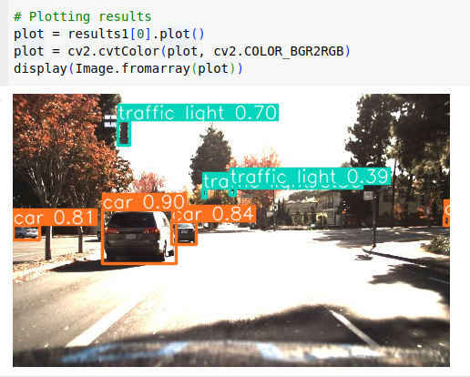
32.03.06 Plot Result
https://www.youtube.com/watch?v=IfRMV2MY9n0&list=PLeo1K3hjS3uu7CxAacxVndI4bE_o3BDtO&index=32
Plot Result (10:31-14:52/14:52)

Slide 20
End

