Slide 1

32.5 Tensorflow Hub: Object Detection
Peter H. Chen

Slide 2
32.5 Tensorflow Hub: Object Detection
https://www.youtube.com/watch?v=IfRMV2MY9n0&list=PLeo1K3hjS3uu7CxAacxVndI4bE_o3BDtO&index=32
Tensorflow Hub: Object Detection (2:51-3:00/14:52)
Tensorflow hub implement algorithm for object detection:
Tensorflow pre-trained model called TF-Hub Module.
1. The algorithm is FasterRCNN and Image dataset is from ResNet V2
2. The algorithm SSD (Single Shot MultiBox Detector) and image dataset is from ImageNet (Dataset name is MobileNet V2).
https://colab.research.google.com/github/tensorflow/docs/blob/master/site/en/hub/tutorials/object_detection.ipynb#scrollTo=DZ18R7dWNyoU

Slide 3
32.3 Setup

Slide 4
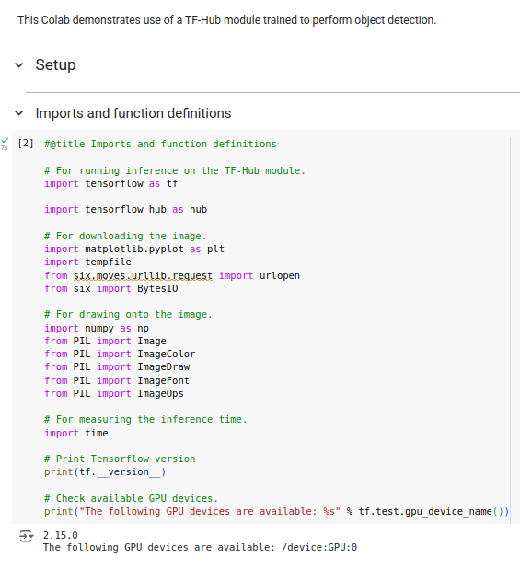
32.3 Setup
https://www.youtube.com/watch?v=IfRMV2MY9n0&list=PLeo1K3hjS3uu7CxAacxVndI4bE_o3BDtO&index=32
Setup (3:01-4:00/14:52)
Import library

Slide 5
32.4 Helper Functions

Slide 6
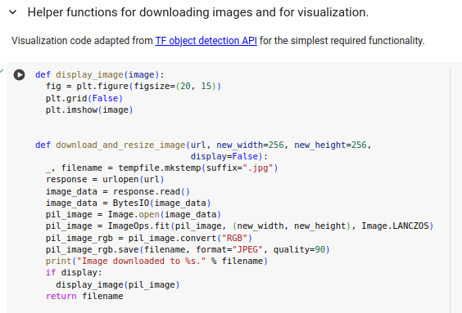
32.4 Helper Functions
https://www.youtube.com/watch?v=IfRMV2MY9n0&list=PLeo1K3hjS3uu7CxAacxVndI4bE_o3BDtO&index=32
Helper Functions (4:01-5:00/14:52)
1. Display Image
2. Download and resize image

Slide 7
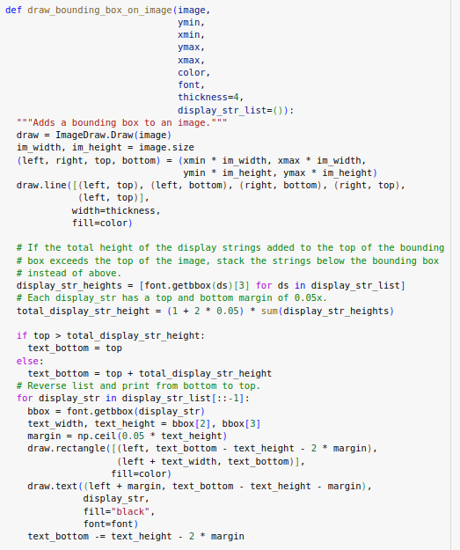
32.4 Helper Functions
https://www.youtube.com/watch?v=IfRMV2MY9n0&list=PLeo1K3hjS3uu7CxAacxVndI4bE_o3BDtO&index=32
Helper Functions (5:01-6:00/14:52)
Draw Bounding Box

Slide 8
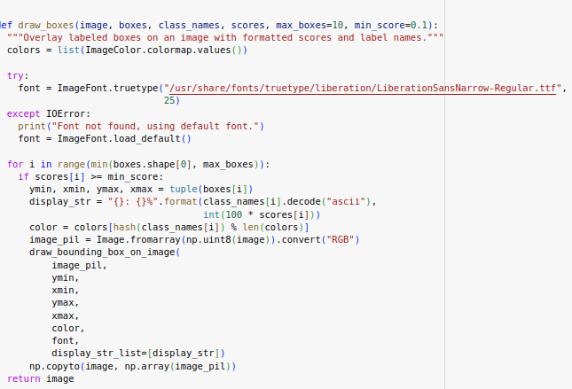
32.4 Helper Functions
https://www.youtube.com/watch?v=IfRMV2MY9n0&list=PLeo1K3hjS3uu7CxAacxVndI4bE_o3BDtO&index=32
Helper Functions (6:01-7:00/14:52)
Draw Bounding Box and scores.

Slide 9
32.5 Detect Image

Slide 10
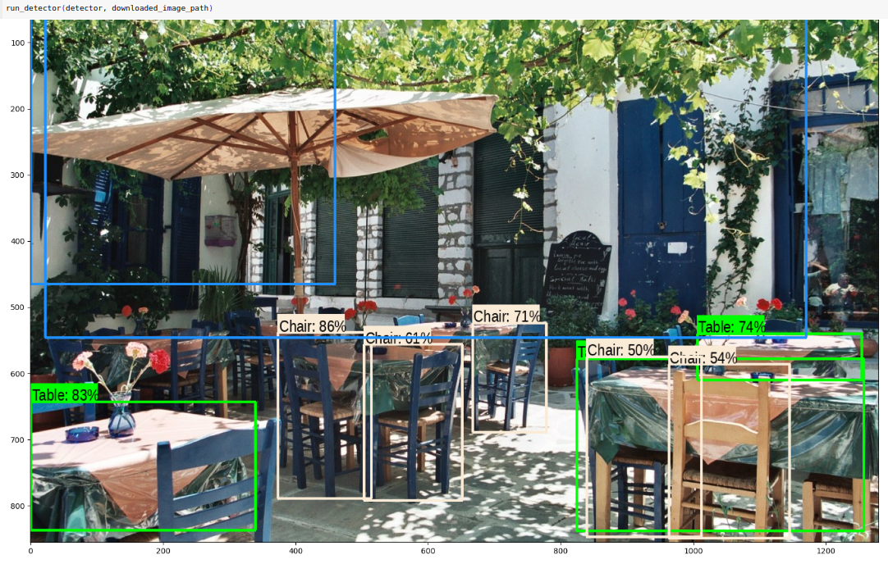
32.6 Detect Image
https://www.youtube.com/watch?v=IfRMV2MY9n0&list=PLeo1K3hjS3uu7CxAacxVndI4bE_o3BDtO&index=32
Apply Modules (7:01-11:00/14:52)
Download Test Image to detect.
It take time to detect.

Slide 11
32.6 Detect More Images

Slide 12
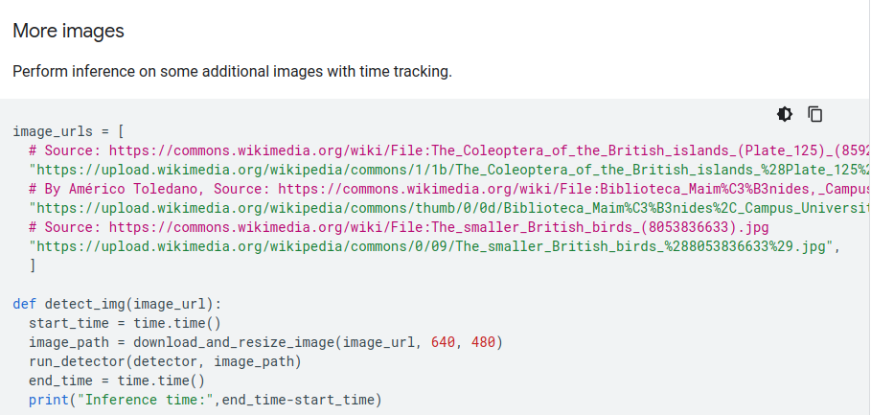
32.6 Detect More Images
https://www.youtube.com/watch?v=IfRMV2MY9n0&list=PLeo1K3hjS3uu7CxAacxVndI4bE_o3BDtO&index=32
Detect More Images (11:01-12:00/14:52)
Detect more images:

Slide 13
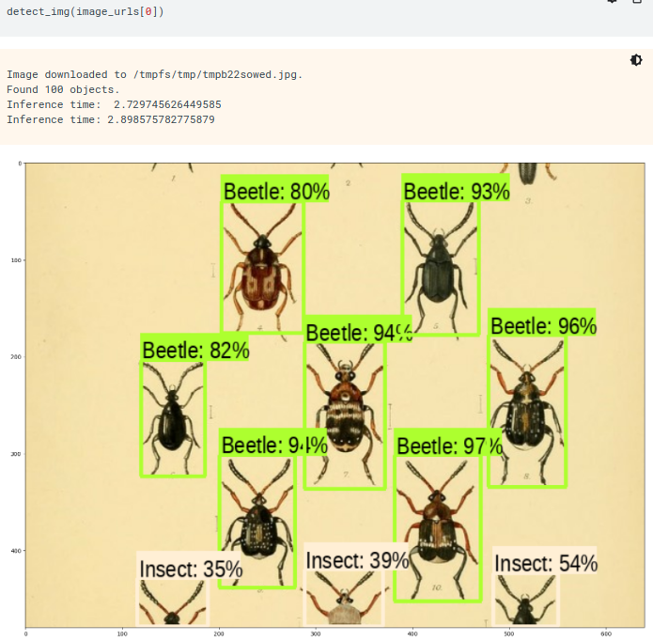
32.5 Tensorflow Hub: Object Detection
https://www.youtube.com/watch?v=IfRMV2MY9n0&list=PLeo1K3hjS3uu7CxAacxVndI4bE_o3BDtO&index=32
Tensorflow Hub: Object Detection (12:01-13:00/14:52)
https://colab.research.google.com/github/tensorflow/docs/blob/master/site/en/hub/tutorials/object_detection.ipynb
Detect more images(image_url[0]):

Slide 14
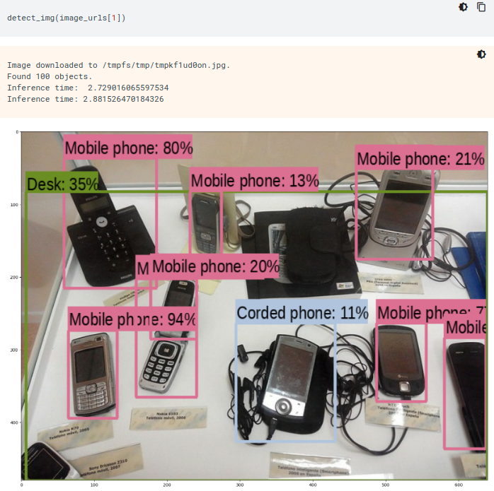
32.5 Tensorflow Hub: Object Detection
https://www.youtube.com/watch?v=IfRMV2MY9n0&list=PLeo1K3hjS3uu7CxAacxVndI4bE_o3BDtO&index=32
Tensorflow Hub: Object Detection (13:01-14:00/14:52)
https://colab.research.google.com/github/tensorflow/docs/blob/master/site/en/hub/tutorials/object_detection.ipynb
Detect more images(image_url[1]):

Slide 15
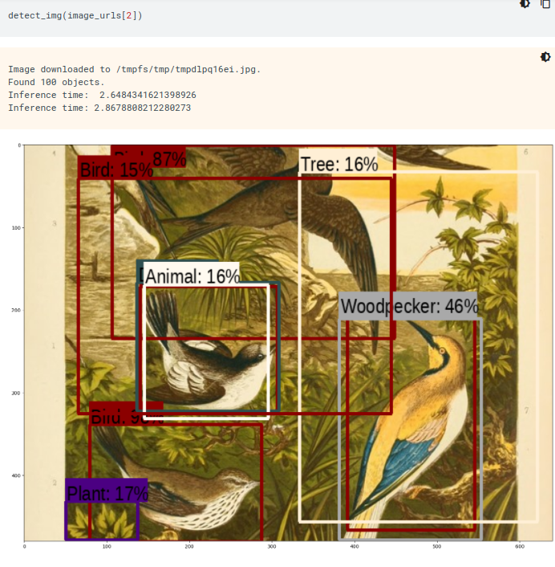
32.5 Tensorflow Hub: Object Detection
https://www.youtube.com/watch?v=IfRMV2MY9n0&list=PLeo1K3hjS3uu7CxAacxVndI4bE_o3BDtO&index=32
Tensorflow Hub: Object Detection (14:01-14:52/14:52)
https://colab.research.google.com/github/tensorflow/docs/blob/master/site/en/hub/tutorials/object_detection.ipynb
Detect more images(image_url[2]):

Slide 16
End

