Slide 1

12 Gradient Descent
Peter H. Chen

Slide 2
12 Gradient Descent
https://www.youtube.com/watch?v=pXGBHV3y8rs&list=PLeo1K3hjS3uu7CxAacxVndI4bE_o3BDtO&index=12
Gradient Descent (0:00-1:20/41:33)
Gradient Descent is at the heart (kernel) of supervised machine learning.
Gradient Descent can be in the statistical machine learning or deep learning.
We will discuss the Gradient Descent in theory and Python Code implementation.
Previously, we already discussed the gradient descent in machine learning class.
We will repeat the theory in this discussion,
We will build gradient descent for simple neural network or logistic regression for an insurance dataset.
Gradient descent is the common topic for machine learning and deep learning in the interview.
It is important to understand what is the math and technique under the hood.
Gradient Descent is the heart of Machine Learning, especially supervised machine learning.
Gradient Descent is everywhere and the core (kernel) of the Machine Learning and Deep Learning.

Slide 3
12.1 Prediction Function

Slide 4
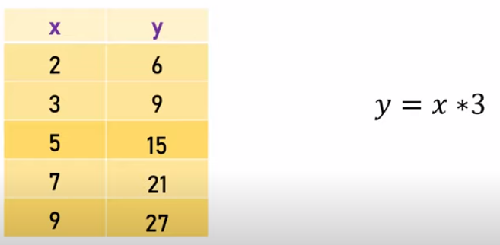
12.1 Prediction Function
https://www.youtube.com/watch?v=pXGBHV3y8rs&list=PLeo1K3hjS3uu7CxAacxVndI4bE_o3BDtO&index=12
Prediction Function (1:21-1:50/41:33)
Quesiton: We have x and y data. We want to know the relation of x and y.
Answer: The relation of x and y is y = x * 3

Slide 5
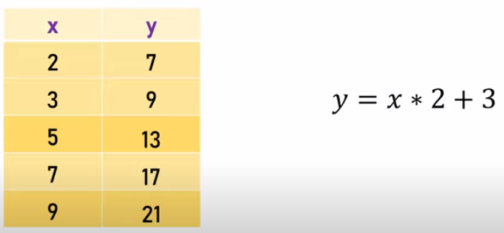
12.1 Prediction Function
https://www.youtube.com/watch?v=pXGBHV3y8rs&list=PLeo1K3hjS3uu7CxAacxVndI4bE_o3BDtO&index=12
Prediction Function (2:01-2:10/41:33)
Quesiton: How about this? What is the relation of x and y?
Answer: The relation of x and y is y = x * 2 + 3

Slide 6
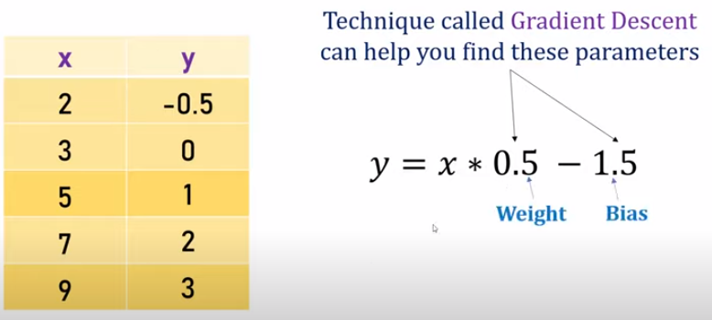
12.1 Prediction Function
https://www.youtube.com/watch?v=pXGBHV3y8rs&list=PLeo1K3hjS3uu7CxAacxVndI4bE_o3BDtO&index=12
Prediction Function (2:01-3:30/41:33)
Quesiton: How about this one? What is the relation of x and y?
Answer:
It is very difficult for human to figure it out.
Computer can use Gradient Descent to figure out the linear equation for this table.
The relation of x and y is y = x * 0.5 – 1.5.
This is the core of machine learning and deep learning, especially supervised learning.
In supervised learning, you have truth data which is x (parameter) and y (target value).
What is Gradient Descent do?
Gradient Descent find the relationship between the input parameters x and output target y.
This is also called a prediction function. You can put any input of x and get the output value y.
Here, 0.5 is called weight and 1.5 is called bias.
This is a simple linear algebra.

Slide 7
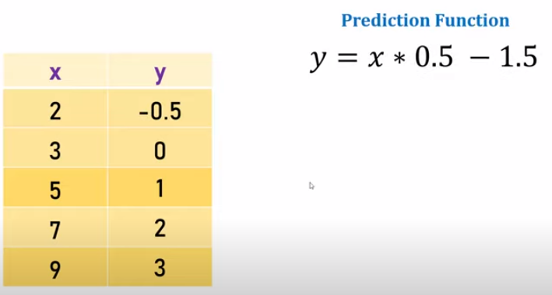
12.1 Prediction Function
https://www.youtube.com/watch?v=pXGBHV3y8rs&list=PLeo1K3hjS3uu7CxAacxVndI4bE_o3BDtO&index=12
Prediction Function (3:36-3:40/41:33)
As we mentioned before, this is a prediction function.
The prediction function is the main point of machine learning and deep learning.
Prediction function is the especially important for supervised machine learning and supervised deep learning.

Slide 8
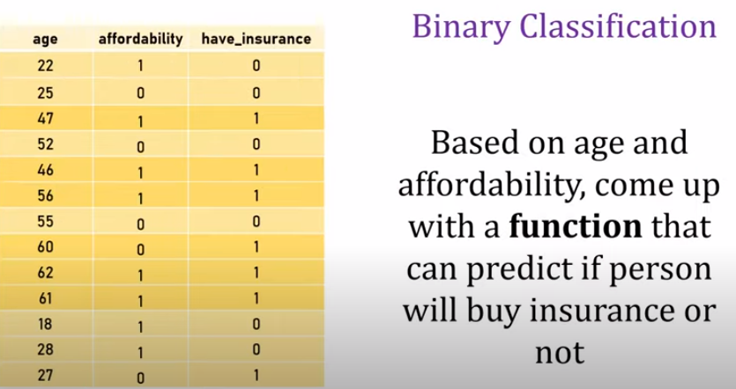
12.1 Prediction Function
https://www.youtube.com/watch?v=pXGBHV3y8rs&list=PLeo1K3hjS3uu7CxAacxVndI4bE_o3BDtO&index=12
Prediction Function (3:47-4:30/41:33)
Let’s look at the insurance data set.
We have input columns (features) of age and affordability.
We we have output column (target) of have_insurance.
Based on the age and affordability, we can predict the person will buy insurance or not.
We have target label have_insurance (yes/no) in the target. This is a binary classification problem.
We want to find a function that can take age and affordability as an input and it can tell you whether the person will buy insurance or not.

Slide 9
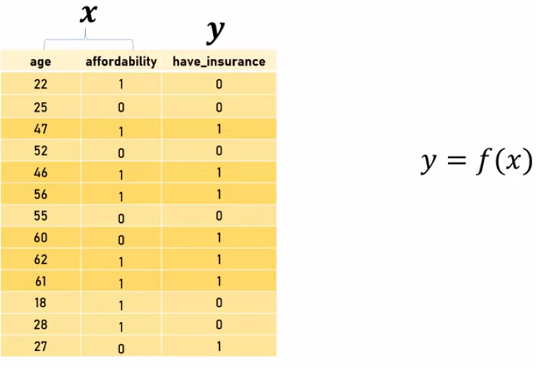
12.1 Prediction Function
https://www.youtube.com/watch?v=pXGBHV3y8rs&list=PLeo1K3hjS3uu7CxAacxVndI4bE_o3BDtO&index=12
Prediction Function (4:32-4:40/41:33)
We have input features X and output target y.
The formulation is y = f(X).

Slide 10
End

