Slide 1

12.2 Train Neural Network

Slide 2
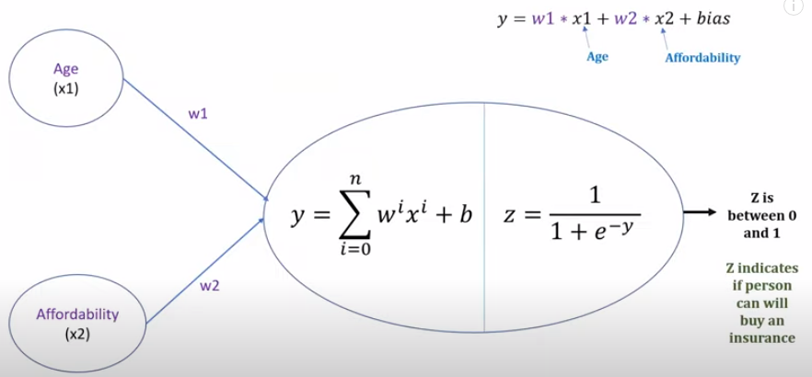
12.2 Train Neural Network
https://www.youtube.com/watch?v=pXGBHV3y8rs&list=PLeo1K3hjS3uu7CxAacxVndI4bE_o3BDtO&index=12
Train Neural Network (4:45-5:20/41:33)
We define a simple three layers (input, hidden, output) of neural network with single neuron.
It is a simple logistic regression with single neuron.
This is a machine learning is a shallow neural network (three layers of neural network).
In logistic regression, there are two components, one is weighted sum and the second one is the sigmoid function.

Slide 3
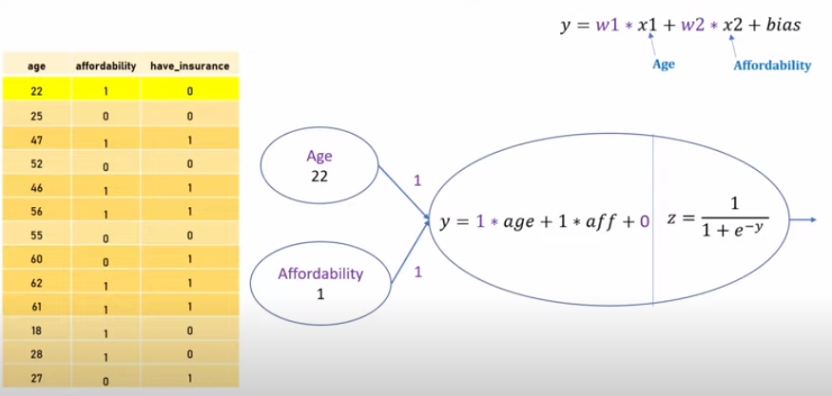
12.2 Train Neural Network
https://www.youtube.com/watch?v=pXGBHV3y8rs&list=PLeo1K3hjS3uu7CxAacxVndI4bE_o3BDtO&index=12
Train Neural Network (5:26-6:30/41:33)
When we train a neural network, The Gradient Descent is used during the training of neural network.
We have 13 data points for neural network. We want to use all of the 13 data to train this neural network. We have age 22 and affordability 1.
We initialize the weight w1 = 1, w2 = 1 and bias = 0 (or randomized between 0 and 1).
We can substitute the data for calculation. We call this substitution a forward pass.
y = 1 * 22 + 1 * 1 + 0 = 23.
z = 1 / [1 + exp (-23)] = 0.999999999989

Slide 4
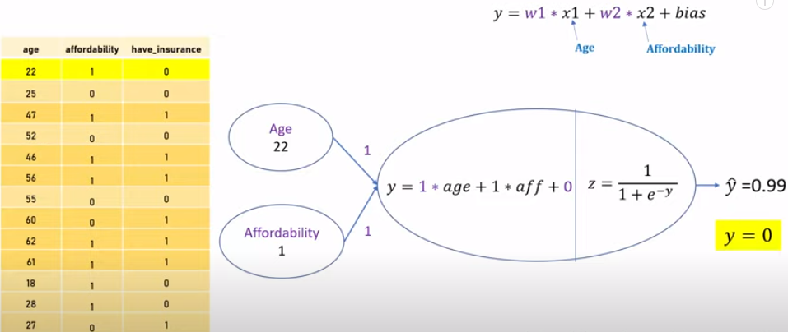
12.2 Train Neural Network
https://www.youtube.com/watch?v=pXGBHV3y8rs&list=PLeo1K3hjS3uu7CxAacxVndI4bE_o3BDtO&index=12
Train Neural Network (6:31-7:30/41:33)
For the first sample, Age = 22, affordability = 1, w1 = 1, w2 = 1, bias = 0.
We have y = 1 * 22 + 1 * 1 + 0 = 23
We have z = 1/[1 + e(-23)] = 0.99, i.e., ŷ = 0.99.
Since have_insurance y = 0, we find the error.
error1 = - [y * log (ŷ) + (1-y) * log (1- ŷ)]
= - [0 * log (0.99) + (1 – 0) * log (1 – 0.99)]
= - 1 * loge (0.01)
= 4.6
error1 = - [y * log (ŷ) + (1-y) * log (1- ŷ)]
= 4.6

Slide 5
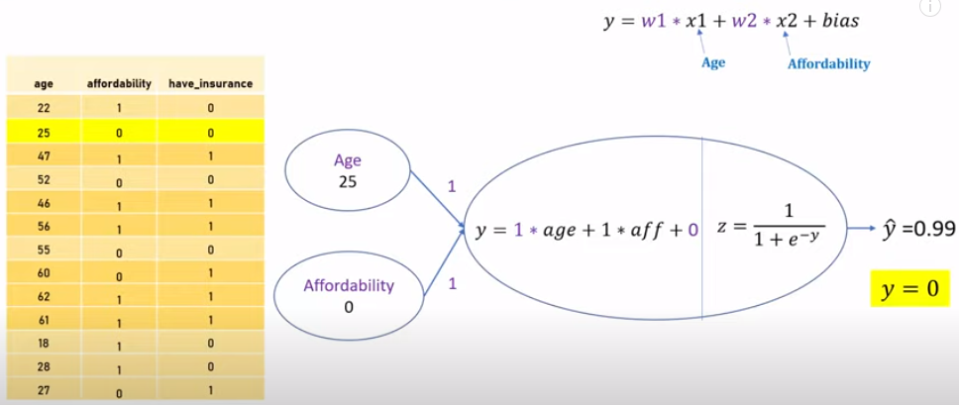
12.2 Train Neural Network
https://www.youtube.com/watch?v=pXGBHV3y8rs&list=PLeo1K3hjS3uu7CxAacxVndI4bE_o3BDtO&index=12
Train Neural Network (6:31-7:30/41:33)
For the second second sample, Age = 25, affordability = 0, w1 = 1, w2 = 1, bias = 0.
We have y = 1 * 25 + 1 * 0 + 0 = 25
We have z = 1/[1 + e(-25)] = 0.99, i.e., ŷ = 0.99.
Since have_insurance y = 0, we find the error.
error2 = - [y * log (ŷ) + (1 - y) * log (1- ŷ)]
= - [0 * log (0.99) + (1 – 0) * log (1 – 0.99)]
= - 1 * loge (0.01)
= 4.6
error2 = - [y * log (ŷ) + (1-y) * log (1- ŷ)]
= 4.6

Slide 6
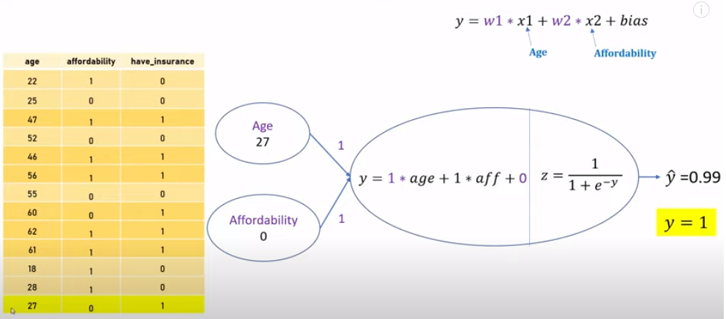
12.2 Train Neural Network
https://www.youtube.com/watch?v=pXGBHV3y8rs&list=PLeo1K3hjS3uu7CxAacxVndI4bE_o3BDtO&index=12
Train Neural Network (6:31-8:10/41:33)
We go the all the samples to the last sample, Age = 27, affordability = 0, w1 = 1, w2 = 1, bias = 0.
We have y = 1 * 27 + 1 * 0 + 0 = 27
We have z = 1/[1 + e(-27)] = 0.99, i.e., ŷ = 0.99.
Since have_insurance y = 0, we find the error.
error13 = - [y * log (ŷ) + (1 - y) * log (1- ŷ)]
= - [1 * log (0.99) + (1 – 1) * log (1 – 0.99)]
= - 1 * loge (0.09)
= 0.01
error13 = - [y * log (ŷ) + (1-y) * log (1- ŷ)]
= 0.01

Slide 7

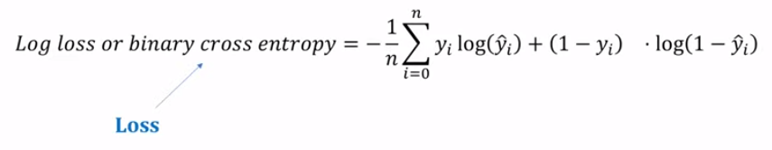
12.2 Train Neural Network
https://www.youtube.com/watch?v=pXGBHV3y8rs&list=PLeo1K3hjS3uu7CxAacxVndI4bE_o3BDtO&index=12
Train Neural Network (8:12-8:30/41:33)
Now, we sum off all the error of the samples.
We calculate the log loss or binary entropy for the loss.

Slide 8
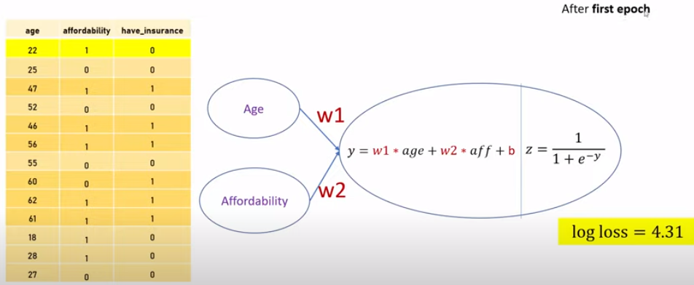
12.2 Train Neural Network
https://www.youtube.com/watch?v=pXGBHV3y8rs&list=PLeo1K3hjS3uu7CxAacxVndI4bE_o3BDtO&index=12
Train Neural Network (8:36-9:40/41:33)
After the first epoch, we have log loss = 4.31.
What is epoch?
Epoch is “Go through all the samples once”.
We have gone through all the samples from number 1 to number 13. This means that we have completed one Epoch. After the first Epoch, we have total loss is 4.31.
Then, our goal is to back propagate this loss so that we can adjust the weights w1 and w2. During the training, we might get multiple epochs until we get a correct value of w1 and w2.
After first epoch, our log loss is 4.31. Our goal is to adjust the weights w1 and w2 so that our log loss will be reduced to less than 4.31.

Slide 9

12.2 Train Neural Network
https://www.youtube.com/watch?v=pXGBHV3y8rs&list=PLeo1K3hjS3uu7CxAacxVndI4bE_o3BDtO&index=12
Train Neural Network (9:41-10:20/41:33)
How do you do that?
We need to do “something” for weight.

Slide 10
12.2 Train Neural Network
https://www.youtube.com/watch?v=pXGBHV3y8rs&list=PLeo1K3hjS3uu7CxAacxVndI4bE_o3BDtO&index=12
Train Neural Network (10:21-10:30/41:33)
How much loss changes for a given change in w1.
That is an important parameter to understand.

Slide 11
End

