Slide 1

12.3 Gradient and Gradient Descent

Slide 2
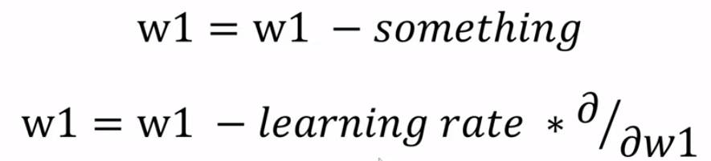
12.3 Gradient and Gradient Descent
https://www.youtube.com/watch?v=pXGBHV3y8rs&list=PLeo1K3hjS3uu7CxAacxVndI4bE_o3BDtO&index=12
Gradient and Gradient Descent (10:37-11:10/41:33)
Now, we know how to do “something”.
We need to do “something” for weight.
We can do something like this learning rate and take “derivative of the loss respective to w1”.
Below formula is saying how the loss is change with w1.

Slide 3
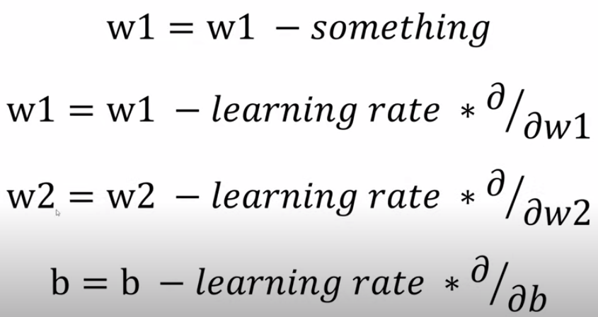
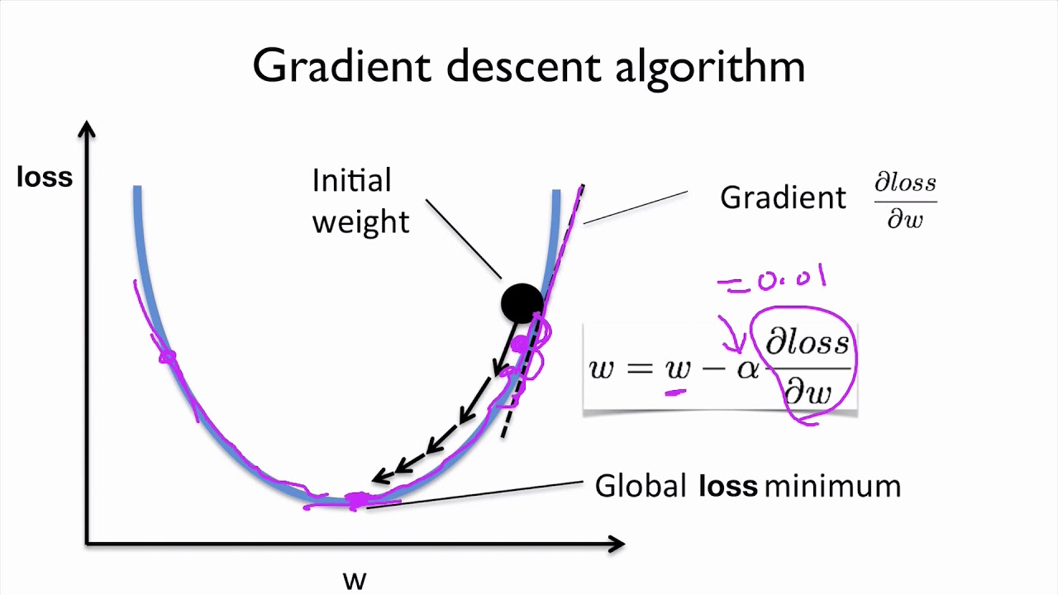
12.3 Gradient and Gradient Descent
https://www.youtube.com/watch?v=pXGBHV3y8rs&list=PLeo1K3hjS3uu7CxAacxVndI4bE_o3BDtO&index=12
Gradient and Gradient Descent (11:11-11:30/41:33)
For w2, the equation is same as w2.
For bias, we have the similar equation. We take the derivative of the loss with respect to the bias b.
Here, we have the Vector of Derivative is called Gradient.

Slide 4
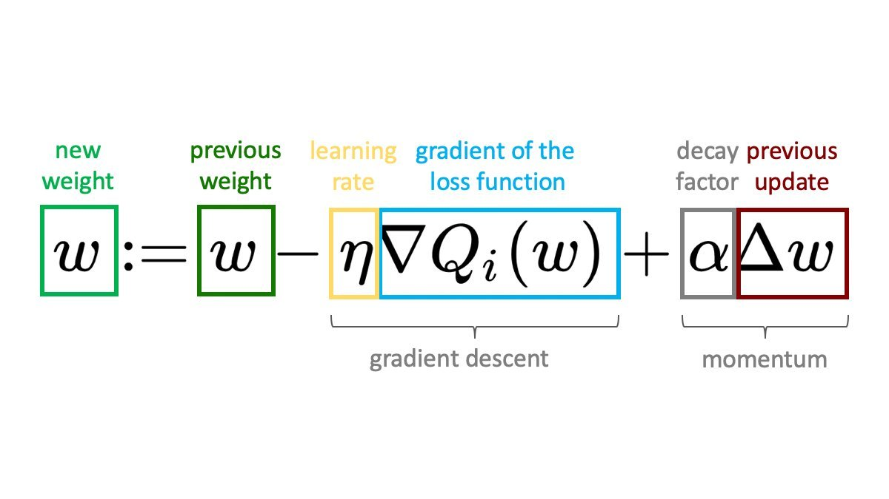
12.3 Gradient and Gradient Descent
https://www.youtube.com/watch?v=pXGBHV3y8rs&list=PLeo1K3hjS3uu7CxAacxVndI4bE_o3BDtO&index=12
Gradient and Gradient Descent (11:11-11:30/41:33)
The learning rate * Gradient is called Gradient Descent.

Slide 5
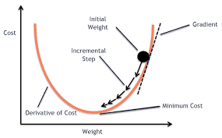
12.3 Gradient and Gradient Descent
https://www.youtube.com/watch?v=pXGBHV3y8rs&list=PLeo1K3hjS3uu7CxAacxVndI4bE_o3BDtO&index=12
Gradient and Gradient Descent (11:11-11:30/41:33)
Gradient Descent expressed in graph.

Slide 6
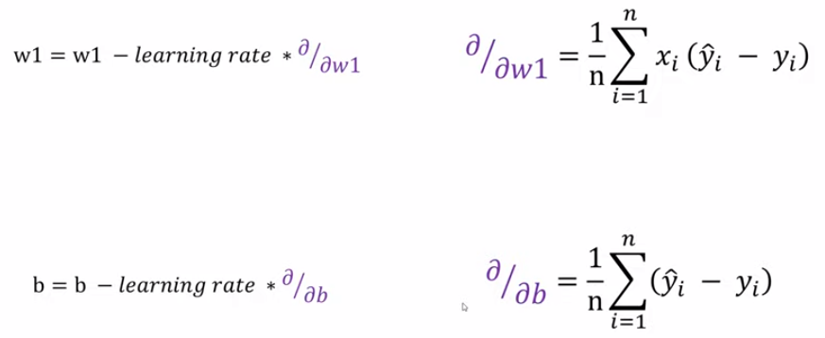
12.3 Gradient and Gradient Descent
https://www.youtube.com/watch?v=pXGBHV3y8rs&list=PLeo1K3hjS3uu7CxAacxVndI4bE_o3BDtO&index=12
Gradient and Gradient Descent (11:21-12:20/41:33)
For log loss function, the derivative is the equation on the right hand side.
Note:
Gradient is the vector formula. Derivatives is the scalar formula.
We need to change the derivative formula into gradient formula.

Slide 7
End

