Slide 1

12.4 Gradient Descent in Epoch

Slide 2
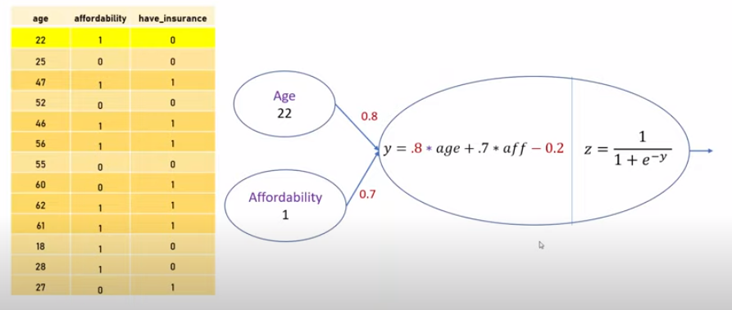
12.4 Gradient Descent in Epoch
https://www.youtube.com/watch?v=pXGBHV3y8rs&list=PLeo1K3hjS3uu7CxAacxVndI4bE_o3BDtO&index=12
Gradient Descent in Epoch (13:01-13:10/41:33)
Now, we have the new epoch with w1 = 0.8 w2 = 0.7 and b = -0.2
We repeat again to feed our entire training set to our neural network.
We do the a forward pass.
First, we feed into the first sample, we find out the ŷ and y. We calculate the error1.
error1 = - [y * log (ŷ) + (1-y) * log (1- ŷ)]

Slide 3
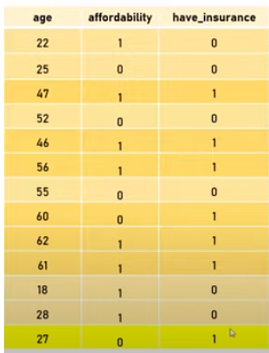
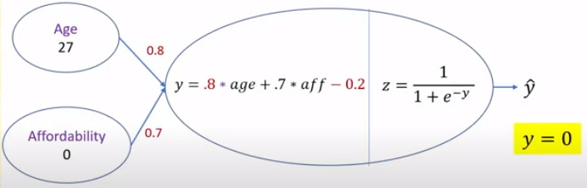

12.4 Gradient Descent in Epoch
https://www.youtube.com/watch?v=pXGBHV3y8rs&list=PLeo1K3hjS3uu7CxAacxVndI4bE_o3BDtO&index=12
Gradient Descent in Epoch (13:11-14:00/41:33)
Then, in epoch 2, we have sample 2, sample 3, …, sample 13 for error2, error3, …, erro13.
Then, we calculate the total loss for all samples.
This is the end of epoch 2.
Right now, we are using batch gradient. We feed in the entire dataset for one epoch before we start the backpropagating.
So, this is the second epoch.
What is difference between the Batch Gradient and Mini-Batch Gradient?
1. Batch gradient: The entire training data are used in gradient descent to update the network's parameters.
2. Mini-Batch Gradient: A subset of the training data used in gradient descent to update the network’s parameters.

Slide 4
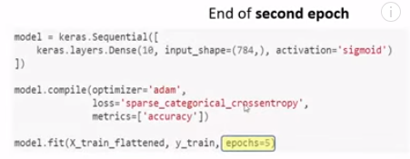
12.4 Gradient Descent in Epoch
https://www.youtube.com/watch?v=pXGBHV3y8rs&list=PLeo1K3hjS3uu7CxAacxVndI4bE_o3BDtO&index=12
Gradient Descent in Epoch (14:07-14:30/41:33)
In the hand-writing prediction example, we have epoch =5. The epoch is one of the parameter in the model.fit(…, epoch=5) in our tensorflow code.
Now, we know it make sense what epoch is.

Slide 5
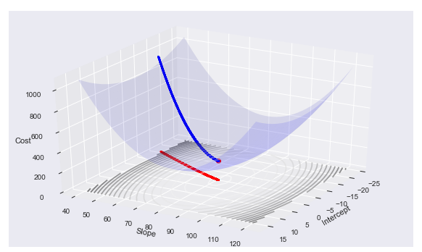
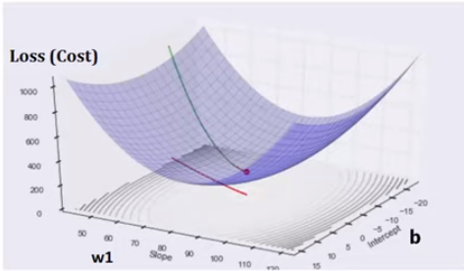
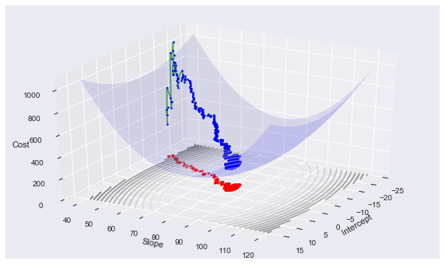
12.4 Gradient Descent in Epoch
https://www.youtube.com/watch?v=pXGBHV3y8rs&list=PLeo1K3hjS3uu7CxAacxVndI4bE_o3BDtO&index=12
Gradient Descent in Epoch (14:31-16:30/41:33)
The errors are convex function.
https://am207.github.io/2018fall/wiki/gradientdescent.html
Here, we have Loss (cost) on z, we only show 3-dimensional z, w1, and b.
We did not show w2 since human cannot see 4-dimensional plot.

Slide 6
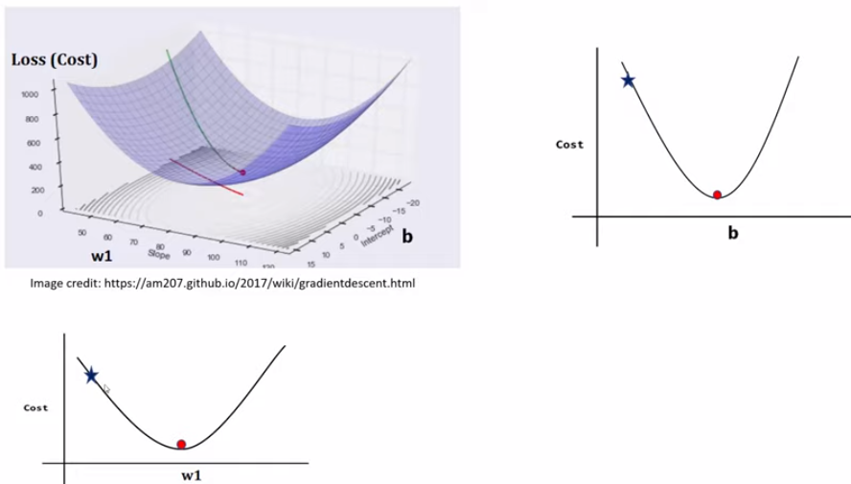
12.4 Gradient Descent in Epoch
https://www.youtube.com/watch?v=pXGBHV3y8rs&list=PLeo1K3hjS3uu7CxAacxVndI4bE_o3BDtO&index=12
Gradient Descent in Epoch (16:31-16:30/41:33)
Loss function is a quadratic (squared-error). It is like a bowl.
We have the global minimum in the loss function.

Slide 7
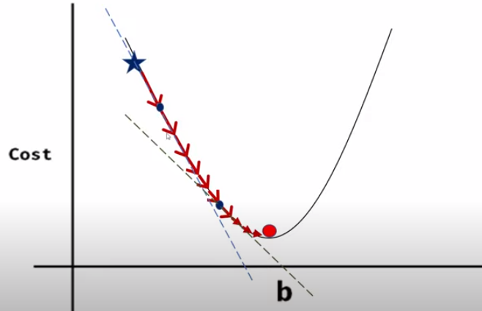
12.4 Gradient Descent in Epoch
https://www.youtube.com/watch?v=pXGBHV3y8rs&list=PLeo1K3hjS3uu7CxAacxVndI4bE_o3BDtO&index=12
Gradient Descent in Epoch (16:41-17:00/41:33)
The gradient (is a vector of sequences of derivative) is a tangent slope.

Slide 8
End

