Slide 1

12.5 Why Google Colab?

Slide 2
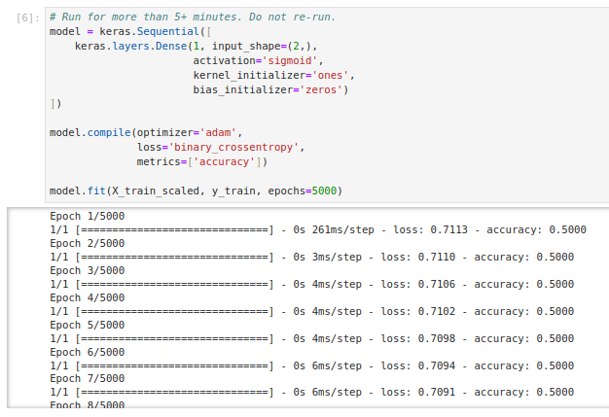
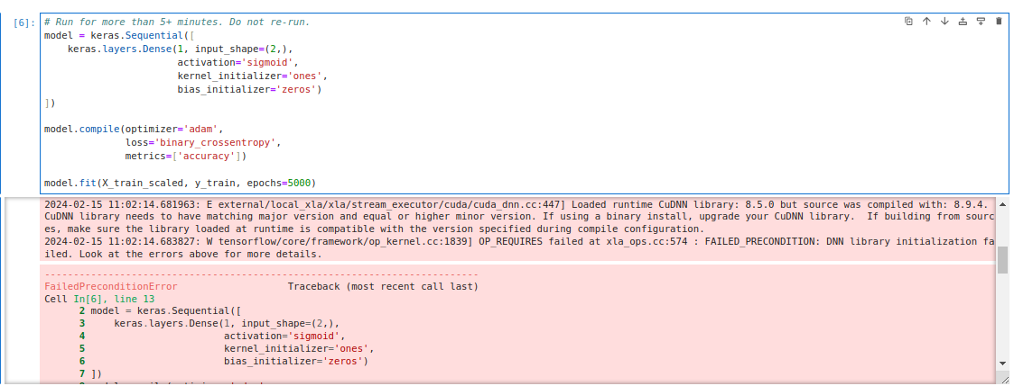
12.5 Why Google Colab?
https://www.youtube.com/watch?v=pXGBHV3y8rs&list=PLeo1K3hjS3uu7CxAacxVndI4bE_o3BDtO&index=12
Why Google Colab? (17:01-17:02/41:33)
Question: Why do we use Google colab?
Answer: We don’t have enough VRAM for model training, i.e., tensorflow code: model.fit().
Below example:
1. Bottom left: Run result from A100 (8GPU and 188GB VRAM).
2. Bottom Right: The code will be broken and generate unknown error when you run.

Slide 3
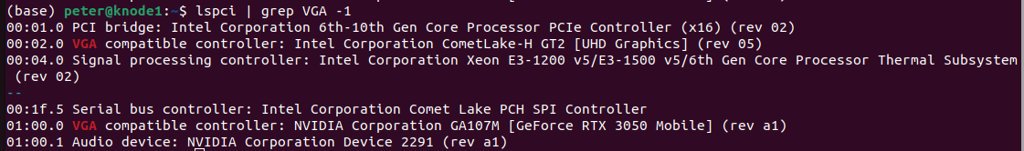
12.5 Why Google Colab?
https://www.youtube.com/watch?v=pXGBHV3y8rs&list=PLeo1K3hjS3uu7CxAacxVndI4bE_o3BDtO&index=12
Why Google Colab? (17:03-17:04/41:33)
Question: what is GPU information on my computer?
> lspci | grep VGA # or > lspci | grep VGA -1
Below shows:
Intel (North Bridge): 1 VGA
NVIDIA (Souther Bridge): 1 GPU (GeForce RTX 3050)

Slide 4
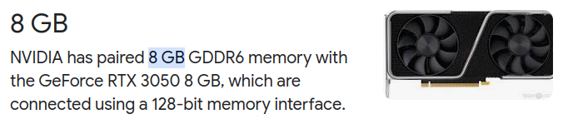
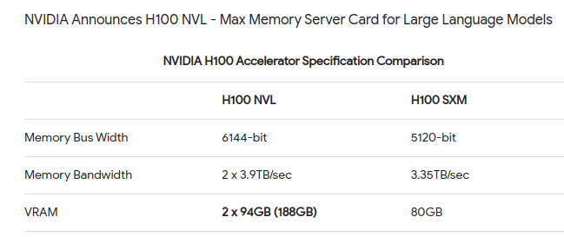
12.5 Why Google Colab?
https://www.youtube.com/watch?v=pXGBHV3y8rs&list=PLeo1K3hjS3uu7CxAacxVndI4bE_o3BDtO&index=12
Why Google Colab? (17:05-17:06/41:33)
Question: How much VRAM of NVIDIA GeForce RTX 3050 (cheapest one in my computer which cost $1,000)?
Answer: 8 GB
Question: How many VRAM that NVIDIA H100 have?
Answer: 188GB

Slide 5
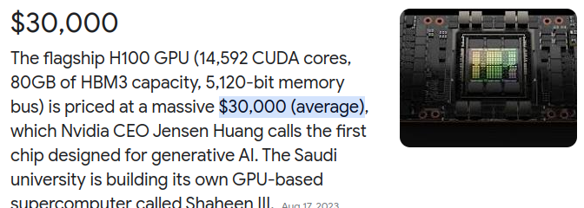
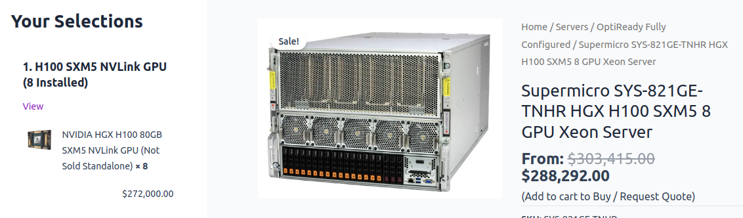
12.5 Why Google Colab?
https://www.youtube.com/watch?v=pXGBHV3y8rs&list=PLeo1K3hjS3uu7CxAacxVndI4bE_o3BDtO&index=12
Why Google Colab? (17:07-17:08/41:33)
Question: How much much GPU H100?
Answer: $30,000
Question: How much much GPU H100 Server?
Answer: $200,000 to $300,000$ (about 8 GPU, i.e., around $30,000 x 8)

Slide 6
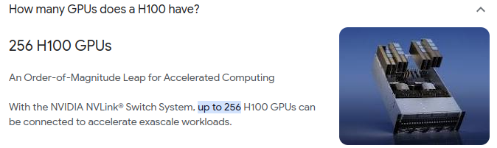
12.5 Why Google Colab?
https://www.youtube.com/watch?v=pXGBHV3y8rs&list=PLeo1K3hjS3uu7CxAacxVndI4bE_o3BDtO&index=12
Why Google Colab? (17:09-17:10/41:33)
Question: What is the maximum GPU that H100 can have?
Answer:
256 GPUs.
Each cost around $30,000. Total: 256 x $30,000/GPU = $7M)

Slide 7

12.5 Why Google Colab?
https://www.youtube.com/watch?v=pXGBHV3y8rs&list=PLeo1K3hjS3uu7CxAacxVndI4bE_o3BDtO&index=12
Why Google Colab? (17:10-17:11/41:33)
Question: Why Choose Google Colab?
Answer:
1. Google colab is free for experiment
2. Default Google colab is Tesla K80 with 12GB VRAM (Video Random-Access Memory). It is enough to run/train small deep learning model.

Slide 8
End

