Slide 1

12.6 Gradient Descent: Colab
Peter H. Chen

Slide 2
12.6 Gradient Descent: Colab
https://www.youtube.com/watch?v=pXGBHV3y8rs&list=PLeo1K3hjS3uu7CxAacxVndI4bE_o3BDtO&index=12
Gradient Descent: Colab (17:12-17:13/41:33)
We do the coding for Gradient Descent

Slide 3
12.6.1 Setup GPU

Slide 4
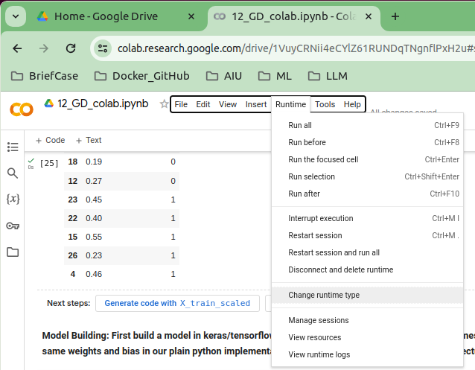
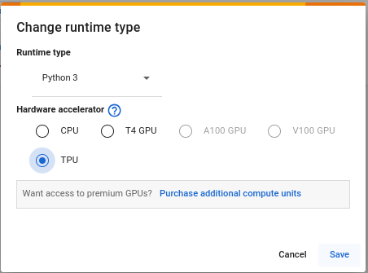
12.6.1 Setup Colab GPU
https://www.youtube.com/watch?v=pXGBHV3y8rs&list=PLeo1K3hjS3uu7CxAacxVndI4bE_o3BDtO&index=12
Setup Colab (17:12-17:13/41:33)
Verify the runtime > Change runtime type

Slide 5
12.6.2 Mount Google Drive

Slide 6

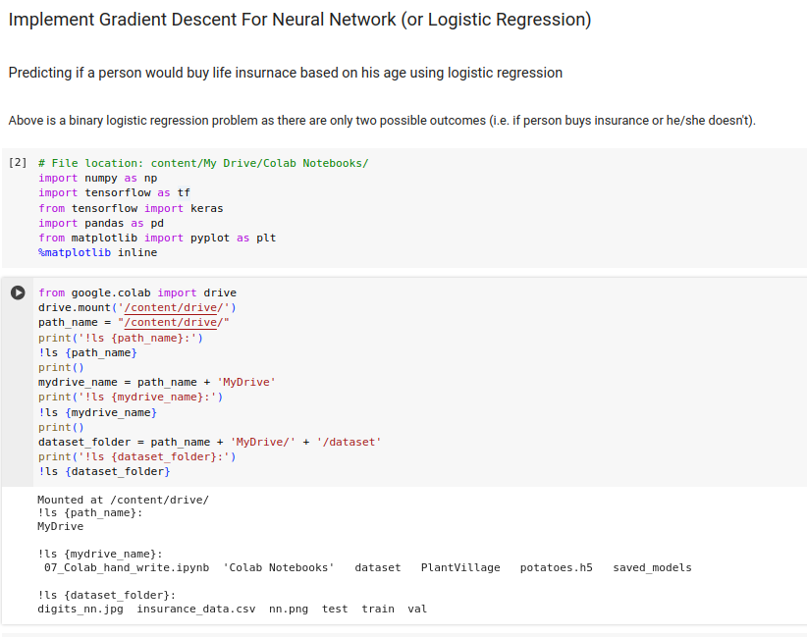
12.6.2 Mount Google Drive
https://www.youtube.com/watch?v=pXGBHV3y8rs&list=PLeo1K3hjS3uu7CxAacxVndI4bE_o3BDtO&index=12
Mount Google Drive (17:13-17:15/41:33)
1. Mount google drive from colab.
2. Read dataset from the paths.

Slide 7
12.6.3 Read Dataset

Slide 8
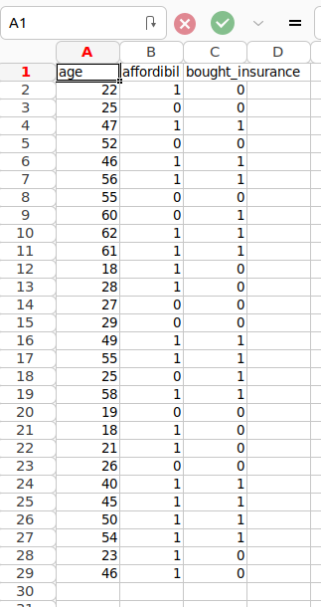
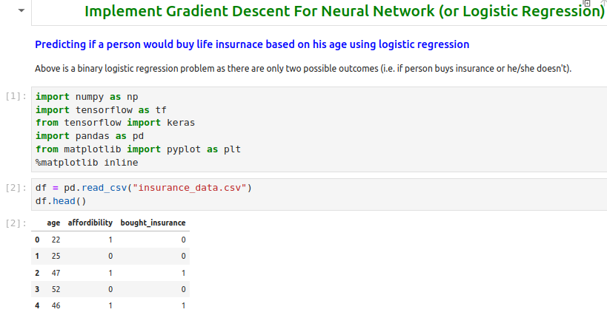
12.6.2 Read Dataset
https://www.youtube.com/watch?v=pXGBHV3y8rs&list=PLeo1K3hjS3uu7CxAacxVndI4bE_o3BDtO&index=12
Read Dataset (17:16-17:22/41:33)
We read the “insurance_data.csv” file.
We display first five rows.

Slide 9
12.6.4 Split Data into Train and Test

Slide 10
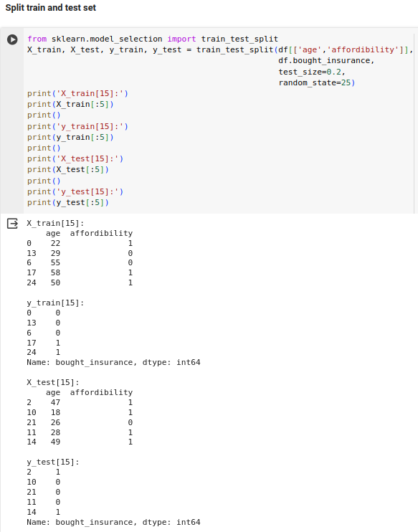
12.6.4 Split Data into Train and Test
https://www.youtube.com/watch?v=pXGBHV3y8rs&list=PLeo1K3hjS3uu7CxAacxVndI4bE_o3BDtO&index=12
Split Data into Train and Test (18:01-18:22/41:33)
We split the data into X_train, X-test, y_train, y_test by train_test_split in sklearn.
Print and check the data.

Slide 11
12.6.5 Scale Data between 0 and 1

Slide 12
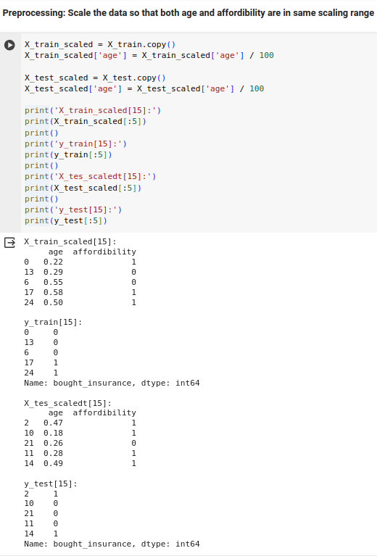
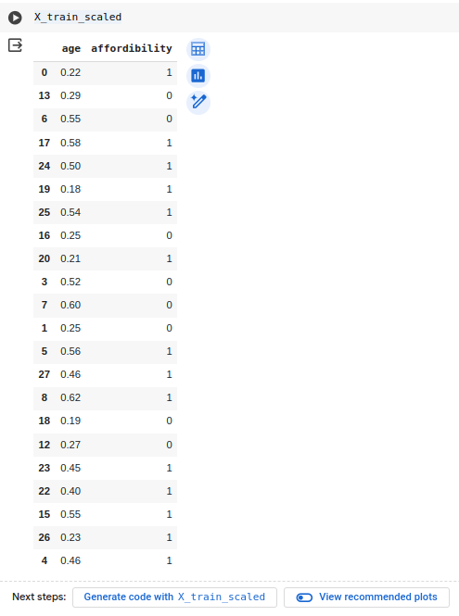
12.6.5 Scale Data between 0 and 1
https://www.youtube.com/watch?v=pXGBHV3y8rs&list=PLeo1K3hjS3uu7CxAacxVndI4bE_o3BDtO&index=12
Scale Data between 0 and 1 (18:23-18:32/41:33)
We scale the data.
Print and verify the scale data.

Slide 13
12.6.6 Create/Train Neural Network

Slide 14
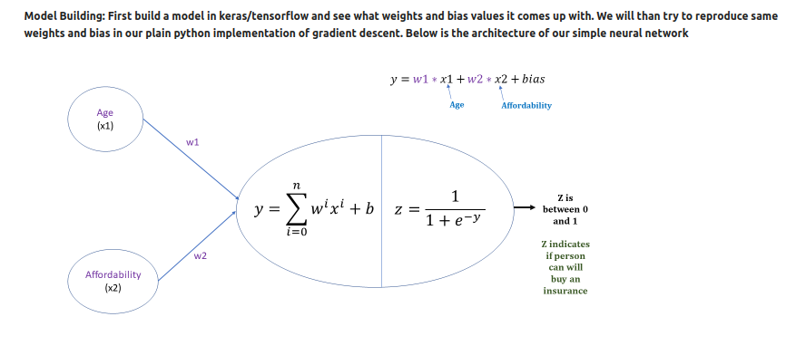
12.6.6 Create/Train Neural Network
https://www.youtube.com/watch?v=pXGBHV3y8rs&list=PLeo1K3hjS3uu7CxAacxVndI4bE_o3BDtO&index=12
Create/Train Neural Network (19:01-20:45/41:33)
Now, we build the insurance model.

Slide 15
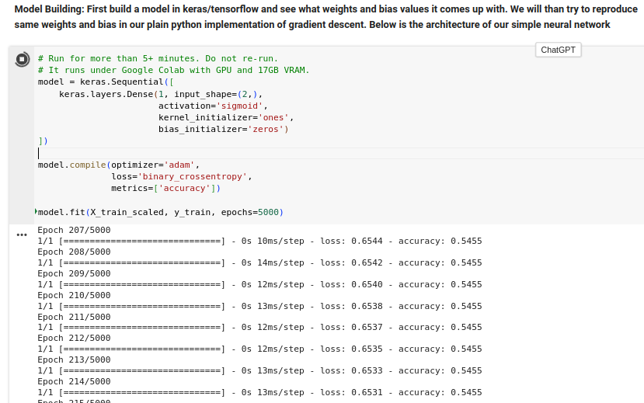
12.6.6 Create/Train Neural Network
https://www.youtube.com/watch?v=pXGBHV3y8rs&list=PLeo1K3hjS3uu7CxAacxVndI4bE_o3BDtO&index=12
Create/Train Neural Network (20:50-22:40/41:33)
We have input shape (2,): age and affordability, Activation is sigmoid, kernel weights =1, bias = 0.
We compile model with optimizer = adam, loss function is binary crossentropy, and display the measurement with metric.
We train X_train_scaled and y_train with epochs = 5000.
This program run 5-10 minutes, not always finished. Try to not re-run.
The accuracy = 0.9091 is good.

Slide 16
12.6.7 Evaluate Model

Slide 17
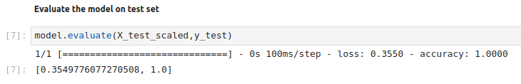
12.6.7 Evaluate Model
https://www.youtube.com/watch?v=pXGBHV3y8rs&list=PLeo1K3hjS3uu7CxAacxVndI4bE_o3BDtO&index=12
Evaluate Model (22:50-23:10/41:33)
Evaluate the X_test_scaled.
We have the results: [0.3549, 1.0]
Loss = 0.3549, 1.0 (100%) accuracy.

Slide 18
12.6.8 Model Prediction

Slide 19
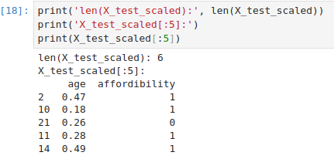
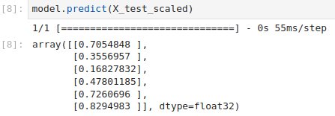
12.6.8 Model Prediction
https://www.youtube.com/watch?v=pXGBHV3y8rs&list=PLeo1K3hjS3uu7CxAacxVndI4bE_o3BDtO&index=12
Model Prediction (23:16-25:00/41:33)
We check x_test_scaled
The age is scaled by 100.
The make the prediction: 0.7 means 70% will buy insurance.

Slide 20
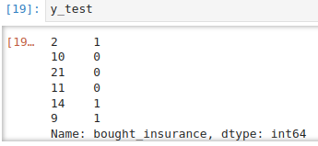
12.6.8 Model Prediction
https://www.youtube.com/watch?v=pXGBHV3y8rs&list=PLeo1K3hjS3uu7CxAacxVndI4bE_o3BDtO&index=12
Model Prediction (25:01-25:15/41:33)
y_test (Age, Buy/Not Buy Insurance) is the to test output y.

Slide 21
12.6.9 Weights of Model

Slide 22
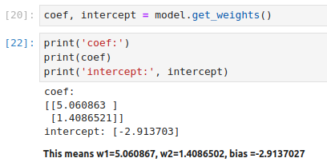
12.6.9 Weights of Model
https://www.youtube.com/watch?v=pXGBHV3y8rs&list=PLeo1K3hjS3uu7CxAacxVndI4bE_o3BDtO&index=12
Weights of Model (25:01-25:15/41:33)
Now, we get the weight and bias of the model.
get_weight():
the coefficient X1 (Age) = 0.5, X2 (Affordability) = 1.4 and
Bias = -2.9.

Slide 23
12.6.10 Custom Predict Function

Slide 24
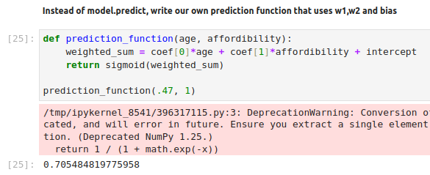

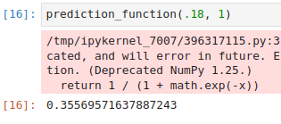
12.6.10 Custom Predict Function
https://www.youtube.com/watch?v=pXGBHV3y8rs&list=PLeo1K3hjS3uu7CxAacxVndI4bE_o3BDtO&index=12
Custom Predict Function (25:15-29:00/41:33)
Instead pf Tensorflow model.predict(), we define our own sigmoid function and predict function.

Slide 25
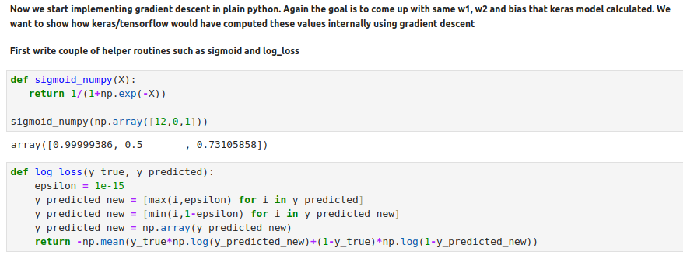
12.6.10 Custom Predict Function
https://www.youtube.com/watch?v=pXGBHV3y8rs&list=PLeo1K3hjS3uu7CxAacxVndI4bE_o3BDtO&index=12
Custom Predict Function (25:00-29:30/41:33)
Define sigmoid_numpy() and log_loss()

Slide 26
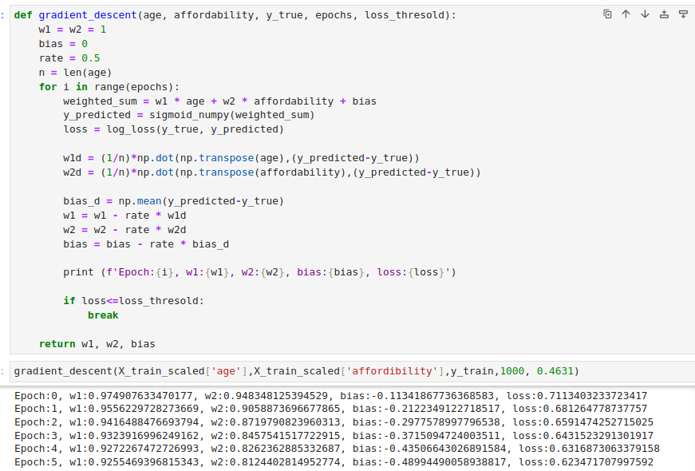
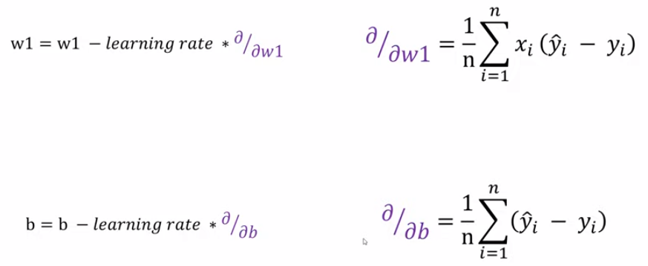
12.6.10 Custom Predict Function
https://www.youtube.com/watch?v=pXGBHV3y8rs&list=PLeo1K3hjS3uu7CxAacxVndI4bE_o3BDtO&index=12
Custom Predict Function (30:00-39:00/41:33)
Calculate the Gradient Descent()
1. sigmoid_numpy() and
2. log_loss().
3. calculate bias mean
4. calculate new w1
5. calculate new w2
6. calculate new bias
7. return w1, w2, bias

Slide 27
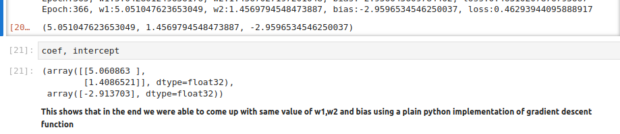
12.6.10 Custom Predict Function
https://www.youtube.com/watch?v=pXGBHV3y8rs&list=PLeo1K3hjS3uu7CxAacxVndI4bE_o3BDtO&index=12
Custom Predict Function (39:01-41:33/41:33)
Compare the tensorflow and python calculation.
The coefficient x1 (age) = 5.0, x2 (affordability) = 1.4.
Bias = -2.91

Slide 28
End

