Slide 1

48 TF Serving
Peter H. Chen

Slide 2


48 TF Serving
https://www.youtube.com/watch?v=P-5sMcpTE0g&list=PLeo1K3hjS3uu7CxAacxVndI4bE_o3BDtO&index=48
TF Serving (0:00-0:20/19:51)
This discussion include the full stack development course.
In the full stack development,
1. Front end GUI (Graphical User Interface): We use front end Meta ReactJS library or Google Angular framework for GUI development and
2. Backend: Flask/FastAPI/Django for point-to-point and parameters processing.
Google Tensorflow has tool called TF Serving can be called inside Flask and FastAPI.
TF Serving provides the the followings (in the better way):
1. Serve the model: manage multiple requests from front end users
2. Model management

Slide 3
48.1 TF Serving: Theory

Slide 4
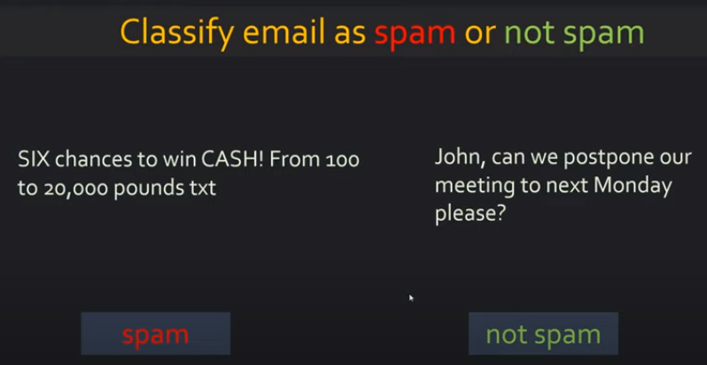
48.1 TF Serving: Theory
https://www.youtube.com/watch?v=P-5sMcpTE0g&list=PLeo1K3hjS3uu7CxAacxVndI4bE_o3BDtO&index=48
TF Serving: Theory (0:25-0:30/19:51)
We build a text classification model (with BERT model and our own neural network) to classify the email into Spam or Ham (Not Spam).

Slide 5
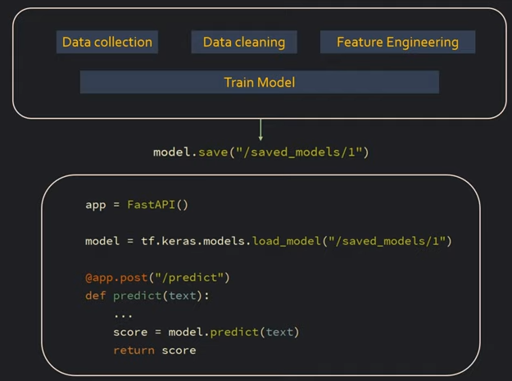
48.1 TF Serving: Theory
https://www.youtube.com/watch?v=P-5sMcpTE0g&list=PLeo1K3hjS3uu7CxAacxVndI4bE_o3BDtO&index=48
TF Serving: Theory (0:32-1:00/19:51)
A typical Data Science workflow is:
1. Collect data
2. Clean Data
3. Extract Features
4. Train a Model
5. Save Model
6. Use FastAPI to serve the model

Slide 6
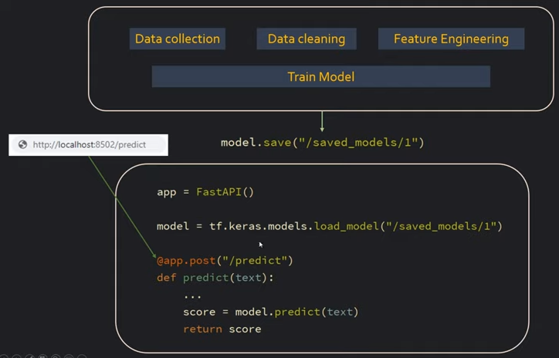
48.1 TF Serving: Theory
https://www.youtube.com/watch?v=P-5sMcpTE0g&list=PLeo1K3hjS3uu7CxAacxVndI4bE_o3BDtO&index=48
TF Serving: Theory (1:04-1:30/19:51)
After the FastAPI server the model, the client can make “http call”.
1. The tf.keras.models.load_model (“saved_model”): server load the saved_model
2. The client give the input text to the server.
3. The server use the loaded the saved_model and do the prediction.

Slide 7
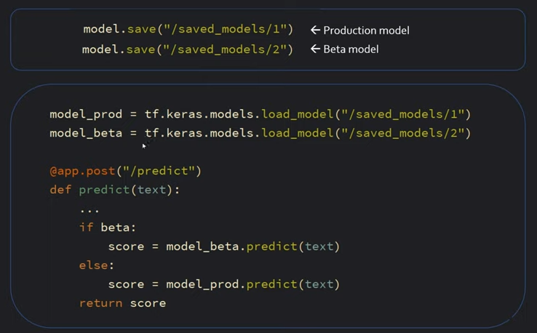
48.1 TF Serving: Theory
https://www.youtube.com/watch?v=P-5sMcpTE0g&list=PLeo1K3hjS3uu7CxAacxVndI4bE_o3BDtO&index=48
TF Serving: Theory (1:31-2:20/19:51)
Below, we have different version of saved_model
1. version 1 is the the production model.
2. version 2 is the beta model.
We load the different versions (production and beta) of model.

Slide 8
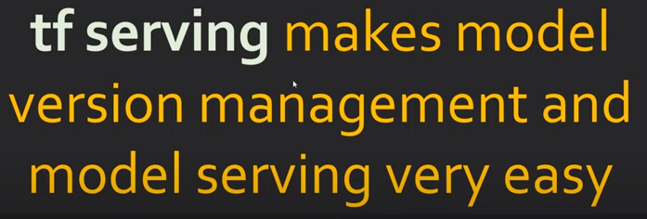
48.1 TF Serving: Theory
https://www.youtube.com/watch?v=P-5sMcpTE0g&list=PLeo1K3hjS3uu7CxAacxVndI4bE_o3BDtO&index=48
TF Serving: Theory (2:30-2:50/19:51)
TF serving help us manage different versions of model.
TF serving makes model serving very easy.

Slide 9
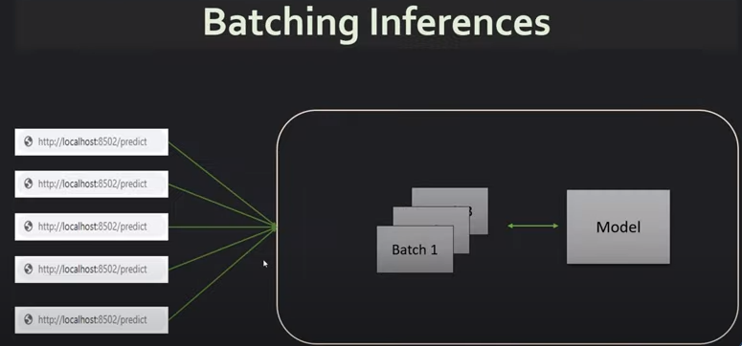
48.1 TF Serving: Theory
https://www.youtube.com/watch?v=P-5sMcpTE0g&list=PLeo1K3hjS3uu7CxAacxVndI4bE_o3BDtO&index=48
TF Serving: Theory (2:51-3:30/19:51)
Below, we have 5 requests from front end user.
TF serving
1. Saves these requests to the model in batches.
2. Manages the hardware resource utilization.
You can have timeout and batch size parameters, such as, timeout = 5 seconds and batch size = 100 (maximum number of request), in 5 second time out period.
TF serving makes sure the model request working properly.

Slide 10
48.2 TF Serving: Docker

Slide 11
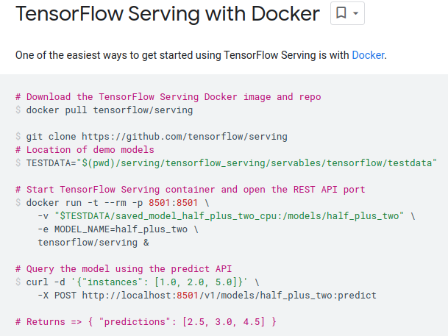
48 TF Serving: Docker
https://www.youtube.com/watch?v=P-5sMcpTE0g&list=PLeo1K3hjS3uu7CxAacxVndI4bE_o3BDtO&index=48
TF Serving: Docker (5:20-5:30/19:51)
The easiest way to serve different models is to use docker.
https://www.tensorflow.org/tfx/serving/docker
Below are the steps to download and setup for the tensorflow/serving

Slide 12
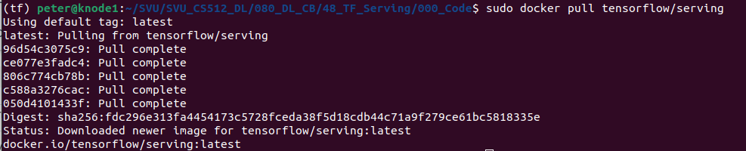
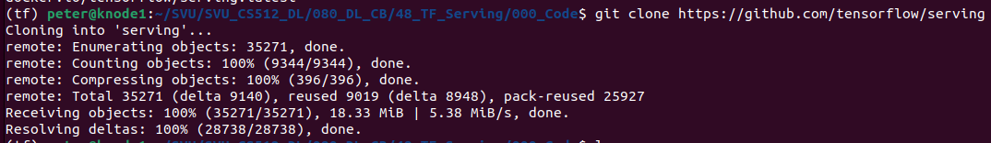
48.2 TF Serving: Docker
https://www.youtube.com/watch?v=P-5sMcpTE0g&list=PLeo1K3hjS3uu7CxAacxVndI4bE_o3BDtO&index=48
TF Serving: Docker (5:31-5:32/19:51)
Below, we have two ways to download the tensorflow/serving:
1. Docker hub have image, we can register account at docker hub and pull the tensorflow/serving from docker hub:
> sudo docker pull tensorflow/serving
Or we can clone the tensorflow/serving to your server directory:
> git clone https://github.com/tensorflow/serving
1
2

Slide 13
48.2 TF Serving: Docker
https://www.youtube.com/watch?v=P-5sMcpTE0g&list=PLeo1K3hjS3uu7CxAacxVndI4bE_o3BDtO&index=48
TF Serving: Docker (5:33-8:30/19:51)
Define a system variable TESTDATA for the location of demo models:
You can put the below command in terminal or in the ~/.bashrc.
> TESTDATA="$(pwd)/serving/tensorflow_serving/servables/tensorflow/testdata"

Slide 14
48. 2 TF Serving: Docker
https://www.youtube.com/watch?v=P-5sMcpTE0g&list=PLeo1K3hjS3uu7CxAacxVndI4bE_o3BDtO&index=48
TF Serving (8:31-9:30/19:51)
You can start the “docker run tensorflow/serving“and specify the parameters of version (-v), model name (-e), etc.
> docker run tensorflow/serving -p 8501:8501 -v … -e

Slide 15
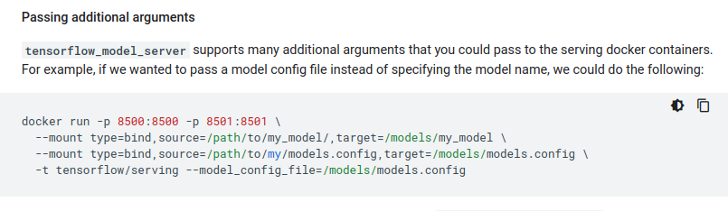
48. 2 TF Serving: Docker
https://www.youtube.com/watch?v=P-5sMcpTE0g&list=PLeo1K3hjS3uu7CxAacxVndI4bE_o3BDtO&index=48
TF Serving: Docker (9:31-11:30/19:51)
Below are command details of
> docker run -t tensorflow/serving ...

Slide 16
48. 2 TF Serving: Docker
https://www.youtube.com/watch?v=P-5sMcpTE0g&list=PLeo1K3hjS3uu7CxAacxVndI4bE_o3BDtO&index=48
TF Serving: Docker (11:31-12:30/19:51)
We can define test_messages for spam/ham:
test_message {
“instances”: [
“Let’s meet for dinner tomorrow”,
“You are awarded s SiPix Digital Camera: call 408-112-2111 for delivery”
]
}

Slide 17

48. 2 TF Serving: Docker
https://www.youtube.com/watch?v=P-5sMcpTE0g&list=PLeo1K3hjS3uu7CxAacxVndI4bE_o3BDtO&index=48
TF Serving: Docker (11:31-19:51/19:51)
We can put below ‘curl” commands in the python code.
Note:
The “curl” (client url) command are http command with specify port and parameter to send the test_message and get the return prediction.
> curl -d test_message -X POST http://localhost:8501/v1/models/…:predict
Them we have the return prediction:
{ “prediction”: [0.9, 0.1]}

Slide 18
End

