Slide 1

49 Quantization
Peter H. Chen

Slide 2
49 Quantization
https://www.youtube.com/watch?v=v1oHf1KV6kM&list=PLeo1K3hjS3uu7CxAacxVndI4bE_o3BDtO&index=49
Quantization (0:00-0:20/15:34)
In many situation, we want to deploy the machine learning model on iPhone, Micro-controller, or any device, such as, Apple Watch, or fitbit.
We discuss:
1. Quantization: Theory
Two ways to perform quantization.
1.1 Post training quantization
1.2 Quantization aware training
2. Coding.
Micro-controller have limited amount of memory and resources.
The inference is much faster.
We discuss the technique called quantization.
Quantization is to make the big model into the smaller one so that we can deploy on edge devices.
What is edge device?
An edge device is an endpoint on the network, the interface between the data center and the real world. Edge devices collect or communicate information. They run the gamut from simple sensors to complex industrial systems.

Slide 3
49 Quantization
https://www.youtube.com/watch?v=v1oHf1KV6kM&list=PLeo1K3hjS3uu7CxAacxVndI4bE_o3BDtO&index=49
Quantization (0:56-1:00/15:34)
We go through and theory and then do the coding.
We convert the Tensorflow mode into the tf.lite model.
Then, we apply the quantization to the edge device.

Slide 4
49.1 Quantization: Theory

Slide 5
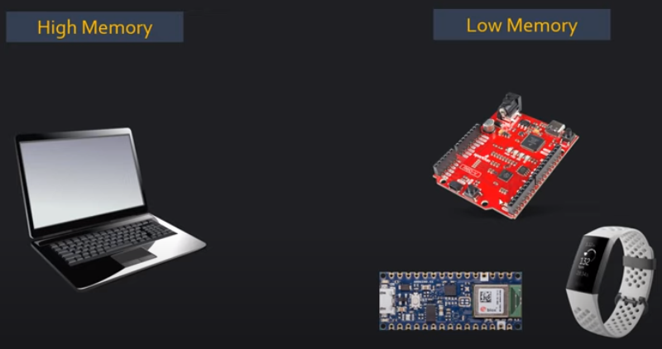
49.1 Quantization: Theory
https://www.youtube.com/watch?v=v1oHf1KV6kM&list=PLeo1K3hjS3uu7CxAacxVndI4bE_o3BDtO&index=49
Quantization: Theory (1:05-1:10/15:34)
Micro-controller devices have less memory compared to the regular computer.

Slide 6
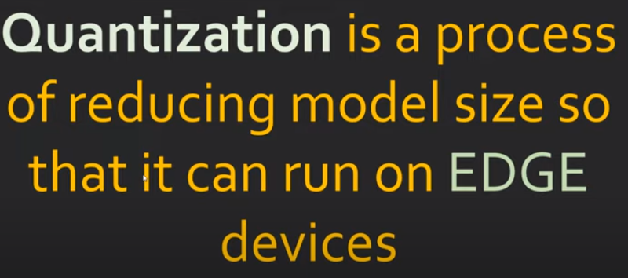
49.1 Quantization: Theory
https://www.youtube.com/watch?v=v1oHf1KV6kM&list=PLeo1K3hjS3uu7CxAacxVndI4bE_o3BDtO&index=49
Quantization: Theory (1:11-1:20/15:34)
Quantization is a process of reducing model size so that it can run on edge devices.
Small devices are called edge devices.

Slide 7
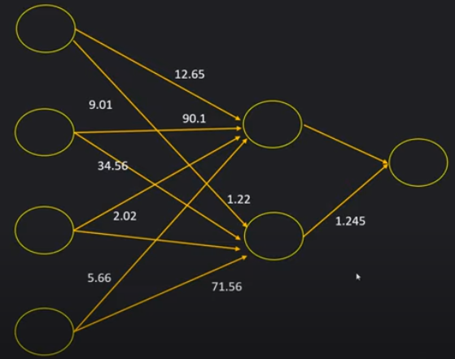
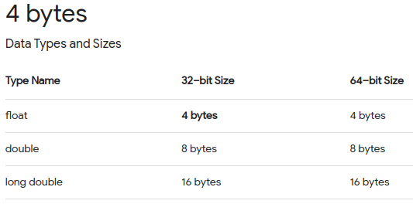
49.1 Quantization: Theory
https://www.youtube.com/watch?v=v1oHf1KV6kM&list=PLeo1K3hjS3uu7CxAacxVndI4bE_o3BDtO&index=49
Quantization: Theory (1:41-2:30/15:34)
Neural network weights are float numbers.
Theses are 8 bytes double floats (Sometimes, we use 4 bytes for floats).

Slide 8
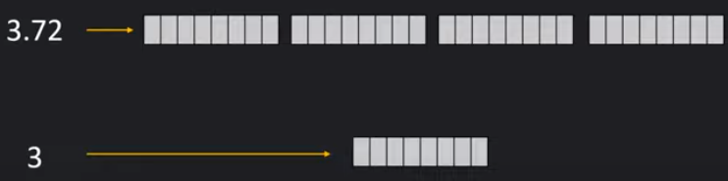
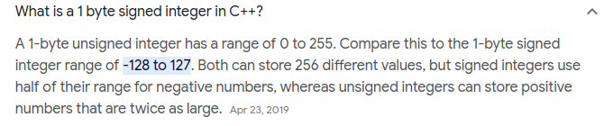
49.1 Quantization: Theory
https://www.youtube.com/watch?v=v1oHf1KV6kM&list=PLeo1K3hjS3uu7CxAacxVndI4bE_o3BDtO&index=49
Quantization: Theory (2:31-3:00/15:34)
unsigned integer is 1 bytes.
8 bytes double floats to 1 byte unsigned integer save a lot of memory.

Slide 9
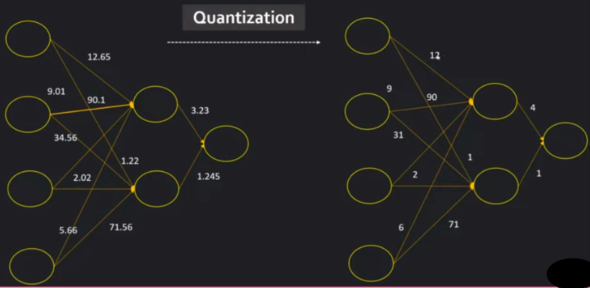
49.1 Quantization: Theory
https://www.youtube.com/watch?v=v1oHf1KV6kM&list=PLeo1K3hjS3uu7CxAacxVndI4bE_o3BDtO&index=49
Quantization: Theory (3:01-3:10/15:34)
Quantization may use:
1. Convert the trained double floats machine learning model into integer machine learning model.
2. Train with Integer weights machine learning model for the edge device.

Slide 10
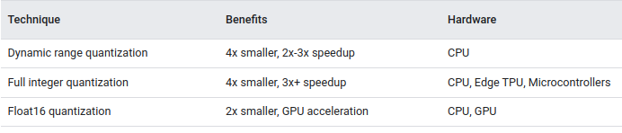
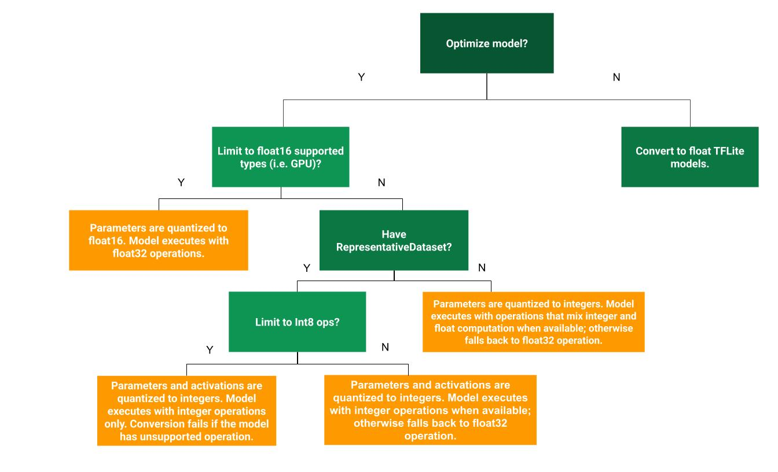
49.1 Quantization: Theory
https://www.youtube.com/watch?v=v1oHf1KV6kM&list=PLeo1K3hjS3uu7CxAacxVndI4bE_o3BDtO&index=49
Quantization: Theory (3:11-3:20/15:34)
https://www.tensorflow.org/lite/performance/post_training_quantization
Google Tensorflow Post-Training Quantization: Theory (Optimization Methods):

Slide 11
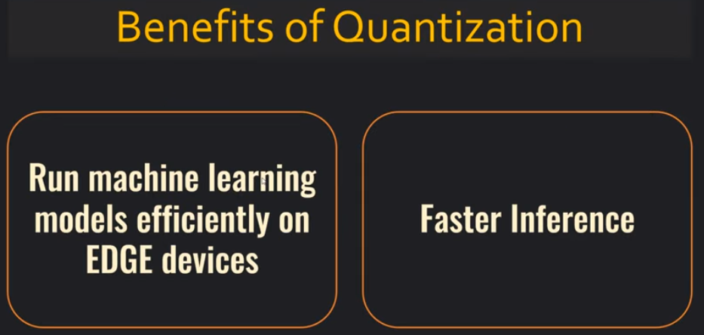
49.1 Quantization: Theory
https://www.youtube.com/watch?v=v1oHf1KV6kM&list=PLeo1K3hjS3uu7CxAacxVndI4bE_o3BDtO&index=49
Quantization: Theory (3:29-3:50/15:34)
What is the benefit ot Quantization?
1. We can store and run machine learning model for edge (smaller) devices.
2. We can run faster inference.

Slide 12
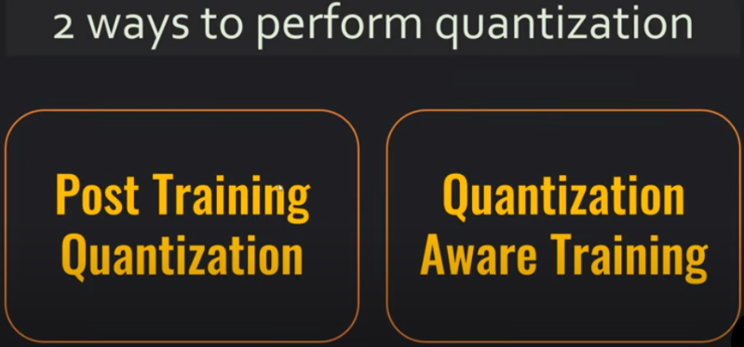
49.1 Quantization: Theory
https://www.youtube.com/watch?v=v1oHf1KV6kM&list=PLeo1K3hjS3uu7CxAacxVndI4bE_o3BDtO&index=49
Quantization: Theory (3:51-3:56/15:34)
We have 2 ways to perform quantization.
1. Post-Training Quantization
2. Quantization Aware Training

Slide 13
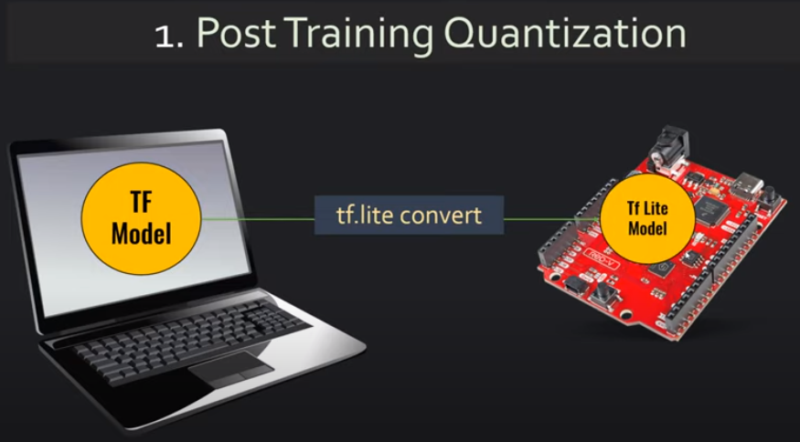
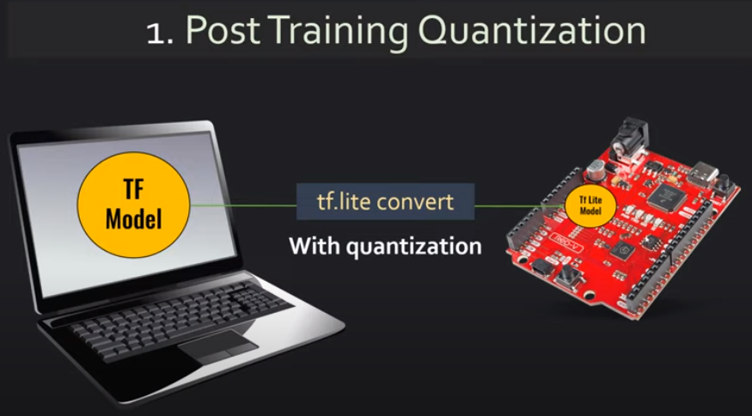
49.1 Quantization: Theory
https://www.youtube.com/watch?v=v1oHf1KV6kM&list=PLeo1K3hjS3uu7CxAacxVndI4bE_o3BDtO&index=49
Quantization: Theory (3:57-4:40/15:34)
In Post-Training Quantization,
1. We can use tf.lite convert double float weights model into integer weights for tf.lite Model.
2. We can use tf.lite convert and quantization together to get even smaller tf.lite model.
1
2

Slide 14
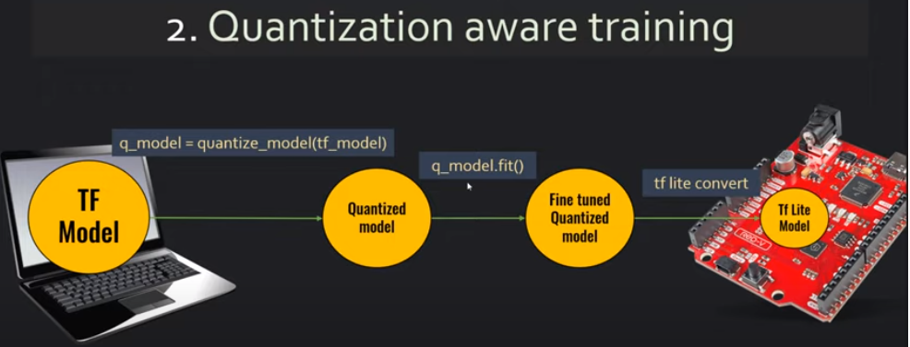
49.1 Quantization: Theory
https://www.youtube.com/watch?v=v1oHf1KV6kM&list=PLeo1K3hjS3uu7CxAacxVndI4bE_o3BDtO&index=49
Quantization: Theory (4:46-5:50/15:34)
The quantization aware is the better approach for quantization.
Quantization Aware:
1. Train with quantize model
2. tf.lite convert into integer.
What is difference from “Quantization-Aware Training” and “Post-Training Quantization”:
1. Quantization-Aware Training: Train the model from the start using low-precision integer for quantized weights and activations.
2. Post-training Quantization: Train the model with double floats and then truncate the double floats weights into integer.
Quantization-Aware Training has better result in higher accuracy than post-training quantization.
Quantization Aware Training:
Little more work but have good accuracy

Slide 15
49.2 Quantization: Coding

Slide 16
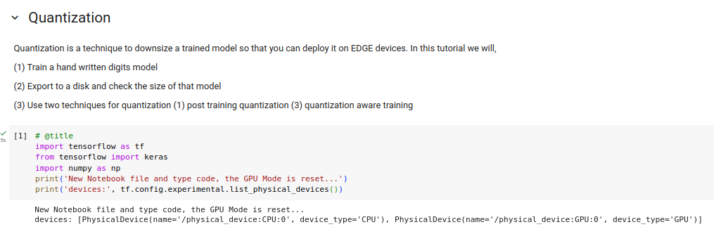
49.2 Quantization: Coding
https://www.youtube.com/watch?v=v1oHf1KV6kM&list=PLeo1K3hjS3uu7CxAacxVndI4bE_o3BDtO&index=49
Quantization: Coding (5:55-6:30/15:34)
We run Quantization Projects on Colab.
1. First, we check the GPU device is on.

Slide 17
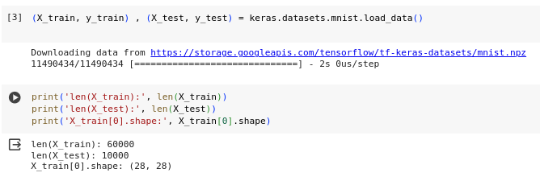
49.2 Quantization: Coding
https://www.youtube.com/watch?v=v1oHf1KV6kM&list=PLeo1K3hjS3uu7CxAacxVndI4bE_o3BDtO&index=49
Quantization: Coding (5:55-6:00/15:34)
1. We load the MNIST digit recognition dataset.
2. We scale the data in dataset.

Slide 18
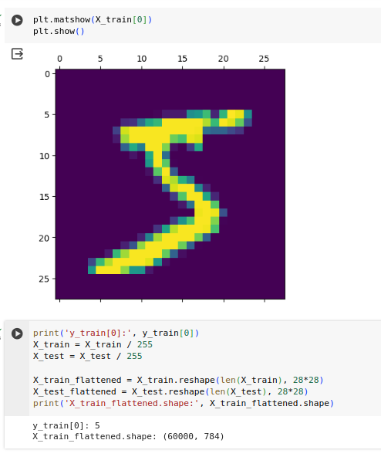
49.2 Quantization: Coding
https://www.youtube.com/watch?v=v1oHf1KV6kM&list=PLeo1K3hjS3uu7CxAacxVndI4bE_o3BDtO&index=49
Quantization: Coding (6:01-6:10/15:34)
1. Display the data
2. Print the data.

Slide 19
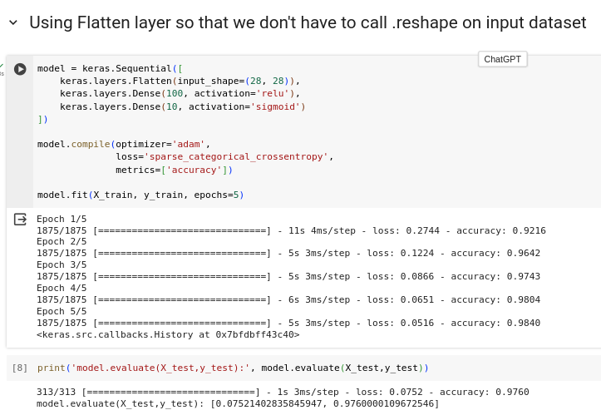
49.2 Quantization: Coding
https://www.youtube.com/watch?v=v1oHf1KV6kM&list=PLeo1K3hjS3uu7CxAacxVndI4bE_o3BDtO&index=49
Quantization: Coding (6:19-6:30/15:34)
1. Train Model without quantization.
2. Evaluate Test data: model loss: 0,075 and model accuracy: 97%.

Slide 20

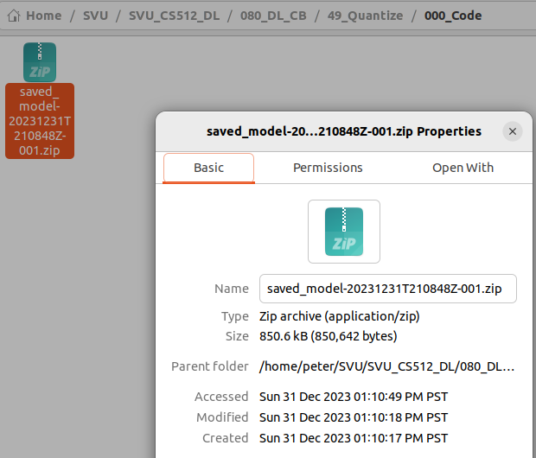
49.2 Quantization: Coding
https://www.youtube.com/watch?v=v1oHf1KV6kM&list=PLeo1K3hjS3uu7CxAacxVndI4bE_o3BDtO&index=49
Quantization: Coding (6:31-7:30/15:34)
1. We save to train model into google drive
2. Google drive does not support folder size. We download into local drive: 850.6 KB Zip Archive.

Slide 21
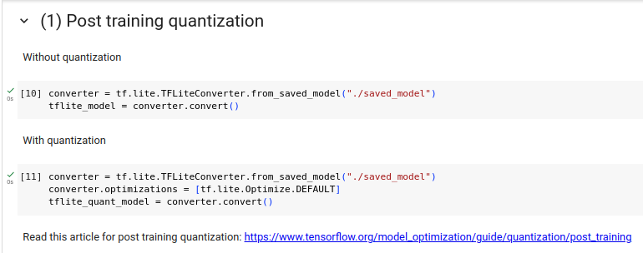
49.2 Quantization: Coding
https://www.youtube.com/watch?v=v1oHf1KV6kM&list=PLeo1K3hjS3uu7CxAacxVndI4bE_o3BDtO&index=49
Quantization: Coding (7:31-8:30/15:34)
(1) Post training quantization:
1.1 Convert the saved model into tf.lite.
1.2 train the weights with truncated double floats into integer.

Slide 22
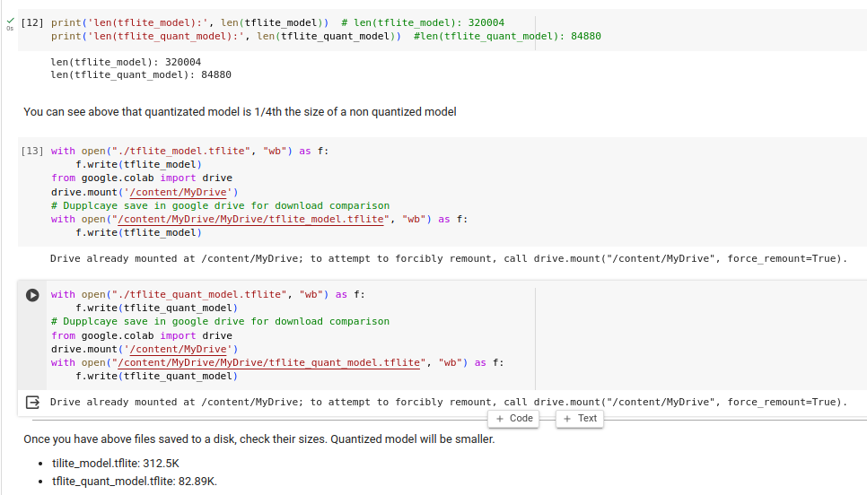
49.2 Quantization: Coding
https://www.youtube.com/watch?v=v1oHf1KV6kM&list=PLeo1K3hjS3uu7CxAacxVndI4bE_o3BDtO&index=49
Quantization: Coding (8:31-9:30/15:34)
We save models (tflite_model.tflite and tflite_quant_model_tflite) in both
1. colab and
2. google drive (for download and comparison)O.

Slide 23
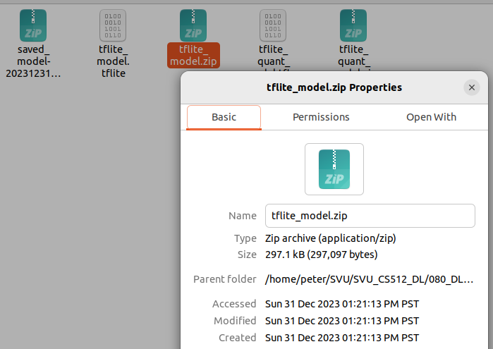
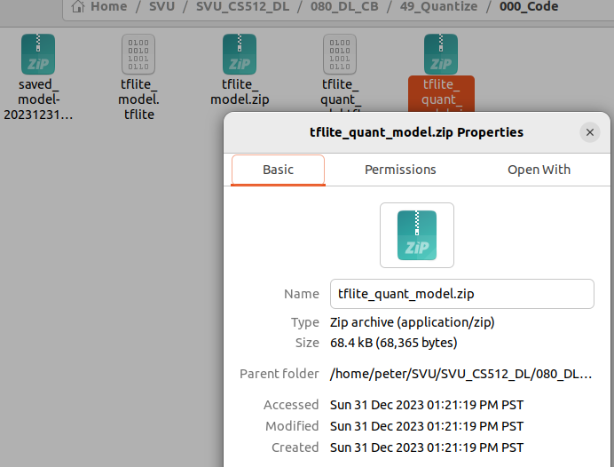
49.2 Quantization: Coding
https://www.youtube.com/watch?v=v1oHf1KV6kM&list=PLeo1K3hjS3uu7CxAacxVndI4bE_o3BDtO&index=49
2.1
Quantization: Coding (9:31-10:30/15:34)
1. original saved_model: 850.6K
2. Post-Training Quantization:
2.1 Without Optimization: tflite_model.tflite: 297.1KB
2.2 With Optimization (Remove Sparsity): tflite_quant_model.tflite: 68.4KB
1
2.2

Slide 24
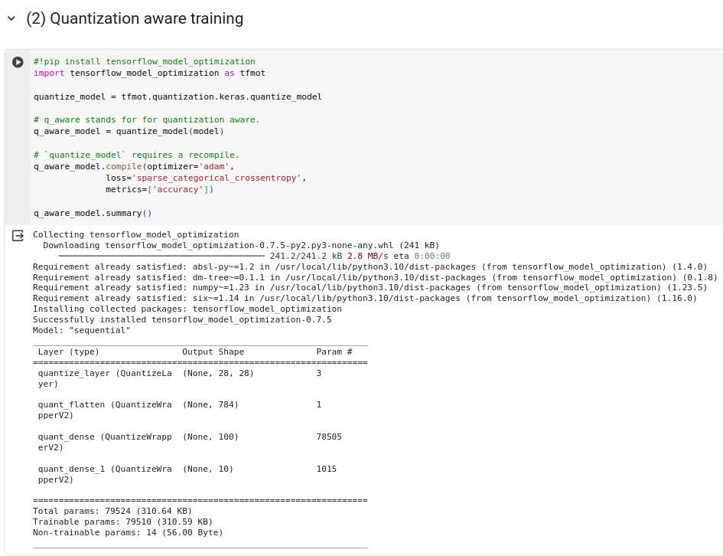
49.2 Quantization: Coding
https://www.youtube.com/watch?v=v1oHf1KV6kM&list=PLeo1K3hjS3uu7CxAacxVndI4bE_o3BDtO&index=49
Quantization: Coding (10:31-11:30/15:34)
Quantization Aware Training:

Slide 25
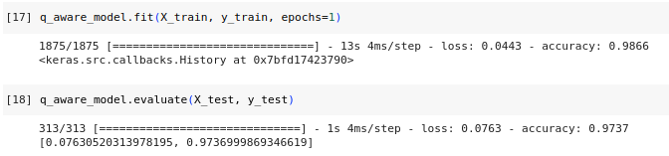
49.2 Quantization: Coding
https://www.youtube.com/watch?v=v1oHf1KV6kM&list=PLeo1K3hjS3uu7CxAacxVndI4bE_o3BDtO&index=49
Quantization: Coding (11:31-12:30/15:34)
Quantization aware training:
Loss: 0.076, Accuracy: 97.37%

Slide 26
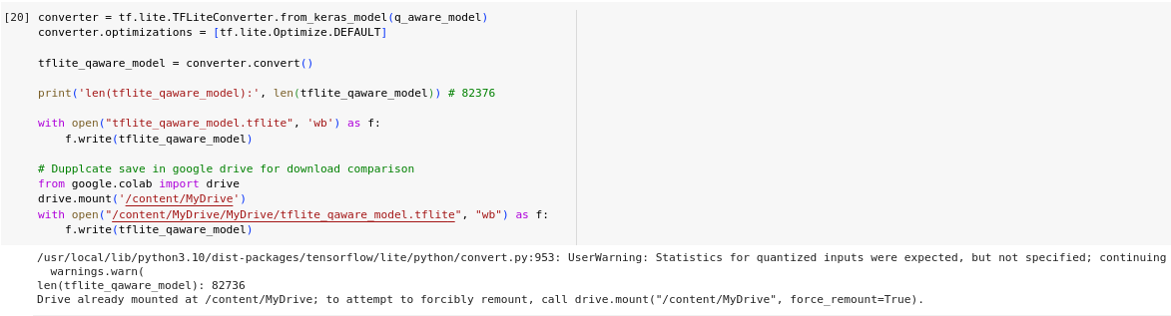
49.2 Quantization: Coding
https://www.youtube.com/watch?v=v1oHf1KV6kM&list=PLeo1K3hjS3uu7CxAacxVndI4bE_o3BDtO&index=49
Quantization: Coding (12:31-13:30/15:34)
Save to
1. colab
2. google drive for download and comparison:

Slide 27
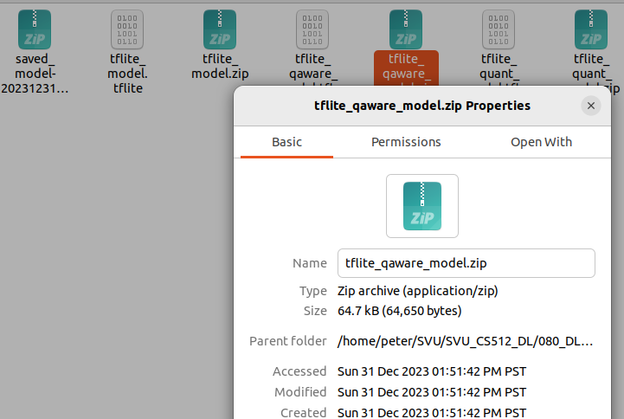
49.2 Quantization: Coding
https://www.youtube.com/watch?v=v1oHf1KV6kM&list=PLeo1K3hjS3uu7CxAacxVndI4bE_o3BDtO&index=49
Quantization: Coding (12:31-13:30/15:34)
tflite_quant_aware_model: 64.7K

Slide 28
49.2 Quantization: Coding
https://www.youtube.com/watch?v=v1oHf1KV6kM&list=PLeo1K3hjS3uu7CxAacxVndI4bE_o3BDtO&index=49
2.1
2.2
Quantization: Coding (13:31-15:35/15:34)
1. original saved_model: 850.6KB
2. Post-Training Quantization:
2.1 Without Optimization: tflite_model.tflite: 297.1KB
2.2 With Optimization (Remove Sparsity): tflite_quant_model.tflite: 68.4KB
3 Quantization Aware Training: 64.7 KB
1
3

Slide 29
End

