Slide 1

50 Full Stack Technology
Peter H. Chen

Slide 2
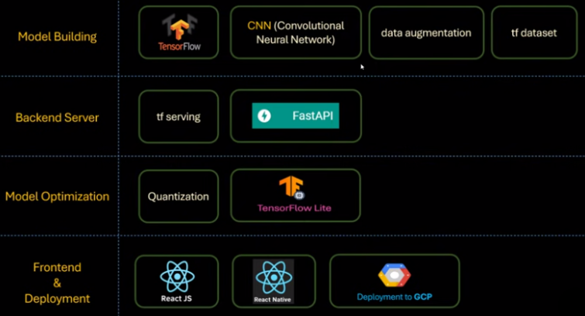
50 Full Stack Technology
https://www.youtube.com/watch?v=dGtDTjYs3xc&list=PLeo1K3hjS3uu7CxAacxVndI4bE_o3BDtO&index=50
Full Stack Technology (3:48-4:30/9:34)
Below is the technology stacks for full stack development:
1. Collect Dataset
2. Build Model
3. Backend Server
4. Quantization/Model Optimization
5. Frontend: ReactJS (Chrome Application), React Native (App).
1
2
3
4
5

Slide 3
50 Full Stack Technology
https://www.youtube.com/watch?v=dGtDTjYs3xc&list=PLeo1K3hjS3uu7CxAacxVndI4bE_o3BDtO&index=50
Full Stack Technology (0:00-0:40/9:34)
End-to-End Application of Potato Disease Classification:
1. Collect Data
2. Build Model
3. Backend Server (ML OPs): Build the backend server using TF serving using fast API.
4. Quantization/Model Optimization (Deploy on GCP): We deploy the model to GCP (Google Cloud Platform)
5. Frontend App: We write Mobile App by React Native.
1. Collect Data
2. Build Model
3. Backend Server
4. Quantization
5. Frontend App

Slide 4
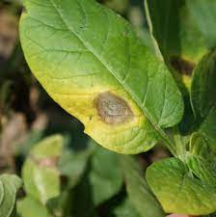
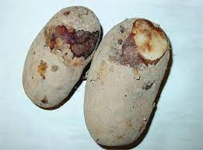
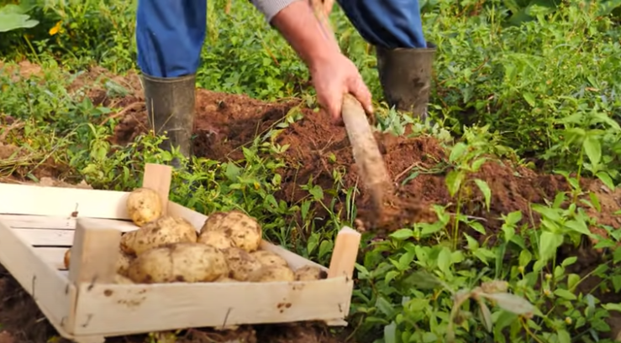
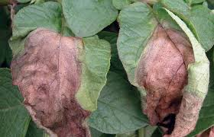
50 Full Stack Technology
https://www.youtube.com/watch?v=dGtDTjYs3xc&list=PLeo1K3hjS3uu7CxAacxVndI4bE_o3BDtO&index=50
Full Stack Technology (0:45-1:30/9:34)
Potato disease causes farmer losses. There are two kinds of common diseases for Potato:
1. Early Blight (枯萎病)
2. Late Blight
If we can detect the early blight and late blight diseases early and take treatments earlier, then we can save lot of finance loss.
1
2

Slide 5
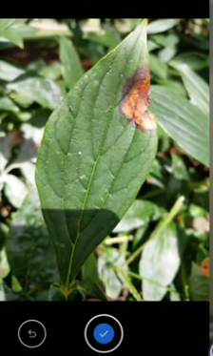
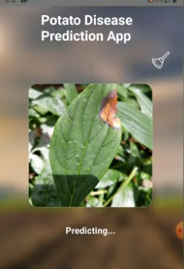
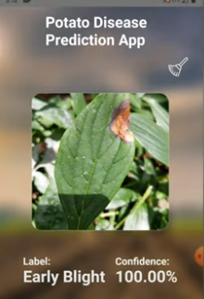
50 Full Stack Technology
https://www.youtube.com/watch?v=dGtDTjYs3xc&list=PLeo1K3hjS3uu7CxAacxVndI4bE_o3BDtO&index=50
Full Stack Technology (1:43-1:50/9:34)
We can build the server and mobile app to the farmers.
1. The farmers can take the picture by iPhone.
2. The Mobile App make the prediction.
3. The Mobile App will identify the potato disease is early blight or late blight.
In the server, we use the CNN (Convolutional Neural Network) for image processing.
1
2
3

Slide 6
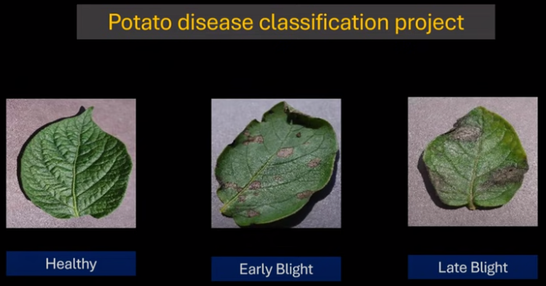
50 Full Stack Technology
https://www.youtube.com/watch?v=dGtDTjYs3xc&list=PLeo1K3hjS3uu7CxAacxVndI4bE_o3BDtO&index=50
Full Stack Technology (2:44-3:00/9:34)
We are the data scientist to build the end-to-end project to predict healthy, early blight, and late blight for potato disease.
First, we have to collect the images of Potato leaf:
1. Healthy
2. Early Blight
3. Late Blight

Slide 7
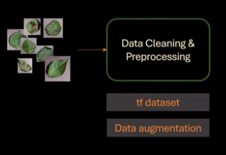
50 Full Stack Technology
https://www.youtube.com/watch?v=dGtDTjYs3xc&list=PLeo1K3hjS3uu7CxAacxVndI4bE_o3BDtO&index=50
Full Stack Technology (3:05-3:30/9:34)
1. We collect the dataset:
1.1 dataset of images of potato leaf
1.2 data augmentation (增强): We may not have enough data. We need to do rotate, shift, flip, contrast, etc. to create more training samples.
1

Slide 8
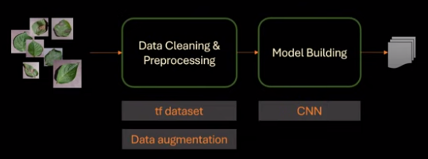
50 Full Stack Technology
https://www.youtube.com/watch?v=dGtDTjYs3xc&list=PLeo1K3hjS3uu7CxAacxVndI4bE_o3BDtO&index=50
Full Stack Technology (3:40-3:45/9:34)
2. We build the model.
2.1 We use CNN (Convolutional Neural Network) to extract features and match images
2.2 We export the Train Model on to the disk.
2

Slide 9
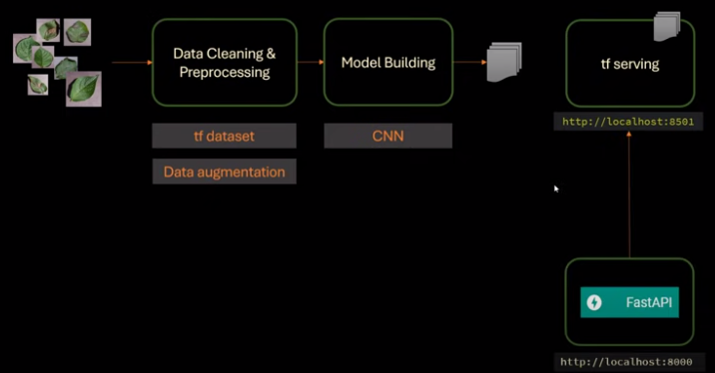
50 Full Stack Technology
https://www.youtube.com/watch?v=dGtDTjYs3xc&list=PLeo1K3hjS3uu7CxAacxVndI4bE_o3BDtO&index=50
Full Stack Technology (3:48-4:30/9:34)
3. We need Backend Server (ML OPs) concept using TF serving.
3.1 TF Serving: We have TF server running at the backend for the exported ML models. TF Serving manages different versions of ML models.
3.2 Flask/FastAPI: TF serving is called from Flask or FastAPI.
3

Slide 10
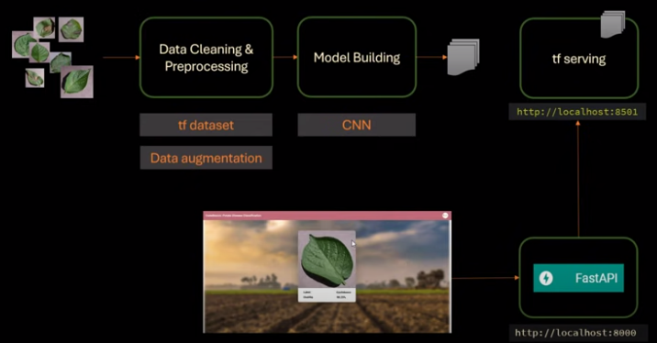
50 Full Stack Technology
https://www.youtube.com/watch?v=dGtDTjYs3xc&list=PLeo1K3hjS3uu7CxAacxVndI4bE_o3BDtO&index=50
Full Stack Technology (4:31-5:30/9:34)
4. We need to Quantization (Model Optimization) deploy on GCP (Google Cloud Platform)
5. We need to create the Chrome front-end application by ReactJS or Mobile App by React Native. The user can take the picture and display result by Chrome ReactJS application or React Native App.
5
4

Slide 11
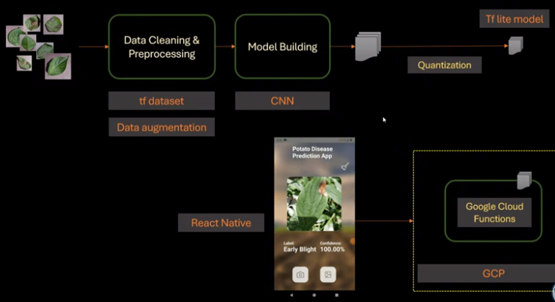
50 Full Stack Technology
https://www.youtube.com/watch?v=dGtDTjYs3xc&list=PLeo1K3hjS3uu7CxAacxVndI4bE_o3BDtO&index=50
Full Stack Technology (5:31-6:30/9:34)
3. To move the model to Edge device, we need to do the quantization.
4. Once we have the Google TF lite model, we can deploy on the GCP (Google Cloud Platform).
5. Front-end Development: The GCP Cloud Function is similar to has the AWS lambda function.
3
5
4

Slide 12
50 Full Stack Technology
https://www.youtube.com/watch?v=dGtDTjYs3xc&list=PLeo1K3hjS3uu7CxAacxVndI4bE_o3BDtO&index=50
Full Stack Technology (6:31-9:34/9:34)
Below is the technology stacks for full stack development:
1. Collect Dataset
2. Build Model
3. Backend Server
4. Quantization/Model Optimization
5. Frontend: ReactJS (Chrome Application), React Native (App).
1. Collect Data
2. Build Model
3. Backend Server
4. Quantization
5. Frontend App

Slide 13
End

