Slide 1

52 Full Stack: Model
Peter H. Chen

Slide 2
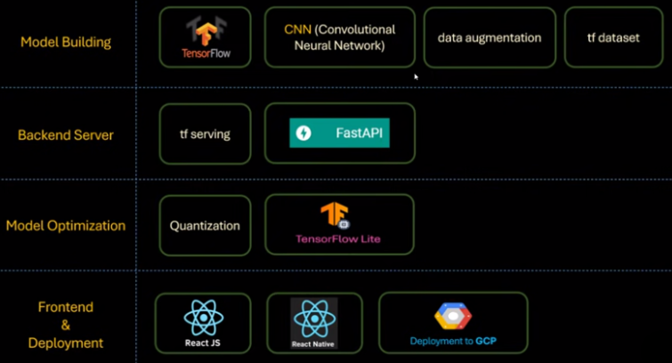
52 Full Stack: Model
https://www.youtube.com/watch?v=ZN6P_GEJ7lk&list=PLeo1K3hjS3uu7CxAacxVndI4bE_o3BDtO&index=52
Full Stack: Model (0:00-0:01/28:25)
Below is the technology stacks for full stack development:
1. Collect Dataset
2. Build Model
3. Backend Server
4. Quantization/Model Optimization
5. Frontend: ReactJS (Chrome Application), React Native (App).
1. Collect Data
2. Build Model
3. Backend Server
4. Quantization
5. Frontend App

Slide 3
52.1 Full Stack/Model: Theory

Slide 4
52.1 Full Stack/Model: Theory
https://www.youtube.com/watch?v=ZN6P_GEJ7lk&list=PLeo1K3hjS3uu7CxAacxVndI4bE_o3BDtO&index=52
Full Stack/Model: Theory (0:01-0:30/28:25)
We have load the dataset into the RAM Memory.
1. The tensorflow cache() manage CPU hardware to open the file once instead of multiple times.
2. Th tensorflow prefetch() allowed us pipeline and parallel run between the CPU and GPU accelerators.
We will build the CNN (Convolutional Neural Network) and train the model with our dataset.
We will measure the accuracy of model prediction with validate and test dataset.
If the accuracy of model is good, we will export the model into the disk.
We can use the model with FastAPI Server.

Slide 5
52.2 Full Stack/Model: Coding

Slide 6
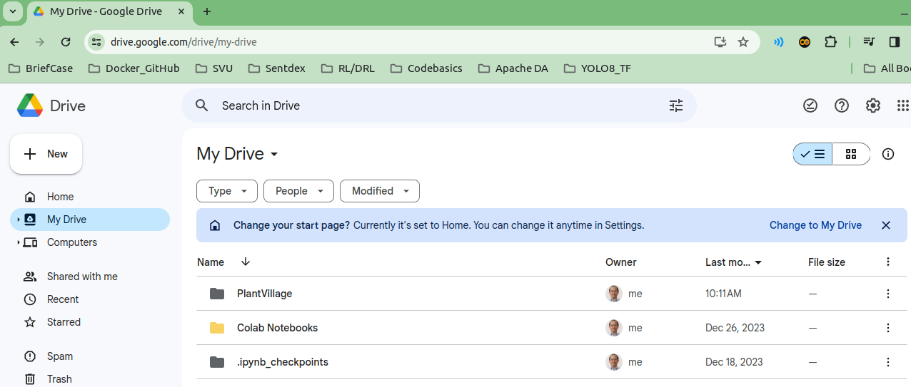
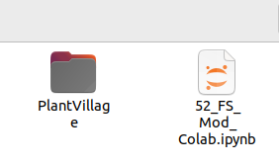
52.2 Full Stack/Model: Coding
https://www.youtube.com/watch?v=ZN6P_GEJ7lk&list=PLeo1K3hjS3uu7CxAacxVndI4bE_o3BDtO&index=52
Full Stack/Model: Coding (0:31-0:31/28:25)
1. Click Google Drive/MyDrive, Drag and drop the PlantVillage from local drive to Google Drive.
2. Click Notebook, Drag and Drop the

Slide 7
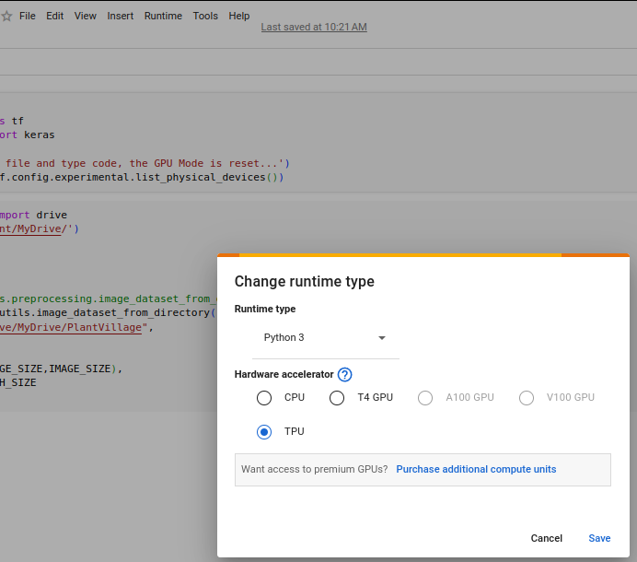
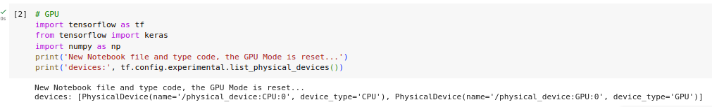
52.2 Full Stack/Model: Coding
https://www.youtube.com/watch?v=ZN6P_GEJ7lk&list=PLeo1K3hjS3uu7CxAacxVndI4bE_o3BDtO&index=52
Full Stack/Model: Coding (0:32-0:33/28:25)
We create new 52_FS_Model.ipynb,
1. Runtime > Change runtime type:
T4 GPU (Tesla-4 GPU) or TPU (Tensorflow Tensor GPU)
2. Colab GPU Device.

Slide 8
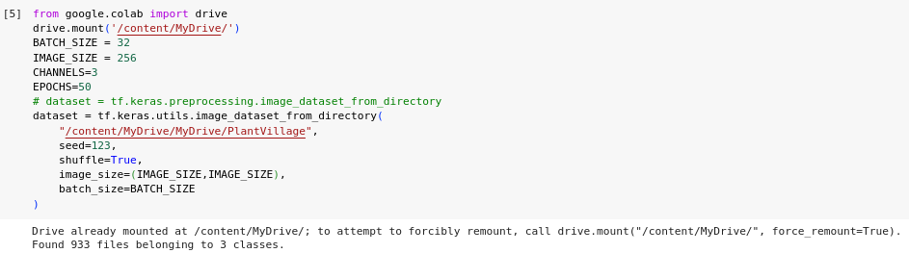
52.2 Full Stack/Model: Coding
https://www.youtube.com/watch?v=ZN6P_GEJ7lk&list=PLeo1K3hjS3uu7CxAacxVndI4bE_o3BDtO&index=52
Full Stack/Model: Coding (0:34-0:35/28:25)
Read dataset from Google Drive:
1. We import drive class from google.colab library.
2. The google drive will prompt the privacy access menu: Click “Allow” to read from Colab.
3. We use google utils to read dataset and preprocess with (BATCH_SIZE=32, IMAGE_SIZE=256x256x3) into RAM.

Slide 9
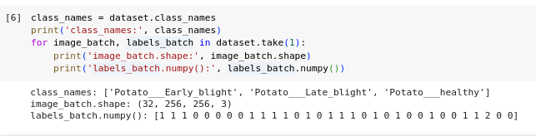
52.2 Full Stack/Model: Coding
https://www.youtube.com/watch?v=ZN6P_GEJ7lk&list=PLeo1K3hjS3uu7CxAacxVndI4bE_o3BDtO&index=52
Full Stack/Model: Coding (0:36-0:37/28:25)
1. Get class_names from folder PlantVillage
2. Take one sample from dataset:
2.1 print image_batch shape: 32 x 256 x 256 x 3
2.2 print the target labels.

Slide 10
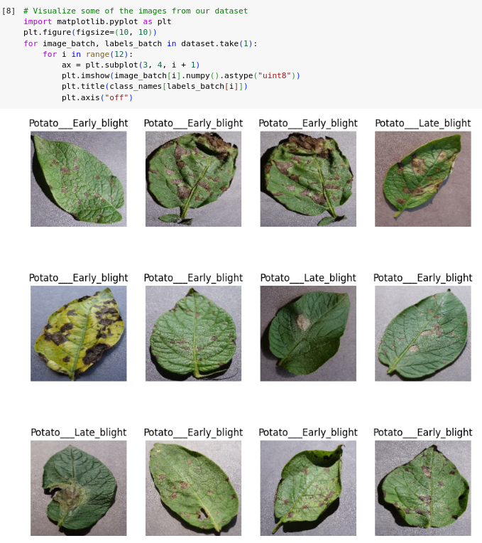
52.2 Full Stack/Model: Coding
https://www.youtube.com/watch?v=ZN6P_GEJ7lk&list=PLeo1K3hjS3uu7CxAacxVndI4bE_o3BDtO&index=52
Full Stack/Model: Coding (0:38-0:39/28:25)
Take one sample from dataset, display first 12 images.

Slide 11
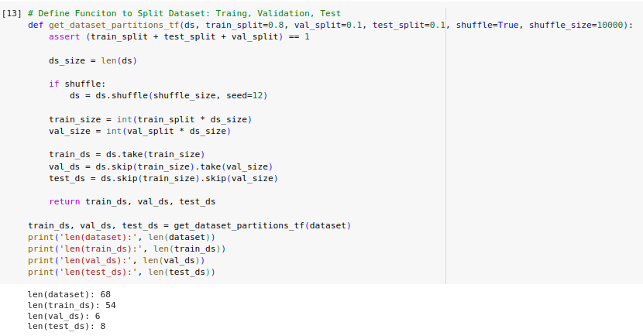
52.2 Full Stack/Model: Coding
https://www.youtube.com/watch?v=ZN6P_GEJ7lk&list=PLeo1K3hjS3uu7CxAacxVndI4bE_o3BDtO&index=52
Full Stack/Model: Coding (0:41-0:42/28:25)
Split the dataset into
1. Train Dataset: 80%
2. validate Dataset: 10% (Form the original dataset (68), skip train sample (54), and take validate sample (6).
3. Test Dataset: 10% (Form the original dataset (68), skip train samples (54), and skip validate samples (6), the remaining 8 samples for test).

Slide 12

52.2 Full Stack/Model: Coding
https://www.youtube.com/watch?v=ZN6P_GEJ7lk&list=PLeo1K3hjS3uu7CxAacxVndI4bE_o3BDtO&index=52
Full Stack/Model: Coding (0:42-0:43/28:25)
Prepare tensorflow training: Cache, shuffle, and prefetch the image into tensor.

Slide 13
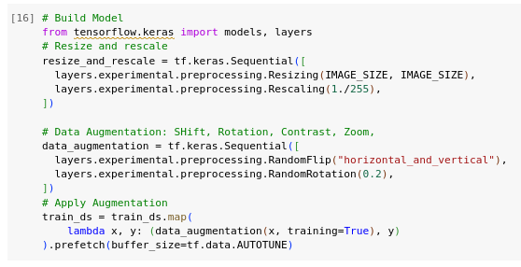
52.2 Full Stack/Model: Coding
https://www.youtube.com/watch?v=ZN6P_GEJ7lk&list=PLeo1K3hjS3uu7CxAacxVndI4bE_o3BDtO&index=52
Full Stack/Model: Coding (0:44-2:10/28:25)
1. Prepare Build Model
1.1 Resize and Rescale
1.2 Data Augmentation
1.3 Apply Augmentation

Slide 14
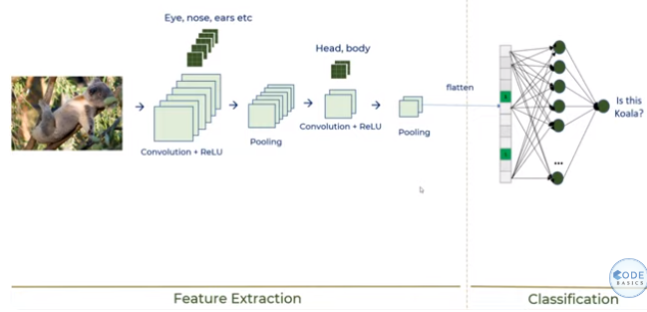
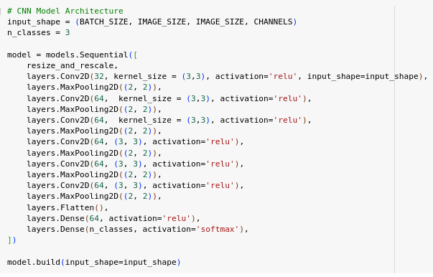
52.2 Full Stack/Model: Coding
https://www.youtube.com/watch?v=ZN6P_GEJ7lk&list=PLeo1K3hjS3uu7CxAacxVndI4bE_o3BDtO&index=52
Full Stack/Model: Coding (2:11-8:00/28:25)
We use the same architecture of 23_CNN (Simple explanation of convolutional neural network)
1. 1-CNN Layer for inputs: Convolution/Pooling (Eye/Nose/Ears/Head/Body): 32, 64, etc are try and error
2. several CNN Convolution/Polling (Eye/Nose/Ears/Head/Body): 32, 64, etc are try and error
3. Flatten:
4. Dense(): 64 neurons
5. Dense(): n_classes = 3
6. Build Model
1
2
4
3
5
6

Slide 15
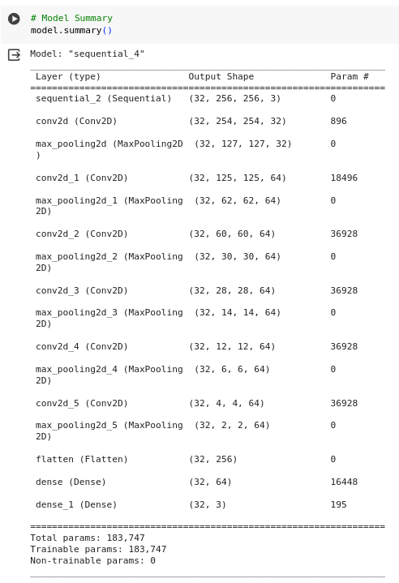
52.2 Full Stack/Model: Coding
https://www.youtube.com/watch?v=ZN6P_GEJ7lk&list=PLeo1K3hjS3uu7CxAacxVndI4bE_o3BDtO&index=52
Full Stack/Model: Coding (8:01-8:30/28:25)
Model Summary

Slide 16
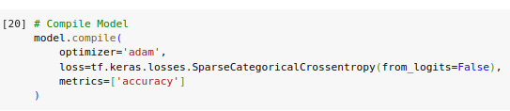
52.2 Full Stack/Model: Coding
https://www.youtube.com/watch?v=ZN6P_GEJ7lk&list=PLeo1K3hjS3uu7CxAacxVndI4bE_o3BDtO&index=52
Full Stack/Model: Coding (8:31-8:52/28:25)
Compile Model: Pass different parameters and compile the model.

Slide 17
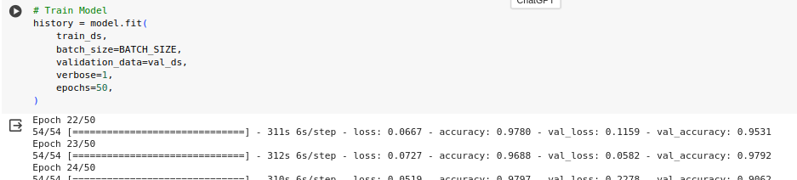
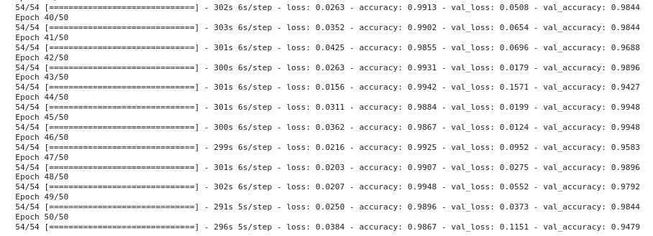
52.2 Full Stack/Model: Coding
https://www.youtube.com/watch?v=ZN6P_GEJ7lk&list=PLeo1K3hjS3uu7CxAacxVndI4bE_o3BDtO&index=52
Full Stack/Model: Coding (8:53-11:20/28:25)
Train Model:
1. Free Colab has only 1 GPU.
2. It takes 2-5 hours to train.

Slide 18
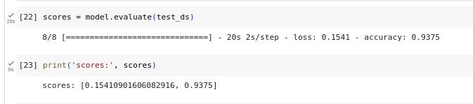
52.2 Full Stack/Model: Coding
https://www.youtube.com/watch?v=ZN6P_GEJ7lk&list=PLeo1K3hjS3uu7CxAacxVndI4bE_o3BDtO&index=52
Full Stack/Model: Coding (11:21-12:20/28:25)
1. Evaluate Model
2. Scores:
2.1 Loss: 0.154
2.2 Accuracy: 0.93

Slide 19
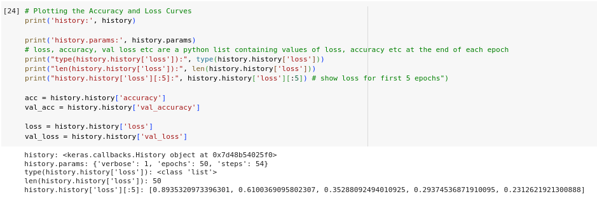
52.2 Full Stack/Model: Coding
https://www.youtube.com/watch?v=ZN6P_GEJ7lk&list=PLeo1K3hjS3uu7CxAacxVndI4bE_o3BDtO&index=52
Full Stack/Model: Coding (12:31-14:00/28:25)
Print Accuracy and Loss.
Save the accuracy and loss into the log.

Slide 20
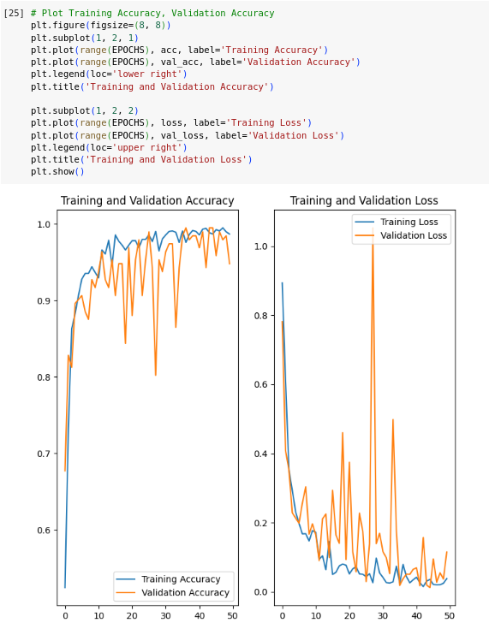
52.2 Full Stack/Model: Coding
https://www.youtube.com/watch?v=ZN6P_GEJ7lk&list=PLeo1K3hjS3uu7CxAacxVndI4bE_o3BDtO&index=52
Full Stack/Model: Coding (14:01-14:50/28:25)
Plot log for Accuracy and Loss

Slide 21
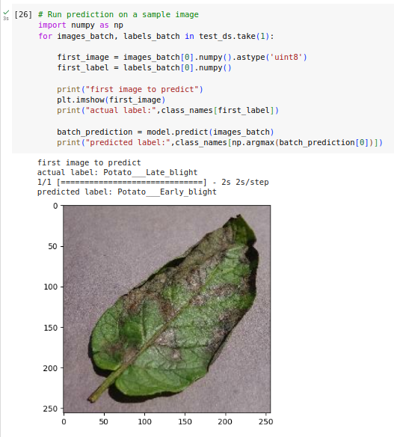
52.2 Full Stack/Model: Coding
https://www.youtube.com/watch?v=ZN6P_GEJ7lk&list=PLeo1K3hjS3uu7CxAacxVndI4bE_o3BDtO&index=52
Full Stack/Model: Coding (15:01-20:30/28:25)
Print the first_image and first_label
First image prediction.
Prediction for first image.
Print the probability distribution.
Find class by argmax()

Slide 22
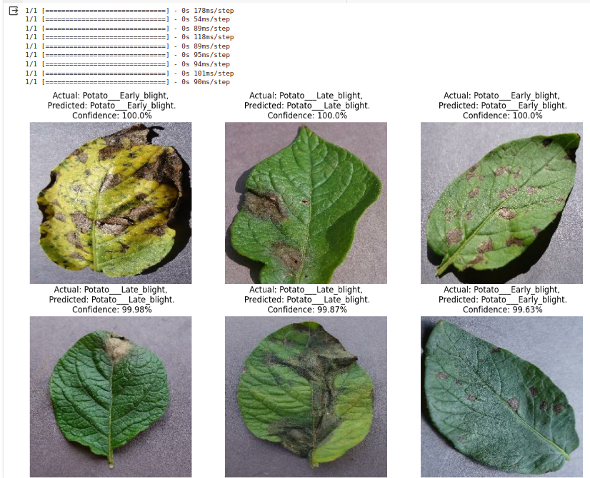
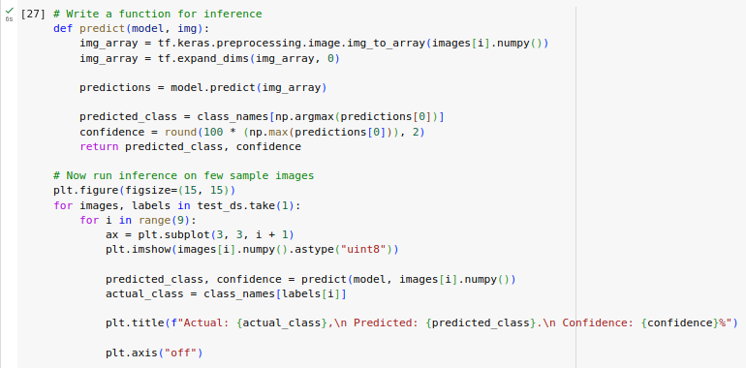
52.2 Full Stack/Model: Coding
https://www.youtube.com/watch?v=ZN6P_GEJ7lk&list=PLeo1K3hjS3uu7CxAacxVndI4bE_o3BDtO&index=52
Full Stack/Model: Coding (20:31-23:50/28:25)
Predict 12-images.

Slide 23
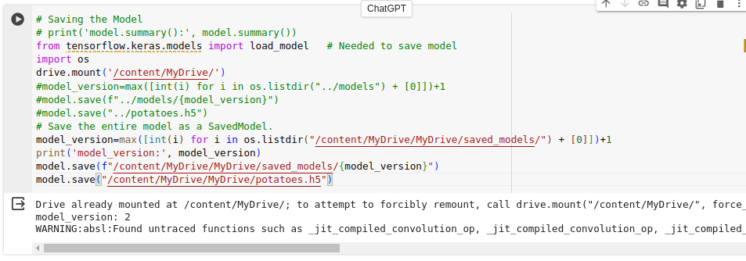
52.2 Full Stack/Model: Coding
https://www.youtube.com/watch?v=ZN6P_GEJ7lk&list=PLeo1K3hjS3uu7CxAacxVndI4bE_o3BDtO&index=52
Full Stack/Model: Coding (24:01-28:00/28:25)
Save the models into the Google Drive.
We store the models in the saved_models folder with different versions.
Do not care about “potatoes.h5”.

Slide 24
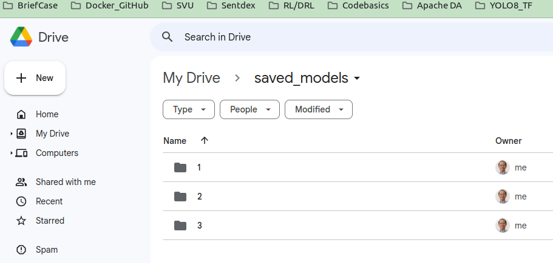
52.2 Full Stack/Model: Coding
https://www.youtube.com/watch?v=ZN6P_GEJ7lk&list=PLeo1K3hjS3uu7CxAacxVndI4bE_o3BDtO&index=52
Full Stack/Model: Coding (28:01-28:20/28:25)
We save three times and we get three version of models.

Slide 25
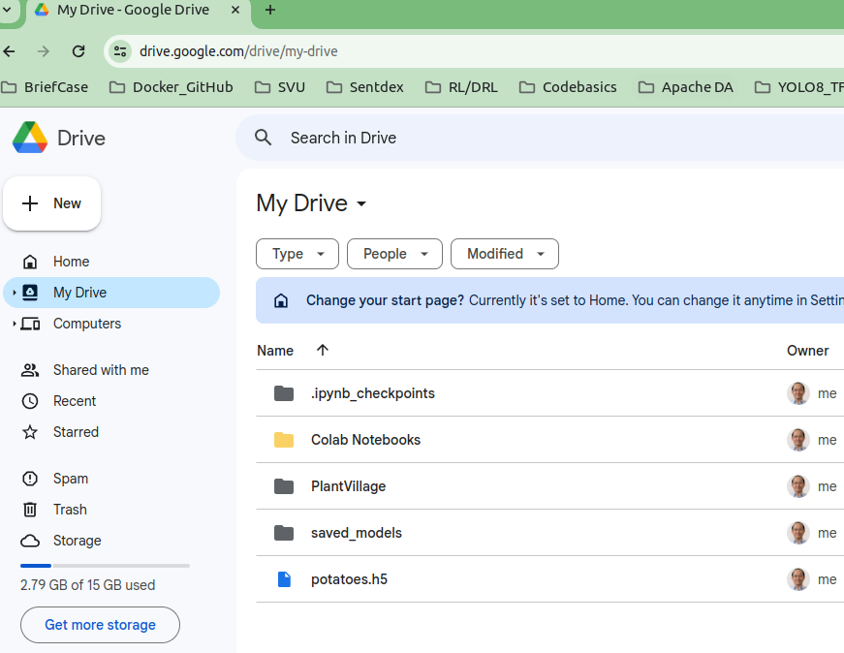
52.2 Full Stack/Model: Coding
https://www.youtube.com/watch?v=ZN6P_GEJ7lk&list=PLeo1K3hjS3uu7CxAacxVndI4bE_o3BDtO&index=52
Full Stack/Model: Coding (28:21-28:25/28:25)
We can download the models into local disk and continue to do the wordk.

Slide 26
End

