Slide 1

53 Full Stack: FastAPI/TF Serving
Peter H. Chen

Slide 2
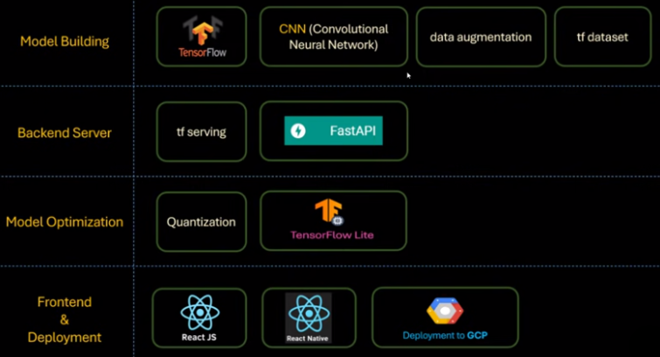
53 Full Stack: FastAPI/TF Serving
https://www.youtube.com/watch?v=t6NI0u_lgNo&list=PLeo1K3hjS3uu7CxAacxVndI4bE_o3BDtO&index=53
Full Stack: FastAPI/TF Serving (0:00-0:01/36:43)
Below is the technology stacks for full stack development:
1. Collect Dataset
2. Build Model
3. Backend Server
4. Quantization/Model Optimization
5. Frontend: ReactJS (Chrome Application), React Native (App).
1. Collect Data
2. Build Model
3. Backend Server
4. Quantization
5. Frontend App

Slide 3
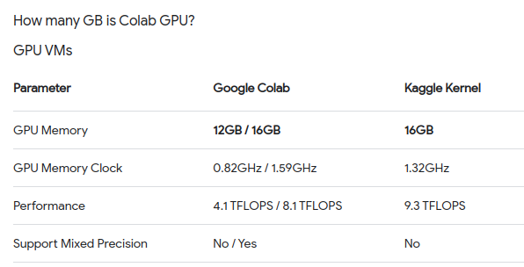
52 Full Stack/FastAPI/TF Serving
https://www.youtube.com/watch?v=t6NI0u_lgNo&list=PLeo1K3hjS3uu7CxAacxVndI4bE_o3BDtO&index=53
Full Stack/FastAPI/TF Serving (0:02-1:00/36:43)
We trained the Model on Colab TPU (with 1 GPU and 12/16GB VRAM) and saved the trained model.
We downloaded the trained Model into local machine.
We will use FastAPI and TF Serving to serve the trained Model.
Note:
Both Google Colab and Google Kaggle provide free Model training/computaiton for jupyter notebook.

Slide 4
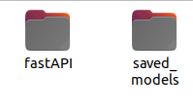
53 Full Stack/FastAPI/TF Serving
https://www.youtube.com/watch?v=t6NI0u_lgNo&list=PLeo1K3hjS3uu7CxAacxVndI4bE_o3BDtO&index=53
Full Stack/FastAPI/TF Serving (1:01-1:05/36:43)
We have
1. folder “saved_model” save the trained from colab.
2. created “api” folder to store FastAPI codes.
We need to install: fastapi, uvicorn, etc as below:

Slide 5
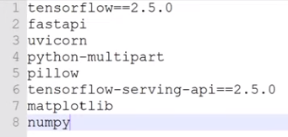
53 Full Stack/FastAPI/TF Serving
https://www.youtube.com/watch?v=t6NI0u_lgNo&list=PLeo1K3hjS3uu7CxAacxVndI4bE_o3BDtO&index=53
Full Stack/FastAPI/TF Serving(1:06-1:30/36:43)
We need to install:
1. fastapi (High-Performance Web framework for backend routing.
> pip install fastapi
2. ASGI (Asynchronous Server Gateway Interface)Web server implementation for Python
> pip install uvicorn
3. Python upload for large streaming files
> pip install python-multipart
4. High performance serving for machine learning model for production environment
> pip install tensorflow-serving-api
5. numpy: scientific computation library
> pip install numpy
6. PIL (Pillow): Python Image Library
> pip install pillow

Slide 6
53 Full Stack/FastAPI/TF Serving
https://www.youtube.com/watch?v=t6NI0u_lgNo&list=PLeo1K3hjS3uu7CxAacxVndI4bE_o3BDtO&index=53
Full Stack/FastAPI/TF Serving (1:31-2:50/36:43)
Below is the file name “requirements.txt”
> pip install -r requirements.txt
You can install individually as well.
The command “pip install -q requirements.txt” install the matched framework dependencies (eact version).

Slide 7
53.1 Uvicorn and FastAPI

Slide 8
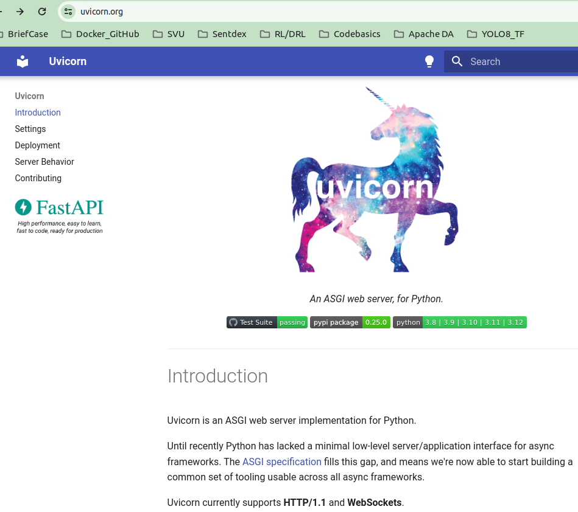
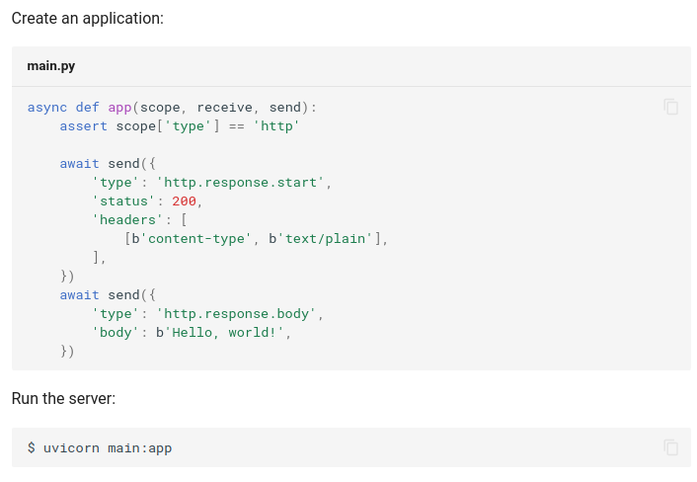
53.1 Uvicorn and FastAPI
https://www.youtube.com/watch?v=t6NI0u_lgNo&list=PLeo1K3hjS3uu7CxAacxVndI4bE_o3BDtO&index=53
Uvicorn and FastAPI (2:51-2:52/36:43)
Uvicorn is the combination of “UVloop” and “Unicorn”.
“UV” refers to UVloop library. UVloop is the ultra-fast event loop for python used in Uvicorn.
> pip install uvicorn
> uvicorn main:app --reload

Slide 9
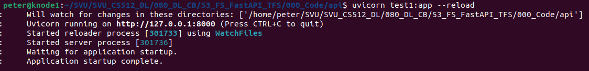
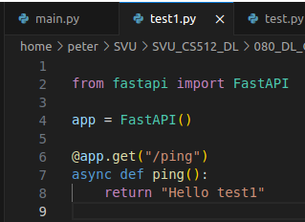
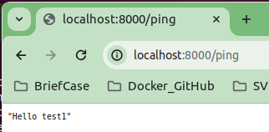
53.1 Uvicorn and FastAPI
https://www.youtube.com/watch?v=t6NI0u_lgNo&list=PLeo1K3hjS3uu7CxAacxVndI4bE_o3BDtO&index=53
Uvicorn and FastAPI (2:54-4:00/36:43)
We create to test1.py
> code test1.py
We use the “uvicorn” command for server. “test1” is the name file test1.py. “app” is the variable of FastAPI instance.
> unicorn test1:app --reload
Open chrome
> localhost:8000/ping # We need to specify the end point.

Slide 10
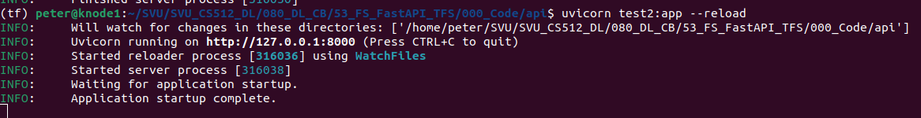
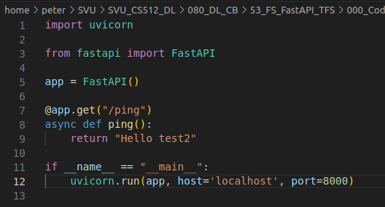
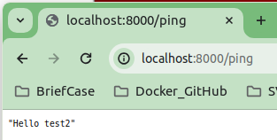
53.1 Uvicorn and FastAPI
https://www.youtube.com/watch?v=t6NI0u_lgNo&list=PLeo1K3hjS3uu7CxAacxVndI4bE_o3BDtO&index=53
Uvicorn and FastAPI (2:54-4:00/36:43)
We create test2.py to run with unicorn.run(app, …):
> code test2.py
We use the “uvicorn” command for server. “test1” is the name file test1.py. “app” is the variable of FastAPI instance.
> unicorn test2:app --reload
Open chrome
> localhost:8000/ping # We need to specify the end point.

Slide 11
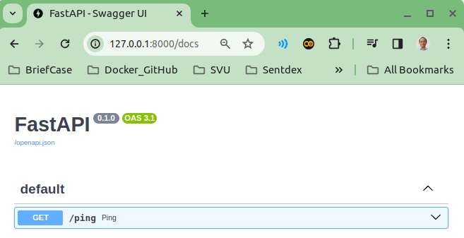
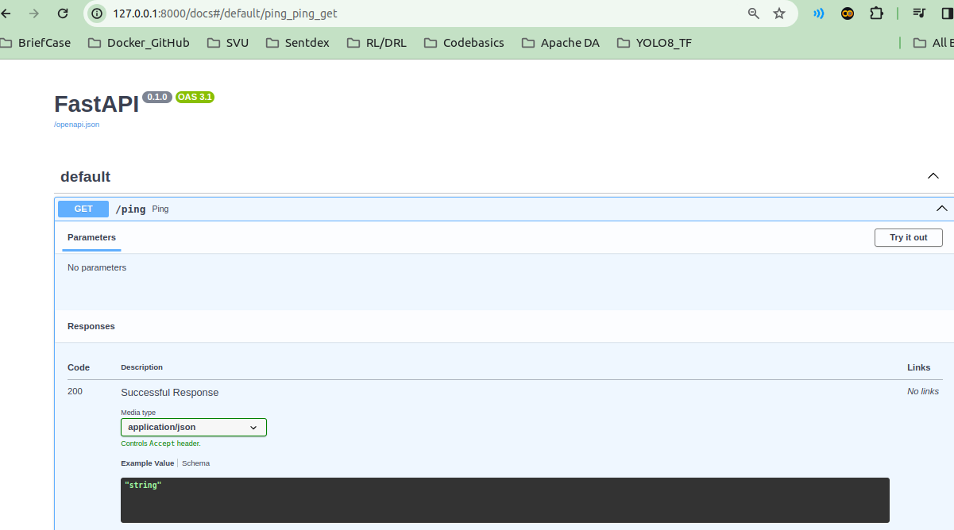
53.1 Uvicorn and FastAPI
https://www.youtube.com/watch?v=t6NI0u_lgNo&list=PLeo1K3hjS3uu7CxAacxVndI4bE_o3BDtO&index=53
Uvicorn and FastAPI (4:01-4:30/36:43)
On the Chrome, we can use
>127.0.0.1:8000/docs or “localhost:8000/docs”
Click “v”
Click “Try it out”

Slide 12
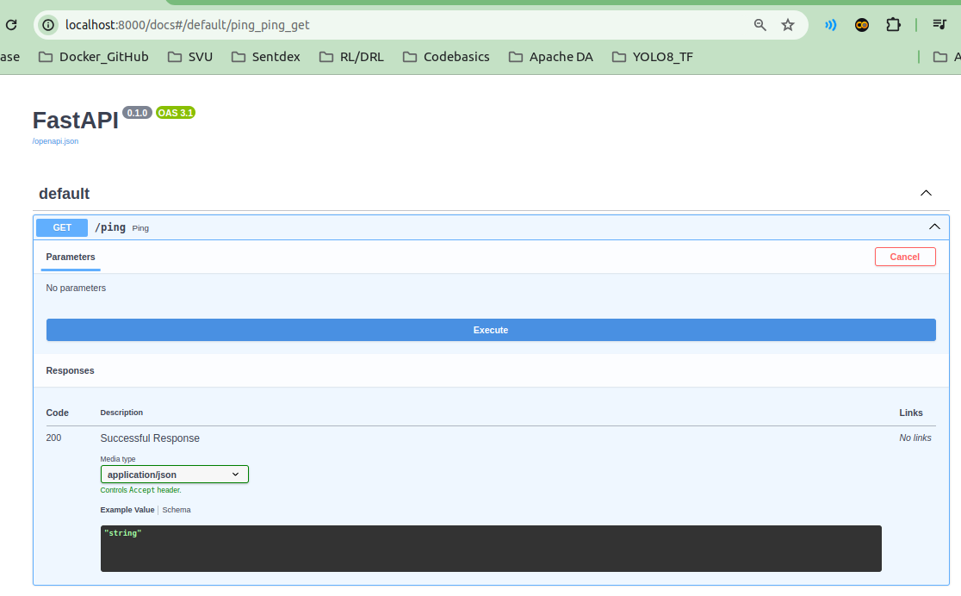
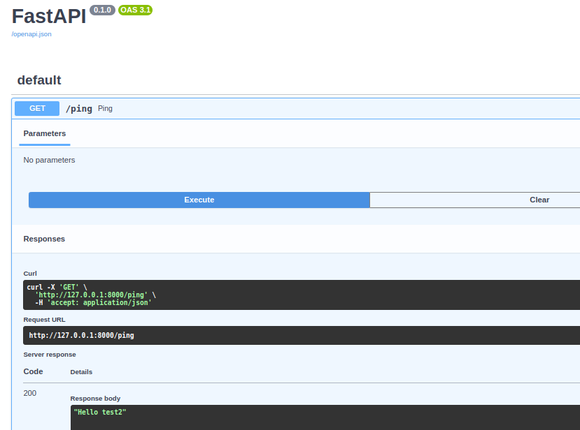
53.1 Uvicorn and FastAPI
https://www.youtube.com/watch?v=t6NI0u_lgNo&list=PLeo1K3hjS3uu7CxAacxVndI4bE_o3BDtO&index=53
Uvicorn and FastAPI (4:31-5:30/36:43)
Click “Execute”
We get the result:
“Hello Test2”

Slide 13
53.2 FastAPI: Coding

Slide 14
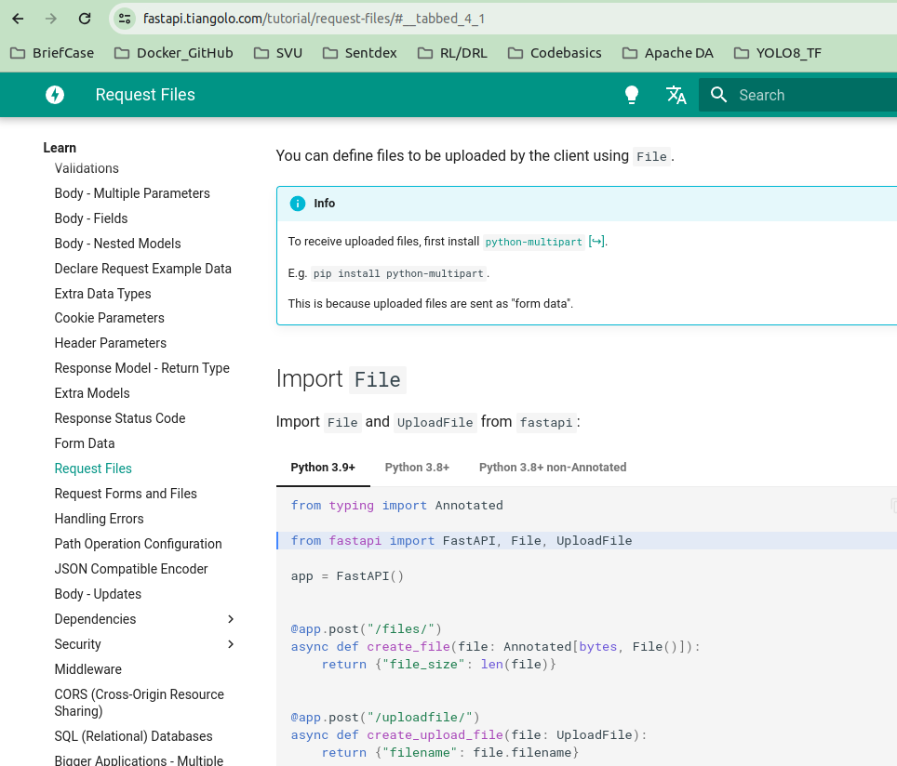
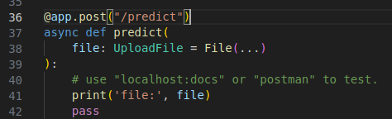
53.2 FastAPI: Coding
https://www.youtube.com/watch?v=t6NI0u_lgNo&list=PLeo1K3hjS3uu7CxAacxVndI4bE_o3BDtO&index=53
FastAPI: Coding (5:01-6:30/36:43)
We have done the basic test of fastapi and uvicorn.
Now, we are going to implement the actual code.
> code main.py
Google search “fastapi upload file”.
> async def predict (file: UploadFile = File (…)):
> print(‘file:’ file)
> pass

Slide 15
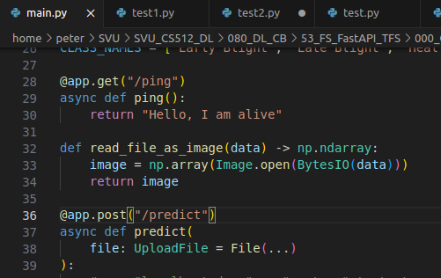
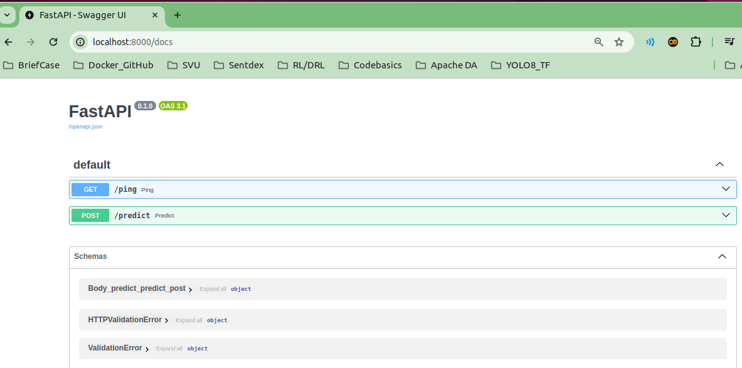
53.2 FastAPI: Coding
https://www.youtube.com/watch?v=t6NI0u_lgNo&list=PLeo1K3hjS3uu7CxAacxVndI4bE_o3BDtO&index=53
FastAPI: Coding (5:01-6:30/36:43)
In main.py, we have both @app.get and @app.post
> uvicorn main:app --reload
We got both “get” and “post” in fastapi/docs

Slide 16
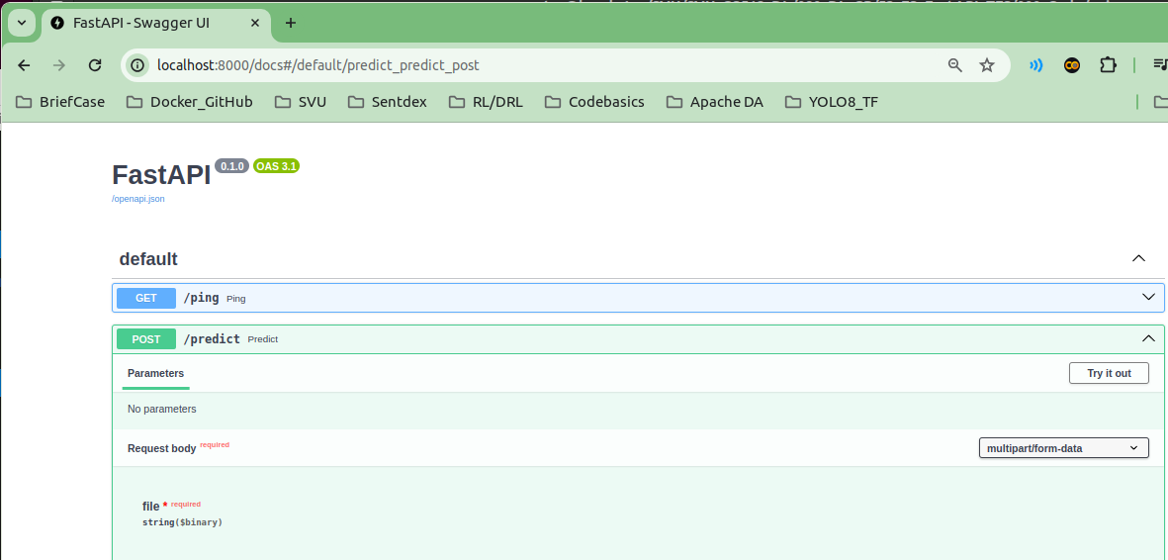
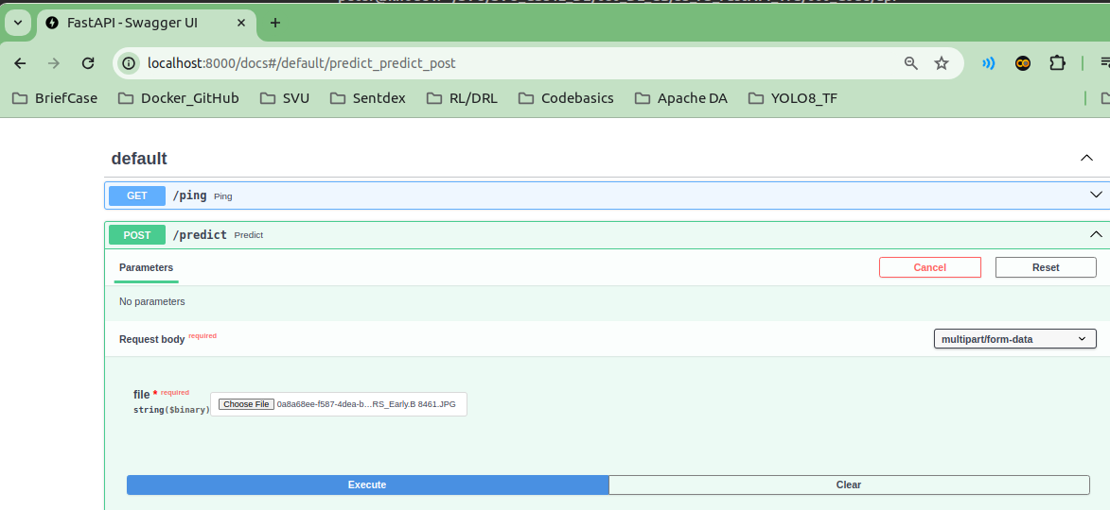
53.2 FastAPI: Coding
https://www.youtube.com/watch?v=t6NI0u_lgNo&list=PLeo1K3hjS3uu7CxAacxVndI4bE_o3BDtO&index=53
FastAPI: Coding (6:31-9:00/36:43)
Click “Try it out”
Click “File” and select any image file to execute.

Slide 17
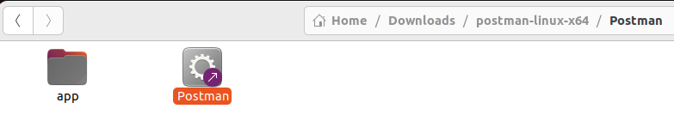
53.2 FastAPI: Coding
https://www.youtube.com/watch?v=t6NI0u_lgNo&list=PLeo1K3hjS3uu7CxAacxVndI4bE_o3BDtO&index=53
FastAPI: Coding (9:01-9:30/36:43)
We can download the postman on chrome.
Google search “postman”. Log in with google account.
Download and registered for free.
Click “Postman” to start.

Slide 18
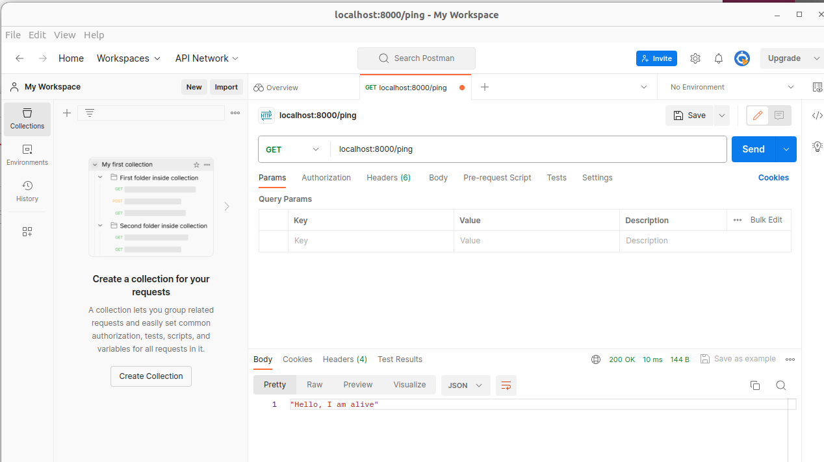
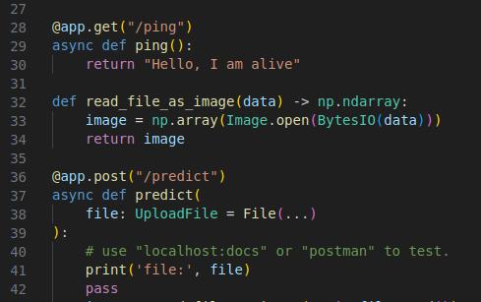
53.2 FastAPI: Coding
https://www.youtube.com/watch?v=t6NI0u_lgNo&list=PLeo1K3hjS3uu7CxAacxVndI4bE_o3BDtO&index=53
FastAPI: Coding (9:01-9:30/36:43)
File > New to start a HTTP communication.
GET > localhost:8000/ping
Response > “hello, I am alive”

Slide 19
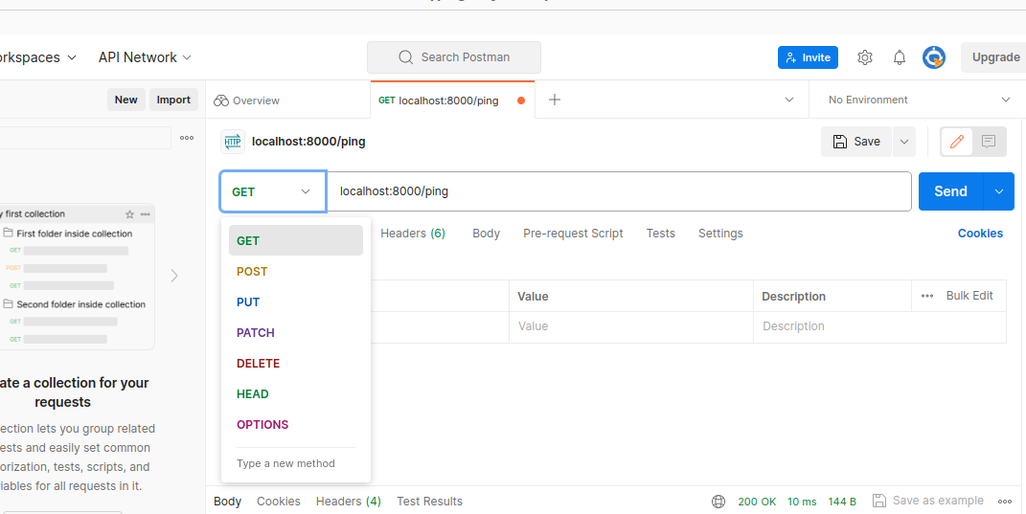
53.2 FastAPI: Coding
https://www.youtube.com/watch?v=t6NI0u_lgNo&list=PLeo1K3hjS3uu7CxAacxVndI4bE_o3BDtO&index=53
FastAPI: Coding (9:01-9:30/36:43)
Use “v” to select the “POST”

Slide 20
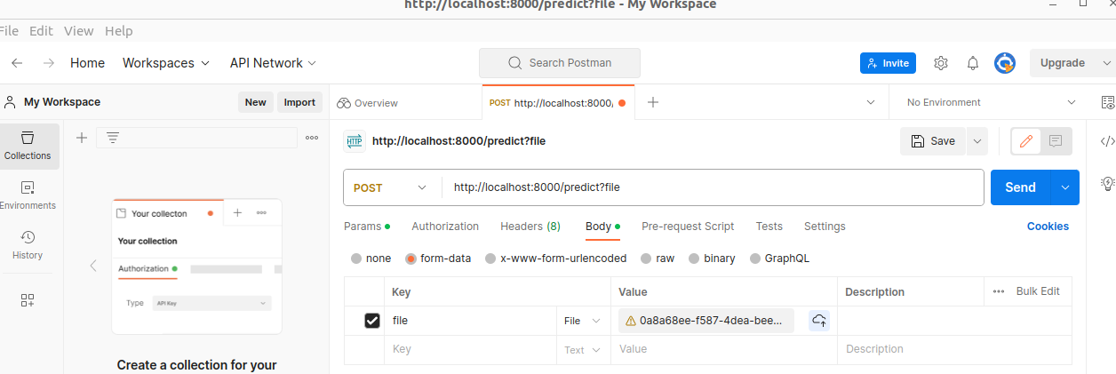
53.2 FastAPI: Coding
https://www.youtube.com/watch?v=t6NI0u_lgNo&list=PLeo1K3hjS3uu7CxAacxVndI4bE_o3BDtO&index=53
FastAPI: Coding (9:01-9:30/36:43)
Use “v” to select the “POST”
1. Select “Body”
2. Select “form-data”
3. Key: file (specified in python code “file”)
4. Value: select from local drive.
5. Click “Send”

Slide 21
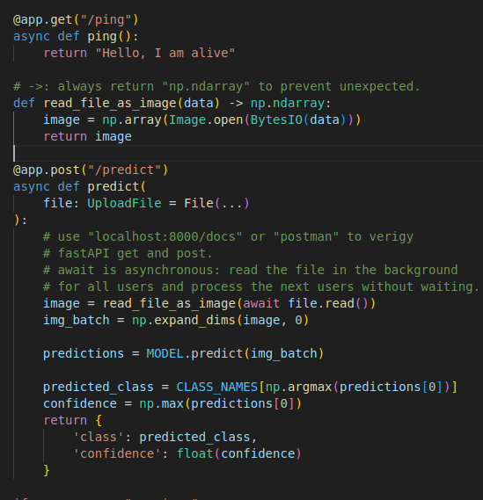
53.2 FastAPI: Coding
https://www.youtube.com/watch?v=t6NI0u_lgNo&list=PLeo1K3hjS3uu7CxAacxVndI4bE_o3BDtO&index=53
FastAPI: Coding (9:01-16:00/36:43)
1. Define get() just return the image data.
2. define post() for prediction: get is more secure in transfer the message.

Slide 22
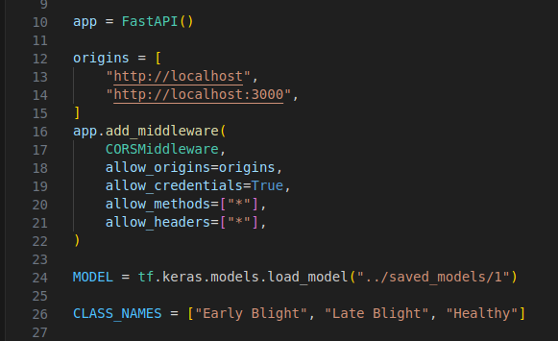
53.2 FastAPI: Coding
https://www.youtube.com/watch?v=t6NI0u_lgNo&list=PLeo1K3hjS3uu7CxAacxVndI4bE_o3BDtO&index=53
FastAPI: Coding (16:01-17:30/36:43)
Read data from “../saved_ models/1”

Slide 23
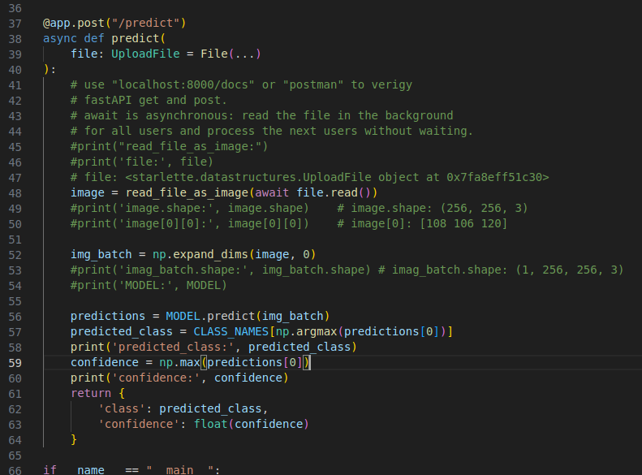
53.2 FastAPI: Coding
https://www.youtube.com/watch?v=t6NI0u_lgNo&list=PLeo1K3hjS3uu7CxAacxVndI4bE_o3BDtO&index=53
FastAPI: Coding (17:31-21:50/36:43)
If have have “DNN” Error.
The tensorflow framework may be messed up.
Try to uninstall and re-installed tensorflow again.
Test by “fastapi/docs”

Slide 24
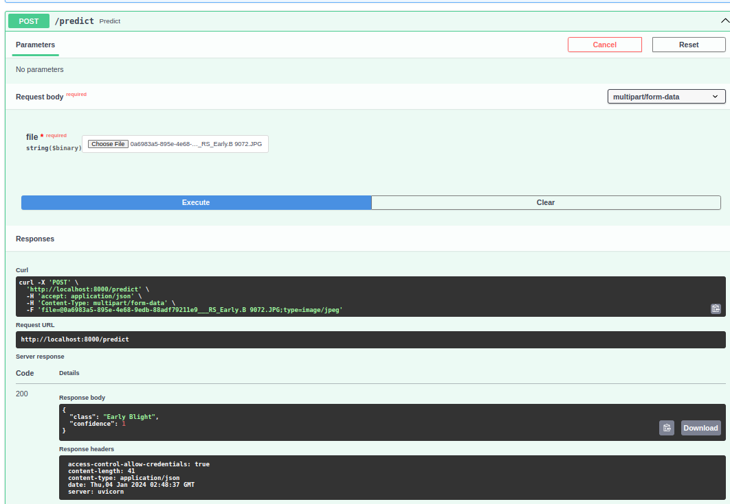
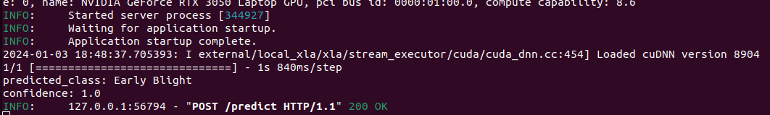
53.2 FastAPI: Coding
https://www.youtube.com/watch?v=t6NI0u_lgNo&list=PLeo1K3hjS3uu7CxAacxVndI4bE_o3BDtO&index=53
FastAPI: Coding (21:51-22:30/36:43)
Test by fastapi/docs:
If have have “DNN” Error.
The tensorflow framework may be messed up.
Try to uninstall and re-installed tensorflow again.
Test by “fastapi/docs”

Slide 25
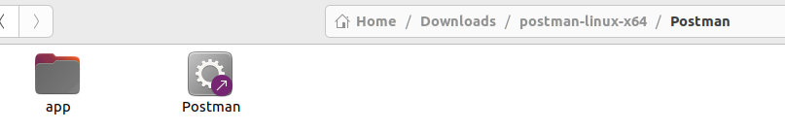
53.2 FastAPI: Coding
https://www.youtube.com/watch?v=t6NI0u_lgNo&list=PLeo1K3hjS3uu7CxAacxVndI4bE_o3BDtO&index=53
FastAPI: Coding (22:31-23:00/36:43)
Test by postman
1. Download postman.
2. unzip postman
3. double click “postman”

Slide 26
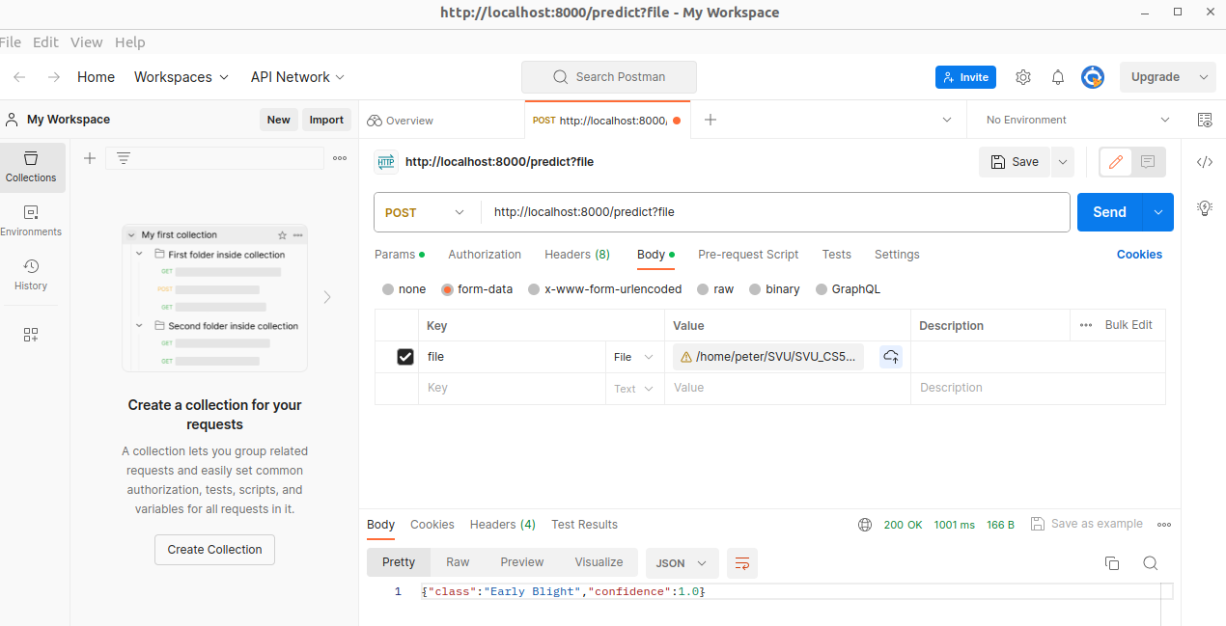
53.2 FastAPI: Coding
https://www.youtube.com/watch?v=t6NI0u_lgNo&list=PLeo1K3hjS3uu7CxAacxVndI4bE_o3BDtO&index=53
FastAPI: Coding (23:01-23:30/36:43)
1. click “v” and select “Post”
2. > http://localhost:8000/prediction
3. clock ”Body”
4. key: “file”
5. Value: Use file browser to select the “image” file.
6. Clock “Send” to backend server.

Slide 27
53.2 TF Serving: Coding

Slide 28
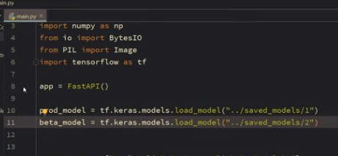
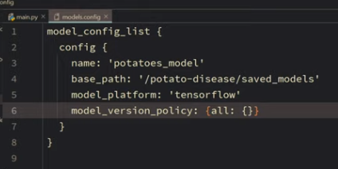
53.2 TF Serving: Coding
https://www.youtube.com/watch?v=t6NI0u_lgNo&list=PLeo1K3hjS3uu7CxAacxVndI4bE_o3BDtO&index=53
TF Serving: Coding (25:01-28:30/36:43)
Not ready yet.

Slide 29
End

