Slide 1

55 Full Stack: Train Model by Image Generator
Peter H. Chen

Slide 2
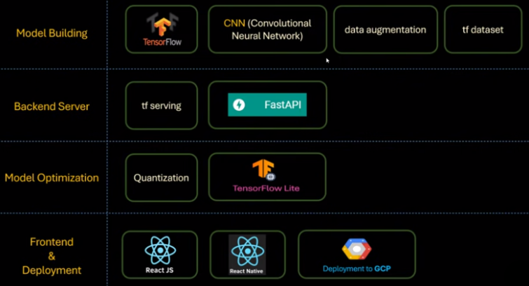
55 Full Stack: Train Model by Image Generator
https://www.youtube.com/watch?v=DQFerxe6o5g&list=PLeo1K3hjS3uu7CxAacxVndI4bE_o3BDtO&index=55
Full Stack: Train Model by Image Generator (0:00-0:01/18:21)
Below is the technology stacks for full stack development:
1. Collect Dataset
2. Build Model
3. Backend Server
4. Quantization/Model Optimization
5. Frontend: ReactJS (Chrome Application), React Native (App).
1. Collect Data
2. Build Model
3. Backend Server
4. Quantization
5. Frontend App

Slide 3
55 Full Stack: Train Model by Image Generator
https://www.youtube.com/watch?v=DQFerxe6o5g&list=PLeo1K3hjS3uu7CxAacxVndI4bE_o3BDtO&index=55
Full Stack: Train Mode by Image Generator (0:01-1:00/18:21)
Before we deploy the model to google cloud, we want to discuss image data generator API.
We will the model again using the image generator.
Reader feedback: “Can we perform the data augmentation using ImageDataGenerator class? It will be great if we can compare the difference between ImageDataGenerator and RandomFlip(), etc methods of DA (Data Augmentation).”
We will train model again with ImageDataGenerator.
This ImageDataGenerator has convenient component for image loading, data augment, etc.
Note:
The tensorflow image generator exceed the limit of Colab GPU VRAM 17GB.
We cannot train the model with free Colab account.

Slide 4
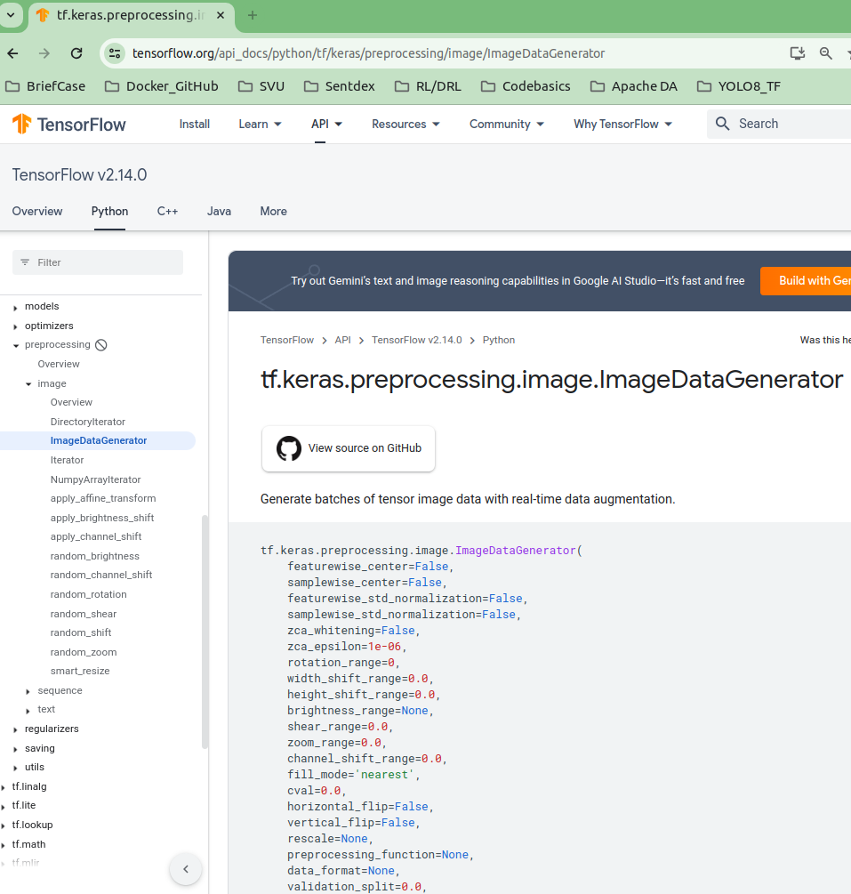
55 Full Stack: Train Model by Image Generator
https://www.youtube.com/watch?v=DQFerxe6o5g&list=PLeo1K3hjS3uu7CxAacxVndI4bE_o3BDtO&index=55
Full Stack: Train Mode by Image Generator (1:20-1:30/18:21)
We google search “ImageDataGenerator”.

Slide 5
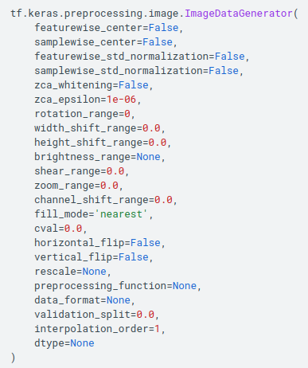
55 Full Stack: Train Model by Image Generator
https://www.youtube.com/watch?v=DQFerxe6o5g&list=PLeo1K3hjS3uu7CxAacxVndI4bE_o3BDtO&index=55
Full Stack: Train Mode by Image Generator (1:31-2:00/18:21)
We can preprocess the image with ImageDataGenerator class by passing in all the arguments.
For example, we want to
1. rotation
2. increase the brightness
3. horizontal flip
4. vertical flip
5. rescale
6. etc

Slide 6
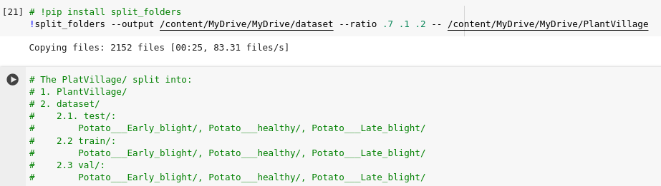
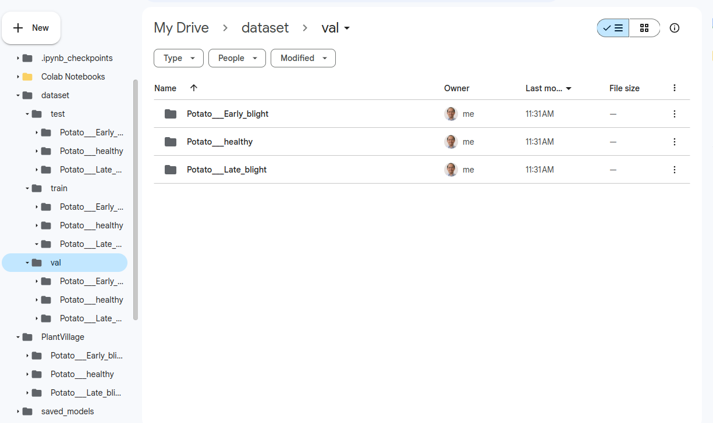
55 Full Stack: Train Model by Image Generator
https://www.youtube.com/watch?v=DQFerxe6o5g&list=PLeo1K3hjS3uu7CxAacxVndI4bE_o3BDtO&index=55
Full Stack: Train Mode by Image Generator (1:31-5:20/18:21)
We split the “PlantVillage” folder has 1000 images and into ratio of (0.7, 0.1, 0.2)
1. PlantVillage: 1000, ...
2. dataset: test (700, ...), train (100, ...), val (200, ...)
As below:

Slide 7
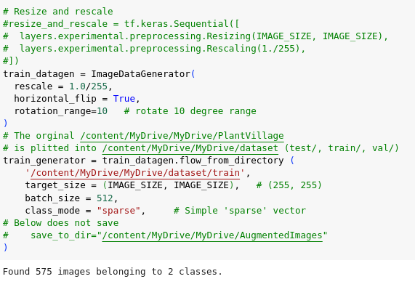
55 Full Stack: Train Model by Image Generator
https://www.youtube.com/watch?v=DQFerxe6o5g&list=PLeo1K3hjS3uu7CxAacxVndI4bE_o3BDtO&index=55
Full Stack: Train Mode by Image Generator (5:31-6:00/18:21)
We use the image data generator class to generate the image.

Slide 8
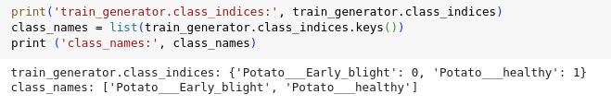
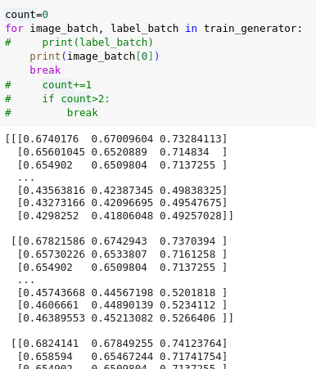
55 Full Stack: Train Model by Image Generator
https://www.youtube.com/watch?v=DQFerxe6o5g&list=PLeo1K3hjS3uu7CxAacxVndI4bE_o3BDtO&index=55
Full Stack: Train Mode by Image Generator (6:01-6:30/18:21)
Verify the image generator in train folder.

Slide 9
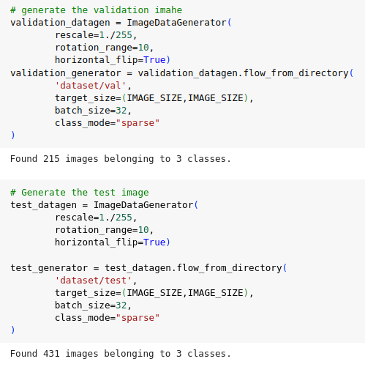
55 Full Stack: Train Model by Image Generator
https://www.youtube.com/watch?v=DQFerxe6o5g&list=PLeo1K3hjS3uu7CxAacxVndI4bE_o3BDtO&index=55
Full Stack: Train Mode by Image Generator (6:31-7:00/18:21)
Verify the image generator in validate and test folder.

Slide 10
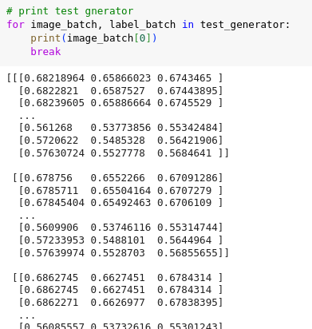
55 Full Stack: Train Model by Image Generator
https://www.youtube.com/watch?v=DQFerxe6o5g&list=PLeo1K3hjS3uu7CxAacxVndI4bE_o3BDtO&index=55
Full Stack: Train Mode by Image Generator (7:01-7:30/18:21)
Verify images in the test folder.

Slide 11
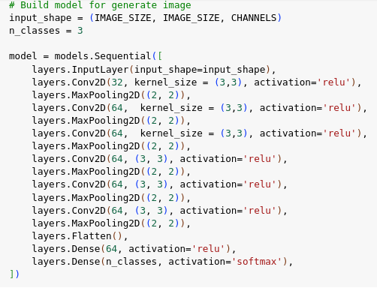
55 Full Stack: Train Model by Image Generator
https://www.youtube.com/watch?v=DQFerxe6o5g&list=PLeo1K3hjS3uu7CxAacxVndI4bE_o3BDtO&index=55
Full Stack: Train Mode by Image Generator (7:31-8:00/18:21)
Build the model for image data generator.

Slide 12
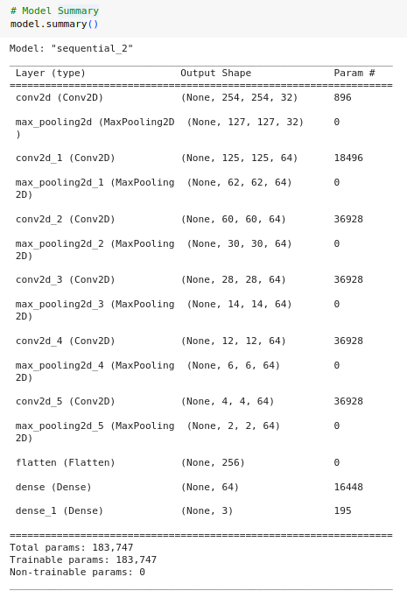
55 Full Stack: Train Model by Image Generator
https://www.youtube.com/watch?v=DQFerxe6o5g&list=PLeo1K3hjS3uu7CxAacxVndI4bE_o3BDtO&index=55
Full Stack: Train Mode by Image Generator (8:01-8:30/18:21)
Check the model summary.

Slide 13
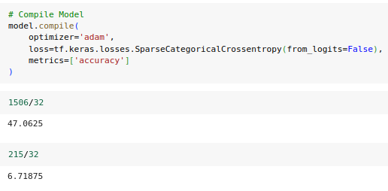
55 Full Stack: Train Model by Image Generator
https://www.youtube.com/watch?v=DQFerxe6o5g&list=PLeo1K3hjS3uu7CxAacxVndI4bE_o3BDtO&index=55
Full Stack: Train Mode by Image Generator (8:31-9:00/18:21)
Check step in in batch

Slide 14
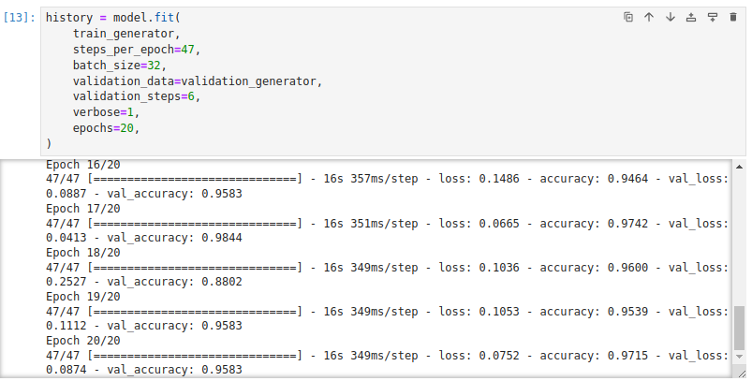
55 Full Stack: Train Model by Image Generator
https://www.youtube.com/watch?v=DQFerxe6o5g&list=PLeo1K3hjS3uu7CxAacxVndI4bE_o3BDtO&index=55
Full Stack: Train Mode by Image Generator (9:01-9:30/18:21)
Check step in in batch
Note:
The tensorflow image generator exceed the limit of Colab GPU VRAM 17GB.
We cannot train the model with free Colab account.
Below code train the model with Tensorflow Image Generator. Too much images is crash in training.
Here, the code and results just for reference only.
We will train the model by the previous way:
https://github.com/peterhchen/SVU_CS512_DL/blob/main/080_DL_CB/52_FS_Model_Src.zip

Slide 15
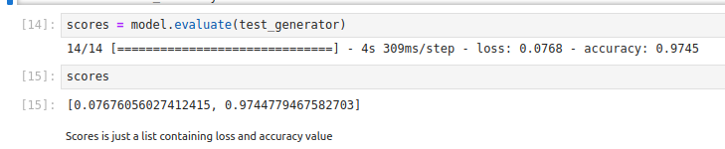
55 Full Stack: Train Model by Image Generator
https://www.youtube.com/watch?v=DQFerxe6o5g&list=PLeo1K3hjS3uu7CxAacxVndI4bE_o3BDtO&index=55
Full Stack: Train Mode by Image Generator (9:31-10:30/18:21)
Score the result of Image Generator

Slide 16
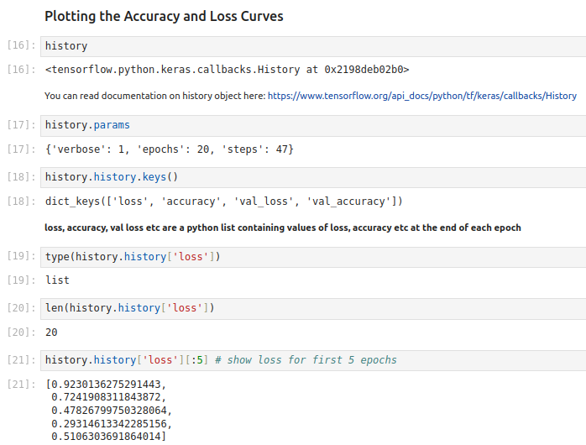
55 Full Stack: Train Model by Image Generator
https://www.youtube.com/watch?v=DQFerxe6o5g&list=PLeo1K3hjS3uu7CxAacxVndI4bE_o3BDtO&index=55
Full Stack: Train Mode by Image Generator (10:31-11:00/18:21)
Plot

Slide 17
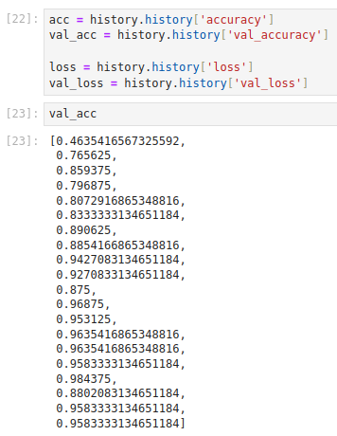
55 Full Stack: Train Model by Image Generator
https://www.youtube.com/watch?v=DQFerxe6o5g&list=PLeo1K3hjS3uu7CxAacxVndI4bE_o3BDtO&index=55
Full Stack: Train Mode by Image Generator (11:01-11:30/18:21)
Accuracy

Slide 18
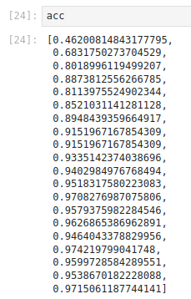
55 Full Stack: Train Model by Image Generator
https://www.youtube.com/watch?v=DQFerxe6o5g&list=PLeo1K3hjS3uu7CxAacxVndI4bE_o3BDtO&index=55
Full Stack: Train Mode by Image Generator (11:31-12:00/18:21)
Accuracy

Slide 19
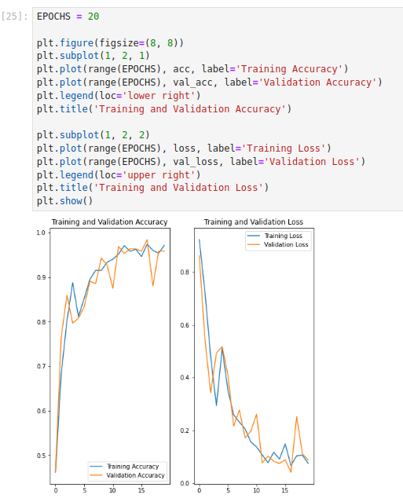
55 Full Stack: Train Model by Image Generator
https://www.youtube.com/watch?v=DQFerxe6o5g&list=PLeo1K3hjS3uu7CxAacxVndI4bE_o3BDtO&index=55
Full Stack: Train Mode by Image Generator (12:01-13:30/18:21)
Plot

Slide 20
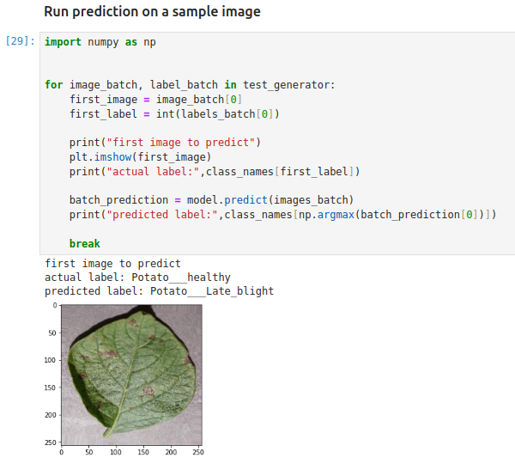
55 Full Stack: Train Model by Image Generator
https://www.youtube.com/watch?v=DQFerxe6o5g&list=PLeo1K3hjS3uu7CxAacxVndI4bE_o3BDtO&index=55
Full Stack: Train Mode by Image Generator (13:31-15:00/18:21)
Make prediction

Slide 21
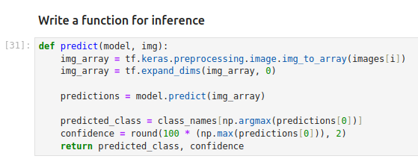
55 Full Stack: Train Model by Image Generator
https://www.youtube.com/watch?v=DQFerxe6o5g&list=PLeo1K3hjS3uu7CxAacxVndI4bE_o3BDtO&index=55
Full Stack: Train Mode by Image Generator (15:01-17:30/18:21)
Inference function

Slide 22
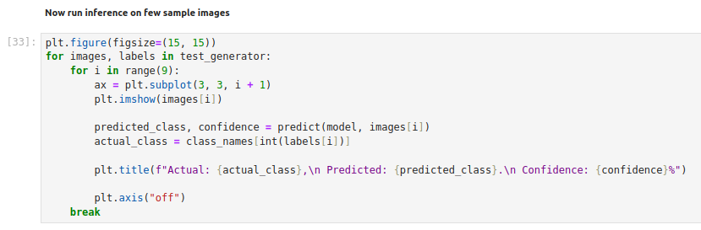
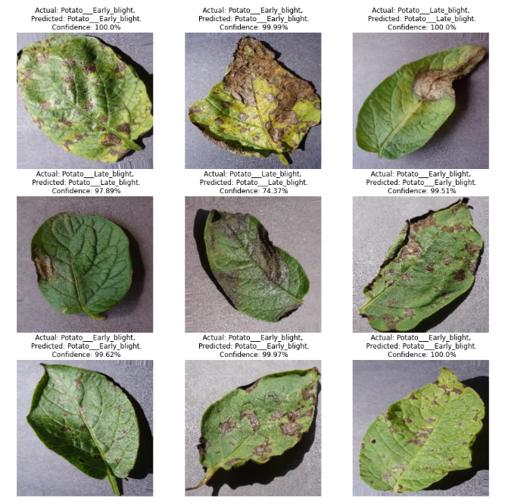
55 Full Stack: Train Model by Image Generator
https://www.youtube.com/watch?v=DQFerxe6o5g&list=PLeo1K3hjS3uu7CxAacxVndI4bE_o3BDtO&index=55
Full Stack: Train Mode by Image Generator (17:31-18:00/18:21)
Run Inference function

Slide 23
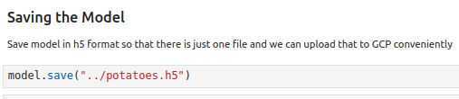
55 Full Stack: Train Model by Image Generator
https://www.youtube.com/watch?v=DQFerxe6o5g&list=PLeo1K3hjS3uu7CxAacxVndI4bE_o3BDtO&index=55
Full Stack: Train Mode by Image Generator (18:01-18:21/18:21)
Save Model

Slide 24
End

