Slide 1

56 Full Stack: Server Deployment
Peter H. Chen

Slide 2
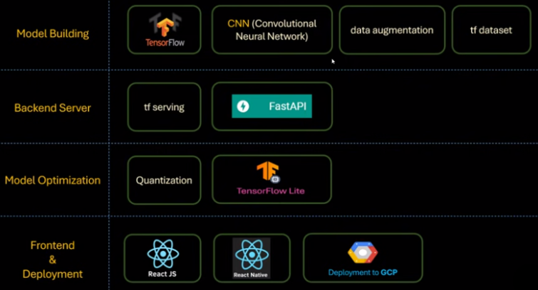
56 Full Stack: Server Deployment
https://www.youtube.com/watch?v=ra4j7yDlakQ&list=PLeo1K3hjS3uu7CxAacxVndI4bE_o3BDtO&index=56
Full Stack: Server Deployment (0:00-0:01/27:39)
Below is the technology stacks for full stack development:
1. Collect Dataset
2. Build Model
3. Backend Server
4. Quantization/Model Optimization
5. Frontend: ReactJS (Chrome Application), React Native (App).
1. Collect Data
2. Build Model
3. Backend Server
4. Quantization
5. Frontend App

Slide 3
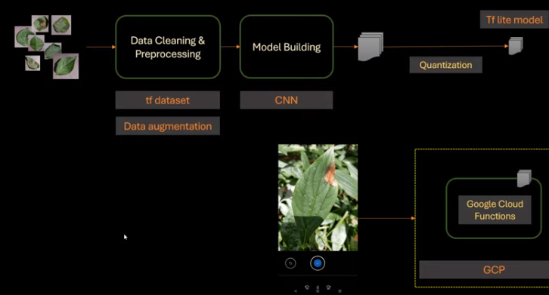
56 Full Stack: Server Deployment
https://www.youtube.com/watch?v=ra4j7yDlakQ&list=PLeo1K3hjS3uu7CxAacxVndI4bE_o3BDtO&index=56
Full Stack: Server Deployment (0:01-0:50/27:39)
We are going to deploy the server.
Previously, we do model quantization with tf.lite (Convert regular model with double weights into lite model with integer weight model).
The lite model with quantization is as below.
Previously, we do model quantization with tf.lite (Convert regular model with double weights into lite model with integer weight model).
The lite model with quantization is as below.

Slide 4
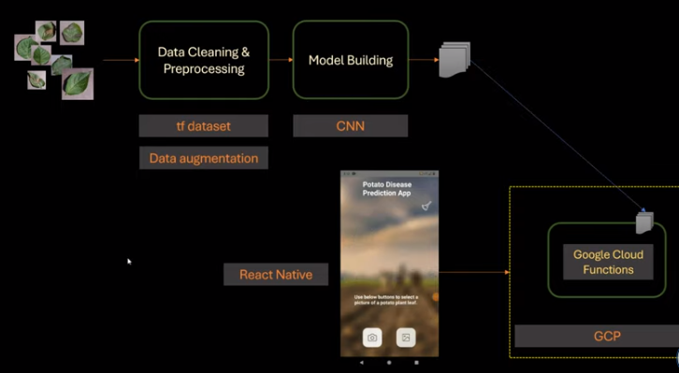
56 Full Stack: Server Deployment
https://www.youtube.com/watch?v=ra4j7yDlakQ&list=PLeo1K3hjS3uu7CxAacxVndI4bE_o3BDtO&index=56
Full Stack: Server Deployment (0:51-1:05/27:39)
The quantization takes extra time (Convert from regular double weights into integer weight).
To keep the accuracy and save time to convert, we use regular instead of lite model.
The regular model use double weights which is 8-bytes and lite model uses short integer is 1-bytes.
We will deploy the regular model directly to cloud. The regular model architecture is as below.
The React Native app will call the function using http to server that host regular model.

Slide 5
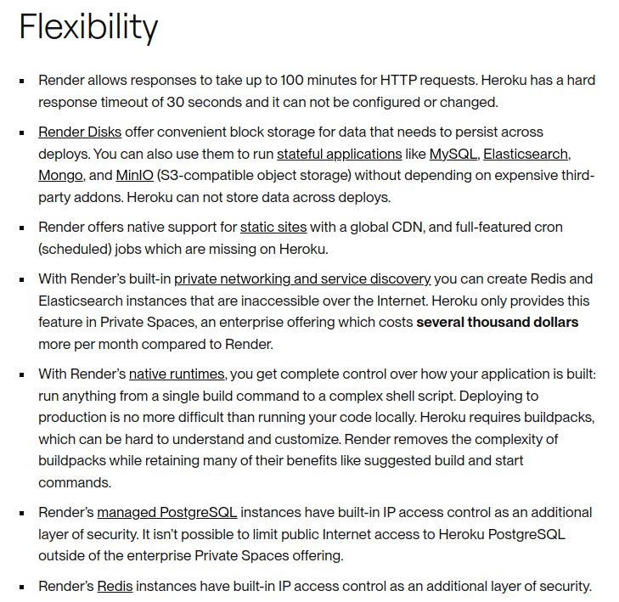
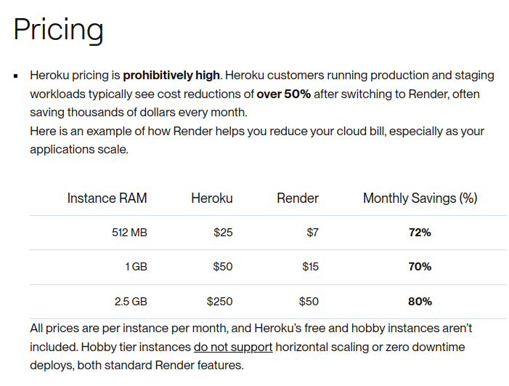
56 Full Stack: Server Deployment
https://www.youtube.com/watch?v=ra4j7yDlakQ&list=PLeo1K3hjS3uu7CxAacxVndI4bE_o3BDtO&index=56
Full Stack: Server Deployment (0:01-0:50/27:39)
We can deploy the server on Render.com, AWS (Amazon Web Service) or GCP (Google Cloud Platform).
GCP gives us 3 months and $300 free credit and more services.
Render.com and heroku.com are free. Render.com allow 750 instances hours per month.
https://docs.render.com/render-vs-heroku-comparison
We are going to use render.com to deploy the server.

Slide 6
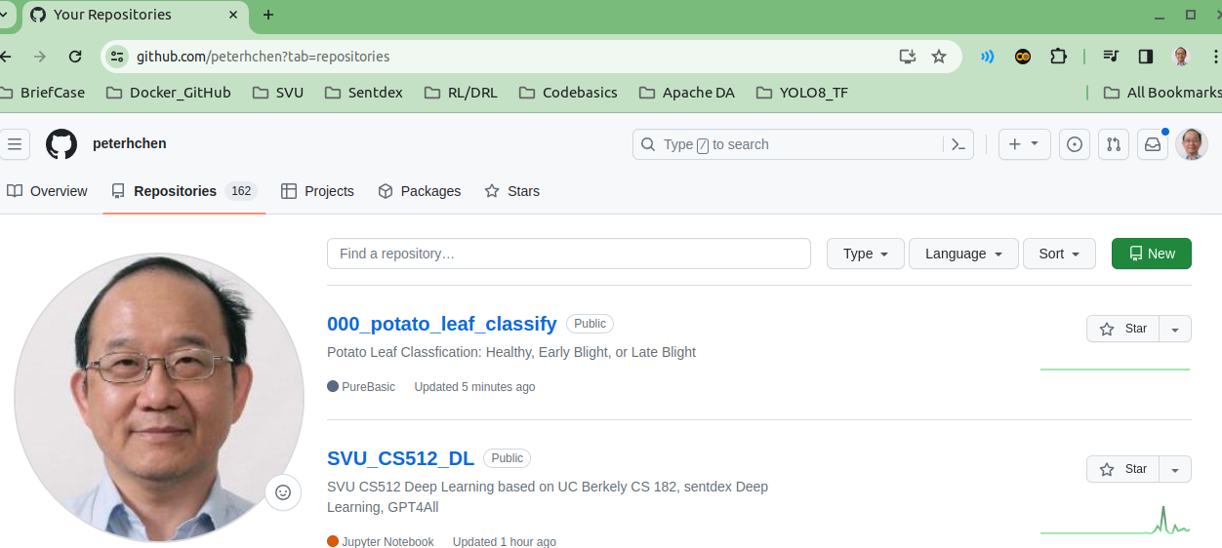
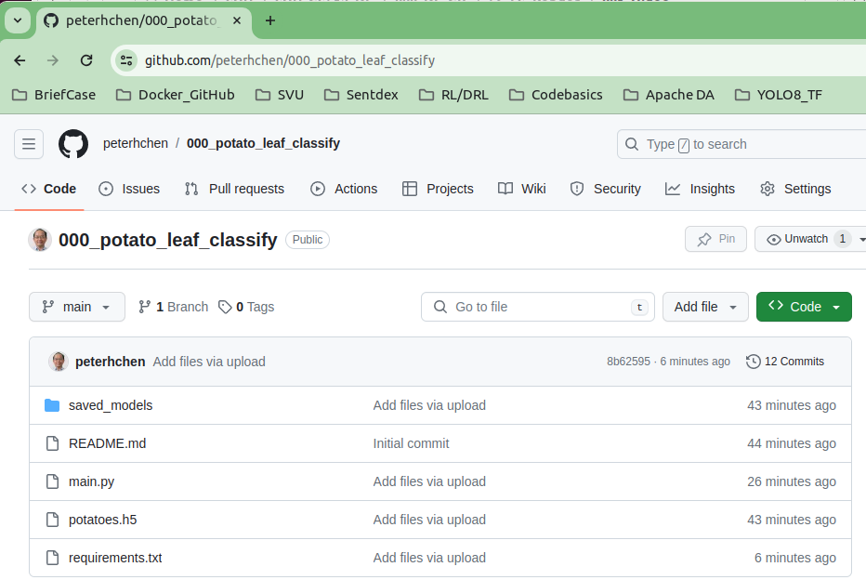
56 Full Stack: Server Deployment
https://www.youtube.com/watch?v=JiA-8oVgPIM&t=77s
Full Stack: Server Deployment (0:55-1:20/3:39)
On the top of your github account. Create your project, e.g., “000_potato_leaf_classify”:
Put you
1. main.py
2. saved_models: tensorflow regular model (double weights).
3. potatoes.h5: tensorflow lite model (integer weights).
Note:
If you put your files in api model, make sure the read model can access the model files.

Slide 7
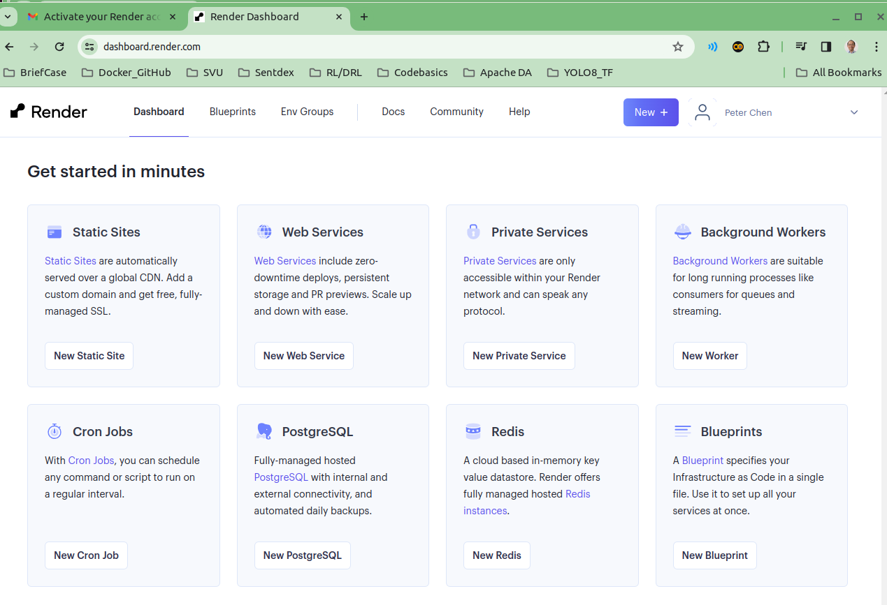
56 Full Stack: Server Deployment
https://www.youtube.com/watch?v=JiA-8oVgPIM&t=77s
Full Stack: Server Deployment (0:00-0:50/3:39)
In the render.com, we go into “get started” page.
Click the “New Web Services”.

Slide 8
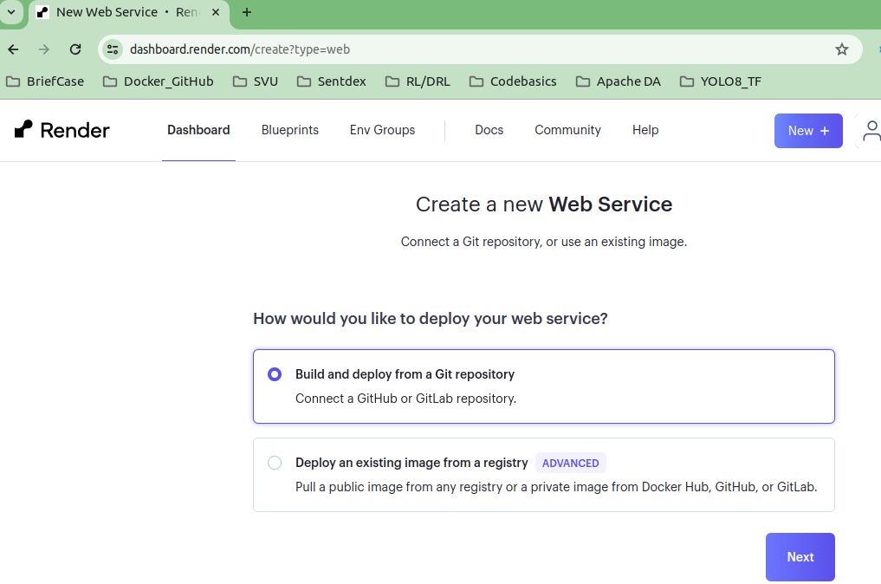
56 Full Stack: Server Deployment
https://www.youtube.com/watch?v=JiA-8oVgPIM&t=77s
Full Stack: Server Deployment (0:51-0:55/3:39)
1. Build and Deploy from a Git Repository
2. Click “Next”

Slide 9
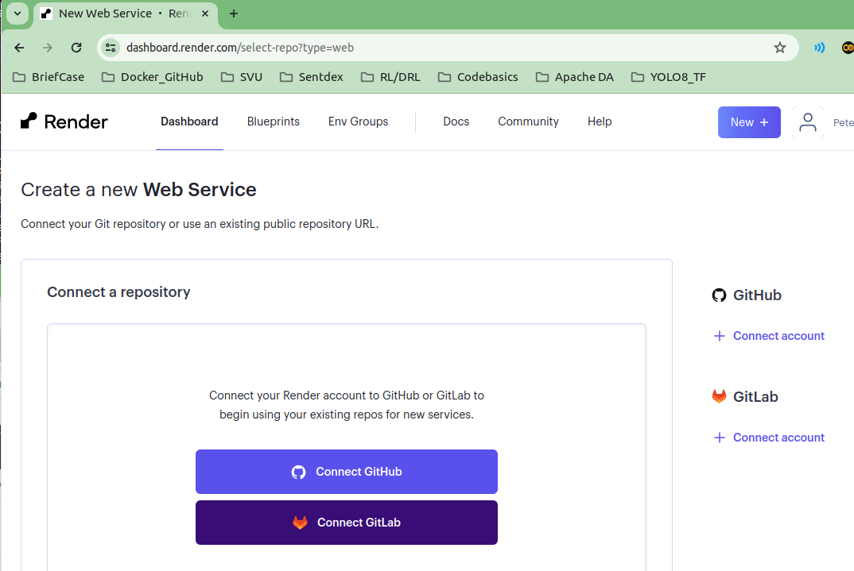
56 Full Stack: Server Deployment
https://www.youtube.com/watch?v=JiA-8oVgPIM&t=77s
Full Stack: Server Deployment (0:56-1:00/3:39)
Click “Connect Github”

Slide 10
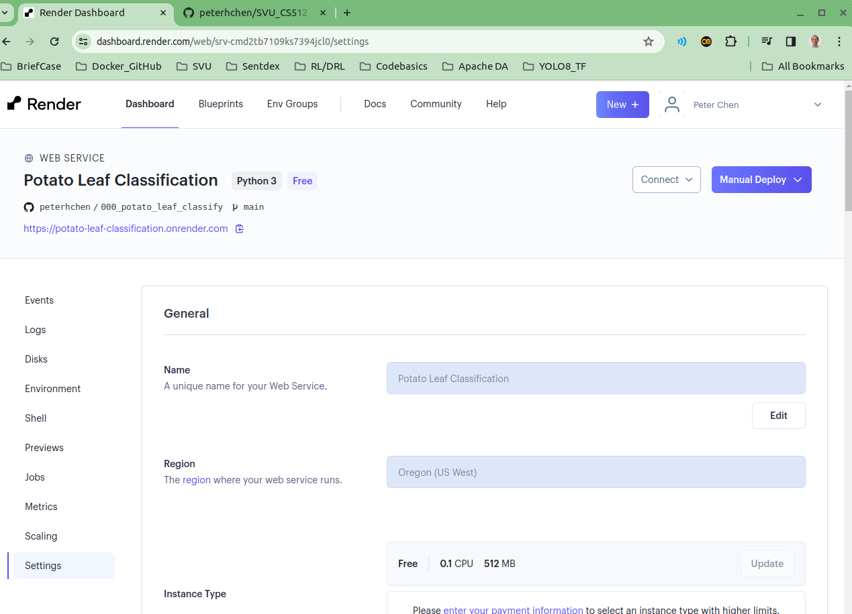
56 Full Stack: Server Deployment
https://www.youtube.com/watch?v=JiA-8oVgPIM&t=77s
Full Stack: Server Deployment (1:01-1:30/3:39)
Setup the following:
1. name of the application: “potato leaf classification”
2. > uvicorn main:app --reload
3. Note: make sure to select “Free” web service
The render.com will deploy for you.

Slide 11
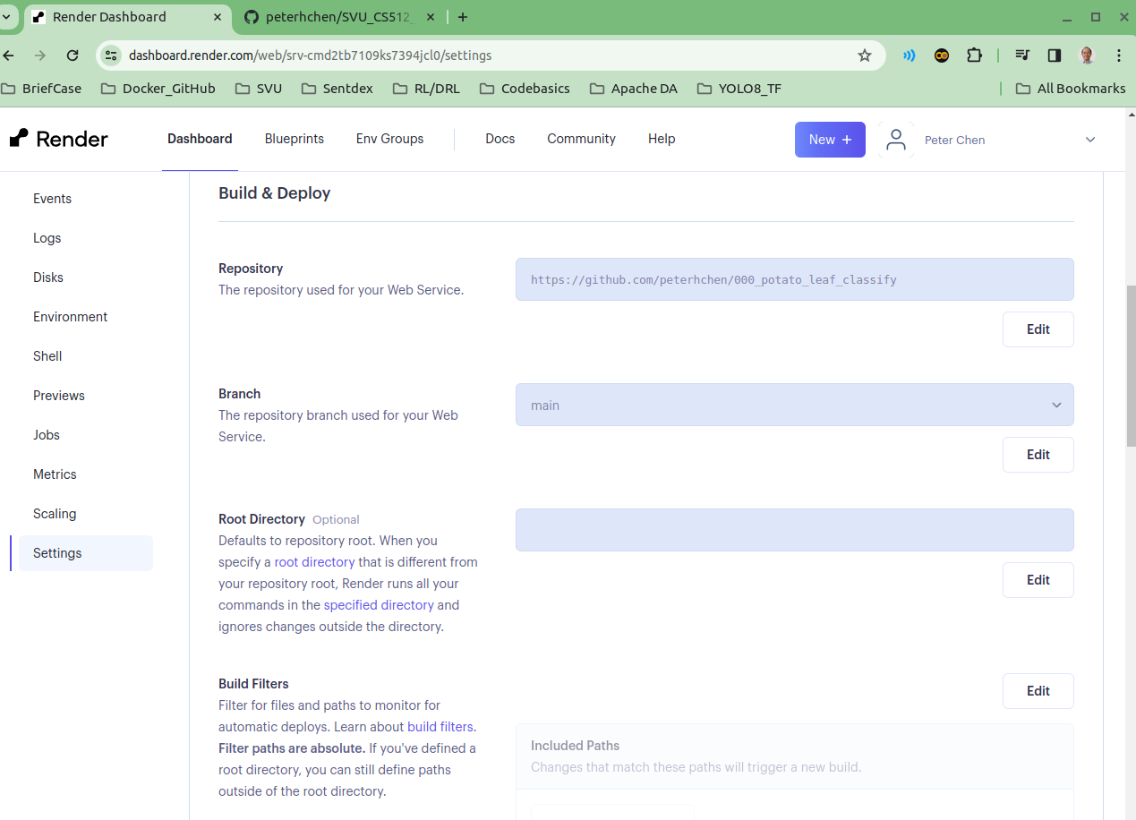
56 Full Stack: Server Deployment
https://www.youtube.com/watch?v=JiA-8oVgPIM&t=77s
Full Stack: Server Deployment (1:06-1:30/3:39)
Github repository: https://github.com/peterhchen/000_potato_leaf_classify

Slide 12
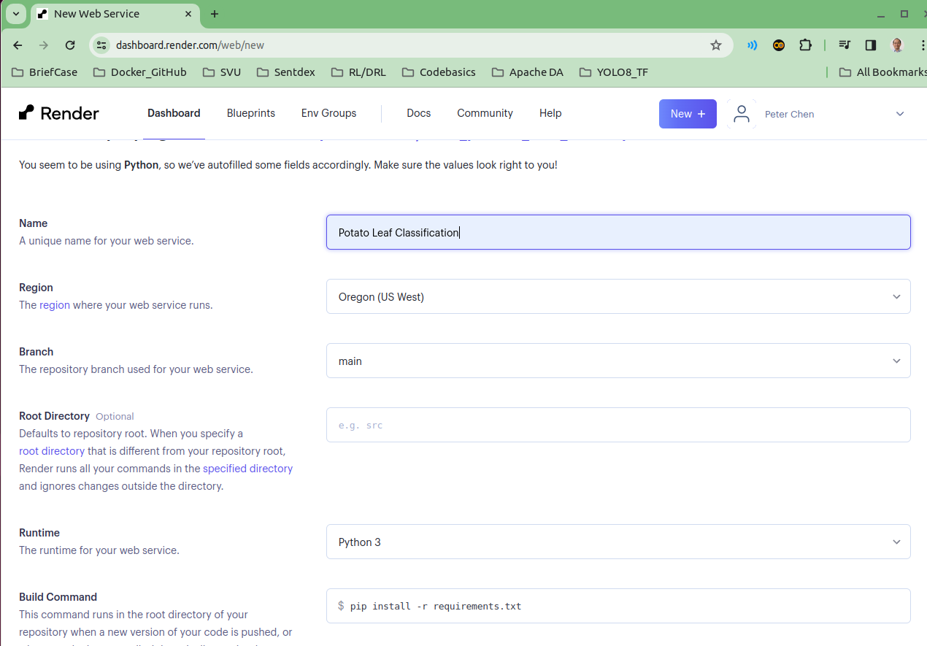
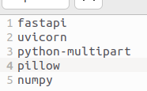
56 Full Stack: Server Deployment
https://www.youtube.com/watch?v=JiA-8oVgPIM&t=77s
Full Stack: Server Deployment (1:31-2:00/3:39)
1. Make sure no error message when you install at your local machine work before check into GitHub.
If you have failed to install, you have to delete the deployment and re-deploy again.
> pip install -r requirements.txt
Note:
1. Remote the tensorflow, tensorflow-tf-serving, matplotlib, etc. hey are used in training only, not in the deployment.
2. We need the numpy and pillow in application.

Slide 13
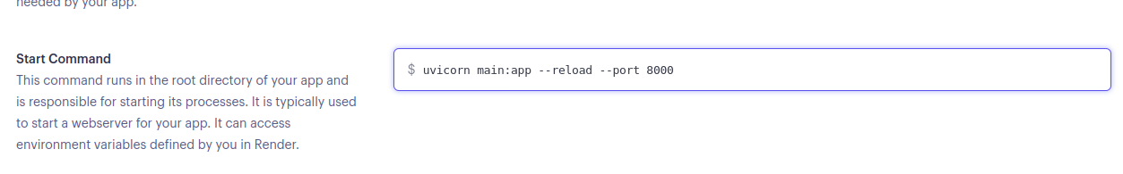
56 Full Stack: Server Deployment
https://www.youtube.com/watch?v=JiA-8oVgPIM&t=77s
Full Stack: Server Deployment (2:01-2:30/3:39)
Setup start command for uvicorn and fastAPI
> uvicorn main:app –reload --port 8000

Slide 14
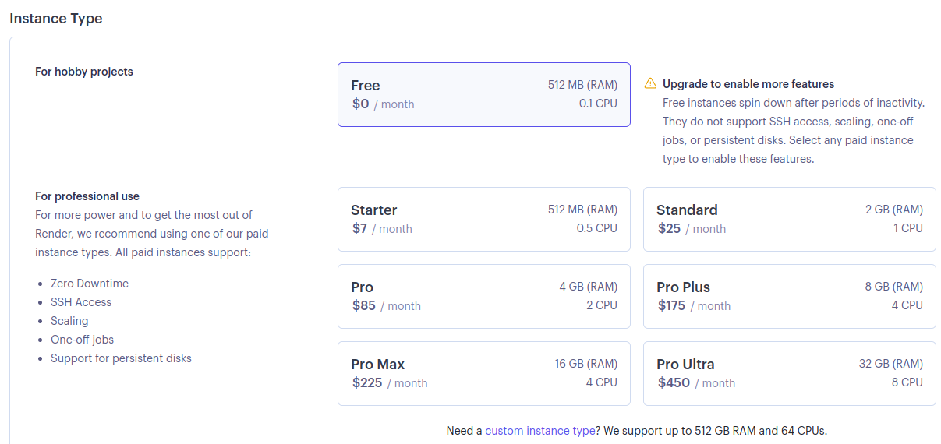
56 Full Stack: Server Deployment
https://www.youtube.com/watch?v=JiA-8oVgPIM&t=77s
Full Stack: Server Deployment (2:31-3:00/3:39)
Select “Free” charge

Slide 15
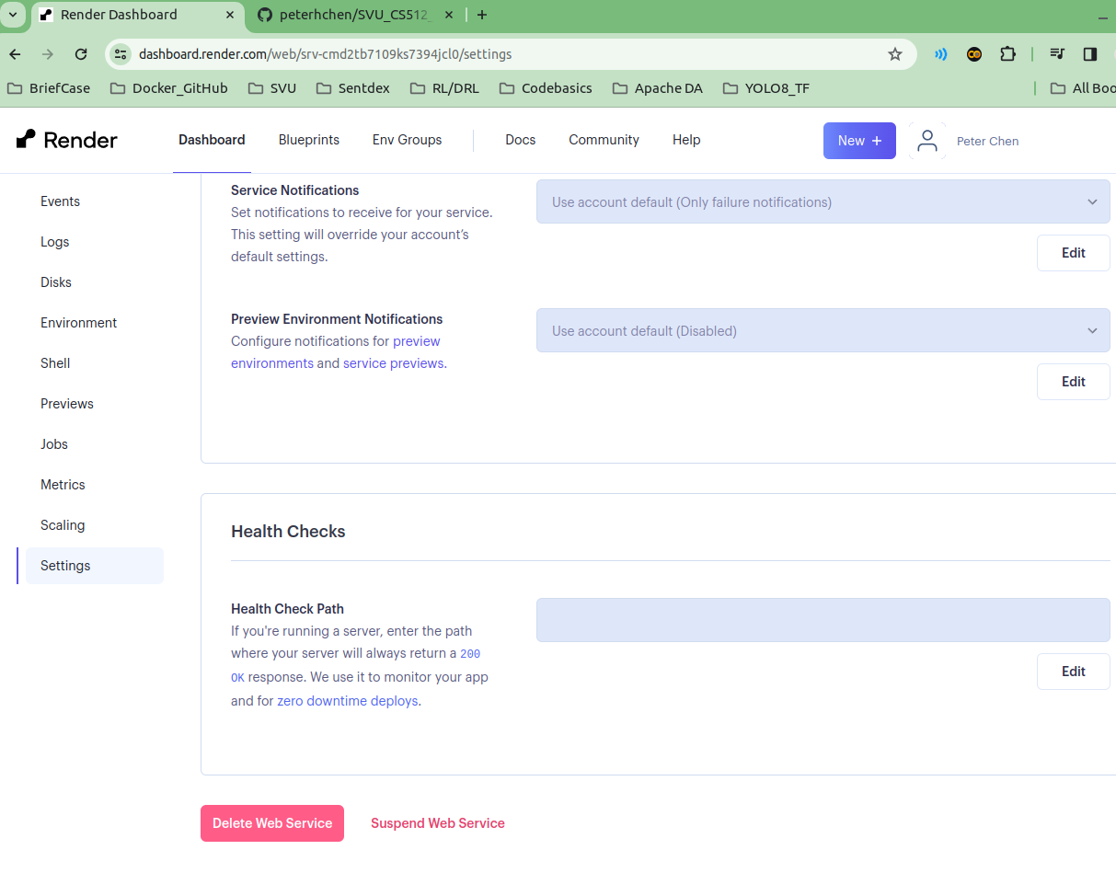
56 Full Stack: Server Deployment
https://www.youtube.com/watch?v=JiA-8oVgPIM&t=77s
Full Stack: Server Deployment (3:01-3:10/3:39)
At the bottom, you can “Delete Web Service”

Slide 16
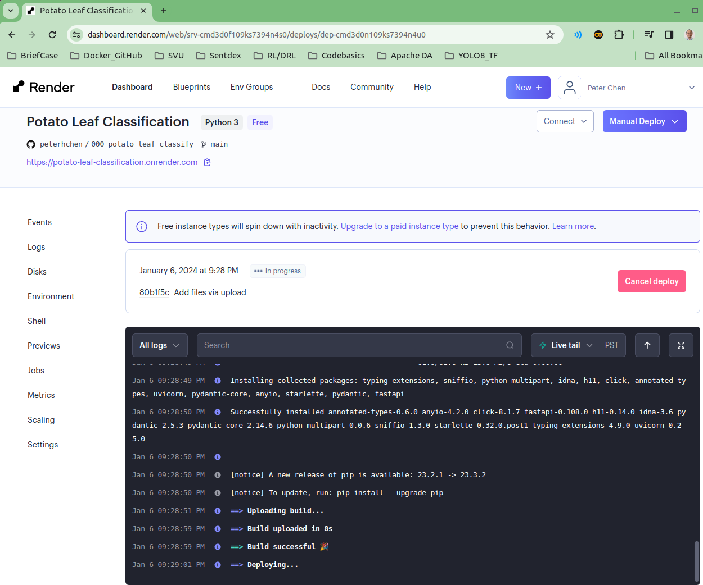
56 Full Stack: Server Deployment
https://www.youtube.com/watch?v=JiA-8oVgPIM&t=77s
Full Stack: Server Deployment (3:11-3:30/3:39)
You should get “successfully build” and “Deploying...” message.
The web site is deploying.
After deployed, the web site is located “https://potato-leaf-classification.onrender.com

Slide 17
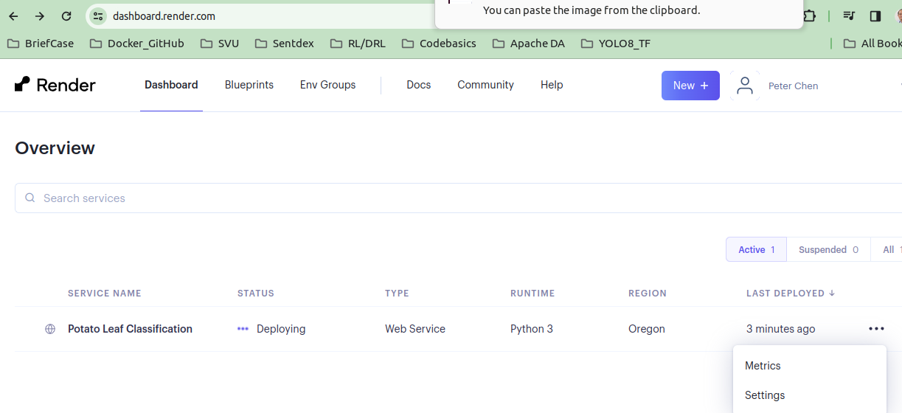
56 Full Stack: Server Deployment
https://www.youtube.com/watch?v=JiA-8oVgPIM&t=77s
Full Stack: Server Deployment (3:31-3:39/3:39)
If you want to delete the service, select “setting” and “Delete Web Service”

Slide 18
End

