Slide 1

57 Full Stack: React Native
Peter H. Chen

Slide 2
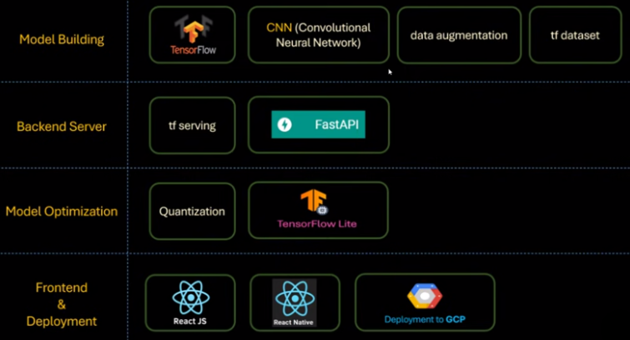
57 Full Stack: React Native
https://www.youtube.com/watch?v=mSf0j8qkkFI&list=PLeo1K3hjS3uu7CxAacxVndI4bE_o3BDtO&index=57
Full Stack: React Native (0:00-0:01/11:54)
Below is the technology stacks for full stack development:
1. Collect Dataset
2. Build Model
3. Backend Server
4. Quantization/Model Optimization
5. Frontend: ReactJS (Chrome Application), React Native (App).
1. Collect Data
2. Build Model
3. Backend Server
4. Quantization
5. Frontend App

Slide 3
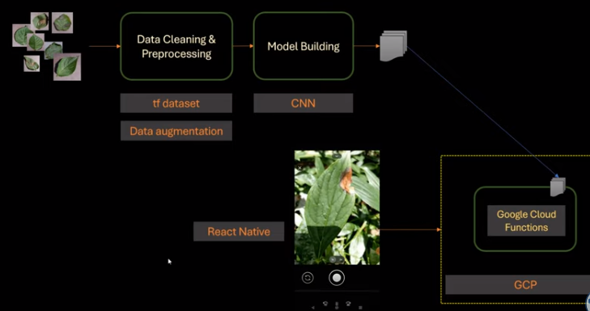
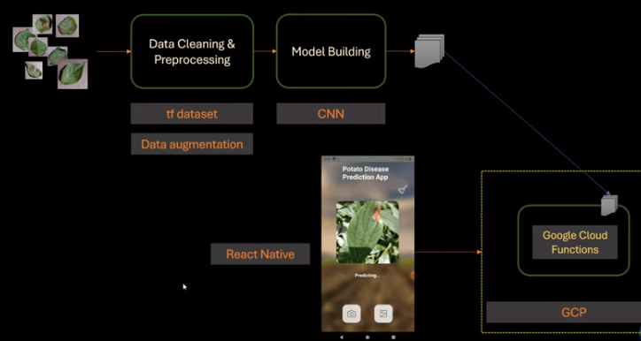
57 Full Stack: React Native
https://www.youtube.com/watch?v=mSf0j8qkkFI&list=PLeo1K3hjS3uu7CxAacxVndI4bE_o3BDtO&index=57
Full Stack: React Native (0:01-0:30/11:54)
In the last discussion, we deploy the ReactJS and fastAPI on Render (Heroku).
We will use React Native to develop App for iPhone, Android, devices, etc.
React Native is very popular technology for Mobile devices.

Slide 4
57.1 React Native Setup

Slide 5
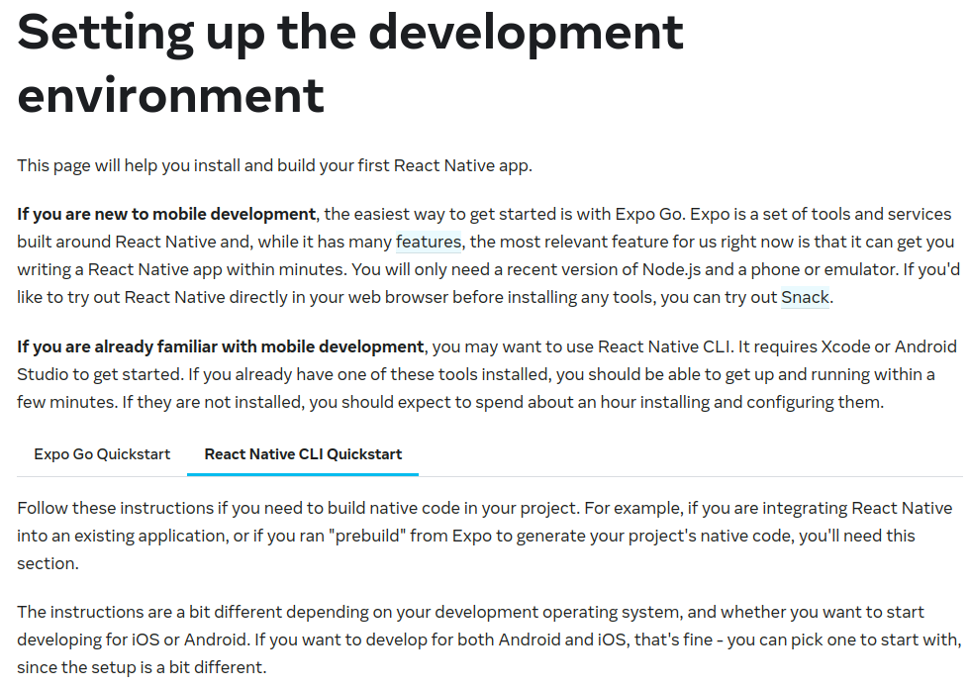
57.1 React Native Setup
https://www.youtube.com/watch?v=mSf0j8qkkFI&list=PLeo1K3hjS3uu7CxAacxVndI4bE_o3BDtO&index=57
React Native Setup (0:31-1:00/11:54)
Go to: https://reactnative.dev/docs/environment-setup
Setup up the development environment.
Go to “React Native CLI Quickstart”

Slide 6
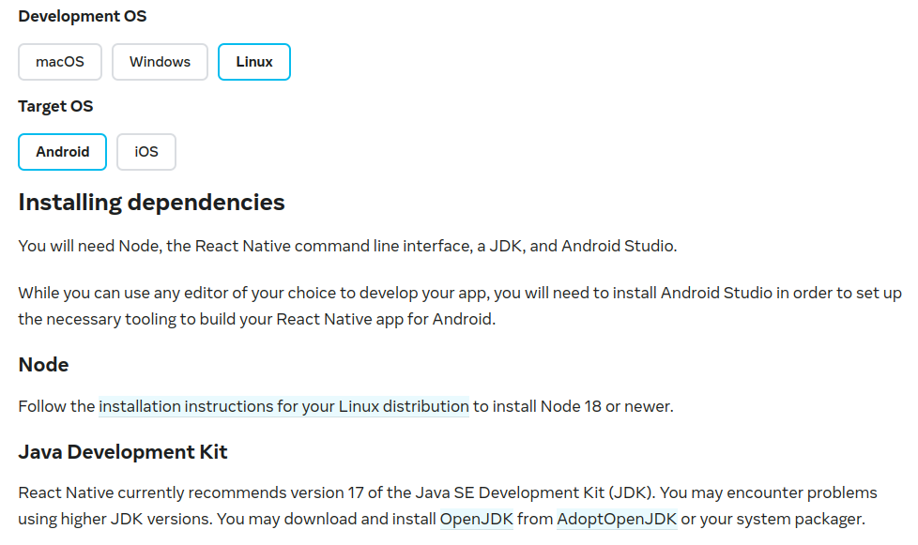
57.1 React Native Setup
https://www.youtube.com/watch?v=mSf0j8qkkFI&list=PLeo1K3hjS3uu7CxAacxVndI4bE_o3BDtO&index=57
React Native Setup (0:31-1:00/11:54)
Go to: https://reactnative.dev/docs/environment-setup
We need
1. Node
2. JDK
3. Android Studio.

Slide 7
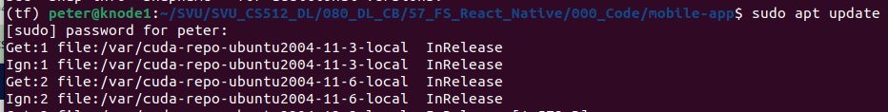
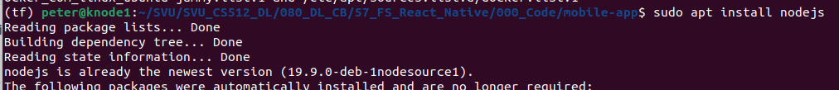
57.1 React Native Setup: Install NodeJS
https://www.youtube.com/watch?v=mSf0j8qkkFI&list=PLeo1K3hjS3uu7CxAacxVndI4bE_o3BDtO&index=57
Install NodeJS (1:01-1:10/11:54)
Go to: https://reactnative.dev/docs/environment-setup
Install Node JS:
1. > sudo apt update
2. > sudo apt install nodejs
3. > node -v
4. > sudo apt
5. > sudo aptitude install npm
Note: “aptitude” used to remove the installed packaged.
1
2
3
4
5

Slide 8
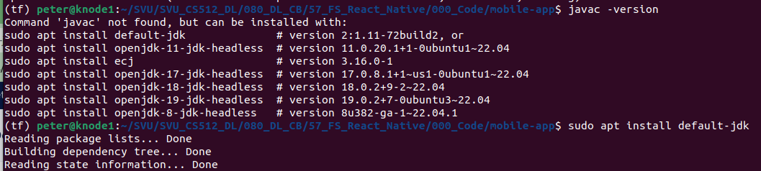
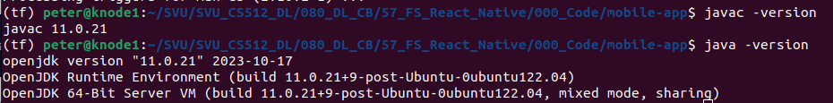
57.1 React Native Setup: Install JDK
https://www.youtube.com/watch?v=mSf0j8qkkFI&list=PLeo1K3hjS3uu7CxAacxVndI4bE_o3BDtO&index=57
Install JDK (1:11-1:20/11:54)
Go to: https://reactnative.dev/docs/environment-setup
2. Install OpenJDK.
> sudo apt update
> sudo apt install default-jdk
2. Check Java compiler
> javac -version
3. Check JDK, JDK Runtime, and JDK VM
> java -version
1
2
3

Slide 9
57.2 Install Android Studio/SDK

Slide 10
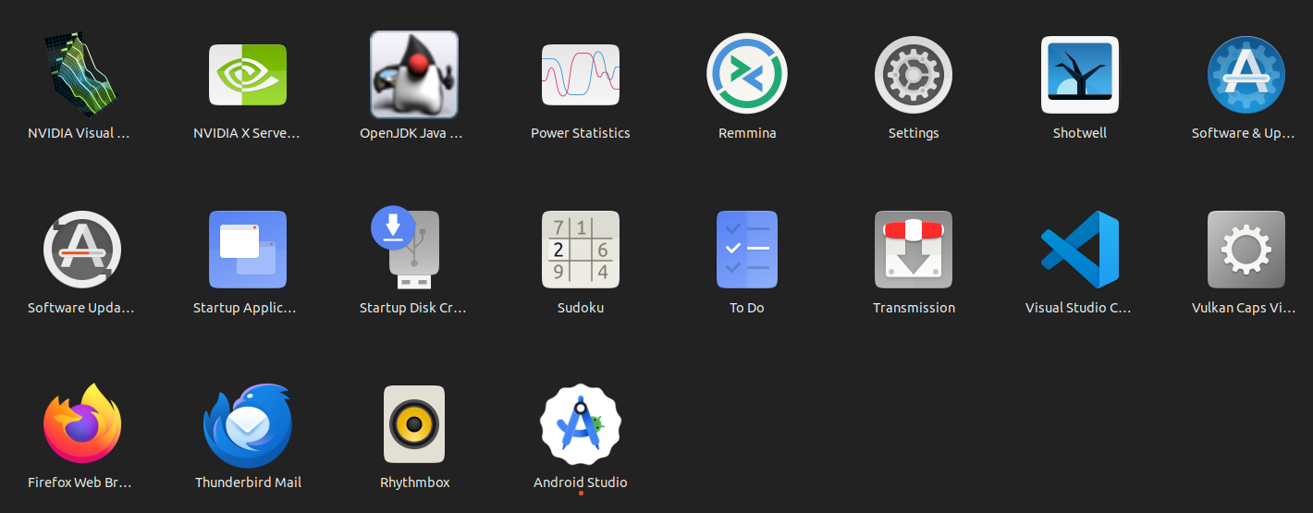
57.2 Install Android Studio/SDK
https://www.youtube.com/watch?v=mSf0j8qkkFI&list=PLeo1K3hjS3uu7CxAacxVndI4bE_o3BDtO&index=57
Install Android Studio (1:21-1:30/11:54)
https://www.educative.io/answers/how-to-install-android-studio-in-ubuntu
Install Android Studio:
1. > sudo apt install snap
2. > sudo snap install android-studio –class
3. Check “Android Studio”
1
2
3

Slide 11
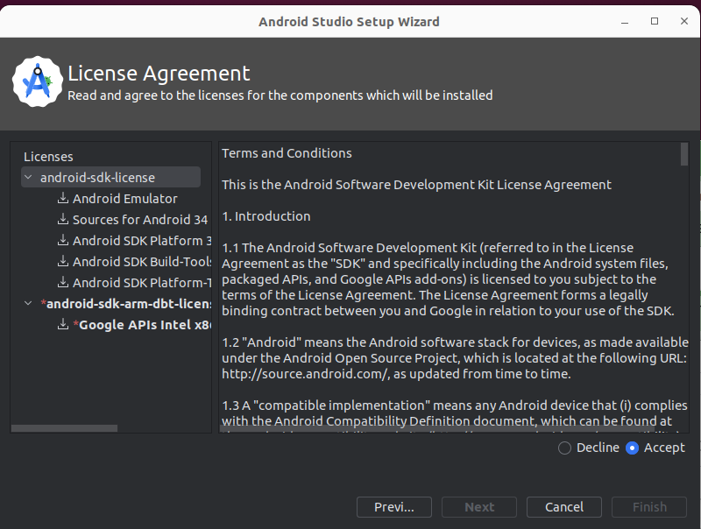
57.2 Install Android Studio/SDK
https://www.youtube.com/watch?v=mSf0j8qkkFI&list=PLeo1K3hjS3uu7CxAacxVndI4bE_o3BDtO&index=57
Install Android Studio/SDK (1:31-1:30/11:54)
https://www.educative.io/answers/how-to-install-android-studio-in-ubuntu
1. Double click “Android Studio”
2. Install Android SDK: Choose Standard Installation for all SDK and Accept All Licenses Agreement
1
2

Slide 12
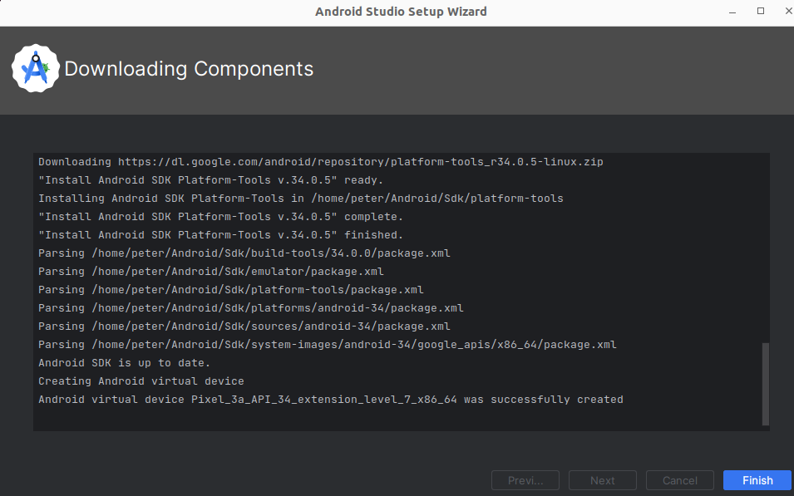
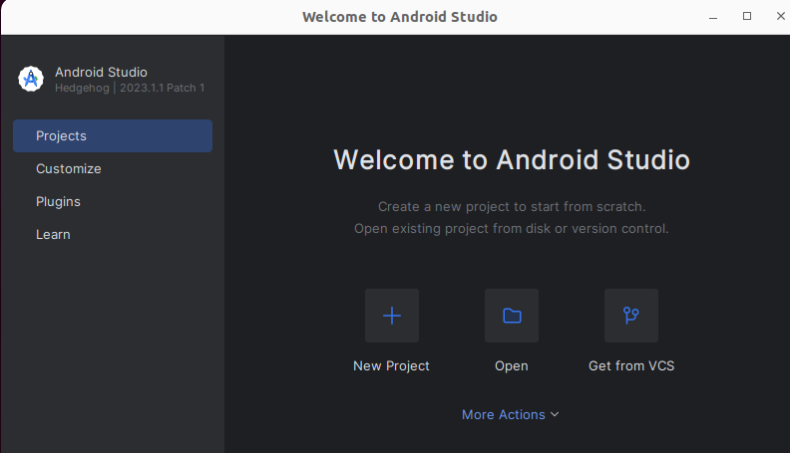
57.2 Install Android Studio/SDK
https://www.youtube.com/watch?v=mSf0j8qkkFI&list=PLeo1K3hjS3uu7CxAacxVndI4bE_o3BDtO&index=57
Install Android Studio/SDK (1:31-1:30/11:54)
https://www.educative.io/answers/how-to-install-android-studio-in-ubuntu
1. Downloading components: Take 10 minutes. During the download, do not click “Cancel”.
After downloaded, click “Finish”.
2. We have complete installation of “Android Studio” on Ubuntu.
1
2

Slide 13

57.2 Install Android Studio/SDK
https://www.youtube.com/watch?v=mSf0j8qkkFI&list=PLeo1K3hjS3uu7CxAacxVndI4bE_o3BDtO&index=57
Start Android Studio/SDK (1:31-2:00/11:54)
https://www.educative.io/answers/how-to-install-android-studio-in-ubuntu
1. Go to Ubuntu Application and double click the “Android Studio”.
2. Starting Android Studio...
1
2
2

Slide 14
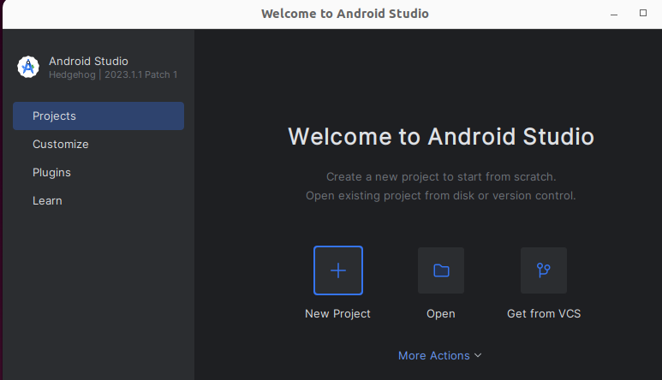
57.2 Install Android Studio/SDK
https://www.youtube.com/watch?v=mSf0j8qkkFI&list=PLeo1K3hjS3uu7CxAacxVndI4bE_o3BDtO&index=57
Start Android Studio/SDK (2:01-2:30/11:54)
https://www.educative.io/answers/how-to-install-android-studio-in-ubuntu
We have done:
1. Android Studio installation and
2. SDK installation

Slide 15
57.3 Configure Android Studio

Slide 16
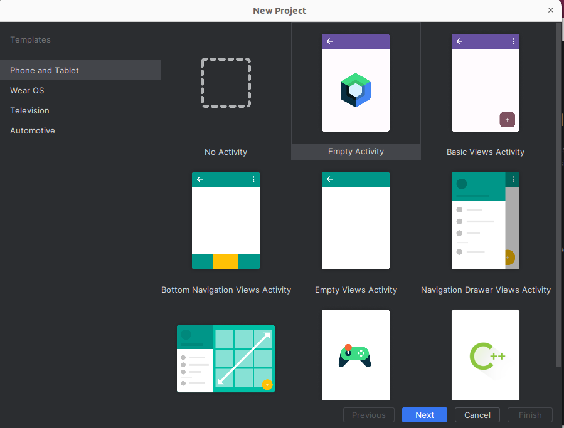
57.3 Configure Android Studio
https://www.youtube.com/watch?v=mSf0j8qkkFI&list=PLeo1K3hjS3uu7CxAacxVndI4bE_o3BDtO&index=57
Configure Android Studio (2:31-3:00/11:54)
https://developer.android.com/studio/intro/studio-config
Start the Android Studio: Projects
1. Click “New Project
2. Choose “Empty Activity”
3. Click “Next”
2
1
3

Slide 17
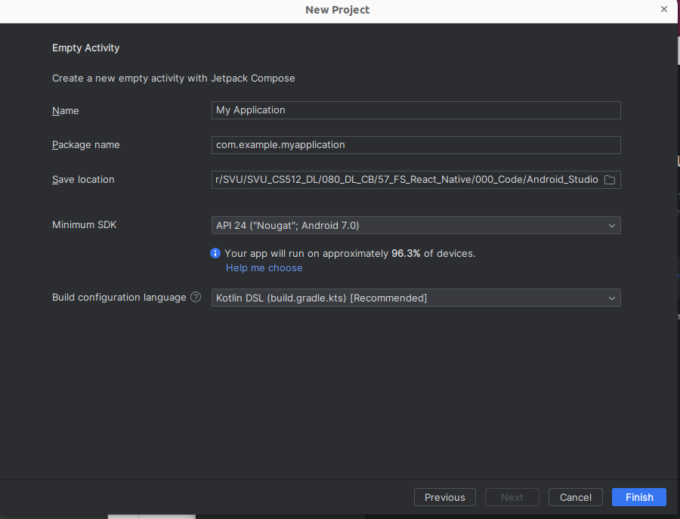
57.3 Configure Android Studio
https://www.youtube.com/watch?v=mSf0j8qkkFI&list=PLeo1K3hjS3uu7CxAacxVndI4bE_o3BDtO&index=57
Configure Android Studio (3:01-3:30/11:54)
https://developer.android.com/studio/intro/studio-config
1. Specify the save location: Android_Studio.
2. Click “Finish”
1
2

Slide 18
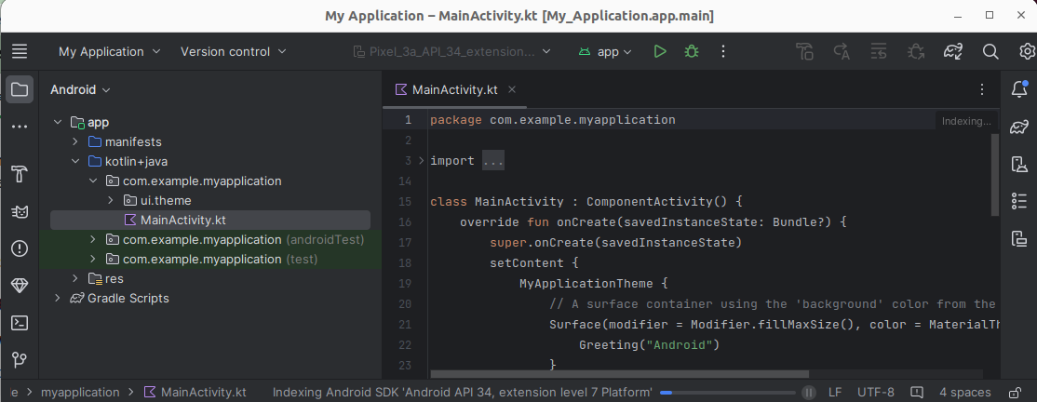
57.3 Configure Android Studio
https://www.youtube.com/watch?v=mSf0j8qkkFI&list=PLeo1K3hjS3uu7CxAacxVndI4bE_o3BDtO&index=57
Configure Android Studio (3:01-3:30/11:54)
https://developer.android.com/studio/intro/studio-config
Android Creates all the libraries for us.

Slide 19
57.4 Configure Android Home

Slide 20
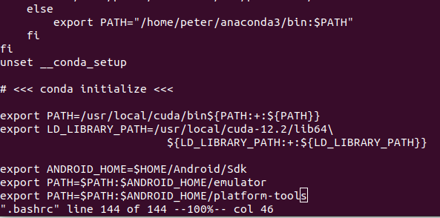

57.4 Configure Android Home
https://www.youtube.com/watch?v=mSf0j8qkkFI&list=PLeo1K3hjS3uu7CxAacxVndI4bE_o3BDtO&index=57
Configure Android Home (3:01-3:30/11:54)
https://reactnative.dev/docs/environment-setup
The React Native tools require some environment variables to be set up in order to build apps with native code.
Below is the Android SDK Home, Android Emulator, and Android platform tools
Add the following lines at the end of ~/.bashrc (Bash shell when Ubuntu start)
> vi ~/.bashrc

Slide 21
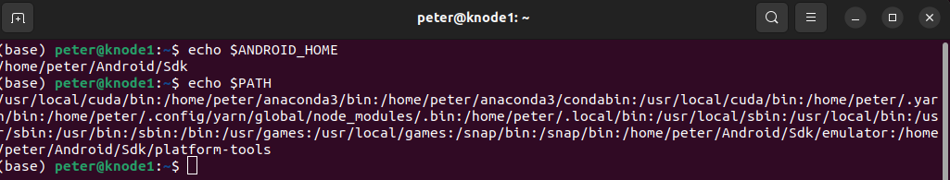
57.4 Configure Android Home
https://www.youtube.com/watch?v=mSf0j8qkkFI&list=PLeo1K3hjS3uu7CxAacxVndI4bE_o3BDtO&index=57
Configure Android Home (3:31-4:00/11:54)
https://reactnative.dev/docs/environment-setup
Start a new terminal and check
1. > echo $ANDROID_HOME
2. > echo $PATH
1
2

Slide 22
57.5 Create React Native App

Slide 23
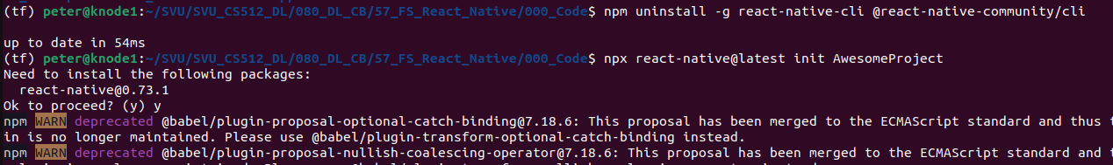
57.5 Create React Native App
https://www.youtube.com/watch?v=mSf0j8qkkFI&list=PLeo1K3hjS3uu7CxAacxVndI4bE_o3BDtO&index=57
Create Android Native App (3:01-3:30/11:54)
https://reactnative.dev/docs/environment-setup
1. Remove the previous CLI:
> npm uninstall -g react-native-cli @react-native-community/cli
2. Create a Android Native App “AwesomeProject”
> npx react-native@latest init AwesomeProject

Slide 24
57.6 Run React Native App

Slide 25
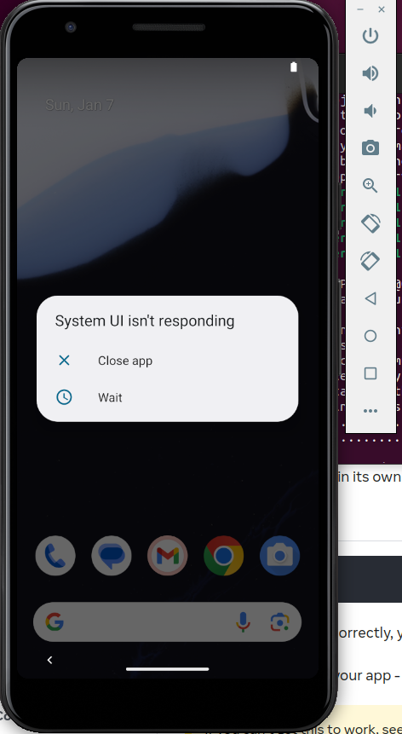
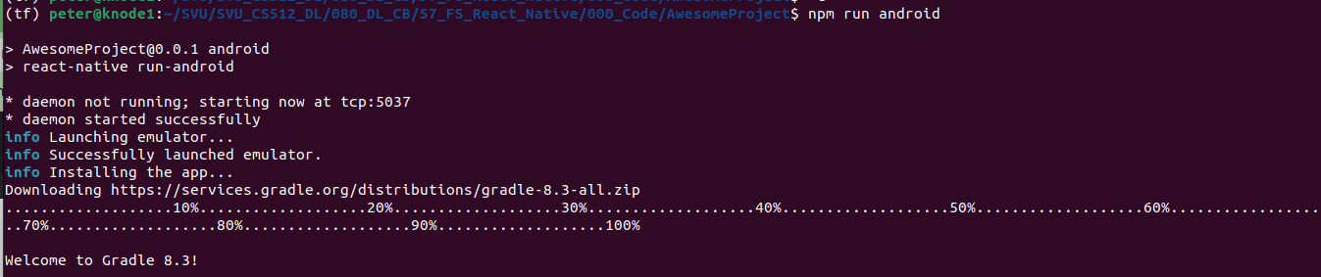
57.6 Run React Native App
https://www.youtube.com/watch?v=mSf0j8qkkFI&list=PLeo1K3hjS3uu7CxAacxVndI4bE_o3BDtO&index=57
Run Android Native App (3:01-3:30/11:54)
https://reactnative.dev/docs/environment-setup
> cd AwesomeProject
We run android emulator
> npm run android

Slide 26
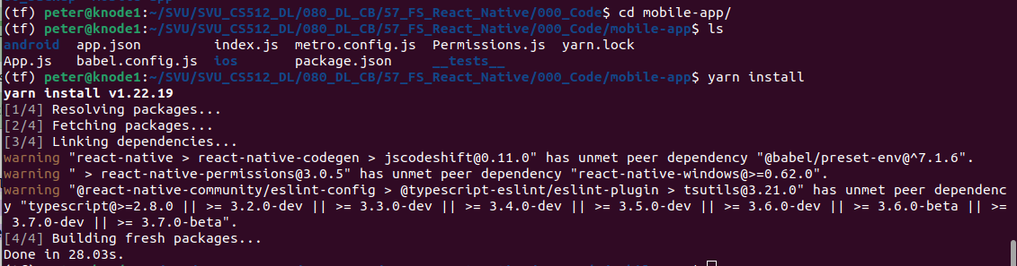
57.1 React Native Setup
https://www.youtube.com/watch?v=mSf0j8qkkFI&list=PLeo1K3hjS3uu7CxAacxVndI4bE_o3BDtO&index=57
Full Stack: React Native (4:31-0:32/11:54)
Go to: https://reactnative.dev/docs/environment-setup
> cd mobile-app
> ls
> yarn install
Note:
The “yarn install” Install all the dependencies listed within package.json in the local node_modules folder.

Slide 27
End

