Slide 1

58 Full Stack: React Native
Peter H. Chen

Slide 2
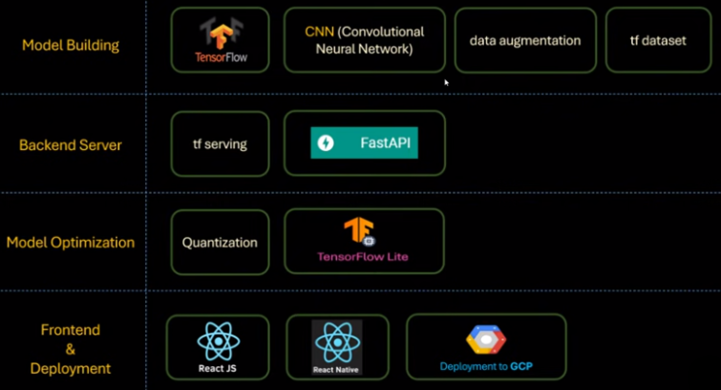
58 Full Stack: React Native
https://www.youtube.com/watch?v=mSf0j8qkkFI&list=PLeo1K3hjS3uu7CxAacxVndI4bE_o3BDtO&index=57
Full Stack: React Native (0:00-0:01/11:54)
Below is the technology stacks for full stack development:
1. Collect Dataset
2. Build Model
3. Backend Server
4. Quantization/Model Optimization
5. Frontend: ReactJS (Chrome Application), React Native (App).
1. Collect Data
2. Build Model
3. Backend Server
4. Quantization
5. Frontend App

Slide 3
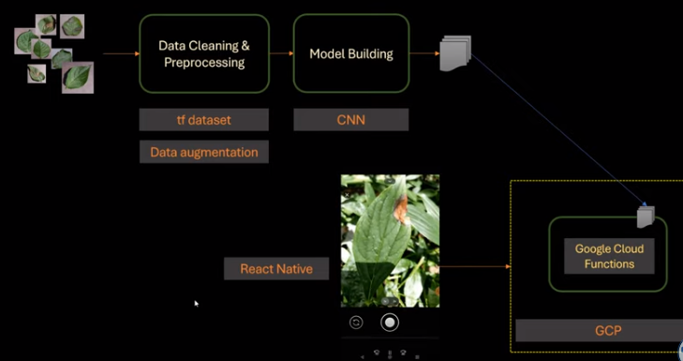
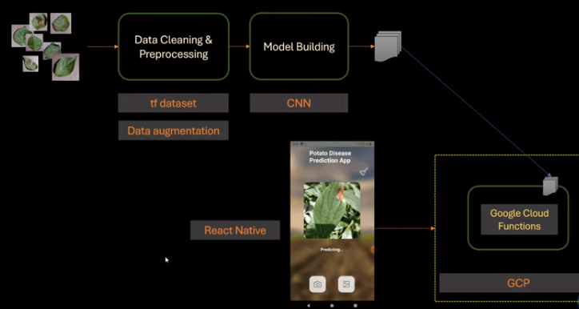
58 Full Stack: React Native
https://www.youtube.com/watch?v=mSf0j8qkkFI&list=PLeo1K3hjS3uu7CxAacxVndI4bE_o3BDtO&index=57
Full Stack: React Native (0:01-0:30/11:54)
In the last discussion, we deploy the ReactJS and fastAPI on Render (Heroku).
We will use React Native to develop App for iPhone, Android, devices, etc.
React Native is very popular technology for Mobile devices.

Slide 4
58.1 React Native Setup

Slide 5
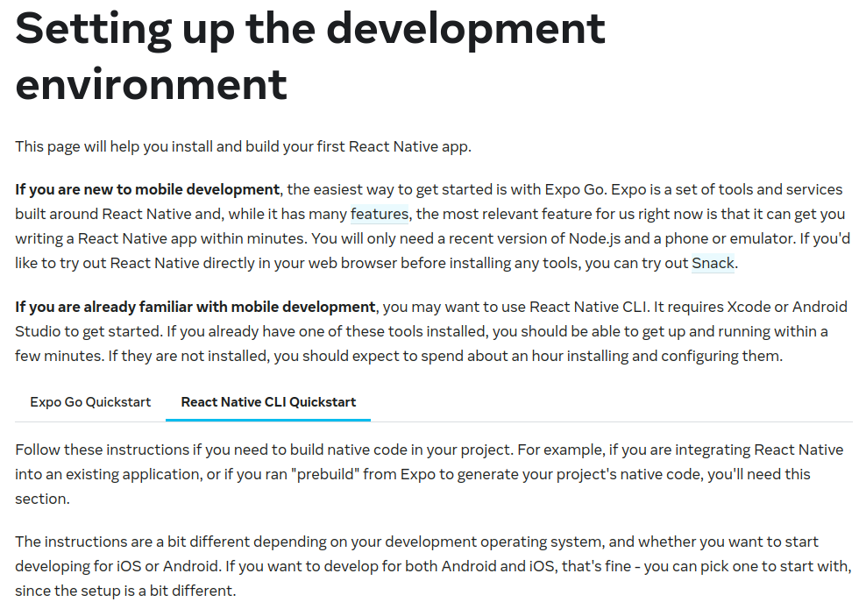
58.1 React Native Setup
https://www.youtube.com/watch?v=mSf0j8qkkFI&list=PLeo1K3hjS3uu7CxAacxVndI4bE_o3BDtO&index=57
React Native Setup (0:31-1:00/11:54)
Go to: https://reactnative.dev/docs/environment-setup
Setup up the development environment.
Go to “React Native CLI Quickstart”

Slide 6
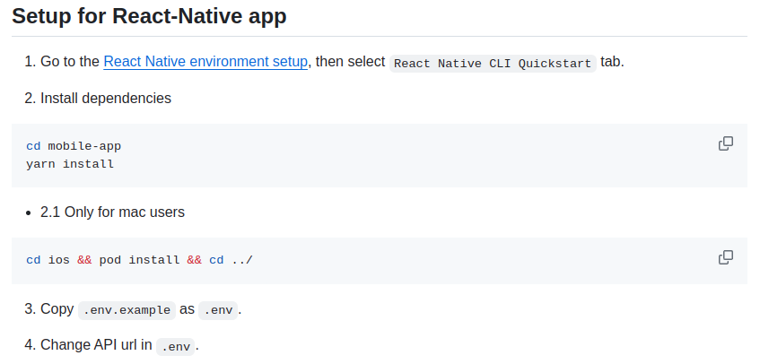
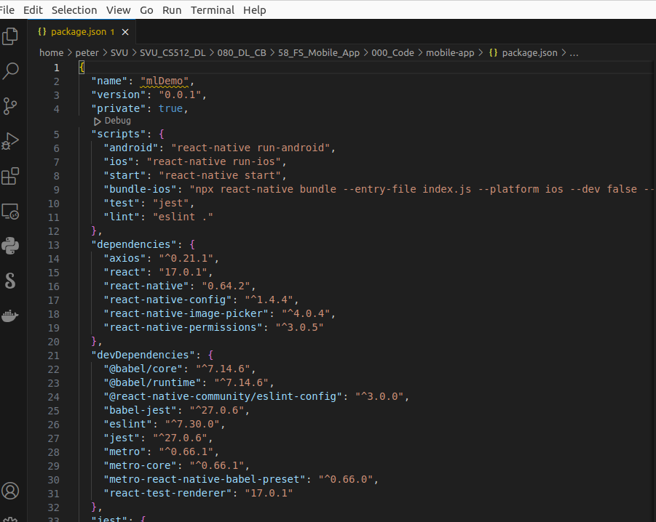
58.1 React Native Setup
https://www.youtube.com/watch?v=mSf0j8qkkFI&list=PLeo1K3hjS3uu7CxAacxVndI4bE_o3BDtO&index=57
React Native Setup (0:31-0:32/11:54)
https://github.com/codebasics/potato-disease-classification
> cd mobile-app
> code package.json
The package.json contains
1. All the packages and dependencies required by project
2. axios, reacts, react-native, babel, jest, metro (build tool)

Slide 7
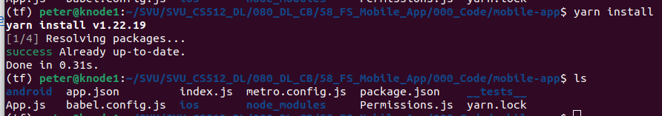
58.1 React Native Setup
https://www.youtube.com/watch?v=mSf0j8qkkFI&list=PLeo1K3hjS3uu7CxAacxVndI4bE_o3BDtO&index=57
React Native Setup (0:33-0:34/11:54)
https://github.com/codebasics/potato-disease-classification
> yarn install
“yarn install” is same as “npm install”.
“yarn install” install all the packages and dependencies defined in package.json into the current directory.
The “node_modules” folder are generated. “node_modules” contains all the react native packages and dependencies.

Slide 8
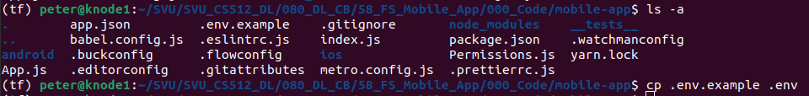
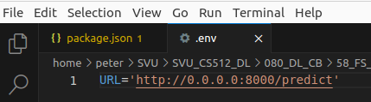
58.1 React Native Setup
https://www.youtube.com/watch?v=mSf0j8qkkFI&list=PLeo1K3hjS3uu7CxAacxVndI4bE_o3BDtO&index=57
React Native Setup (0:34-0:35/11:54)
https://github.com/codebasics/potato-disease-classification
> ls -a
We can see all the hidden files.
> cp .env.example .env
> code .env
We define the URL = ‘http://0.0.0.0:8000/predict’ for React-Native for axios call.

Slide 9
58.2 Start fastAPI

Slide 10
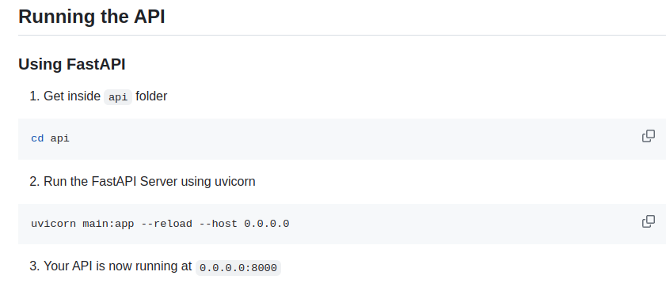
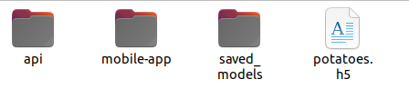
58.2 Start fastAPI
https://www.youtube.com/watch?v=mSf0j8qkkFI&list=PLeo1K3hjS3uu7CxAacxVndI4bE_o3BDtO&index=57
Start fastAPI (0:36-0:37/11:54)
https://github.com/codebasics/potato-disease-classification
1. Check the folders:
1.1 api: backend fastAPI
1.2 mobile-app: front end React-Native
1.3 saved_models: tf.lite trained integer weights model from colab TPU.
2. Check the file:
potates.h5: tensorflow trained double weights model from colab TPU.

Slide 11
58.2 Start fastAPI
https://www.youtube.com/watch?v=mSf0j8qkkFI&list=PLeo1K3hjS3uu7CxAacxVndI4bE_o3BDtO&index=57
Start fastAPI (0:38-0:39/11:54)
https://github.com/codebasics/potato-disease-classification
Start the FastAPI
1. > cd api
2. > uvicorn main:app --reload --host 0.0.0.0
The FastAPI is running at 0.0.0.0:8000
Note:
Difference from 127.0.0.1 and 0.0.0.0
The address 127.0. 0.1 means that the server only listens to the loopback interface.
The 0.0.0.0 means we want to accept traffic from all of the available interfaces.

Slide 12
58.3 Create AVD (Android Virtual Device)

Slide 13
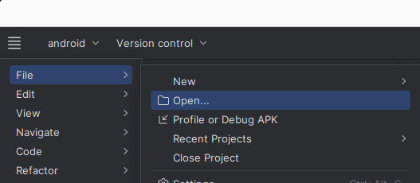
58.3 Create AVD (Android Virutal Device)
https://www.youtube.com/watch?v=mSf0j8qkkFI&list=PLeo1K3hjS3uu7CxAacxVndI4bE_o3BDtO&index=57
Create AVD (Android Virtual Device) (6:30-6:41/11:54)
https://developer.android.com/studio/run/managing-avds#:~:text=After%20opening%20a%20project%2C%20select,and%20then%20click%20Create%20device.
Start Android Studio, Open the project “android”

Slide 14
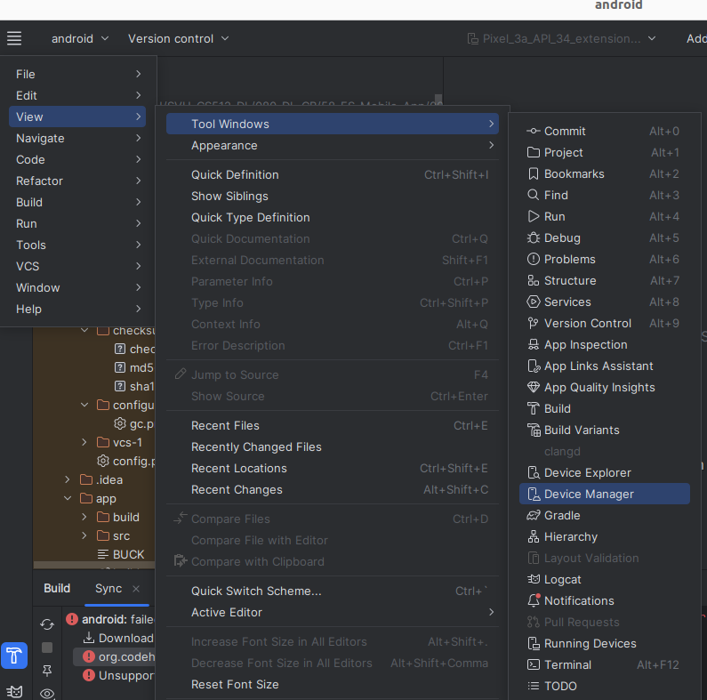
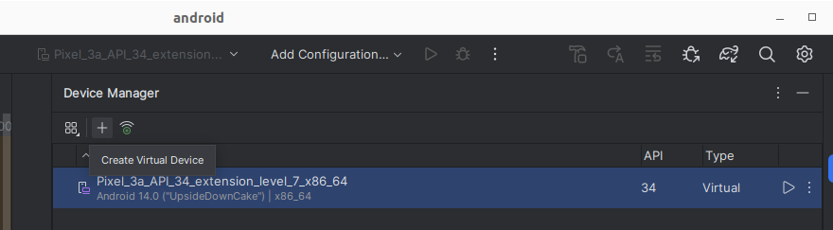
58.3 Create AVD (Android Virutal Device)
https://www.youtube.com/watch?v=mSf0j8qkkFI&list=PLeo1K3hjS3uu7CxAacxVndI4bE_o3BDtO&index=57
Create AVD (Android Virtual Device) (6:30-6:41/11:54)
https://developer.android.com/studio/run/managing-avds#:~:text=After%20opening%20a%20project%2C%20select,and%20then%20click%20Create%20device.
Setup the AVD (Android Virtual Device)
1. Control Panel: View > Tool Windows > Device Manager
2; “+”: Create Virtual Device

Slide 15
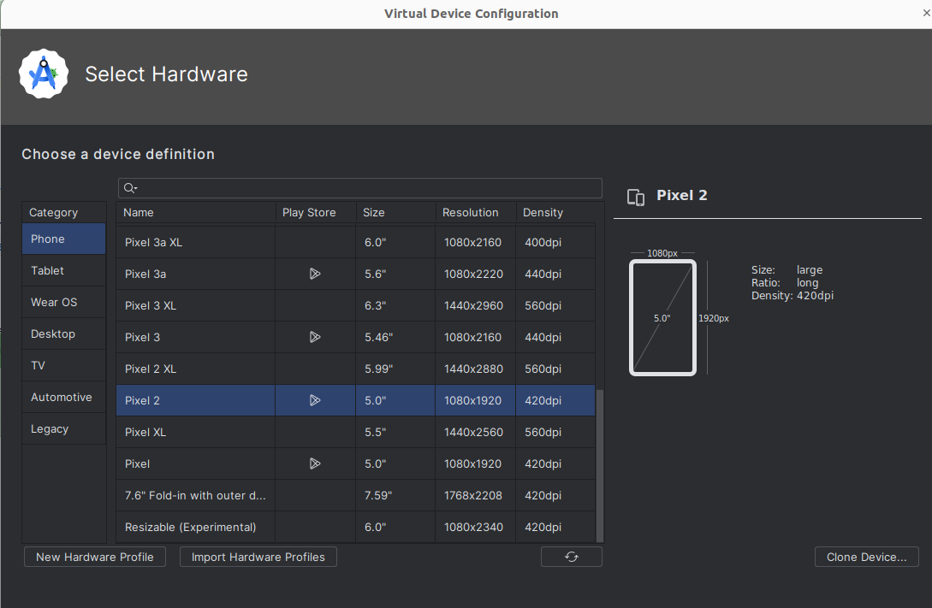
58.3 Create AVD (Android Virutal Device)
https://www.youtube.com/watch?v=mSf0j8qkkFI&list=PLeo1K3hjS3uu7CxAacxVndI4bE_o3BDtO&index=57
Create AVD (Android Virtual Device) (6:30-7:40/11:54)
https://developer.android.com/studio/run/managing-avds#:~:text=After%20opening%20a%20project%2C%20select,and%20then%20click%20Create%20device.
Select the Virtual Device you want to use.
You can run the virtual device emulator juts like the real mobile phone.

Slide 16
58.4 App.js Coding

Slide 17

58.4 App.js
https://www.youtube.com/watch?v=mSf0j8qkkFI&list=PLeo1K3hjS3uu7CxAacxVndI4bE_o3BDtO&index=57
App.js (10:01-10:30/11:54)
The Mobile App is similar to App.js for Web-site.
The web-site App.js is build by ReactJS.
The Mobile App.js is build by React Native.
The App.js for React Native and ReactJS is very similar but there are some changes.
For example, there is a dimension for mobile phone.

Slide 18
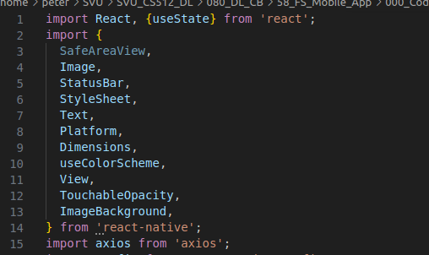
58.4 App.js
https://www.youtube.com/watch?v=mSf0j8qkkFI&list=PLeo1K3hjS3uu7CxAacxVndI4bE_o3BDtO&index=57
App.js (10:31-10:35/11:54)
We use the library ‘react-native’.

Slide 19
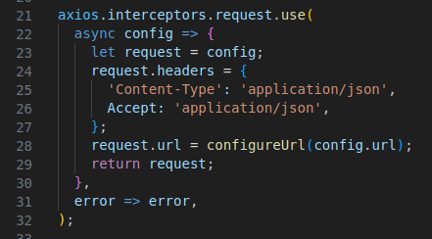
58.4 App.js
https://www.youtube.com/watch?v=mSf0j8qkkFI&list=PLeo1K3hjS3uu7CxAacxVndI4bE_o3BDtO&index=57
App.js (10:31-10:40/11:54)
We use the same axios for reactJS and React Native.

Slide 20
58.5 Run Mobile App

Slide 21
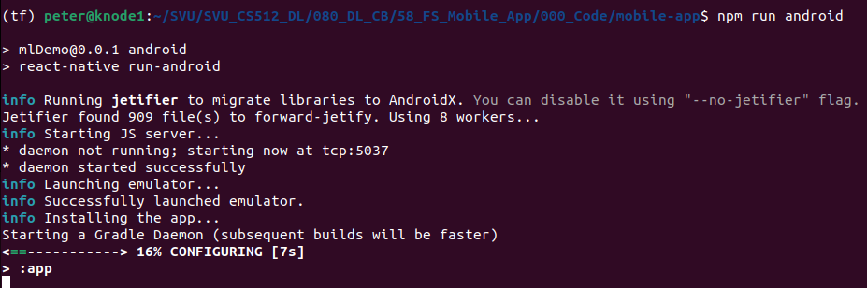
58.5 Run mobile-app
https://www.youtube.com/watch?v=mSf0j8qkkFI&list=PLeo1K3hjS3uu7CxAacxVndI4bE_o3BDtO&index=57
Run Mobile App (10:41-11:00/11:54)
https://github.com/codebasics/potato-disease-classification
1. > npm run android --verbose

Slide 22
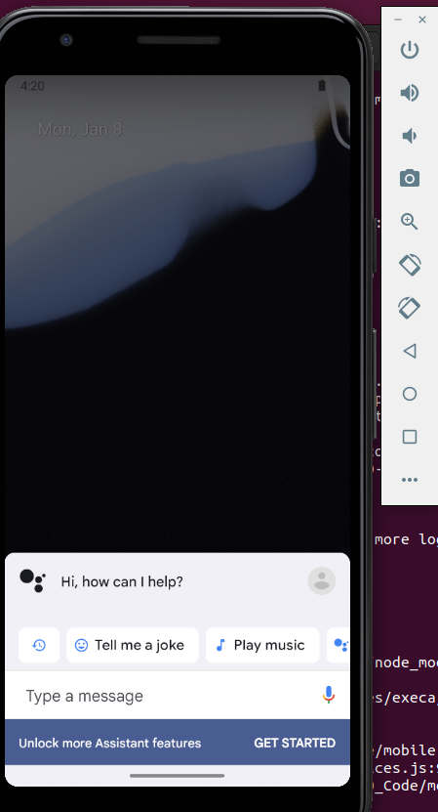
58.5 Run mobile-app
https://www.youtube.com/watch?v=mSf0j8qkkFI&list=PLeo1K3hjS3uu7CxAacxVndI4bE_o3BDtO&index=57
Run Mobile App (11:01-11:54/11:54)
https://github.com/codebasics/potato-disease-classification
1. > npm run android --verbose

