Slide 1

20.00 Review Confusion Matrix: Multi-Class
Peter H. Chen

Slide 2
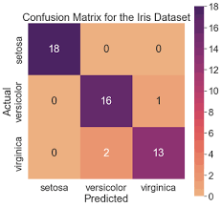
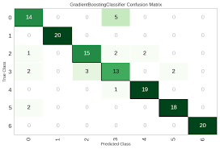
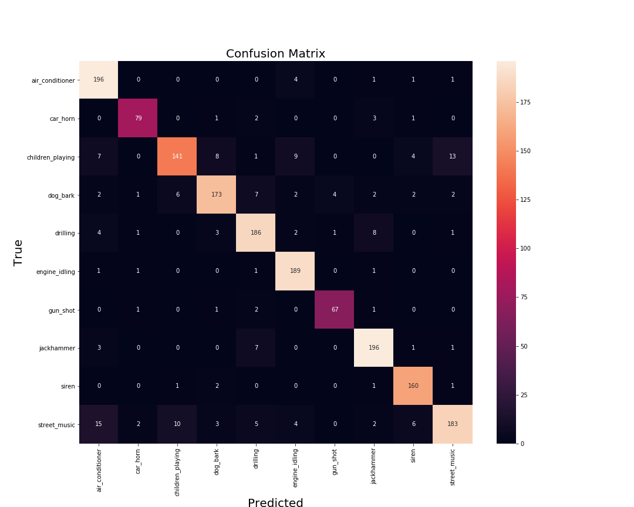
20.00 Review Confusion Matrix: Multi-Class
https://www.analyticsvidhya.com/blog/2021/06/confusion-matrix-for-multi-class-classification/
Review Confusion Matrix: Multi-Class
Multi-classes (3, 7, 10) Confusion Matrix examples:
1. In semiconductor design or foundry companies (such as, NVIDIA, Intel, AMD, TSMC, UMC, Samsung, etc.) use Confusion Matrix for deviation and variance of corners, such as, B (Best), W (Worst), BB (Best-Best), BW (Best-Worse), WW (Worst, Worst), etc. for PVT (Process, Voltage, and Temperature). Since each wafer cost Million dollars to Fab. It is very important to find what causes the off-Diagonal defect distribution and improve reduce the defect.
2. Input features:P (Process): 2nm, 3nm, etc.; V (Voltage): 3.3V, 5V, etc.; T (Temperature) 25°C, 120°C, etc.
3. Output Target/Model Predition: PAT (Power, Area, Timing), i.e., Minimum Power, Minimum Area, Maximum Performance (maximum instance per second).
3-classes
7-classes
10-classes

Slide 3


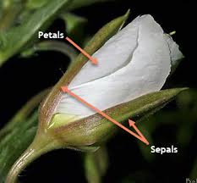



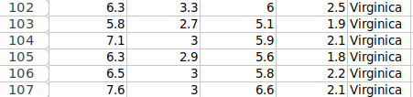
20.00 Review Confusion Matrix: Multi-Class
https://www.analyticsvidhya.com/blog/2021/06/confusion-matrix-for-multi-class-classification/
Review Confusion Matrix: Multi-Class
Iris [鸢尾花; アイリス ] has 3 classes:
Features:
1. Sepal [萼片; がく片(Gaku-hen)]
2. petal (花瓣; 花弁/花びら)
Target Labels/Model Prediction:
1. Veriscolor (spring, ベリス),
2. Virginica (Sparsely, バージニカ)
3. Setoa (Versatile,セトア):

Slide 4
20.01 Read Iris Dataset

Slide 5
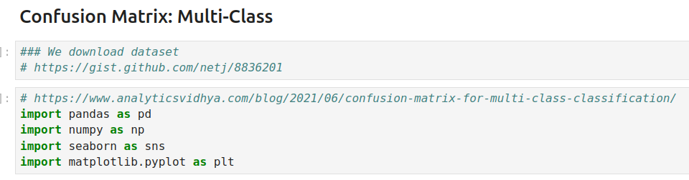
20.01 Read Iris Dataset
https://www.analyticsvidhya.com/blog/2021/06/confusion-matrix-for-multi-class-classification/
Read Iris Dataset
Import libraries

Slide 6
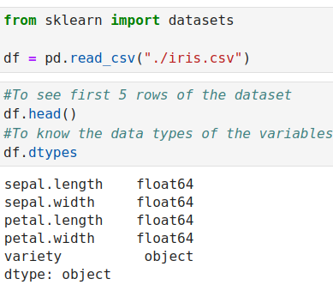
20.00 Review Confusion Matrix: Multi-Class
https://www.analyticsvidhya.com/blog/2021/06/confusion-matrix-for-multi-class-classification/
Review Confusion Matrix: Multi-Class
Read iris.csv

Slide 7
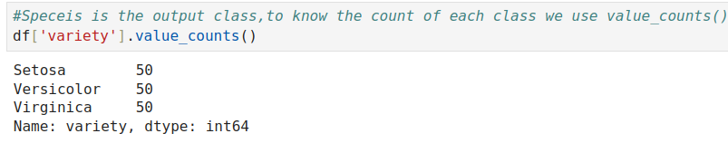
20.00 Review Confusion Matrix: Multi-Class
https://www.analyticsvidhya.com/blog/2021/06/confusion-matrix-for-multi-class-classification/
Review Confusion Matrix: Multi-Class
Check how many data in dataset.

Slide 8
20.02 Model Fit

Slide 9
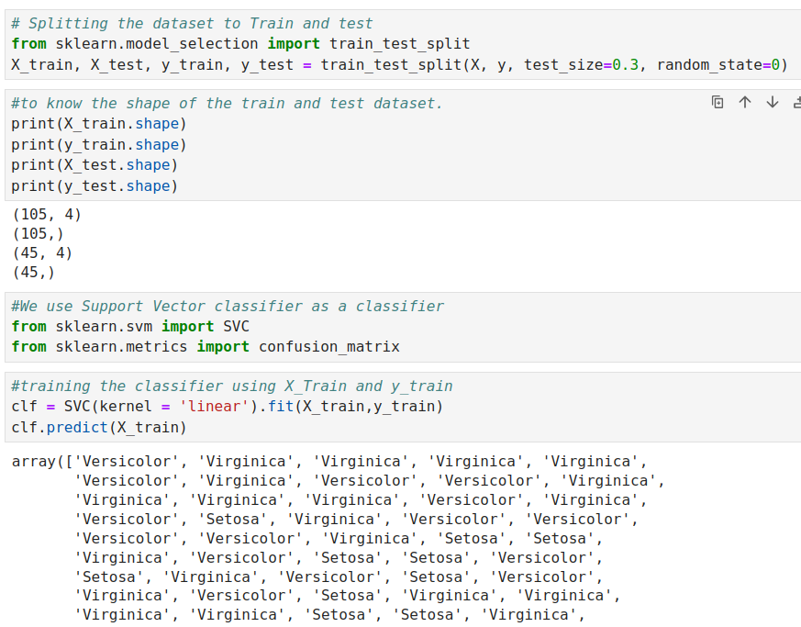
20.02 Model Fit
https://www.analyticsvidhya.com/blog/2021/06/confusion-matrix-for-multi-class-classification/
Model Fit
Here, we use skit-learn for Statistical Machine Learning Model
Note:
We also can use Tensorflow neural network).

Slide 10
20.03 Plot Confusion Matrix

Slide 11
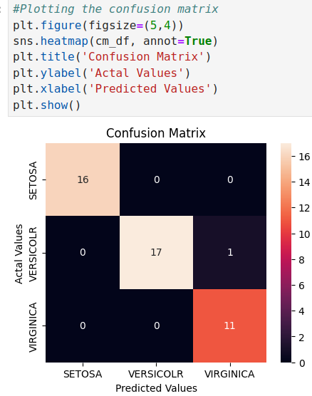
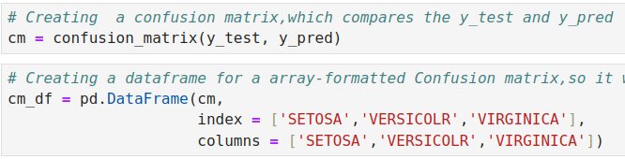
20.03 Plot Confusion Matrix
https://www.analyticsvidhya.com/blog/2021/06/confusion-matrix-for-multi-class-classification/
Plot Confusion Matrix
Plot Multi-class Confusion Matrix.
Note:
We can continue to calculate Precision, Recall, F1-Score, Specificity to know statistical details about data (imbalanced, bias, etc).

Slide 12
End

