Slide 1

14.0 Week 04 Review
Peter H. Chen

Slide 2
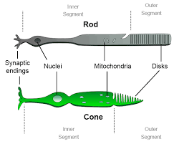
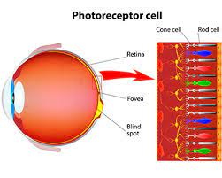
14.0 Week 04 Review
https://github.com/peterhchen/AIU_CS512_DL/tree/main/000_Lecture_Project/week03
Week 4 Review
https://ai.stackexchange.com/questions/6099/what-activation-function-does-the-human-brain-use
Biological Neuron vs. Neural Network Neuron:
Biological Image cells:
1. Rod cells are highly sensitive to light and operate under dim lighting conditions.
2. Cone cells function under ambient and only in bright lighting conditions, exhibit rapid responses to variations in light intensity, and are responsible for color vision and high visual acuity.
Rod cells are highly sensitive to light and function in night vision, whereas cone cells are capable of detecting a wide spectrum of light photons and are responsible for color vision.

Slide 3
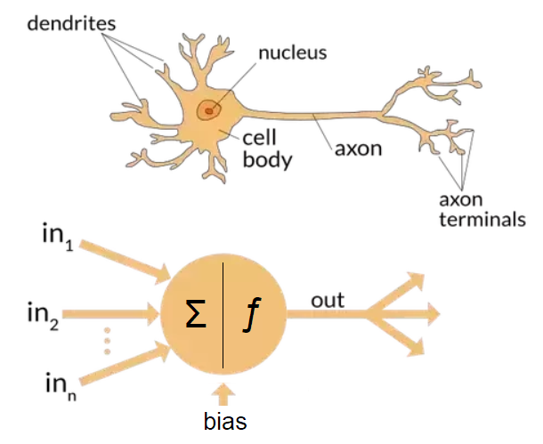
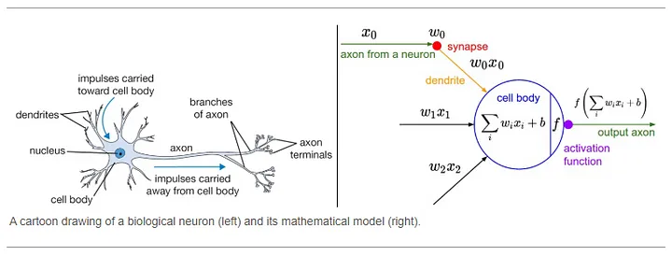
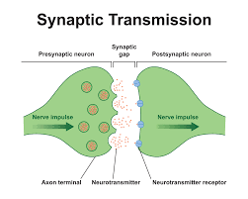
14.0 Week 04 Review
https://github.com/peterhchen/AIU_CS512_DL/tree/main/000_Lecture_Project/week03
Week 4 Review
https://ai.stackexchange.com/questions/6099/what-activation-function-does-the-human-brain-use
Biological Neuron vs. Neural Network Neuron:
Brain Cell:
1. Dendrite: weight (multiplication)
2. Cell Body: summation
3. Synapse: Transmitter for ion (Sodium or Chloride) channel.
Note:
1. The brains of mammals do not use an activation function.
2. Only machine learning model have activation function.

Slide 4
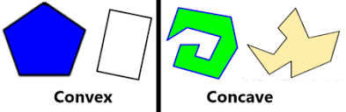
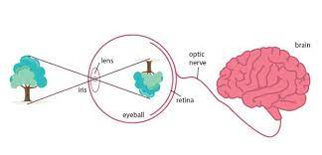
14.0 Week 04 Review
https://github.com/peterhchen/AIU_CS512_DL/tree/main/000_Lecture_Project/week03
Week 4 Review
1. Why neural network?
Neural Network is Linear Stack of Layers of Neurons. It reduces the complexity of non-convex (i.e., concave) of polynomial modeling problem.
2. Biological Reinforcement Learning?
2.1 Human being is learn by experience (trial and error), brain wave is 0V-4V, and never go under or beyond.
2.2 Eye to brain mapping: When eyes see line and map into curve in the brain; eyes see curve and map into line in the brain; eyes see up and map into down in the brain; eyes see down and map into up in the brain; left eye map into right brain; right eye map into left brain; eyes see the circle, brain maps into square; eyes see the square, brain map into circle.
2.3 Fish learn by experience (trial and error) as well: When you feed the baby fish, the baby fish eat the food by trial and error (can be upside down). They get used to in few weeks. However, when we rotate the fish eye 180 degree, the upside-down happen again for few weeks and then get used to again.

Slide 5
14.0 Week 04 Review
https://github.com/peterhchen/AIU_CS512_DL/tree/main/000_Lecture_Project/week03
Week 4 Review
chatBot Application technology stack
ChatBot Integration | ChatBot | LLM (Large Language Model) | API | Private Database | Real-time Information | GUI | Host
Open Source: LangChain | Open Source: 1. Google Gemini 2. Google Bard | Open Source: 1. Google Gemini 2. Google PaLM 2 (Pathway Language Model) | fastAPI, etc | Open Source: MySQL, etc. | Google Real-time Search Engine (SerpApi) | Meta ReactJS (Chrome), Meta React Native (App), Google Angular, streamit | Render.com, Heroku, HuggingFace, GCP (Google Cloud Platform), AWS
Same as above | Open Source: Meta FAISS (Facebook AI Similarity Search) | Open Source: Meta Llama 2 (Large Langue Model for Meta AI) | Same as above | Same as above | Same as above | Same as above | Same as above
Same as above | Non-Open Source: ChatGPT | Non-Open Source: GPT | Same as above | Same as above | Same as above | Same as above | Same as above

Slide 6
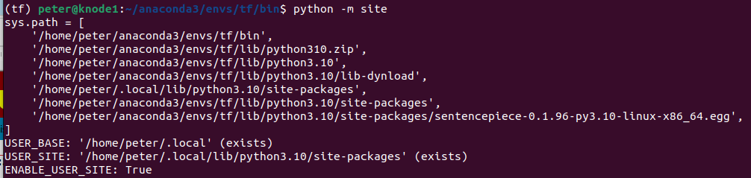
14.0 Python Neural Network from Scratch
https://www.youtube.com/watch?v=pXGBHV3y8rs&list=PLeo1K3hjS3uu7CxAacxVndI4bE_o3BDtO&index=12
Python Neural Network from Scratch (4:45-5:20/41:33)
How to find where is tensorflow located?
1. First, we have to create the anaconda environment
> conda create --name tf
2. Go into the tf (tensorflow) environment:
> conda activate tf
(tf) > pip install tensorflow
(tf) > python -m site
*so: compiled shared object

Slide 7
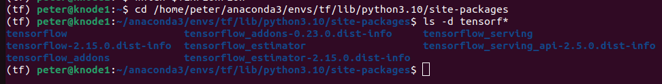
14.0 Python Neural Network from Scratch
https://www.youtube.com/watch?v=pXGBHV3y8rs&list=PLeo1K3hjS3uu7CxAacxVndI4bE_o3BDtO&index=12
Python Neural Network from Scratch (4:45-5:20/41:33)
3. Go to site-packages location
(tf) > cd cd /home/peter/anaconda3/envs/tf/lib/python3.10/site-packages
(tf) > ls -d tensorfl*
>> tensorflow ….

Slide 8
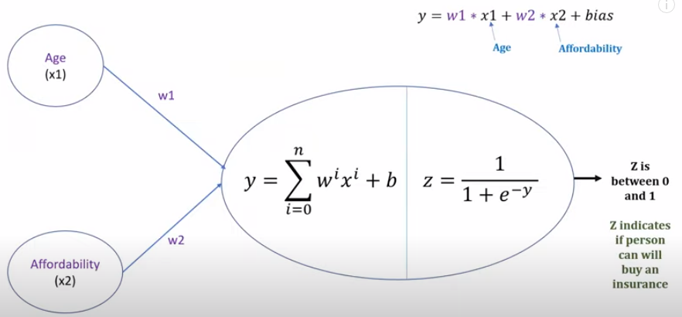
14.0 Python Neural Network from Scratch
https://www.youtube.com/watch?v=pXGBHV3y8rs&list=PLeo1K3hjS3uu7CxAacxVndI4bE_o3BDtO&index=12
Python Neural Network from Scratch (4:45-5:20/41:33)
We define a simple three layers (input, hidden, output) of neural network with single neuron.
It is a simple logistic regression with single neuron.
This is a machine learning is a shallow neural network (three layers of neural network).
In logistic regression, there are two components, one is weighted sum and the second one is the sigmoid function.

Slide 9
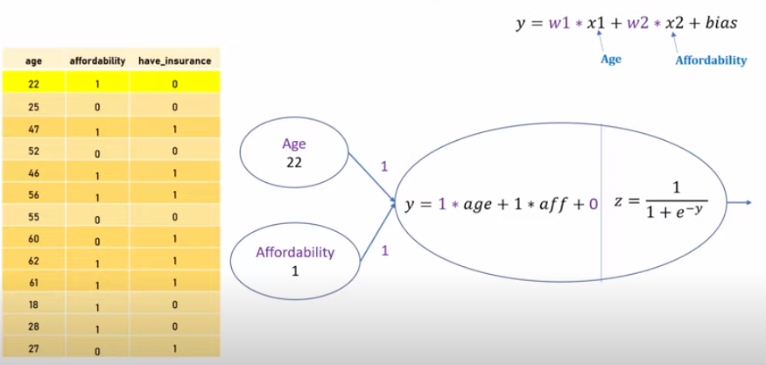
14.0 Python Neural Network from Scratch
https://www.youtube.com/watch?v=pXGBHV3y8rs&list=PLeo1K3hjS3uu7CxAacxVndI4bE_o3BDtO&index=12
Python Neural Network from Scratch (5:26-6:30/41:33)
When we train a neural network, The Gradient Descent is used during the training of neural network.
We have 13 data points for neural network. We want to use all of the 13 data to train this neural network. We have age 22 and affordability 1.
We initialize the weight w1 = 1, w2 = 1 and bias = 0 (or randomized between 0 and 1).
We can substitute the data for calculation. We call this substitution a forward pass.
y = 1 * 22 + 1 * 1 + 0 = 23.
z = 1 / [1 + exp (-23)] = 0.999999999989

Slide 10
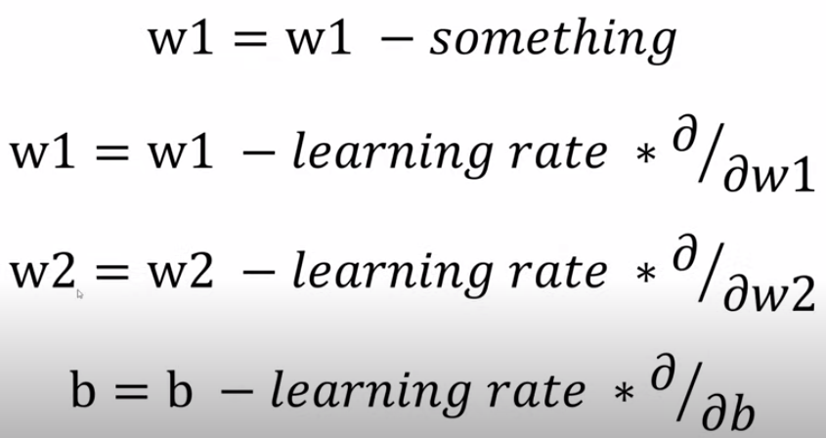
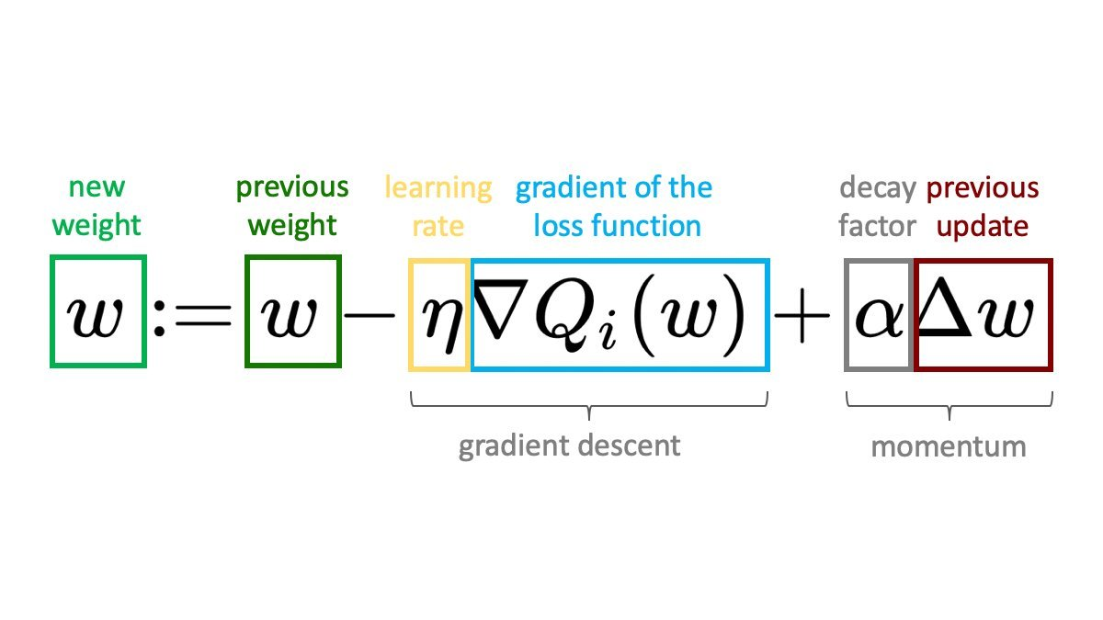
14.0 Gradient and Gradient Descent
https://www.youtube.com/watch?v=pXGBHV3y8rs&list=PLeo1K3hjS3uu7CxAacxVndI4bE_o3BDtO&index=12
Gradient and Gradient Descent (11:11-11:30/41:33)
The learning rate * Gradient is called Gradient Descent.

Slide 11
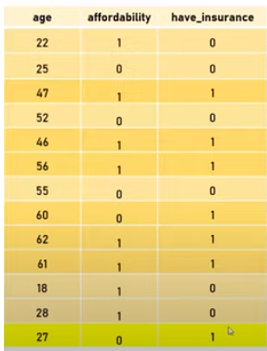
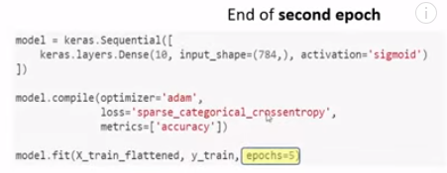
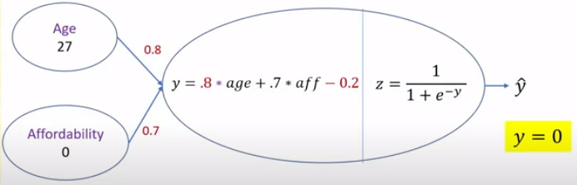

14.0 Gradient Descent in Epoch
https://www.youtube.com/watch?v=pXGBHV3y8rs&list=PLeo1K3hjS3uu7CxAacxVndI4bE_o3BDtO&index=12
Gradient Descent in Epoch (14:07-14:30/41:33)
In the hand-writing prediction example, we have epochs =5. The epoch is one of the parameter in the model.fit(…, epoch=5) in our tensorflow code.
Now, we know it make sense what epoch is.

Slide 12
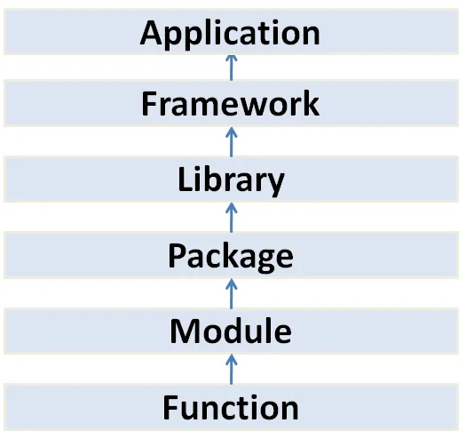
14.0 Mount Google Drive
https://www.youtube.com/watch?v=pXGBHV3y8rs&list=PLeo1K3hjS3uu7CxAacxVndI4bE_o3BDtO&index=12
Mount Google Drive (17:13-17:15/41:33)
Use classes as blueprints for objects that model your problem domain. Class contains methods.
Use modules to collect functionality into logical units.
Python package means “folder”.
Tensorflow Playground
(Browser-based Application)
Google Tensorflow, Google Angular
Meta PyTorch, Meta ReactJS, Keras
Tensorboard, numpy, pandas, Matplotlib, Seaborn,
GUI Tkinter, Nokia PyQt, ...
Folder/Directory with __init__.py
File
class
math
Method
sqrt()

Slide 13
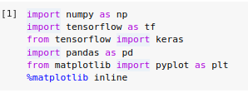
14.0 Mount Google Drive
https://www.youtube.com/watch?v=pXGBHV3y8rs&list=PLeo1K3hjS3uu7CxAacxVndI4bE_o3BDtO&index=12
Mount Google Drive (17:13-17:15/41:33)
Examples:
> from tensorflow (framework) import keras (library)
> from keras (library) import layers, sequential, … (package)
> from matplotlib (Package) import pyplot (module) as plt
> from math (module) import sqrt (function)
Tensorflow Playground
(Browser-based Application)
Google Tensorflow, Google Angular
Meta PyTorch, Meta ReactJS, Keras
Tensorboard, numpy, pandas, Matplotlib, Seaborn,
GUI Tkinter, Nokia PyQt, ...
Math, pyplot
sqrt()

Slide 14

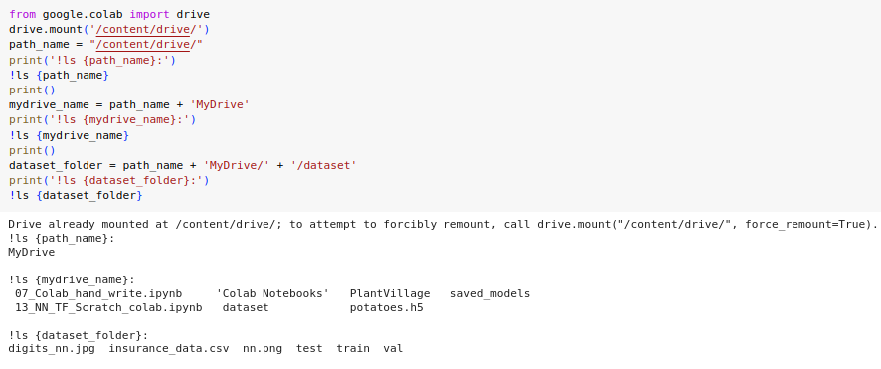
14.0 Mount Google Drive
https://www.youtube.com/watch?v=pXGBHV3y8rs&list=PLeo1K3hjS3uu7CxAacxVndI4bE_o3BDtO&index=12
Mount Google Drive (17:13-17:15/41:33)
1. Mount google drive from colab.
2. Read dataset from the paths.

Slide 15
End

