Slide 1

9 Derivative
Peter H. Chen

Slide 2
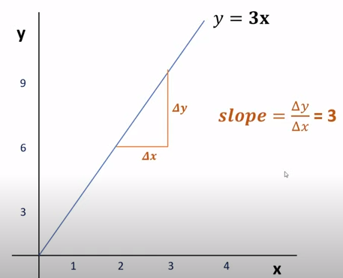
9 Derivative
https://www.youtube.com/watch?v=cT4pQT5Da0Q&list=PLeo1K3hjS3uu7CxAacxVndI4bE_o3BDtO&index=9
Derivative (0:00-1:00/12:34)
Linear Slope = Δ y / Δ x = 3.
The linear slope is very simple mathematics, nothing complicated.

Slide 3
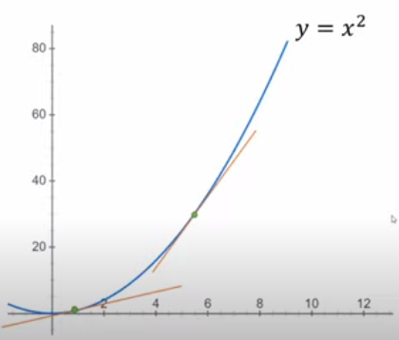
9 Derivative
https://www.youtube.com/watch?v=cT4pQT5Da0Q&list=PLeo1K3hjS3uu7CxAacxVndI4bE_o3BDtO&index=9
Derivative (1:01-2:00/12:34)
But, when we have a line like below, The line is not linear, slope is not constant.
The slope is varied, how to find the slope of this line?

Slide 4
9.1 Slope vs. Derivative

Slide 5
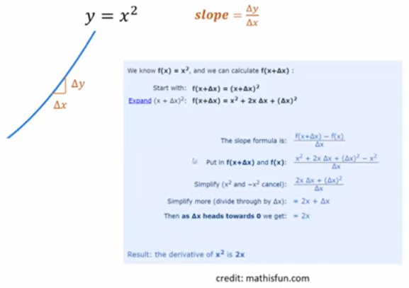
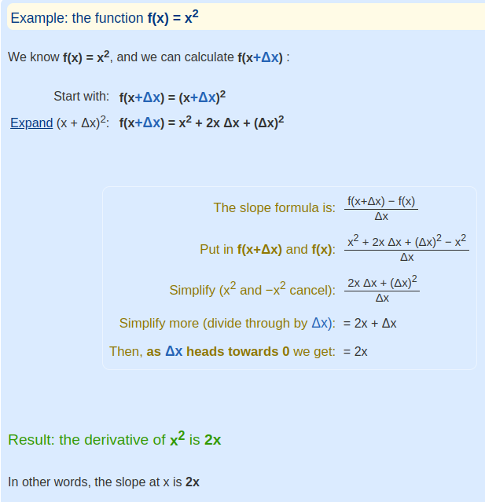
9.1 Slope vs. Derivative
https://www.youtube.com/watch?v=cT4pQT5Da0Q&list=PLeo1K3hjS3uu7CxAacxVndI4bE_o3BDtO&index=9
Slope vs. Derivative (2:01-2:50/12:34)
https://www.mathsisfun.com/calculus/derivatives-introduction.html
We zoom in and look like a straight line. We take very small Δ(x).
For f(x) = x², we substitute x = x+Δx and find the slope = 2x.
If f(x) is non-linear function, the slope = d[f(x)]/dx is varied and is called derivative.
The slope is for linear function. For non-linear function, we use derivative instead.

Slide 6
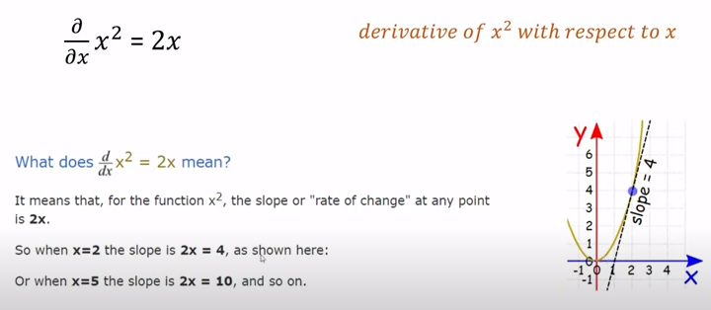
9.1 Slope vs. Derivative
https://www.youtube.com/watch?v=cT4pQT5Da0Q&list=PLeo1K3hjS3uu7CxAacxVndI4bE_o3BDtO&index=9
Slope vs. Derivative (3:01-3:30/12:34)
https://www.mathsisfun.com/calculus/derivatives-introduction.html
What is Derivative d(x²)/dx = 2x mean?
Derivative means “rate of change”.
Look at any point, x = 2, slope is 4, x = 5, slope is 10, etc.
That is why we use derivative as a function to represent a slope.

Slide 7
9.2 Power/Sum Rule

Slide 8
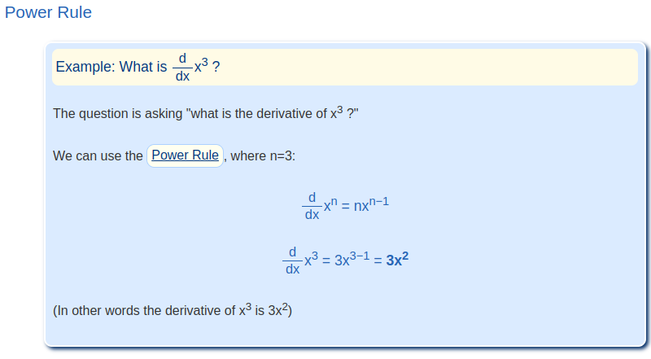
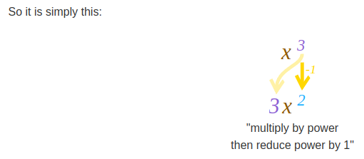
9.2 Power/Sum Rule
https://www.youtube.com/watch?v=cT4pQT5Da0Q&list=PLeo1K3hjS3uu7CxAacxVndI4bE_o3BDtO&index=9
Power/Sum Rule (3:31-4:00/12:34)
https://www.mathsisfun.com/calculus/derivatives-rules.html
Power rule:

Slide 9
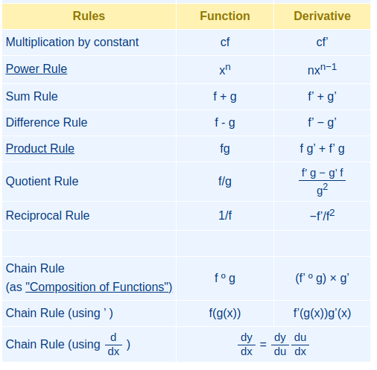



9.2 Power/Sum Rule
https://www.youtube.com/watch?v=cT4pQT5Da0Q&list=PLeo1K3hjS3uu7CxAacxVndI4bE_o3BDtO&index=9
Power/Sum Rule (4:01-5:00/12:34)
https://www.mathsisfun.com/calculus/derivatives-rules.html
Derivative rule for function: power rule and sum rule.
Power Rule:
Power Rule + Sum Rule:

Slide 10
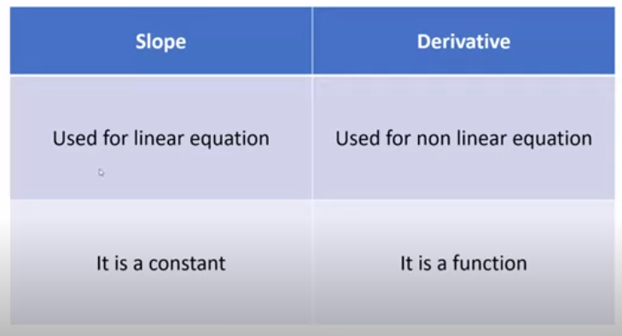
9.2 Power/Sum Rule
https://www.youtube.com/watch?v=cT4pQT5Da0Q&list=PLeo1K3hjS3uu7CxAacxVndI4bE_o3BDtO&index=9
Power/Sum Rule (5:01-5:20/12:34)
Summary of Slope and Derivative:
Linear vs non-linear equation

Slide 11
9.3 Derivative vs. Partial Derivative

Slide 12
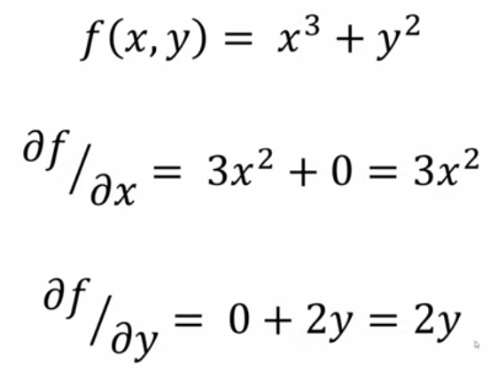
9.3 Derivative vs. Partial Derivative
https://www.youtube.com/watch?v=cT4pQT5Da0Q&list=PLeo1K3hjS3uu7CxAacxVndI4bE_o3BDtO&index=9
Derivative vs. Partial Derivative (5:21-6:30/12:34)
Partial Derivatives:
When we have more than one variables, e.g., x and y.
(1) We can take derivative for x by power rule (assume variable y is not existed). That is partial derivative of x.
(2) Same thing as y. We can take derivative for y by power rule (assume variable x is not existed).
(3) Then, we use sum rule to sum (1) and (2) together to get the result.

Slide 13
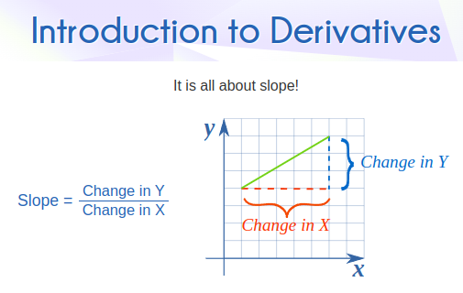
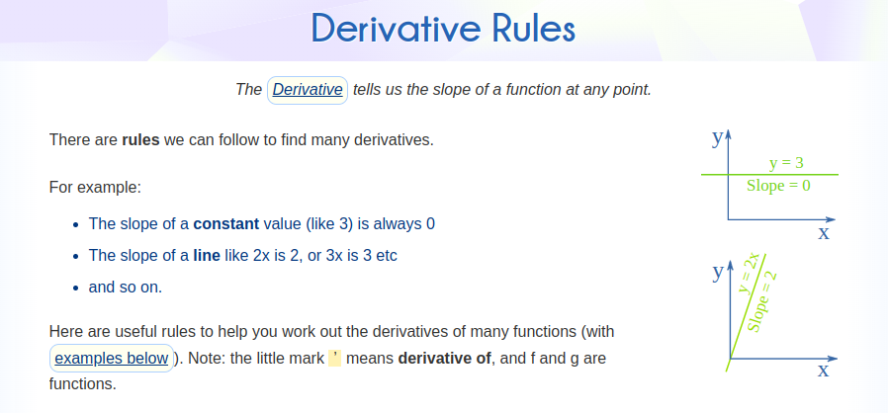
9.3 Derivative vs. Partial Derivative
https://www.youtube.com/watch?v=cT4pQT5Da0Q&list=PLeo1K3hjS3uu7CxAacxVndI4bE_o3BDtO&index=9
Derivative vs. Partial Derivative (6:31-6:50/12:34)
https://www.mathsisfun.com/calculus/derivatives-rules.html
We can go through mathsisfun.com to see more explanation on derivatives and derivatives rules.
These basic rules are very useful for deep learning.

Slide 14
9.4 Why Derivative for Deep Learning?

Slide 15
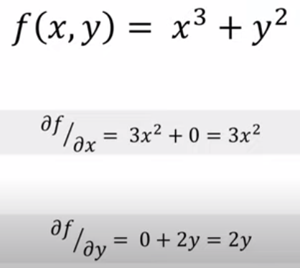
9.4 Why Derivative for Deep Leaning?
https://www.youtube.com/watch?v=cT4pQT5Da0Q&list=PLeo1K3hjS3uu7CxAacxVndI4bE_o3BDtO&index=9
Why Derivative for Deep Learning? (7:01-7:20/12:34)
Why do we need derivative in deep learning?

Slide 16
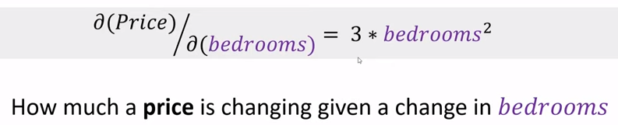
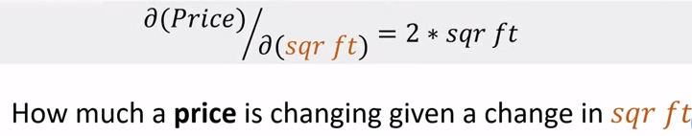
9.4 Why Derivative for Deep Learning?
https://www.youtube.com/watch?v=cT4pQT5Da0Q&list=PLeo1K3hjS3uu7CxAacxVndI4bE_o3BDtO&index=9
Why Derivative for Deep Learning? (7:21-8:20/12:34)
Look at example of
1. house price with bedroom and sqr ft (square-feet):
We have house price = f(bedroom, sqr ft)
2. How much price change with change in bedrooms?
3. How much price change with change in sqr ft?
1
2
3

Slide 17
9.5 NN Model for Insurance Prediction

Slide 18
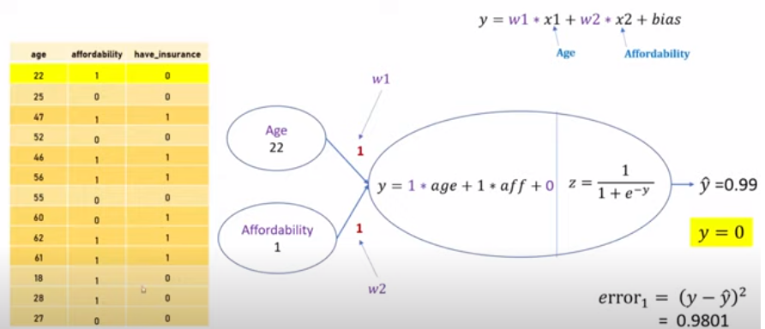
9.5 NN Model for Insurance Prediction
https://www.youtube.com/watch?v=cT4pQT5Da0Q&list=PLeo1K3hjS3uu7CxAacxVndI4bE_o3BDtO&index=9
Neural Network Model for Insurance Prediction (8:21-10:10/12:34)
1. Below, we are given a dataset (table), The dataset contains the age (x1) and affordability (x2) as features (x1, and x2 as independent variables). We have “have insurance” as the target output (y).
2. The weights (w1 and w2) are the coefficients. Initially, the weights = 1.
3. We feed through the samples and calculate the value.
4. Compare the calculate value with target output y = 0.
5. Based on the error, we wan to modify the weights (w1 and w2). This is more like a trial and error approach. Our neural network training is all about the adjusting weights. Once we get the right weights, our neural network is trained. We want to avoid the infinity loop of trial and error.
6. The derivative help us to do that. We want to minimize the error by adjusting weights.

Slide 19
9.6 Partial Derivative Exercise

Slide 20
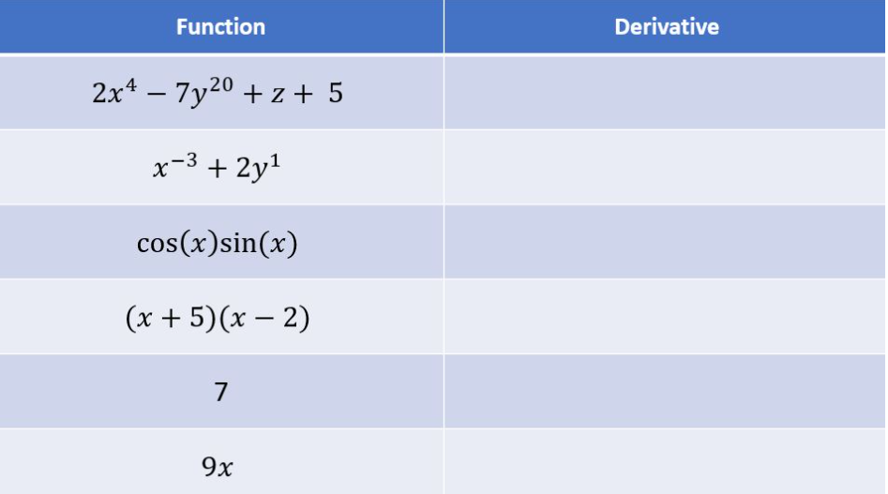
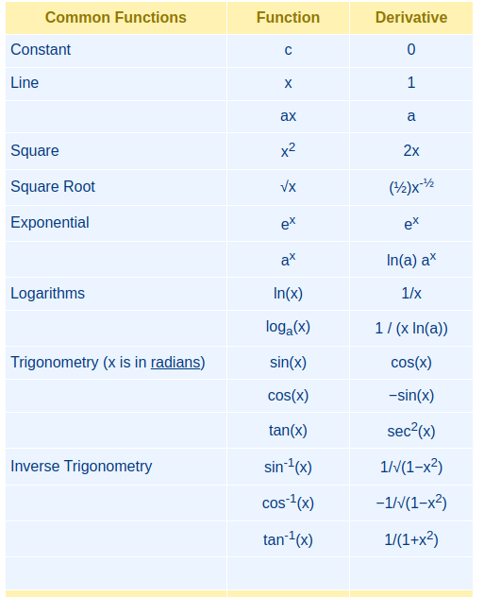
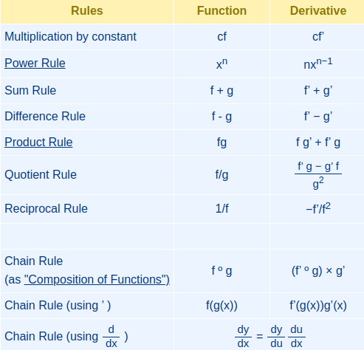
9.6 Partial Derivative Exercise
https://www.youtube.com/watch?v=cT4pQT5Da0Q&list=PLeo1K3hjS3uu7CxAacxVndI4bE_o3BDtO&index=9
Partial Derivative Exercise (10:51-11:10/12:34)
https://github.com/codebasics/deep-learning-keras-tf-tutorial/blob/master/3_derivatives/derivatives_exercise.md
What are the derivatives of the below?
You can use the table to find the answer.

Slide 21
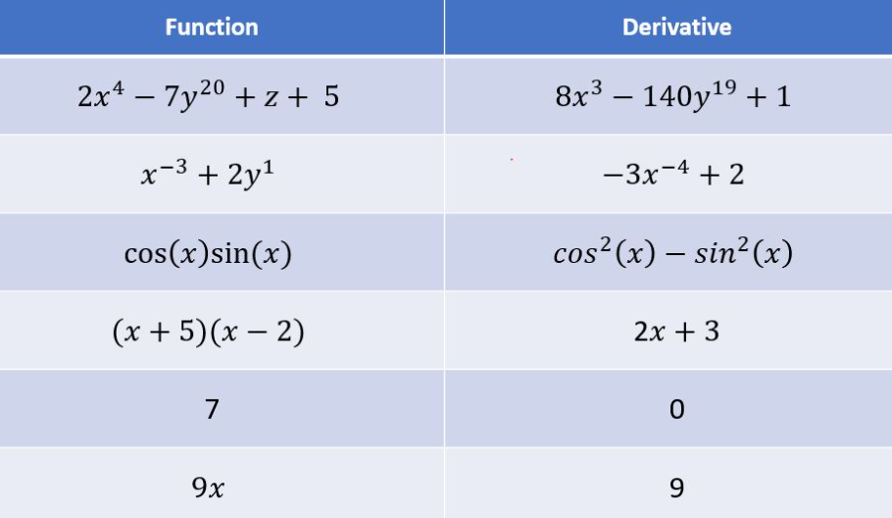
9.6 Partial Derivative Exercise
https://www.youtube.com/watch?v=cT4pQT5Da0Q&list=PLeo1K3hjS3uu7CxAacxVndI4bE_o3BDtO&index=9
Partial Derivative Exercise (9:21-9:10/12:34)
https://github.com/codebasics/deep-learning-keras-tf-tutorial/blob/master/3_derivatives/derivatives_exercise.md
What are the derivatives of the below?
Answers on the right.

Slide 22
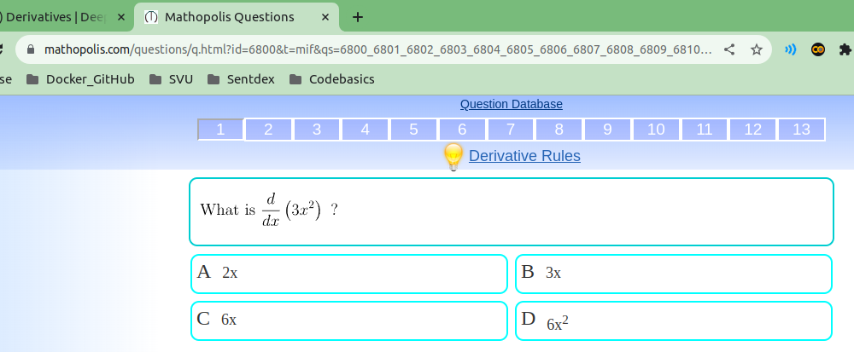
9.6 Partial Derivative Exercise
https://www.youtube.com/watch?v=cT4pQT5Da0Q&list=PLeo1K3hjS3uu7CxAacxVndI4bE_o3BDtO&index=9
Partial Derivative Exercise (9:21-9:10/12:34)
https://www.mathopolis.com/questions/q.html?id=6800&t=mif&qs=6800_6801_6802_6803_6804_6805_6806_6807_6808_6809_6810_6811_6812&site=1&ref=2f63616c63756c75732f64657269766174697665732d72756c65732e68746d6c&title=446572697661746976652052756c6573
Some more exercises:

Slide 23
End

