Slide 1

001 Google Colab: Introduction
Peter H. Chen

Slide 2
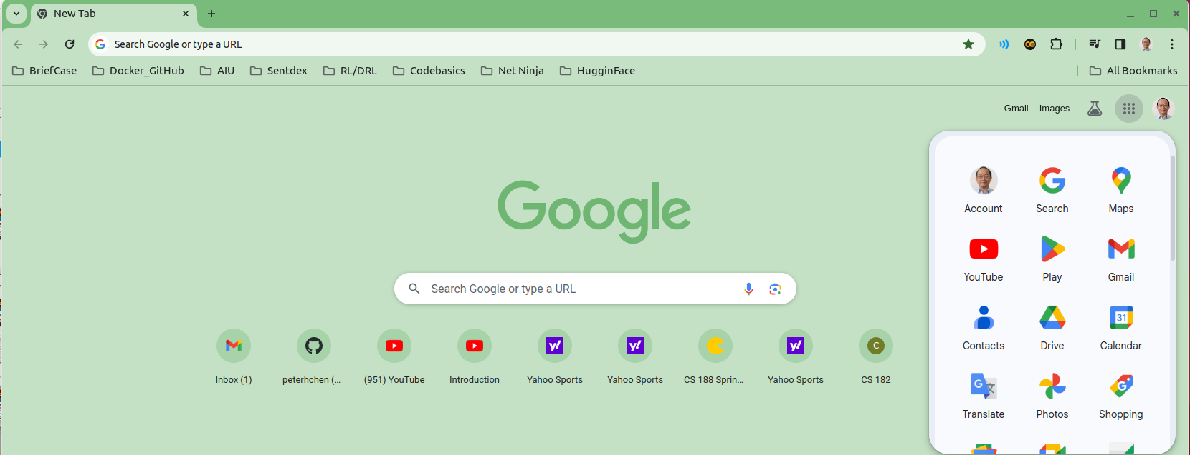
001 Google Colab: Introduction
https://www.youtube.com/watch?v=oCngVVBSsmA&list=PLtqF5YXg7GLlAkFCnMedsu_RzW47kR0Nc&index=1
Google Colab: Introduction (0:00-0:30/10:14)
Google Colab is a cloud computing platform for data science project.
Before we start the “Google Colab”, make sure we have created a gmail account and signed in gmail account.
We should have “Google Drive” (5 GB free) for Google Colab code.

Slide 3
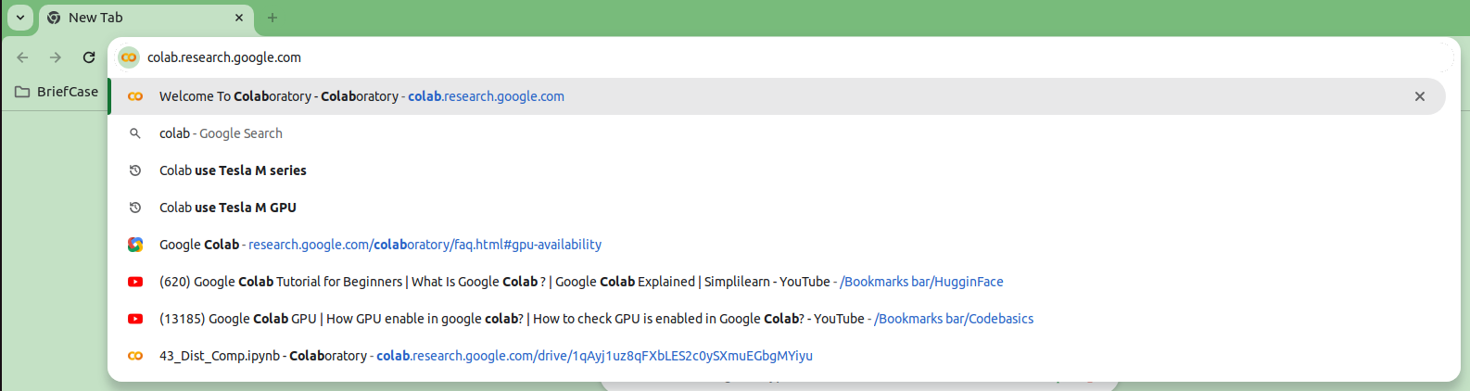
001 Google Colab: Introduction
https://www.youtube.com/watch?v=oCngVVBSsmA&list=PLtqF5YXg7GLlAkFCnMedsu_RzW47kR0Nc&index=1
Google Colab: Introduction (0:00-0:30/10:14)
Google Colab is a cloud computing platform for data science project.
1. Open Chrome
2. > Colab # colab.research.google.com will automatically prompted <enter>

Slide 4
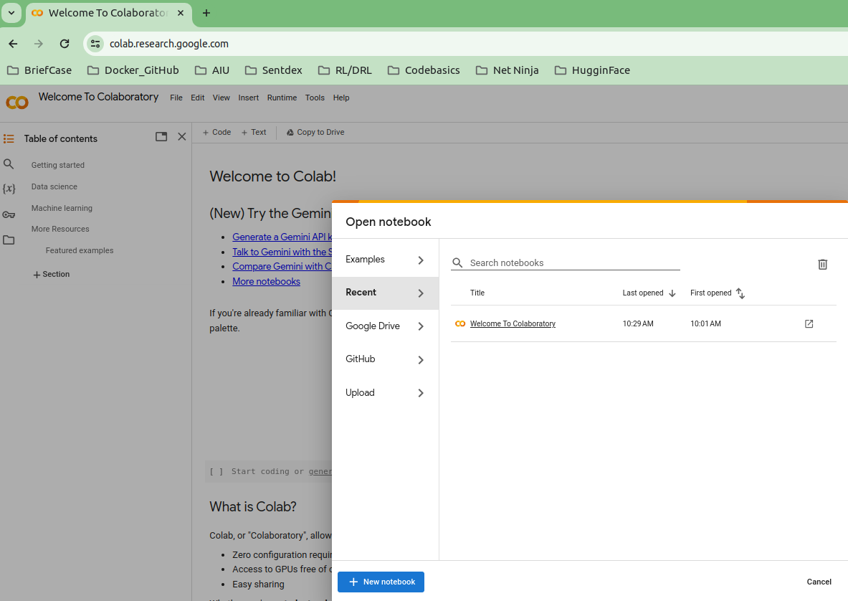
001 Google Colab: Introduction
https://www.youtube.com/watch?v=oCngVVBSsmA&list=PLtqF5YXg7GLlAkFCnMedsu_RzW47kR0Nc&index=1
Google Colab: Introduction (0:43-0:50/10:14)
Before you do the coding, you have to create gmail account and sign in.
1. Click “Welcome To Colaboratory”, to see the “Google Colab Introduction”,
2. Click “+ New notebook” to start the “Jupyter Notebook” coding,

Slide 5
001 Google Colab: Introduction
https://www.youtube.com/watch?v=oCngVVBSsmA&list=PLtqF5YXg7GLlAkFCnMedsu_RzW47kR0Nc&index=1
Google Colab: Introduction (1:01-1:20/10:14)
On the left hand pans, we have
1. Examples: Jupyter Notebook Code examples
2. Recent: Recent created codes
3. Google Drive: The codes you saved on Google Drive
4. GitHub: Upload file from GitHub
5. Upload: Upload files from local drive to Google Drive.

Slide 6
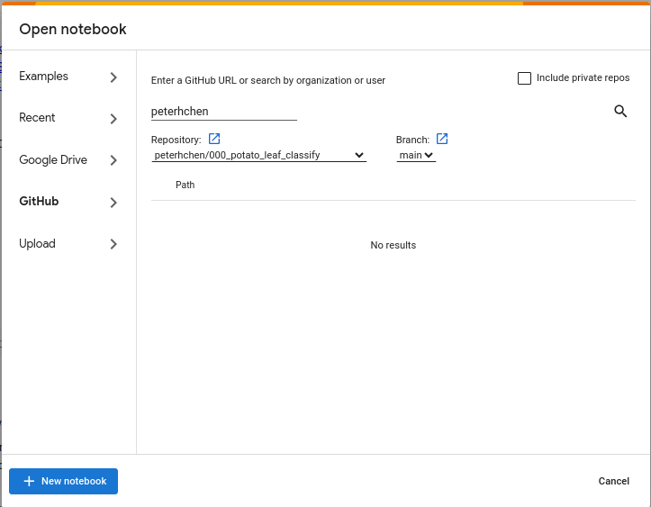
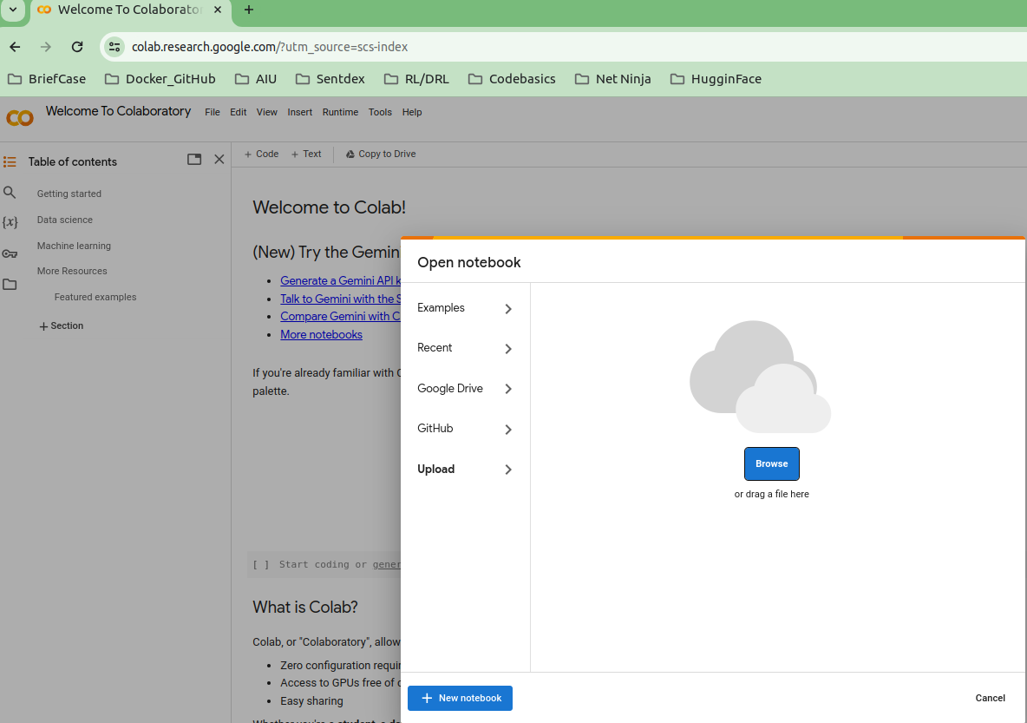
001 Google Colab: Introduction
https://www.youtube.com/watch?v=oCngVVBSsmA&list=PLtqF5YXg7GLlAkFCnMedsu_RzW47kR0Nc&index=1
Google Colab: Introduction (1:01-1:30/10:14)
1. If we click “github”,
> peterhchen
I will go to my “peterhchen github” account.
Click :Repository”, Colab will browse your github repository.
You can download the files from github.
2. If we click “Upload”, then we can upload the local drive to the “Google Drive”.

Slide 7
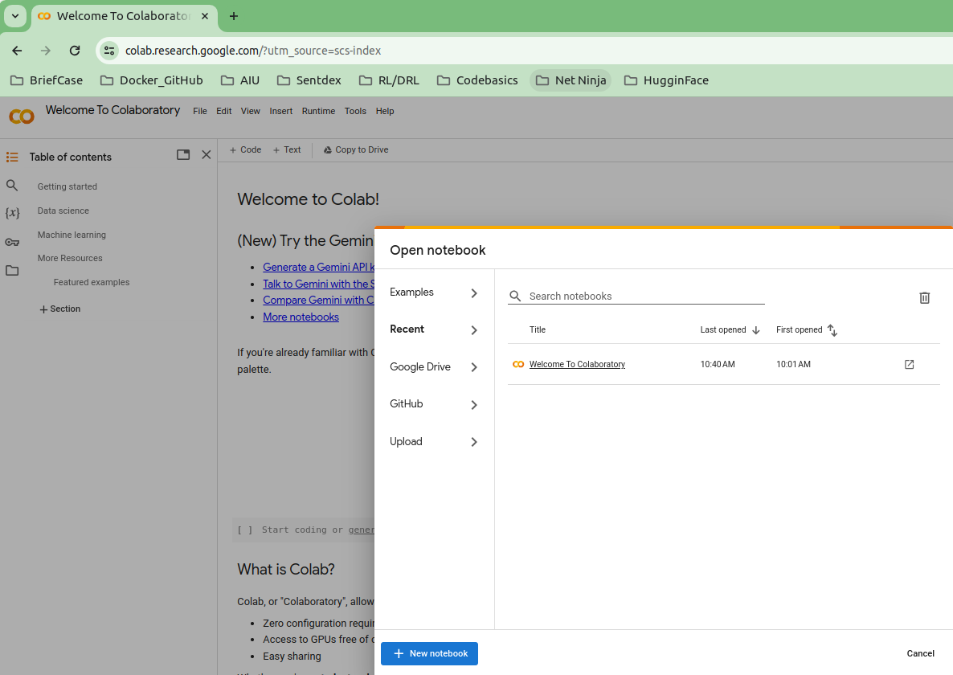
001 Google Colab: Introduction
https://www.youtube.com/watch?v=oCngVVBSsmA&list=PLtqF5YXg7GLlAkFCnMedsu_RzW47kR0Nc&index=1
Google Colab: Introduction (1:43-1:44/10:14)
Now,
1. We click Google Chrome Refresh to to back to the top of Colab.
2. We click “+ New notebook” to start the “Jupyter Notebook” coding.

Slide 8
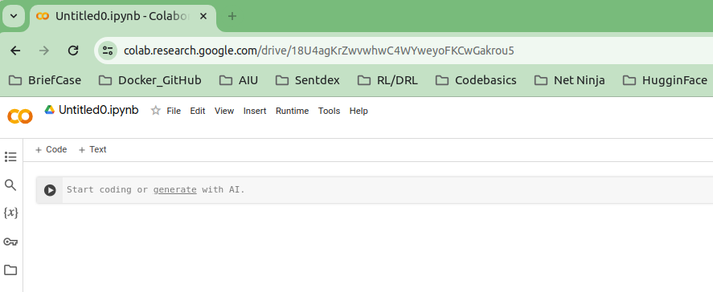
001 Google Colab: Introduction
https://www.youtube.com/watch?v=oCngVVBSsmA&list=PLtqF5YXg7GLlAkFCnMedsu_RzW47kR0Nc&index=1
Google Colab: Introduction (1:45-1:46/10:14)
Now, we can start the “Jupyter Notebook” coding on Colab.
Python interpreter provides two mode: Script mode and Interactive Mode.
Jupyter Notebook uses Python’s Interactive Mode. Jupyter Notebook can create and run in separated interactive cells.
We can create Code or Text in separated cells.
1. Code: Python code can be created in separated Cells or
2. Text: Document in separated cells
3. Start enter your code and run from here.

Slide 9
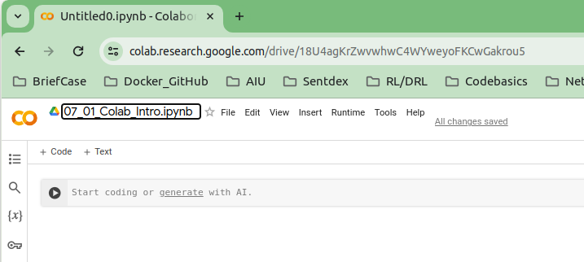
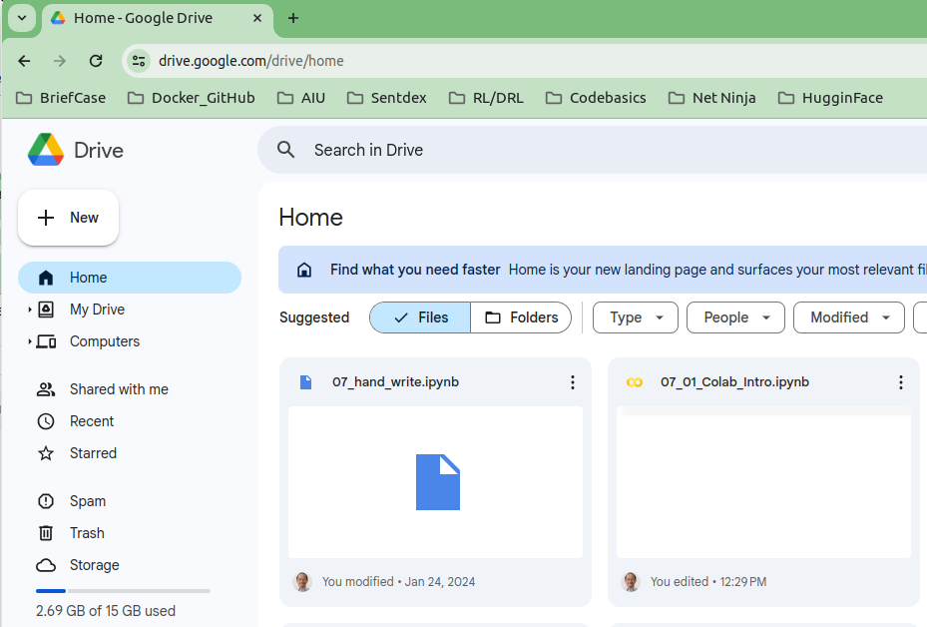
001 Google Colab: Introduction
https://www.youtube.com/watch?v=oCngVVBSsmA&list=PLtqF5YXg7GLlAkFCnMedsu_RzW47kR0Nc&index=1
Google Colab: Introduction (1:47-1:50/10:14)
1. Give the name of “01_01_Colab_Intro.ipynb” (file extension “ipynb” stands for for “Interactive Python Notebook”)
2. You can check Google Drive. There is a file “07_01_Colab_Intro.ipynb” is created.
1
2

Slide 10
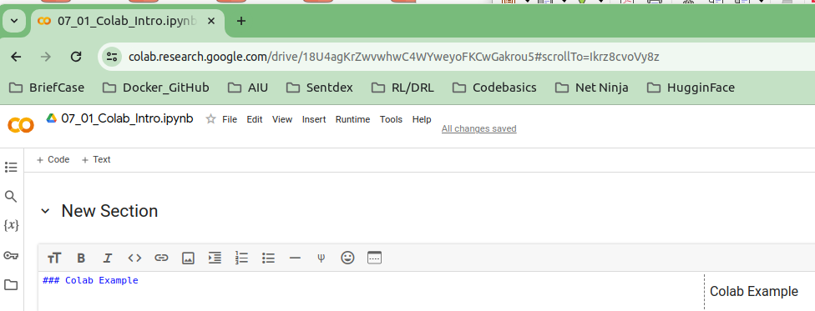
001 Google Colab: Introduction
https://www.youtube.com/watch?v=oCngVVBSsmA&list=PLtqF5YXg7GLlAkFCnMedsu_RzW47kR0Nc&index=1
Google Colab: Introduction (1:47-2:10/10:14)
1. Click “+ Test” to add a text cell for document.
2. You type in markdown format “### Colab Example”. The right hand side display the display of “markdown” format.

Slide 11
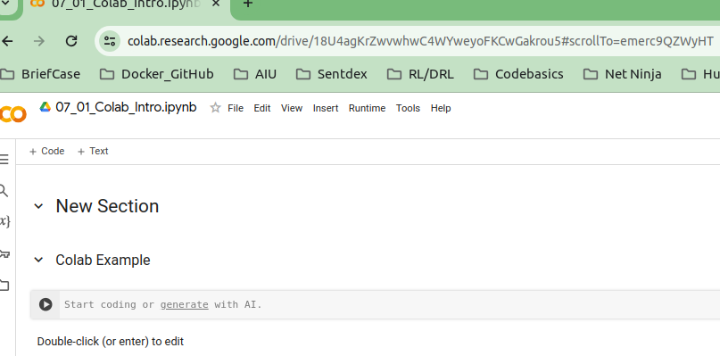
001 Google Colab: Introduction
https://www.youtube.com/watch?v=oCngVVBSsmA&list=PLtqF5YXg7GLlAkFCnMedsu_RzW47kR0Nc&index=1
Google Colab: Introduction (3:01-5:00/10:14)
1. Click “+ Code” to add a Code cell for document.

Slide 12
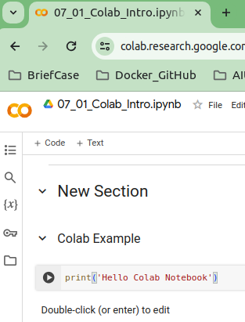
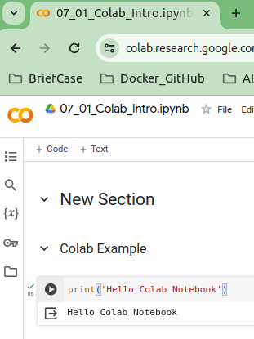
001 Google Colab: Introduction
https://www.youtube.com/watch?v=oCngVVBSsmA&list=PLtqF5YXg7GLlAkFCnMedsu_RzW47kR0Nc&index=1
Google Colab: Introduction (5:01-10:14/10:14)
1. Add “print (‘Hello Colab Notebook’)”
2. “Control+Enter” to run or click “>” to run.
1
2

Slide 13
End

