Slide 1

17 CPU vs. GPU Benchmark
Peter H. Chen

Slide 2
17 CPU vs. GPU Benchmark
https://www.youtube.com/watch?v=YmDaqXMIoeY&list=PLeo1K3hjS3uu7CxAacxVndI4bE_o3BDtO&index=17
CPU vs. GPU Benchmark (0:00-0:30/23:57)
We discuss the CPU vs. GPU Benchmark with ANN. We take 60,000 small images and classify them by ANN (Artificial Neural network).
In this discussion, we use ANN to benchmark the CPU/GPU. We do not use CNN (Convolutional Neural Network) because we do not discussed CNN yet. In CNN, we do extract the image features to reduce the computation speed.
We train model by CPU first and then run by NVIDIA RTX Titan and Google Colab.
We compare the CPU and GPU benchmark result shows
1. NVIDIA RTX Titan is 15 times faster then CPU, 1 Epoch and 10 Epochs, respectively.
2. Colab TPU/GPU is 11 to 16 faster than CPU, 1 Epoch and 10 Epochs, respectively.
Whatever you have on your computer, you can see the speed difference.

Slide 3
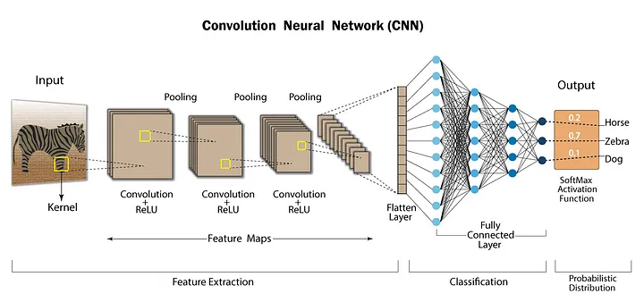
17 CPU vs. GPU Benchmark
https://www.youtube.com/watch?v=YmDaqXMIoeY&list=PLeo1K3hjS3uu7CxAacxVndI4bE_o3BDtO&index=17
CPU vs. GPU Benchmark (0:31-1:00/23:57)
Below diagram shows the difference between ANN and CNN:
1. ANNs (Artificial Neural Networks) are linear stack of neurons to solve complex problems.
2. CNNs (Convolution Neural Networks): CNN = ANN + feature extraction filter. CNNs are used to solve Computer Vision-related problems to reduce computation time.
ANN
Feature Extraction Filter

Slide 4
17.1 Import Libraries

Slide 5
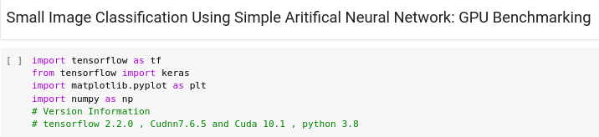
17.1 Import Libraries
https://www.youtube.com/watch?v=YmDaqXMIoeY&list=PLeo1K3hjS3uu7CxAacxVndI4bE_o3BDtO&index=17
Import Libraries (1:01-1:15/23:57)
First, we import the Frameworks and libraries

Slide 6
17.2 Verify Physical Device

Slide 7
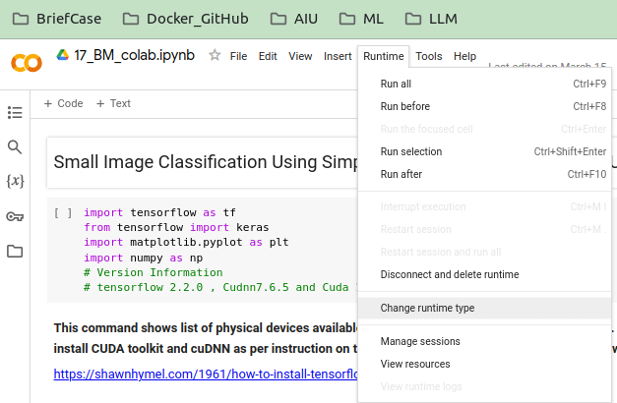
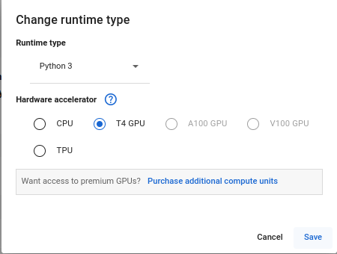
17.2 Verify Physical Device
https://www.youtube.com/watch?v=YmDaqXMIoeY&list=PLeo1K3hjS3uu7CxAacxVndI4bE_o3BDtO&index=17
Verify Physical Device (1:01-1:30/23:57)
Before we start, we need make sure the what are the physical devices available on computer.
We have both CPU and GPU on Colab.
This step is very important.
By default, colab run CPU mode only. If you only setup with CPU Mode, Colab will not warning you errors if you try to use use GPU device to run.
If you do not setup GPU mode, the GPU results will be same as CPU results.

Slide 8
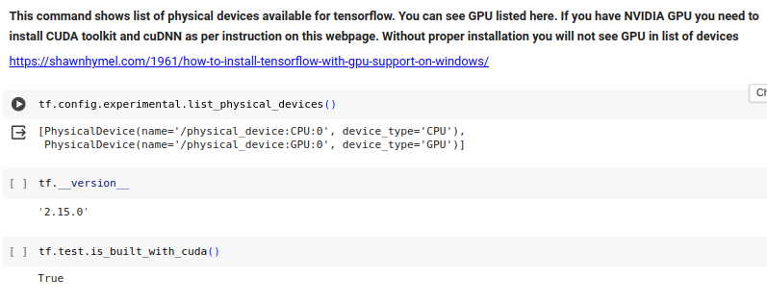
17.2 Verify Physical Device
https://www.youtube.com/watch?v=YmDaqXMIoeY&list=PLeo1K3hjS3uu7CxAacxVndI4bE_o3BDtO&index=17
Verify Physical Device (1:31-1:35/23:57)
Check the physical devices contain the CPU and GPU. If you computer has GPU, you need to install Cuda Toolkit and cuDNN library.
1. Cuda Toolkit is a software development kit for parallel computing.
2. CuDNN library is a GPU-accelerated Deep Neural Network Library for deep neural networks. CuDNN is built on top of the CUDA Toolkit.
Both Libraries are required for Google tensorflow and Meta PyTorch for Neural Network/Deep Learning.

Slide 9
17.2 Verify Physical Device
https://www.youtube.com/watch?v=YmDaqXMIoeY&list=PLeo1K3hjS3uu7CxAacxVndI4bE_o3BDtO&index=17
Verify Physical Device (1:36-2:00/23:57)
1. Only installed both Cuda Toolkit and cuDNN, you can see both CPU and GPU physical devices on your computer.
2. Since Google Colab already installed Cuda Toolkit and CuDNN Library for us, we do not have to install Cuda Toolkit and CuDNN.
3. Since Tensorflow is built based on Cuda, we can verify test.is_built_with_cuda() is True.

Slide 10
17.3 SMI, Cuda Toolkit, and CuDNN

Slide 11
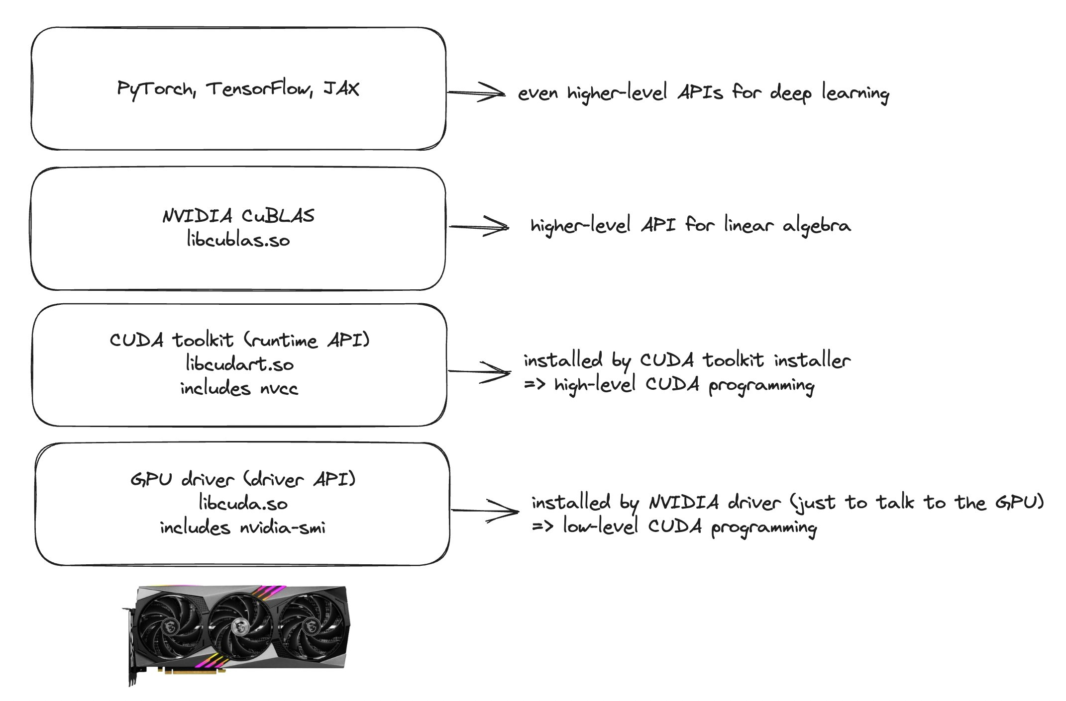
17.3 SMI, Cuda Toolkit, and CuDNN
https://www.youtube.com/watch?v=YmDaqXMIoeY&list=PLeo1K3hjS3uu7CxAacxVndI4bE_o3BDtO&index=17
SMI, Cuda Toolkit, and CuDNN (2:01-2:10/23:57)
Hierarchical diagram from NVIDIA “Robert Crovella”.
a. CuDNN (Deep Learning High Level API): Google Framework Tensorflow, Meta Library PyTorch
b. NVIDIA CuBLAS share library: libcublas.so
c. NVIDIA Cuda Toolkit (run-time API): libcudart.so (include NVCC).
d. NVIDIA SMI (hardware GPU driver API): libcuda.so (include NVIDIA-SMI).
https://stackoverflow.com/questions/53422407/different-cuda-versions-shown-by-nvcc-and-nvidia-smi#:~:text=You%20may%20need%20to%20adjust,a%20GPU%20driver%20install%20alone.)

Slide 12
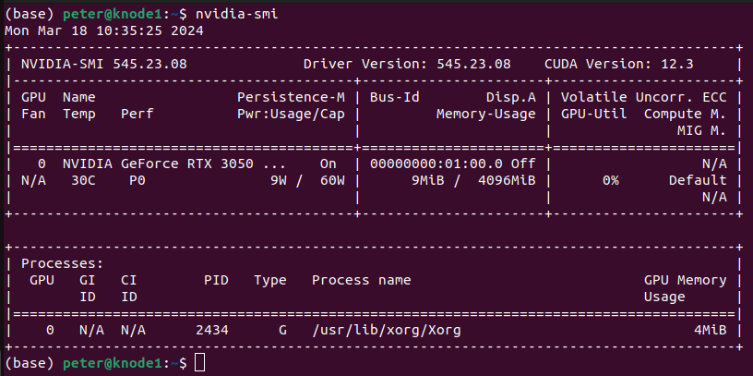
17.3 SMI, Cuda Toolkit, and CuDNN
https://www.youtube.com/watch?v=YmDaqXMIoeY&list=PLeo1K3hjS3uu7CxAacxVndI4bE_o3BDtO&index=17
SMI, Cuda Toolkit, and CuDNN (2:21-2:30/23:57)
What is difference between SMI (System Management Interface), Cuda Toolkit library, and CuDNN Library.
NVIDIA hardware driver comes with each external GPU accelerator (Graphic Card), such as, RTX, GeForce, etc.
What is the command to check the NVIDIA Hardware Driver (or SMI)?
Check Cuda Version in NVIDIA SMI (System Management Interface)
> nvidia-smi
We have Cuda Version installed from NVIDIA Hardware:
Cuda Version: 12.3

Slide 13
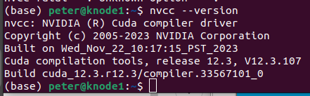
17.3 SMI, Cuda Toolkit, and CuDNN
https://www.youtube.com/watch?v=YmDaqXMIoeY&list=PLeo1K3hjS3uu7CxAacxVndI4bE_o3BDtO&index=17
SMI, Cuda Toolkit, and CuDNN (2:01-2:50/23:57)
Check Cuda Version in Cuda Toolkit:
> nvcc –version
>> 12.3
>> Here, we have same Cuda Version (12.3) for both SMI (Hardware GPU release) and Toolkit (Software API release for CuDNN, Tensorflow, and PyTorh)
Question: Different Cuda Version shown by NVCC and NVIDIA-SMI?
If there is a new hardware release, you may get newer cuda version of SMI than Cuda Toolkit Version

Slide 14
17.4 CIFAR10 Dataset

Slide 15
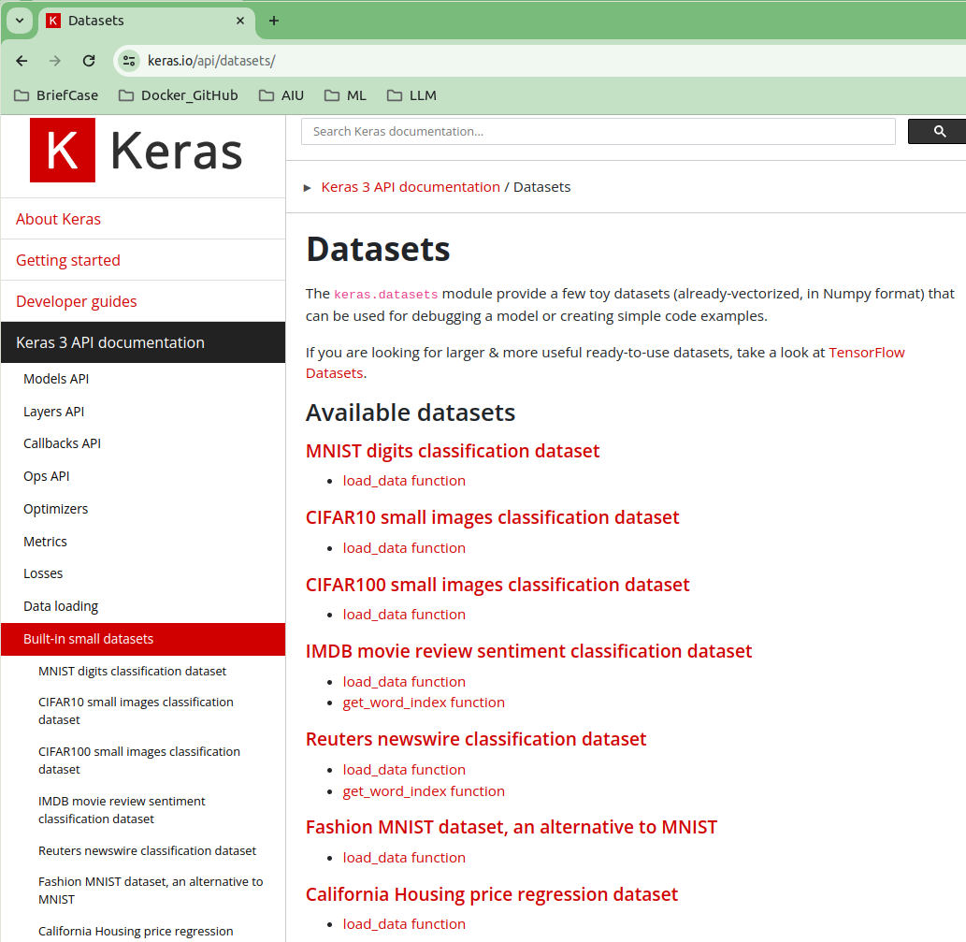
17.4 CIFAR10 Dataset
https://www.youtube.com/watch?v=YmDaqXMIoeY&list=PLeo1K3hjS3uu7CxAacxVndI4bE_o3BDtO&index=17
CIFAR10 Dataset (3:05-3:10/23:57)
Now, we have to load the dataset.
Google search “keras dataset”
https://keras.io/api/datasets/
Click the CIFAR10 (Canadian Institute For Advanced Research: 10 Target Labels) for small image classification.

Slide 16
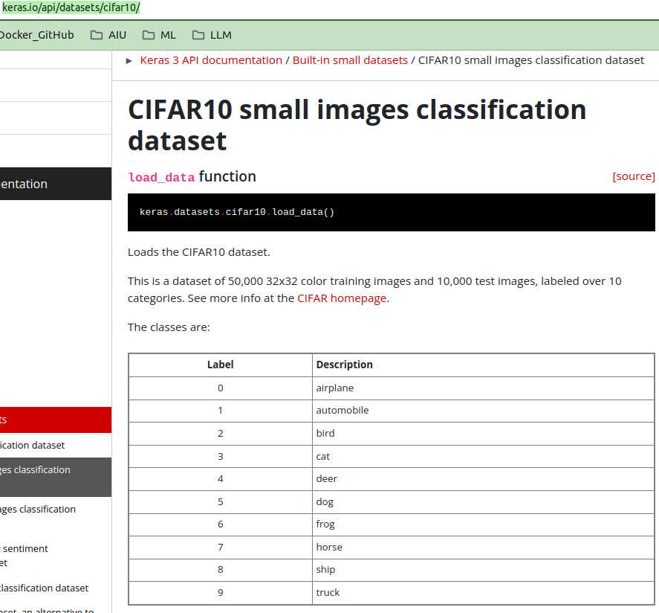
17.4 CIFAR10 Dataset
https://www.youtube.com/watch?v=YmDaqXMIoeY&list=PLeo1K3hjS3uu7CxAacxVndI4bE_o3BDtO&index=17
CIFAR10 Dataset (3:11-3:15/23:57)
https://keras.io/api/datasets/cifar10/
There are 10 target labels:
0: airplane
1: automobile
2: bird
3: cat
4: deer
5: dog
6: frog
7: horse
8: ship
9: truck
Click the “CIFAR homepage”

Slide 17
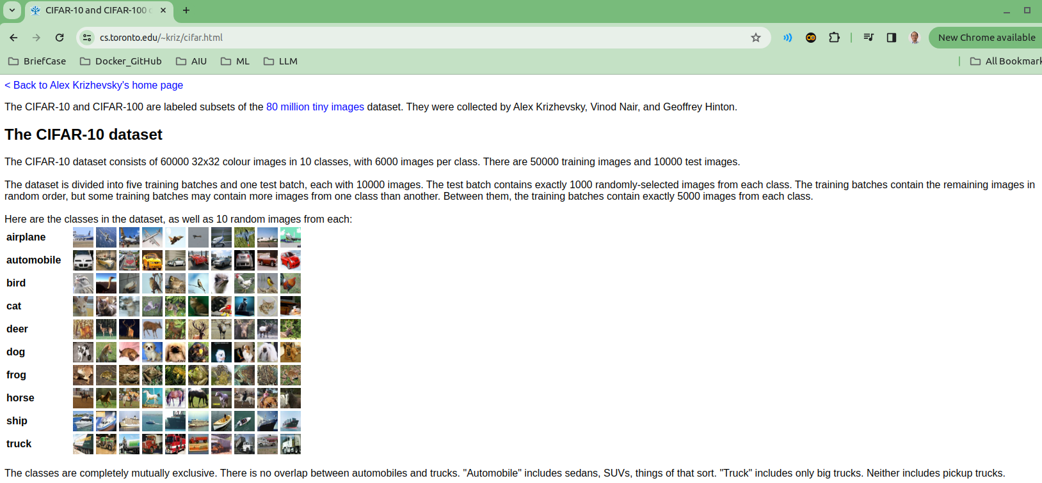
17.4 CIFAR10 Dataset
https://www.youtube.com/watch?v=YmDaqXMIoeY&list=PLeo1K3hjS3uu7CxAacxVndI4bE_o3BDtO&index=17
CIFAR10 Dataset (3:21-3:30/23:57)
https://www.cs.toronto.edu/~kriz/cifar.html
The CIFAR-10 Dataset are 60,000 32x32 small color images with 10 target labels.
60,000 images with 50,000 training images and 10,000 test images.
Images are divided into 5 training batches and on test batch. Each batch is 10,000 images.

Slide 18
17.4 CIFAR10 Dataset
https://www.youtube.com/watch?v=YmDaqXMIoeY&list=PLeo1K3hjS3uu7CxAacxVndI4bE_o3BDtO&index=17
CIFAR10 Dataset (3:21-4:00/23:57)
https://www.cs.toronto.edu/~kriz/cifar.html
The images are airplane, automobile, bird, etc. We will do the image classification using ANN (Artificial Neural Network). Here, we do not use CNN (Convolutional Neural Network) which is typically use for image classification with filter for feature extraction to reduce the run time. We will do CNN later on.
We do ANN and run for both CPU and GPU performance test and benchmark the results.

Slide 19
17.5 Load Sample

Slide 20
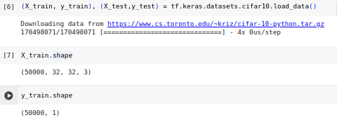
17.5 Load Sample
https://www.youtube.com/watch?v=YmDaqXMIoeY&list=PLeo1K3hjS3uu7CxAacxVndI4bE_o3BDtO&index=17
Load Sample (4:01-4:40/23:57)
Let’s load the CIFAR-10 Dataset.
We
1. load the dataset
2. Check X_train and y_train dimension.
We can see that we have 50,000 of training samples.
The image size is 32 x 32 x 3 (RGB colors).

Slide 21
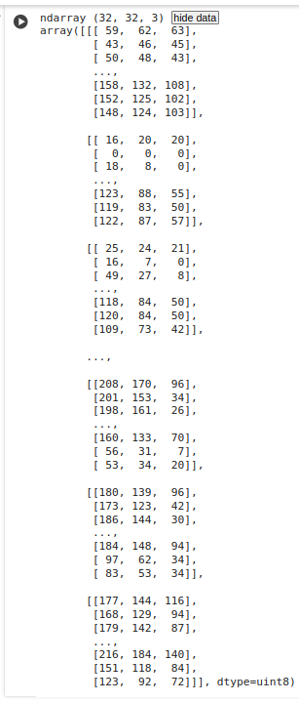

17.5 Load Sample
https://www.youtube.com/watch?v=YmDaqXMIoeY&list=PLeo1K3hjS3uu7CxAacxVndI4bE_o3BDtO&index=17
Load Sample (4:41-4:50/23:57)
We check the first image.
1. Click “show data” to see the data content.
2. Click “hide data” to see the small image.

Slide 22
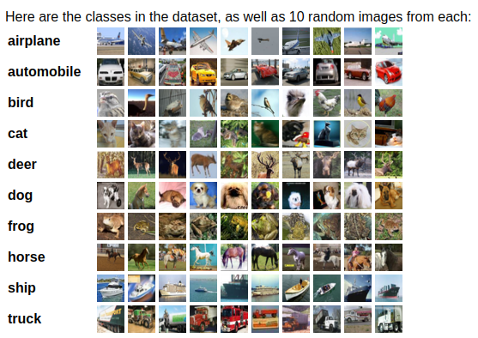
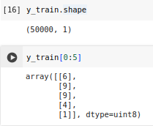
17.5 Load Sample
https://www.youtube.com/watch?v=YmDaqXMIoeY&list=PLeo1K3hjS3uu7CxAacxVndI4bE_o3BDtO&index=17
Load Sample (5:11-5:50/23:57)
1. Check for y_train.shape.
2. Check the target label index of y_train[0:5] = [[6], [9], [9], [4], [1]]
[[6], [9], [9], [4], [1]] means [[“frog”], [“truck”], [“truck”], [“deer”], [“airplane”]], respectively.
0
1
2
3
4
5
6
7
8
9

Slide 23
17.6 Data Visualization

Slide 24
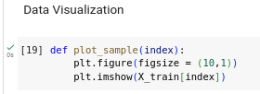
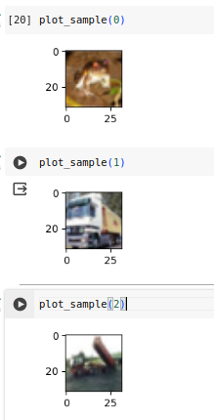
17.6 Data Visualization
https://www.youtube.com/watch?v=YmDaqXMIoeY&list=PLeo1K3hjS3uu7CxAacxVndI4bE_o3BDtO&index=17
Data Visualization (5:56-6:30/23:57)
Let’s verify the image one by one.
We define a function called “plot_image” to show the image with index.
We have [[6], [9], [9], [4], [1]] means [[“frog”], [“truck”], [“truck”], [“deer”], [“airplane”]]
We can verify:
1. plot_image[0] = “frog”.
2. plot_image[1] = “truck”.
3. plot_image[2] = “truck”

Slide 25
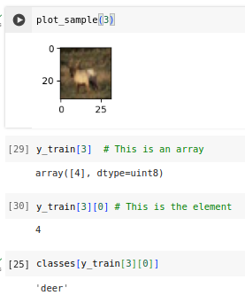
17.6 Data Visualization
https://www.youtube.com/watch?v=YmDaqXMIoeY&list=PLeo1K3hjS3uu7CxAacxVndI4bE_o3BDtO&index=17
Data Visualization (6:31-7:40/23:57)
To make convenient, we define the “classes” = [“airplane”, “automobile”, “bird”, “cat”, “deer”, “dog”, “frog”. “horse”, “ship”, “truck”].
We have [[6], [9], [9], [4], [1]] means [[“frog”], [“truck”], [“truck”], [“deer”], [“airplane”]]
We can verify:
1. plot_image[3] = “deer”.
2. y_train[3] is an array. y_train[3][0] is an element.
3. class[y_train[3][0]]
These are the data visualization.

Slide 26
17.7 Preprocessing: Scale Images

Slide 27
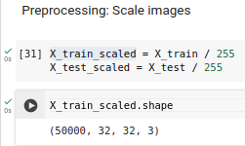
17.7 Preprocessing: Scale Images
https://www.youtube.com/watch?v=YmDaqXMIoeY&list=PLeo1K3hjS3uu7CxAacxVndI4bE_o3BDtO&index=17
Preprocessing: Scale Image (7:41-9:00/23:57)
When we scale the image, the model prediction is better.
In numpy array, we can divide the training samples by 255.
Why 255?
The RGB values are in the range of 0 to 255.
We normalize the value to 0 to 1.

Slide 28
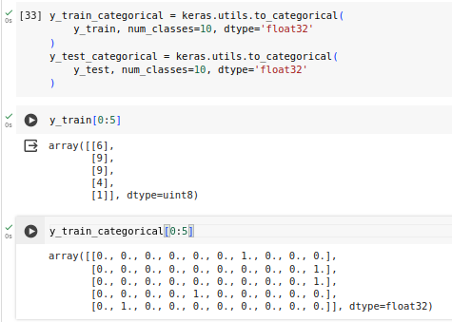
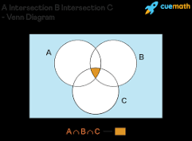
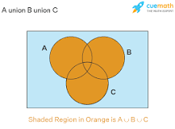
17.7 Preprocessing: Scale Images
https://www.youtube.com/watch?v=YmDaqXMIoeY&list=PLeo1K3hjS3uu7CxAacxVndI4bE_o3BDtO&index=17
Preprocessing: Scale Image (9:01-10:05/23:57)
We do the one-hot encoding here.
We have y_train[0:5] = [[6], [9], [9], [4], [1]]
Why do we want to one-hot encoding?
1. We want to operate the set operation (intersection, union, etc) with “+”, “-” operation. Each member of set has to be the unique number so that we can perform the set operation without overlapping.
2. Each categorical variables as numerical values in a machine learning model.

Slide 29
17.7 Preprocessing: Scale Images
https://www.youtube.com/watch?v=YmDaqXMIoeY&list=PLeo1K3hjS3uu7CxAacxVndI4bE_o3BDtO&index=17
Preprocessing: Scale Image (10:07-10:30/23:57)
We have total 10 classes in categorical.
Instead of 6, we have [0, 0, 0, 0, 0, 0, 1, 0, 0, 0]
Instead of 9, we have [0, 0, 0, 0, 0, 0, 0, 0, 0, 1]
The number are are unique so that we can do the algebraic operation (+, -, etc) for the set attribute (for example, “queen” = “woman” + “king”) operation without confusion and without mistake.

Slide 30
17.8 Model Building and Training

Slide 31
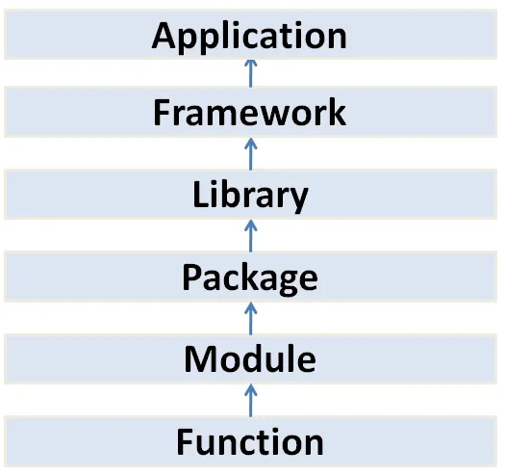
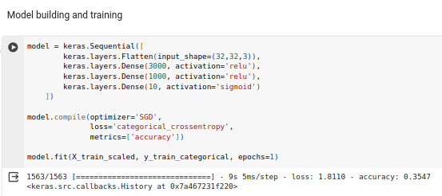
17.8 Model Building and Training
https://www.youtube.com/watch?v=YmDaqXMIoeY&list=PLeo1K3hjS3uu7CxAacxVndI4bE_o3BDtO&index=17
Model Building and Training (10:31-16:00/23:57)
Here, we use keras to build the model.
Here, our input feature is (32 x 32 x 3)
Hidden layers 3000 and 1000 are trial and error.
Output is 10 classes.
We use optimizer “SGD” and epoch = 1.
Google Tensorflow,
Keras

Slide 32
17.9 Make Prediction

Slide 33
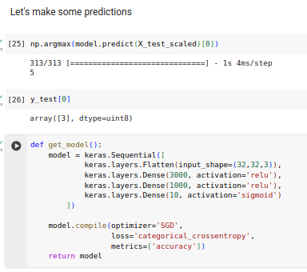
17.9 Make Prediction
https://www.youtube.com/watch?v=YmDaqXMIoeY&list=PLeo1K3hjS3uu7CxAacxVndI4bE_o3BDtO&index=17
Make Prediction (16:01-18:20/23:57)

Slide 34
17.10 Train with CPU: 1 Epoch

Slide 35
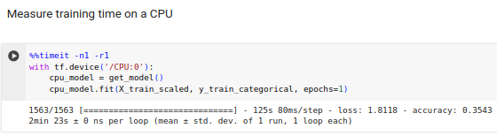
17.10 Train with CPU: 1 Epoch
https://www.youtube.com/watch?v=YmDaqXMIoeY&list=PLeo1K3hjS3uu7CxAacxVndI4bE_o3BDtO&index=17
Train with CPU: 1 Epoch (18:21-20:40/23:57)
1. We need to specify tf.device(‘CPU:0’)
2. We need to measure the time with “%%timeit -n1 -r1”
143 sec (2min 23 sec)
1. What is the command “%%” in Jupyter notebook?
“%%” is the magic command to capture the output of a cell.
2. What is the command “%%timeit” in Jupyter notebook?
%%timeit measures the execution time of the entire cell.
3. What is “n1” and “r1”?
a. n1: n (Execute statement) “1” time. We only run one time.
b. r1: r (repeat the timer) “1” time. We only measure the time one time (at the end).

Slide 36
17.11 Train with GPU: 1 Epoch

Slide 37
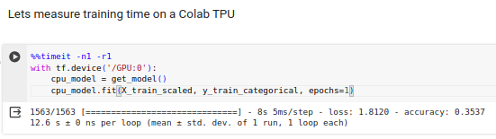
17.11 Train with GPU: 1 Epoch
https://www.youtube.com/watch?v=YmDaqXMIoeY&list=PLeo1K3hjS3uu7CxAacxVndI4bE_o3BDtO&index=17
Train with GPU: 1 Epoch (20:21-21:20/23:57)
12.6 sec

Slide 38
17.12 Train with CPU: 10 Epoch

Slide 39
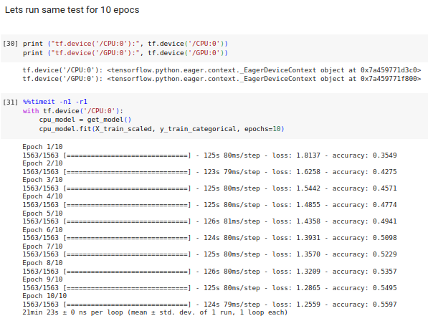
17.12 Train with CPU: 10 Epoch
https://www.youtube.com/watch?v=YmDaqXMIoeY&list=PLeo1K3hjS3uu7CxAacxVndI4bE_o3BDtO&index=17
Train with CPU: 10 Epoch (21:21-22:20/23:57)
1283 sec (21 min 23 sec)

Slide 40
17.13 Train with GPU: 10 Epochs

Slide 41
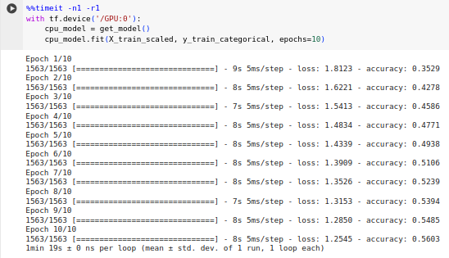
17.13 Train with GPU: 10 Epoch
https://www.youtube.com/watch?v=YmDaqXMIoeY&list=PLeo1K3hjS3uu7CxAacxVndI4bE_o3BDtO&index=17
Train with GPU: 10 Epoch (21:21-21:30/23:57)
79 sec (1 min 19 sec)

Slide 42
17.14 Summary

Slide 43
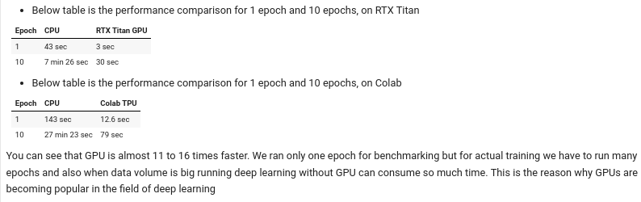
17.14 Summary
https://www.youtube.com/watch?v=YmDaqXMIoeY&list=PLeo1K3hjS3uu7CxAacxVndI4bE_o3BDtO&index=17
Summary (21:21-21:35/23:57)
CPU/NVIDA RTX GPU Benchmark:
Colab CPU/GPU Benchmark:
Epoch | CPU (sec) | GPU (sec) | Benchmark
1 | 44.5 | 3.6 | 44.5/3.6 = 12.36
10 | 446 (7 min 26 sec) | 30 | 446/30 = 14.8
Epoch | CPU (sec) | Colab TPU (sec) | Benchmark
1 | 143 sec (2min 23 sec) | 12.6 | 143/12.6 = 11.3
10 | 1643 (27 min 23 sec) | 79 | 1683/79 = 16.2

Slide 44
17.15 Exercise

Slide 45
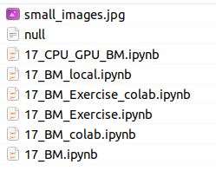

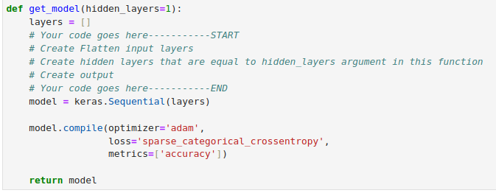
17.15 Exercise
https://www.youtube.com/watch?v=YmDaqXMIoeY&list=PLeo1K3hjS3uu7CxAacxVndI4bE_o3BDtO&index=17
Exercise (21:37-23:57/23:57)
Below, we have exercise in the Benchmark code for colab.
1. In stead of CIFAR-10, we use MNIST fashion.
2. Create 1 Hidden Layer
3. Create 5 Hidden Layers.
model = Sequential(...)
model.add(Dense(500, activation='relu'))
model.add(Dense(1))
model = Sequential(...)
model.add(Dense(50, activation='relu'))
model.add(Dense(500, activation='relu'))
model.add(Dense(300, activation='relu'))
model.add(Dense(100, activation='relu'))
model.add(Dense(50, activation='relu'))
model.add(Dense(1))

Slide 46
End

