Slide 1

30 week 14 review Transfer Learning
Peter H. Chen

Slide 2
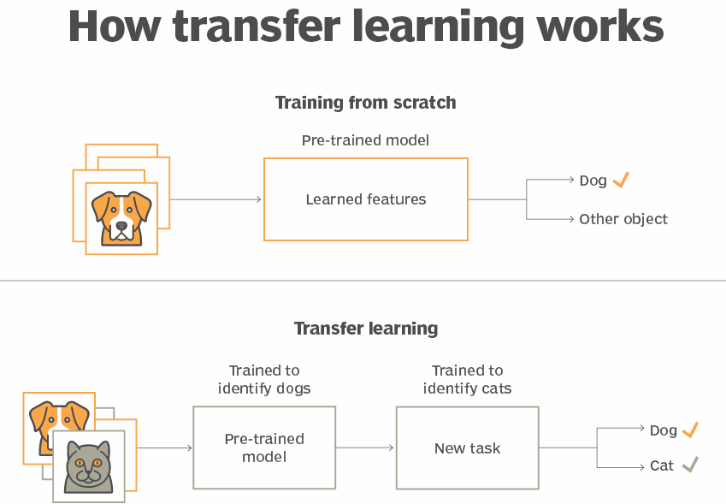
27 Transfer Learning
https://www.youtube.com/watch?v=LsdxvjLWkIY&list=PLeo1K3hjS3uu7CxAacxVndI4bE_o3BDtO&index=27
Introduction to Transfer Learning (0:00-0:05/25:54)
What is transfer Learning?
1. Transfer of learning uses the previously acquired knowledge and fine-tune with new knowledge for future prediction or classification.
2. The similarities and analogies between previous and current learning content and processes are important and play a crucial role.
3. For example, Using transfer learning, a model that is pre-trained for identifying dogs can be used to identify cats.

Slide 3
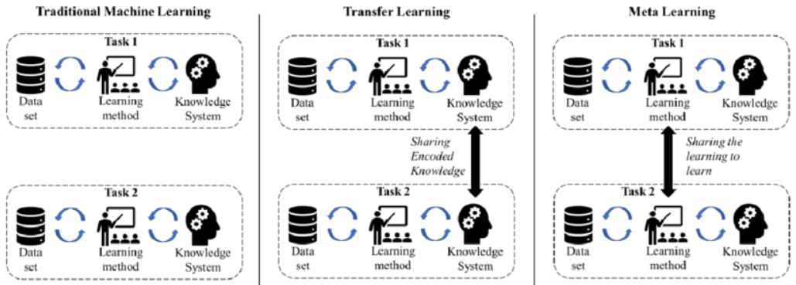
27 Transfer Learning
https://www.youtube.com/watch?v=LsdxvjLWkIY&list=PLeo1K3hjS3uu7CxAacxVndI4bE_o3BDtO&index=27
Introduction to Transfer Learning (0:06-0:10/25:54)
What is difference between Traditional Machine Learning, transfer learning and meta learning?
1. Traditional Machine Learning: Re-train the original weights and bias of neural network with new dataset. Take long time.
2. Transfer Learning: Keep the original weight and bias of neural network. Add new layer for new dataset.
3. Meta Learning: Learn (Share the learning) from output of another learning system.
https://www.researchgate.net/figure/Traditional-ML-versus-Transfer-Learning-versus-Meta-Learning_fig3_339895075

Slide 4
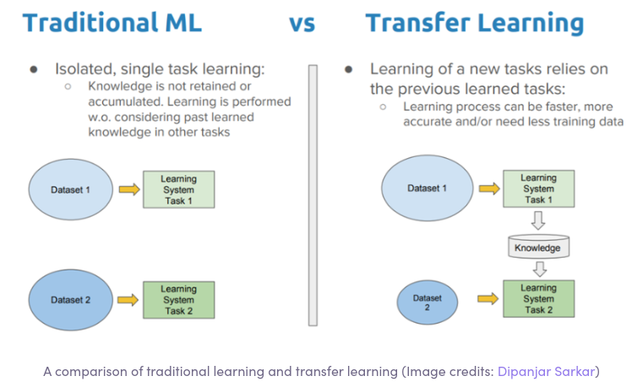
27 Transfer Learning
https://www.youtube.com/watch?v=LsdxvjLWkIY&list=PLeo1K3hjS3uu7CxAacxVndI4bE_o3BDtO&index=27
Introduction to Transfer Learning (0:11-0:15/25:54)
What is advantage of Transfer Learning vs traditional Machine Learning?
1. Neural networks are trained on large datasets of images to recognize objects.
2. However, this training and the use of huge datasets is a time-consuming process and a tedious one too. Use the transfer learning, we save time with pre-train Model and fine-tune for future model prediction or classification.

Slide 5
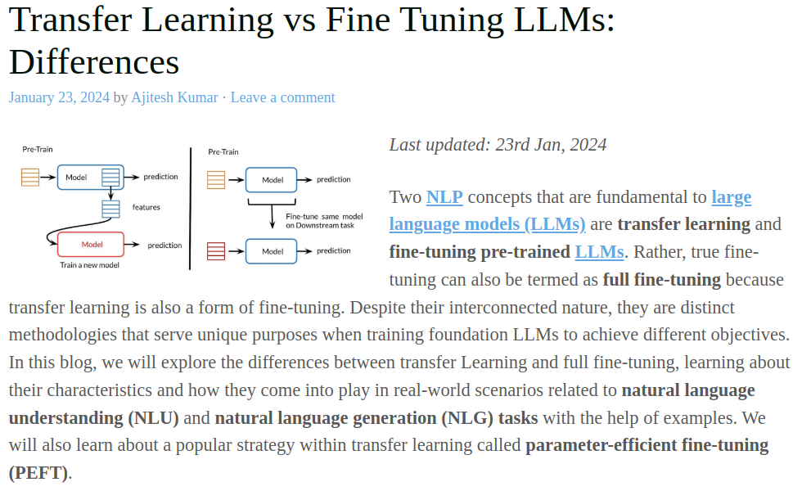
27 Transfer Learning
https://www.youtube.com/watch?v=LsdxvjLWkIY&list=PLeo1K3hjS3uu7CxAacxVndI4bE_o3BDtO&index=27
Introduction to Transfer Learning (0:16-0:20/25:54)
What is difference of Fine-Tune and Transfer Learning?
1. Transfer Learning is a kinds of fine-tuning.
2. Fine-Tune tune the parameter. Transfer learning fix the original parameters and add additional layers for new knowledge.
https://vitalflux.com/transfer-learning-vs-fine-tuning-differences/

Slide 6
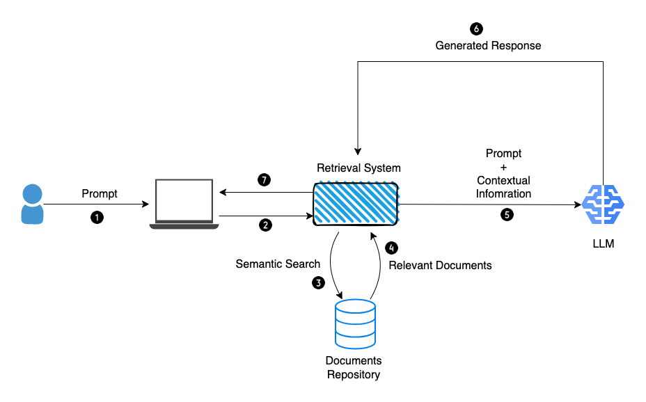
27 Transfer Learning
https://www.youtube.com/watch?v=LsdxvjLWkIY&list=PLeo1K3hjS3uu7CxAacxVndI4bE_o3BDtO&index=27
Introduction to Transfer Learning (0:21-0:25/25:54)
Is RAG a type of transfer learning?
1. RAG (Retrieval-Augmented Generation) is a transfer learning technique that enriches a generative model's training data by retrieving relevant documents from an external corpus.
2. The LLM (Large Language Model) Google Gemini, Meta Llama, and OpenAI GPT, are pre-trained Model. We can use transfer learning technique to fine-tune the pre-train Model with private Database.
3. The RAG (Retrival Augmented Generative) to improve the LLM by their internal private dataset.
https://blog.gopenai.com/retrieval-augmented-generation-101-de05e5dc21ef

Slide 7
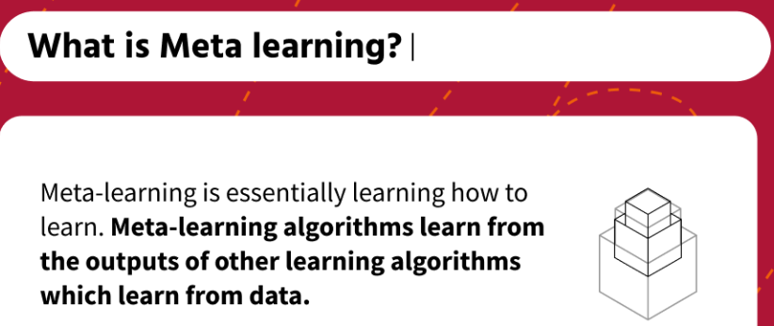
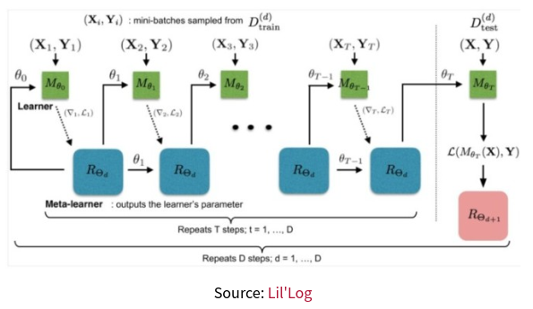
27 Transfer Learning
https://www.youtube.com/watch?v=LsdxvjLWkIY&list=PLeo1K3hjS3uu7CxAacxVndI4bE_o3BDtO&index=27
Introduction to Transfer Learning (0:25-0:30/25:54)
What is is meta learning?
Meta Learning learn (or share the learning or learn from summary) from output of other learning algorithms.
https://www.engati.com/glossary/meta-learning

Slide 8
27.16 Predict Flowers with Model MobileNet V2

Slide 9
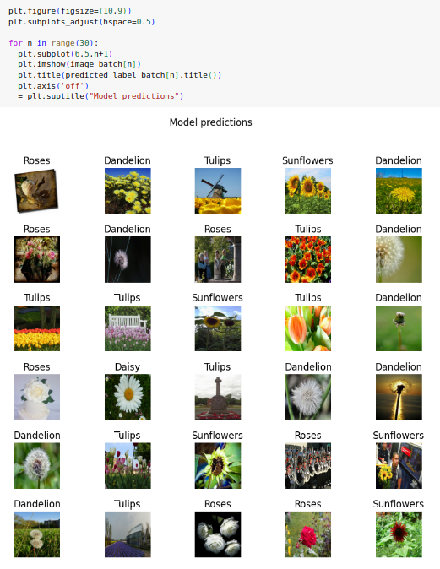
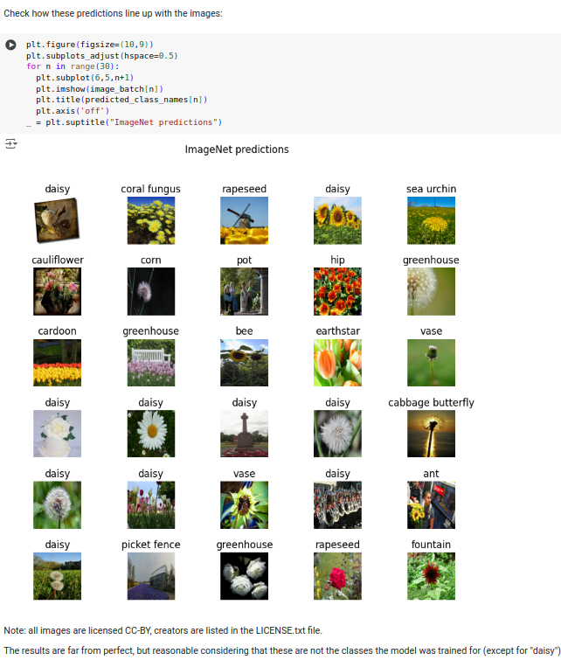
27.16 Predict Flowers with Model MobileNet V2
https://www.youtube.com/watch?v=LsdxvjLWkIY&list=PLeo1K3hjS3uu7CxAacxVndI4bE_o3BDtO&index=27
Predict Flowers with MobileNet V2 (20:31-21:30/25:54)
The MobileNet V2 does not know the Flower Dataset very well.
The predictions are very poor (0%).
Check TL (MobileNet + Dense Layer) Prediction (22:31-23:00/25:54)
Plot Model Predictions (100%).

Slide 10
29 Computer Vision: Dataset

Slide 11
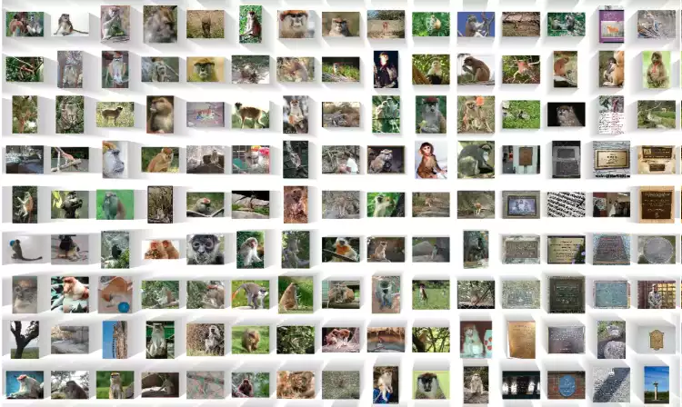
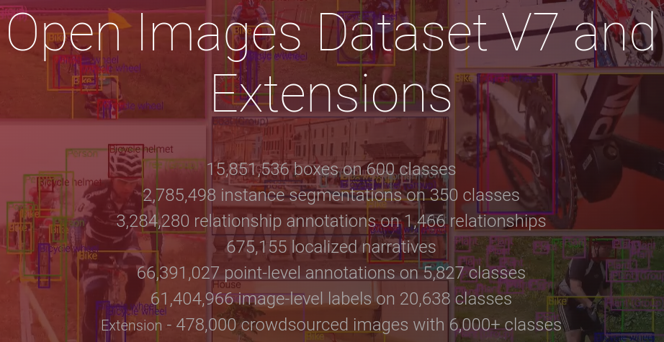
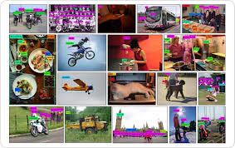
29 Computer Vision: Dataset
https://www.youtube.com/watch?v=SfqN-Hc5two&list=PLeo1K3hjS3uu7CxAacxVndI4bE_o3BDtO&index=29
1
Computer Vision: Dataset (0:00-0:10/13:01)
Popular Computer Vision Datasets:
1. ImageNet: Created by Stanford Professor Dr. Fei-Fei Li,
2. Coco (Common Objects in Context): Created by Microsoft, and
3. Google Open Images: has huge collections including 15Milion of Bounding boxes on 600 classes, 2.7M instances of segmentation on 350 classes, 2.2M relationship annotation on 1,4K relationships, etc.
https://storage.googleapis.com/openimages/web/index.html
2
3

Slide 12
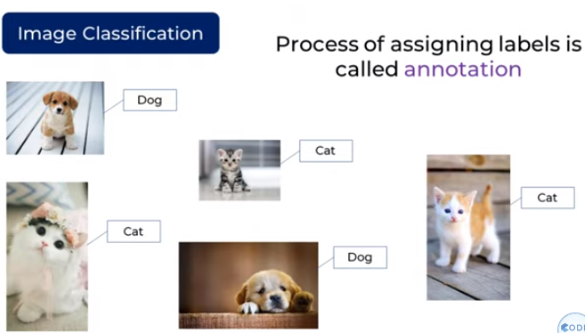
29 Computer Vision: Dataset
https://www.youtube.com/watch?v=SfqN-Hc5two&list=PLeo1K3hjS3uu7CxAacxVndI4bE_o3BDtO&index=29
Computer Vision: Dataset (0:31-0:40/13:01)
The image annotate is a labor intensive work.

Slide 13
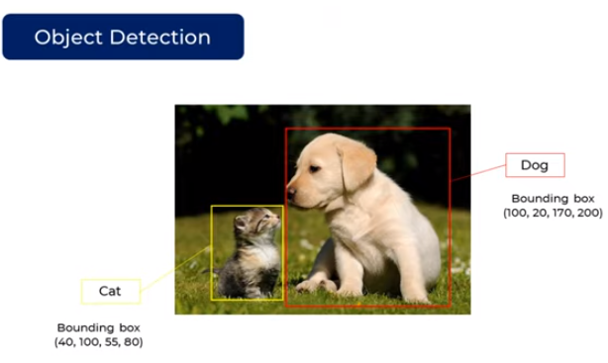
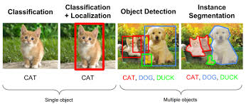
29 Computer Vision: Dataset
https://www.youtube.com/watch?v=SfqN-Hc5two&list=PLeo1K3hjS3uu7CxAacxVndI4bE_o3BDtO&index=29
Computer Vision: Dataset (0:41-0:50/13:01)
For object detection, the problem gets worse.
There is not only cat and dog but also there are bounding boxes around them.

Slide 14
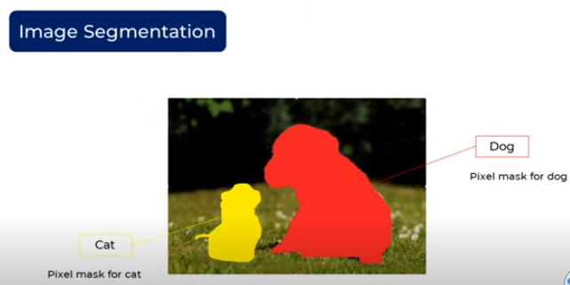
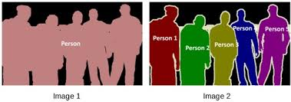
29 Computer Vision: Dataset
https://www.youtube.com/watch?v=SfqN-Hc5two&list=PLeo1K3hjS3uu7CxAacxVndI4bE_o3BDtO&index=29
Computer Vision: Dataset (1:01-1:10/13:01)
Same thing as image segmentation. This is the pixel mask for dog and cat.
We realize the annotation of object detection and image segmentation are very labor intensive.
Below are examples of image segmentation.

Slide 15
End

