Slide 1

30 Slide Window Object Detection
Peter H. Chen

Slide 2
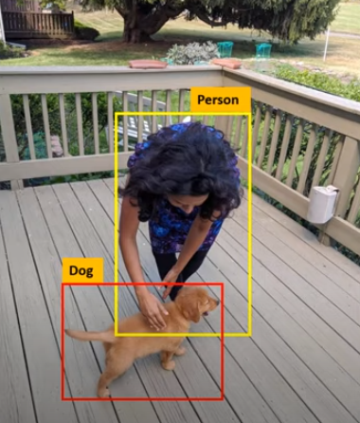
30 Slide Window Object Detection
https://www.youtube.com/watch?v=AimW3j7M2Uw&list=PLeo1K3hjS3uu7CxAacxVndI4bE_o3BDtO&index=30
Slide Window Object Detection (0:00-0:15/4:57)
We discuss the Sliding Window Object Detection.
1. We will use Sliding Window to detects the objects, such as, Dog and Person, etc.
2. We will get the bounding boxes of each object in the picture.

Slide 3
30.1 Detect Dog Object

Slide 4

30.1 Detect Dog Object
https://www.youtube.com/watch?v=AimW3j7M2Uw&list=PLeo1K3hjS3uu7CxAacxVndI4bE_o3BDtO&index=30
Detect Dog Object (0:16-0:19/4:57)
First, Let’s detect dog.

Slide 5
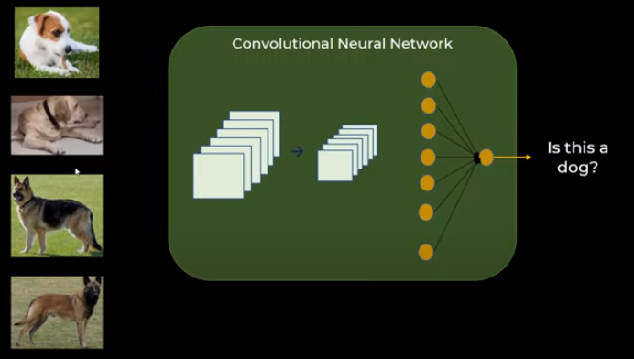
30.1 Detect Dog Object
https://www.youtube.com/watch?v=AimW3j7M2Uw&list=PLeo1K3hjS3uu7CxAacxVndI4bE_o3BDtO&index=30
Detect Dog Object (0:20-0:22/4:57)
1. In the left below, we have the cropped (クロップド;裁剪过的) of dog images
2. We can train the CNN (Convolutional Neural Network)
1
2

Slide 6
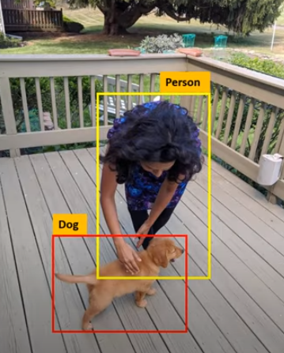
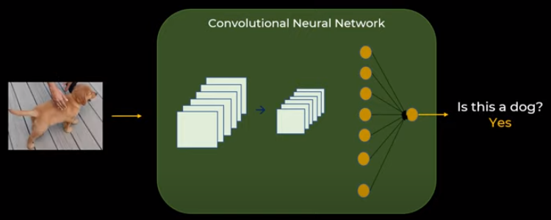
30.1 Detect Dog Object
https://www.youtube.com/watch?v=AimW3j7M2Uw&list=PLeo1K3hjS3uu7CxAacxVndI4bE_o3BDtO&index=30
Detect Dog Object (0:45-0:55/4:57)
After we train the CNN Neural network (right below),
1. We can input the image (left below),
2. We can see another cropped dog image
3. We predict there is a dog not?
1
2
3

Slide 7
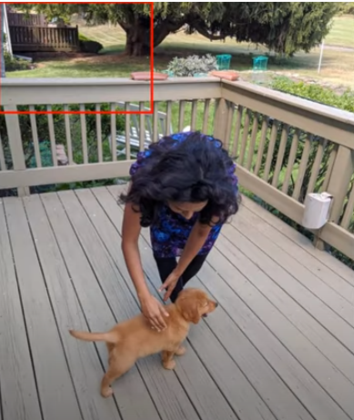
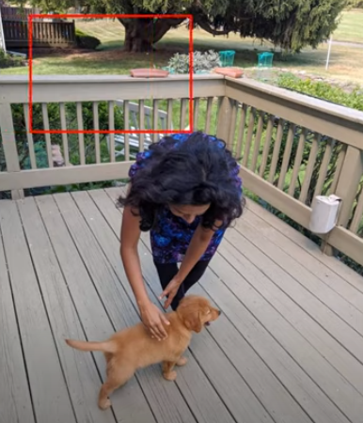
30.1 Detect Dog Object
https://www.youtube.com/watch?v=AimW3j7M2Uw&list=PLeo1K3hjS3uu7CxAacxVndI4bE_o3BDtO&index=30
Detect Dog Object (0:56-1:30/4:57)
Now, we can slide the windows in any given image.
1. We can start with any window size, we can start at top-left of the window. We have Convolutional result inside the window, We know inside the window has the Dog or not.
2. Then, we move another window, and see there is a dog or not.
1
2

Slide 8
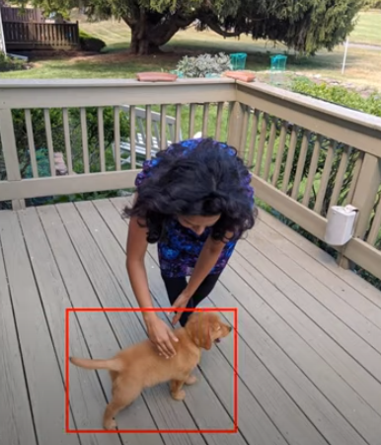
30.1 Detect Dog Object
https://www.youtube.com/watch?v=AimW3j7M2Uw&list=PLeo1K3hjS3uu7CxAacxVndI4bE_o3BDtO&index=30
Detect Dog Object (2:01-2:15/4:57)
We keep on moving the window until there is a convolutional match.
For particular window with CNN value, we can detect “this is the dog”.
By using the sliding window, we can detect the location of dog and dog object.

Slide 9
30.2 Window Size

Slide 10

30.2 Window Size
https://www.youtube.com/watch?v=AimW3j7M2Uw&list=PLeo1K3hjS3uu7CxAacxVndI4bE_o3BDtO&index=30
Window Size (2:16-2:25/4:57)
Now, the question is: What should be the window size?
Answer:
We can trail and error.

Slide 11

30.2 Window Size
https://www.youtube.com/watch?v=AimW3j7M2Uw&list=PLeo1K3hjS3uu7CxAacxVndI4bE_o3BDtO&index=30
Window Size (2:26-2:30/4:57)
Let say, we have this window size. We keep on moving with this window size.
It may not the perfect window size to fit the dog object.

Slide 12
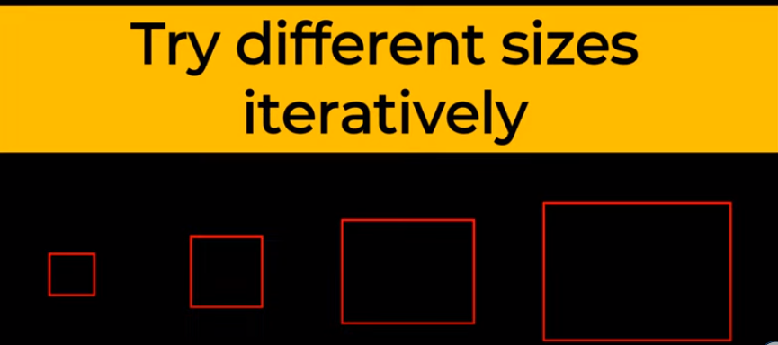
30.2 Window Size
https://www.youtube.com/watch?v=AimW3j7M2Uw&list=PLeo1K3hjS3uu7CxAacxVndI4bE_o3BDtO&index=30
Window Size (2:31-2:45/4:57)
We can start with the small window size and increase the window size more and more.
Then, we find our object with some window size.

Slide 13
30.3 YOLO: Improve Computation

Slide 14
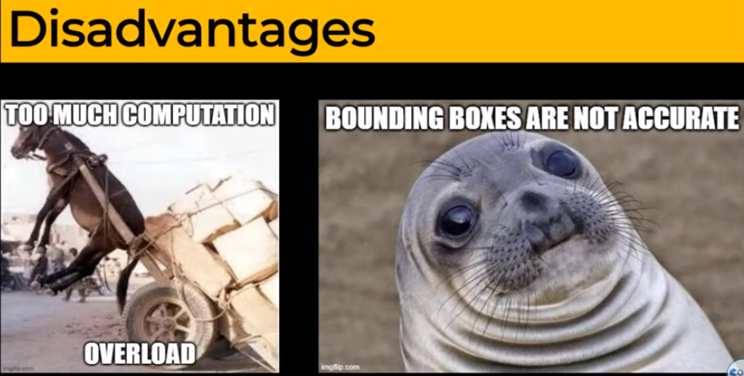
30.3 YOLO: Improve Computation
https://www.youtube.com/watch?v=AimW3j7M2Uw&list=PLeo1K3hjS3uu7CxAacxVndI4bE_o3BDtO&index=30
YOLO: Improve Computation (2:46-3:25/4:57)
We can see there is an disadvantage: The disadvantage is too much computation.
1. There is overloading for the Donkey.
2. The bounding box might not be accurate. You object maybe square, rectangular, etc.
So, sliding window is popular but there are problems in computation and bounding shape.
1
2

Slide 15
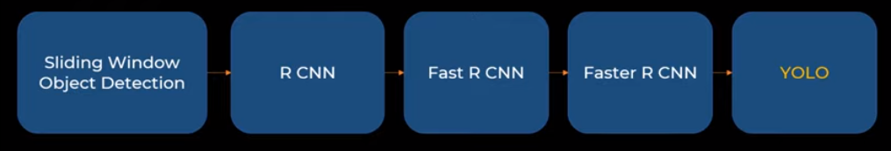
30.3 YOLO: Improve Computation
https://www.youtube.com/watch?v=AimW3j7M2Uw&list=PLeo1K3hjS3uu7CxAacxVndI4bE_o3BDtO&index=30
YOLO: Improve Computation (3:26-4:00/4:57)
1. We have seen what is the “Sliding Window Object Detection”.
2. There are R-CNN (Region based Convolutional Neural Network). R-CNN propose region search and try different combination of region. In R-CNN, we only try certain area in the image.
3. Then, Fast R-CNN comes out with speed improvement in R-CNN.
4. Then, Faster R-CNN comes out with another speed improvement of Fast R-CNN.
5. Finally, YOLO (You Only Look Once) algorithm come out. YOLO is the industry standard for sliding window. YOLO also have many version of improvement.
1
2
3
4
5

Slide 16
30.4 YOLO Algorithm

Slide 17
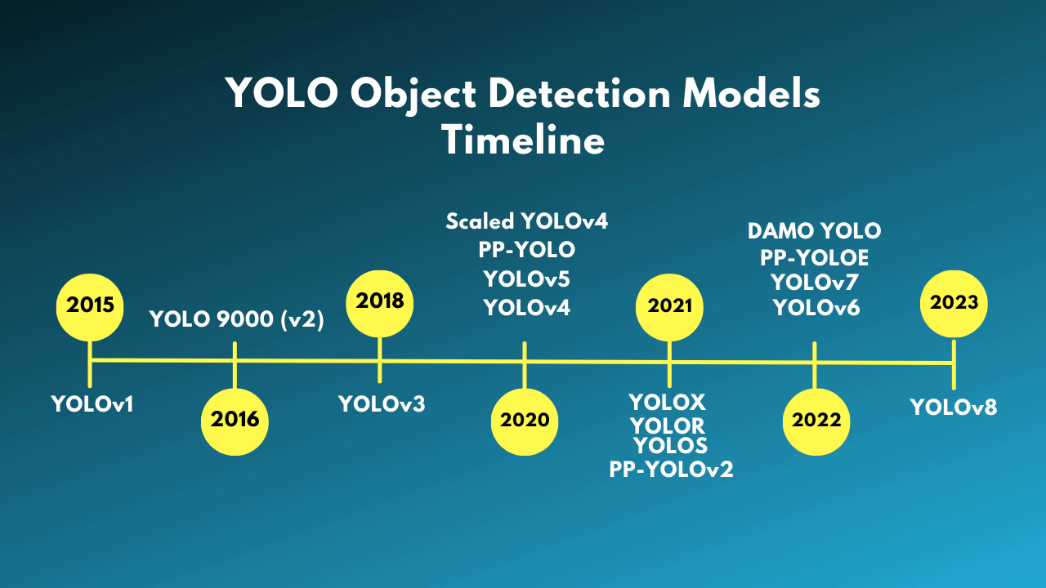
30.4 YOLO Algorithm
https://www.youtube.com/watch?v=AimW3j7M2Uw&list=PLeo1K3hjS3uu7CxAacxVndI4bE_o3BDtO&index=30
YOLO Algorithm (4:01-4:30/4:57)
What is current version of YOLO?
Answer:
1. YOLOv9 (You Only Look Once, Version 9) is the latest version of YOLO, released in February 2024, by Chien-Yao Wang, I-Hau Yeh, and Hong-Yuan Mark Liao.
2. YOLO is an improved real-time object detection model that aims to surpass all convolution-based, and transformer-based methods.

Slide 18
30.5 YOLO Computer Vision Model

Slide 19
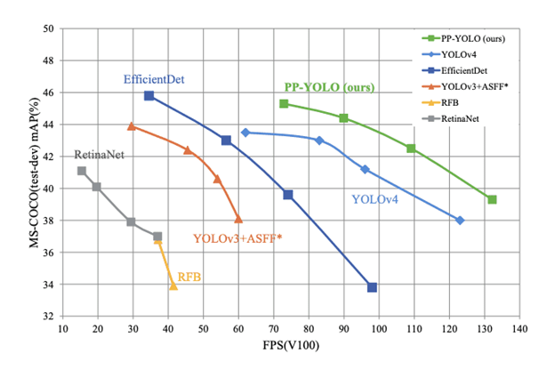
30.5 YOLO Computer Vision Model
https://www.youtube.com/watch?v=AimW3j7M2Uw&list=PLeo1K3hjS3uu7CxAacxVndI4bE_o3BDtO&index=30
YOLO: Improve Computation (4:31-4:40/4:57)
YOLO Algorithm Comparison
FPS (Frame Per Second)
https://dataphoenix.info/a-guide-to-the-yolo-family-of-computer-vision-models/

Slide 20
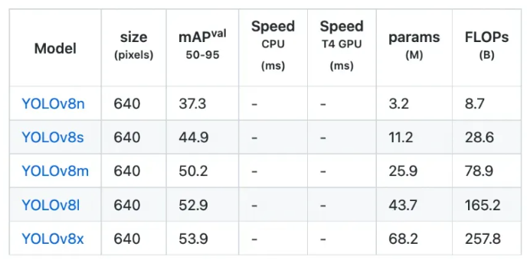
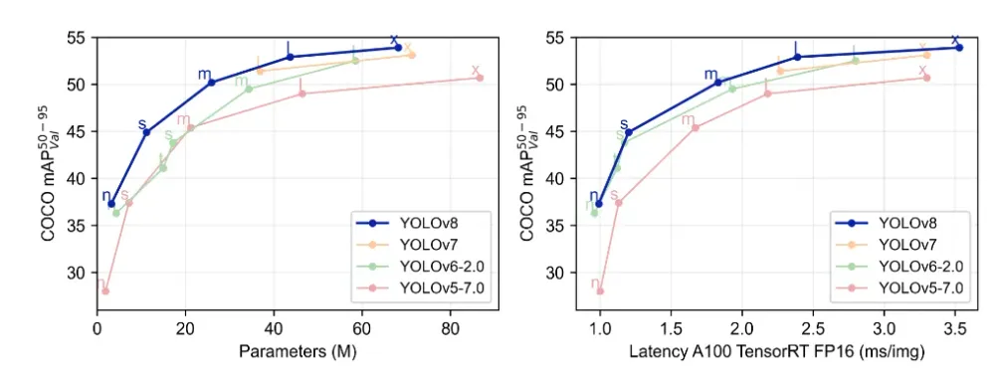
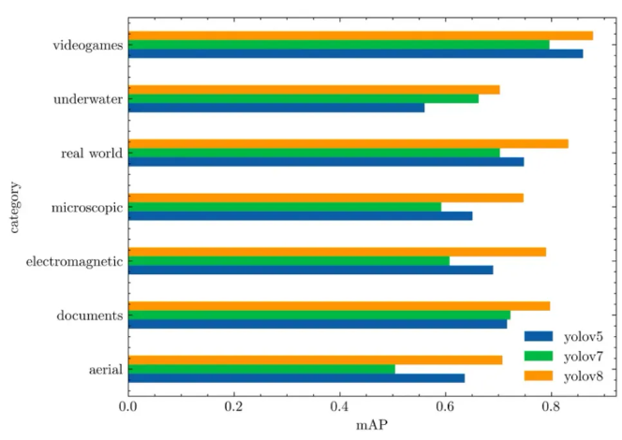
30.5 YOLO Computer Vision Model
https://www.youtube.com/watch?v=AimW3j7M2Uw&list=PLeo1K3hjS3uu7CxAacxVndI4bE_o3BDtO&index=30
YOLO: Improve Computation (4:41-4:57/4:57)
YOLO Family Benchmark.
FLOPS (Floating-Point Operations Per Second,
https://dataphoenix.info/a-guide-to-the-yolo-family-of-computer-vision-models/

Slide 21
End

