Slide 1

25.00 ANN to CNN
Peter H. Chen

Slide 2
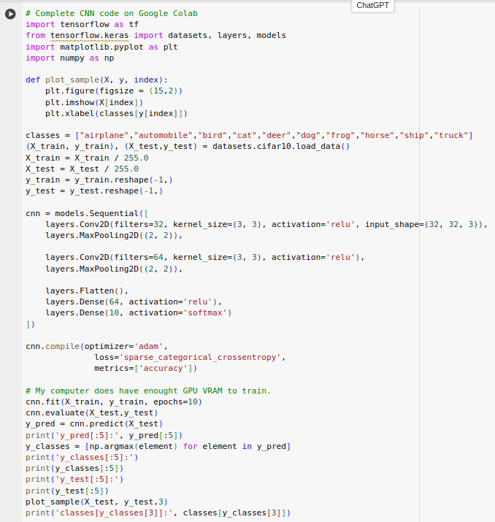
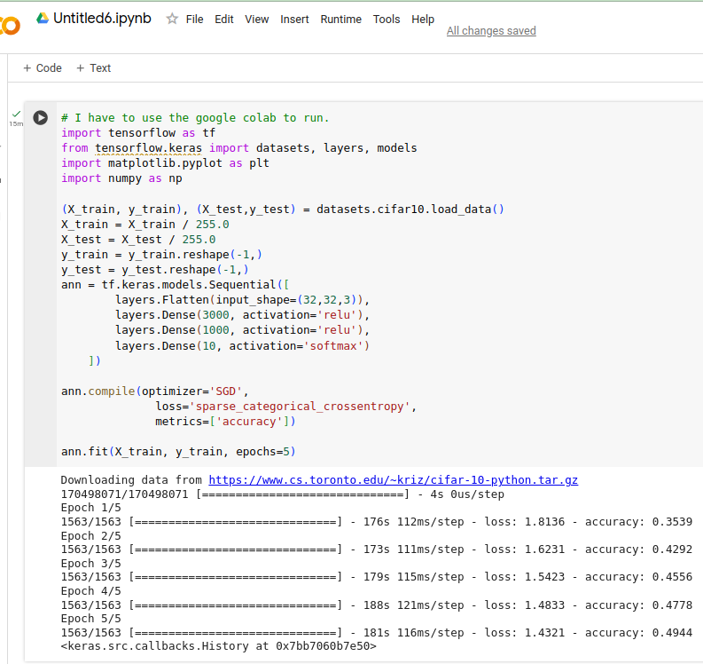
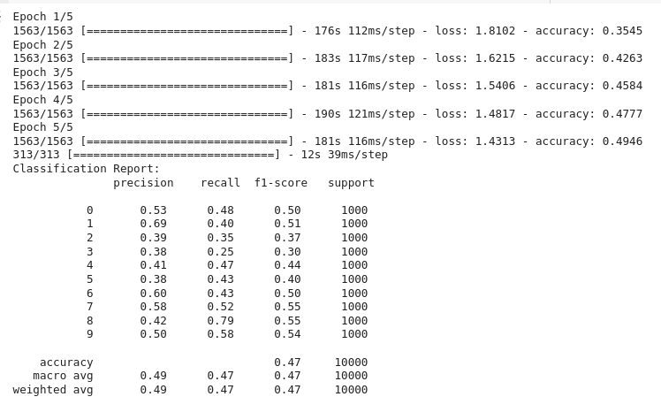
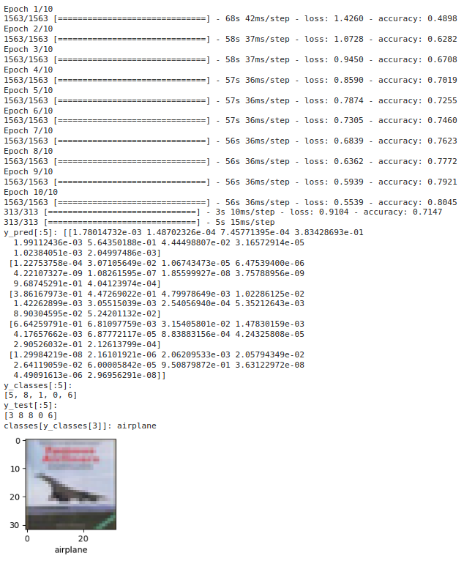
25.00 CIFAR-10 ANN to CNN
https://www.youtube.com/watch?v=7HPwo4wnJeA&list=PLeo1K3hjS3uu7CxAacxVndI4bE_o3BDtO&index=24
CIFAR-10 ANN to CNN
1. CIFAR-10 ANN: Accuracy 50%.
2. CIFAR-10 CNN reduce input parameter, reduce run-time, accuracy 80%.
3. improve accuracy from 50% (ANN) to CNN (80%).
CIFAR-10 CNN
CIFAR-10 ANN

Slide 3
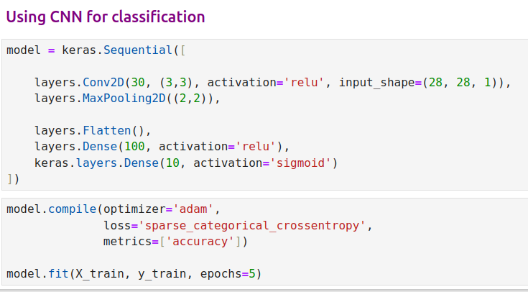
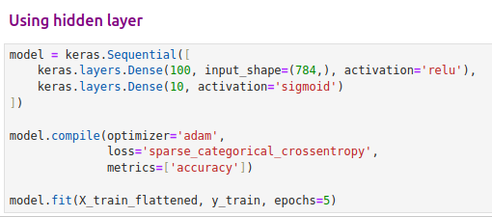

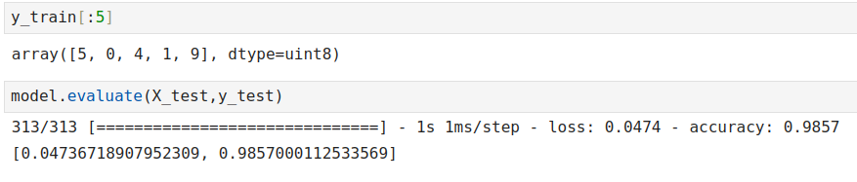
25.00 MNIST ANN to CNN
https://www.youtube.com/watch?v=7HPwo4wnJeA&list=PLeo1K3hjS3uu7CxAacxVndI4bE_o3BDtO&index=24
MNIST ANN to CNN
1. MNIST ANN: Accuracy 97%
2. MNIST CNN reduce input parameter, weight, improve overfit, cut run-time, accuracy 98%.
3. Improve accuracy from 97% (ANN) to 98% (CNN)
MNIST CNN
MNIST ANN

Slide 4
End

