Slide 1

011 Loss Function
Peter H. Chen

Slide 2
011 Loss Function
https://www.youtube.com/watch?v=E1yyaLRUnLo&list=PLeo1K3hjS3uu7CxAacxVndI4bE_o3BDtO&index=11
Loss Function (0:00-0:20/24:36)
It is important to understand the Loss or cost function in neural network.
We discuss the theory and various implementations of cost function in Python.

Slide 3
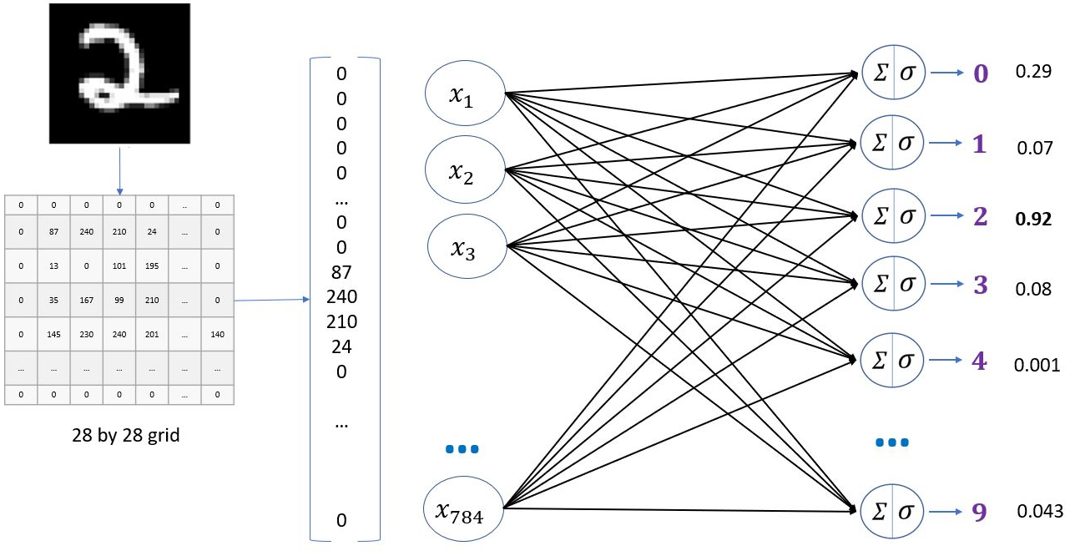
011 Loss Function
https://www.youtube.com/watch?v=E1yyaLRUnLo&list=PLeo1K3hjS3uu7CxAacxVndI4bE_o3BDtO&index=11
Loss Function (0:21-1:00/24:36)
We have a neural network to recognize handwritten digits.

Slide 4
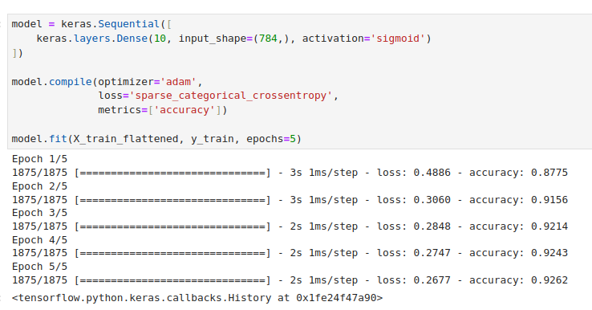
011 Loss Function
https://www.youtube.com/watch?v=E1yyaLRUnLo&list=PLeo1K3hjS3uu7CxAacxVndI4bE_o3BDtO&index=11
Loss Function (0:21-0:30/24:36)
We have neural network model with loss function “sparse_categorical_crossentropy”.

Slide 5
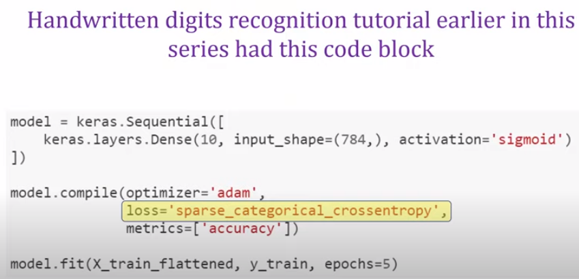
011 Loss Function
https://www.youtube.com/watch?v=E1yyaLRUnLo&list=PLeo1K3hjS3uu7CxAacxVndI4bE_o3BDtO&index=11
Loss Function (0:31-0:40/24:36)
Here, we talk about the the loss function.

Slide 6
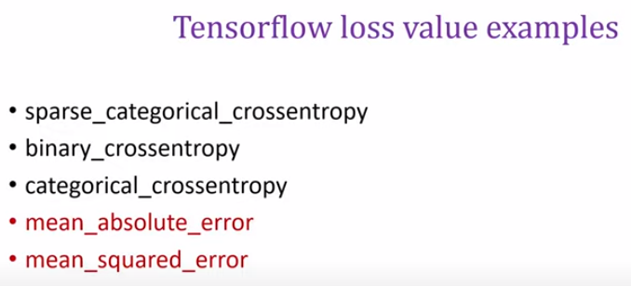
011 Loss Function
https://www.youtube.com/watch?v=E1yyaLRUnLo&list=PLeo1K3hjS3uu7CxAacxVndI4bE_o3BDtO&index=11
Loss Function (0:59-0:40/24:36)
Tensorflow loss parameters.

Slide 7
011 Loss Function
https://www.youtube.com/watch?v=E1yyaLRUnLo&list=PLeo1K3hjS3uu7CxAacxVndI4bE_o3BDtO&index=11
Loss Function (0:59-1:00/24:36)
Tensorflow loss parameters: sparse_categorical_crossentropy, binary_crossentropy, categorical_crossentropy, mean_absolute_error, and mean_squared_error.
In the machine learning, we often see mean_absolute_error and mean_squared_error.

Slide 8
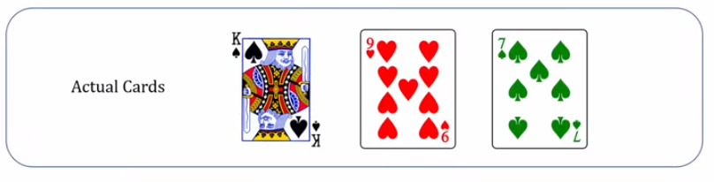
011 Loss Function
https://www.youtube.com/watch?v=E1yyaLRUnLo&list=PLeo1K3hjS3uu7CxAacxVndI4bE_o3BDtO&index=11
Loss Function (1:20-1:30/24:36)
Below is the example for playing card:
You do not see your friend’s cards in his hand
Your friend ask you to make a guess.

Slide 9
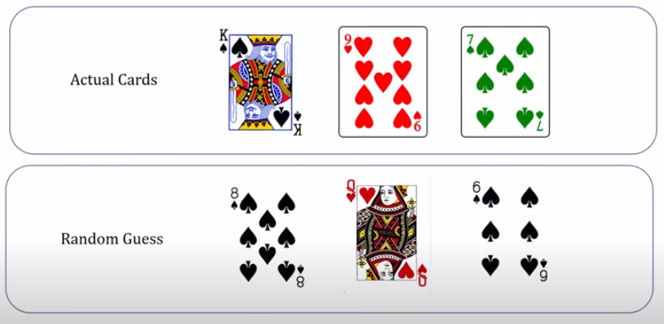
011 Loss Function
https://www.youtube.com/watch?v=E1yyaLRUnLo&list=PLeo1K3hjS3uu7CxAacxVndI4bE_o3BDtO&index=11
Loss Function (1:20-1:30/24:36)
To start with, we make a random guess.
Then, you ask your friend how accurate of your guess.

Slide 10
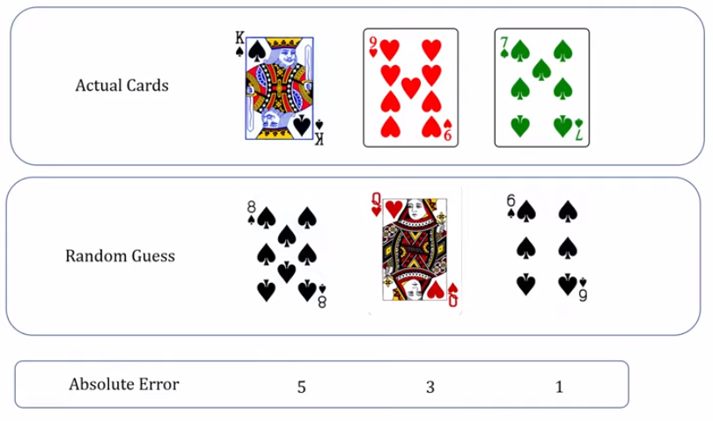
011 Loss Function
https://www.youtube.com/watch?v=E1yyaLRUnLo&list=PLeo1K3hjS3uu7CxAacxVndI4bE_o3BDtO&index=11
Loss Function (2:03-2:30/24:36)
The error is the absolute number difference (5, 3, 1) between your friend’s hand and your guess.

Slide 11
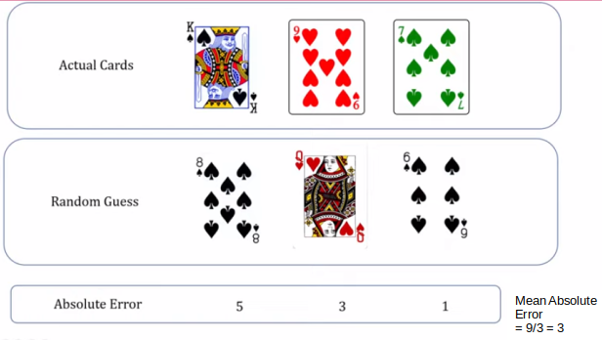
011 Loss Function
https://www.youtube.com/watch?v=E1yyaLRUnLo&list=PLeo1K3hjS3uu7CxAacxVndI4bE_o3BDtO&index=11
Loss Function (2:03-2:30/24:36)
The total error you made is 9.
The average error is 9/3 = 3
In machine learning and deep learning, we use mean square error for scalar derivative and vector gradient.

Slide 12
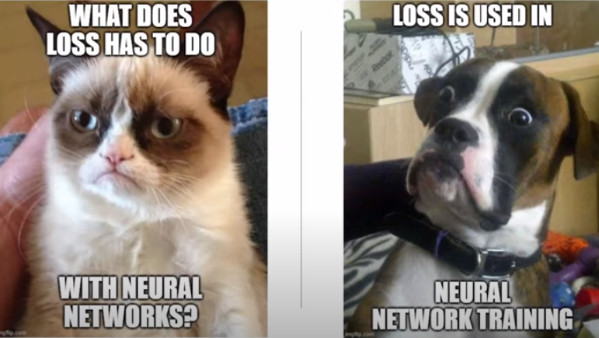
011 Loss Function
https://www.youtube.com/watch?v=E1yyaLRUnLo&list=PLeo1K3hjS3uu7CxAacxVndI4bE_o3BDtO&index=11
Loss Function (3:20-3:30/24:36)
Why do we use loss in neural network training?

Slide 13
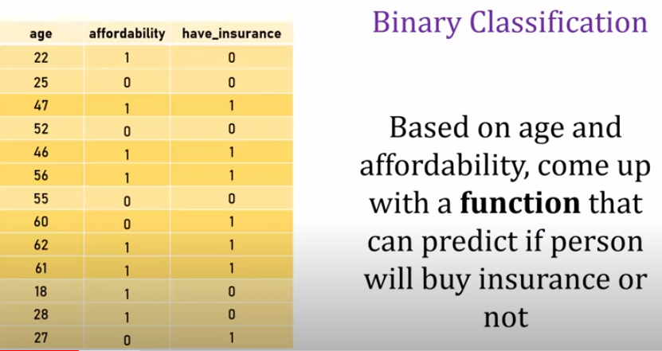
011 Loss Function
https://www.youtube.com/watch?v=E1yyaLRUnLo&list=PLeo1K3hjS3uu7CxAacxVndI4bE_o3BDtO&index=11
Loss Function (3:31-3:50/24:36)
Look at the insurance dataset example.
We have features of age and affordability. We have the output target: have insurance or not.
We try to predict the person will buy insurance based on these features.
For example, we have some people is 47 and affordability is 1, we try to predict the person will buy insurance or not.

Slide 14
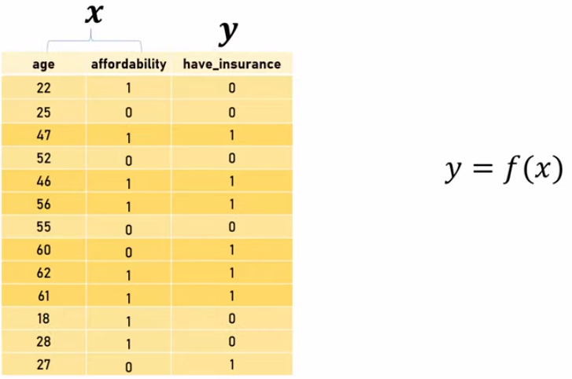
011 Loss Function
https://www.youtube.com/watch?v=E1yyaLRUnLo&list=PLeo1K3hjS3uu7CxAacxVndI4bE_o3BDtO&index=11
Loss Function (4:31-4:50/24:36)
We have features is X and output target is y.

Slide 15
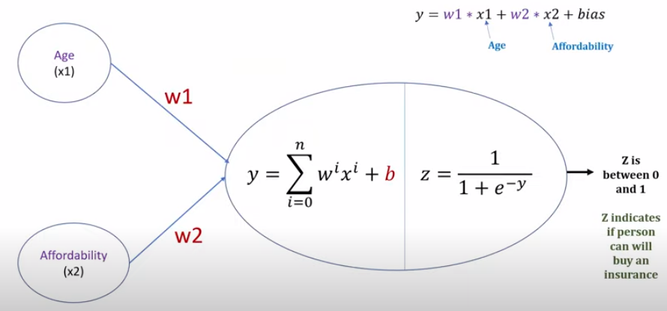
011 Loss Function
https://www.youtube.com/watch?v=E1yyaLRUnLo&list=PLeo1K3hjS3uu7CxAacxVndI4bE_o3BDtO&index=11
Loss Function (5:01-5:30/24:36)
We have neural network as below.

Slide 16
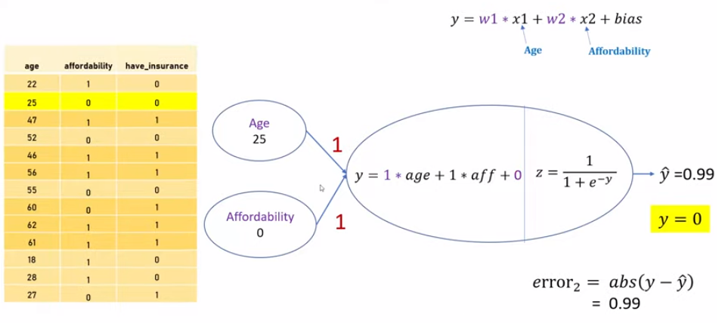
011 Loss Function
https://www.youtube.com/watch?v=E1yyaLRUnLo&list=PLeo1K3hjS3uu7CxAacxVndI4bE_o3BDtO&index=11
Loss Function (5:41-5:50/24:36)
We change weight to model the neural network.
Initially, we set w1 = 1, w2 = 1. and b = 0.
Then, we substitute the feature data (age and affordability) in the dataset to calculate the estimate value (have insurance).
Lastly, we calculate the difference of target and estimate value.
This is a supervised learning.

Slide 17
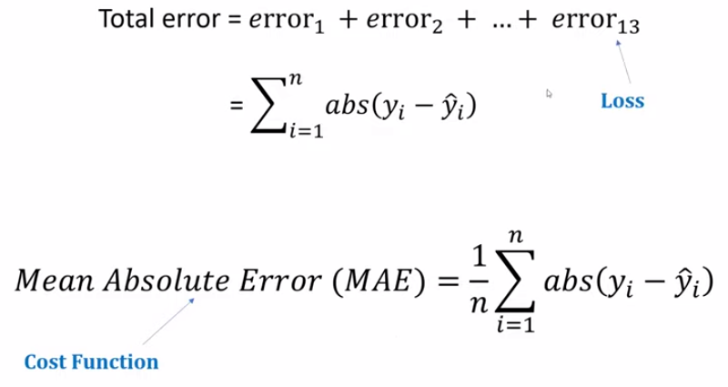
011 Loss Function
https://www.youtube.com/watch?v=E1yyaLRUnLo&list=PLeo1K3hjS3uu7CxAacxVndI4bE_o3BDtO&index=11
Loss Function (7:18-7:50/24:36)
We sum of the total error.
Andrew Ng called the individual error is the Loss and the cumulative error is called the cost function.

Slide 18
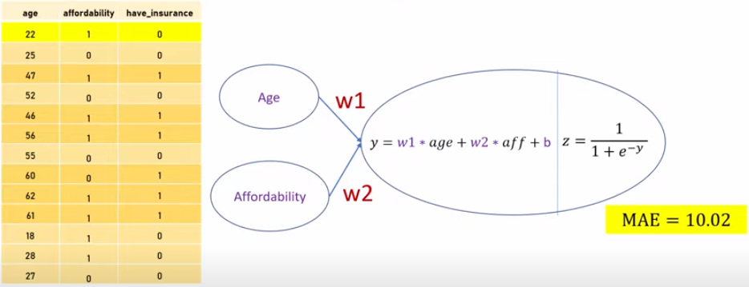
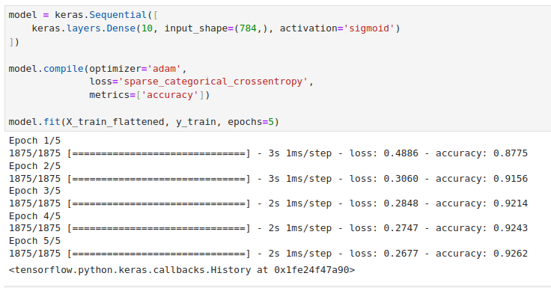
011 Loss Function
https://www.youtube.com/watch?v=E1yyaLRUnLo&list=PLeo1K3hjS3uu7CxAacxVndI4bE_o3BDtO&index=11
Loss Function (8:08-8:50/24:36)
When we do the forward passing in each epochs, we have cost function MAE.

Slide 19
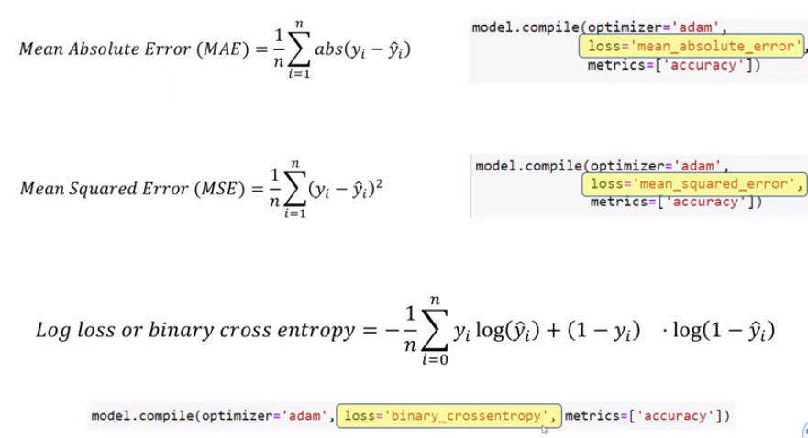
011 Loss Function
https://www.youtube.com/watch?v=E1yyaLRUnLo&list=PLeo1K3hjS3uu7CxAacxVndI4bE_o3BDtO&index=11
Loss Function (9:01-9:50/24:36)
Below are some errors definition:
MAE (Mean Absolute Error), MSE (Mean Squared Error), Log Loss (Binary Cross Entropy).

Slide 20
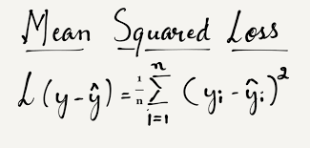
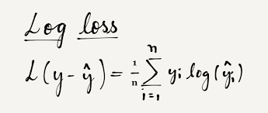
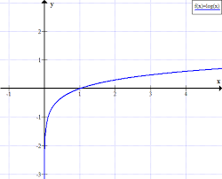
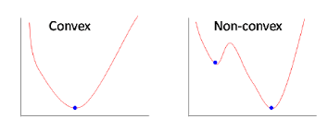
011 Loss Function
https://www.youtube.com/watch?v=E1yyaLRUnLo&list=PLeo1K3hjS3uu7CxAacxVndI4bE_o3BDtO&index=11
Loss Function (10:01-10:50/24:36)
Now, why do we use log loss for logistic regression?
https://towardsdatascience.com/why-not-mse-as-a-loss-function-for-logistic-regression-589816b5e03c
We do not use mean square error or mean absolute error for logistic regression.
The graph of the Mean squared error function is non-convex for logistic regression. As we are putting dependent variable x in a non-linear sigmoid function. As discussed above gradient descent does not work for non-convex functions, logistic regression model would never be able to converge to optimal values.

Slide 21
011.1 Loss Function: Coding

Slide 22

011.1 Loss Function: Coding
https://www.youtube.com/watch?v=E1yyaLRUnLo&list=PLeo1K3hjS3uu7CxAacxVndI4bE_o3BDtO&index=11
Loss Function: Coding (12:10-12:50/24:36)
We have two array y_predicted and y_true (Target value) .
We want to calculate the MAE, MSE, and Log loss.

Slide 23
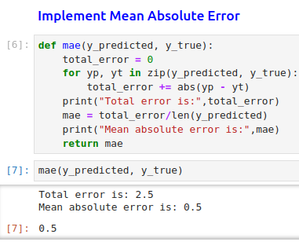
011.1 Loss Function: Coding
https://www.youtube.com/watch?v=E1yyaLRUnLo&list=PLeo1K3hjS3uu7CxAacxVndI4bE_o3BDtO&index=11
Loss Function: Coding (14:10-15:00/24:36)
Calculate MAE: We need to loop the elements one-by-one.

Slide 24
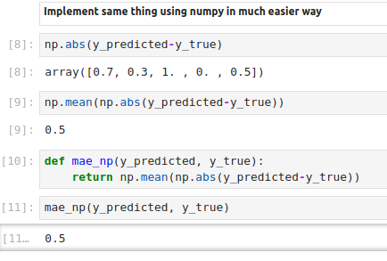
011.1 Loss Function: Coding
https://www.youtube.com/watch?v=E1yyaLRUnLo&list=PLeo1K3hjS3uu7CxAacxVndI4bE_o3BDtO&index=11
Loss Function: Coding (18:10-15:00/24:36)
We can use numpy which is easier.
np.abs(y_predicted - y_true)

Slide 25
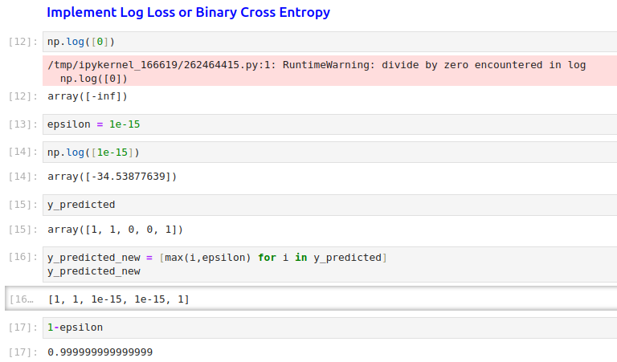
011.1 Loss Function: Coding
https://www.youtube.com/watch?v=E1yyaLRUnLo&list=PLeo1K3hjS3uu7CxAacxVndI4bE_o3BDtO&index=11
Loss Function: Coding (18:10-21:00/24:36)
We have log problem in log(0).
We use epsilon instead.

Slide 26
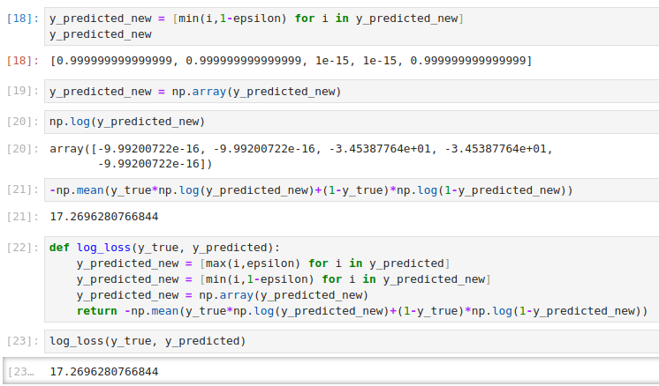
011.1 Loss Function: Coding
https://www.youtube.com/watch?v=E1yyaLRUnLo&list=PLeo1K3hjS3uu7CxAacxVndI4bE_o3BDtO&index=11
Loss Function: Coding (18:10-21:00/24:36)
Implement log loss function.

Slide 27
011.2 Loss Function: Exercise

Slide 28
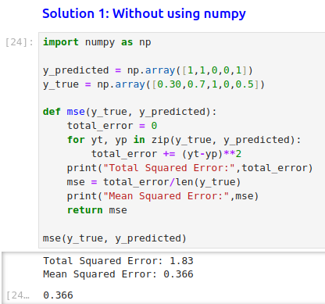
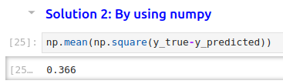
011.2 Loss Function: Exercise
https://www.youtube.com/watch?v=E1yyaLRUnLo&list=PLeo1K3hjS3uu7CxAacxVndI4bE_o3BDtO&index=11
Loss Function: Exercise (18:10-21:00/24:36)
Implement mean squared error (or MSE) in two ways,
1. Without using numpy (i.e. using plain python)
2. With the use of numpy

Slide 29
End

